Slide 1
skipper-CCD
Juan Estrada - Fermilab
Nov, 2018

Slide 2
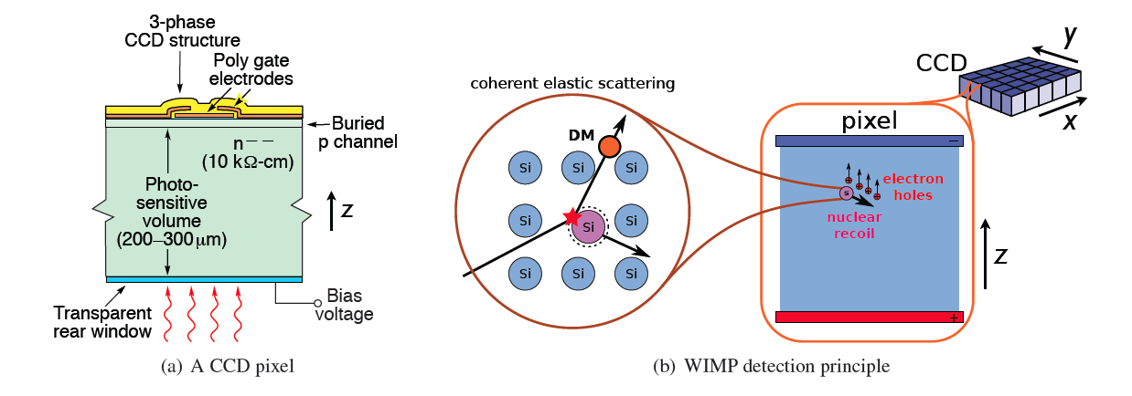
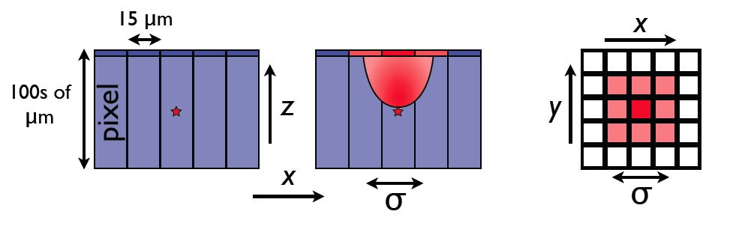
Recent developments by the MSL group at LBNL has allowed the fabrication for “massive” CCDs. 675 um is now possible.

Slide 3
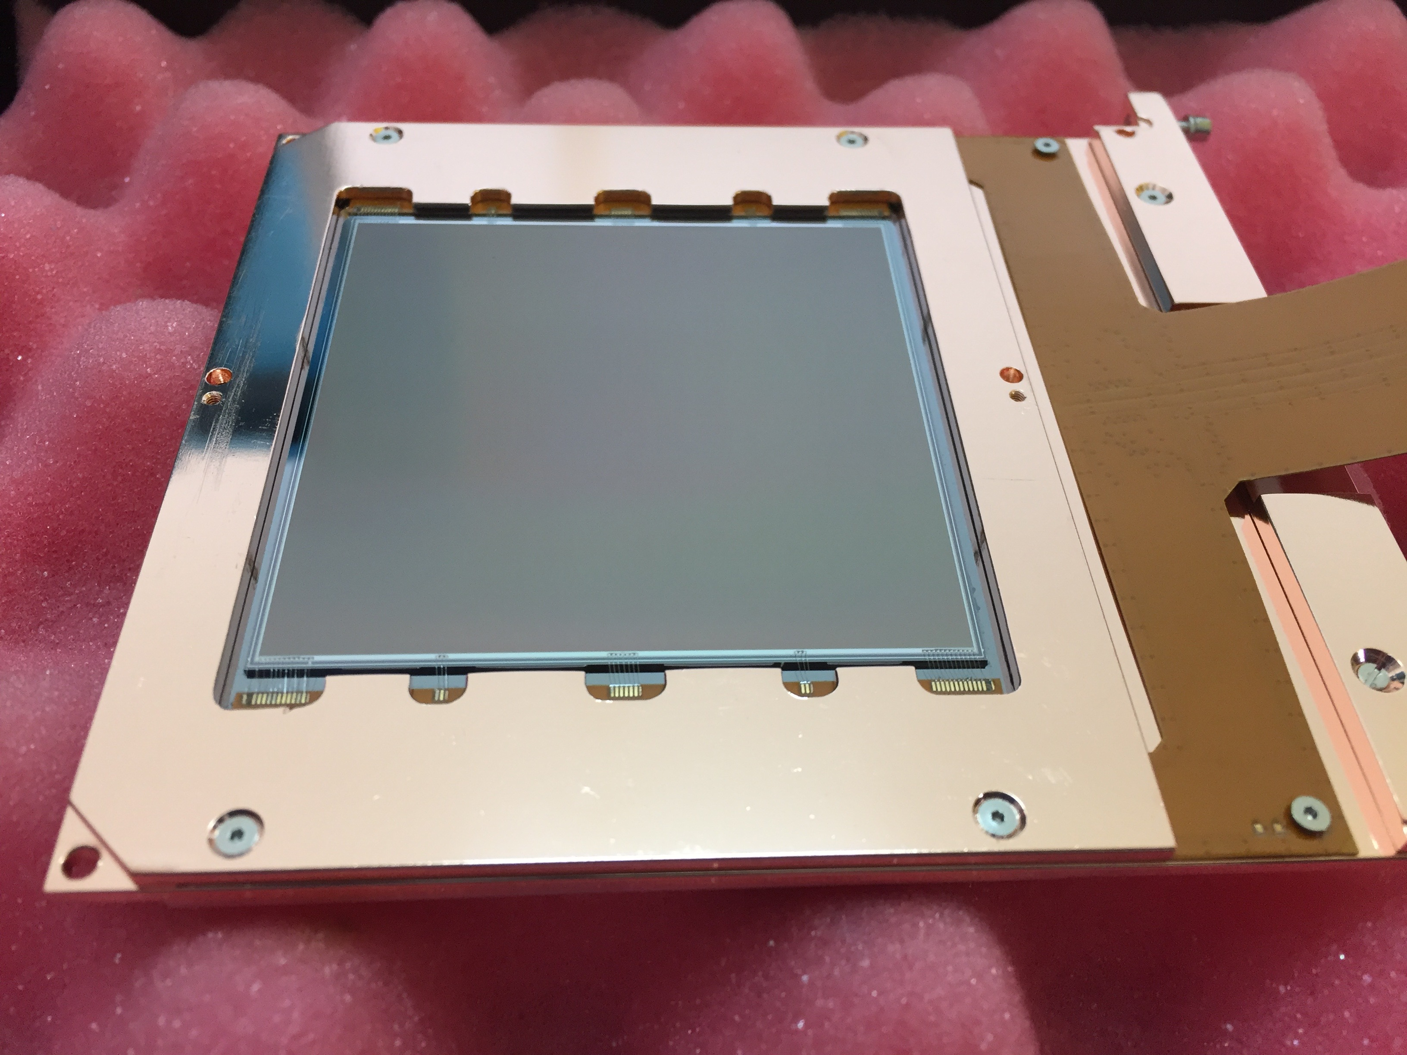
CONNIE-DAMIC 2016 sensors
675 um thick CCD
Developed by LBNL Microsystems LAB
4k x 4k
15 x 15 um pixels
4 amplifiers
2e- noise
low background package
16 Mpix — 6g

Slide 4

Particle identification in a CCD image
muons, electrons and diffusion limited hits.

Slide 5
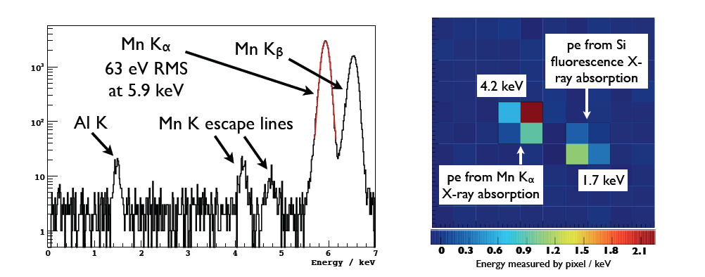
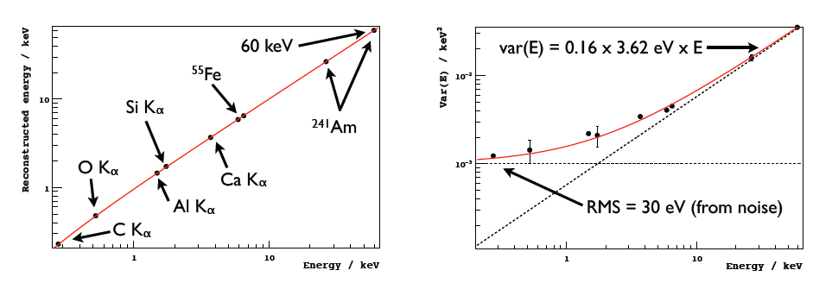
Calibration using X-rays

Slide 6
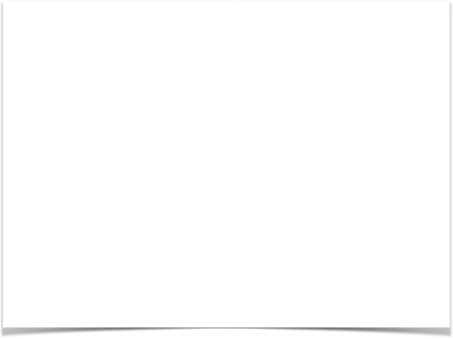
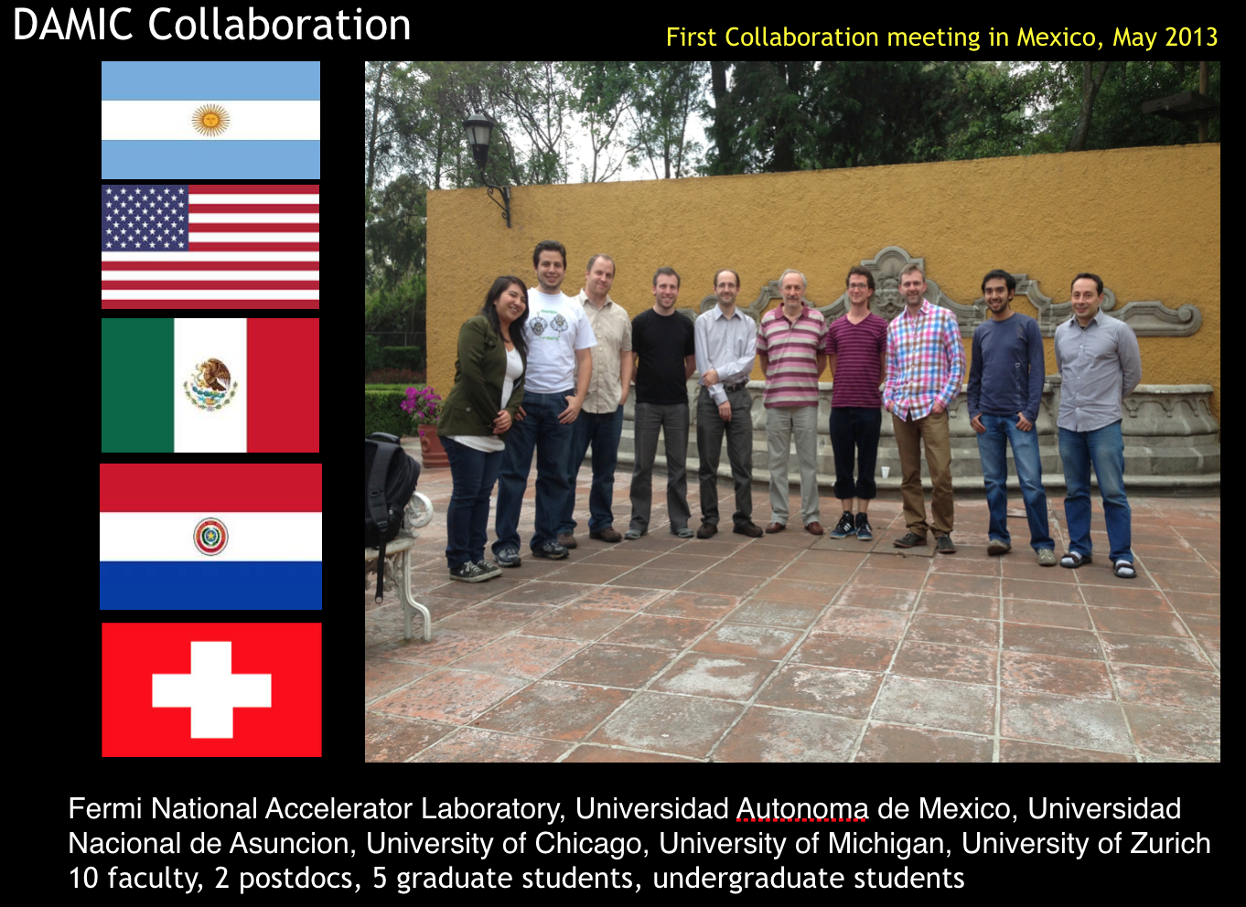

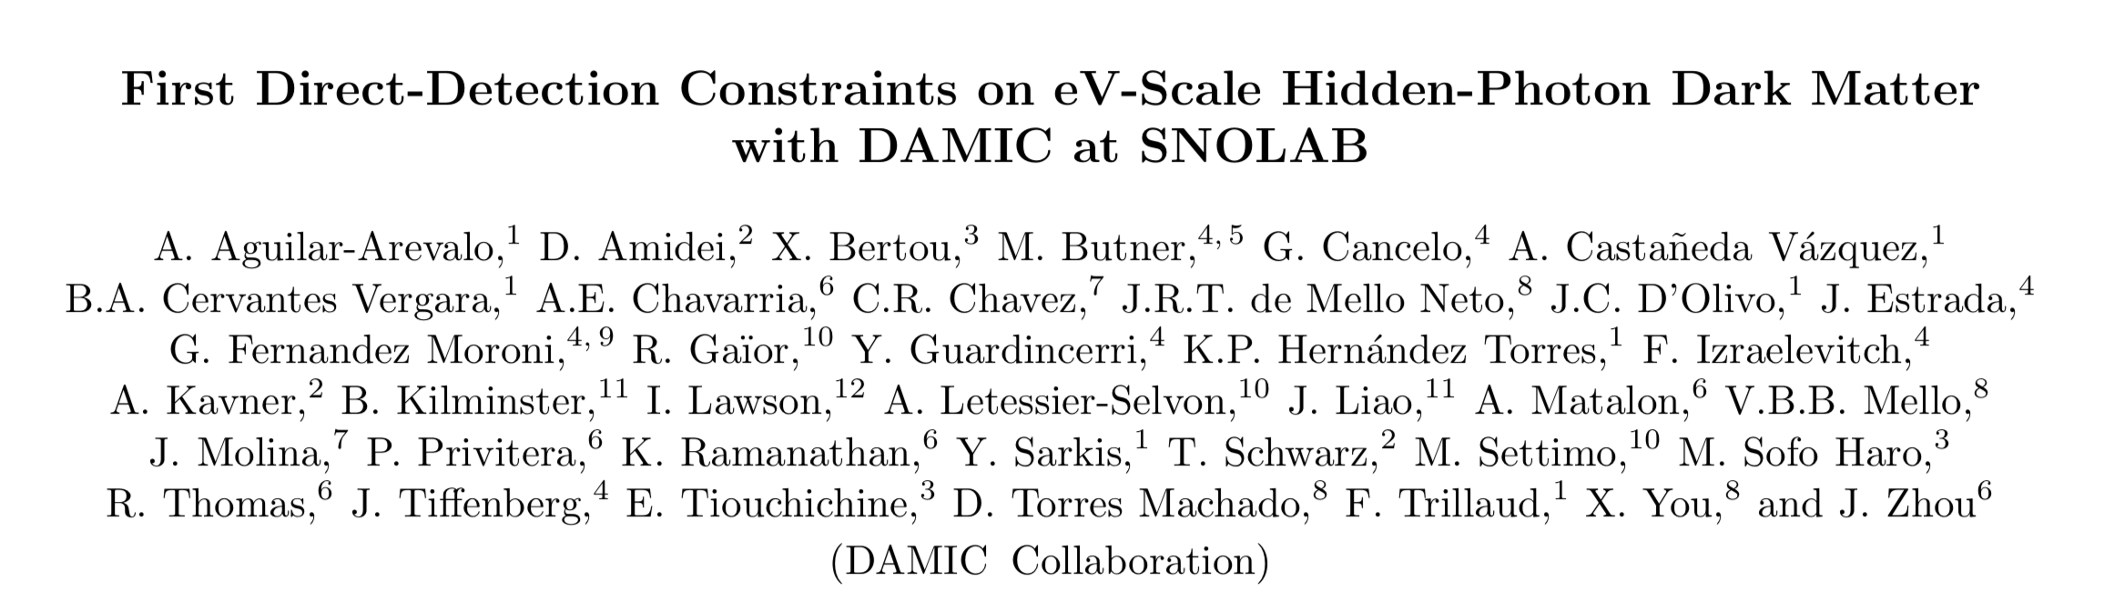

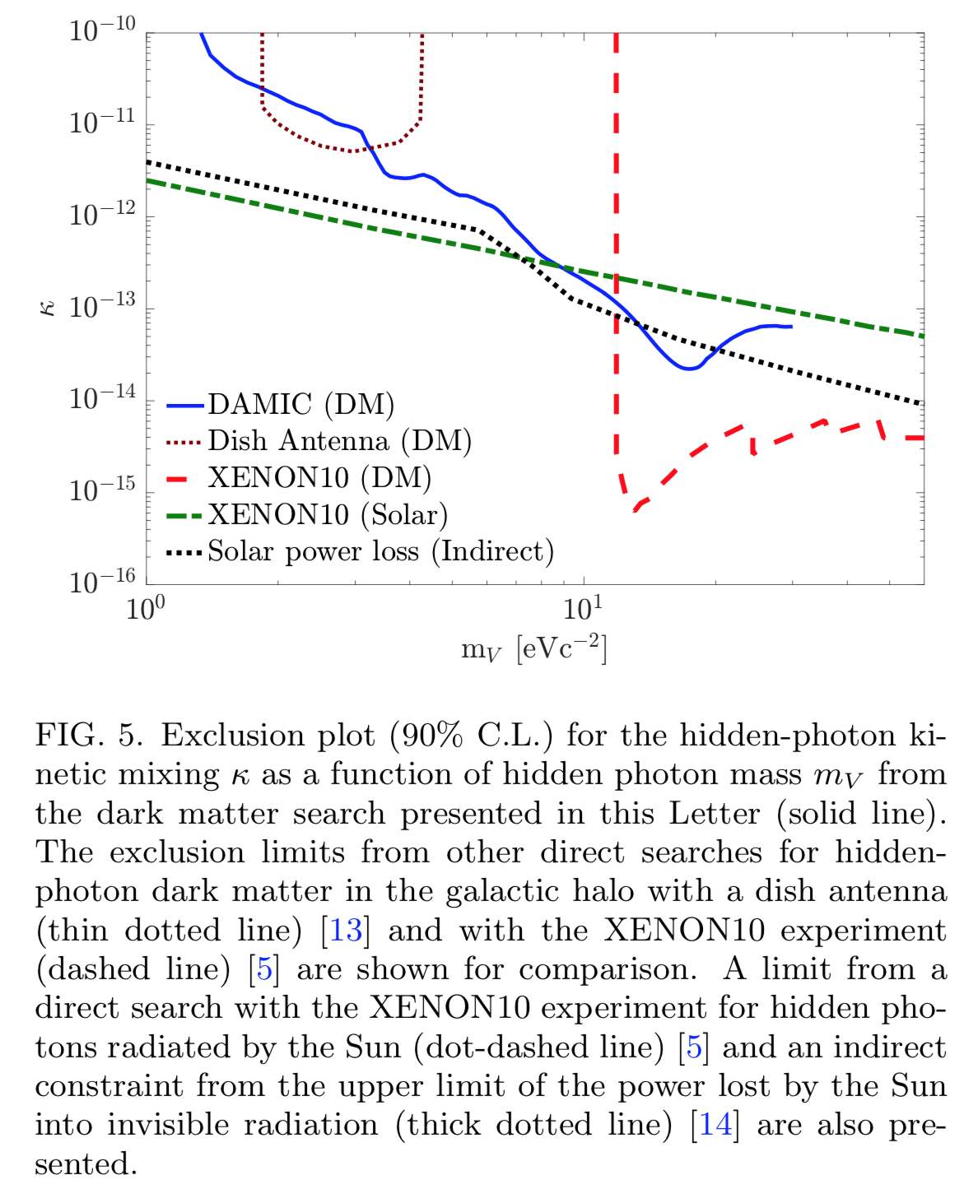

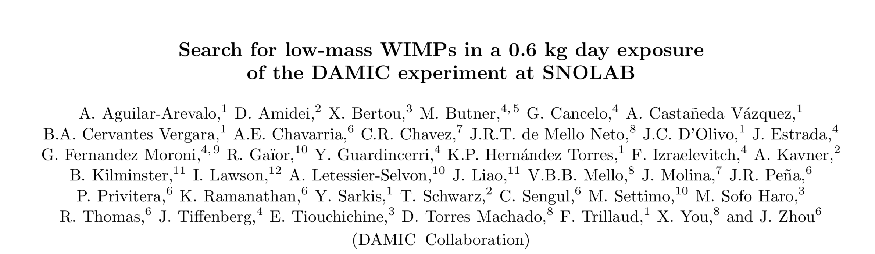

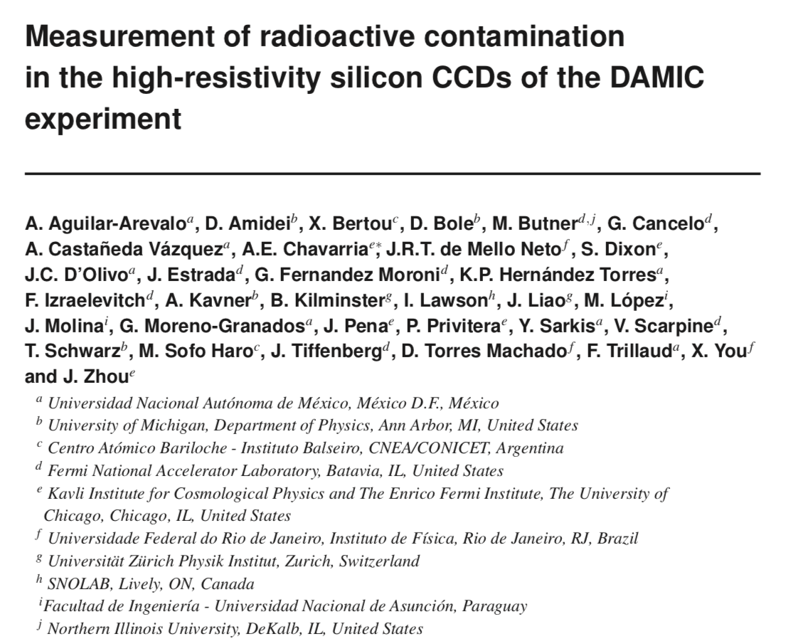
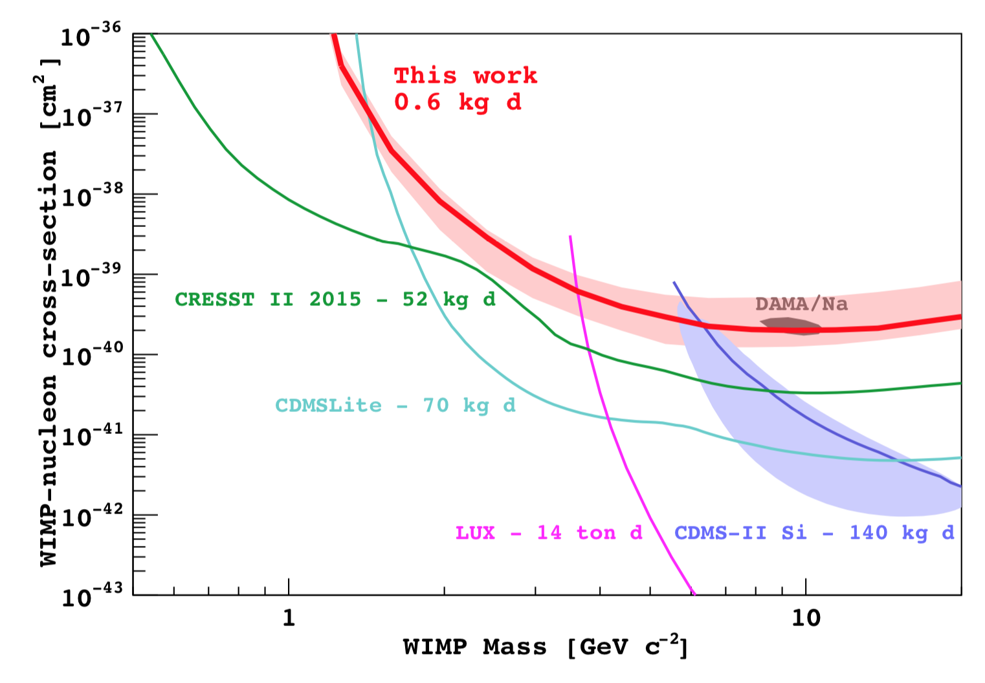
Dark Matter in CCDs:
During 2013 we got together in Mexico to start this Collaboration. Since then we provide the best limits in the low mass WIMPs with silicon target, an best limits for hidden photon dark matter
2017
2014
2016

Slide 7


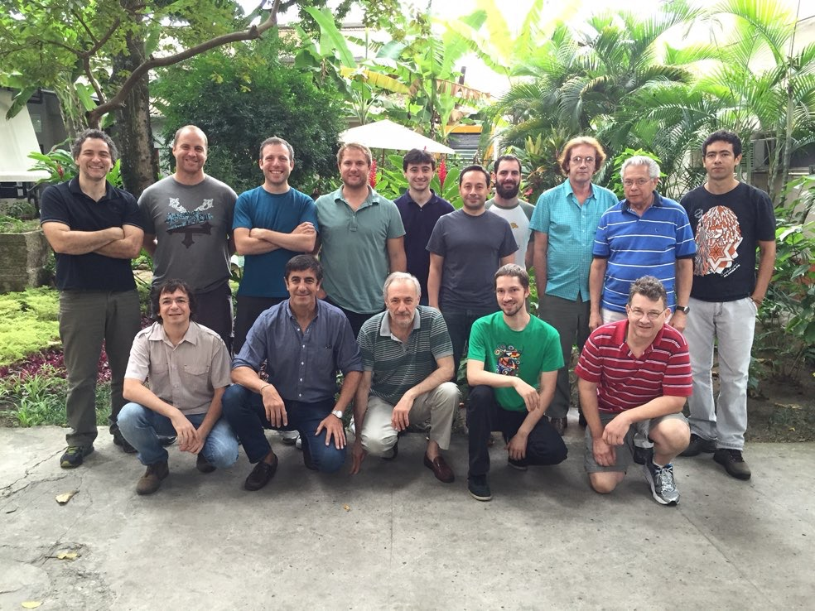

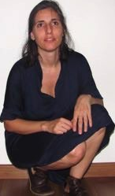


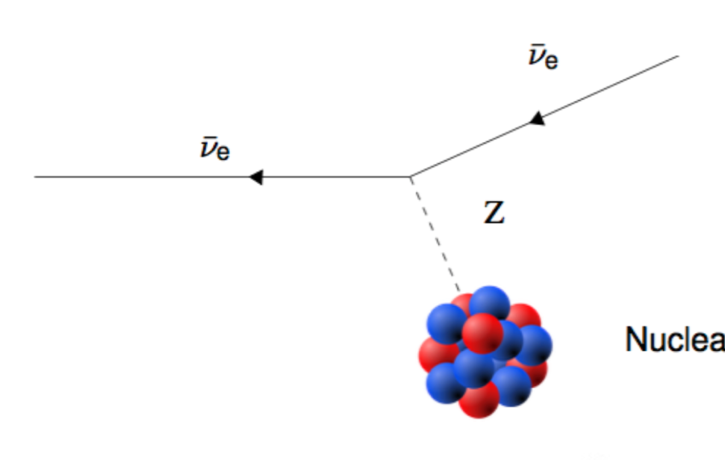



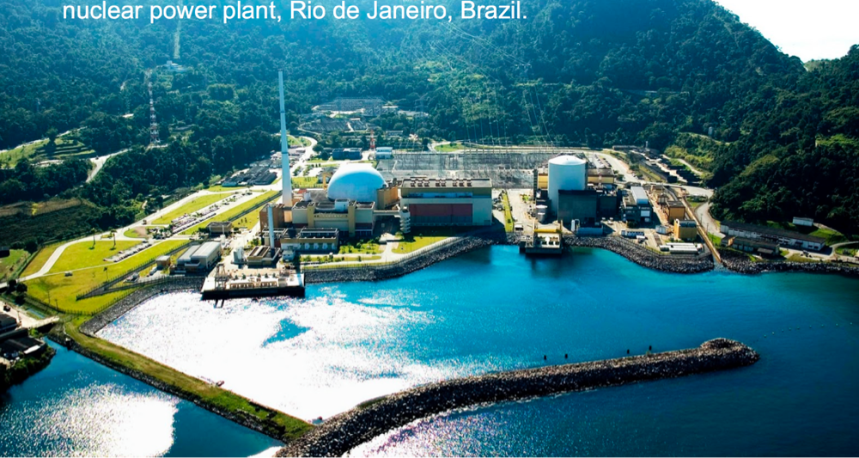
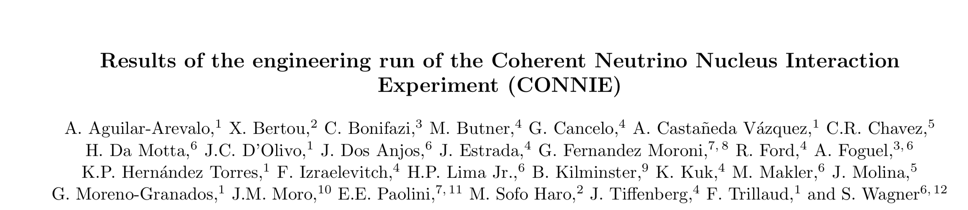
2014
a window to new physics in the low energy neutrino sector
standard model process
Centro Atómico Bariloche, Argentina
Centro Brasileiro de Pesquisas Físicas, Brazil
Universidad Nacional de Asunción, Paraguay
Fermi National Accelerator Laboratory, USA
Universidad Nacional Autónoma de México, Mexico
Universidad Nacional del Sur, Bahia Blanca, Argentina
Universidade Federal do Rio de Janeiro, Brazil
Universitat Zurich Physik Institut, Switzerland
University of Michigan, USA
2016

Slide 8
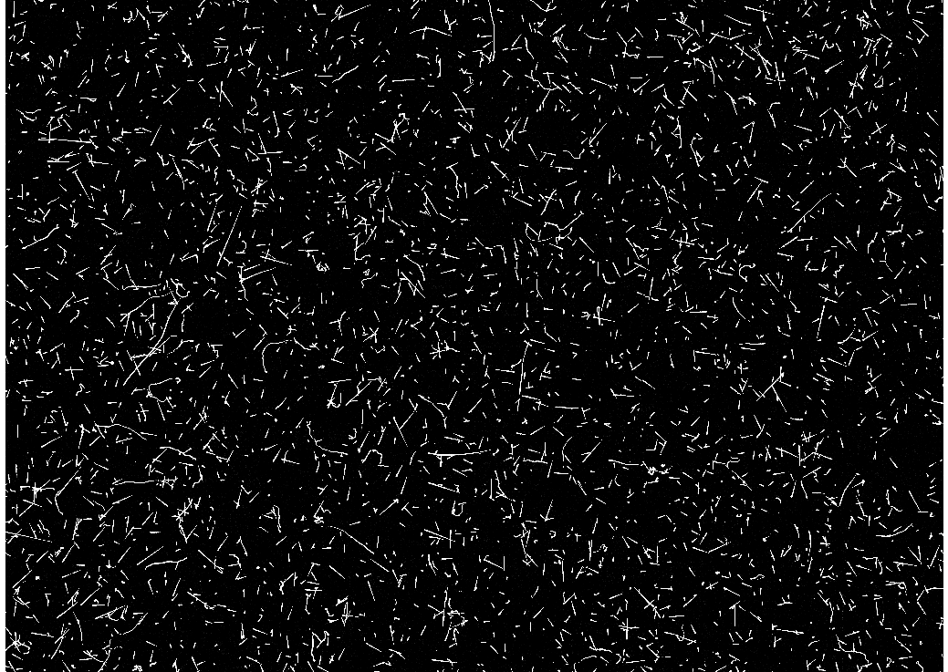
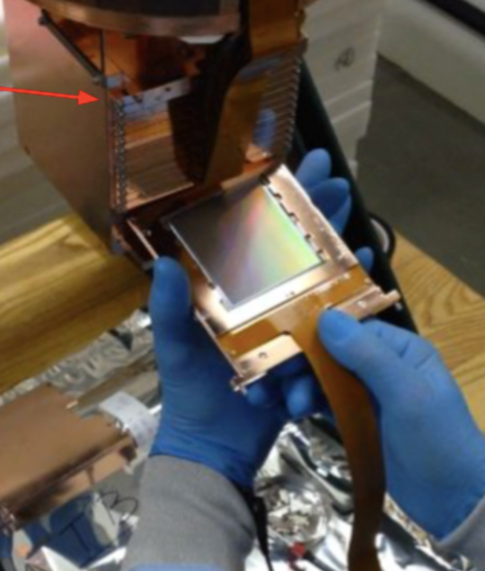
CONNIE is > 80 g CCD array
(larger than LSST 😀)

Slide 9
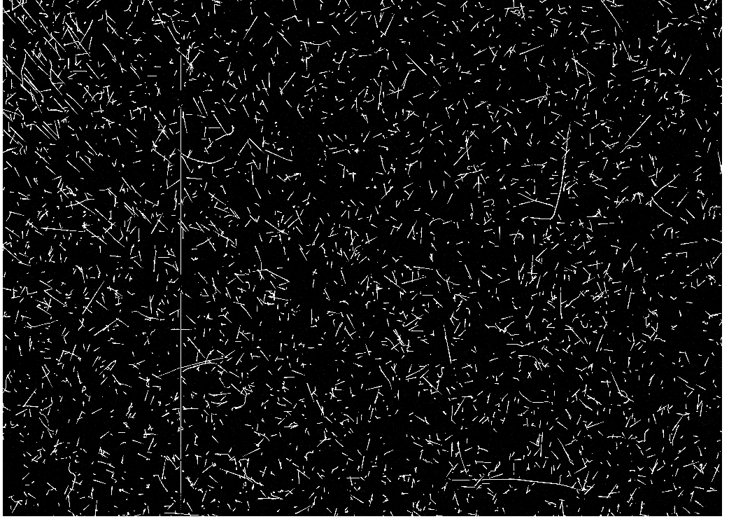

Slide 10
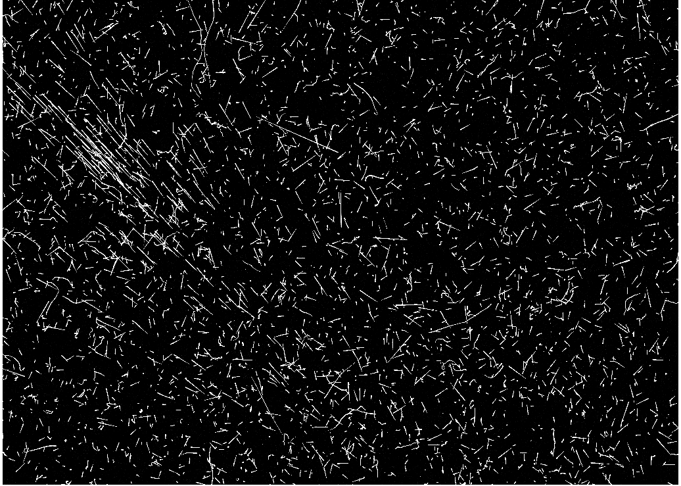

Slide 11
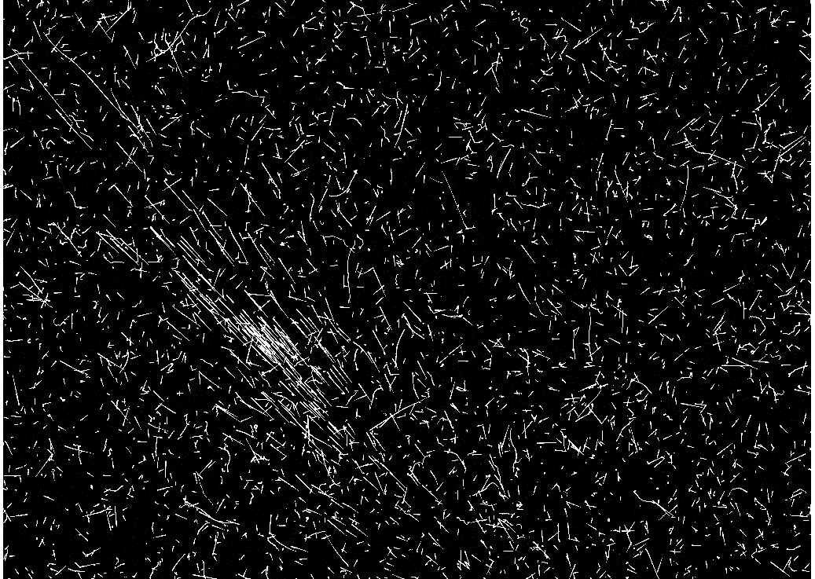

Slide 12
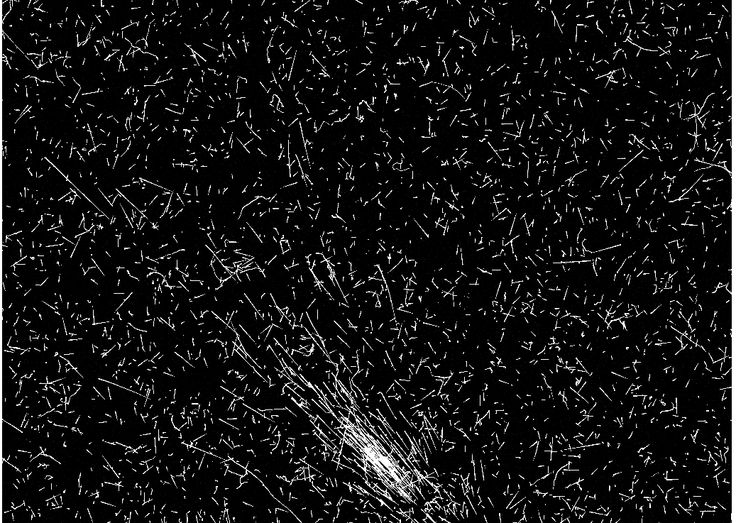

Slide 13
skipper-CCD

Slide 14
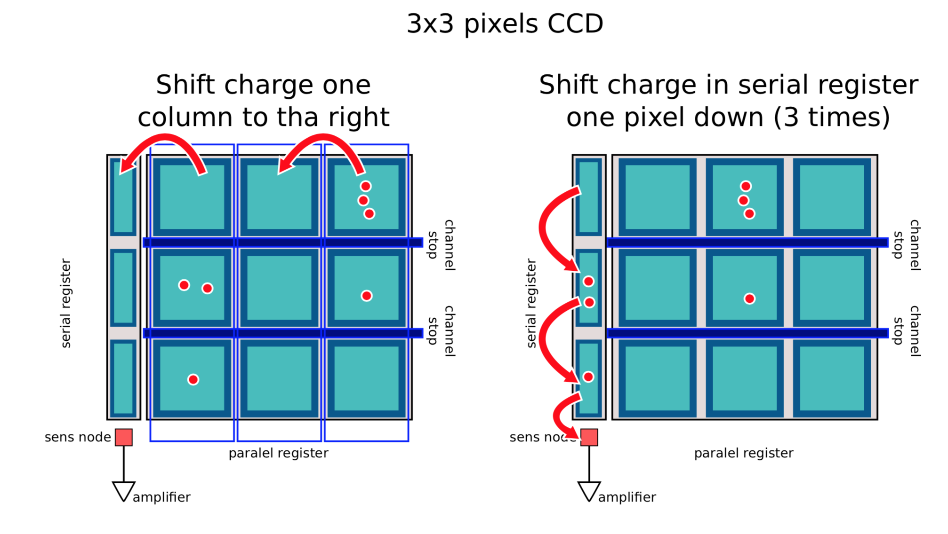
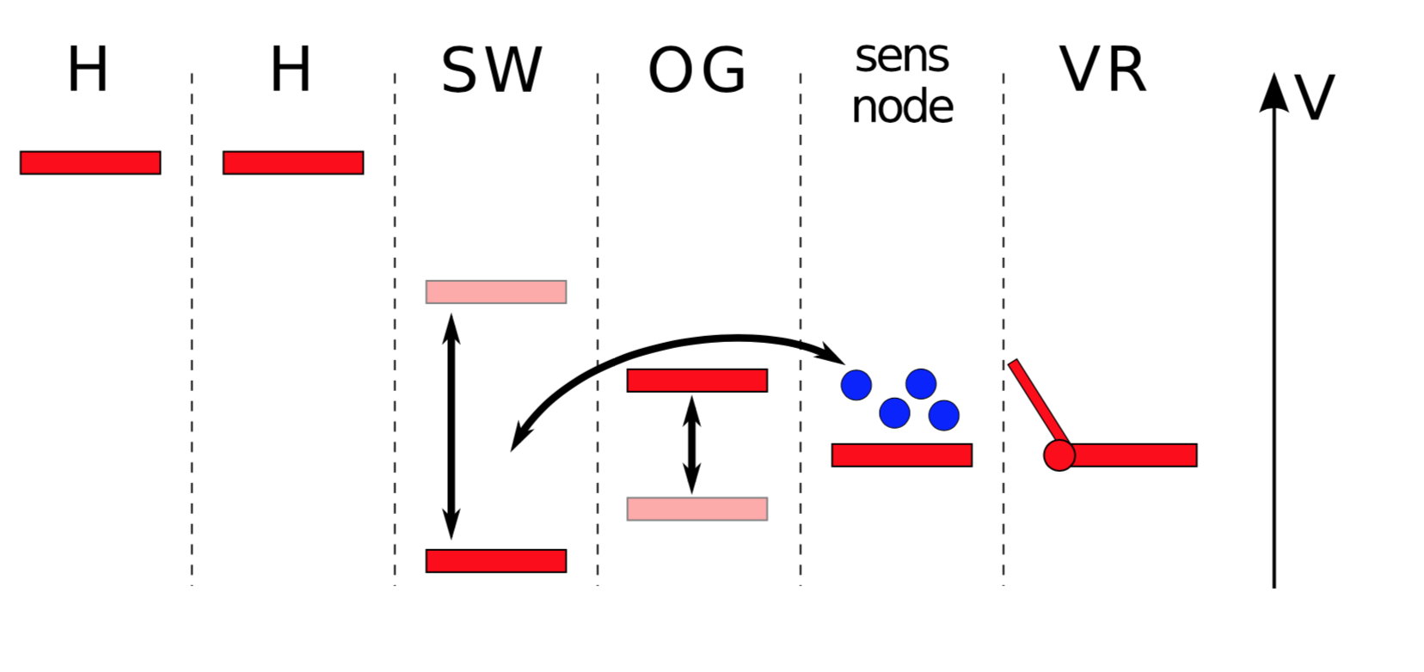
The skipper-CCD is a modification of the output stage of a CCD (Janesik et al -1990). It allows for multiple non-destructive readout of the charge in a pixel.

Slide 15
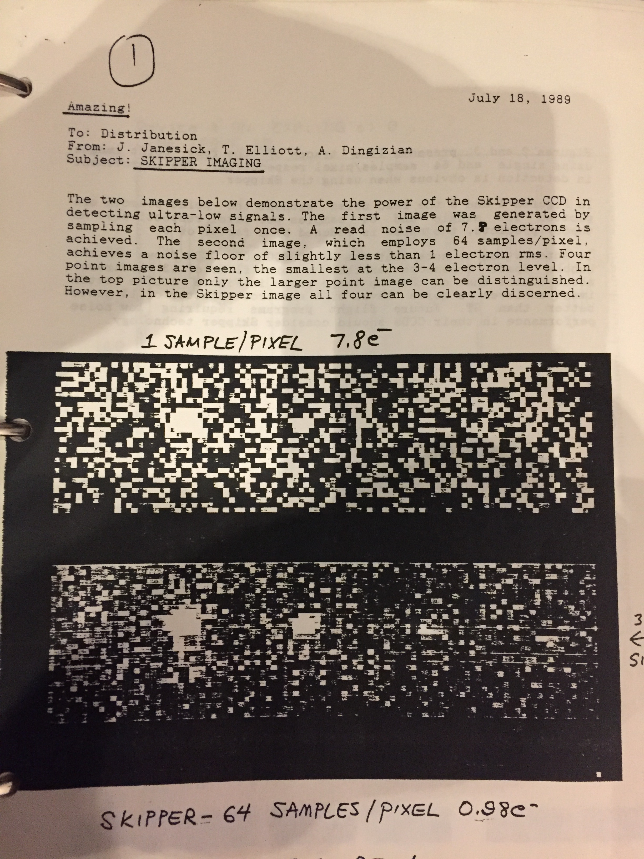
not a new invention,

Slide 17
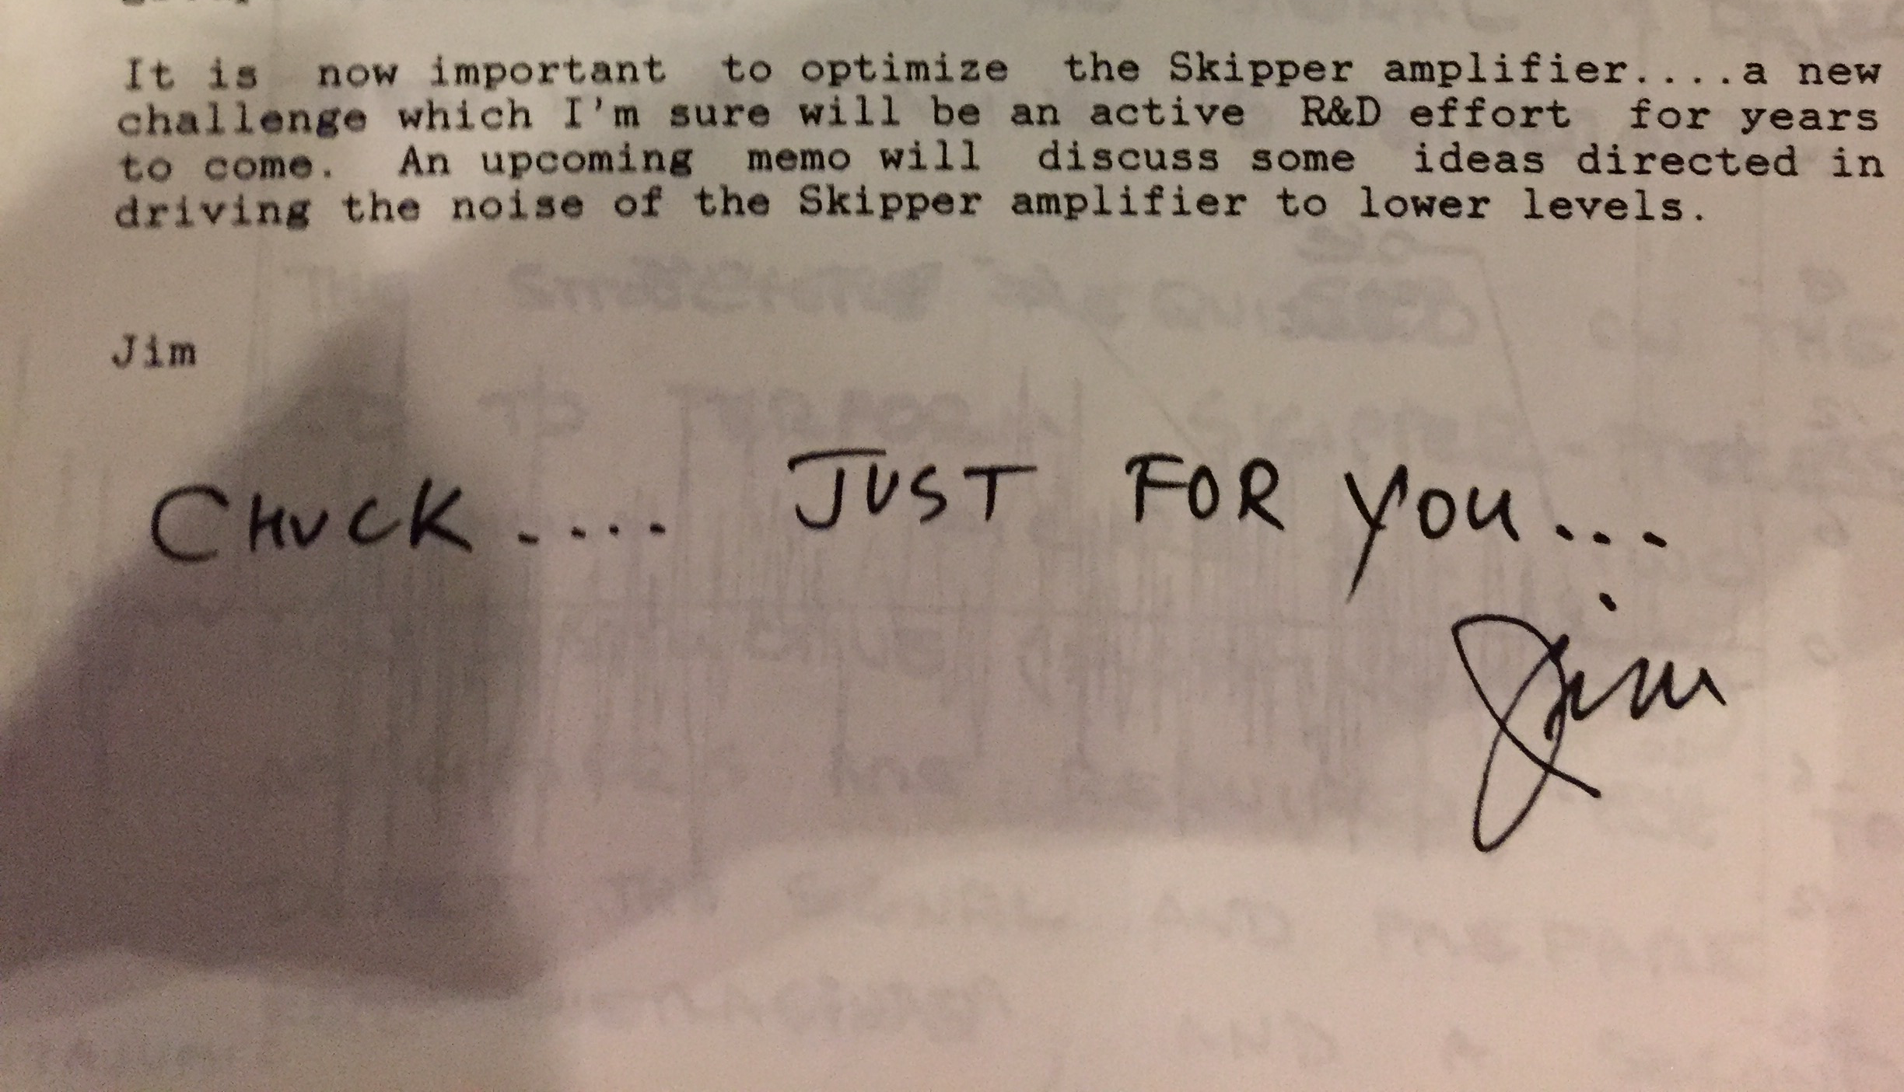

Slide 18
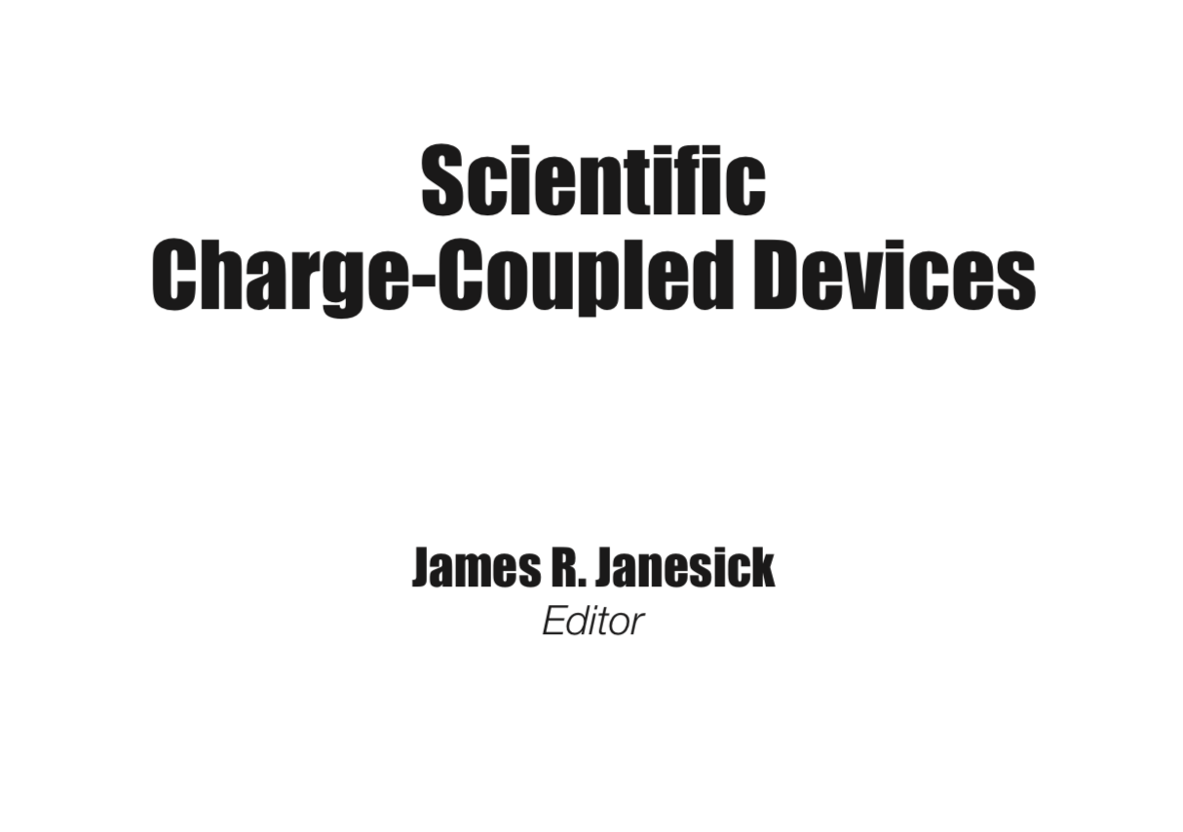
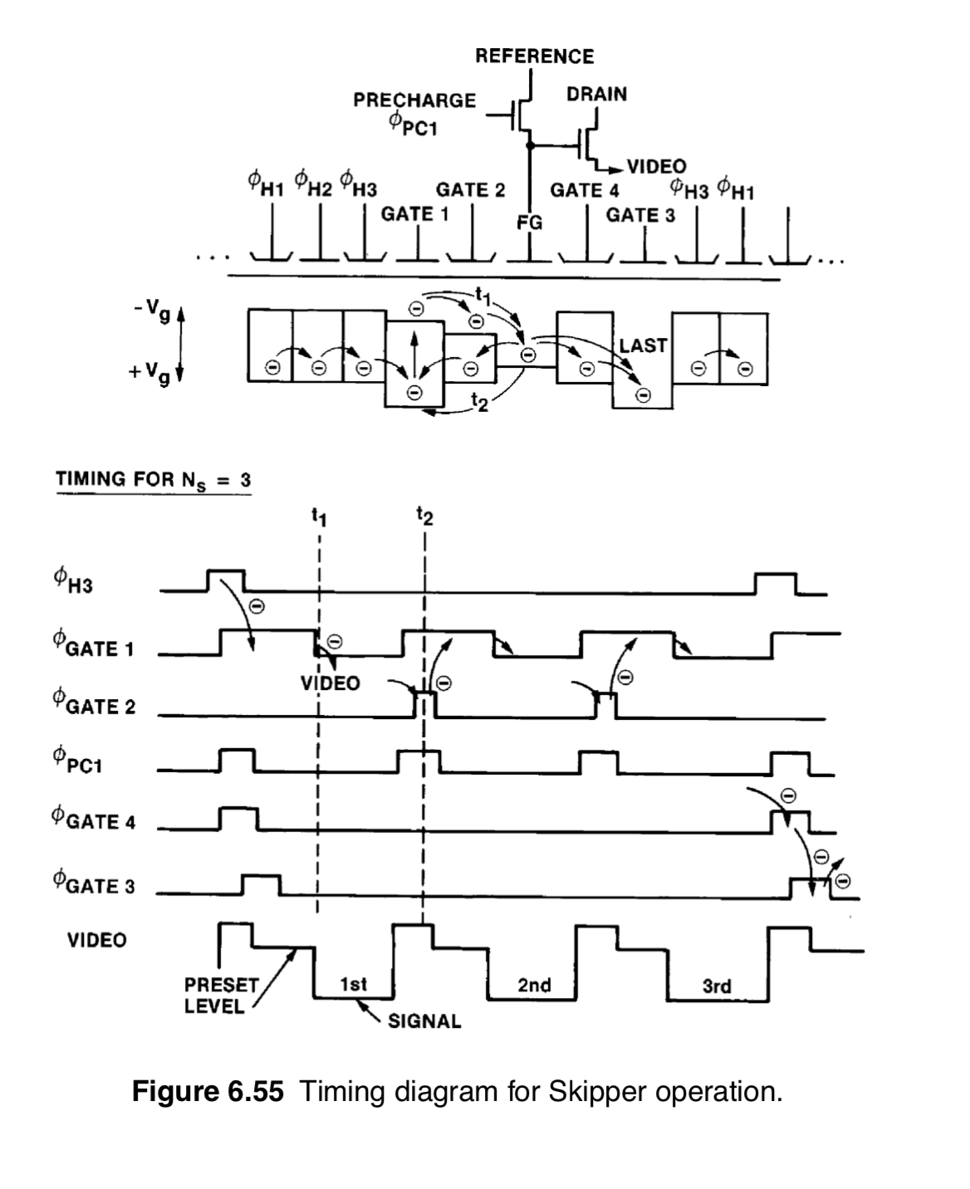
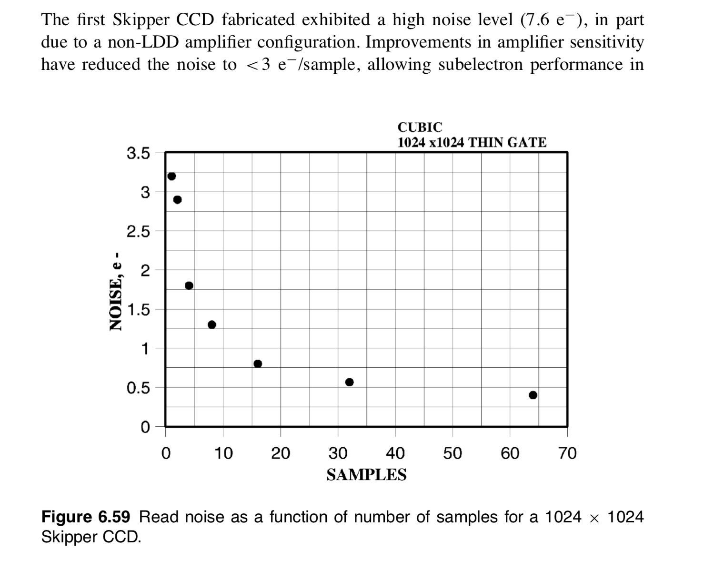
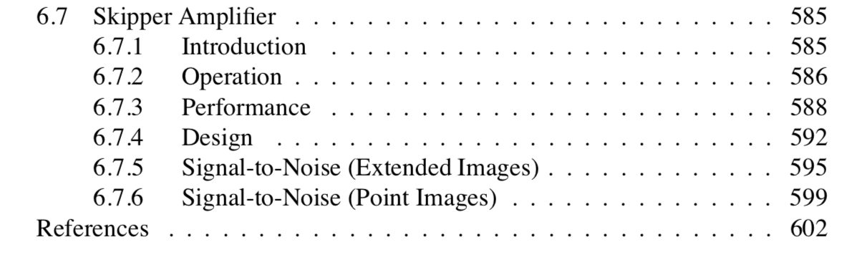
not a new invention,
2000 CCD textbook
From Steve Holland:
•Used these papers as the basis of our first FG amplifier
•Chandler et al, 1990 SPIE
•Janesick et al, 1990 SPIE
•First reports of FG amplifiers (Fairchild R&D Laboratory)
—Wen and Salisbury, ISSCC, 154, 1973
—Wen, IEEE JSSC, 410,1974

Slide 19
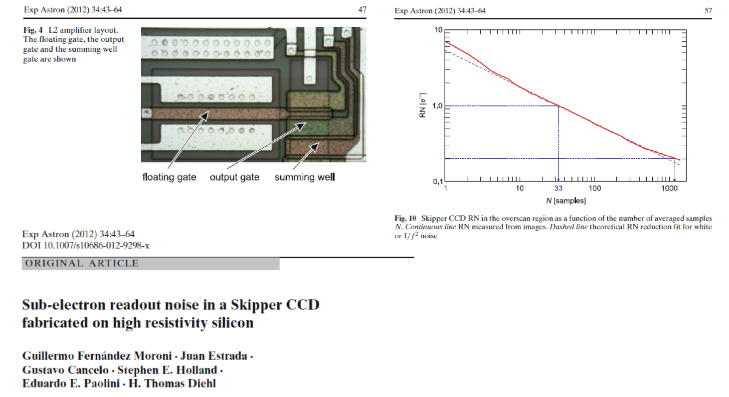
R&D development @ FNAL/LBNL (G.Fernandez-Moroni)

Slide 20
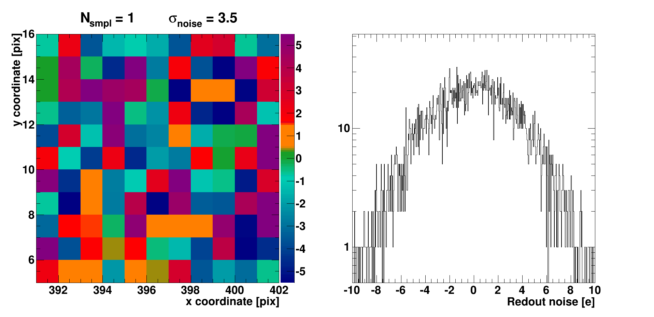
the new skippers

Slide 21
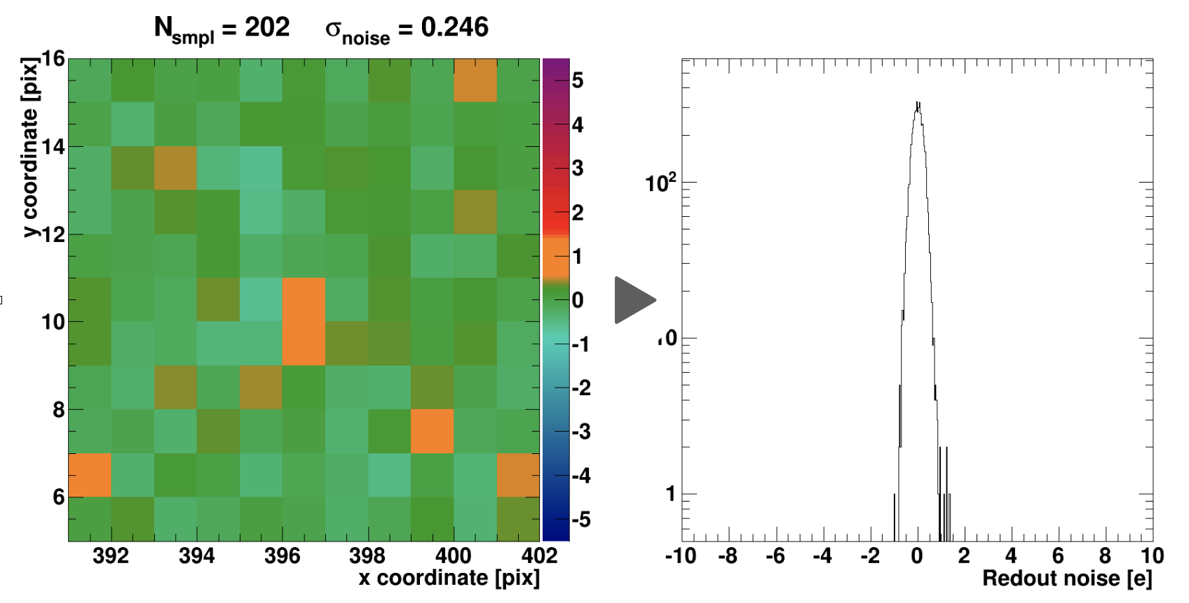
the new skippers

Slide 22
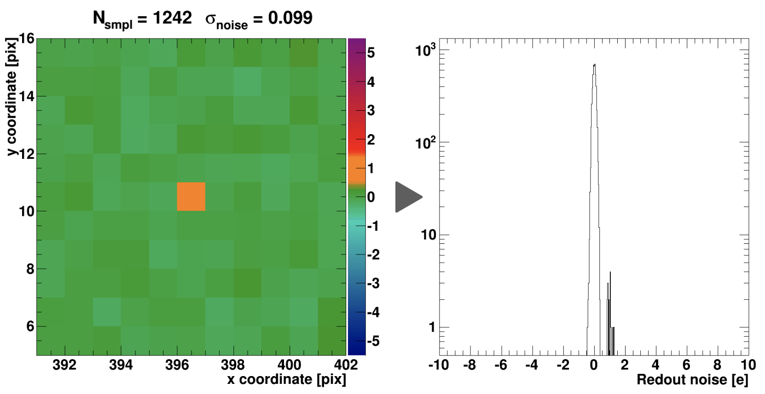
the new skippers

Slide 23
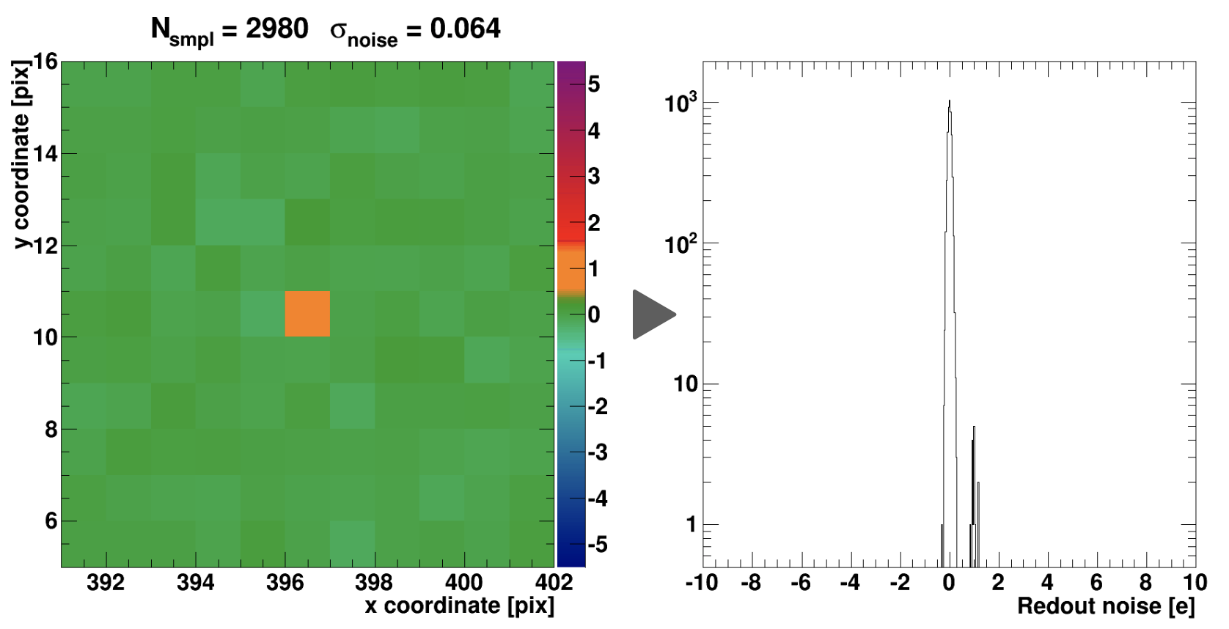
the new skippers

Slide 24
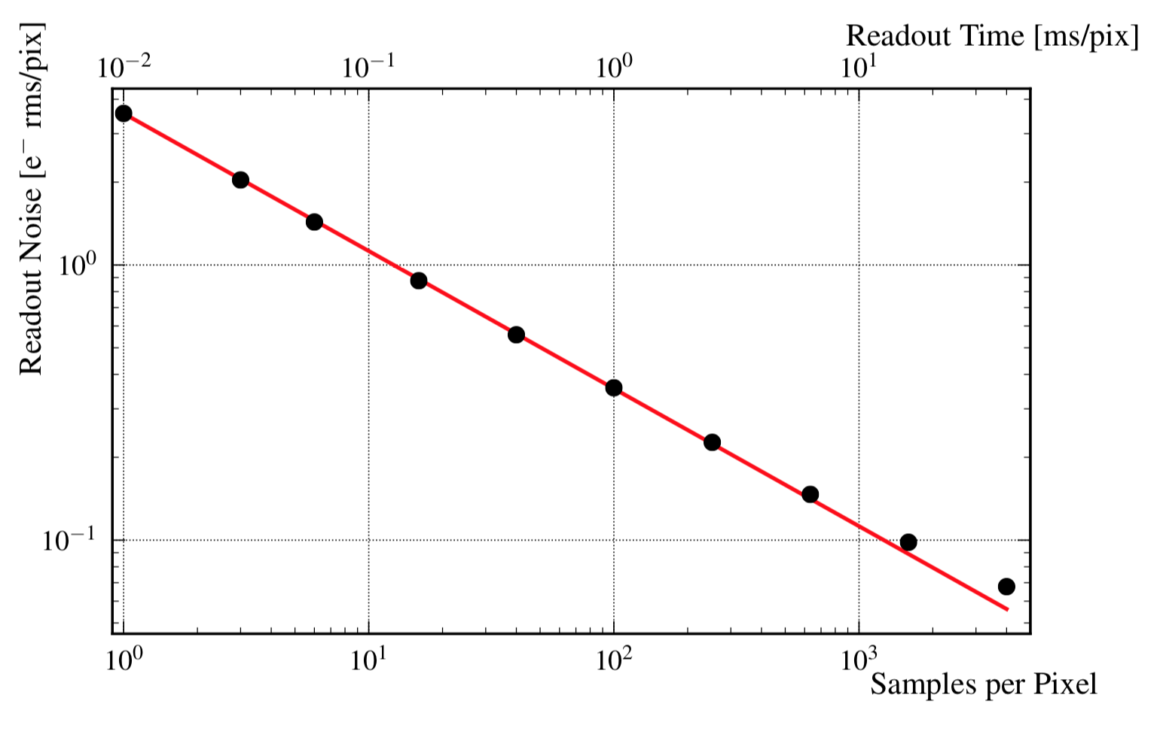

Slide 25
Single-electron and single-photon sensitivity with silicon Skipper-CCD (J. Tiffenberg et al)
Physical Review Letters, Volume 119, Issue 13, (2017)
CONNIE/DAMIC now
skipper CCD
Designed at least~30 years ago, and reduces the noise to “0”

Slide 26
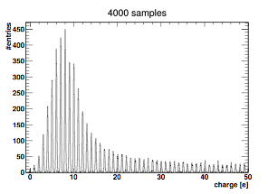
impressive ability to count electrons!

Slide 27
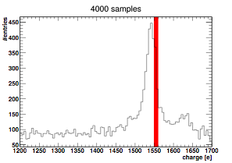
⁵⁵Fe X-ray line 5.9 keV

Slide 28
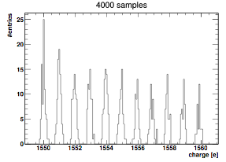
⁵⁵Fe X-ray line 5.9 keV

Slide 29
dark sector search

Slide 30
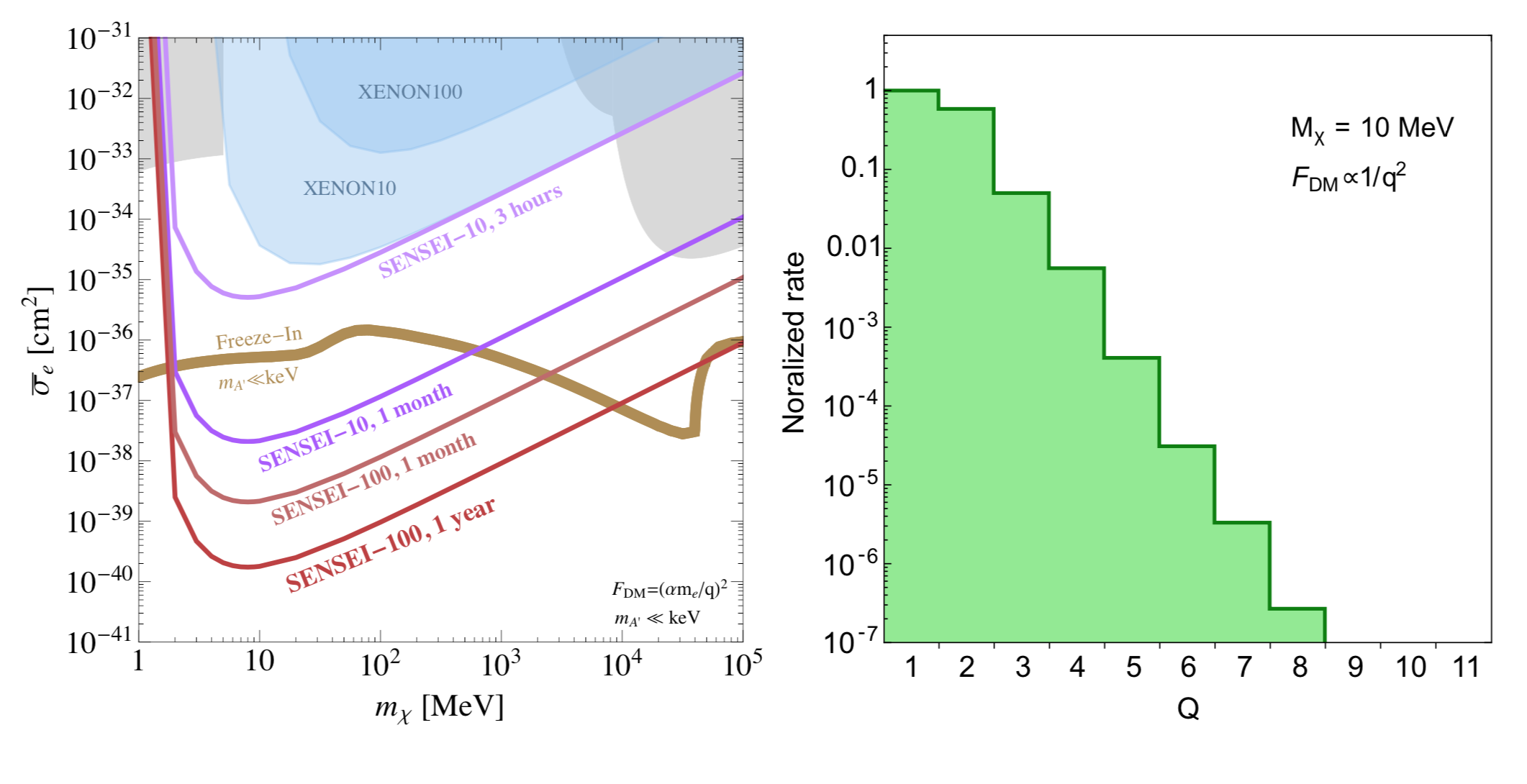
Once you can count electrons, you can search for electron recoils produced by very low mass dark matter (dark sector searches). This is what we are planning to do with the skipper-CCD in the SENSEI experiment.

Slide 31
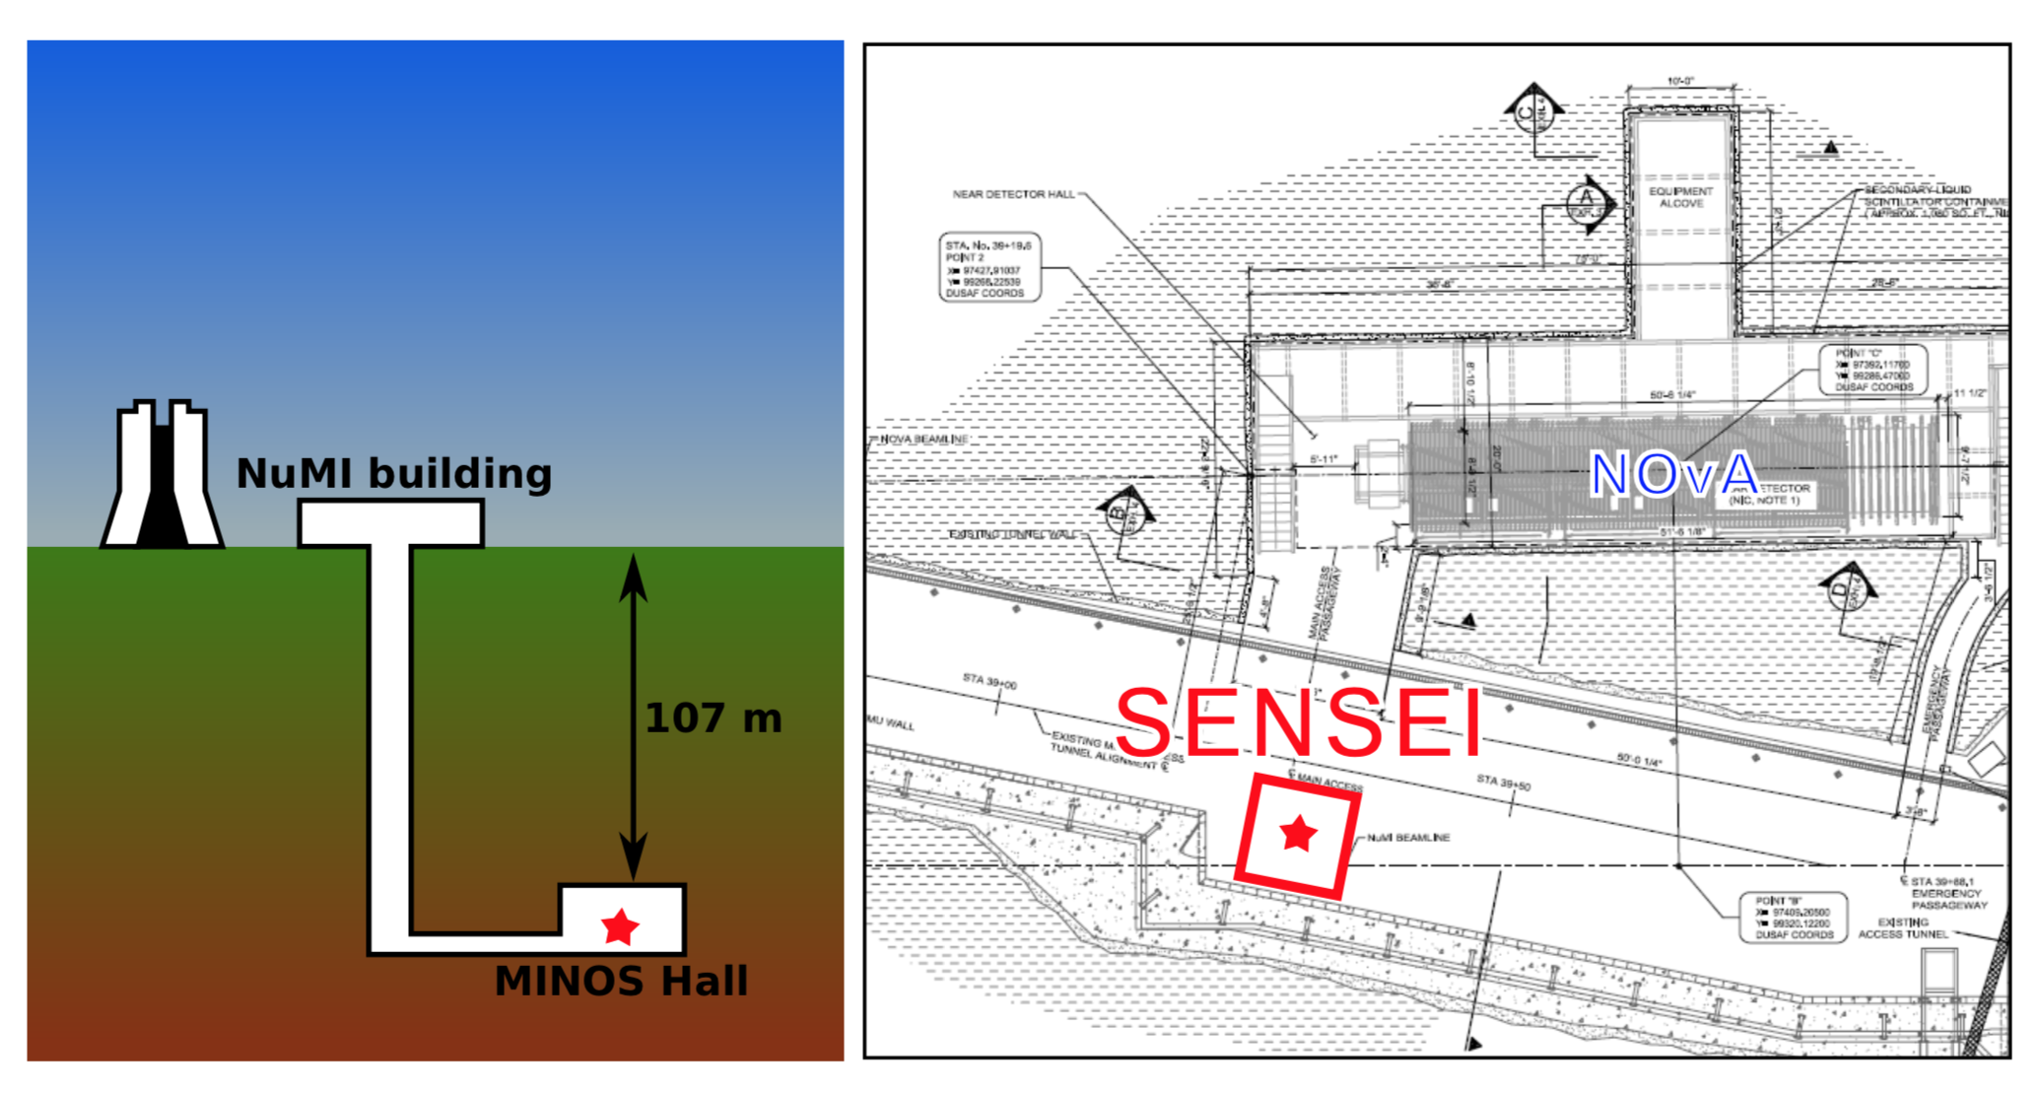
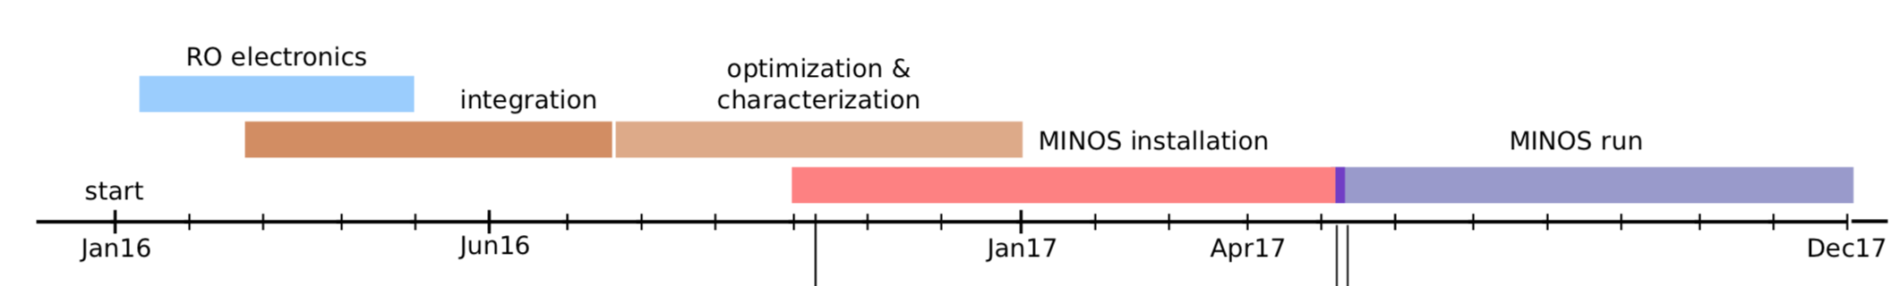

Slide 32
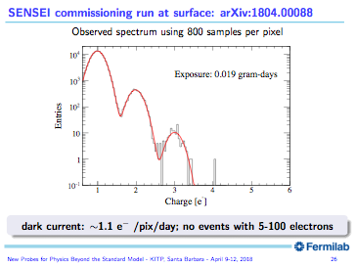

Slide 33
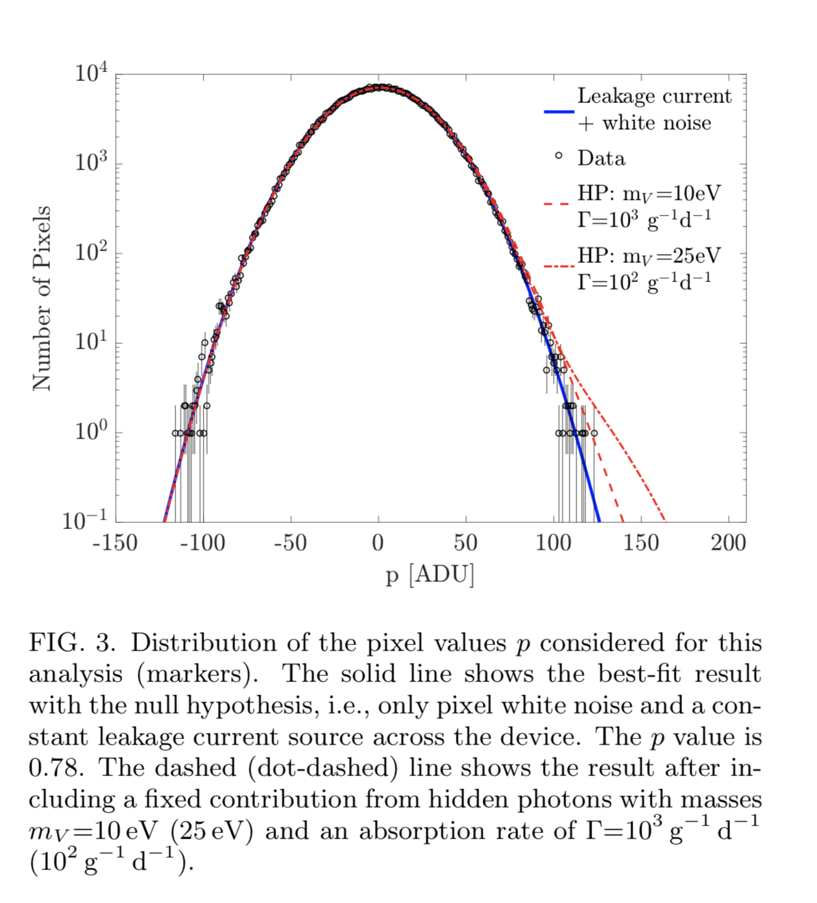
DAMIC
Physical Review Letters, Volume 118,
Issue 14 (2017) ]
In this business, even this low level of dark current is a limitation.
Using standard CCDs (searching for hidden photons) we have achieved:
λ=4.0 e⁻ mm⁻² d⁻¹
DC=0.9 x10⁻³ e⁻/pix/d
we think we can do little better.

Slide 34
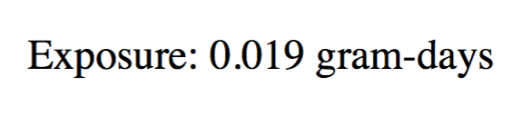
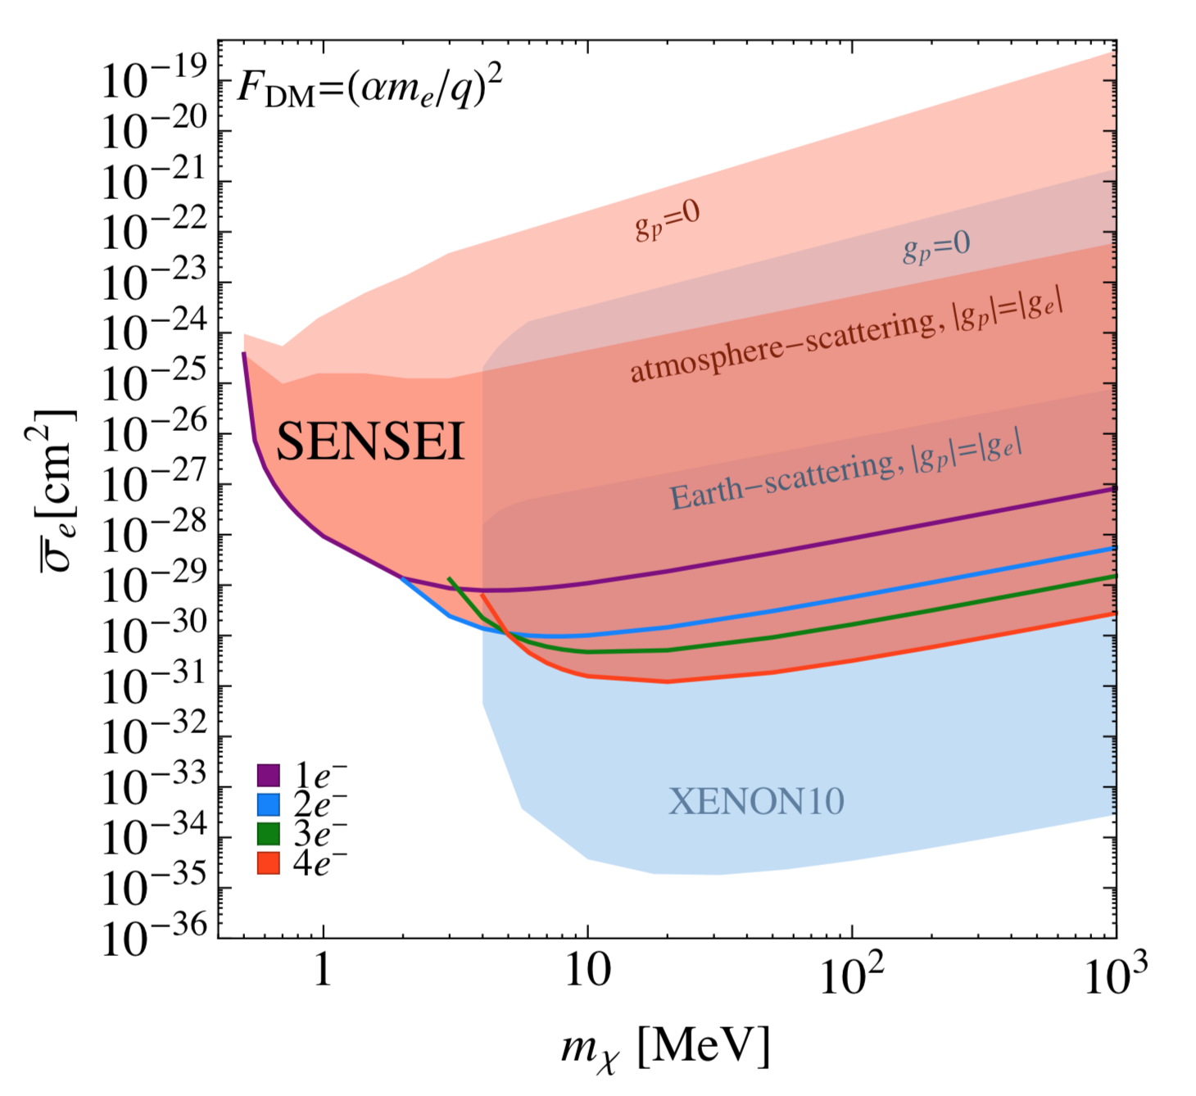
ultralight dark photon
an updated result hopefully before the en of 2018…

Slide 35
the future is all skipper…

Slide 36
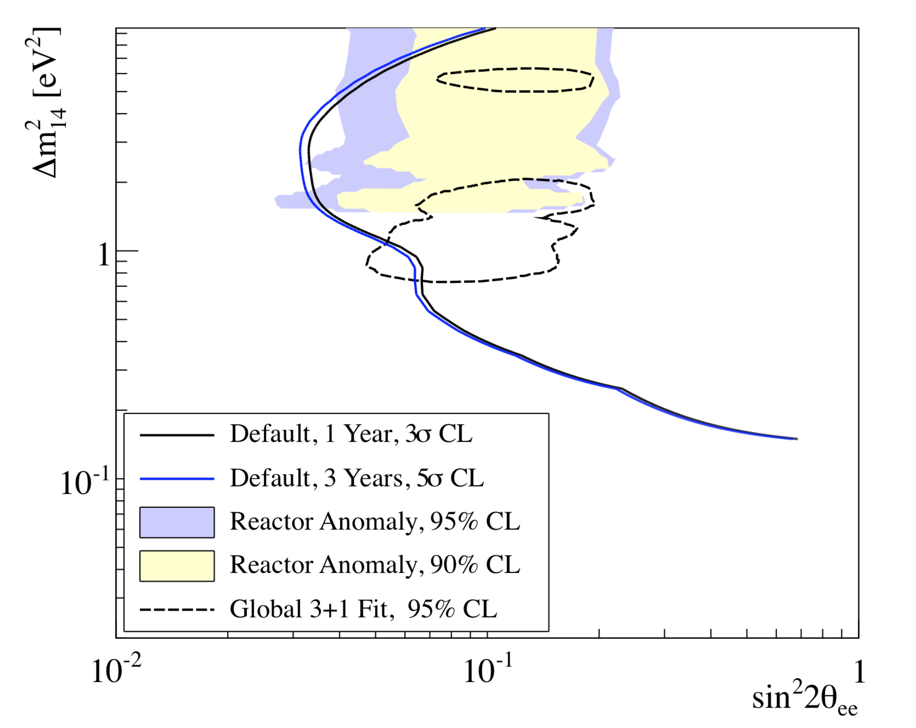
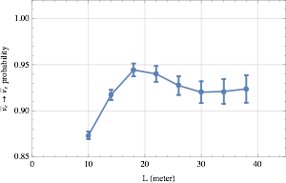

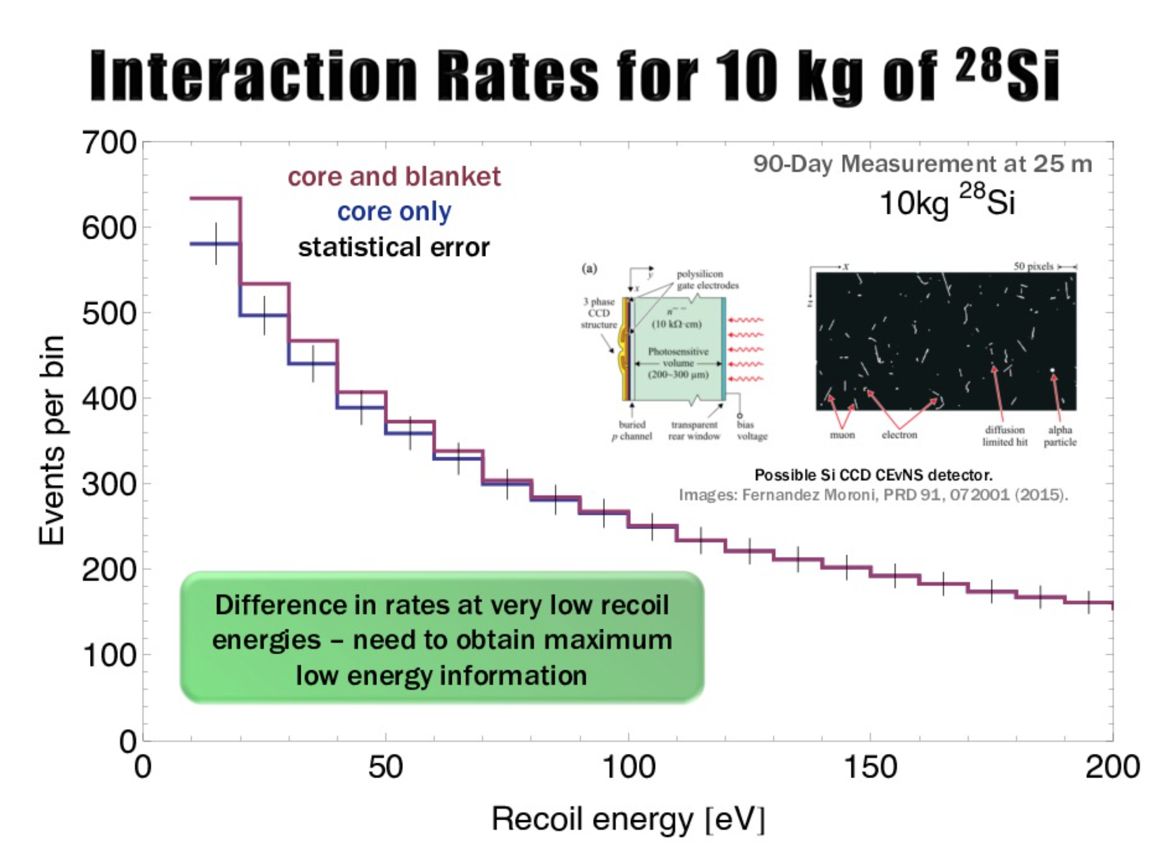
> 10 kg detectors could be used for neutrino and DM science in the future
Expected CENNS measured anti-νe survival probability. Each point corresponds to a 2 kg skipper-CCD detector with 10eV threshold and 300 days of data collection. For the sterile neutrinos we assumed : ∆m²S = 0.5 eV², sin(2θS)² = 0.15 .
arXiv:1212.2182

Slide 37
NATURE PHOTONICS | VOL 4 | APRIL 2010 | www.nature.com/naturephotonics
entangled photons produced with non-linear crystal and imaged with CCDs.
[sub-shot noise imaging]

Slide 38
skipper for quantum imaging
state-of-the-art sensors can not count more than
1 photon (EMCCD)
skipper-CCD developed by FNAL+LBNL can count whatever number you like…

Slide 39



skipper in space
cubeSat for detecting
the decay of dark matter in our own galaxy.

Slide 40



skipper for cosmic surveys
new skipper-CCD technology could improve the efficiency of a survey spectrograph reducing readout time.
Signal to noise could be tuned to optimizing readout time (target specific pixels for low noise).
(A.Drilica-Wagner)

Slide 41
for experiments with > 10 kg of CCDs, we need “a bit” of development

Slide 42


10 kg skipper Detector (4000sensors)

Slide 43


Low Threshold Acquisition
Single board CCD readout
clocks generation
flexible programing
4 channels
low cost
available (fmoroni.guillermo@gmail.com)
already achieved <0.05e- RMS noise with this system

Slide 44


correlated noise subtraction
We try to make systems that do not pickup noise… but if it often hard to do this perfectly.
Since we have 28 amplifiers we can optimize the noise using the correlated information from all the other channels.
How this works in CONNIE array (14 CCDs)
raw noise(CCD2)
after subtracting correlated noise

Slide 45


Implemented this on LTA for a single CCD with 2 channels
Fully digital LTA gives this kind of flexibility. Obviously not needed for the ideal system, but seems to always help in the real system.

Slide 46
Skipper-CCD is fun!
first results already out
new results coming soon
working hard on the R&D to go BIG

Slide 48


Slide 49


NEWS: First light for CEvNS, “Observation of coherent elastic neutrino-nucleus scattering” by the COHERENT collaboration, published in Science, August 3, 2017

Slide 50


Two ways to get high flux low energy neutrinos
Neutrinos from a nuclear reactor
Very large flux, close to core.
Low energy recoils, harder to see.
Deal with background by shielding.
A window to very low energy neutrino sector.
MINER, CONNIE
Neutrinos produced by stopped pions (decay at rest).
Higher energy recoils, easier to see
Pulsed to control background.
Has to deal with beam associated background.
COHERENT
Coherent Collaboration
SBS neutrino spectrum

Slide 51
Nuclear Recoil Calibration (A.Chavarria et al)

Slide 52

Nuclear Recoil Calibration (F. Izraelevitch et al)
Complete calibration down to our threshold for CONNIE.

Slide 53

CONNIE rates

Slide 54

now selecting the low energy events….
For each muon measure make a measurement of charge diffusion in the CCD
Using all the muons in a 10 day period make a model for the detector
Use this model to eliminate surface events.
coming soon…

