Slide 1
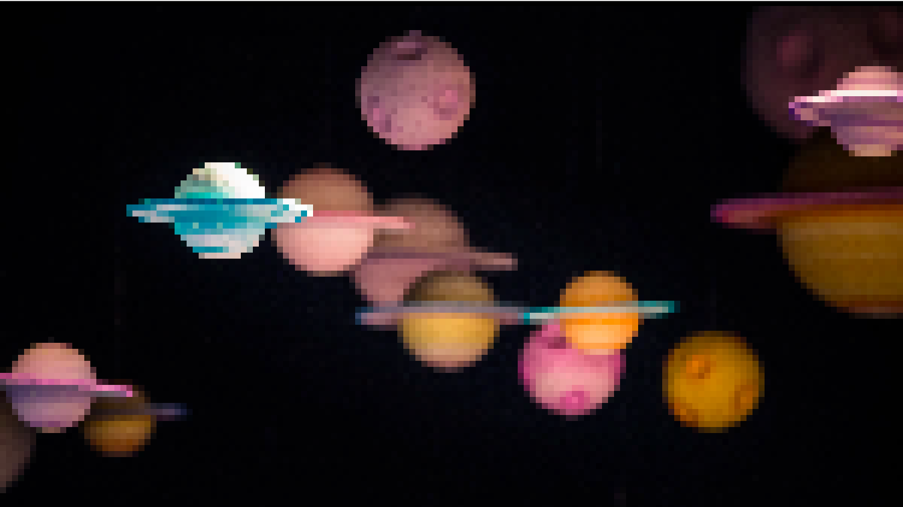
Impact of Detector Imperfections
On Precision Radial Velocity Exoplanet Searches
Arpita Roy
Notes:
What does it mean to break the 1 m/s barrier
- not always going to get down to this
- point is to be photon noise dominated as much as you can, not instrument or other systematic dominated (including stellar noise)
- error budget driven (not only hardware design) but data analysis and survey design

Slide 2
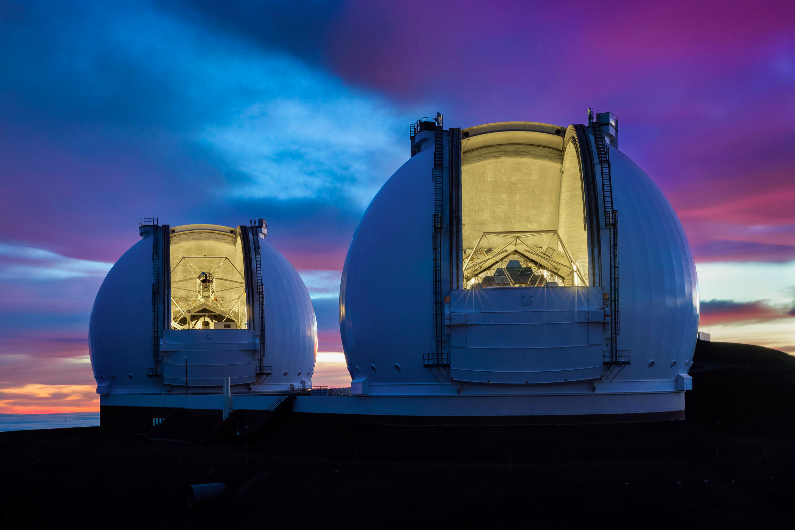
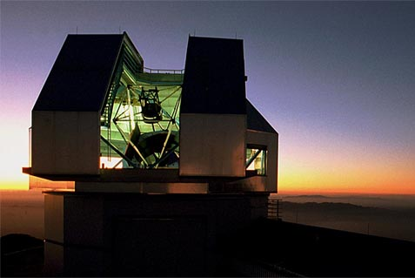

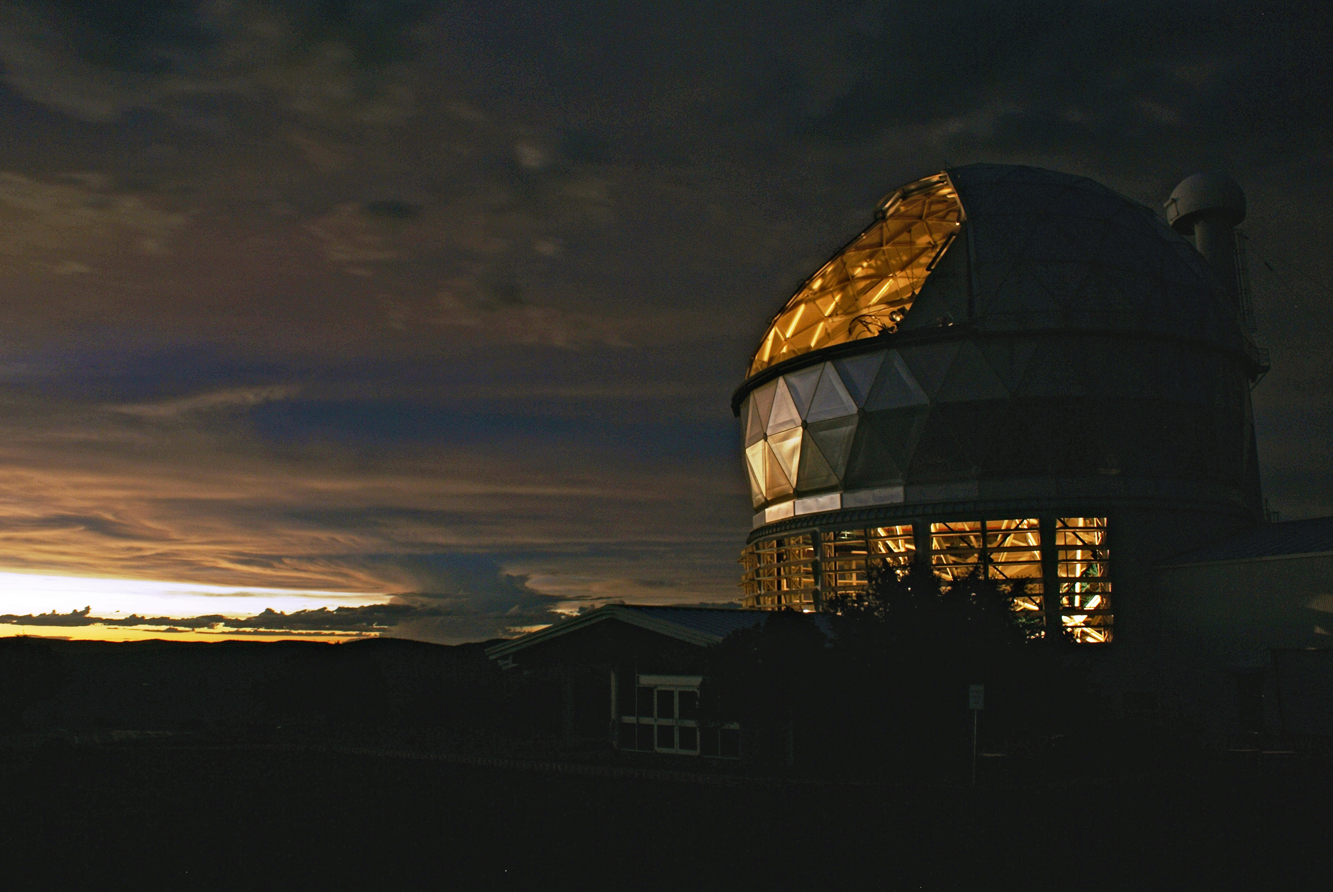
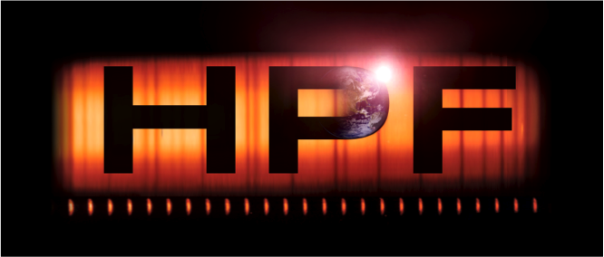
Future of the Field
Heralding Extreme Precision Spectroscopy
50cm/s precision with a goal of 30cm/s
30cm/s precision with a goal of 10cm/s
Keck Planet Finder
10m Keck Telescopes
3.5m WIYN Telescope
1m/s precision goal, frontier in NIR
10m Hobby Eberly Telescope
Notes:
Most systematics higher than planet signal, need to either
-decrease the strength of these
-understand the pattern and correct it out
-beat down with many many observations (assuming they average out over sampling timescales)

Slide 3
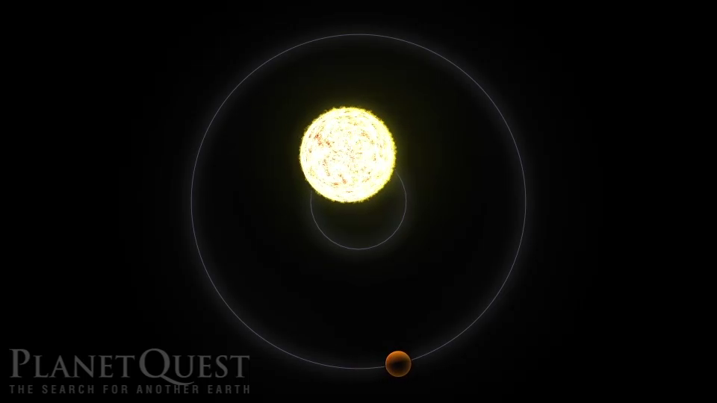
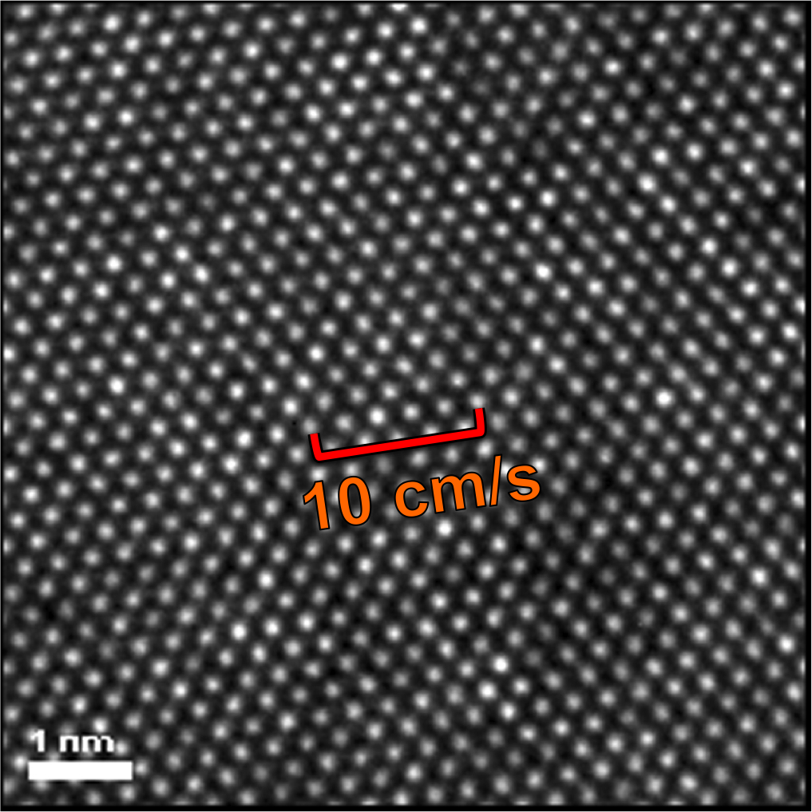
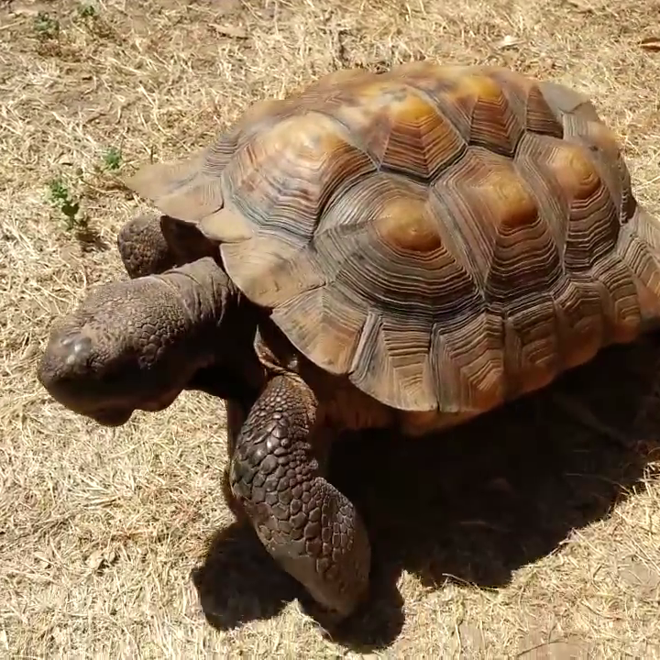
Future of the Field
Heralding Extreme Precision Spectroscopy
Instruments attempting to achieve ~10cm/s precision for the detection of Earths
10cm/s corresponds to 1/6,000th of a 10 micron pixel
Silicon Lattice: High Resolution TEM Image of individual Si atoms.
[Ki Bun Kin, SPIE 2012]
Notes:
Most systematics higher than planet signal, need to either
-decrease the strength of these
-understand the pattern and correct it out
-beat down with many many observations (assuming they average out over sampling timescales)

Slide 4
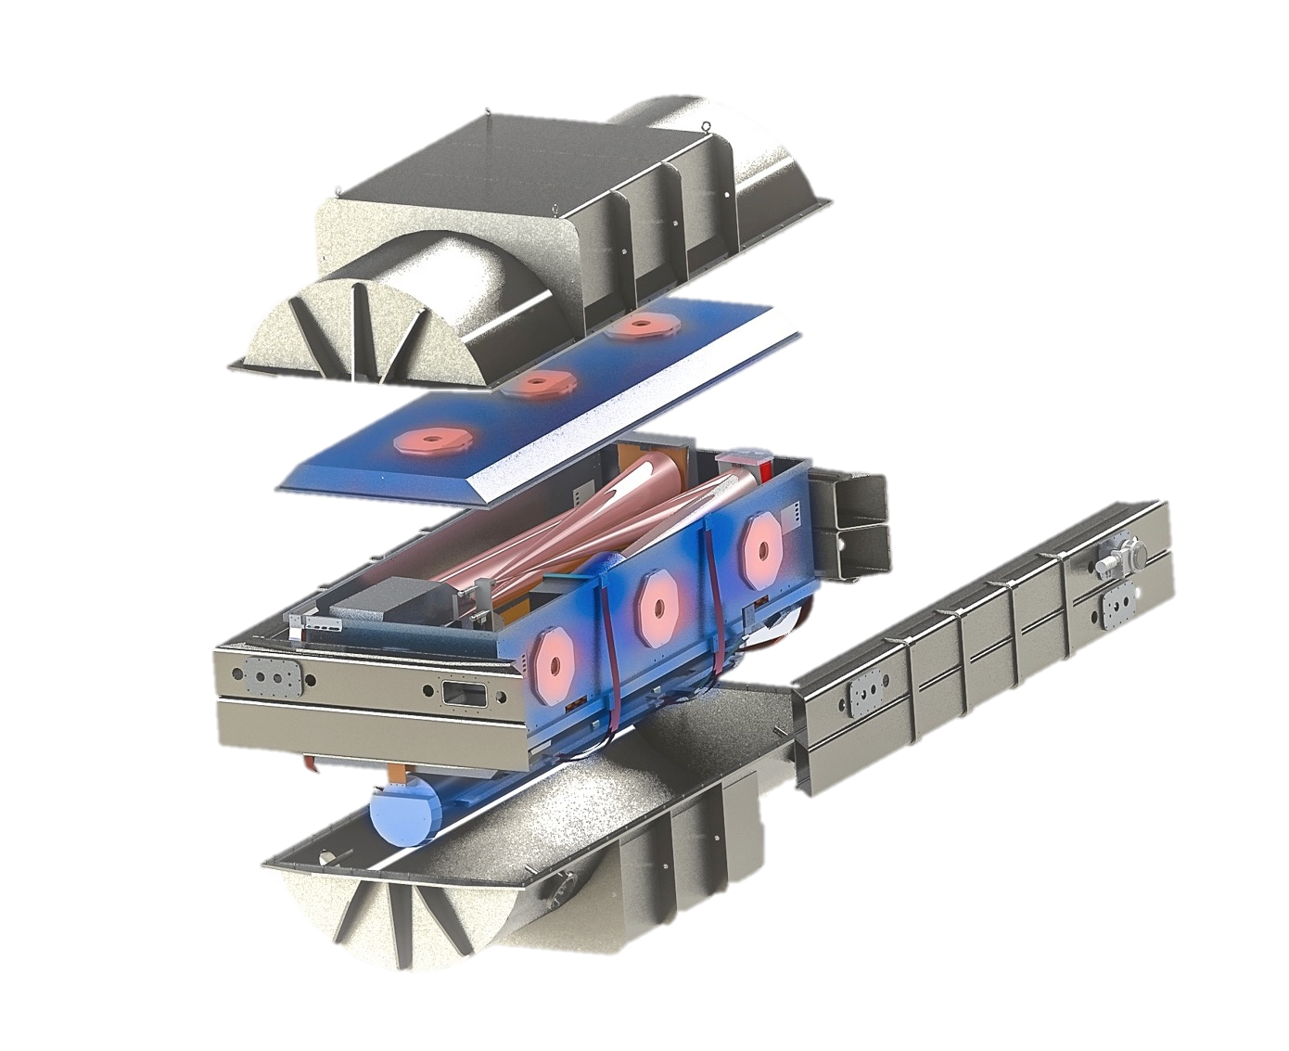
Overall Philosophy
Remove all other effects to isolate bulk stellar motion
Stabilize hardware with exquisite thermo-mechanical control within vacuum
Notes:
Most systematics higher than planet signal, need to either
-decrease the strength of these
-understand the pattern and correct it out
-beat down with many many observations (assuming they average out over sampling timescales)

Slide 5
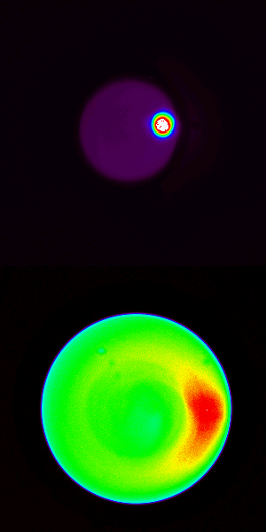
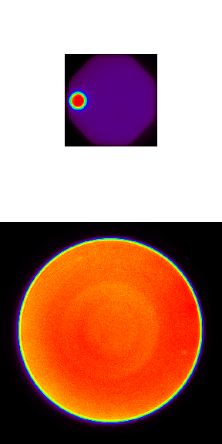
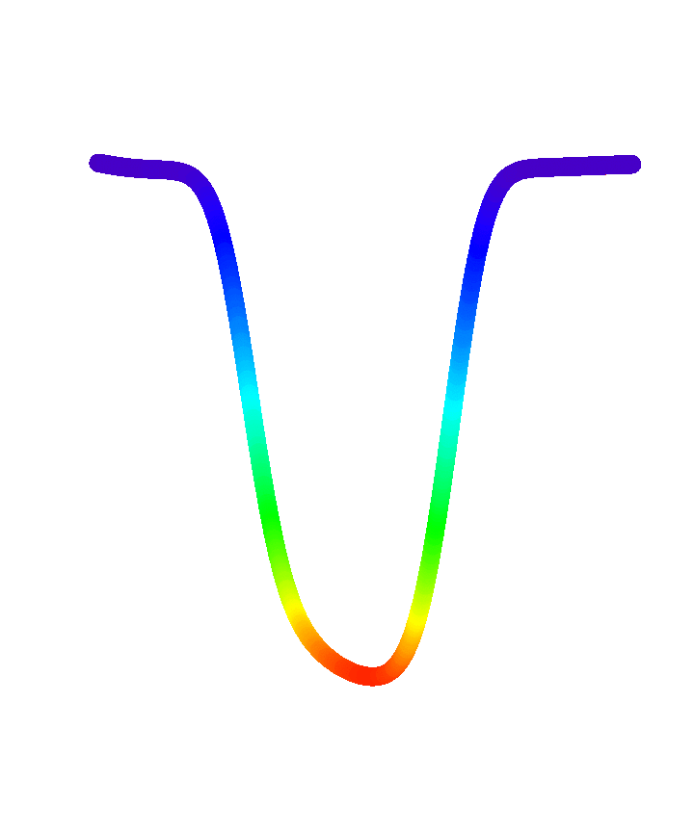
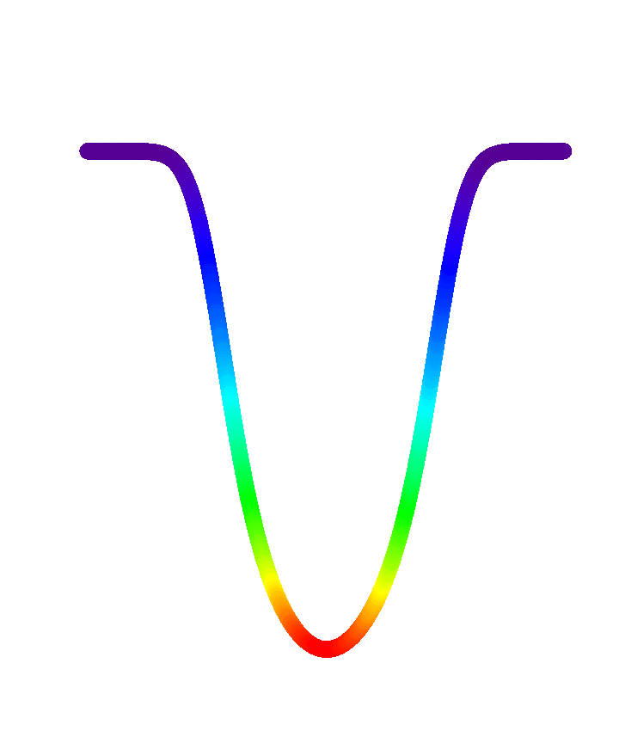
Overall Philosophy
Remove all other effects to isolate bulk stellar motion
Single fiber
Fibers + double scrambler
Stabilize hardware with exquisite thermo-mechanical control within vacuum
Stabilize illumination with highly scrambled and agitated fiber feed
Telescope focal plane
Fiber output
Instrument profile
(spectral line)
Halverson & Roy+ 2015
Notes:
Most systematics higher than planet signal, need to either
-decrease the strength of these
-understand the pattern and correct it out
-beat down with many many observations (assuming they average out over sampling timescales)

Slide 6
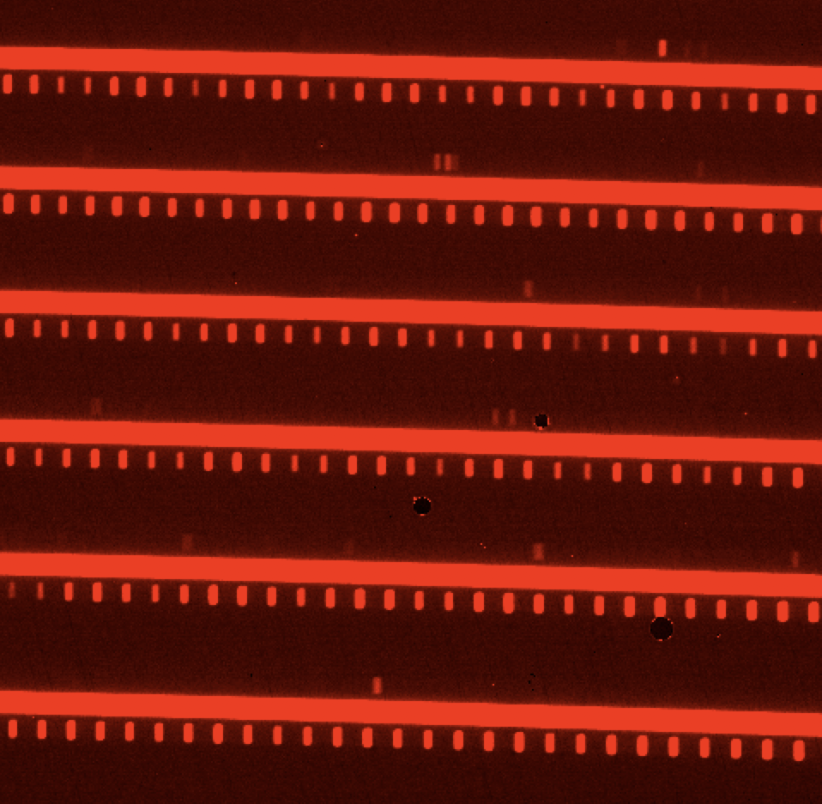
Overall Philosophy
Remove all other effects to isolate bulk stellar motion
Stabilize hardware with exquisite thermo-mechanical control within vacuum
Stabilize illumination with highly scrambled and agitated fiber feed
Calibrate out instrument variability with simultaneous reference eg. laser frequency comb, in software
Sky
Star
Laser Comb
Habitable Zone Planet Finder: Raw frame of Barnard’s Star with laser frequency comb calibration
Notes:
Most systematics higher than planet signal, need to either
-decrease the strength of these
-understand the pattern and correct it out
-beat down with many many observations (assuming they average out over sampling timescales)

Slide 7
Overall Philosophy
Remove all other effects to isolate bulk stellar motion
Stabilize hardware with exquisite thermo-mechanical control within vacuum
Stabilize illumination with highly scrambled and agitated fiber feed
Calibrate out instrument variability with simultaneous reference eg. laser frequency comb, in software
Diagnose stellar activity variations that can mimic planetary signatures, in software
100
CCF Depth [%]
50
0
Constructing Bisectors
-2O
-10
0
10
20
Velocity [km/s]
Habitable Zone Planet Finder: Raw frame of Barnard’s Star with laser frequency comb calibration
Notes:
Most systematics higher than planet signal, need to either
-decrease the strength of these
-understand the pattern and correct it out
-beat down with many many observations (assuming they average out over sampling timescales)

Slide 8
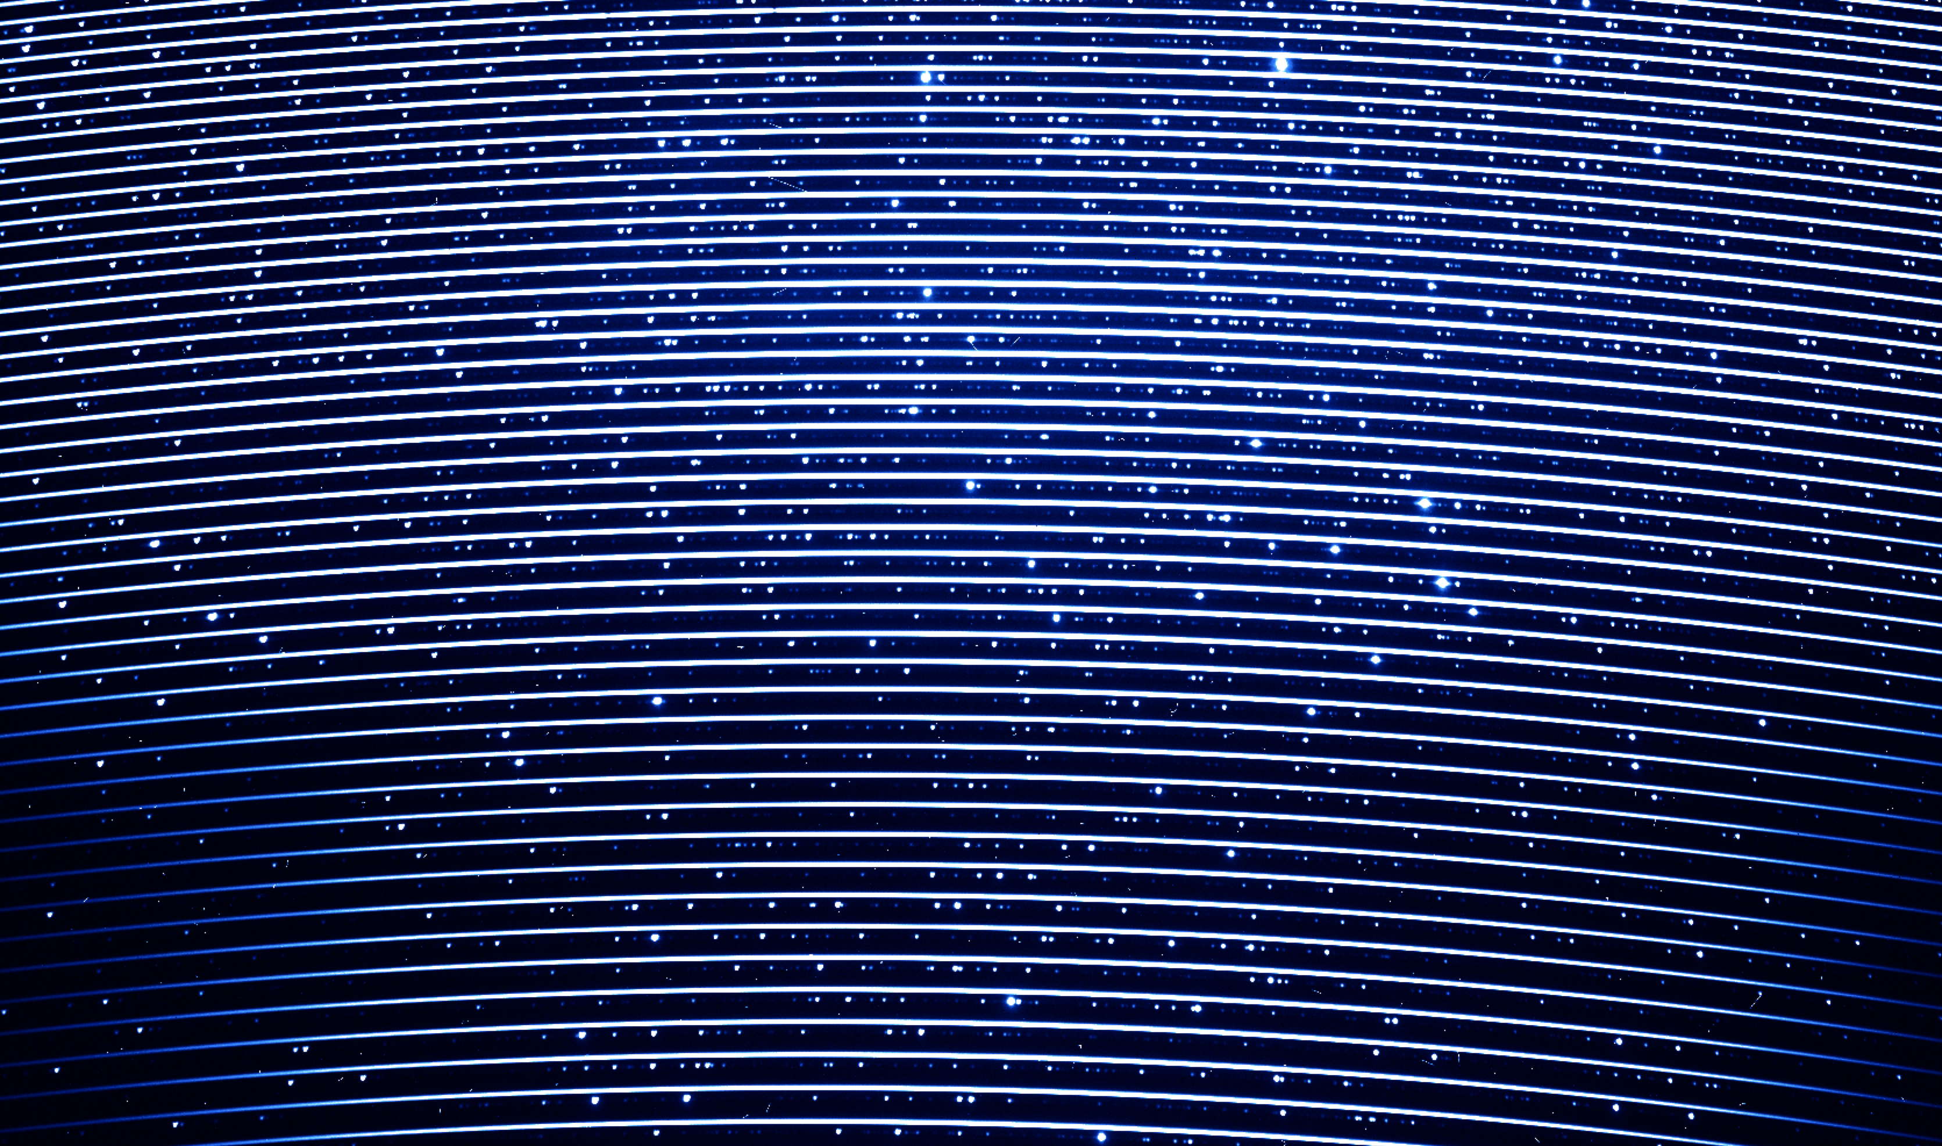
Overall Philosophy
Remove all other effects to isolate bulk stellar motion
Need to be able to trust line position, line depth, and line shape
PARAS data
Notes:
Most systematics higher than planet signal, need to either
-decrease the strength of these
-understand the pattern and correct it out
-beat down with many many observations (assuming they average out over sampling timescales)

Slide 9
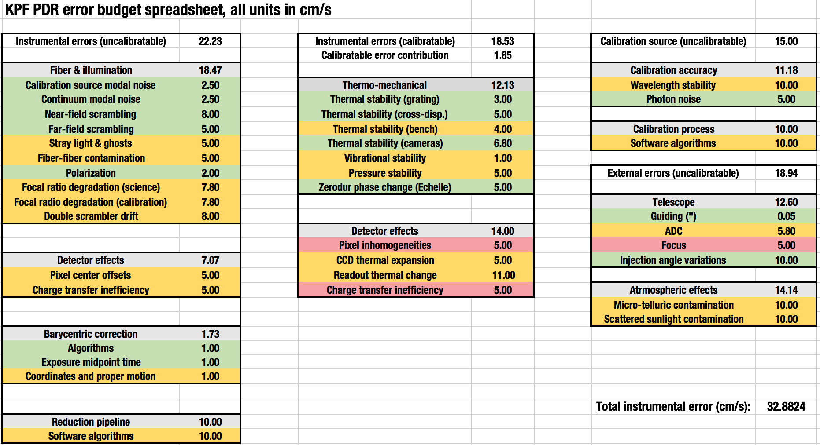
Error Budget Driven Approach
Beyond the Era of Single Dominant Sources of Error
Credit: Sam Halverson

Slide 10
Error Budget Driven Approach
Beyond the Era of Single Dominant Sources of Error
Credit: Sam Halverson

Slide 11
CCD Defects
Aiming for 10cm/s in the Optical

Slide 12
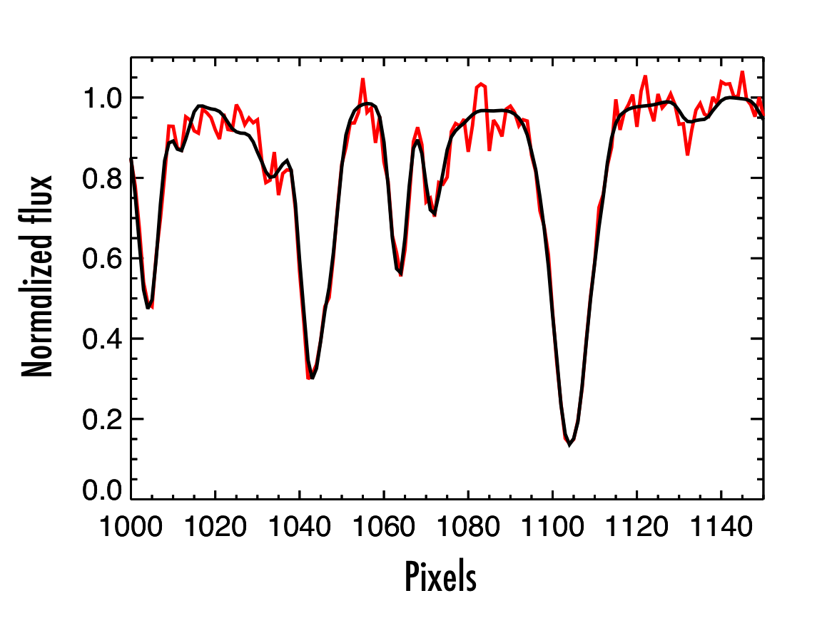
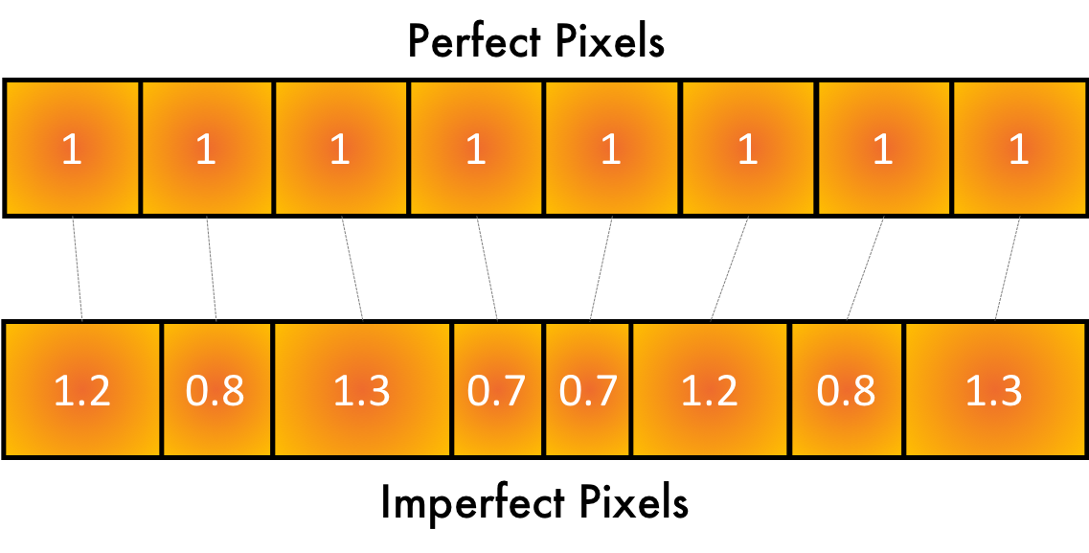
Detector Imperfections
1. Static Pixel Inhomogeneities
Errors in the photolithographic fabrication process produce real physical differences in the sizes of pixels in CCDs. These can be periodic, as with block stitching boundaries (eg. Dumusque et al. 2015) or more stochastic (Stubbs et al. 2014).
Translate to RV error in two ways
by changing the flux distribution
by perturbing the assumption of a wavelength solution that is uniformly sampled in velocity space.
Correction: Flux effect should be removed with flat fielding
Wavelength error might be possible to correct if every sub-pixel shape mapped out in laboratory

Slide 13
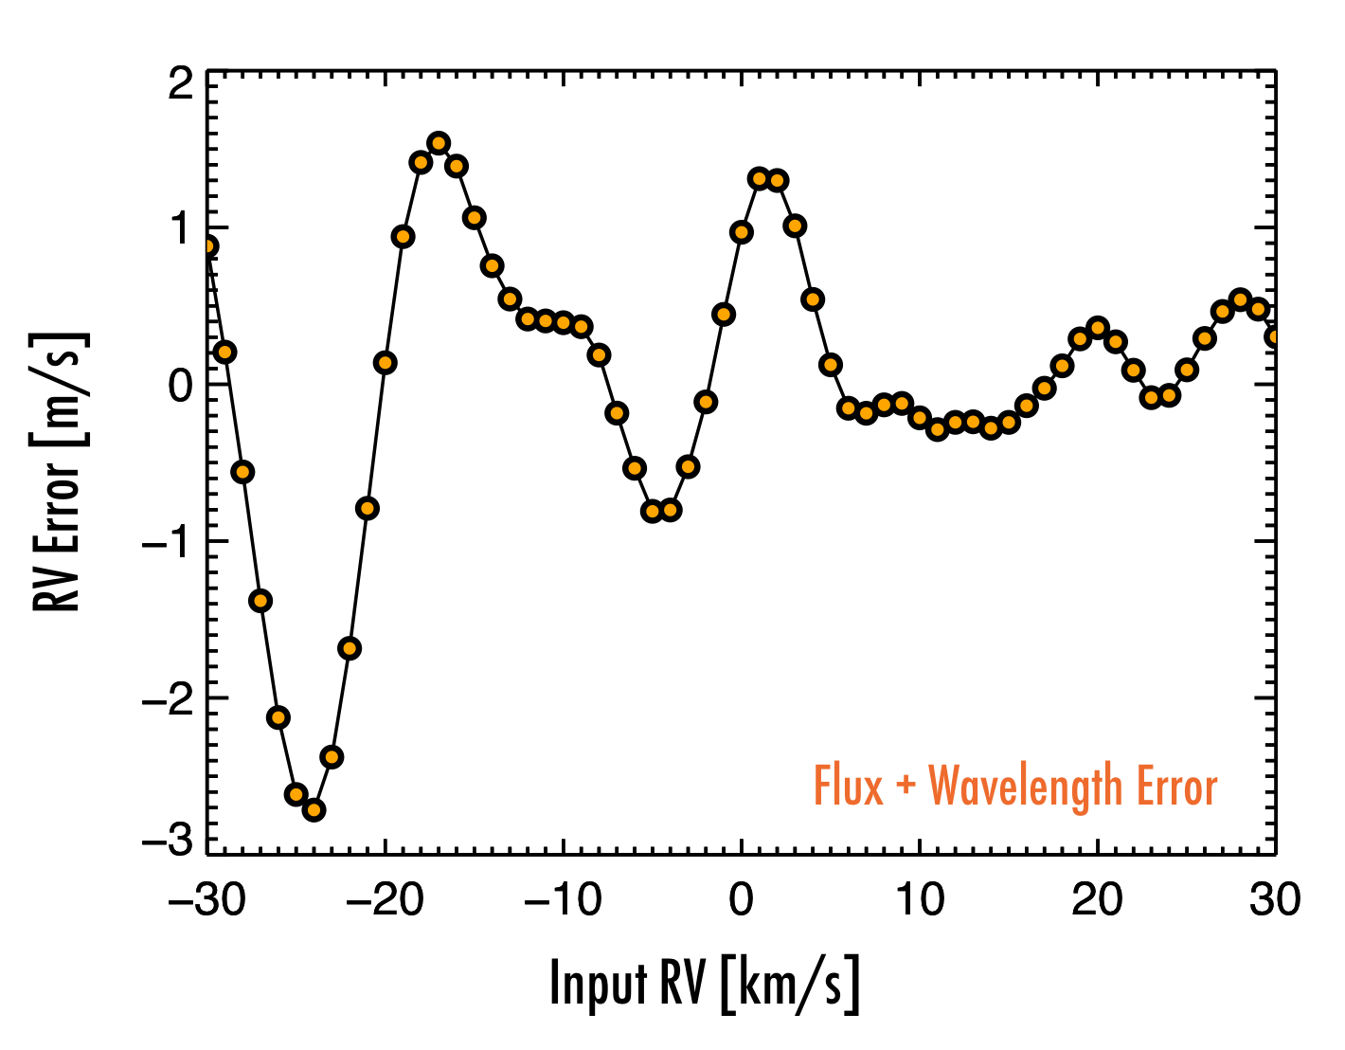
Detector Imperfections
1. Static Pixel Inhomogeneities
Assuming PRNU = 1%
RV impact not stochastic because of interaction with spectrum
Cannot be flat fielded out in the presence of any intra-pixel structure

Slide 14
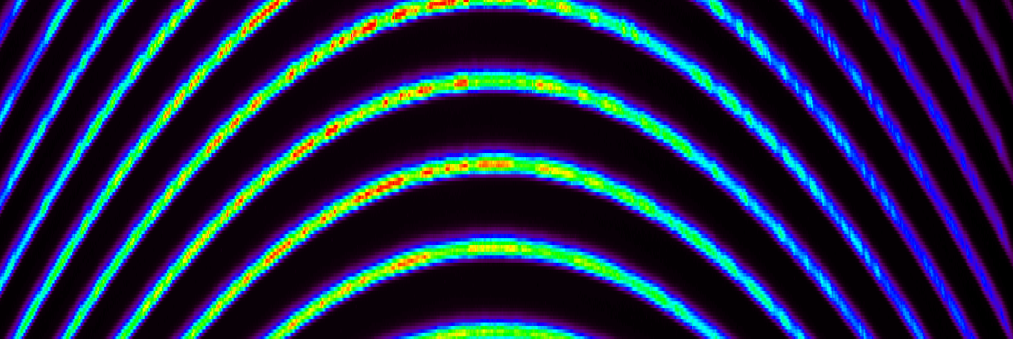
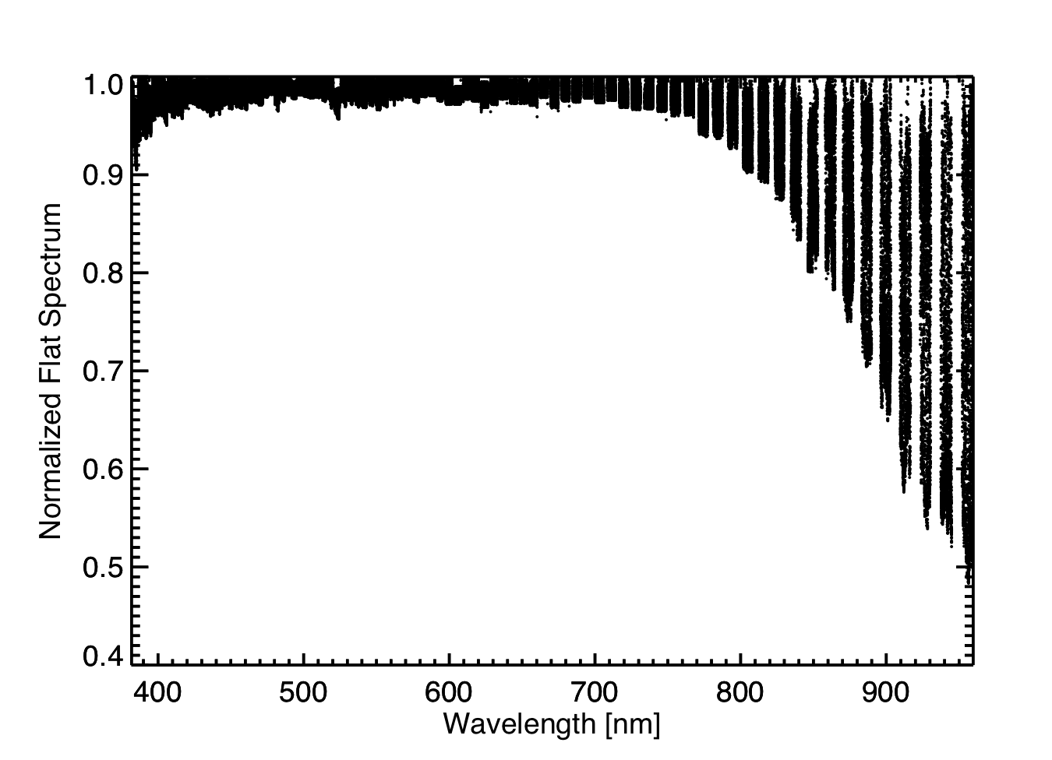
Detector Imperfections
2. Fringing (usually considered static)
Several upcoming optical instruments reaching into the red with CCDs to access M dwarf planets
PARAS 4kx4k deep depletion e2v CCD with a custom ASTRO-broadband antireflection coating
40 micron device thickness
Reddest orders (960nm) show 50% fringing
[Roy+2015]

Slide 15
Detector Imperfections
2. Fringing (usually considered static)
One echelle order of the observed spectrum of Vega (black), and an extracted contemporaneous flat frame (red).
Vega, with the extracted flat order divided out. To first order, the flat provides good fringe correction.
But how good is it in terms of RV?
[Roy+2015]

Slide 16
Detector Imperfections
2. Fringing (usually considered static)
Corrected
Red orders = 24m/s
Uncorrected
Red orders = 63m/s
Blue orders = 2.8m/s
The effect of uncorrected fringing on RV extraction. Variations in fringing degrade RV precision in a subset of red orders (order 86-92, 8300 - 9050 ̊A) compared to precision achieved for a subset of blue orders (order 42-47, 5150 - 5450 ̊A). Simply dividing out a single flat improves the red RV precision to 24.4 m s⁻¹.
[Roy+2015]

Slide 17
Detector Imperfections
2. Fringing (usually considered static)
Need CCDs with better fringing performance or contemporaneous flats (wasteful of on-sky time)
Beginning of the night flats are not enough for correction, even on a stabilized fiber-fed spectrograph
RV Variation [m/s]
Time [Days]
Synthetic M dwarf spectra modulated by flats taken over an observing run, and then processed with RV pipeline
*Illumination more variable for PARAS since no scrambler or agitator

Slide 18
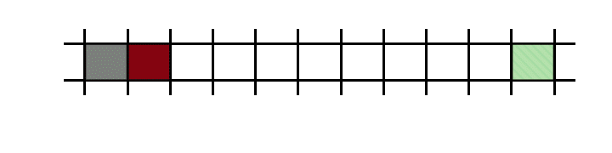
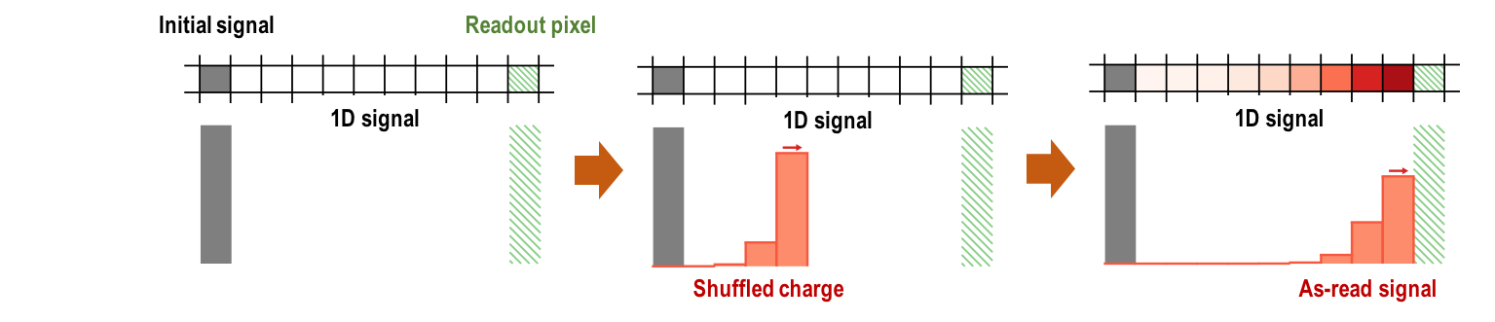
Detector Imperfections
3. Charge Transfer Inefficiency
CTI changes continuum level and skews line shape in direction of readout
Figure: Sam Halverson

Slide 19
Detector Imperfections
3. Charge Transfer Inefficiency
CTI changes continuum level and skews line shape in direction of readout
Correction: Measure CTI for your CCD, consider correcting in pipeline
Difficult because flux dependent - need library of flats at different SNR
Figure: Sam Halverson

Slide 20
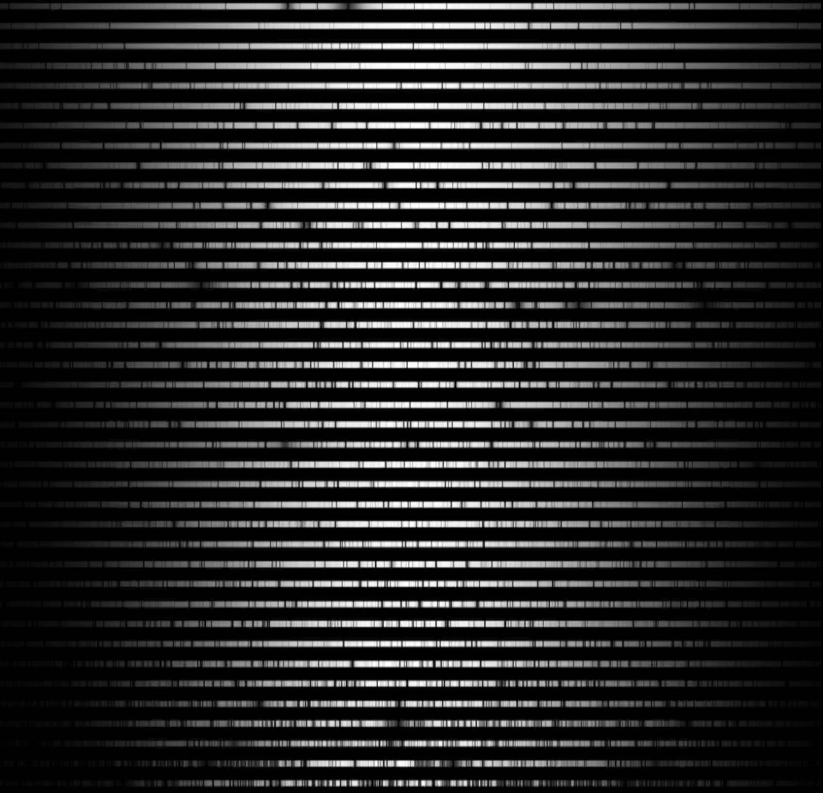
Detector Imperfections
3. Charge Transfer Inefficiency
RV impact of uncorrected CTI can overwhelm other error sources
Correction: Measure CTI for your CCD, consider correcting in pipeline
Difficult because flux dependent - need library of flats at different SNR
Figure: Sam Halverson

Slide 21
Detector Imperfections
4. Brighter Fatter
Pixel boundaries become dynamical based on level of charge accumulation
Guyonnet+2017
For spectroscopy, this means
The wings of the lines will spread out faster than the cores
The wings will begin to fill in the line cores
BF measured from either spots or flats do not exactly replicate space charge effects during stellar illumination
Wavelength dependent because photon delivery and QE are chromatic
Correction: Possible to restore flux to correct pixels with enough calibration data? Perfect case deconvolution

Slide 22
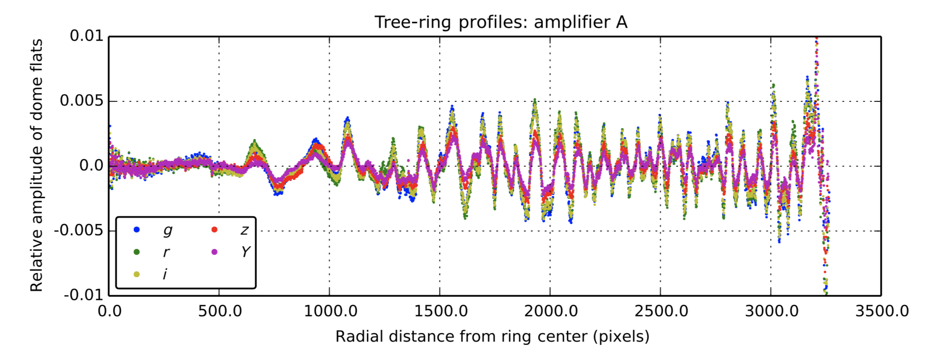
Detector Imperfections
5. Tree Rings
Plazas+2014
Tree rings effectively modify the pixel area and shift the photogenerated charge around, displacing the observed photon positions
This modulates the spectra and applies different RV shifts to different regions of the detector

Slide 23
H2RG Defects
Aiming for 1m/s in the Near-Infrared

Slide 24
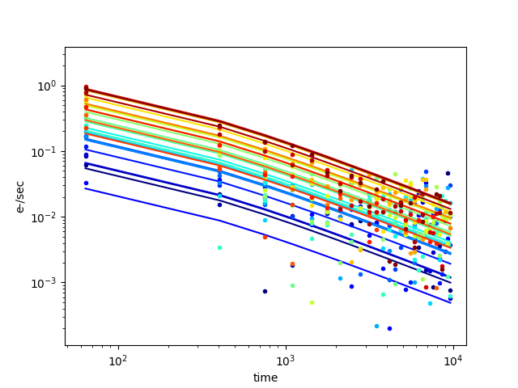
Detector Imperfections
RVs with H2RGs: Limiting factors
The high frequency bias fluctuations in middle channels are not captured in any reference pixels
(IRS2 implementation in MACIE might be a solution?)
Persistence model which does not overcorrect for bright stars
Courtesy: Joe Ninan

Slide 25
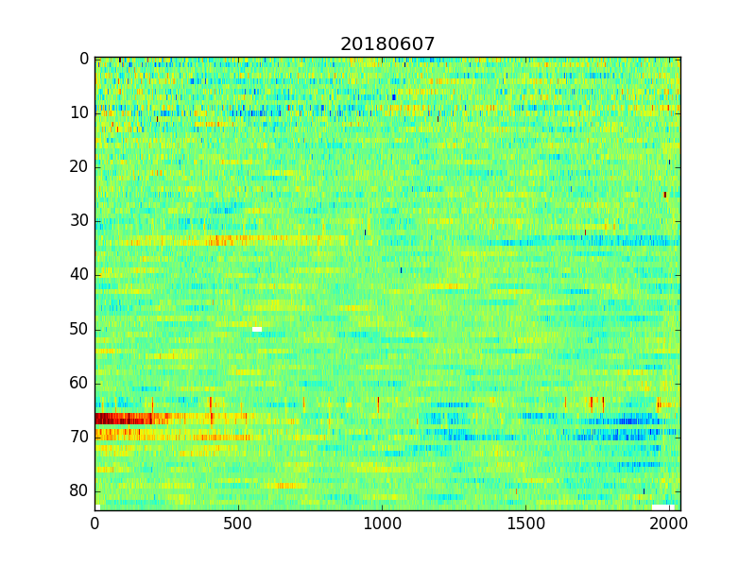
Detector Imperfections
RVs with H2RGs: Limiting factors
Variation in detector gain at 1% level over time
Courtesy: Joe Ninan

Slide 26
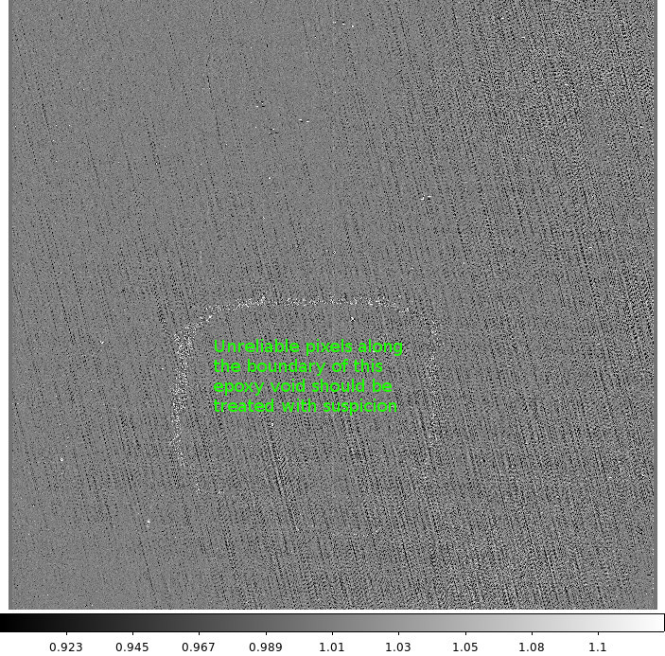
Detector Imperfections
RVs with H2RGs: Limiting factors
Intra-pixel QE variation in crosshatch pattern
Courtesy: Joe Ninan

Slide 27
The Good News
Approaching goal precisions in both regimes

Slide 28
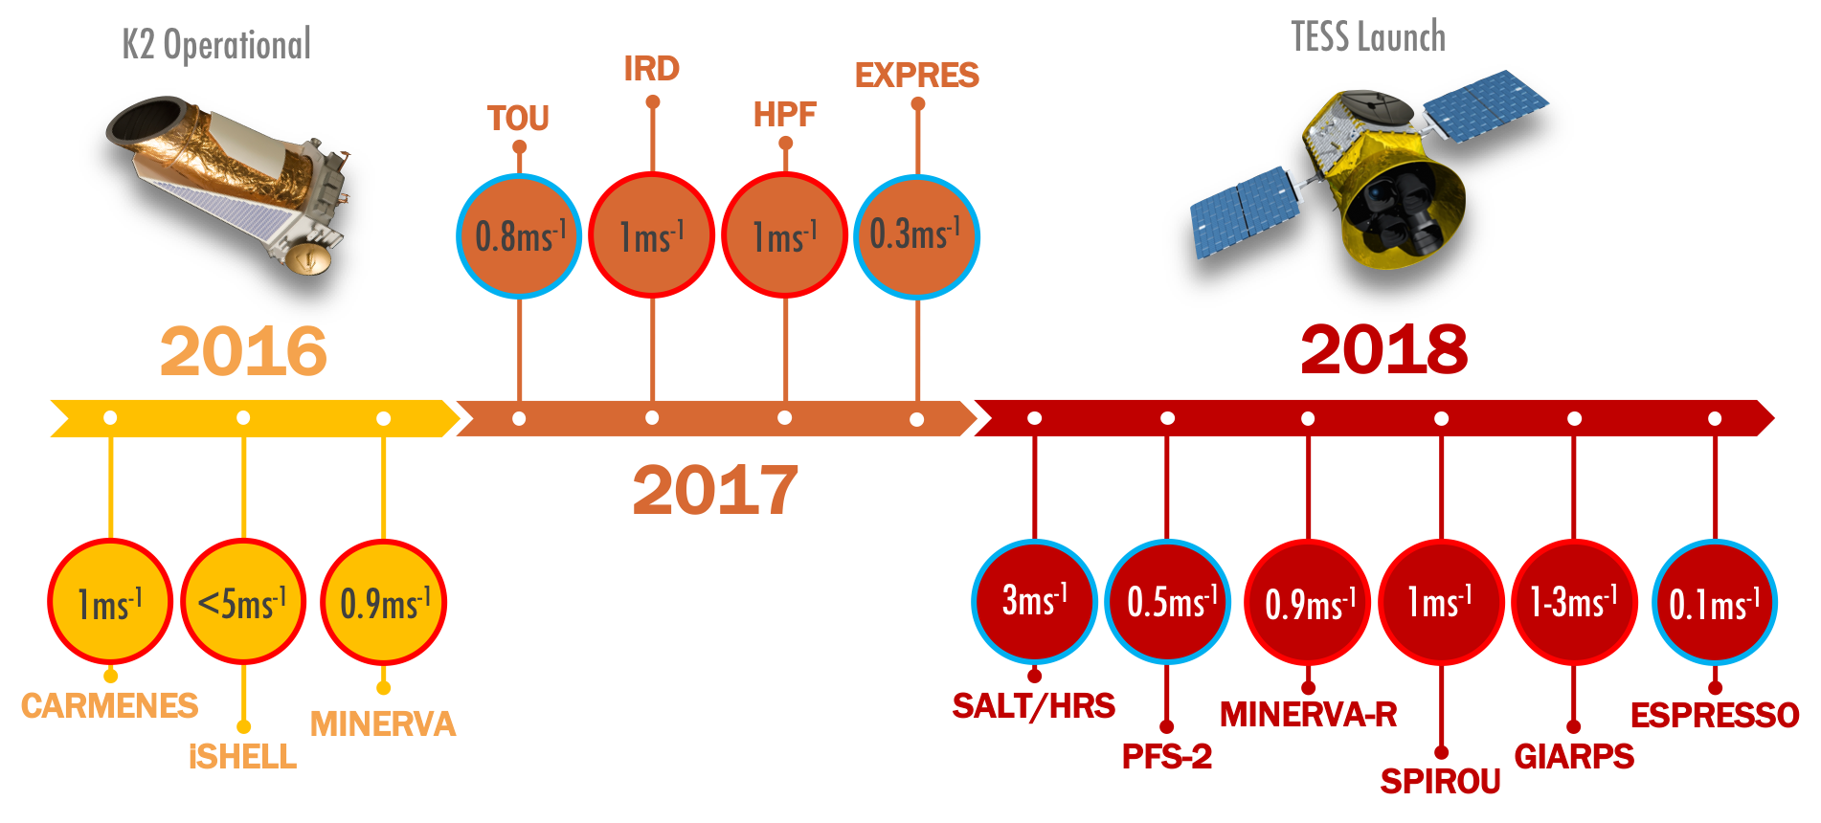
Precision RV Roadmap
Ground-Based Spectroscopy in the Present

Slide 29
Precision RV Roadmap
Ground-Based Spectroscopy in the Present

Slide 30

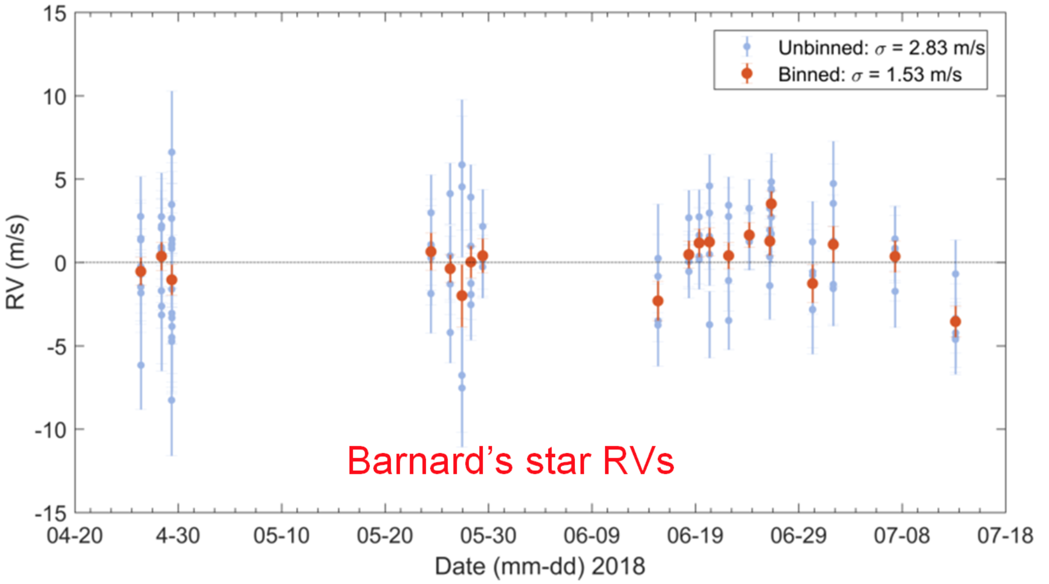
Habitable Zone Planet Finder
Best On-Sky NIR RVs Ever Measured
End Phases of Commissioning
Barnard’s Star
Custom Laser Comb
Ultra-stable environmental control (<1mK)
New data reduction techniques
H2RG with 1.7um cutoff
Highly scrambled fiber feed

Slide 31
Precision RV Roadmap
Ground-Based Spectroscopy in the Present

Slide 32
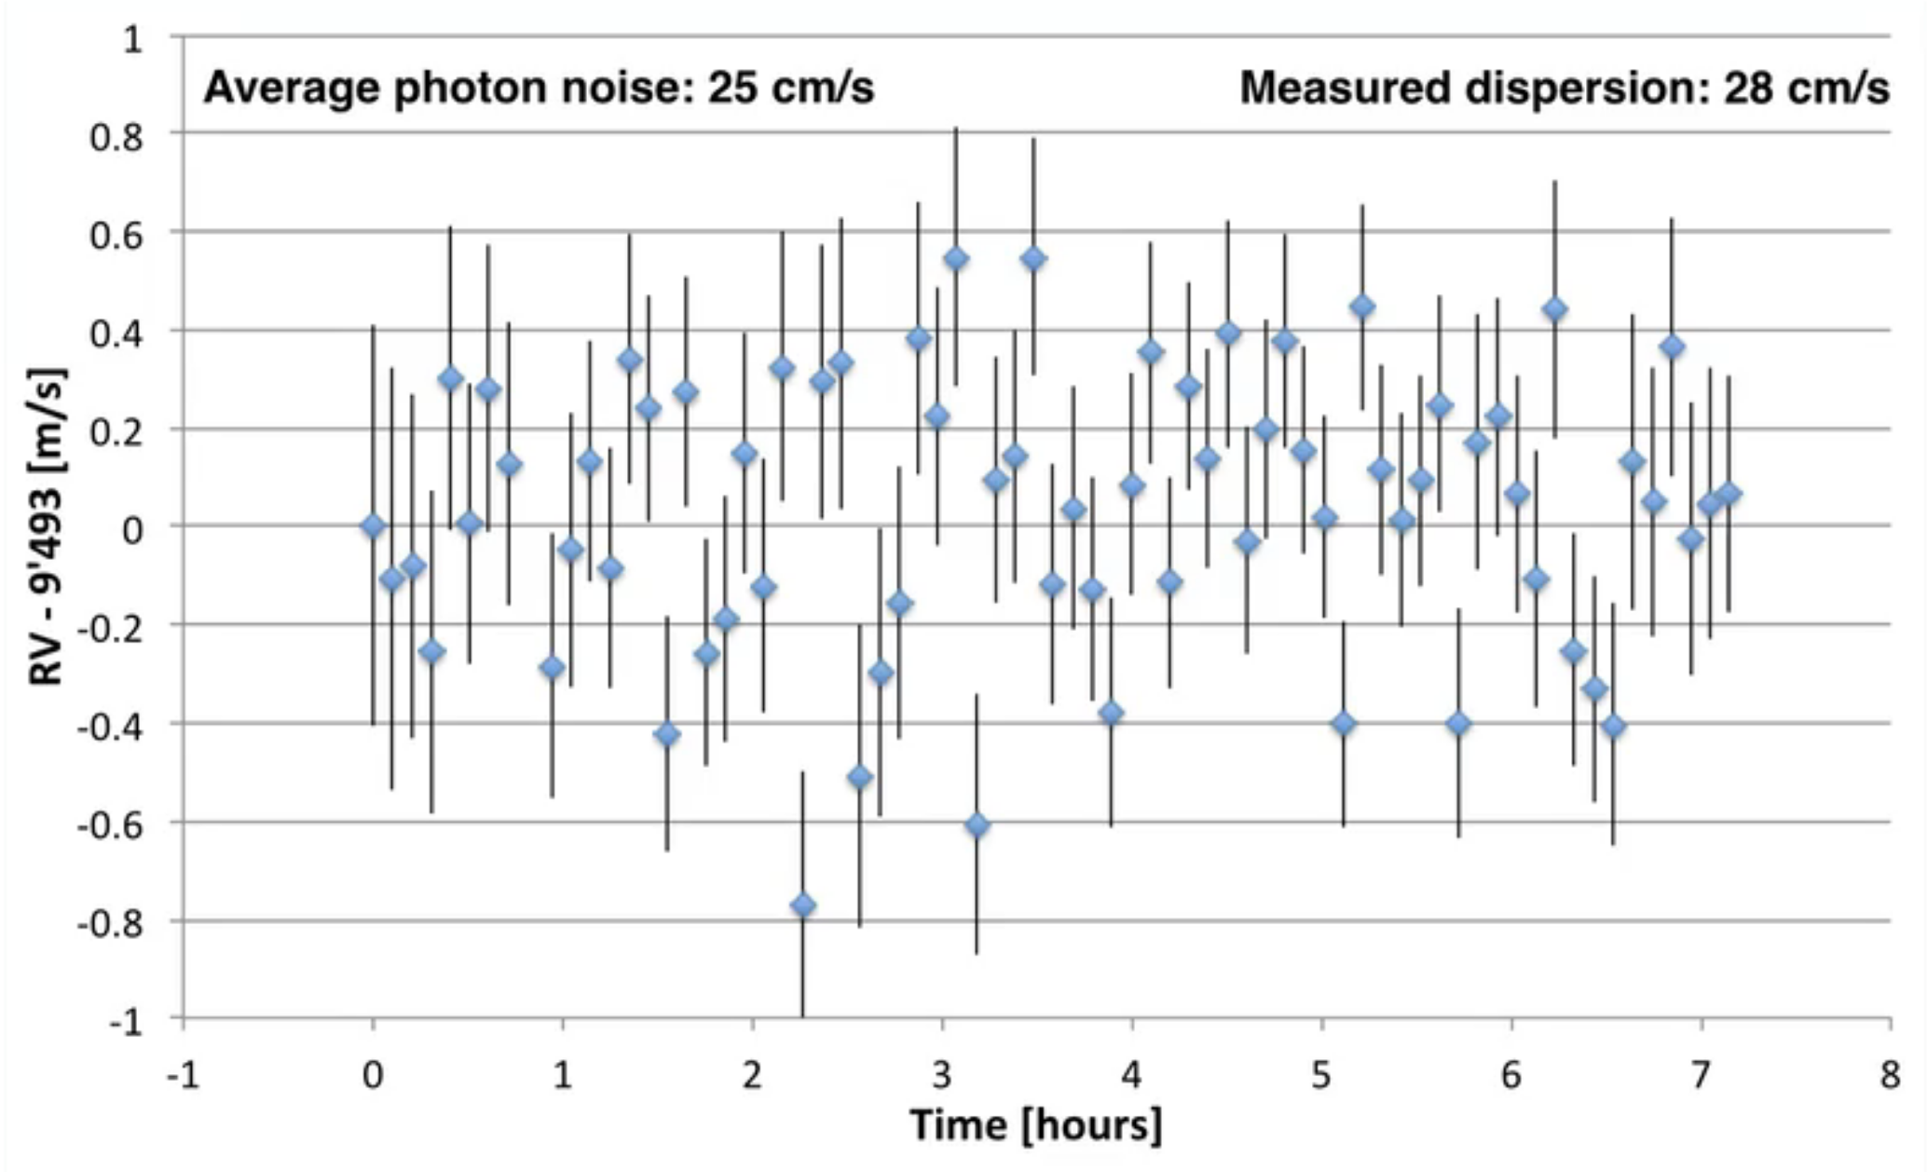
ESPRESSO
[Close to] Best On-Sky Optical RVs Ever Measured
Early Commissioning
HD85512

Slide 33
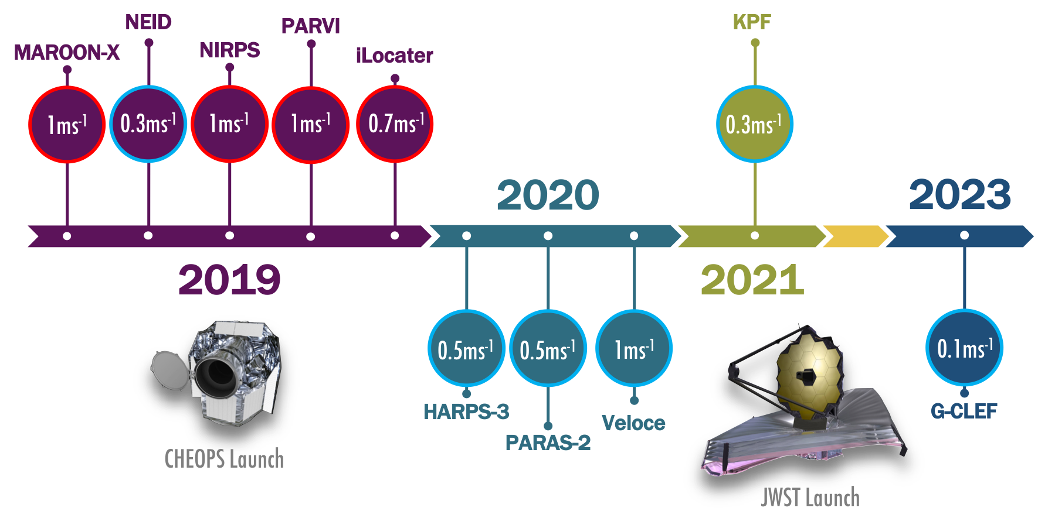
Precision RV Roadmap
Ground-Based Spectroscopy in the Future

