Slide 1

National Aeronautics and Space Administration
Jet Propulsion Laboratory
California Institute of Technology
Summary
Michael Seiffert
Jet Propulsion Laboratory
California Institute of Technology
Notes:
Welcome, everyone

Slide 2
“Detectors are at the heart of everything we do in astronomy” – J. Zmuidzinas

Slide 3
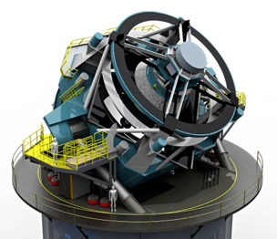
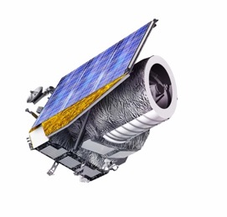
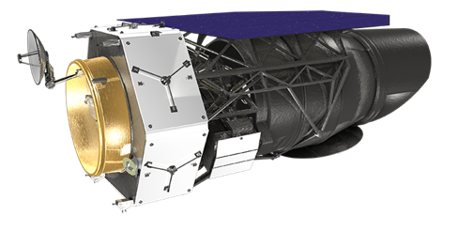
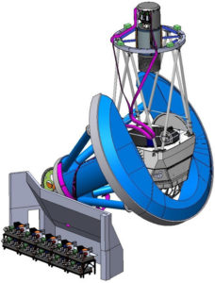
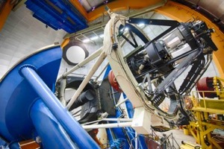
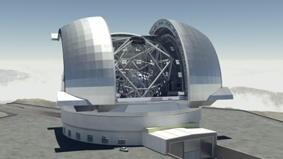
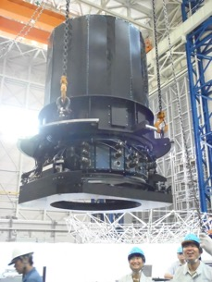
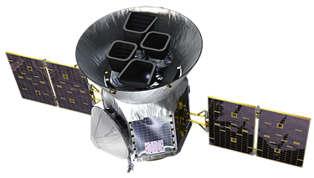
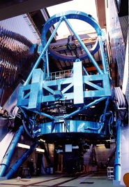
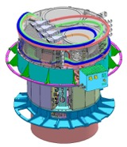
LSST
Euclid
WFIRST
ELT
DES
DESI
PFS
HSC
TESS
Notes:
Note added after talk: I neglected KIDS, Simons observatory, SKA, etc

Slide 4
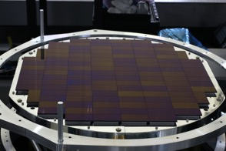
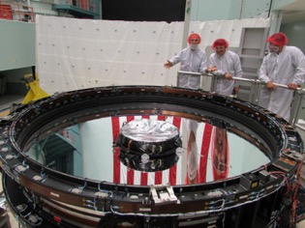
There are many hurdles in the path of our scientific ambitions …
Complex instruments
Detectors
Focal planes
Telescopes
but, detectors are playing an increasingly important role
Notes:
Walk through some of the technologies
You’ll hear about some of the systematic effects in the following talks.
I’m struck by the resources and sophistication being brought to the pursuit of the properties of dark energy

Slide 5
Euclid flight candidates
1400nm flats

Slide 6
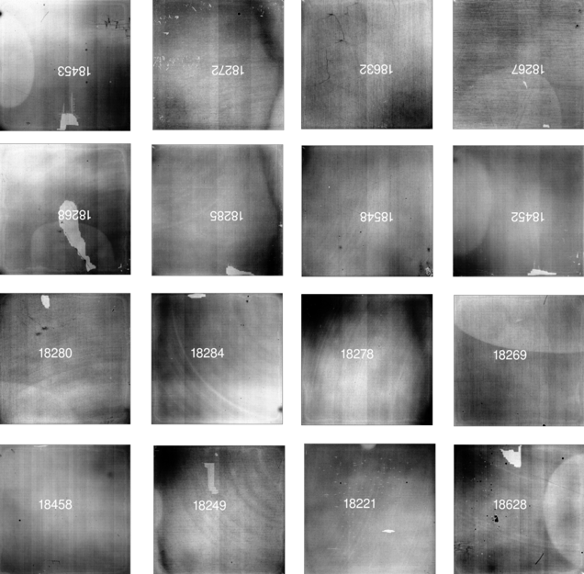
Euclid flight focal plane

Slide 7
This meeting has highlighted:
Impact of detector systematics on science goals
      CTI, cross-hatch, tree rings, non-linearity, IPC, brighter-fatter, persistence, trap behavior, dark current noise statistics, initial signal deficit, blooming effects, intrapixel response, subpixel response, astrometric distortions, correlated pixel noise, …
Strategies for characterization, calibration, mitigation
      PCA, Legendre polynomials, signal injection, reset strategy, physical modeling of detectors, empirical modeling, dither strategies, image emulation, sophisticated data analysis techniques, signal sampling, single pixel reset experiments, …
    New instrument and detector systems
      Impressive progress on production flow, lab infrastructure, new detector technologies, new improvements to detectors

Slide 8
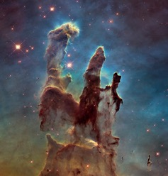
Era of Precision Astronomy
Era of high signal-to-noise measurements of
single objects
transition to
Very challenging measurements
How photons couple to detectors is of primary importance
Extract the scientific signal in a robust unbiased manner

Slide 9
The Future
Detector scientists, engineers, technologists must together advocate for the importance of a robust infrastructure for the detailed understanding of the detectors that are at the heart of our scientific ambitions.

