Slide 1
Investigation of Deferred Charge Effects in LSST CCD Sensors Adam Snyder
Stanford University, SLAC
ISPA: 12/04/2018

Slide 2
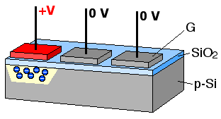
CCD Charge Transfer
Credit: Michael Schmind
Each pixel-to-pixel transfer of charge is driven by:
Self-induced drift/electrostatic repulsion at high signal
Fringing fields at low signal
Thermal diffusion in intermediate cases
Dependent on CCD temperature, clock timing and clock voltages.

Slide 3
Sources of Deferred Charge
Effects dependent on number of transfers:
Transfer due to self-induced drift, fringing fields, and diffusion
Uniformly distributed single electron traps
Bulk traps
Radiation-induced traps
Effects independent on number of transfers:
Design traps - fixed charge loss of up to O(100) e-
Process traps - fixed charge loss of O(10) e-
Electronic effects
Drifting bias offset
Incomplete reset of the sense node

Slide 4
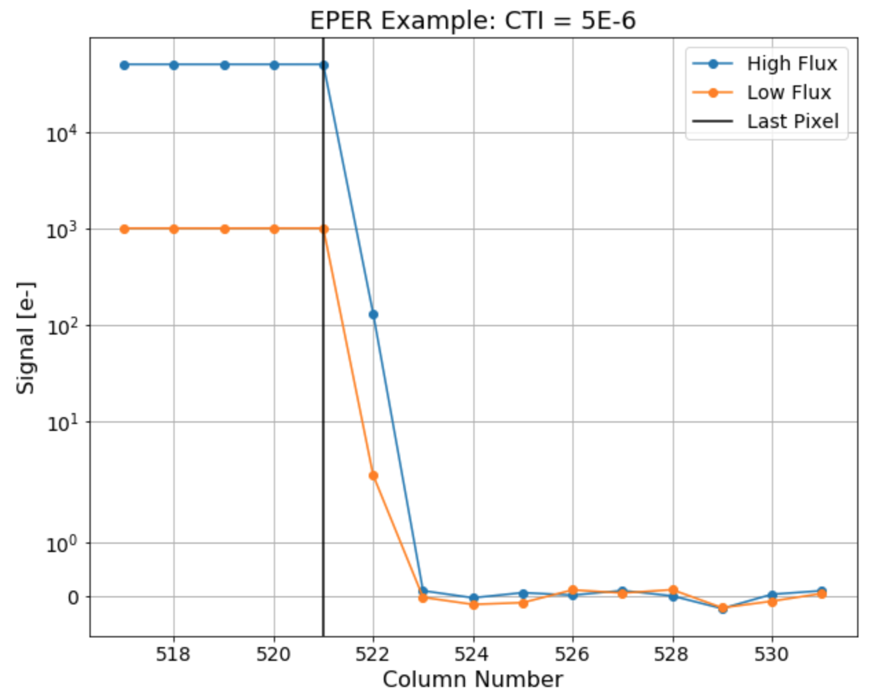
Deferred Charge Measurement
Charge Transfer Inefficiency (CTI) - ratio of electrons not transferred between two pixels, to the total electrons before the transfer.
Extended Pixel Edge Response (EPER) - measurement of deferred charge in the overscan pixel region, after a flat field image.

Slide 5
ITL Serial Deferred Charge

Slide 6
LSST Sensor Testing
LSST Serial CTI Specification: < 5E-6
Measured with EPER at 50,000 e- and 1,000 e-
Additional analysis using Fe55 X-ray events
Data from testing of assembled rafts
Serial Deferred Charge Results:
Majority of channels meet LSST specifications, but…
Deferred charge seen in overscans at high flux
Deferred charge seen in Fe55 hits at low flux
The following results are from one typical ITL production sensor.

Slide 7
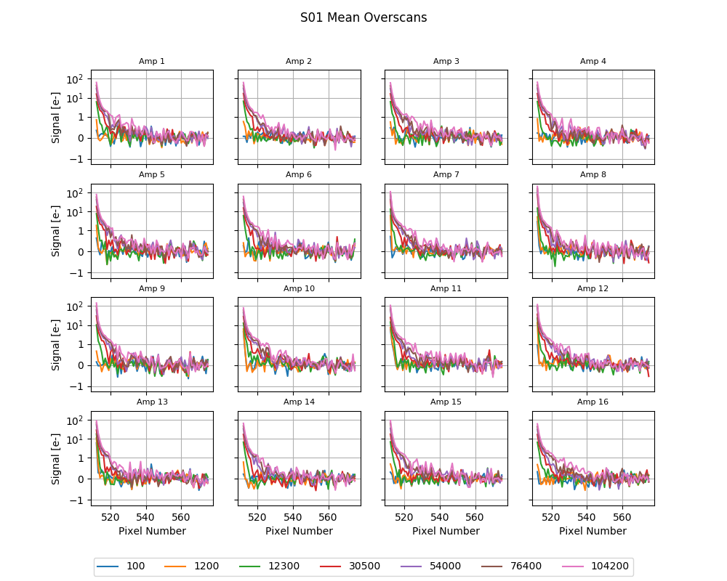
High Flux Deferred Charge
Flux [e-]
Overscan traces at different fluxes show deferred charge signal at high flux.

Slide 8
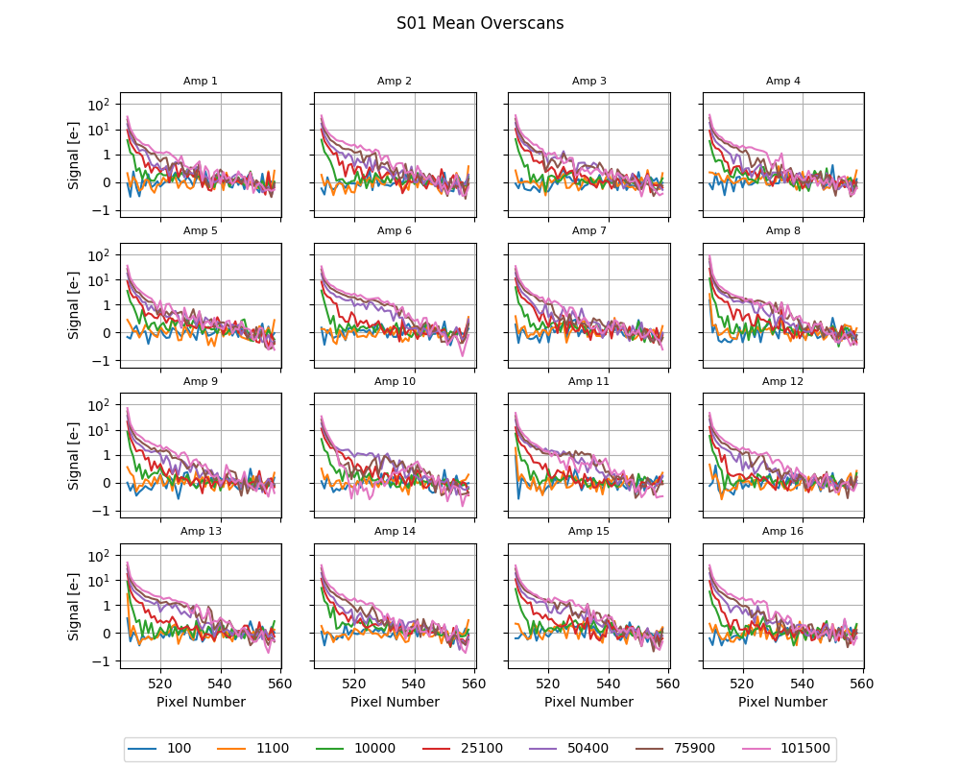
High Flux Deferred Charge
Flux [e-]
Similar effect seen more strongly in vendor data.

Slide 9
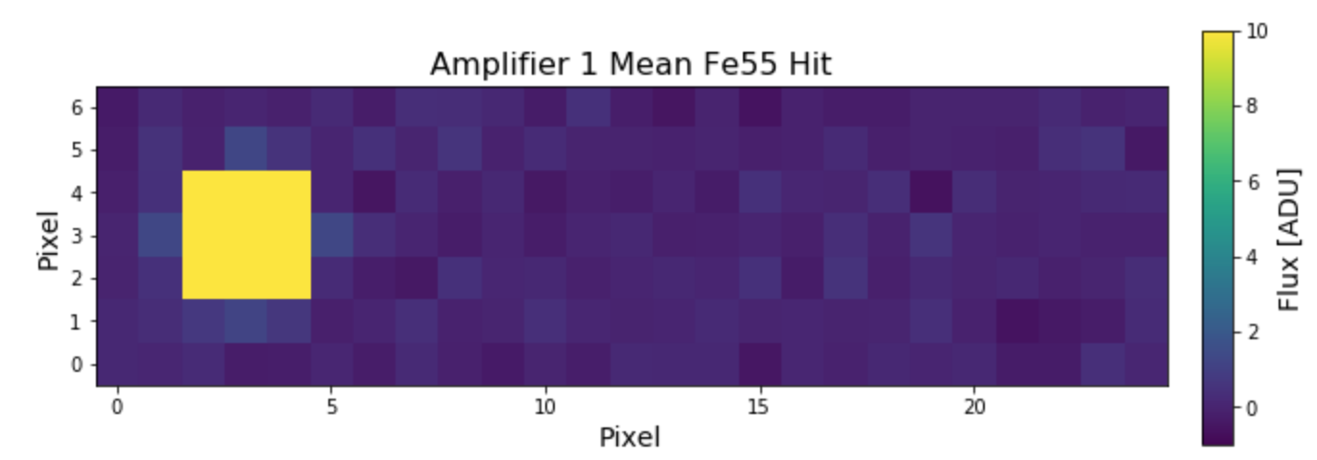
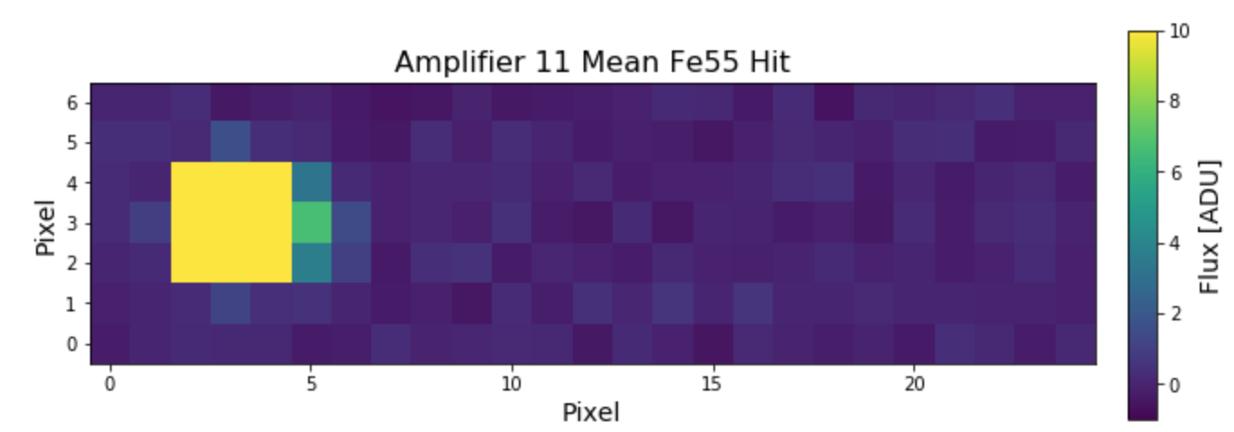
Low Flux Deferred Charge
Analysis of Fe55 hits:
Take many Fe55 acquisitions (w/ or w/out “sky” background)
Aggregate identified Fe55 hits using a median stack
No sky background:
Nominal:
Affected:

Slide 10
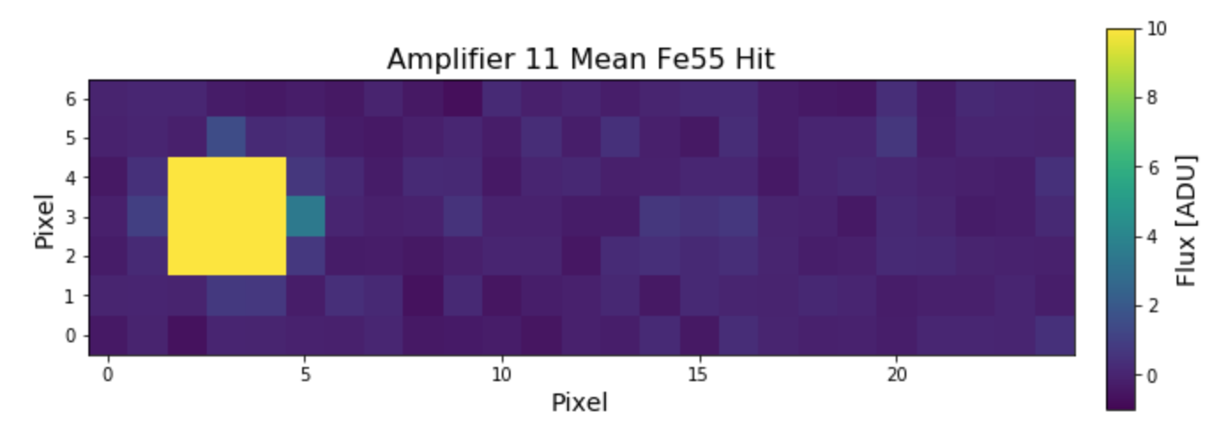
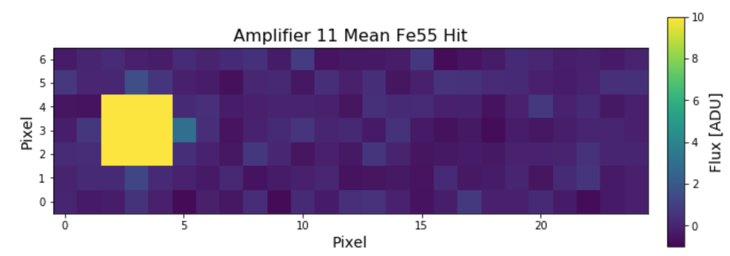
Low Flux Deferred Charge
Effect is lessened with increasing “sky” background, but still present.
50 ADU :
100 ADU:

Slide 11
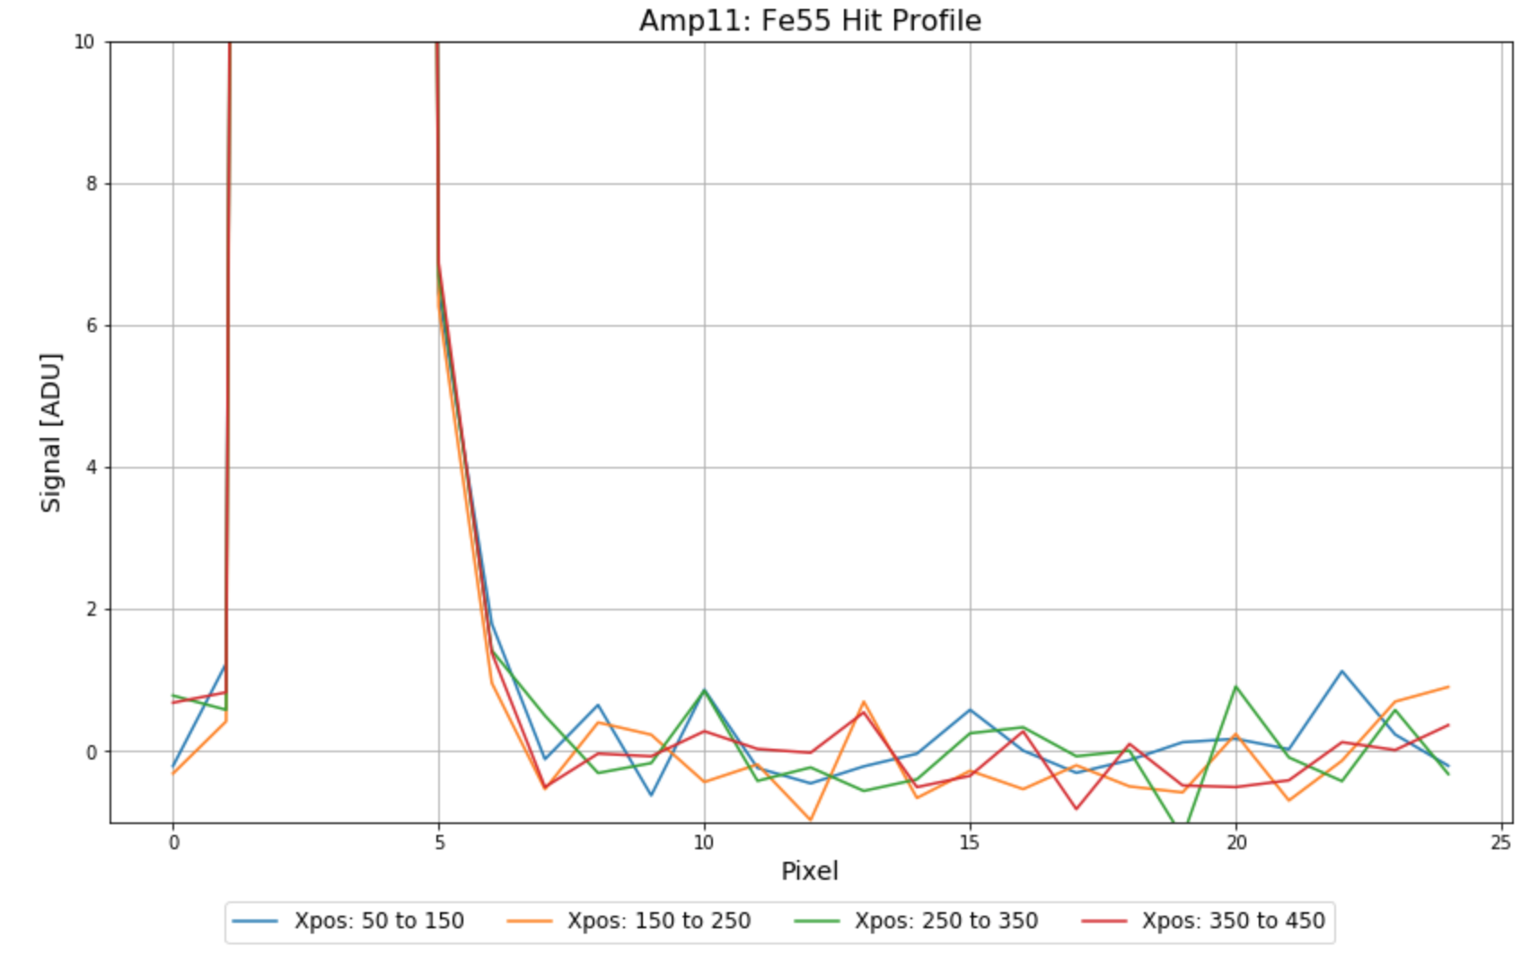
Low Flux Deferred Charge
2 pixels after Fe55 central pixel
2 pixels before Fe55 central pixel
Coarse binning in the serial direction shows no dependence on number of transfers.

Slide 12
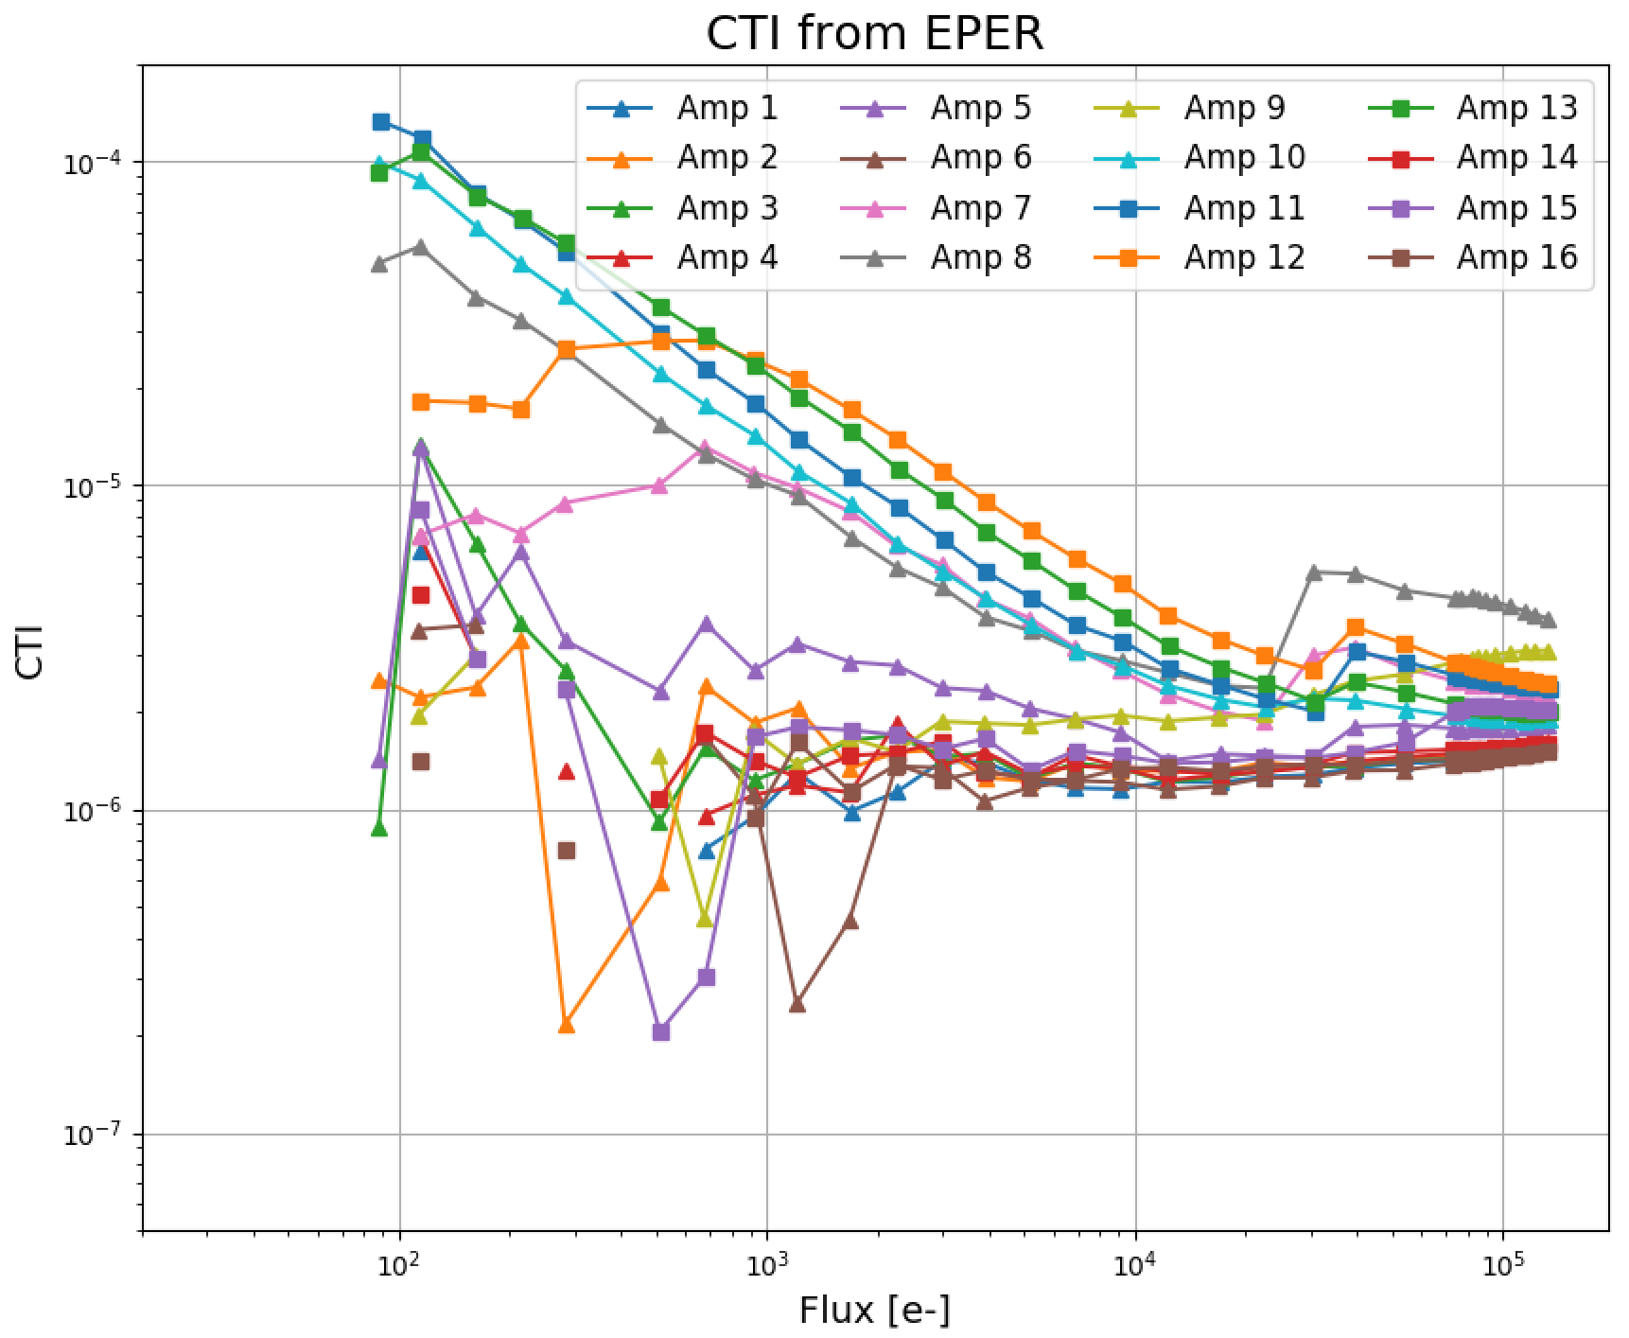
Low Flux Deferred Charge
Affected channels (CTI + low flux effect)
Nominal channels (CTI only)
This effect is reflected in EPER measurements as high CTI at low flux but is NOT necessarily dependent on # of transfers.

Slide 13
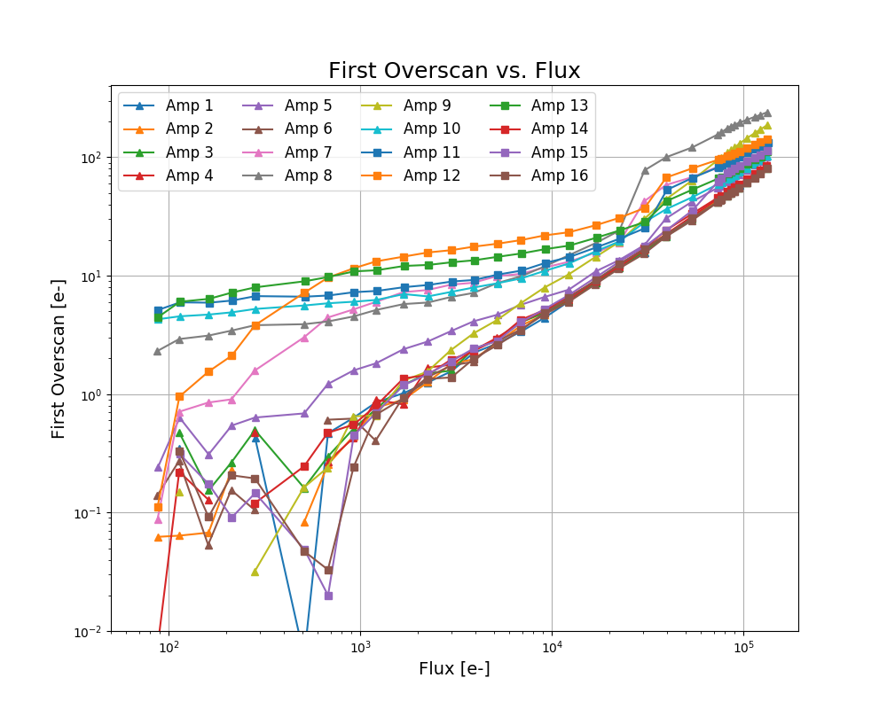
Low Flux Deferred Charge
Affected channels
Nominal channels
Signal in the first overscan provides evidence of a trap (<10 e-).

Slide 14
Deferred Charge Summary
Two effects at work:
All channels show deferred charge effects at high flux.
Flux dependent, exponential decay in overscans.
Present in both vendor (Archon controller) and raft data (REB controller).
Some channels show deferred charge effects at low flux.
Non-proportional, very high CTI from EPER measurements.
Asymmetry in aggregated Fe55 profiles.
No dependence on number of transfers.
Evidence for a constant number of trapped electrons.

Slide 15
Phenomenological Modeling

Slide 16
Modeling Assumptions
Model the following deferred charge effects in separate regimes:
High Flux (>50,000 e-):
Proportional CTI component
Assume constant or small linear dependence.
Video channel electronic effect
Assume flux-dependent exponential decay.
Assume no dependence on number of transfers.
Negligible contribution from low-flux component.
x = overscan pixel number
N_{T} = number of transfers
F = Flux in last pixel

Slide 17
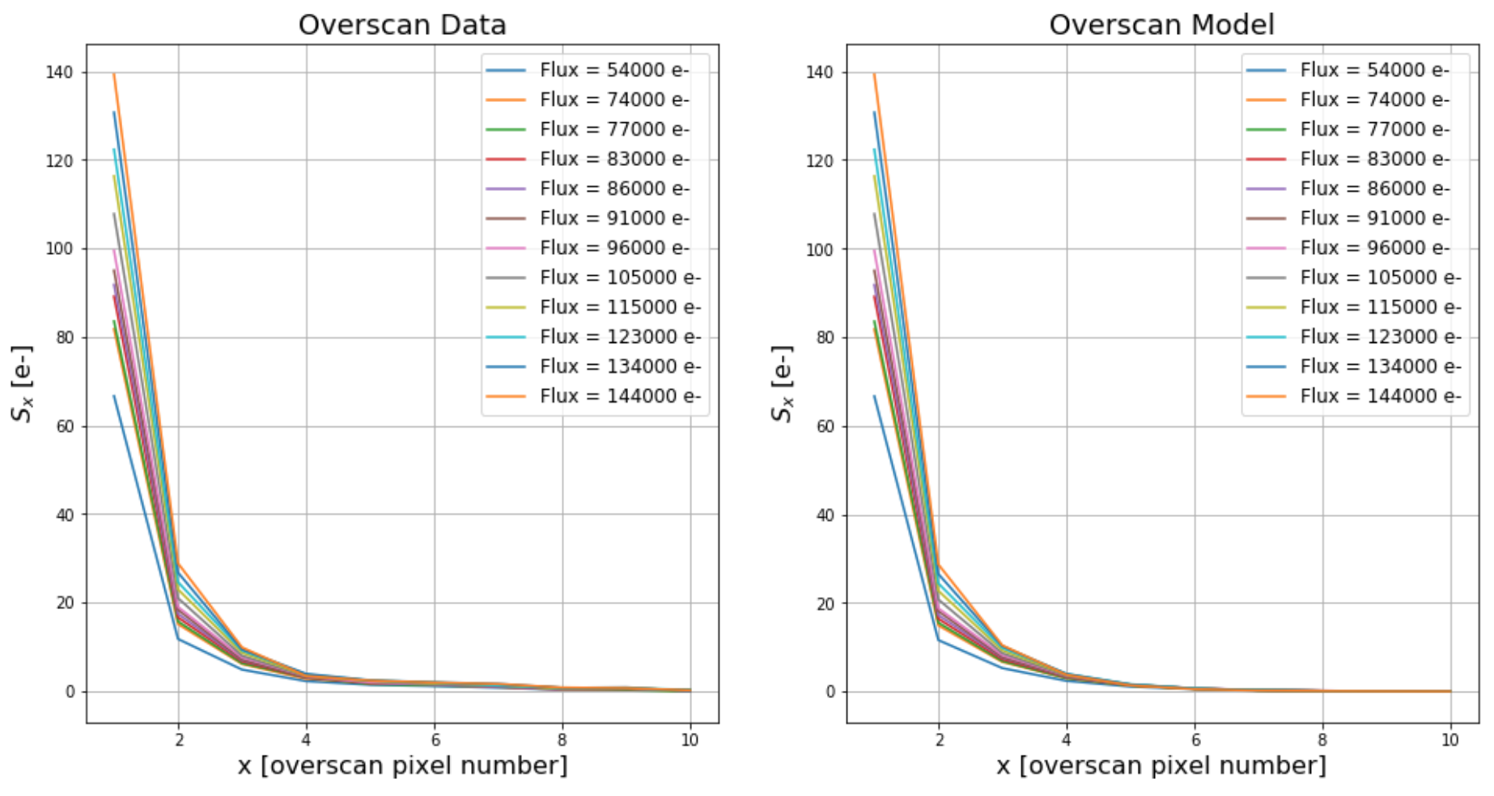
High Flux Exponential Model

Slide 18
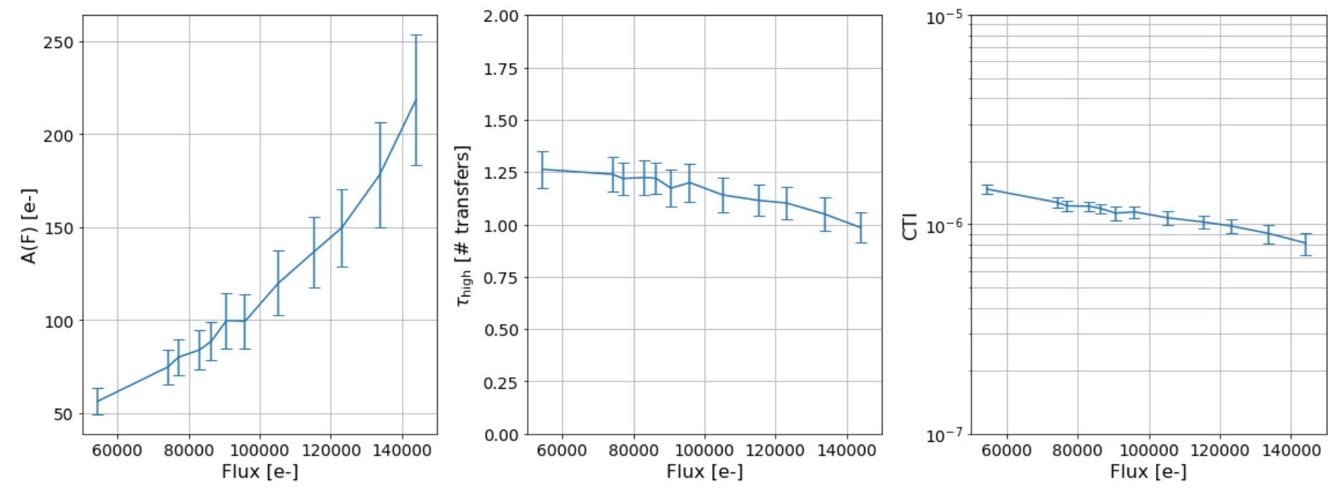
High Flux Exponential Model
High Flux Results:
A(F) increases with flux, though not a “simple” linear relation.
Tau and CTI relatively stable over 60,000 e- to 140,000 e- range.

Slide 19
Modeling Assumptions
Low Flux (<3000 e-):
Proportional CTI component
Contributes only to first overscan.
Calculated by extrapolating from high flux CTI results.
Trap of O(10) e- at the start of the serial register.
Assume trapped charge is constant with flux in this regime.
Assume exponential release of trapped charge.
Assume no dependence on number of transfers.
Negligible contribution from high-flux component.
x = overscan pixel number
N_{T} = number of transfers
F = Flux in last pixel

Slide 20
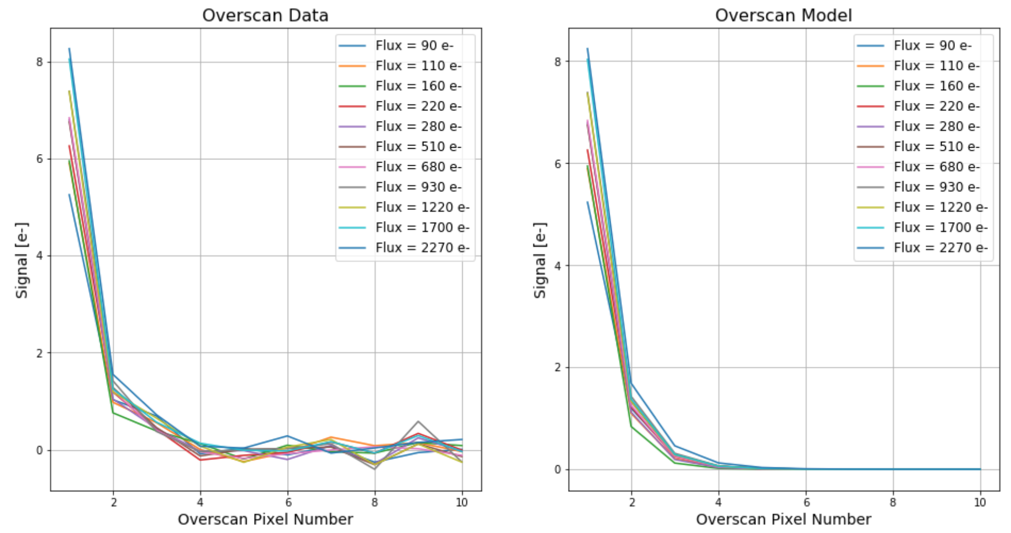
Low Flux Exponential Model
Notes:
Relabel x-axis

Slide 21
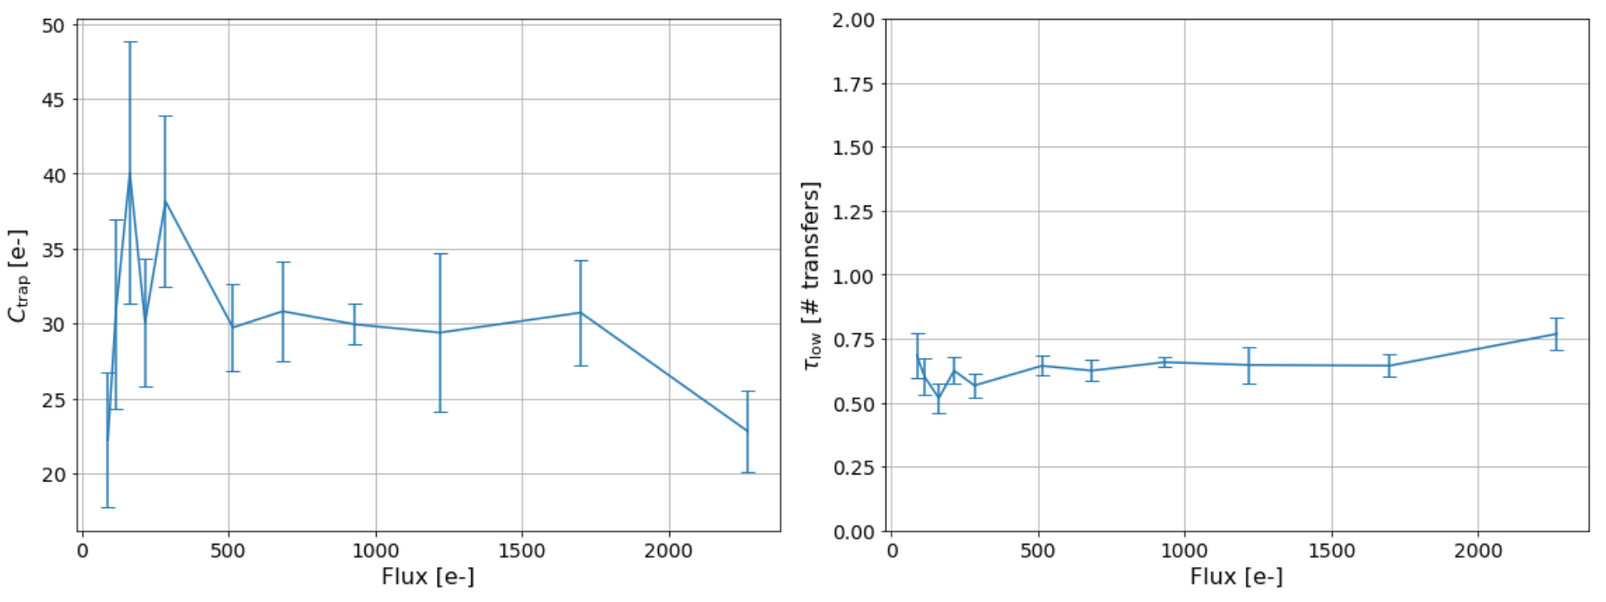
Low Flux Exponential Model
Low Flux Results:
Fit results provide evidence for fast release trap.
Constant regime trapped charge between 100 e- and 1700 e-.
Fluxes not low enough to fully probe proportional trapped charge regime.

Slide 22
Summary
Encouraging results for 3-component model for overscan results:
Next steps:
Generalize for multiple amplifiers
Joint fitting of all data to the model
What about realistic sources?
Use model to simulate deferred charge effects on realistic sources and Fe55 X-rays events.
Analyze images of realistic sources and compare with predictions from model.

Slide 23
Backup Slides

Slide 24
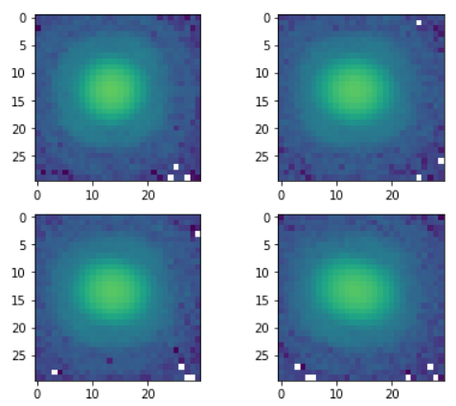
Deferred Charge for Realistic Sources
Measuring deferred charge in realistic sources:
Project grid of “spots” onto the CCD.
Use HSM for source moment calculations.
Study deferred charge effects as function of:
Position
Flux
“Sky” background

Slide 25
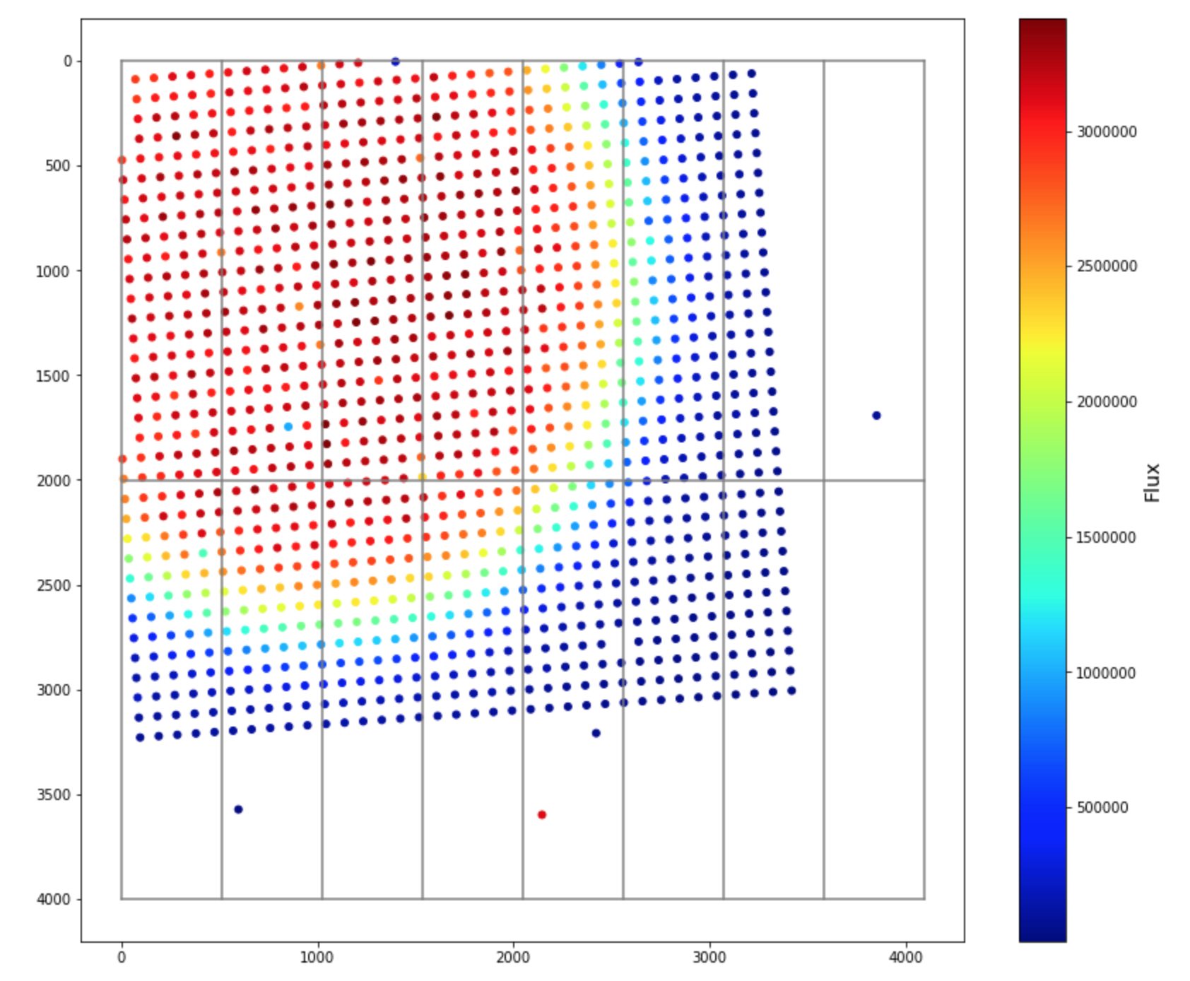
Deferred Charge for Realistic Sources
Real projected sources on LSST CCD.

Slide 26
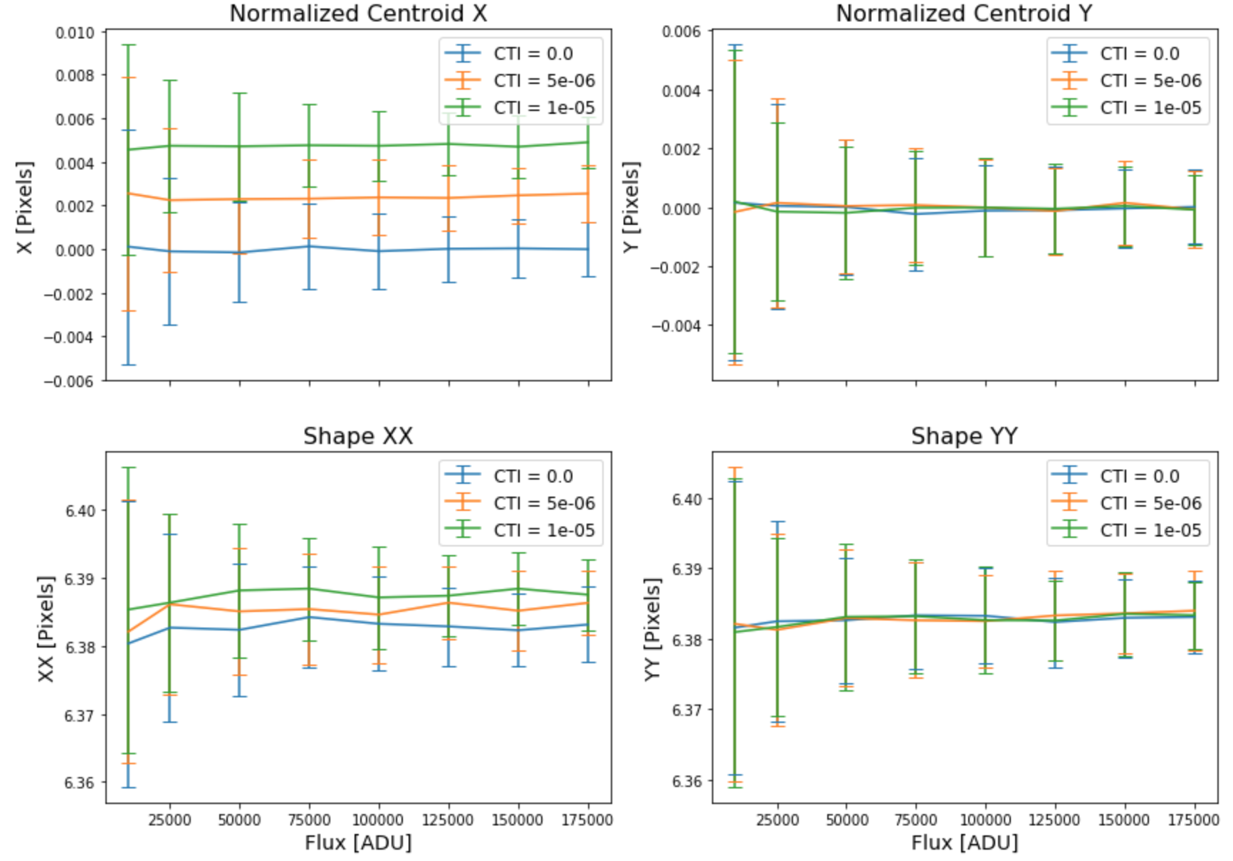
Deferred Charge for Realistic Sources
Simulated sources with only proportional CTI (500 transfers)
Notes:
Look up what the flux was

Slide 27
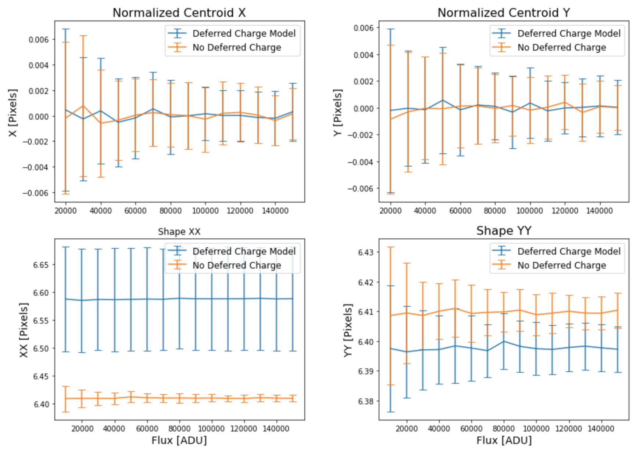
Deferred Charge for Realistic Sources
Simulated sources with high flux deferred charge model.
Notes:
Fix labels

Slide 28
Summary
Current Work:
“Spot” projector has been built and tested at SLAC.
Source moment measurements dominated by vibrations in the test set-up.
Characterizing effects of vibrations on moment results.
Minimization of vibrations by modifying the test set-up.
Notes:
Add picture of spot projector

Slide 29
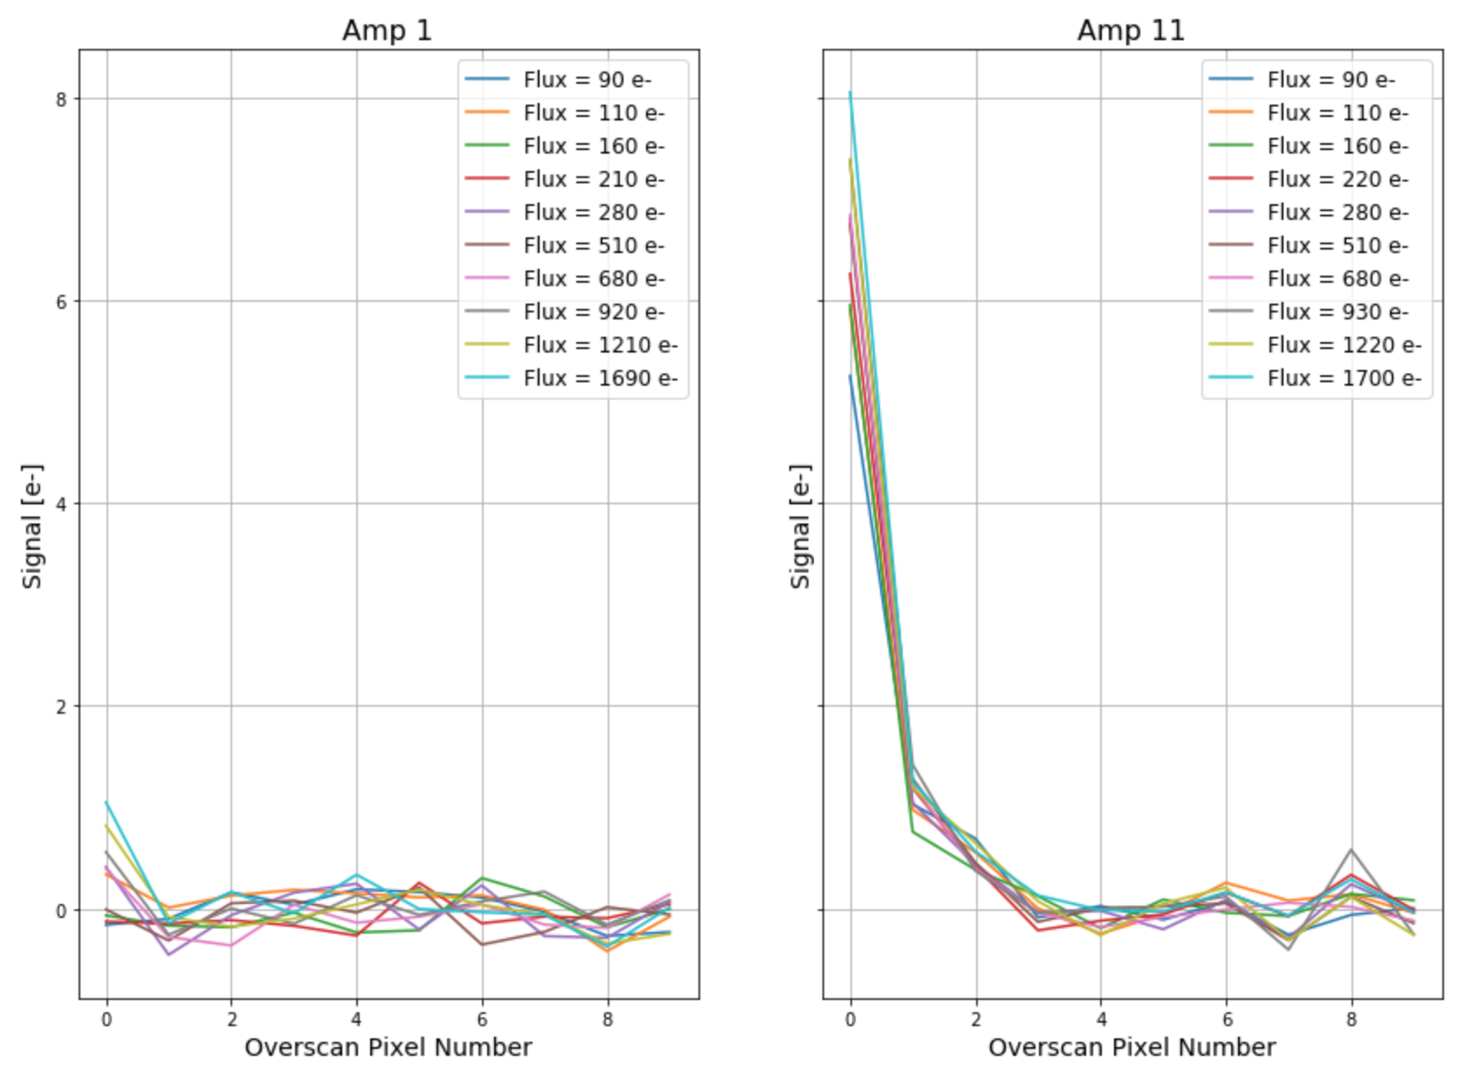
Low Flux EPER
Comparison of two amplifiers, showing large CTI discrepancies at low flux.

Slide 30
Simulated Fe55 Results
High Flux Effects Only:
Fit parameters extrapolated to low flux.
Randomly simulated Fe55 hits across an amplifier.
Applied deferred charge model (CTI+Exponential Decay).
Unable to recover Fe55 asymmetry and non-proportional CTI.

Slide 31
E2V Serial Deferred Charge

Slide 32
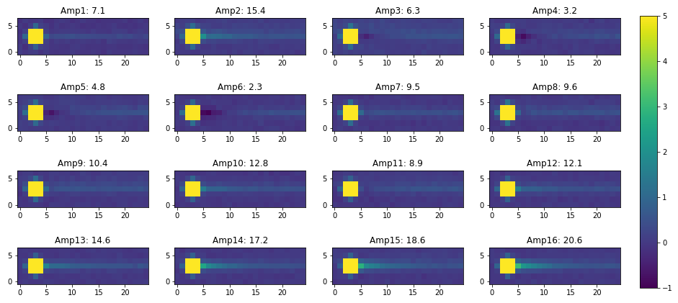
Fe55 Results
Fe55 analysis:
No position dependence.
Large affect even at low fluxes.

Slide 33
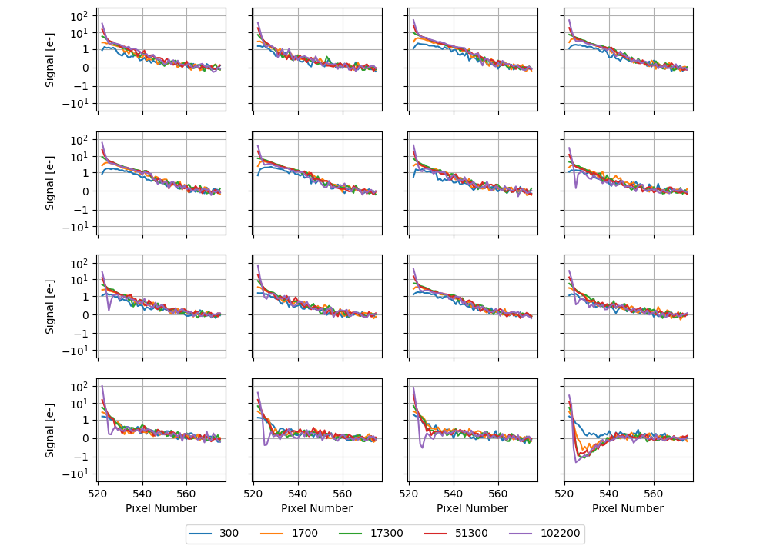
Overscan Traces
Trailing charge (no flux dependence) seen in E2V sensors at BNL.

Slide 34
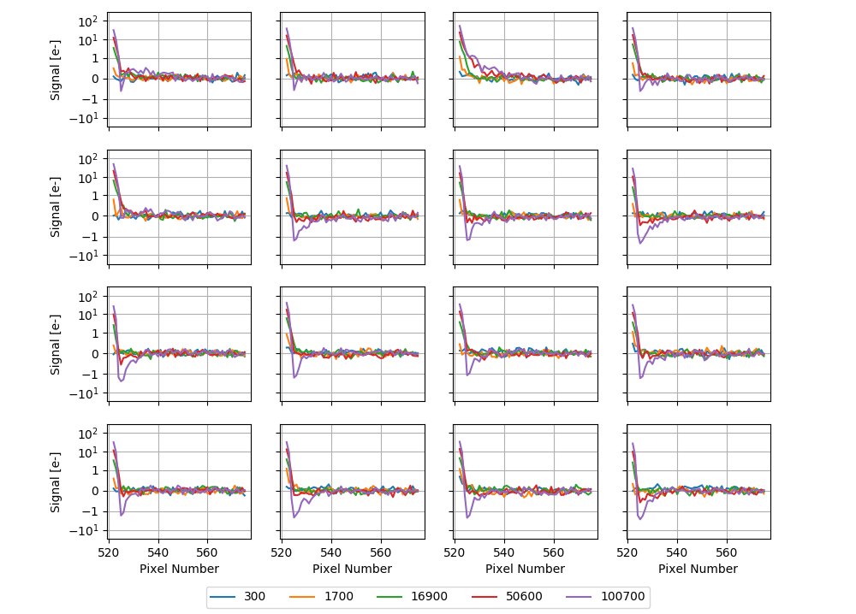
Overscan Traces (New Operating Conditions)
Effect disappears with increasing reset gate voltage swing.

