Slide 1
Archiving storage for Scientific Research ENVIRONMENT
David Yu
Workshop on Central Computing support for Photon Sciences

Slide 2
BNL Scientific Data and Computing Center
RHIC Tire-0
Primary Data storage for all RHIC experiment data.
LHC ATLAS Tier-1 for the US
Secondary data storage for fraction of data (~23%).
Belle-2 Tier-1 (New)

Slide 3
Amount of Data Archived in BNL
~145 PB
150 PB
HOT
100 PB
~60 PB
50 PB
COLD
2004
2005
2006
2007
2008
2009
2010
2011
2012
2013
2014
2015
2016
2017
2018

Slide 4
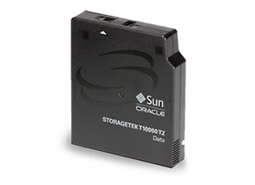
Long Term Storage
Keeping 100+ PB data for a long time
Life Expectancy
Tape: 30+ years
Reliability
Bit Error Rate (BER): Number of user bits transferred between two unrecoverable error events
T10K, LTO-7, LTO-8, IBM JD: 1 x 10¹⁹
1 error event in 1.25 exabytes *
Performance
T10K | LTO-7 | LTO-8 | IBM JD
250 MB/s | 300 MB/s | 360 MB/s | 360 MB/s
Scalability
Just add more tape cartridges.
Add more tape libraries.
* https://www.lto.org/wp-content/uploads/2014/07/LTO_Get_The_Facts_10_15.pdf

Slide 5
Scalability
Increasing Capacity
- Add Tapes
Library Capacity: 10,000 Tapes
LTO-7: 60,000 TB or 60 PB
LTO-8: 120,000 TB or 120 PB
39 tapes per load
39 LTO-7 = 234 TB
Will take ~ 7 minutes
Tape initializing:
1 min/tape-drive
Fill 1 PB storage
LTO-7: 3.5 hours
LTO-8: 1 hr 42 min

Slide 6
scalability
Library Full?
Add Library

Slide 7
Scalability
Increasing Bandwidth
- Add Tape Drives
Library Capacity: 64 Tape Drives / Library
LTO-7: 64 x 300 MB/s = 19.2 GB/s
LTO-8: 64 x 360 MB/s = 23 GB/s
Bandwidth can be expanded easily by adding more drives
Bandwidth can be controlled easily by allocating number of drives.

Slide 8
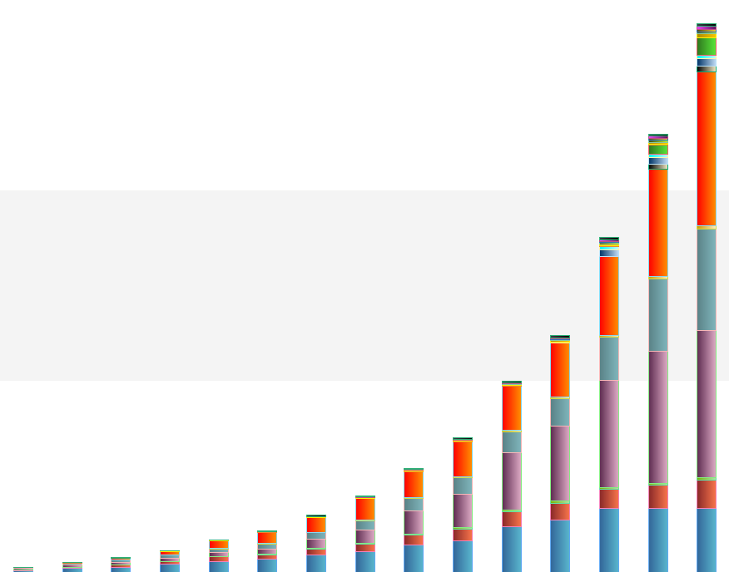
Tape Storage in BNL
150 PB
145 PB
HOT
100 PB
Other Research Institutes
50 PB
Tape Storage
COLD
2004
2005
2006
2007
2008
2009
2010
2011
2012
2013
2014
2015
2016
2017
2018
BNL Data Center

Slide 9
High Throughput Active Archiving System
RHIC Experiment data directly go to tape storage (archive as primary copy)
RHIC detectors:
STAR
Detector
Streaming data
Disk cache

Slide 10
High Throughput Active Archiving System
Reprocessing data, retrieving data from tape archival storage
Disk cache
Streaming data
Data processing

Slide 11
High Throughput Active Archiving System
HPSS
Write 200 MB/s/drive
Automatic Tape Library
Need 8 drives = 1.6 GB/s
80 Gb NIC
Data movers with disk cache
FC
Write 1.5 GB/s
N files
N/4 files
FC
~400 MB/s
N/4 files
~400 MB/s
Data Reprocessing
N/4 files
~400 MB/s
Read X MB/s
N/4 files
~400 MB/s
Read X MB/s

Slide 12
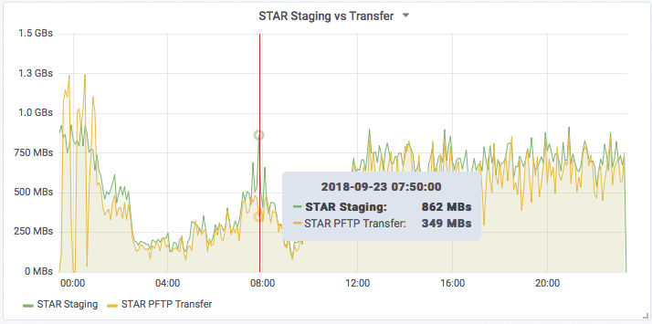
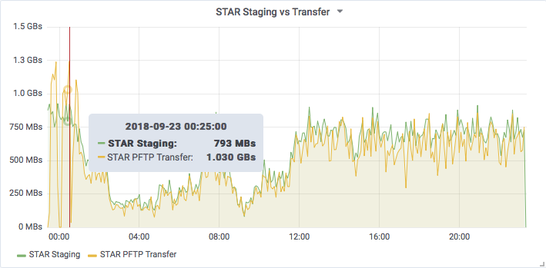
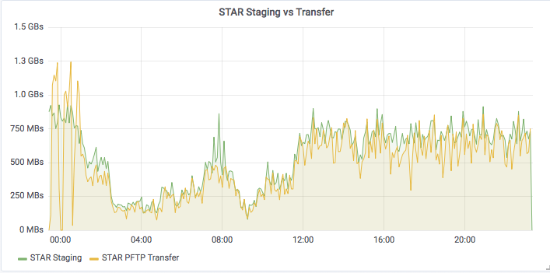
Staging vs network transfer

Slide 13
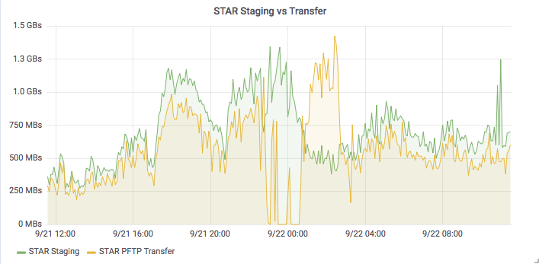
Transfer out of sync

Slide 14
RHIC run 18 data rate
2.7 GB/s
Scientific experiment data
Green: Data acquisition (RAW and DST)
Blue: Data Access (RAW and DST)
1.6 GB/s
~1.1 GB/s
~1 GB/s
1 week

Slide 15
RHIC run 18 Data Acquisition Rate
RHIC Run 18 Data (new data only)
Over all average rate: 591 MB/s
Allocated 5 drives: Real time average 829 MB/s
20 hours
50 hours

Slide 16
HPSS Resource control
STAR RAW Tapes
STAR RAW Disk
STAR Gateway
STAR Tape Drives pool
STAR DST Disk
STAR DST Tapes
HPSS
core
PHENIX RAW Disk
PHENIX RAW Tapes
PHENIX Gateway
PHENIX DST Disk
PHENIX Tape Drives pool
PHENIX DST Tapes
ATLAS HAProxy
Gateway
ATLAS Disk
ATLAS Tapes
Gateway
Gateway
ATLAS Tape Drives pool
Belle-II Gateway
Belle-II Disk
Belle-II Tapes

Slide 17
Data ownership

Slide 18
Tape Storage Usage
In 2017
Archived to tape:
19,412,702 files – Average 53,185 files/day
20.8 PB – Average 58.4 TB / day
20.8 PB
Restored from tape:
11,693,141 files - Average 32,036 files/day,
24.8 PB - Average 69.5 TB/day
24.8 PB

Slide 19
Accessing Data From Tape Storage
LTO-5
140 MB/s
LTO-6
160 MB/s
LTO-7
300 MB/s
Tape is sequential access media
Tape is designed for streaming data
Minimized redundant tape-mounts.
Large files works better.
Use File Family to keep the dataset together, to reduce the file positioning/seeking time
We have observed files recall at average 132 MB/s/drive for LTO-5 in production.
All files were compressed. All overhead (mount and seek) included.
LTO-5 max speed: 140 MB/s

Slide 20
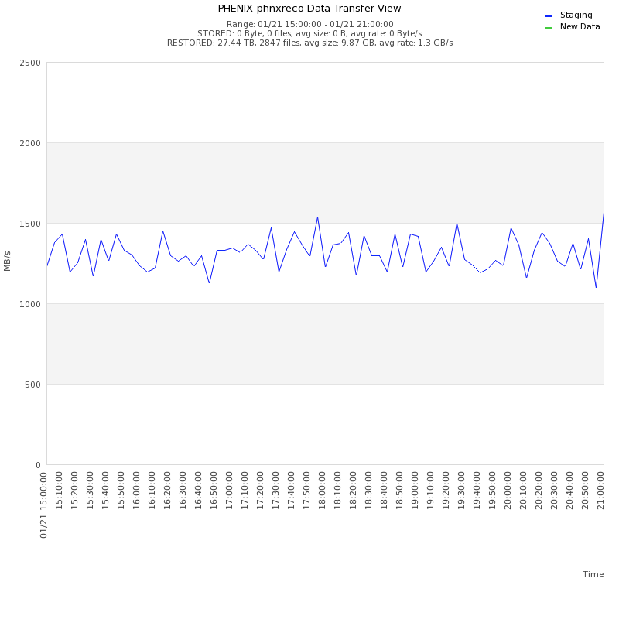
File Recall Performance
42,196 files requested
Average file size: 10 GB
Destination disk limit: <1.5 GB/s
Need to adjust staging drives, to keep @ <1.5 GB/s
1.3 GB/s
15:00 – 21:00 sample: 1.3 GB/s
Limited 10 drives
1.3 / 10 Drives = 132 MB/s/drive
All overheads included
(mount/dismount, seek … )
6 hours

Slide 21
Conclusions
We have implemented an active tape-storage data archive currently holding near 150 PB of scientific data and serving scientists from multiple collaborations worldwide
The archive and the underlying tape storage complex are managed in a very efficient way by a suite of in-house developed optimization and monitoring tools
The data archive volume can grow infinitely with the addition of relevant tape storage resources (media, libraries and tape drives)
Tape is still the leader in cost per GB and power efficiency. The implementation concept is based on the most cost-effective and energy efficient (green) memory model available today

