Slide 1

Supporting users
long term
Dr Andrew Richards
Head of Scientific Computing
Diamond Light Source Ltd
andrew.j.Richards@diamond.ac.uk
Notes:
The Future depends on what we do in the present (Mahatma Gandhi)
- a brief precis of the function and scope of the group (1-2 slides)
- the broad history of the group, key achievements over the lifetime of Diamond (1-2 slides)
- a short focus on the past 12 months – key achievements and challenges (2 slides)
- a short focus on the next 12 months – key milestones and aspirations (2-3 slides)
- conclusion (1 slide)

Slide 2
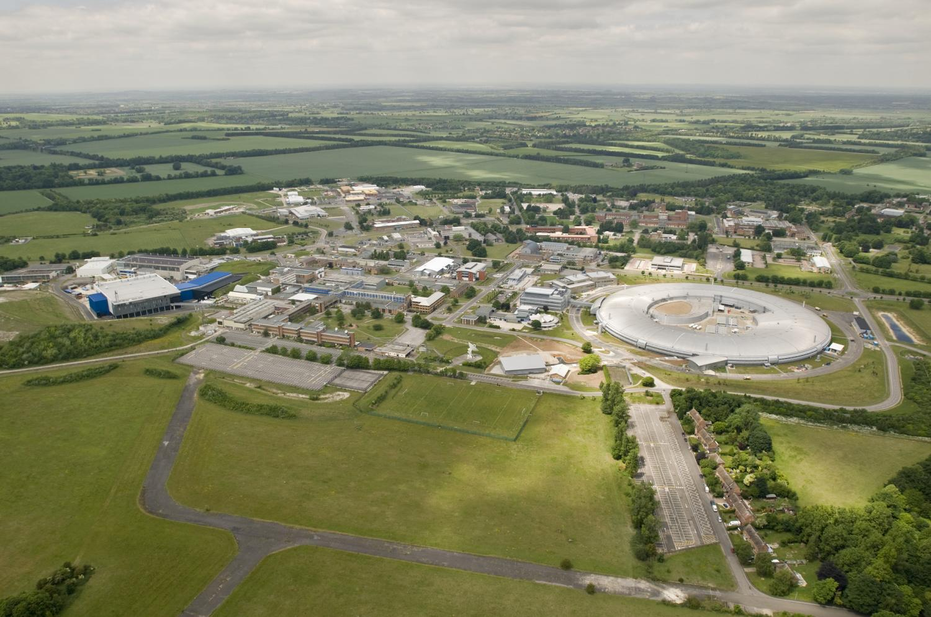
Harwell Science and Innovation Campus
LHC Tier 1 computing
ISIS (Spallation Neutron Source)
Central Laser Facility
Research Complex (for users of Diamond, ISIS and CLF)
Diamond Light Source

Slide 3
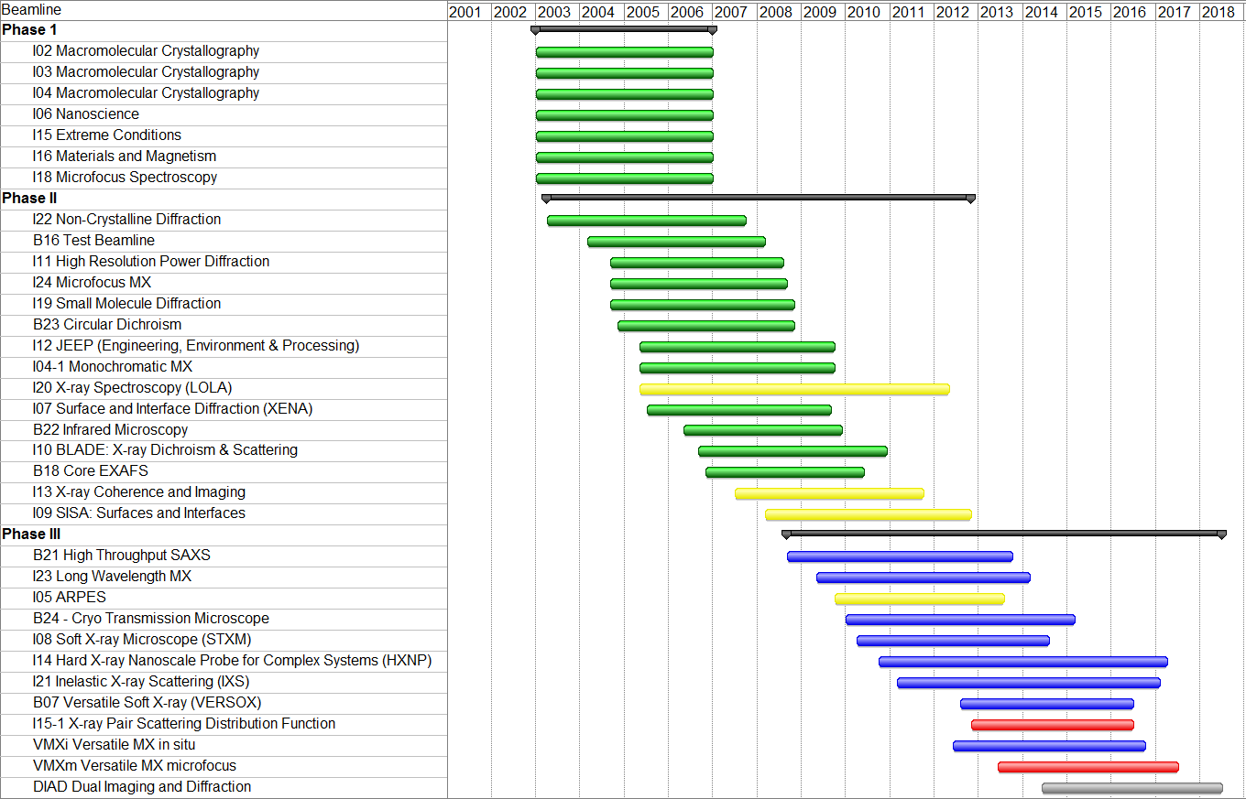
Beamlines or Instruments
Operational
period

Slide 4
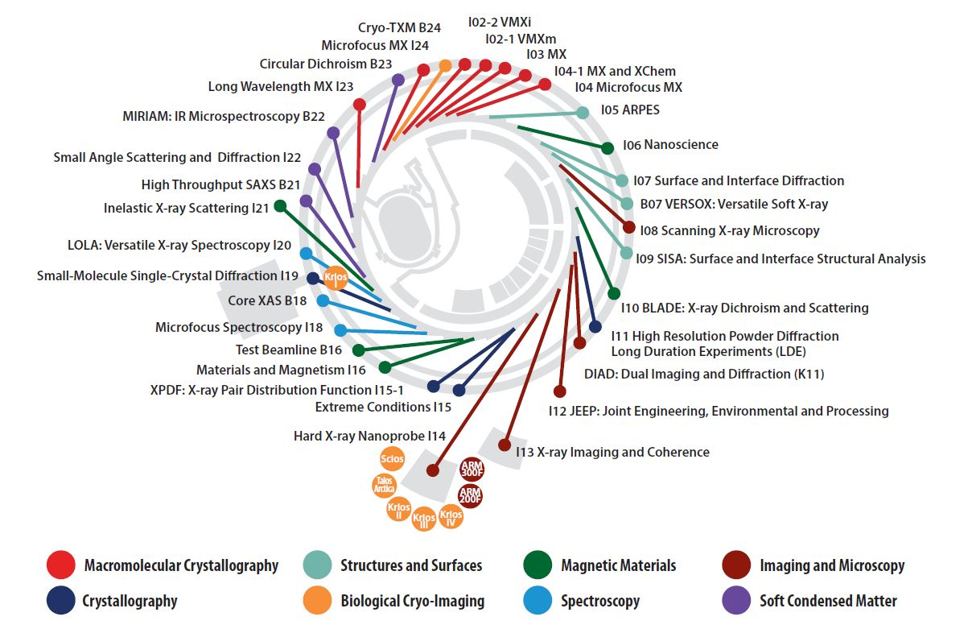
Beamlines by Village and EM

Slide 5
Data Flows
24/6 Operation, ~5000 hours beamtime per year
~9000 visits per year
~30 Operational Beamlines
~6 Operational EM
Planning for Diamond – II underway (2025)

Slide 6
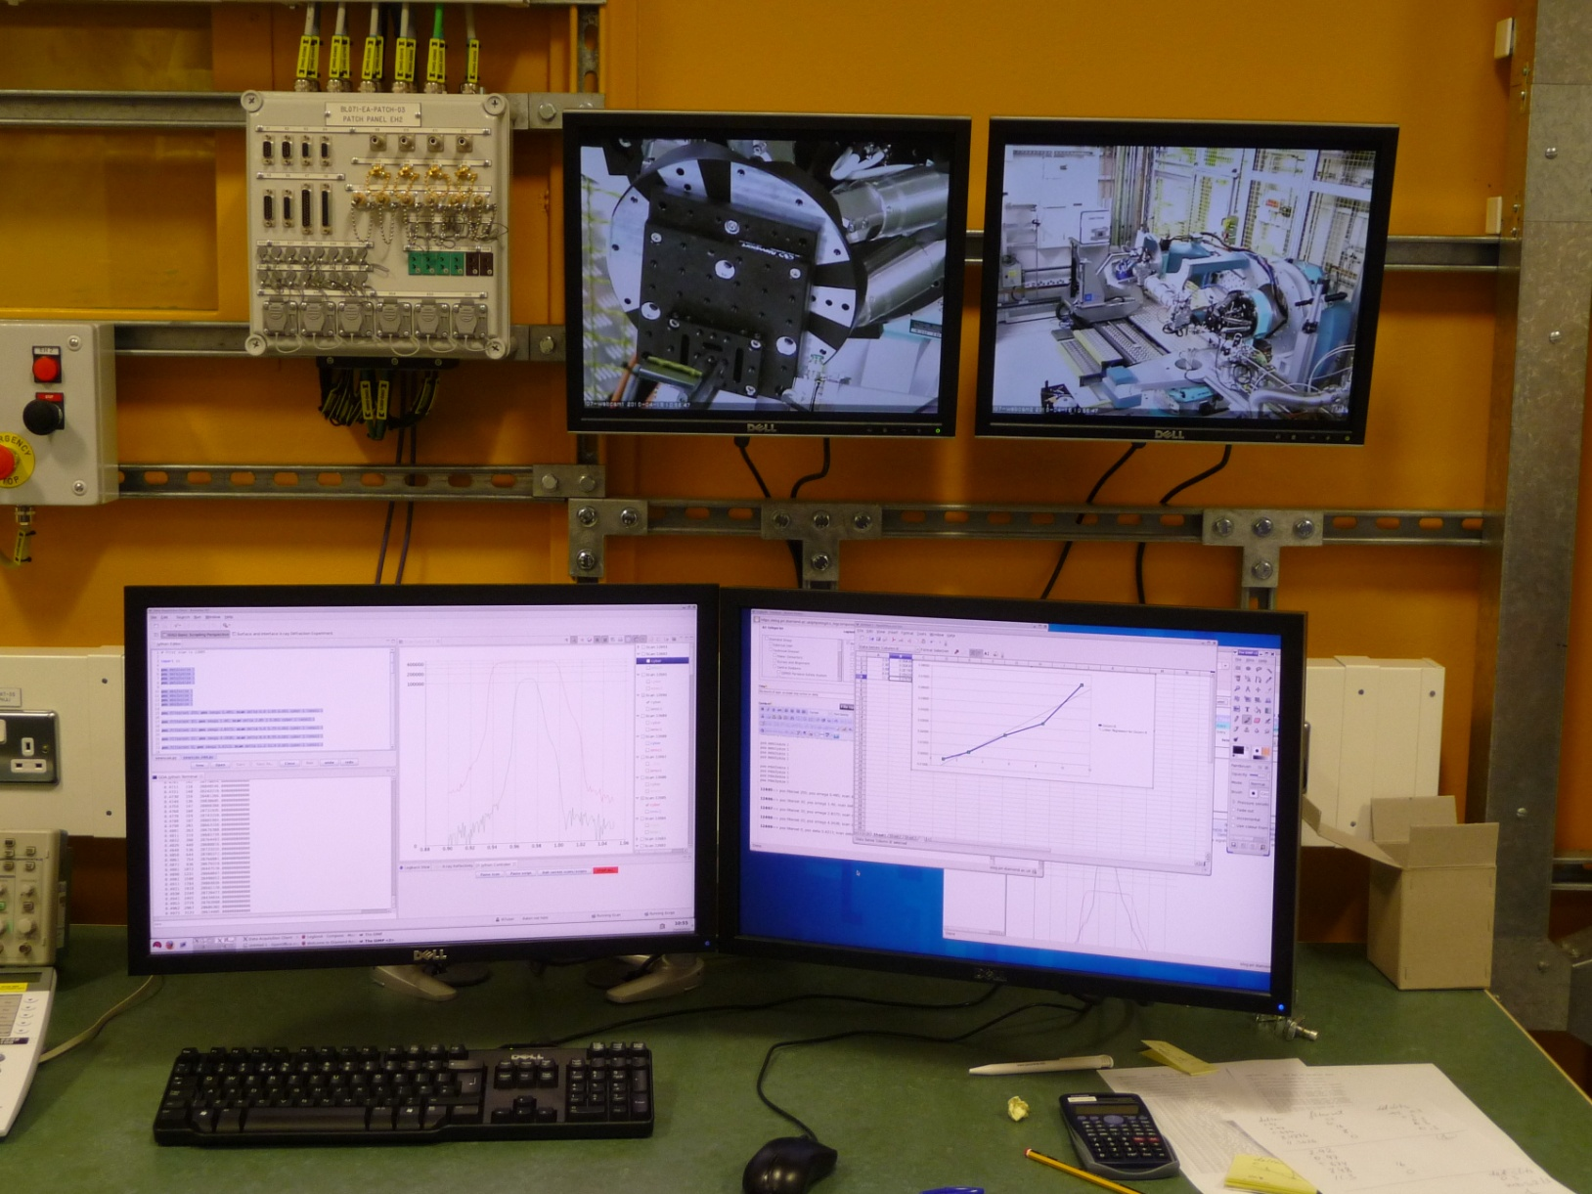

Typical User Setup

Slide 7
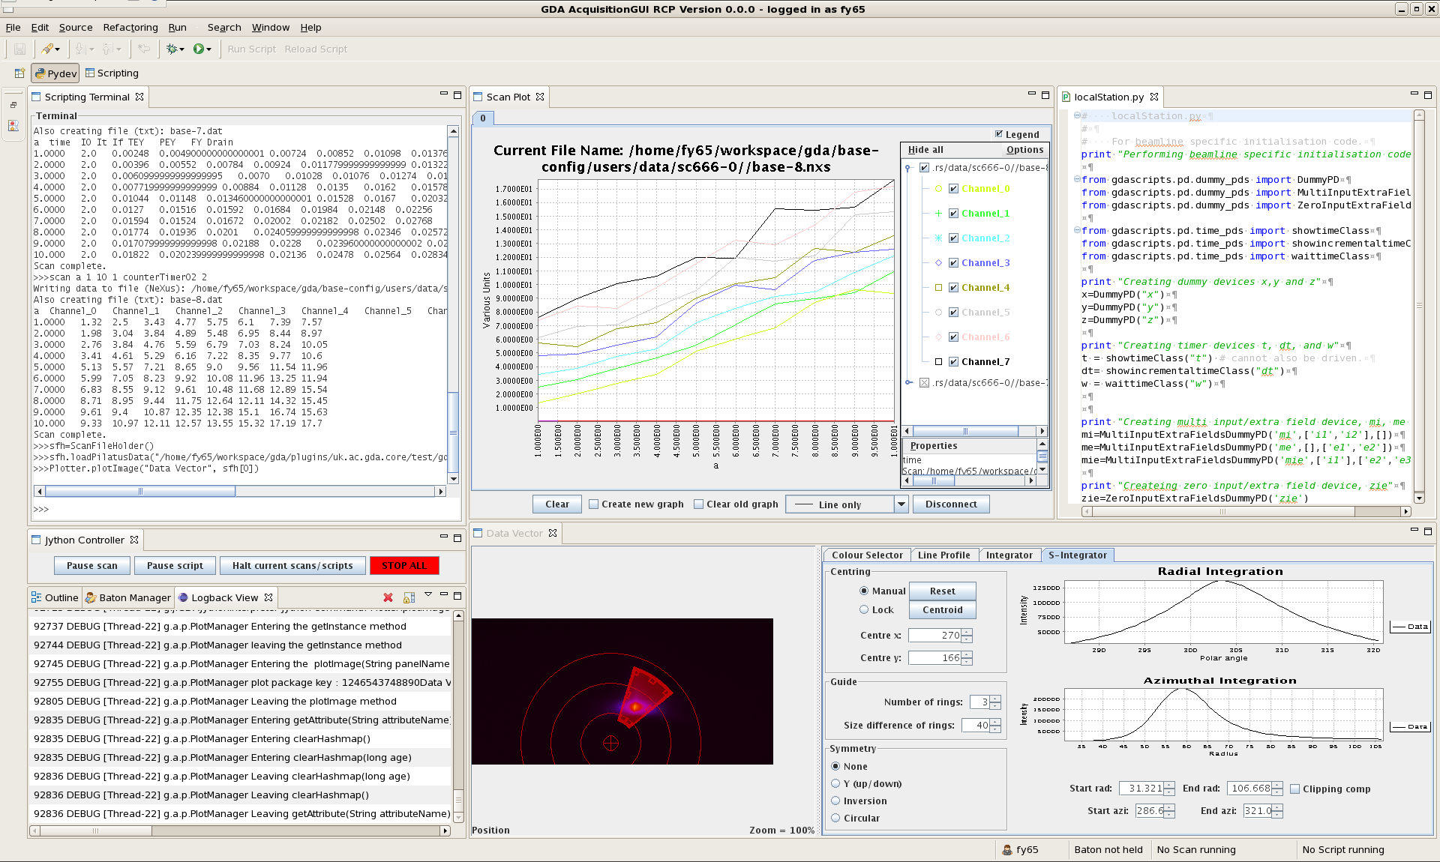
GDA – User Interface
Rich GUI clients
  widgets, views, or perspectives using Eclipse plugin framework
Script Editor
Live Plotting
Terminal
Analysis & Visualisation
Log View

Slide 8
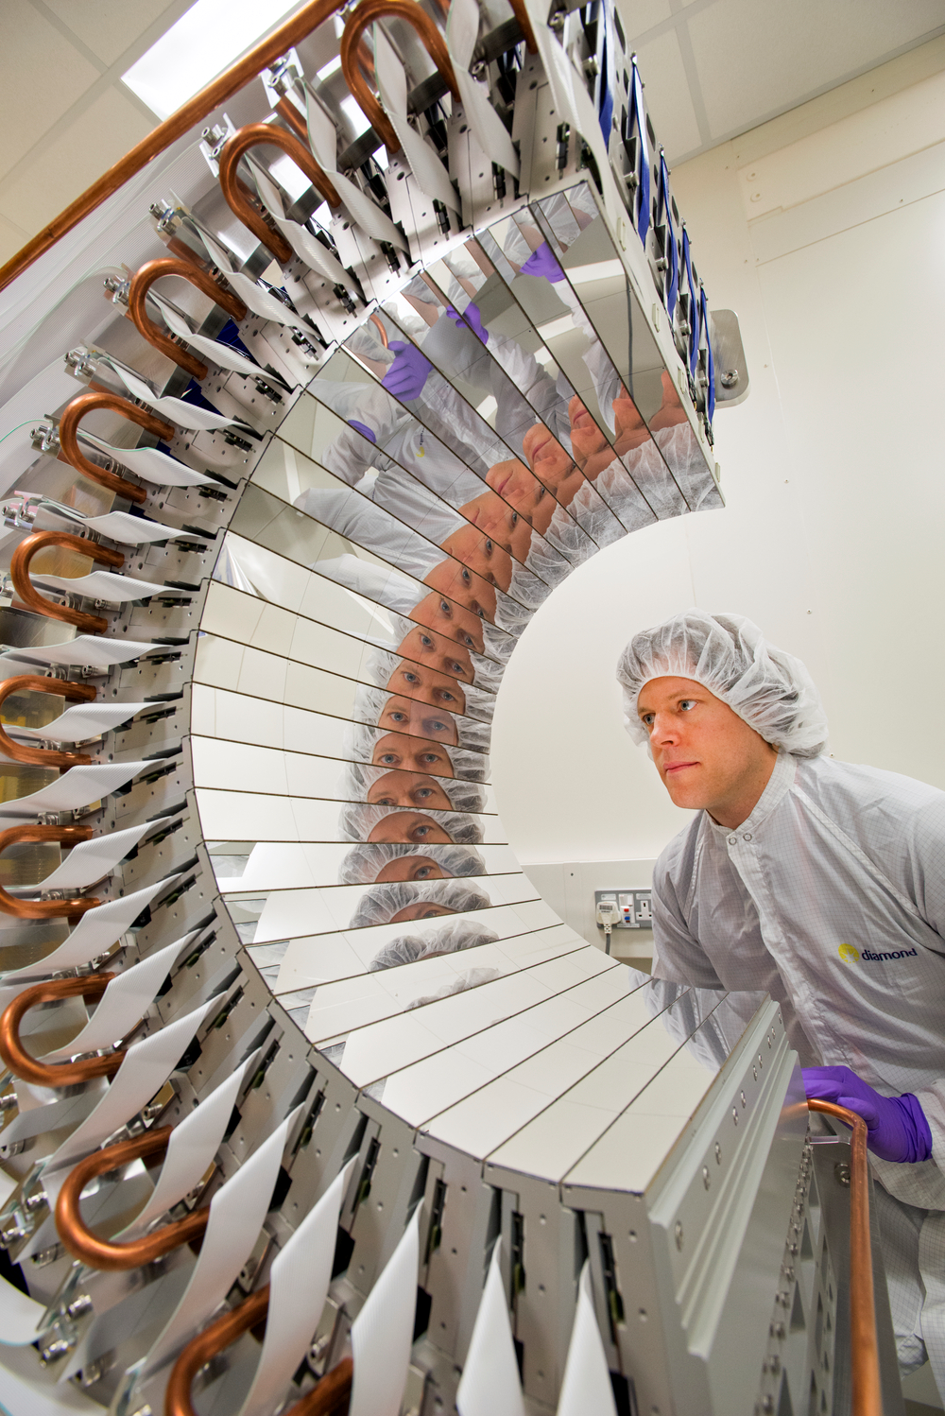
Data Rates
Doubling time = 7.5 months
2007 No detector faster than ~10 MB/sec
2009 Pilatus 6M system 60 MB/s
2011 25Hz Pilatus 6M 150 MB/s
2013 100Hz Pilatus 6M 600 MB/sec
2013 ~10 beamlines with 10 GbE detectors (mainly Pilatus and PCO Edge)
2016 Percival detector 6GB/sec

Slide 9
Data Rates

Slide 10
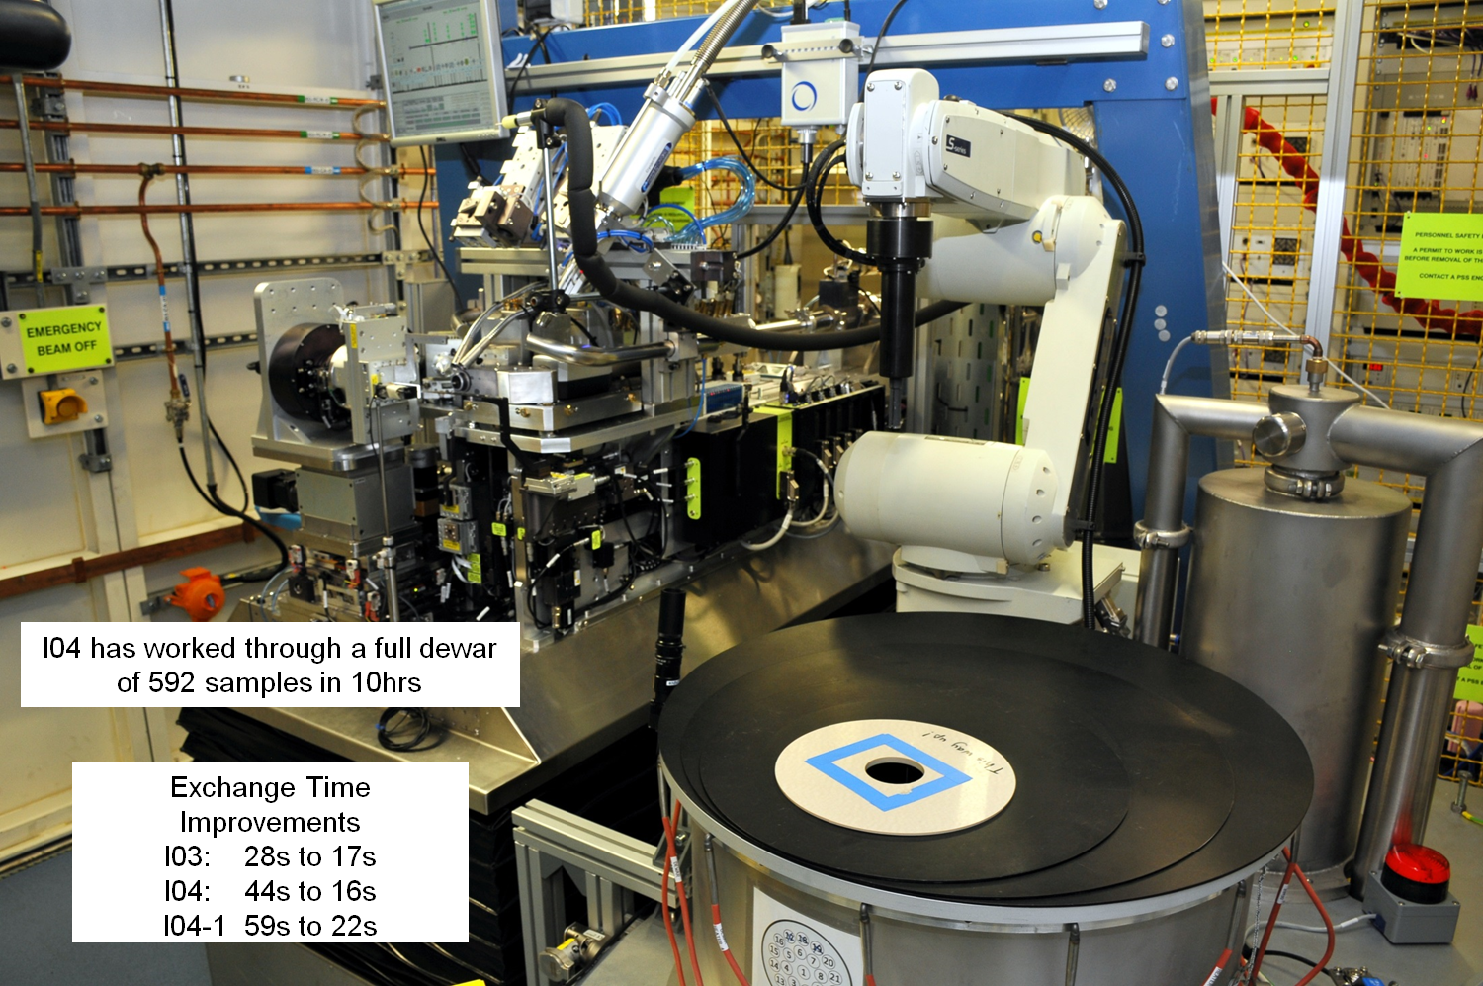

Slide 11
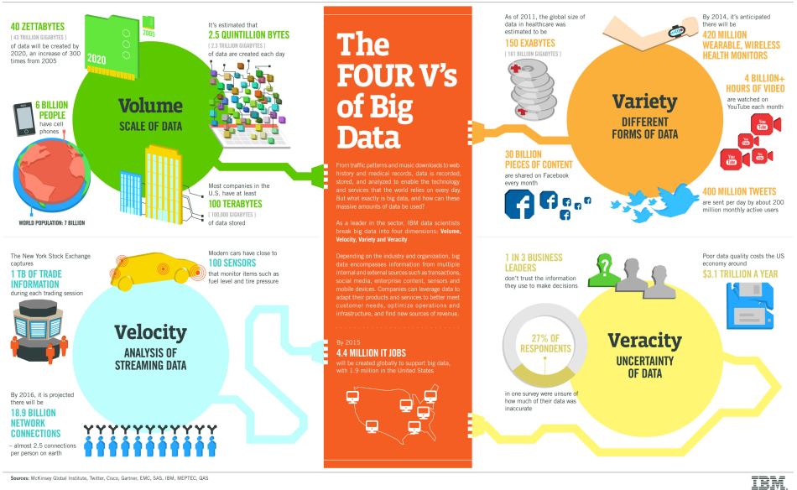
Big Data

Slide 12
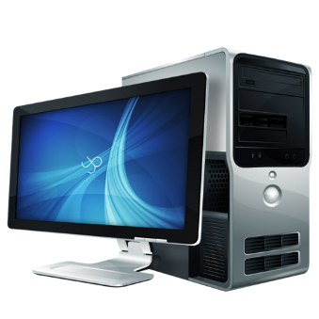
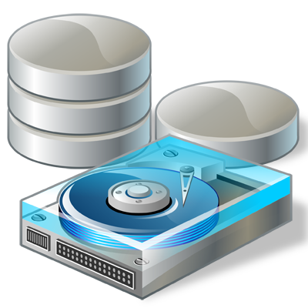


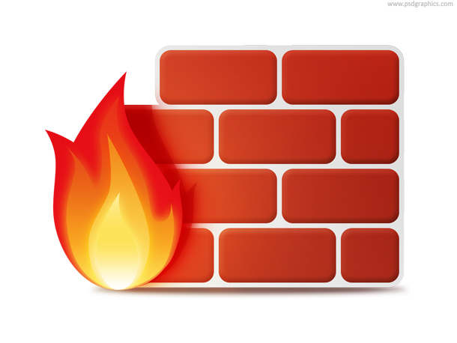
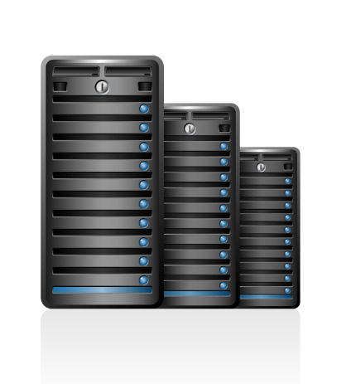

Scientific Computing and Infrastructure at Diamond

Slide 13
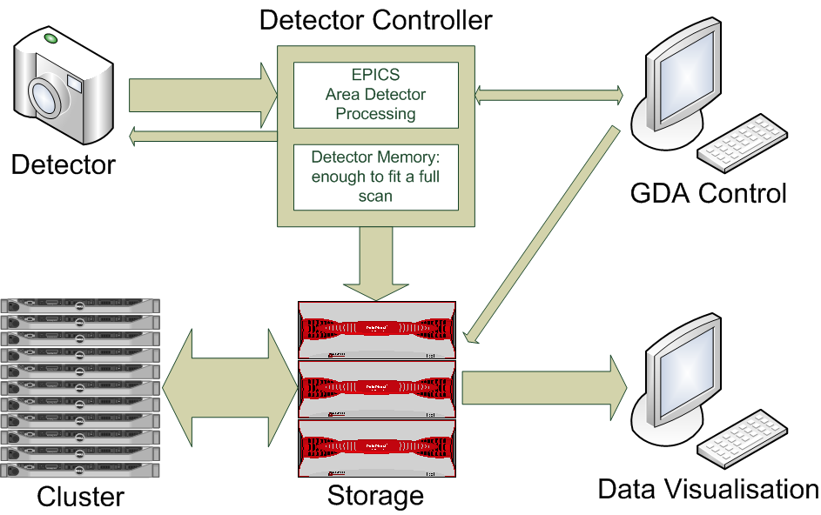
Data Flow

Slide 14
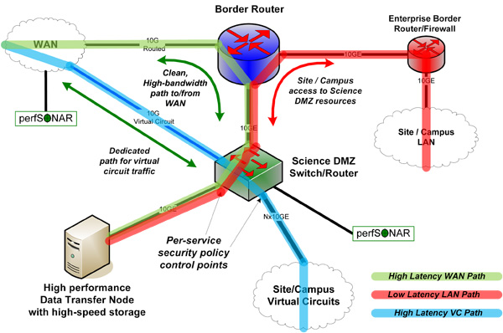
Moving Data Off Site a Science DMZ

Slide 15
Scientific Computing Infrastructure
HPC / HTC Cluster (~3500 cores)
  X86, Nvidia GPU (K80, P100)
High Performance Storage (~7.5PB)
  Lustre03, Lustre04, GPFS01, GPFS02
Network infrastructure
  10Gb/s, 40Gb/s to some beamlines
User Gateways, Visualisation, Data Transfer
  NX Service, Globus endpoint
Support
  Predominantly Linux infrastructure,
  BUT also Windows support to beamlines/EM/etc and VM platforms
  Relies on working with Corporate IT and other groups in Controls and Scientific Software

Slide 16
Statistics: Data
Target | Available | Used | Performance
XFS | 50 TB | 47 TB | < 1GB/s
Lustre03 | 470 TB | 370 TB | 6 GB/s
Lustre04 | 140 TB | 70 TB | 2 GB/s
GPFS01 | 1 PB | 700 TB | 15 GB/s
GPFS02 | 4.7 PB | 3.5 PB | 40 GB/s
NEXT | ~9PB | - | >60GB/s
STFC Archive | n/a | 14 PB | 10 TB – 62 TB per day ingest

Slide 17
Current File systems
2x Lustre systems sub 1PB. (not doing a great deal now but worthy of note)
  DDN based systems SFA10K and SFA12K
2x GPFS
  (1) 877TB usable (GPFS01)
  4 nsd servers
  2 protocol servers
  *Over the last 6 months actual data
    *Read 2GB/s
    *Write 6GB/s
  (2) 4.7PB usable (GPFS02)
  7 NSD servers, 4 protocol nodes
  Netapp E series and EF for metadata
  IB connected to storage
  IB and 10G out the front
  *40GB/s benchmarked throughput. Now in excess of as we have added disks

Slide 18
Key points to address
Data Acquisition and analysis platforms vs post-processing platforms
  Need to separate
  On-site vs off-site
Archiving data (keeping data warmer)
  How long to keep
  The challenge of Open Data
  Who pays

Slide 19
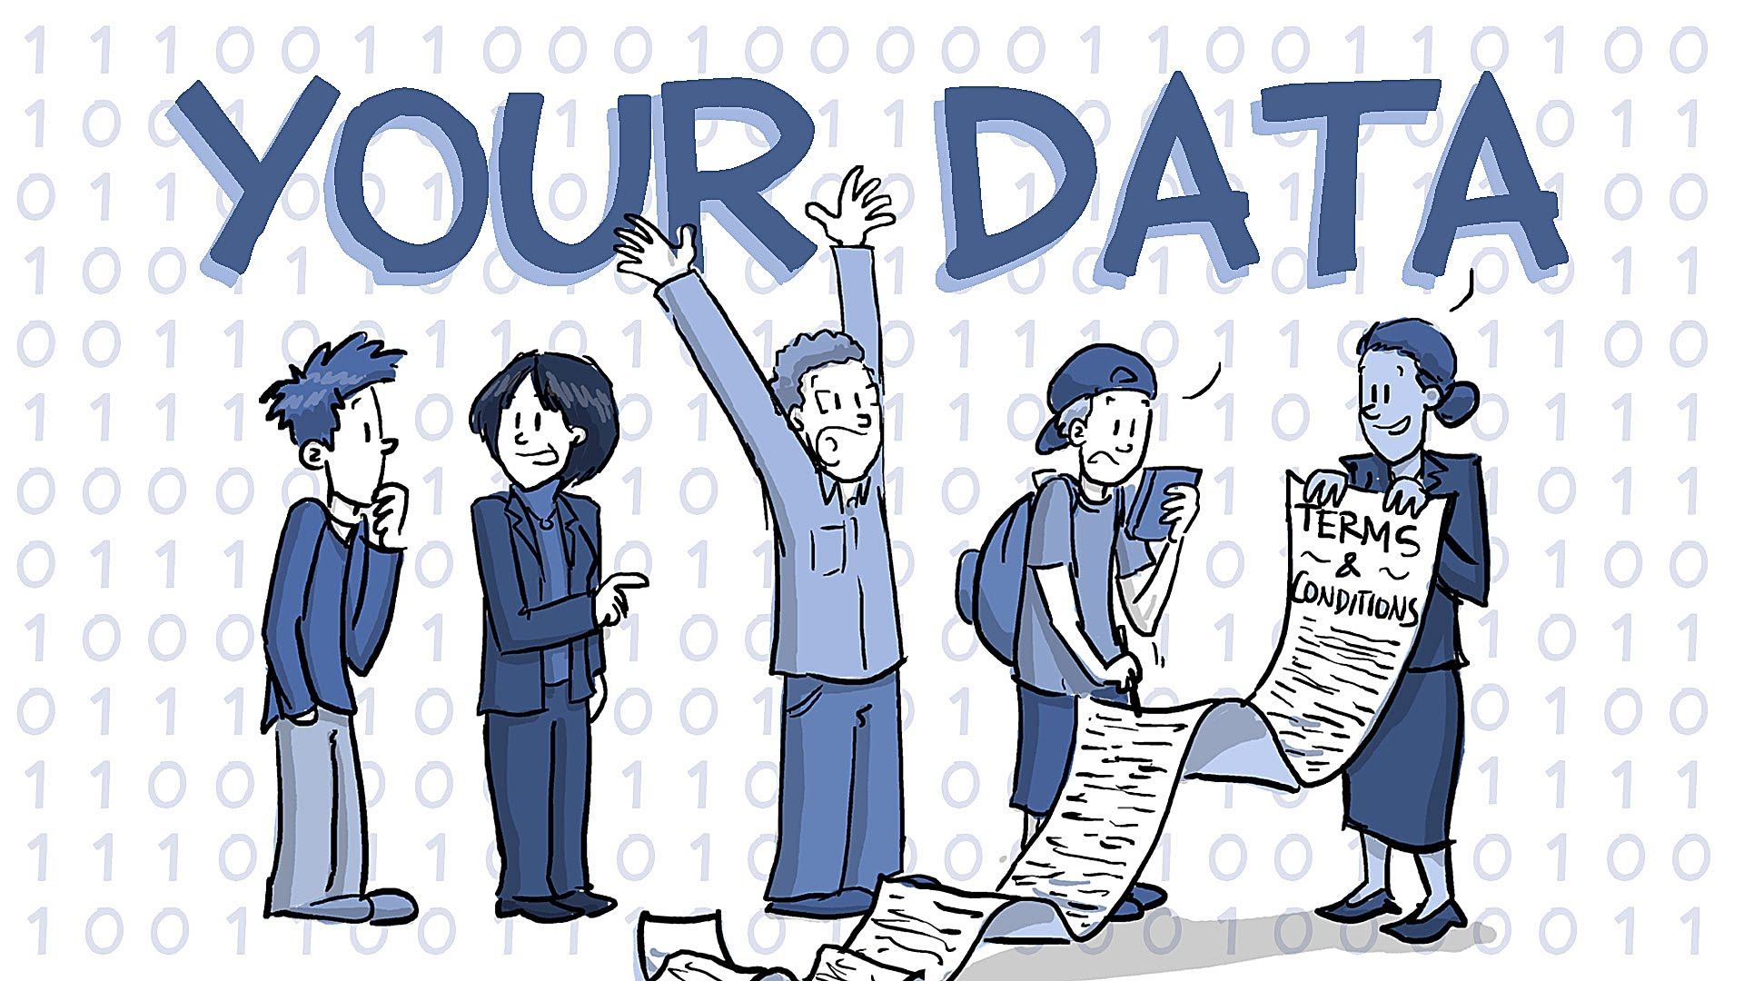
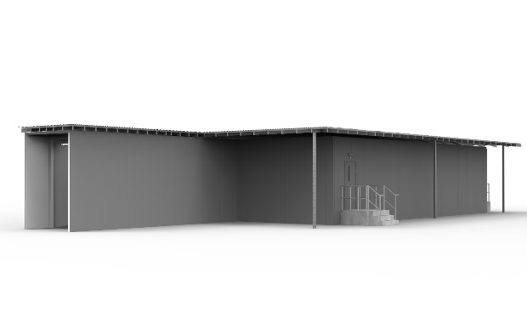
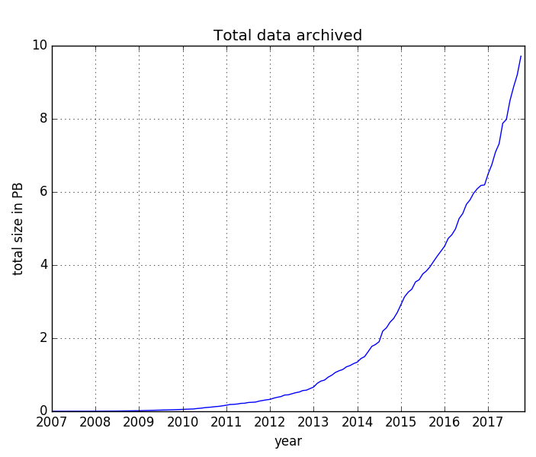
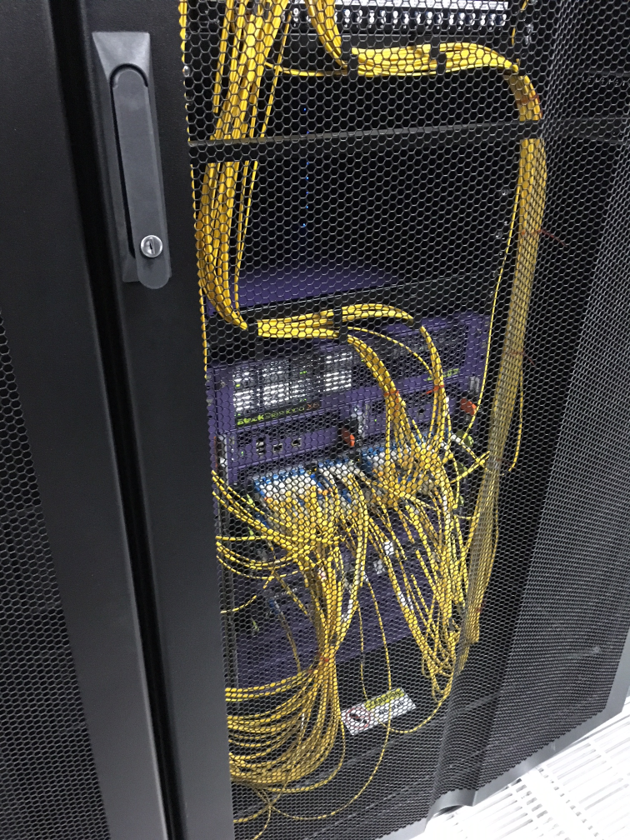
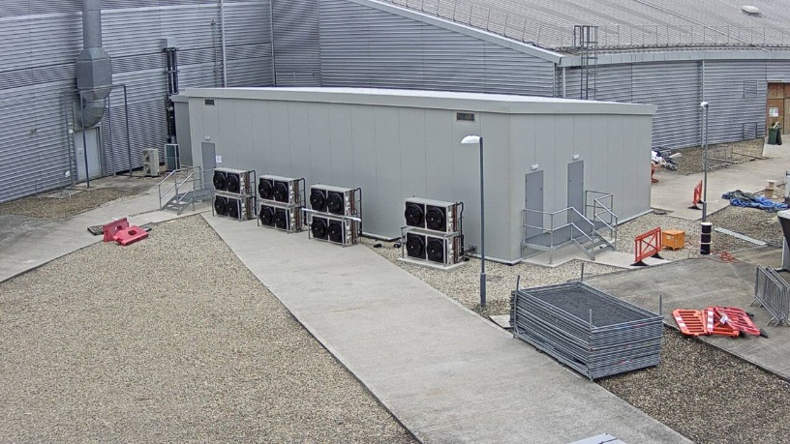
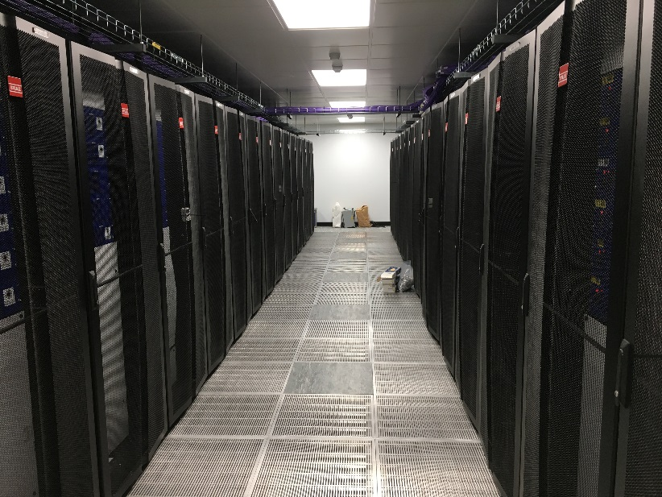

Scientific Computing
New Computer Room
14 PB of Archived Data

Slide 20
Detector Developments
Percival
Main challenge: 6GB/s data rate, sustained forever(ish).
Secondary processing challenge: pixel-per-pixel bit descrambling and pixel-per-pixel calibration algorithms prior to writing an "image" to disk.
Excalibur
Data-rate 750MB/s * 2 channels.
real problem: ptychography and tomo-ptychography - very large scans with TB size datasets.
Secondary processing challenge: block-by-block (i.e. each sensor chip) is angled and need to be rotated 90deg to turn into an "image". Not terribly difficult because of the low(ish) data-rate.
Secondary processing challenge: on-the-fly compression. Data is sparse so we expect it to be relatively easy to get a good compression ratio.
Eiger and Eiger2
Data-rate: variable, depending on compression ratio which depends on SNR. Typically the compressed stream fits in a single 40gbps NIC.
Raw data rate: 4M pixel * 2bpp * 750Hz
Pre-compressed data can not be processed on the fly before hitting disk.
Main challenge: near 100% reliability and uptime! MX beamlines are data factories!
All systems require a degree of parallel DAQ/processing and so that is a key challenge that we face in the software development of all of these systems. We are implementing a single DAQ framework to allow re-use of software for all of these systems.
AND…
Potential for detectors to run at 1PB per hour by 2025

Slide 21
New Eiger Detectors
Eiger on VMXi, we currently see:
Sustained (10 minutes+/indefinite) acquisitions at 500Hz, with typical compressed data size of 2.2Mbs per frame. This gives about ~ 9 Gbits/second.
Full speed acquisition burst (30 – 60 seconds) at 750Hz, with typical compressed data size of 2.2Mbs per frame. This gives ~13 Gbits/second.
This is using 4 writing nodes split across 2 servers.
Files contain 1000 frames, so in big acquisitions, it’s possible to get reasonably large numbers of files being created in the same directory. (We once did a 500000 frame acquisition which created 500 files, though this is not a typical use case).

Slide 22
Post Visit Processing

Slide 23
Current Challenges
Infrastructure is monolithic.
‘One system’ for data acquisition, analysis and increasingly post-visit analysis, restaging of data.
  Competing requirements

Slide 24
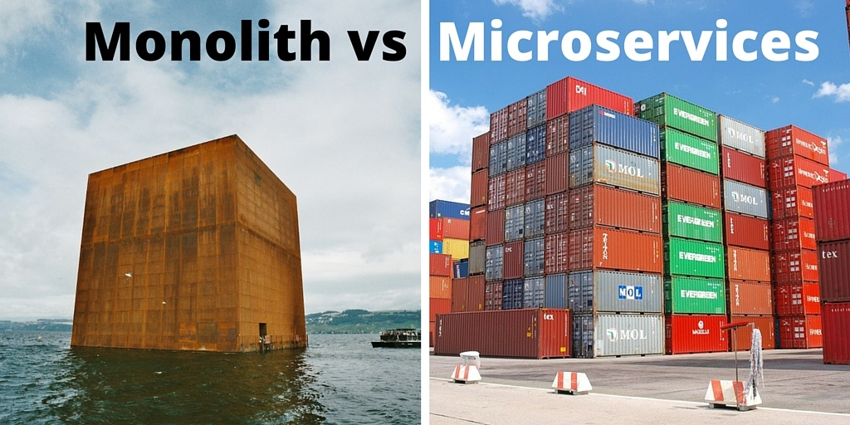
Future

Slide 25
Future file systems and storage architectures
More of the same?
  If we change, how is the step change funded and when
Performance is key but can we move to more scalable file system architectures / object stores?
  Re-write the software layer? Are we prepared to?
Separate acquisition from post-processing
  Where is the logical boundary?
  Would allow better scheduling of jobs
  Would allow off-site (not in Diamond) HPC and Storage to be implemented and used/shared

Slide 26
‘Big’ Data Lifecycle challenges
How much do you mean by BIG?
How ‘FAST’ do you need to analyse the data?
What data can be THROWN AWAY?
  (and at what stage?)
How LONG do you need to keep the data?
Open Access ?
And WHERE? Where do you want to transfer the data to/from?
And WHERE do we best do Post-Processing?

Slide 27
Future Data Catalogue
Move to complement archiving of data with an open data repository.
  Legal changes to Diamond T+C’s
  OpenAIRE
  FAIR
  Who covers the costs long term?
Data catalogue link to compute post processing?

Slide 28
Cloud Project Aims
To explore the usage of ‘cloud’ technologies for the processing of scientific, experimental, data at Diamond. Define three use cases for exploratory, proof of concept project.
Use Cases:
UC1 – Cloud Bursting
UC2 – Post processing in the Cloud
UC3 – Archiving data to the Cloud / Cloud based Data Repository*

Slide 29
Technology
In house exploration of commercial clouds (Amazon AWS, Microsoft Azure, Google).
Containerisation: Using Docker for trial deployment of in-house applications.
Evaluation of Singularity for more secure application deployment instead of Docker.
Used Univa Grid Engine NavOps framework for remote cloud VM control.
Testing of Kubernetes in-house for Container management.
Production deployment of Openstack / OpenShift in Verne Global (Iceland) HPC Direct service for LabXChem fragment screening production pipeline. (Frank von Delft)

Slide 30
Work and Initial Findings
Used Docker containers to enable deployment of Diamond applications across multiple ‘cloud’ platforms. This was relatively easy to achieve.
Docker is widely supported and mature as a technology choice and by creating a dedicated docker image repository at Diamond have been able to manage security concerns over trusting docker containers.
Whilst Docker has proven to be easy to use and well supported a growing preference for the security of Singularity.
With all cloud providers a need to establish a VPN or some form of direct connection (costly). VPN approach cost effective but a lot of time spent unnecessarily getting the basics setup for site to cloud integration. (Note: VPN would not be needed if only doing standalong activities in the cloud)
Data management a problem no one has a good answer to. Evaluating different tools to move data to and from the cloud. Have now done some initial work using Apache Camel to orchestrate the data movement.
Univa NavOps software required some setup to get it working properly. Quite good at controlling remote VMs in the cloud of choice but still does not solve the data management piece. Also investigating for cloud bursting other options such as via SLURM or HTCondor.

Slide 31
Thank you

