Slide 1
NSLS-II Data update
Richard Farnsworth
Controls program manager
24th September 2018

Slide 2
A short update of the Status
A short update of the Status of the NSLS-II computing, its challenges and futures. Including data retention, intentions, remote access requirements, remote control now and further, Real time cluster needs, experimental support and post experiment analysis. Some discussion of the things that work well and some things that don't.

Slide 3
NSLS-II

Slide 4
Beamlines - Introduction

Slide 5
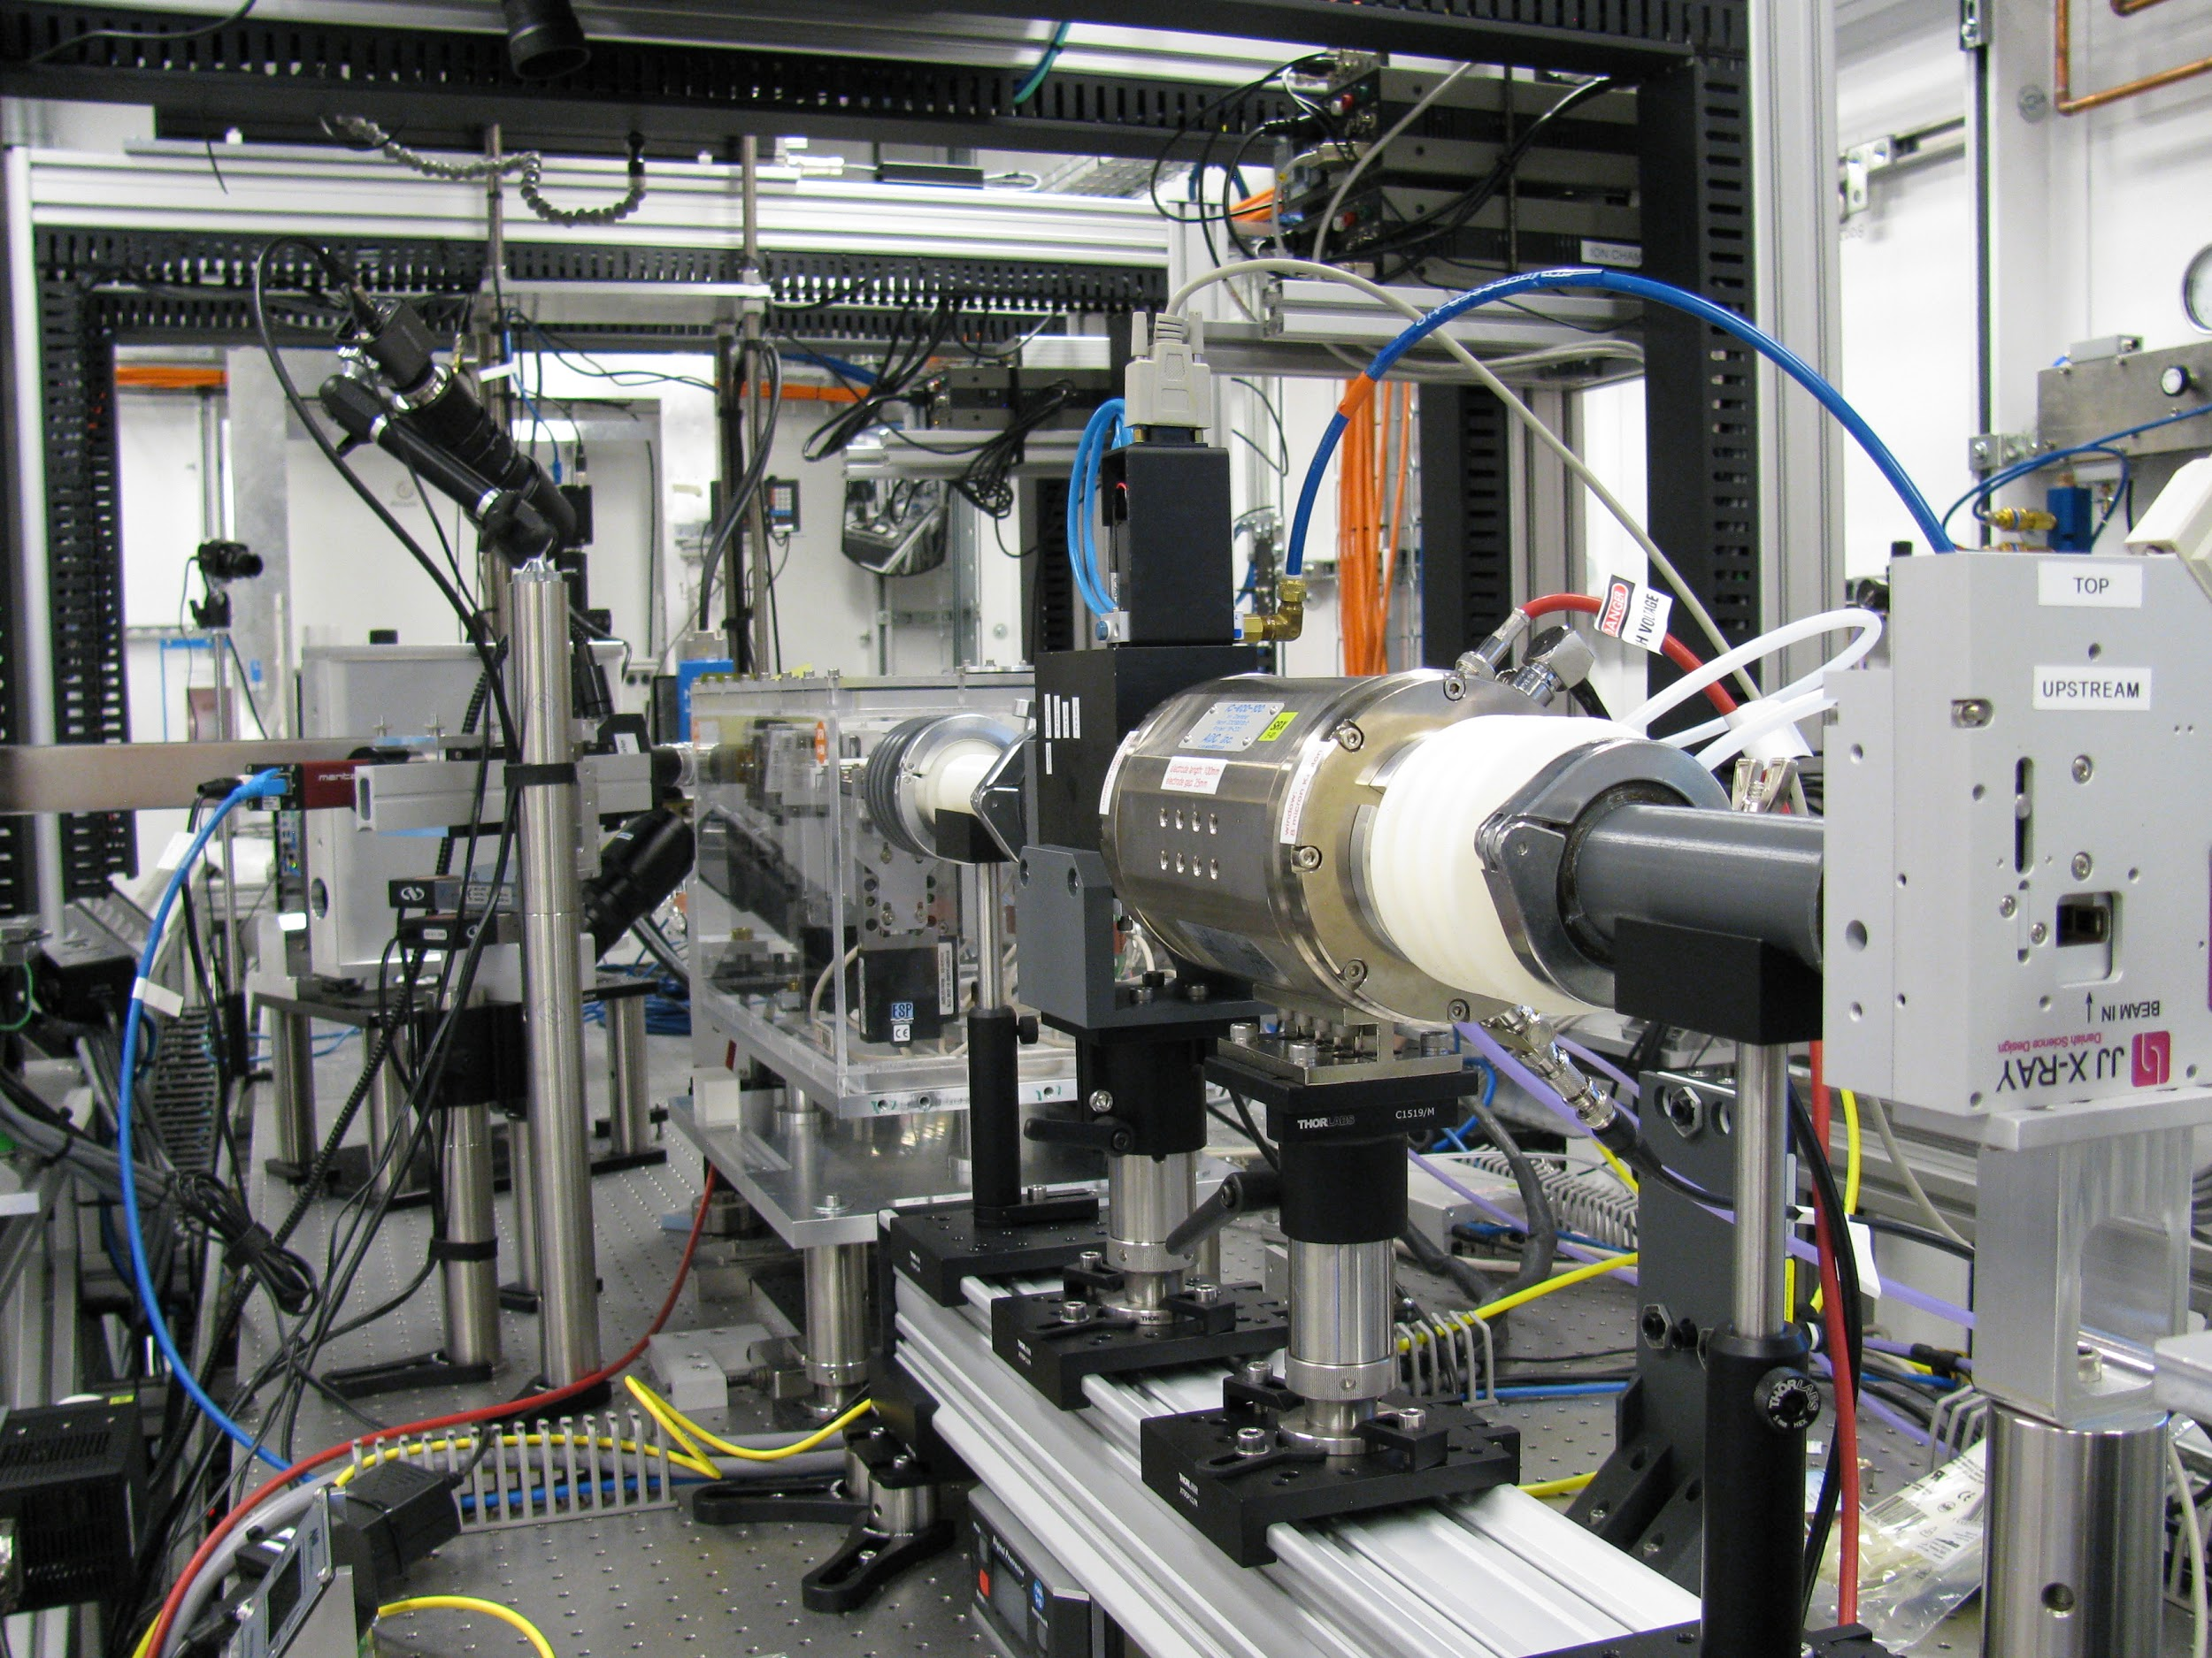
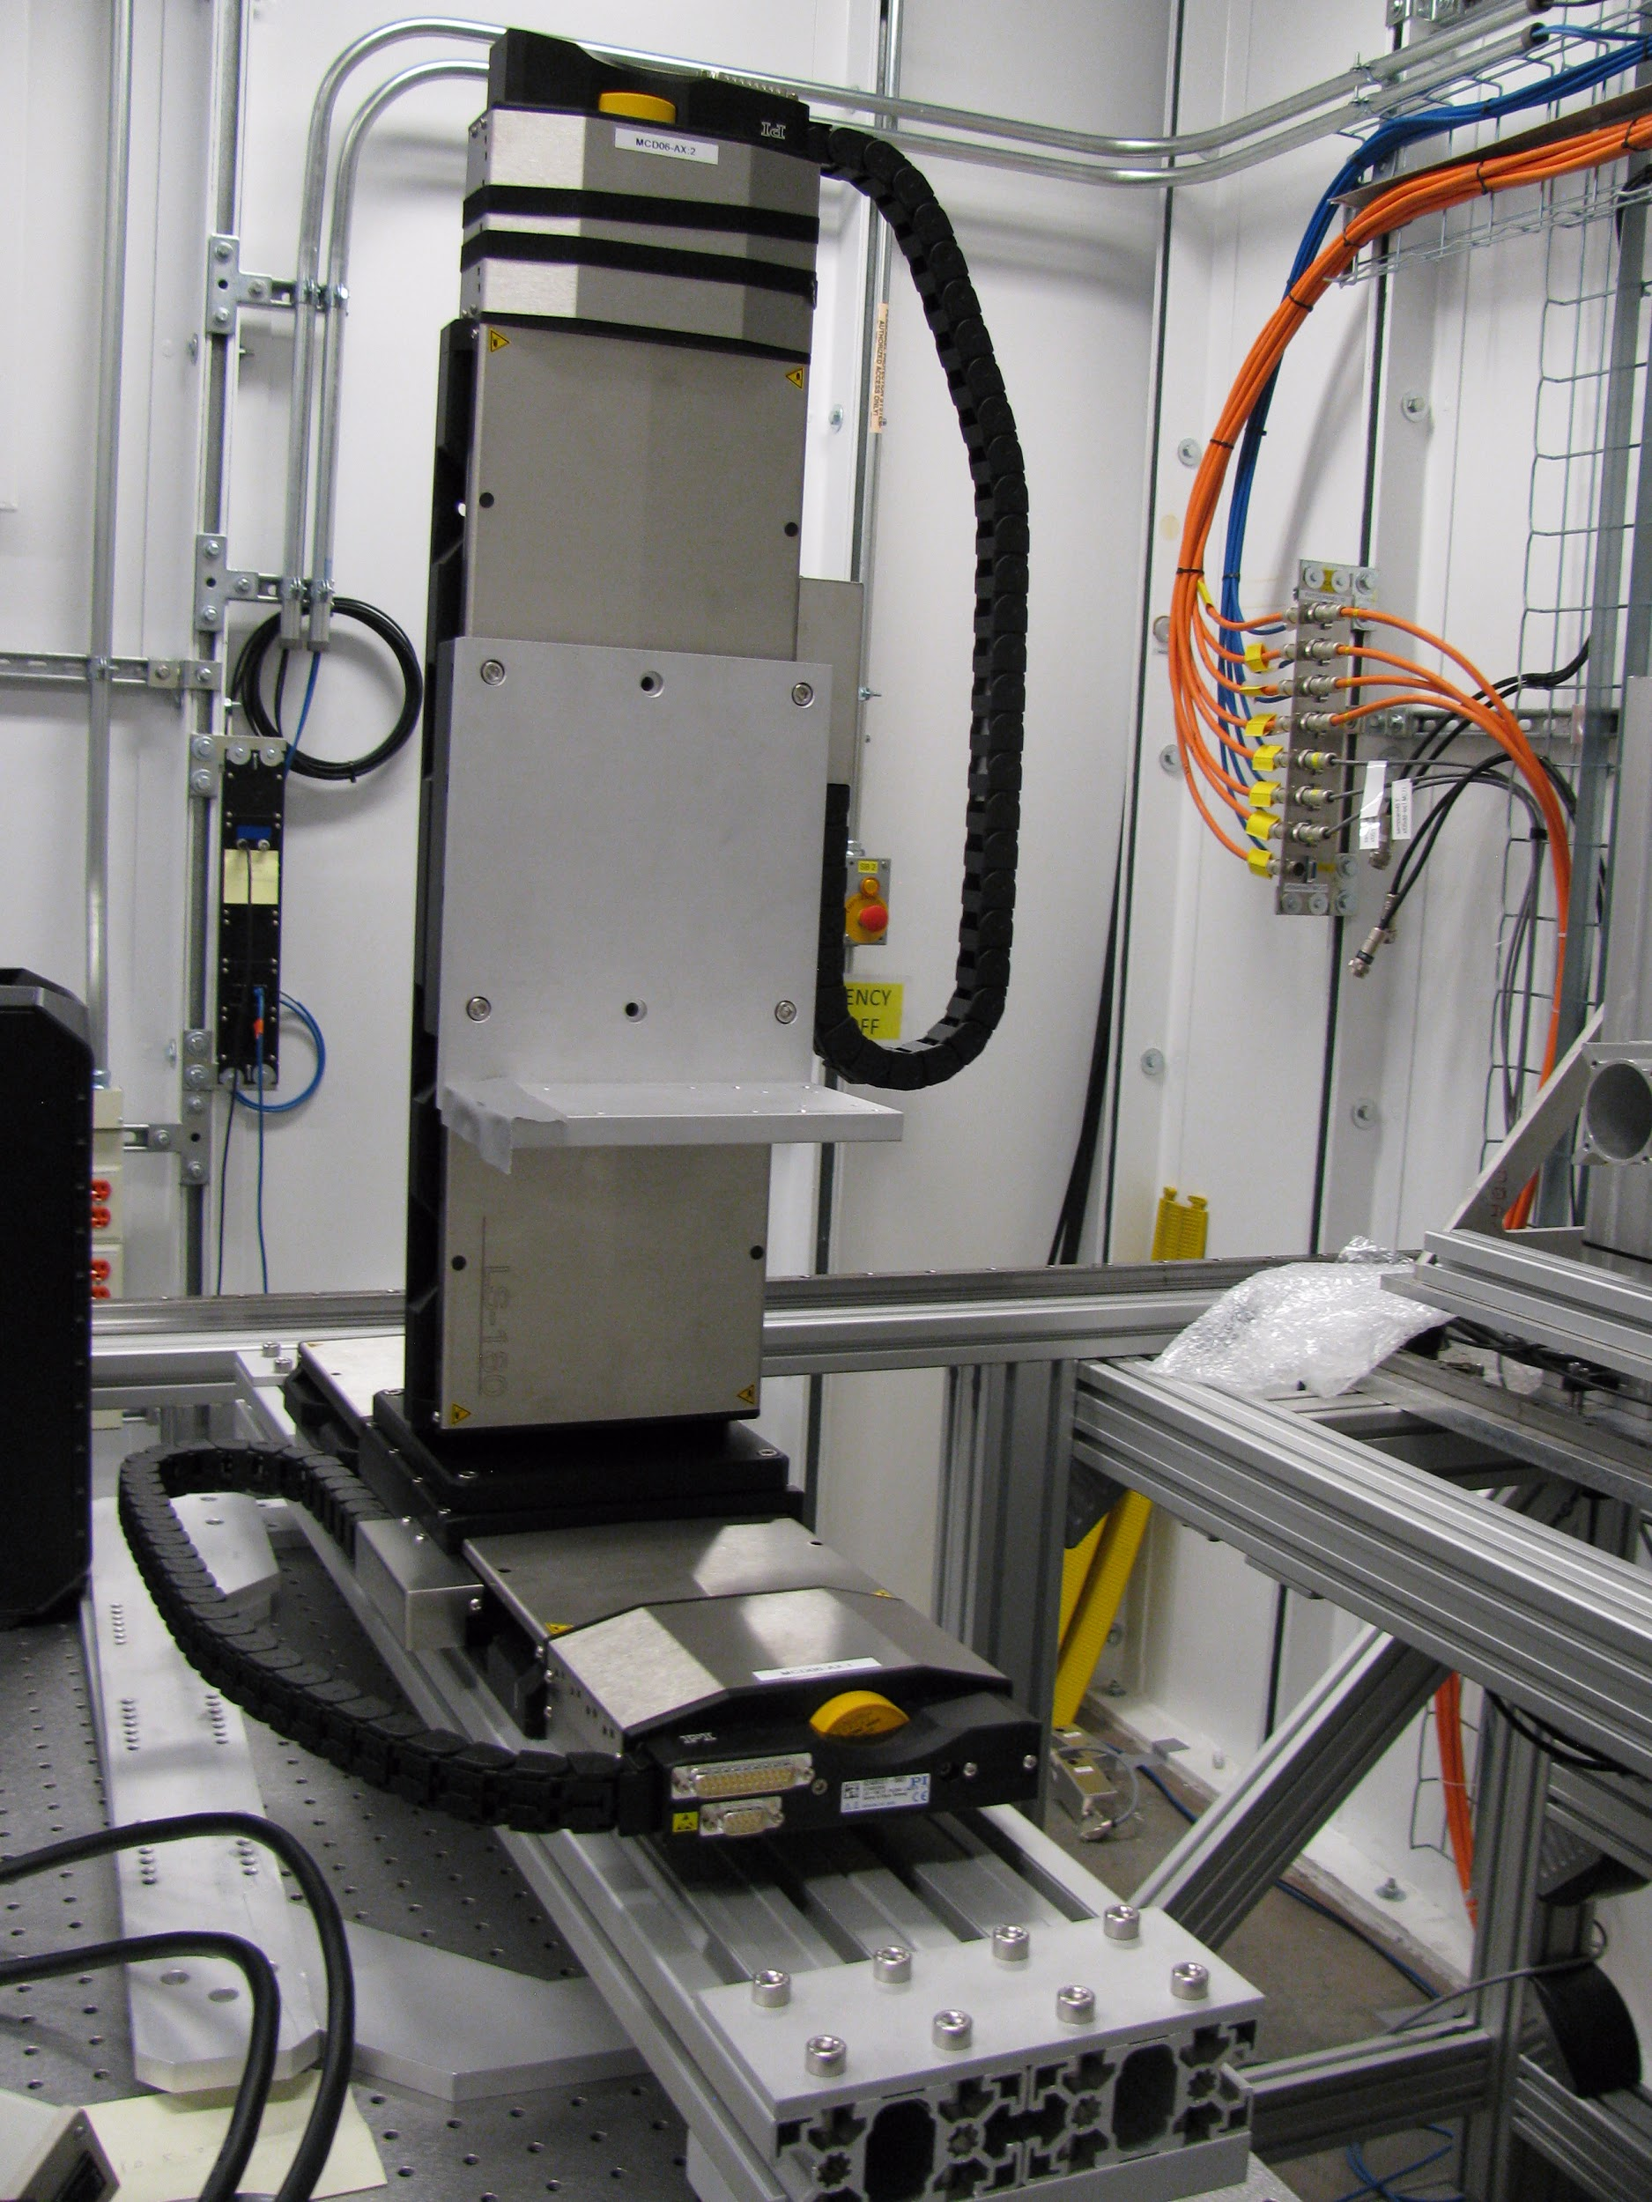
Example Beamline - Imaging and Microscopy
[4BM-XFM] Perkin Elmer XRD 1621 detector IOC setup under windows 10 with areaDetector v3.2 and EPICS V4
[5ID-SRX] KB system replacement project which including 8 axes KB mirror and 4 axes low current slits
[18ID-FXI] DCM Theta2/Chi2 fine Piezo motion position stabilizing PID control implementation.
[5ID-SRX] chip imaging stage setup and flying scan system configuration

Slide 6
What does the (controls) program do?
Group Service Responsibilities ICT: Servers, Disks, Networks, certain apps, Beamline: Motion, Sample, User interfaces, Accelerator: Magnet PS controls, feedback, orbits etc. DAMA: Data Acquisition, Mgt, Analysis Core: Core infrastructure (EPICS, EPS, Techs)
All groups have Operations Responsibilities
Ongoing work, Keeping things functional, upgrades to existing systems, getting keeping SW and HW current project improvements and Installations Responsibilities New beamlines, major upgrade projects
Acronyms: ICT Information and Communications technology, DAMA Date Acquisition and data Mgt and Analysis PS Power supply, EPICS Experimental Physics Control System, EPS Equipment Protection Systems, SW Software, HW hardware

Slide 7
Cooperation - Beamlines and Controls SAC-4
Our Mission is: To enable productive scientific research by making specialist controls and computing technology work for both the facility and the user community. To create controls, data collection, analysis and storage systems that are reliable, standardized, customizable and secure to enable the scientific productivity of the facility for infrequent and expert users.

Slide 8
: 80% of the recent issues are data related :
IT related. “Network” – you will hear “The Network” as if it were a single thing… There have been separate issues with the following:
Core network - Upgraded in Jan, some bugs;
NFS servers – this has been a Total disaster;
GPFS – Not as good as it should be; Performance is spotty, sometimes good, other time not so good.
Specific instances with workflows e.g ; CHX issues
External access – ongoing work;
Aging infrastructure – Five years for some equipment

Slide 9
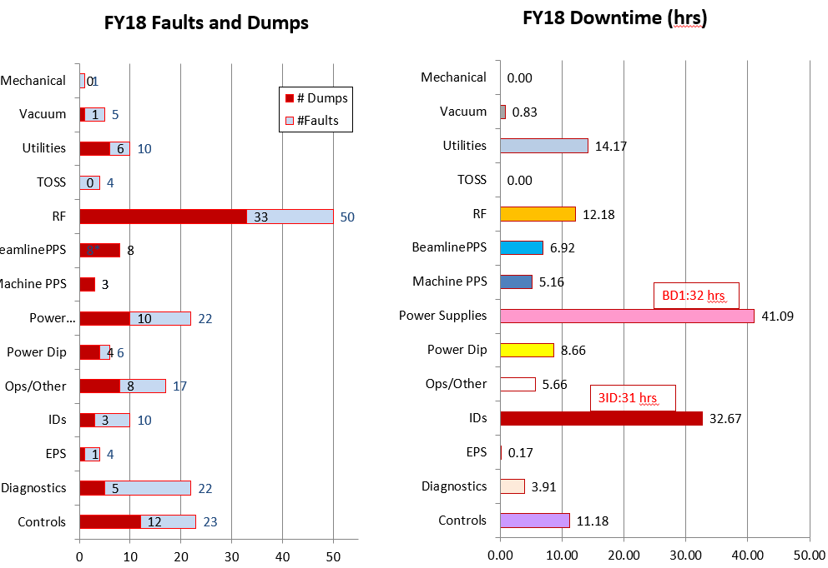
Accelerator Fault statistics
The NFS issues controls have contributed to faults. Once the NFS is proven fixed the controls reliability will be substantively improved

Slide 10
Config Mgt, Incident reponsnse, Change Mgt, release mgt IT 2
Config Mgt in IT is via a tool and a defined process lead by “PUPPET”. Puppet is an automatic way to inspect, deliver, operate all infrastructure and software, no matter the platform.
Change Mgt process are still in the early stages of definition.
Release management is via a new tool called “SNACK” built on top of Ansible.
Plans to improve written process and procedures are being drafted. Builds on existing BNL, NSLS and ITD engineering processes.

Slide 11
Data retention policy and Practices IT-13
As part of the light sources data* working group, we have been working together to have a common template for the data retention policies and practices across all of the light sources. This common language has just been approved and the policy on the NSLS-II website has been updated.
Reproduced next slide or
https://www.bnl.gov/ps/userguide/data-management.php.
* Group was ALS,LCLS, APS and NSLS-II

Slide 12
NSLS-II Data Retention Policy IT13 cont
Date retention policy
The user community and its sponsoring organizations are very diverse with differing requirements for data retention. The NSLS-II cannot guarantee indefinite data archival.
Users of the NSLS-II are responsible for meeting the data management requirements of their home institutions and funding agencies. Once data have been provided to the user group, the user group is responsible for managing the long-term retention of their data.
The ownership of data generated at the NSLS-II is governed by the User Agreement in place between the user group and the facility. Refer to your User Agreement for more details.
Data Retention Practices
The NSLS-II is committed to providing its users with their data in a timely and convenient fashion. Experiment data and metadata collected at the NSLS-II may be stored at and retrieved from the facility for at least 1 year.

Slide 13
Remote Access – one use case

Slide 14
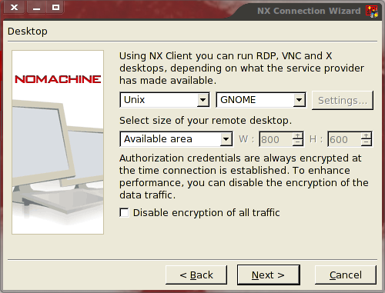
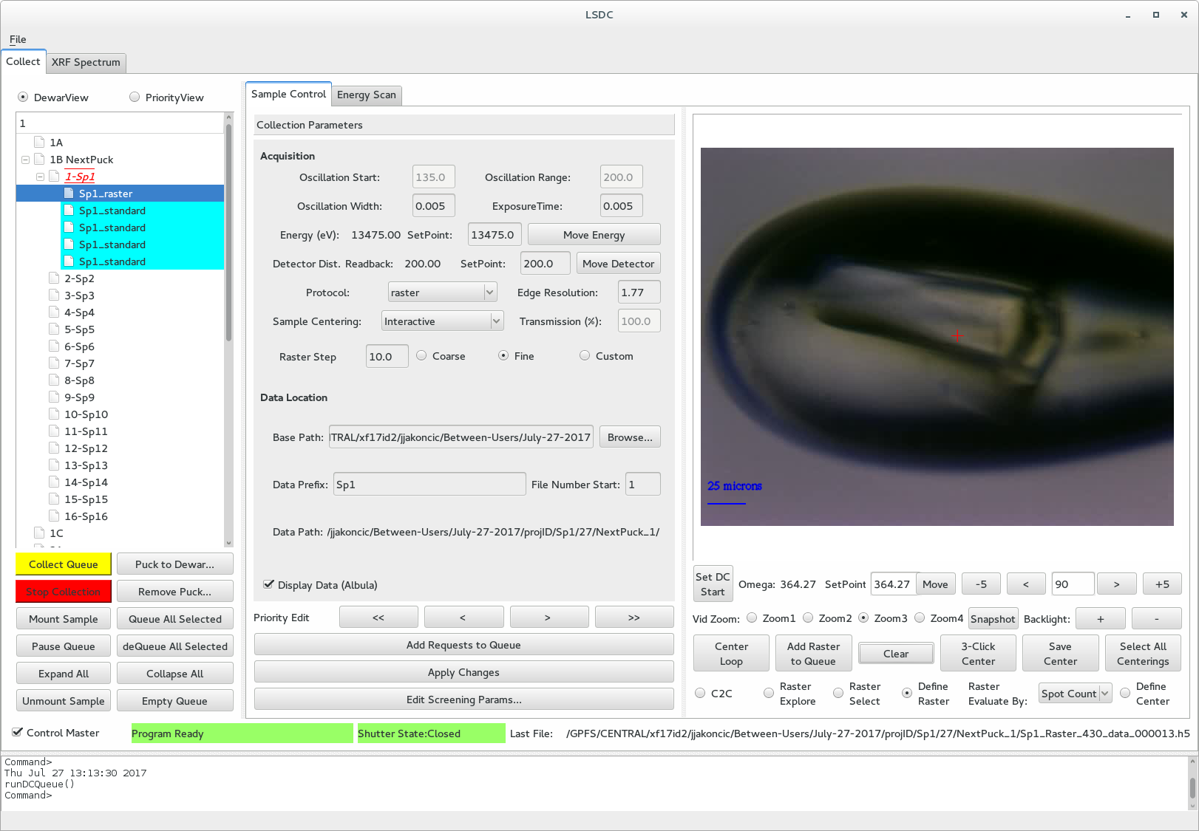
NX – No Machine

Slide 16
High rate
Anticipate a rapid take up – 70% is typical
Mail in Science

Slide 17
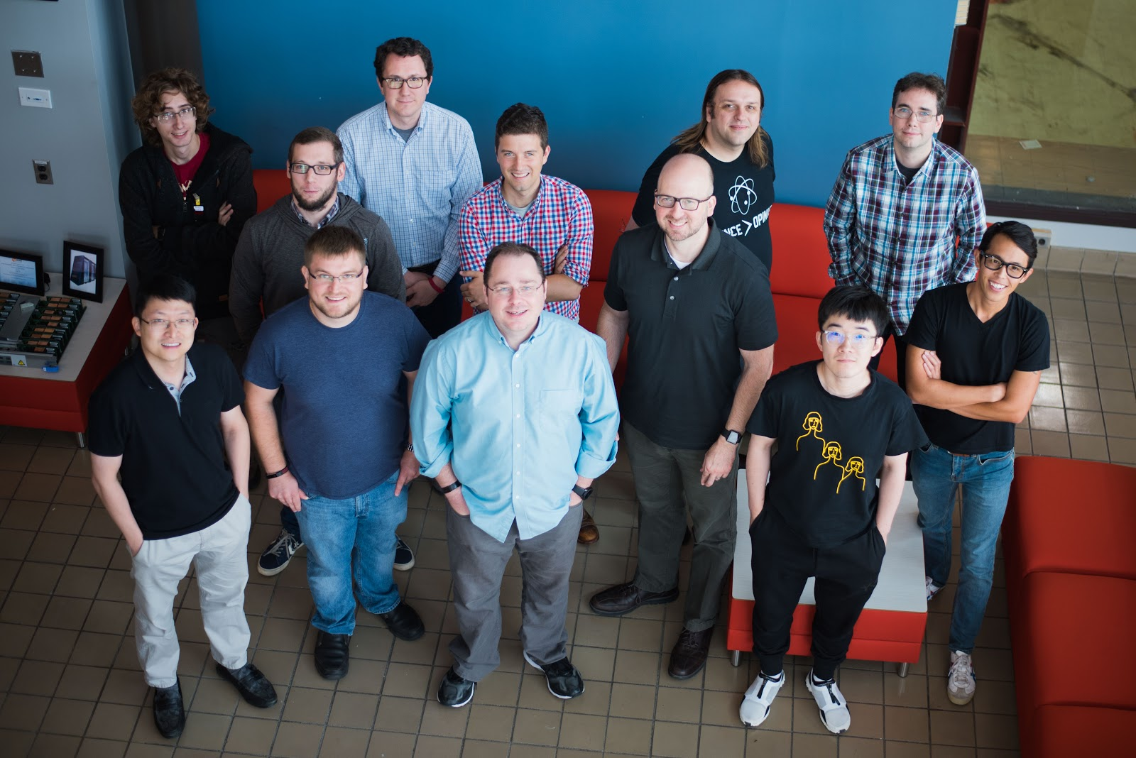
DAMA
Bluesky collaboration is working well, contributions from outside collaborators (APS, SLAC) are increasing.
APS/NSLS-II collaboration is working well. Initial focus on XPCS, kicking off fluorescence mapping soon.
New versions of bluesky suite released and deployed.
Contributions from SLAC in GUI “space”
The ExFaC Data Management Coordination Meeting and Hack-a-thon, August 13 - 17, 2018, at Brookhaven National Laboratory, Group Photo.

Slide 18
GPFS – Seamless (But not yet)
At each Beamline – 30 + NSLS-II - Weeks
Migrate to NSLS-II Central Storage - Months
Migrate to CSI/Other - Years

Slide 19
DATA needs
The highest priority needs for NSLS-II data needs are: (1) build-out of computational and data storage resources that are sufficient to meet the facility requirements. These resources will be a combination of local resources at NSLS-II and remote resources; (2) seamless remote access of user data and analysis resources for post-experiment data analysis; (3) advanced experimental steering and feedback; (4) on-demand access to computing facilities for real-time data analysis; and (5) data management workflows that span across beamlines and facilities (both user and computing). The NSLS-II is working in close coordination with other BNL and BES facilities to meet these needs.

Slide 20
Estimated data rates for NSLS-II. The data rates for 2018 are behind projections due to the newness of the beamlines, but are expected to catch up to projections rapidly.

Slide 21
Upward growth in the amount of data produced by beamlines
We are presently experiencing a dramatic upward growth in the amount of data produced by beamlines. We expect this to continue as the beamlines mature into user operations. By the end of 2018, NSLS-II will have 28 beamlines in operations with room to develop another ~30 beamlines. Although this latter will be a longer-term development, any architecture and solution that is implemented will need to be scalable to deal with such a fully instrumented facility. Further, in the near to medium term (1-5 years), all the current NSLS-II beamlines have plans to upgrade and expand their detector systems. This will drive another jump in the requirements for storage, network and compute infrastructure and systems.
NSLS-II is currently performing a detailed analysis of its computational needs for the next decade. In order to provide an indication on the current level that is required, we show here examples for three beamlines covering different techniques:

Slide 22
The FXI imaging beamline will generate between 3 and 30 TB/day depending on the collection mode. Processing a single tomographic reconstruction in a short amount of time (< 1 minute) will require approximately 0.5 PFLOP of processing power.
The CHX XPCS beamline currently has a raw data rate of ~1 TB/day. In order to process 10 minutes’ worth of data collection, we require 42 TFLOPS of processing to match the processing time to the data collection time of 10 minutes. These numbers are in fact lower bounds as the beamline already has detector systems that will increase the data rate by a factor of 10. Further, there is a project to develop a new detector system (VIPIC), this will be capable of producing a data rate of 800 TB/day (1-3 years).
The HXN nanoprobe beamline produces an average of 12 TB/day. Currently this data is processed locally using a server with 4 GPU cards. In the 1-3 year time scale it is intended to increase the number of data points by 2 orders of magnitude, which will require a significant increase in computational resources, likely to be in the single to double digit PFLOP range.

Slide 23
Remote Access
Some beamlines are being prepared to

