Slide 1
2018 mRICH Beam Test Report June 24 – July 7, 2018, at Fermilab
The team members
INFN Group: Marco Contalbrigo, Luca Barion, Vincenzo Lucherini
Hawaii Group: Gary Varner, Isar Mostafanezhad, Tommy Lam
GSU Group: Xu Sun, William Roh, Sawaiz Syed, Xiaochun He

Slide 2
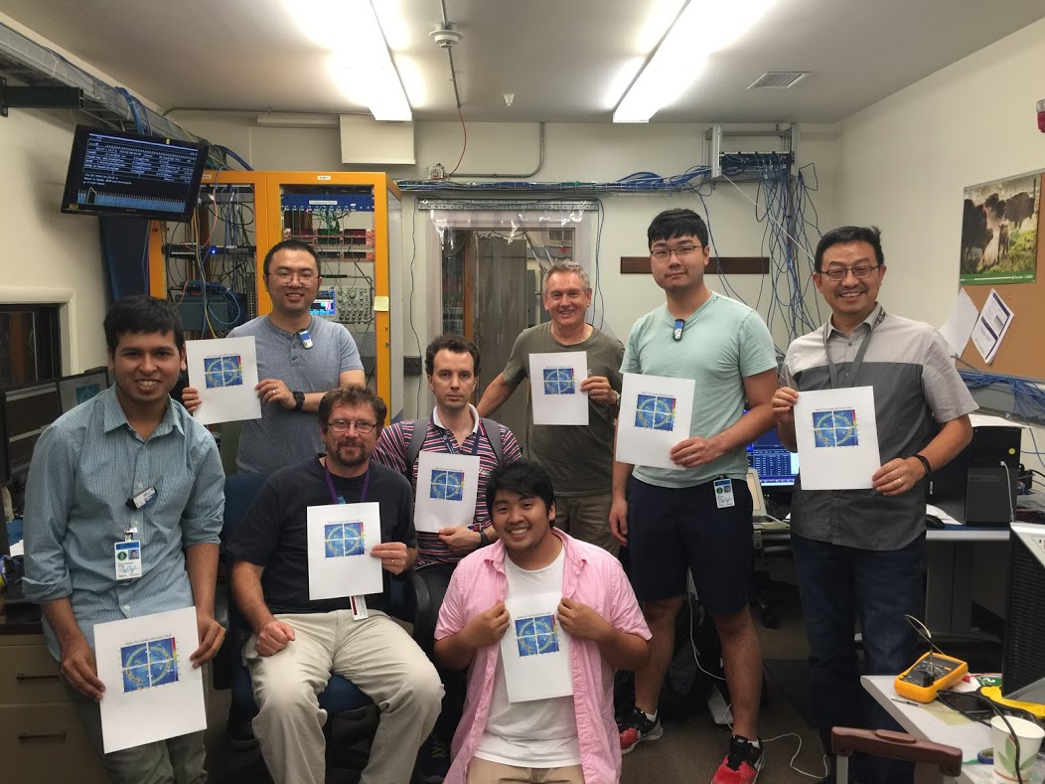
Group Photo
Missing member: Gary and Isar

Slide 3
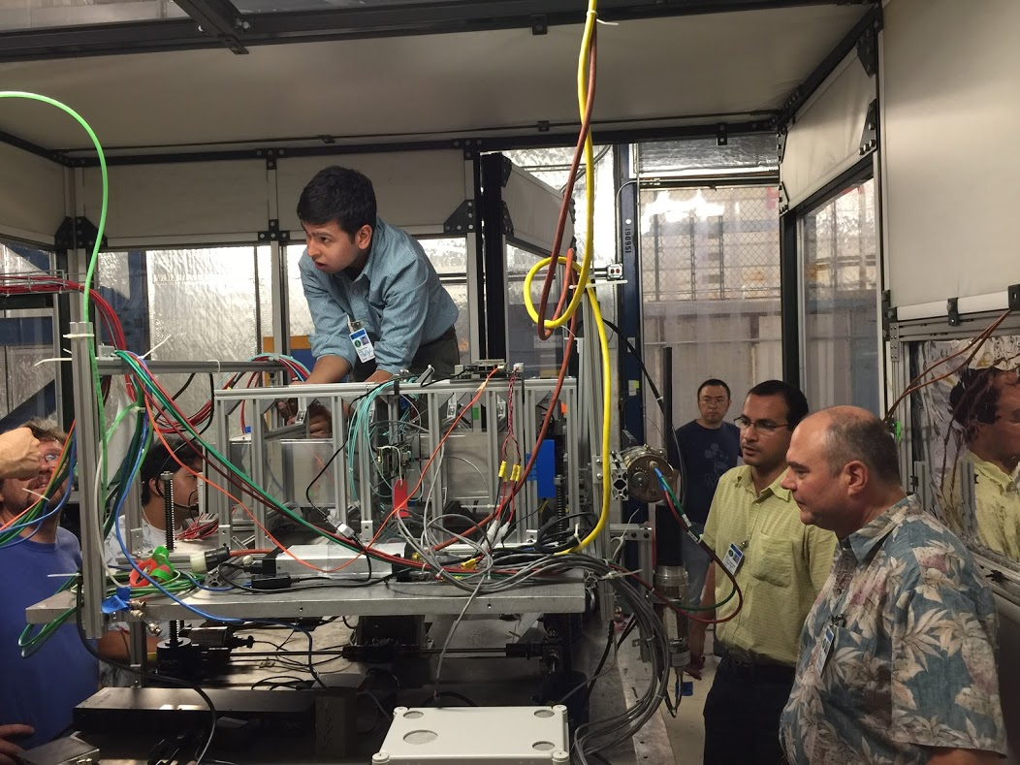
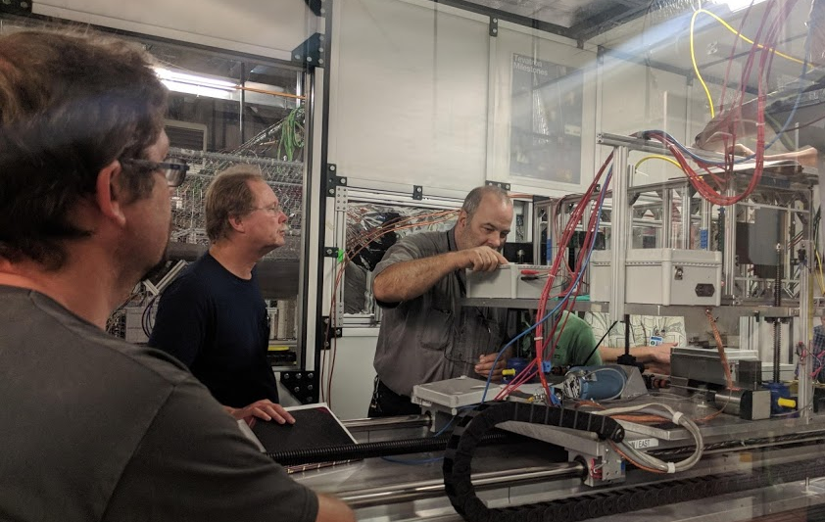
Test Setup
Safety Inspection

Slide 4
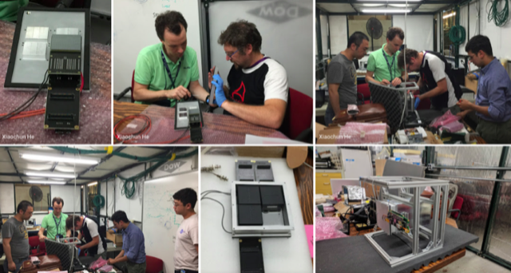
Readout H13700 MAPMTs

Slide 5
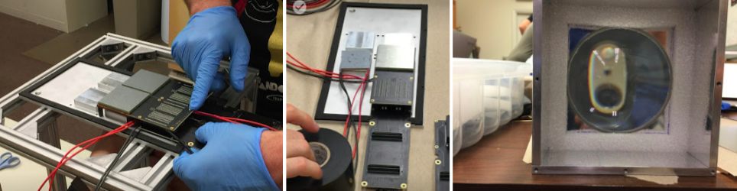
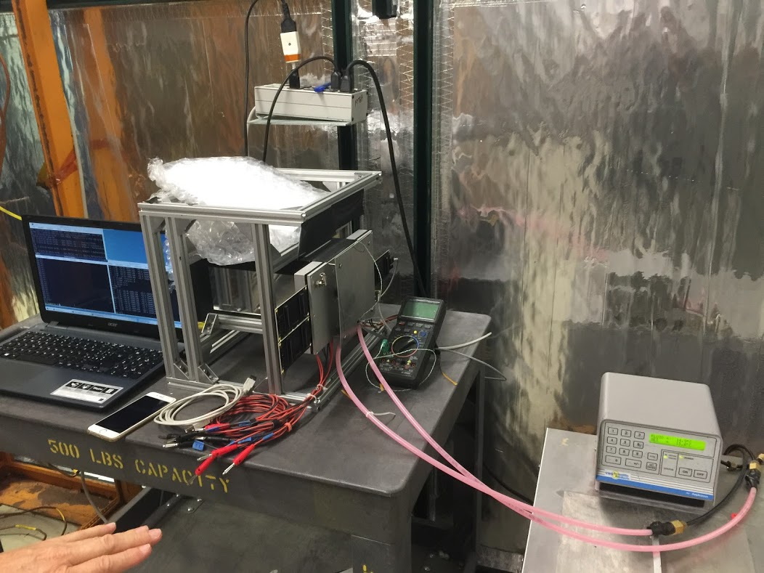
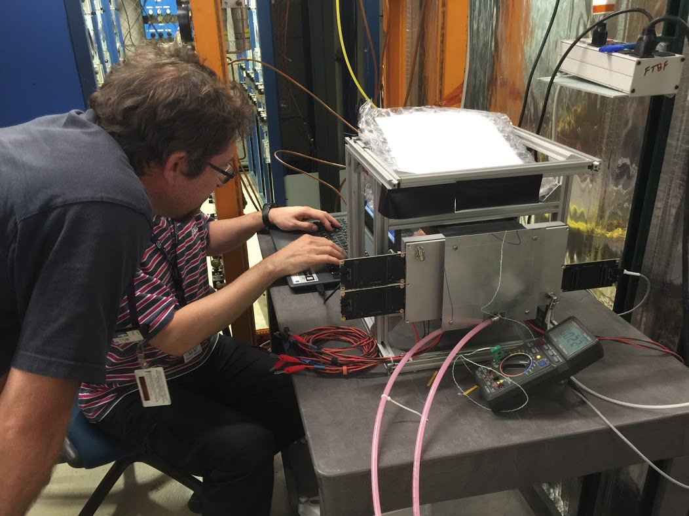
SiPM Matrix Readout
SiPM readout cooling setup test

Slide 6
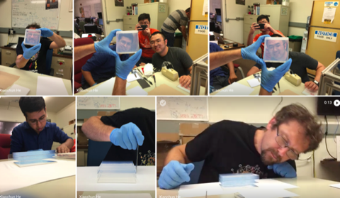
Stacking Aerogel Blocks

Slide 7
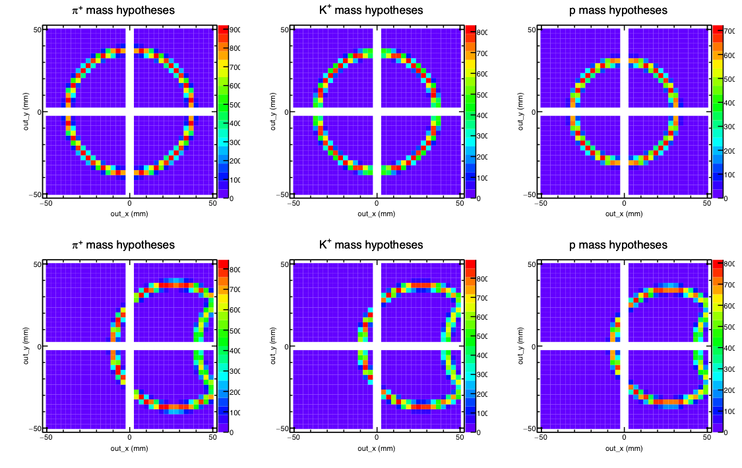
Expectation from Geant4 Simulation
5 GeV/c particles incident
at center at 0 degree angle
5 GeV/c particles incident
at center at 10 degree angle

Slide 8
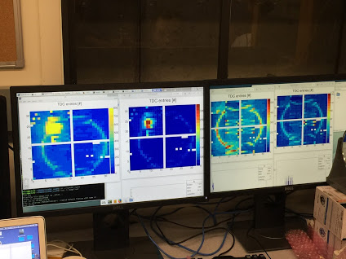
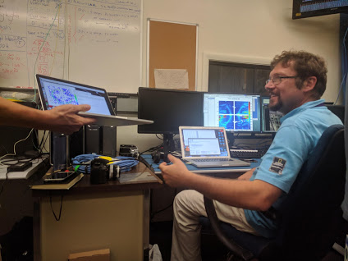
mRICH alignment and image search

Slide 9
Ring Image from 120 GeV/c primary proton beam incident at the center (Preliminary)
120 GeV/c
proton
Still need to verify the pixel mapping

Slide 10
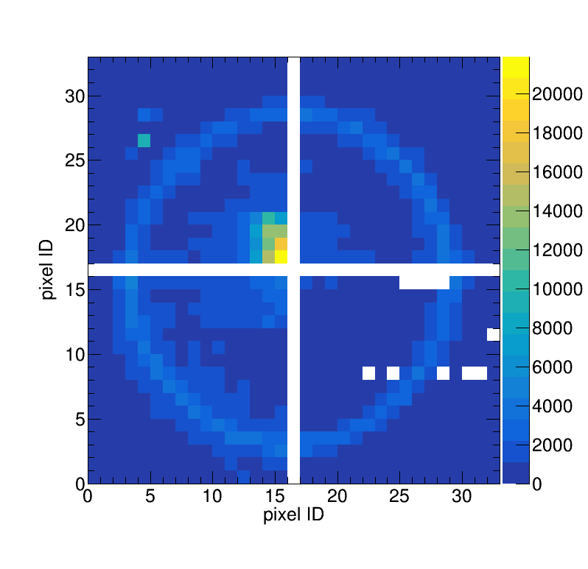
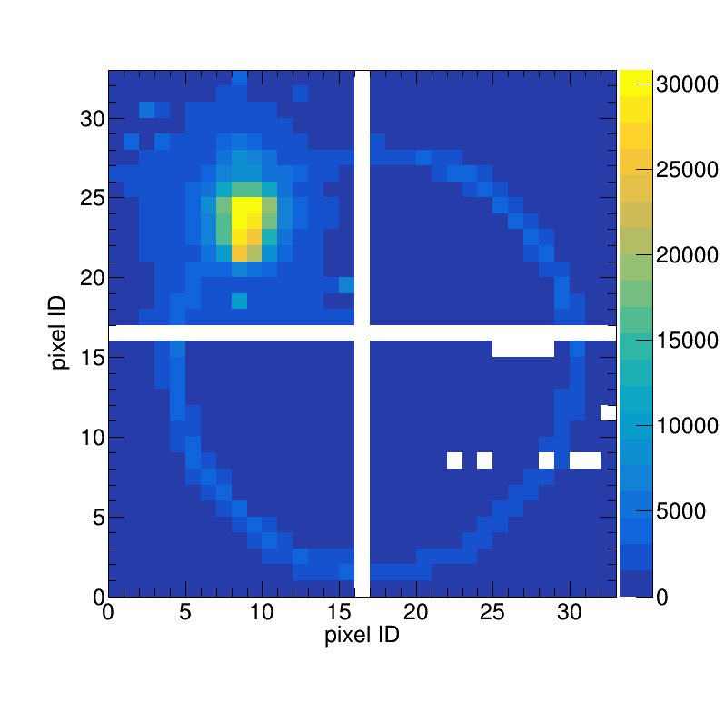
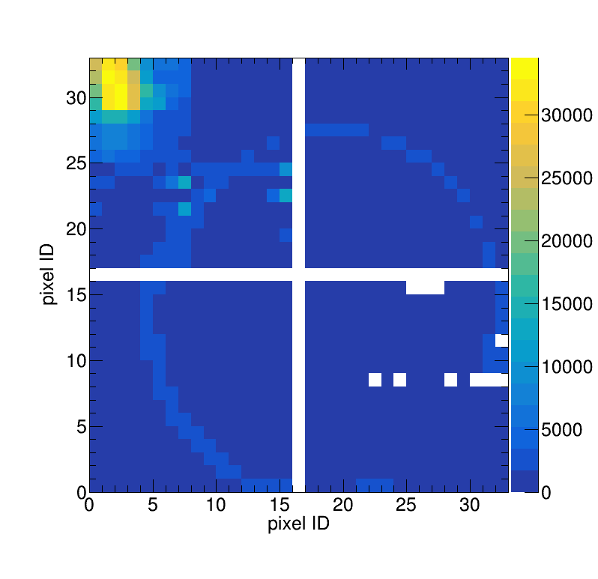
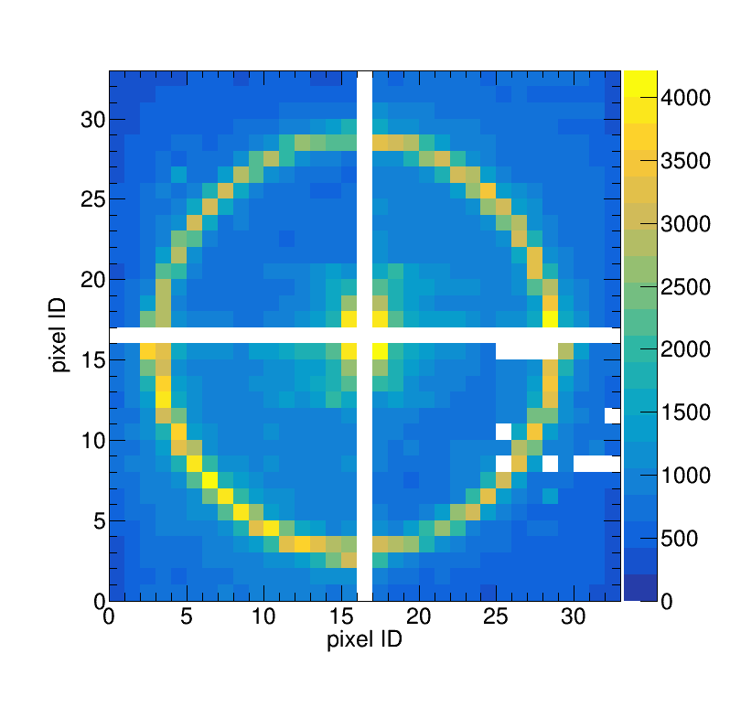
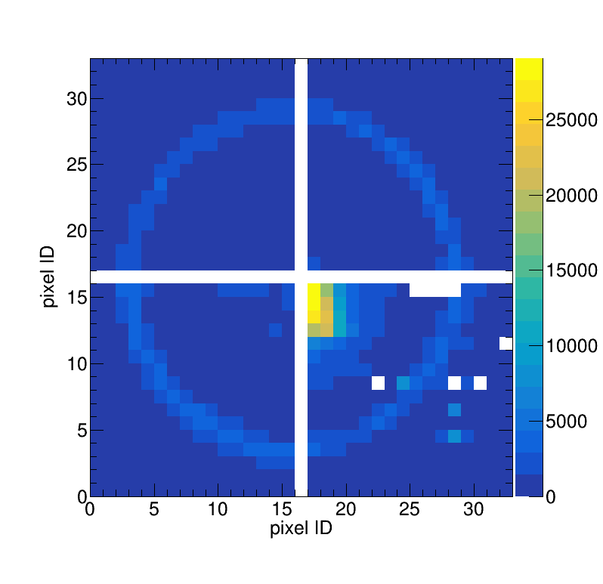
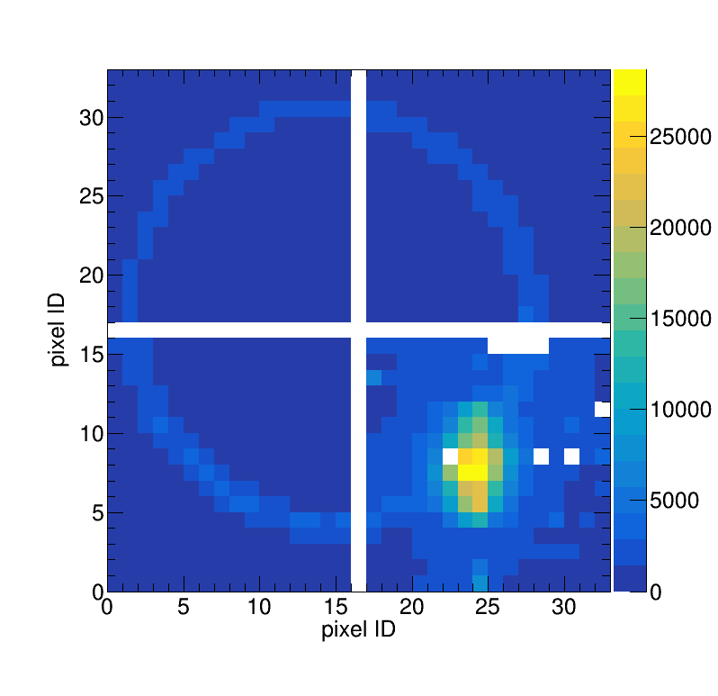
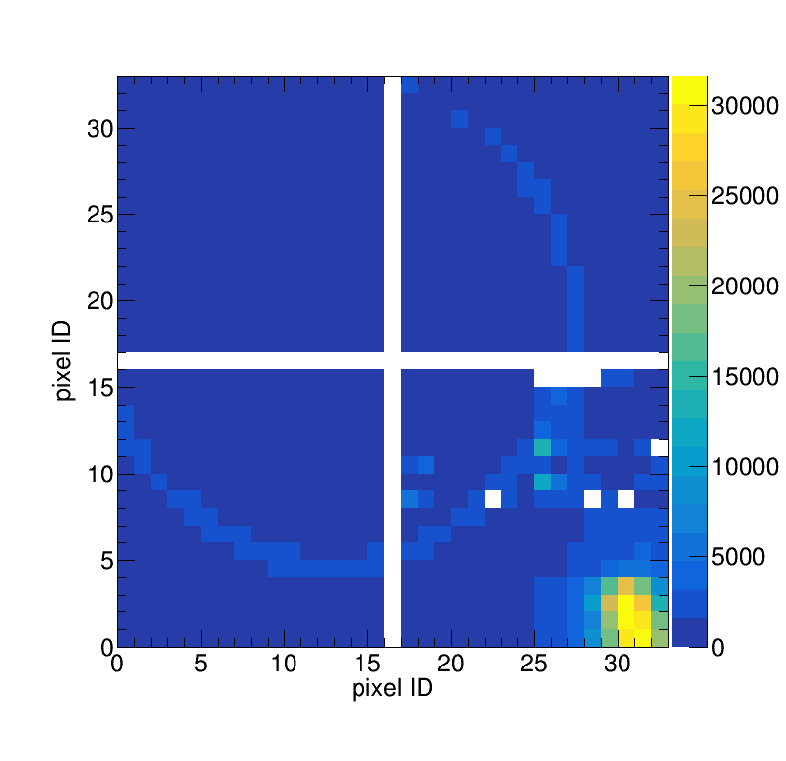
Position scans with 120 GeV/c proton beam
High counts regions
are the beam spots.

Slide 11
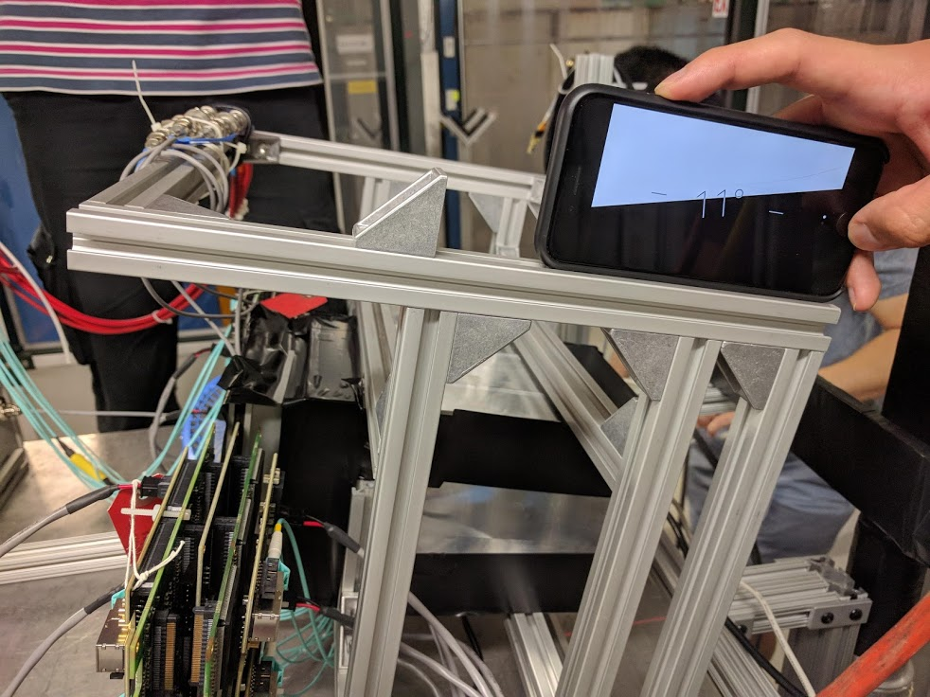
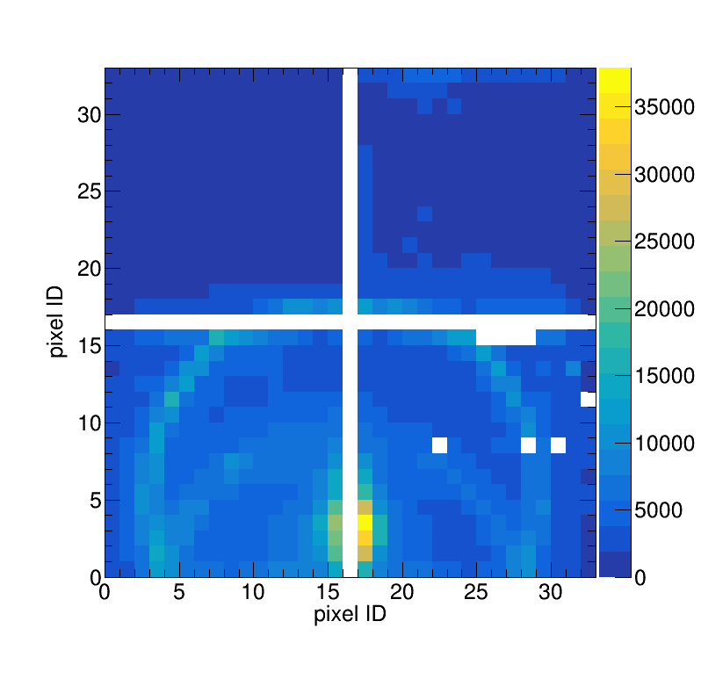
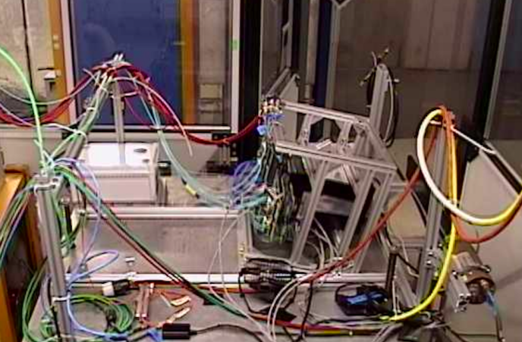
Ring image from proton beam at an angle (11⁰)
11 degree tilt
downward
120 GeV/c proton beam
Beam spot

Slide 12
mRICH readout with SiPM matric sensors
Only 3 sensors modules available
temp at 0 degree
temp at -30 degree. Beam position: 536.4mm (H)
166.3mm (V)
120 GeV/c proton Incident at center
Beam spot

Slide 13
Data Set
(each run has 50k events)
~590 runs with the primary proton beam at 120 GeV/c
For detector alignment studies
For exploring ring image characteristics with beams incident at difference regions of mRICH, including hreshold scans.
21 runs with 8 GeV/c meson beam
13 runs with 5 GeV/c meson beam
4 runs with 2 GeV/c meson beam
~280 runs with SiPM array readout with 120 GeV/c proton beam (position, temperature and threshold scans).

Slide 14
Summary and To-Do
The 2018 mRICH beam test is very successful.
Data QA has started. Data analysis and simulation comparison will be led by Xu Sun (together with Marco Contalbrigo and William Roh).
It is likely that we need to have another test with working beam hodoscope and K/pi beam triggers. To be determined.
Thanks go to everyone who contributed to this successful test one way or another. The support from the Fermilab FBTF staff members were superb.

