Slide 1
Modular aerogel RICH (mRICH)
Goal:
Compact PID device with momentum coverage up to 10 GeV/c for pi/K and e/pi up to 2 GeV/c.
First aerogel RICH with lens-based focusing (for performance and cost)
FY 19:
Analyze the 2nd mRICH test beam data taken from June 25 to July 6, 2018.
Publish the new results from this test and make plan for the 3rd beam test if it is necessary.
Use the mRICH to develop an integrated readout electronics solution.
Search for radiation hard materials for Fresnel lens.
Optical characterization of Fresnel lens and aerogel.

Slide 2
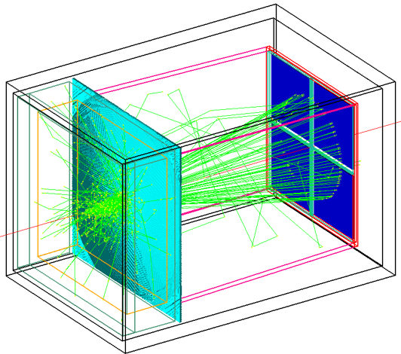
mRICH – lens-based focusing aerogel detector design
Smaller, but thinner ring improves PID performance and reduces length
Fresnel lens
Lens-Based mRICH Design |  | 9GeV/c pion beam launched at the center of xy plane in simulation Smaller and thinner ring image
Two-Layer Proximity Focusing Design (BELLE-2 ARICH) |  | EIC mRICH designed for K/pi ID up to 10 GeV/c BELLE-2 ARICH aims to separate pion and kaon up to 4 GeV/c
Aerogel
Sensor plane
9 GeV/c pion beam launched at the center of xy plane in simulation
Notes:
The modular RICH detector consists of a block of aerogel, Fresnel lens, mirror set and sensor plane.

Slide 3
mRICH – lens-based focusing aerogel detector design
Smaller, but thinner ring improves PID performance and reduces length
Lens-Based mRICH Design |  | 9 GeV/c pion beam launched at the center of xy plane in simulation Smaller and thinner ring image
Two-Layer Proximity Focusing Design (BELLE-2 ARICH) |  | EIC mRICH designed for K/pi ID up to 10 GeV/c BELLE-2 ARICH aims to separate pion and kaon up to 4 GeV/c
9 GeV/c pion beam launched at the center of xy plane in simulation
Notes:
This lens-based design generates smaller and sharper ring image compare to the state of art proximity focusing deisng.

Slide 4
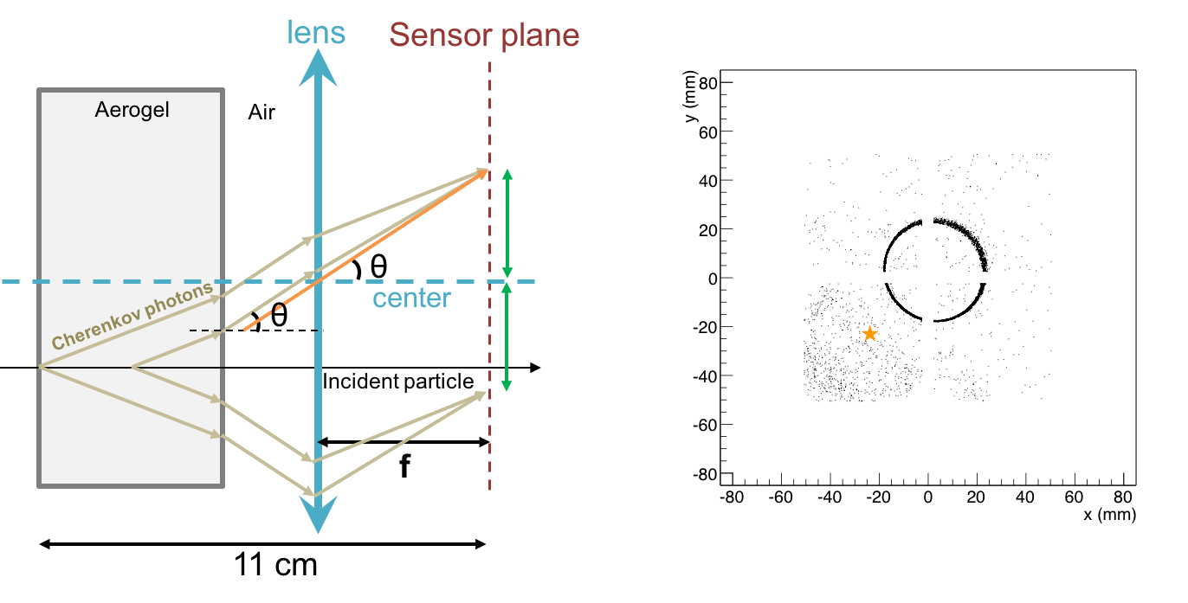
mRICH – lens-based focusing shifts image to center
Ring centering of lens-based optics reduces sensor area (main cost driver)
Lens-Based mRICH Design |  | 9 GeV/c pion beam incident at third quadrant (star) in simulation Ring image is center on the middle of the sensor plane
Two-Layer Proximity Focusing Design (BELLE-2 ARICH) |  | 9 GeV/c pion beam incident at third quadrant (star) in simulation Ring is centered at point of incidence
Notes:
Furthermore, the Cherenkove photons generated at off the optical principle can be shifted to the middle of sensor plane by the lens. These results to less required sensor plane area.

Slide 5
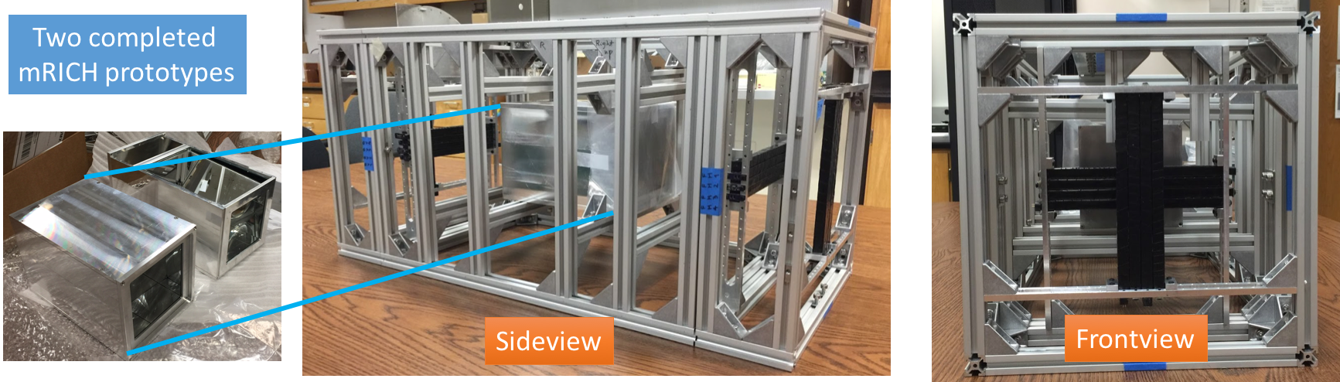
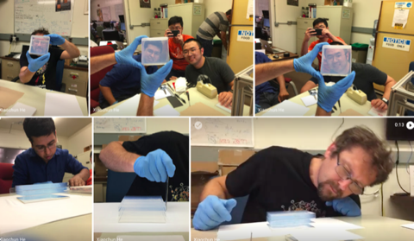
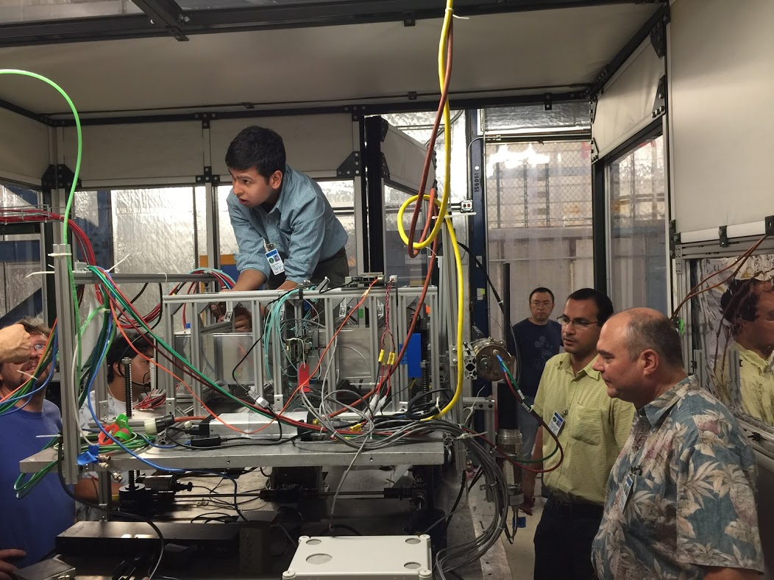
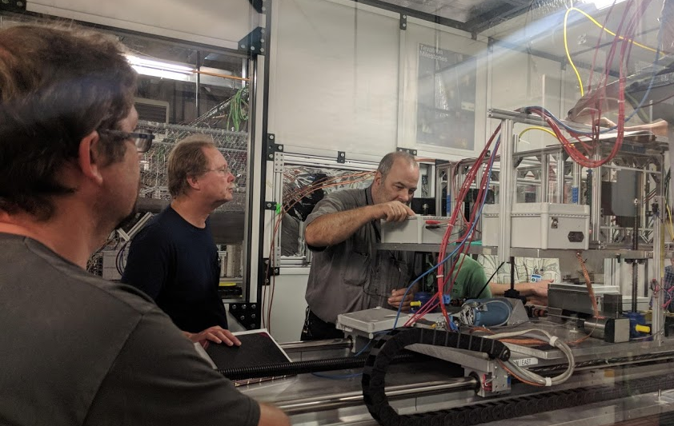
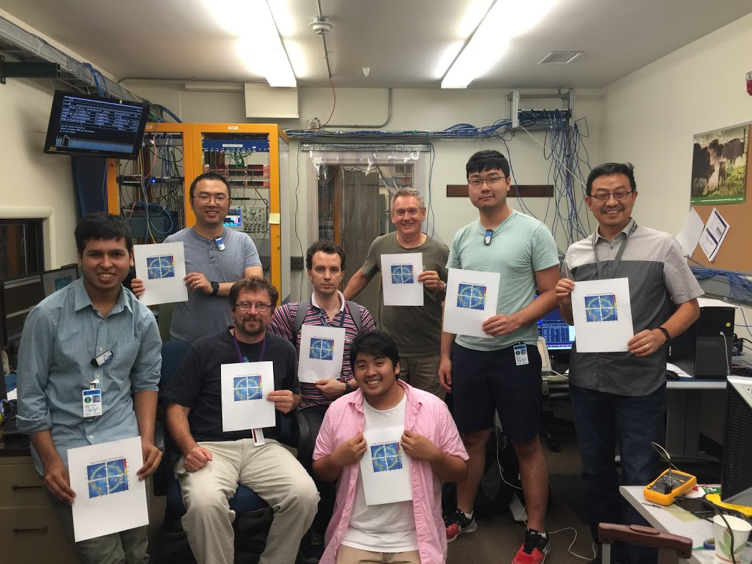
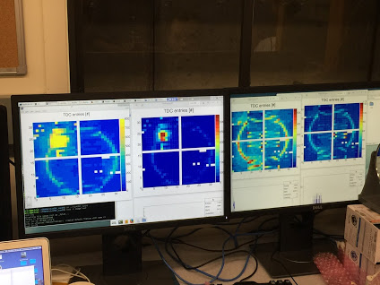
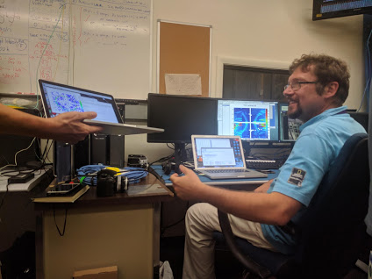
mRICH – FY18 progress (part one)
Another very successful mRICH prototype beam test at Fermilab (6/25 to 7/6/2018)
Group photo (missing two members)
– the first confirmed ring image
Notes:
The first beam test results from last fiscal year will be published in NIM A.

Slide 6
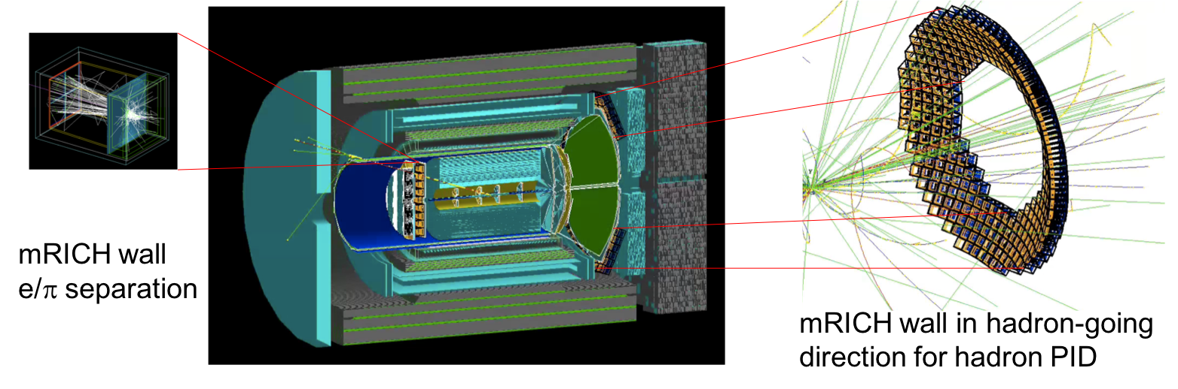
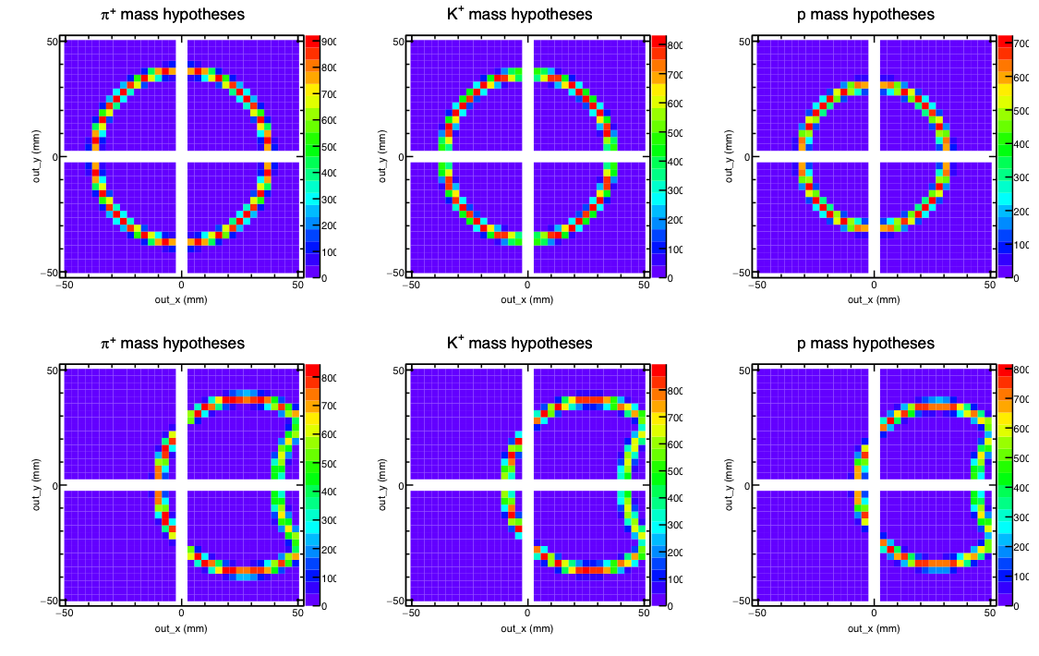
mRICH – FY18 progress (part two)
mRICH array implementation in Forward sPHENIX and JLab EIC detector concept in Geant4 simulation studies. Developed mRICH-based PID algorithms using a loglikelihood method.
Examples of ring image patterns generated from Geant4 simulation for 5 GeV/c pi, K and proton, which are used in the loglikelihood PID method.
Upper row: incident at center at 0⁰ angle
Lower row: incident at center at 10⁰ angle

Slide 7
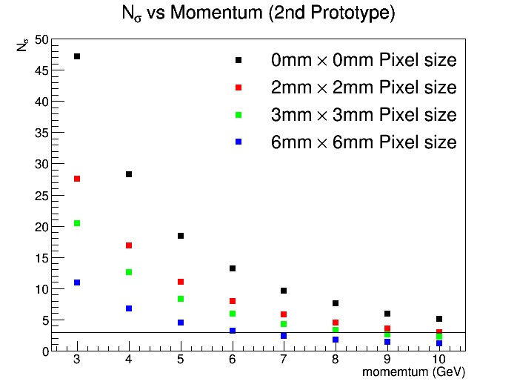
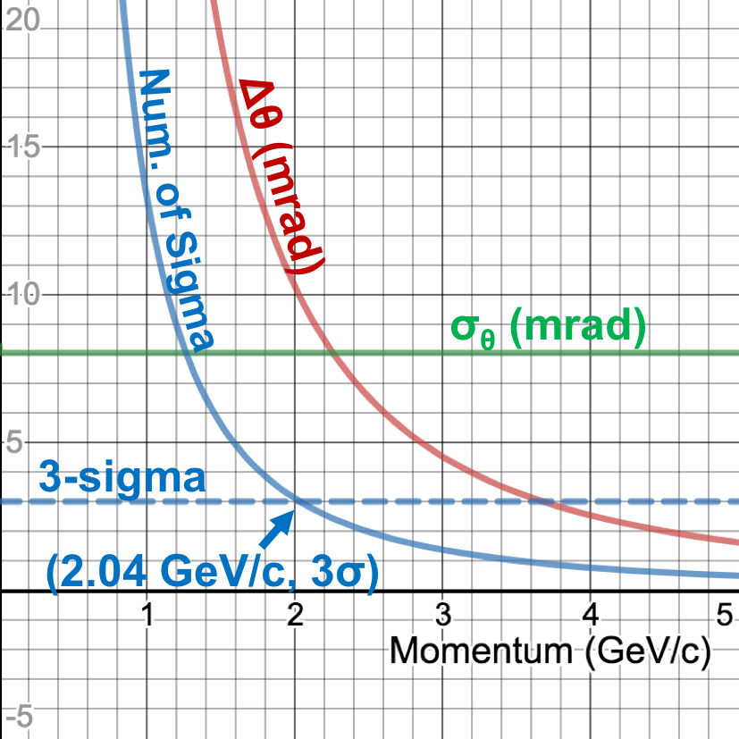
mRICH – FY19 activity (part one)
Data analysis of the 2nd mRICH beam test and publish the new results – verify the PID performance at 2, 5 and 8 GeV/c
Projected K/pi separation of mRICH 2nd prototype detector (Green dots)
2nd prototype detector can achieve 3-sigma K/pi separation up to 8 GeV/c
Projected e/pi separation of mRICH 2nd prototype detector (blue solid line)
2nd prototype detector can achieve 3-sigma e/pi separation up to 2 GeV/c
Data sets taken during the second mRICH beam test at Fermilab in 2018

Slide 8
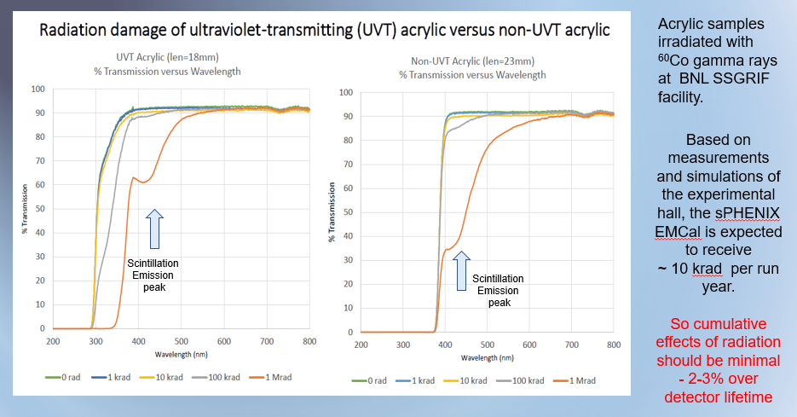
mRICH – FY19 activity (part two)
Study of the radiation hardness of Fresnel lens (i.e., address the committee concern!)
Simulation study of mRICH performance in the Forward sPHENIX experiment at BNL (ongoing effort).
Simulation study of mRICH performance in the electron endcap in JLEIC (ongoing effort).
Work with dRICH group to develop a plan for a join dRICH/mRICH beam test.
Presented by Sean Stoll at IEEE NSS 2017

Slide 9
Backup slides

Slide 10
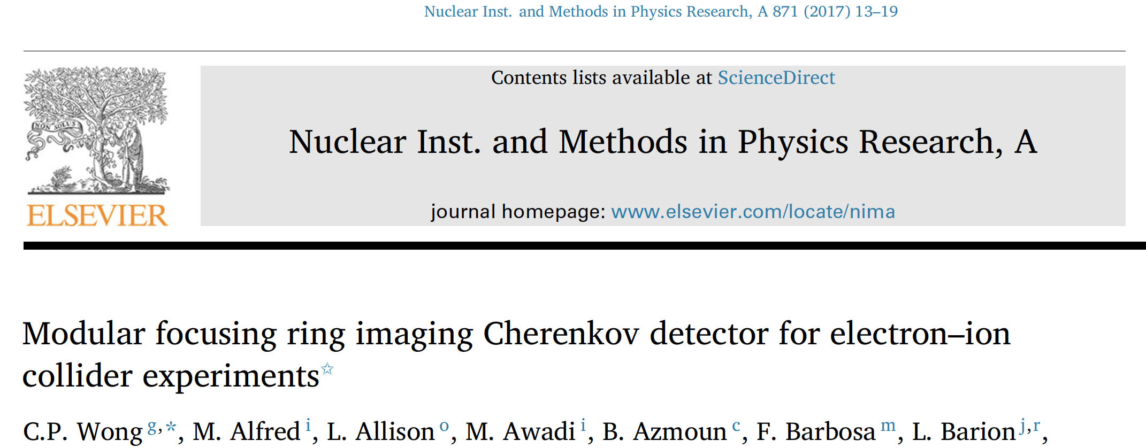
mRICH – FY17 progress
1st mRICH prototype results have been published in NIM A871, 13-19 (2017)
2nd mRICH prototype beam test is under preparation (PID validation test)
Notes:
The first beam test results from last fiscal year will be published in NIM A.

