Slide 1
LAPPDTM / MCP-PMT
Goal:
Adapt LAPPDTM to EIC requirements (magnetic fields, pixelated readout)
FY 18 Report:
6 cm MCP-PMT characterized in details in magnetic fields
20 cm LAPPD characterized in magnetic fields
Pixelated readout baseline tested in beamline
FY 19 Proposed tasks:
MCP-PMT after pulse study to better understand the ion feedback for LAPPD
Improvement of RMS timing by modifying the bias voltages
Produce a detector with 5μm pore size MCP and minimum spacing to further improve magnetic-field performance and fast timing (possibly <10 ps)
Test of MCP-PMT/LAPPD with different configurations (smaller pore size and reduced spacing) in lab and in a magnetic fields
Demonstration of capacitive-coupling pixelated readout through ALD coated glass

Slide 2
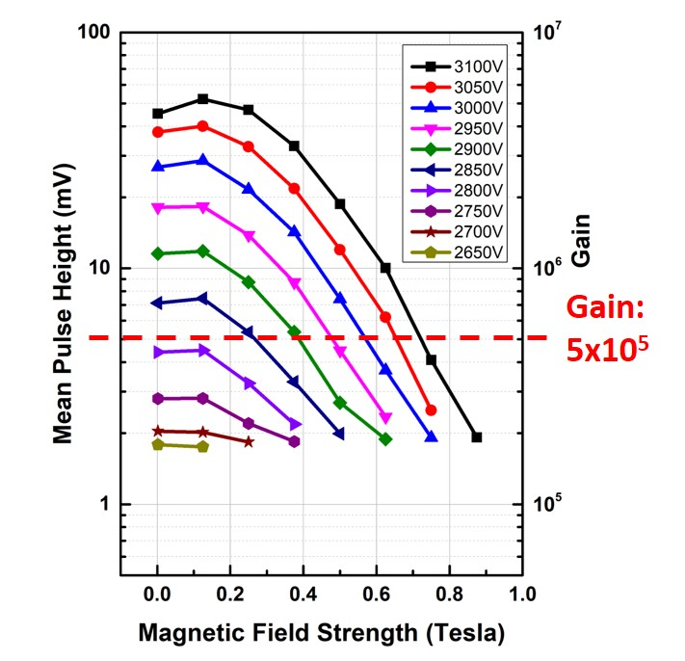
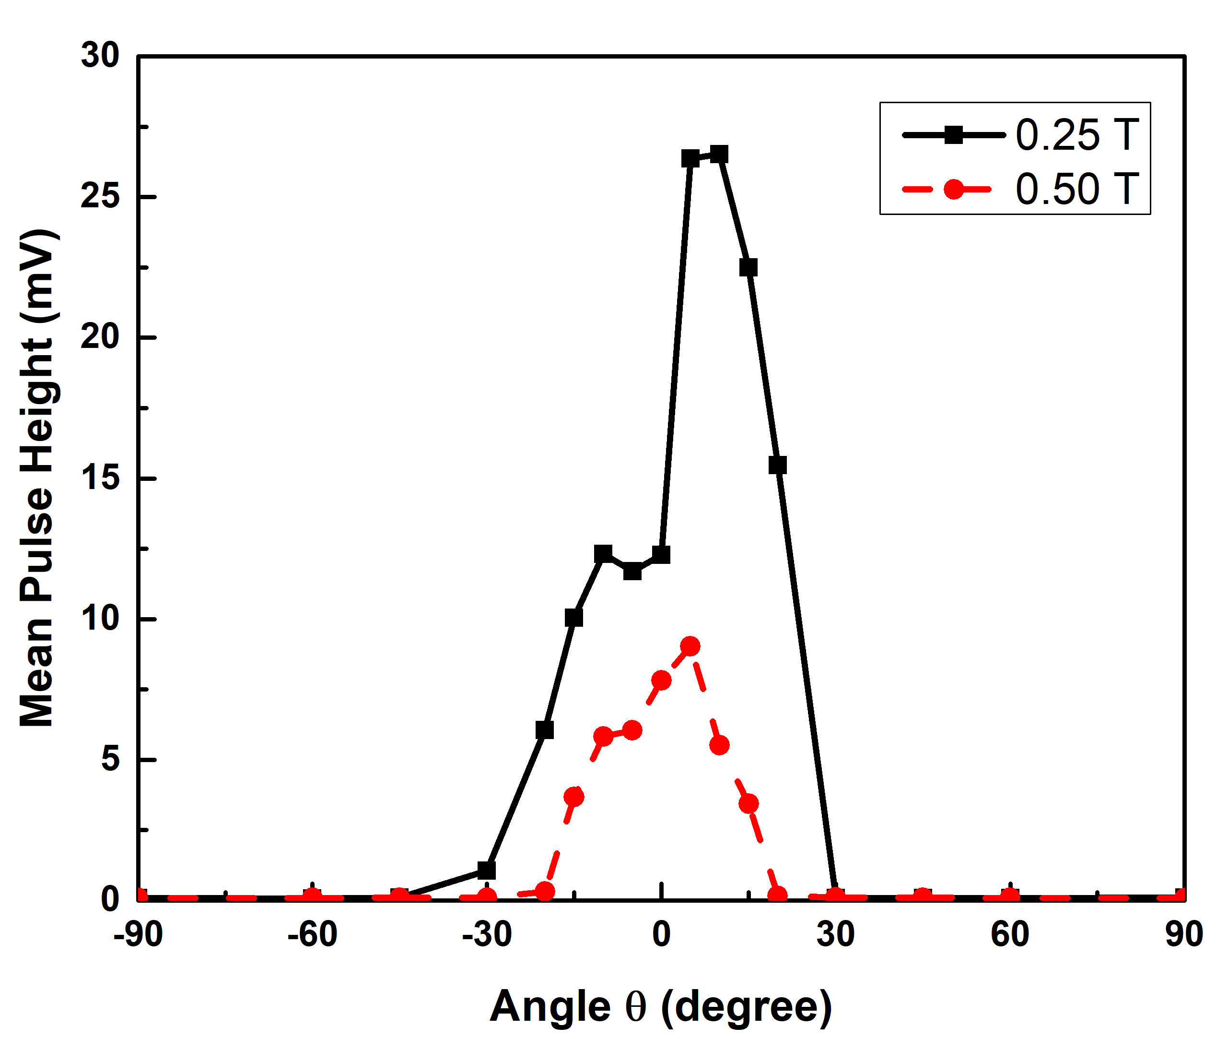
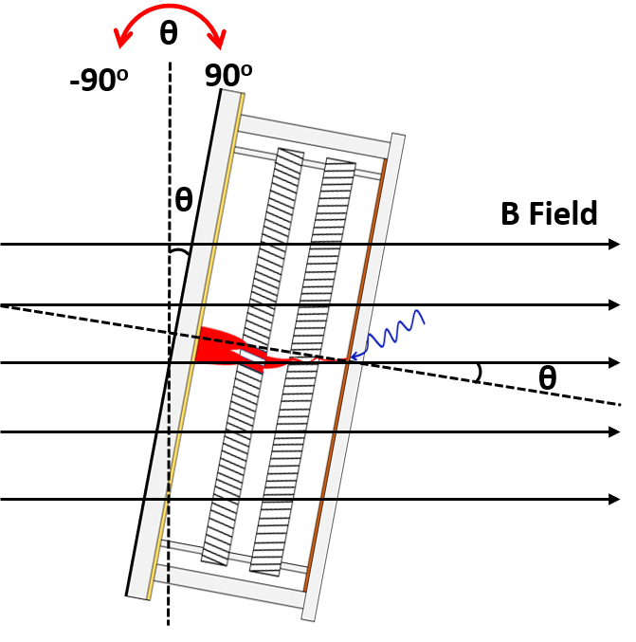
LAPPDs – Characteristics (6 cm ones) in magnetic fields
Independently biased design
θ = 0º
8º MCP bias angle
MCP-PMT characteristics in dependence of: Magnetic field strength, HV, tilt angle, and gap voltages were all tested in magnetic fields
Baseline tests show for a device with Gain > 5x10⁵ , Magnetic Field tolerance is 0.7 T
The MCP-PMT performance in magnetic field is clearly angle related, due to the 8º MCP bias angle, the highest gain is obtained around 8º.
Notice the two peaks around ±8º, indicating the effect from upper and lower MCP bias angles are different. Simulation is undergoing with collaborators to explain the different effect.

Slide 3
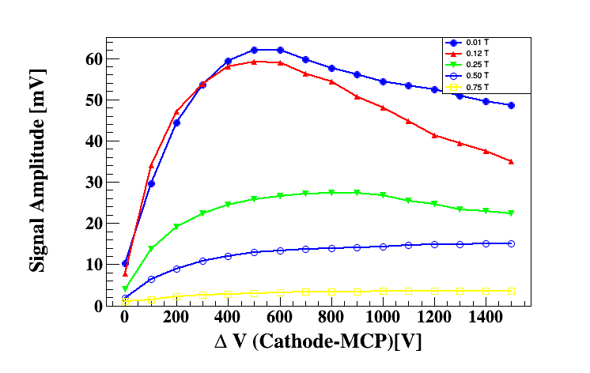
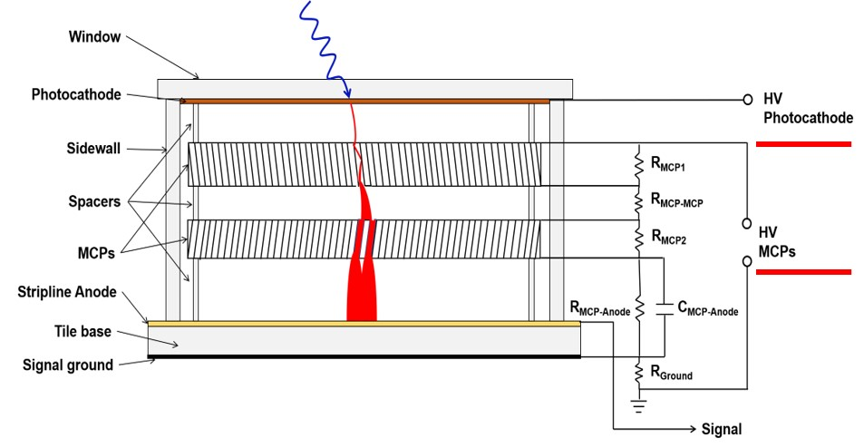
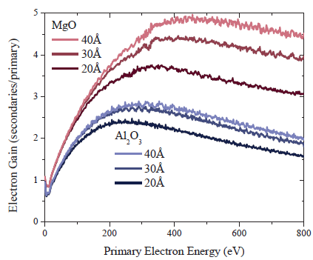
LAPPDs – Characteristics (6 cm ones) in magnetic fields
HV(MCPs) was fixed, varies the HV of first gap ΔHV(photocathode–top MCP) by adjusting HV (Cathode).
Gain increases as ΔHV increases to a maximum then decreases, this can be explained by the MCP gain dependence of primary electron energy.
Ref: S. Jokela et al. Physics Procedia 37 (2012) 740
MCP-PMTs design/operation in magnetic fields resulted in a SBIR phase 1 award (Incomand ANL, $150k for 9 months) to develop magnetic field tolerant LAPPDTM
(> 1.5 Tesla)

Slide 4
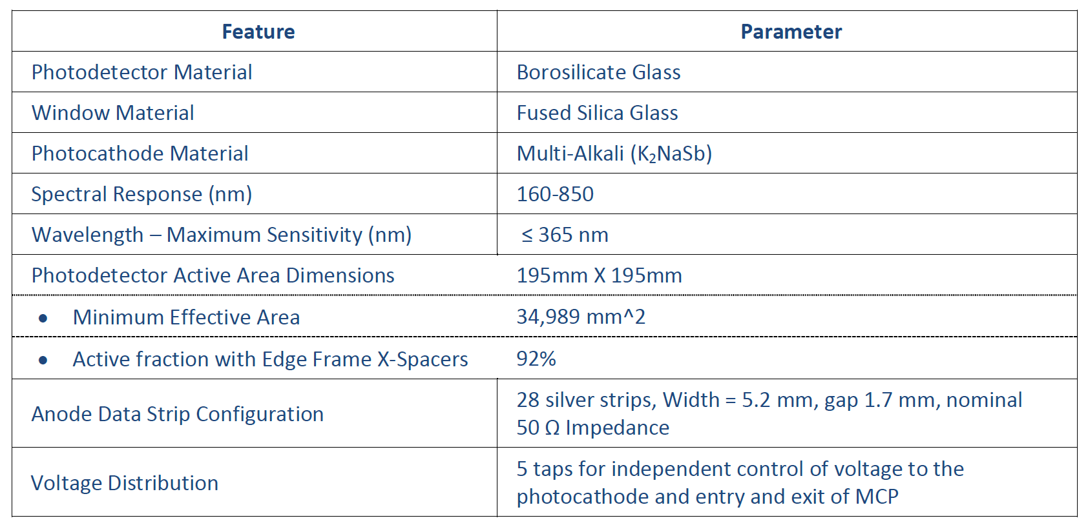
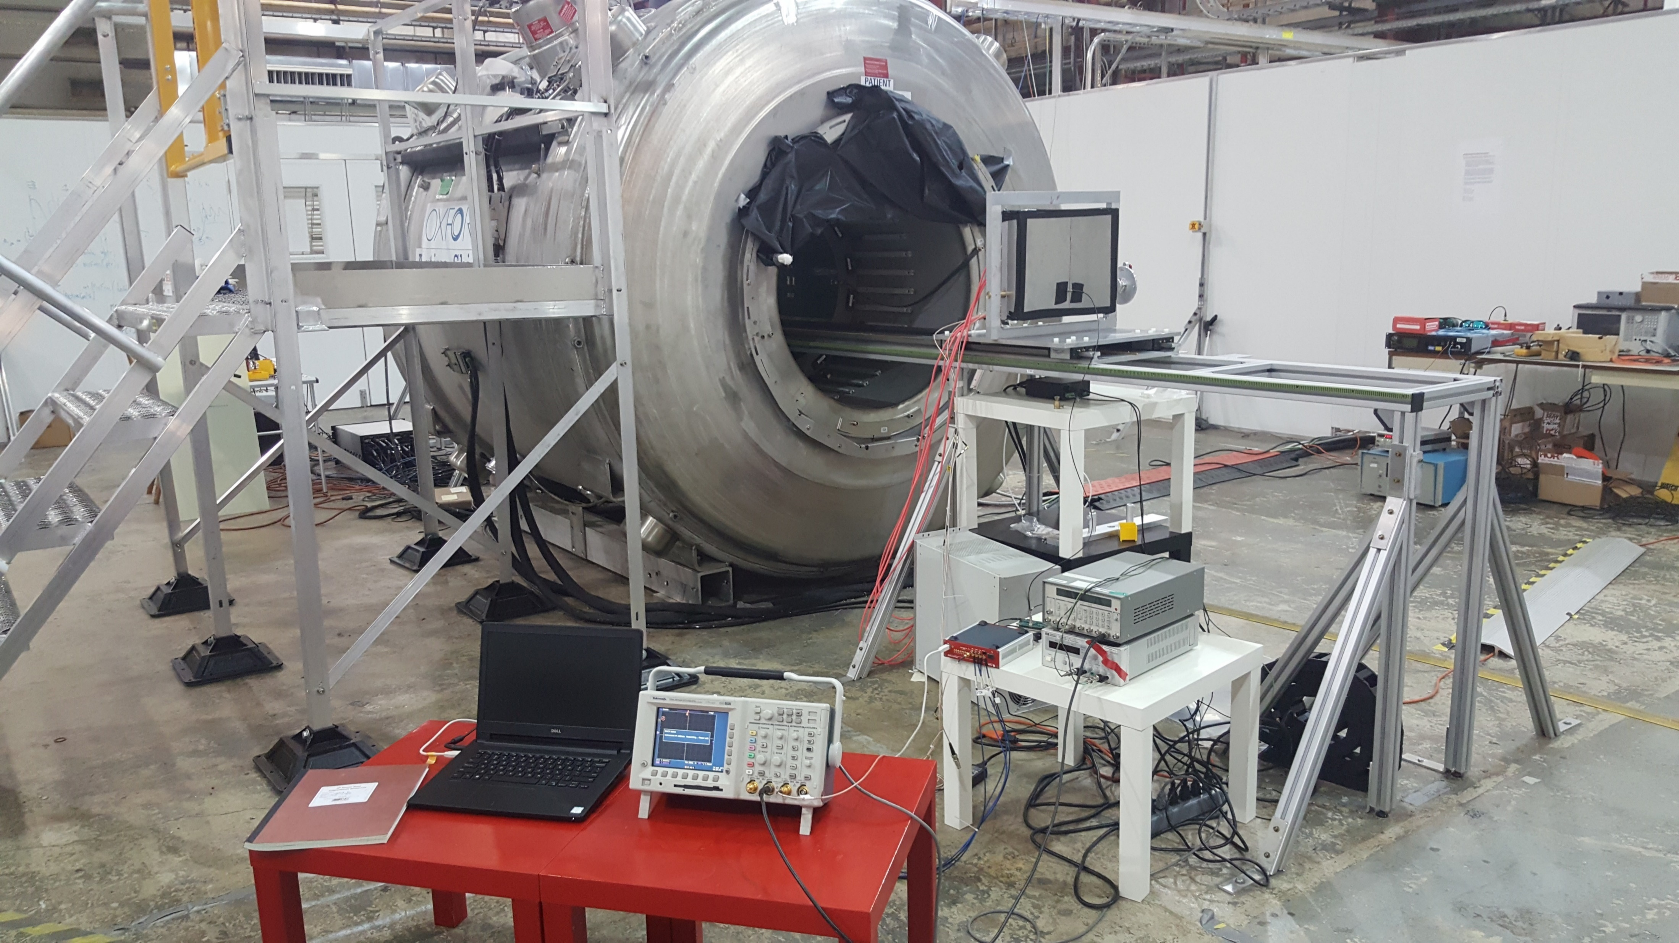
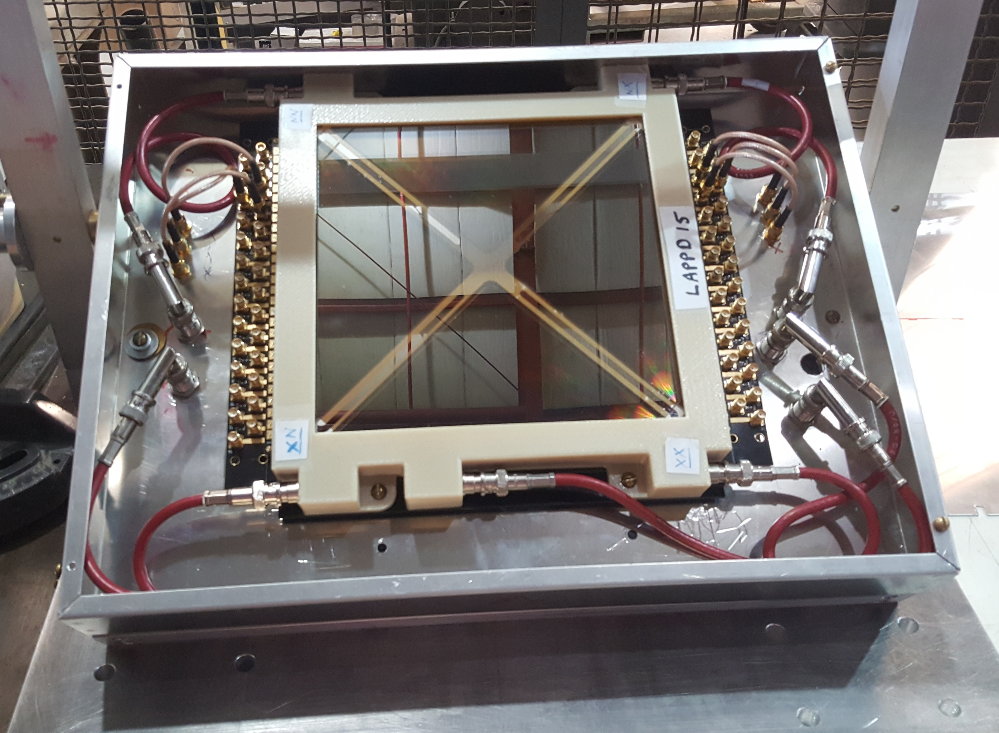
LAPPDs – Characteristics (20 cm) in magnetic fields
Commercial LAPPDTM delivered and installed at ANL B field facility
Pore size: 20 µm
Activation area: 195 mm x 195 mm

Slide 5

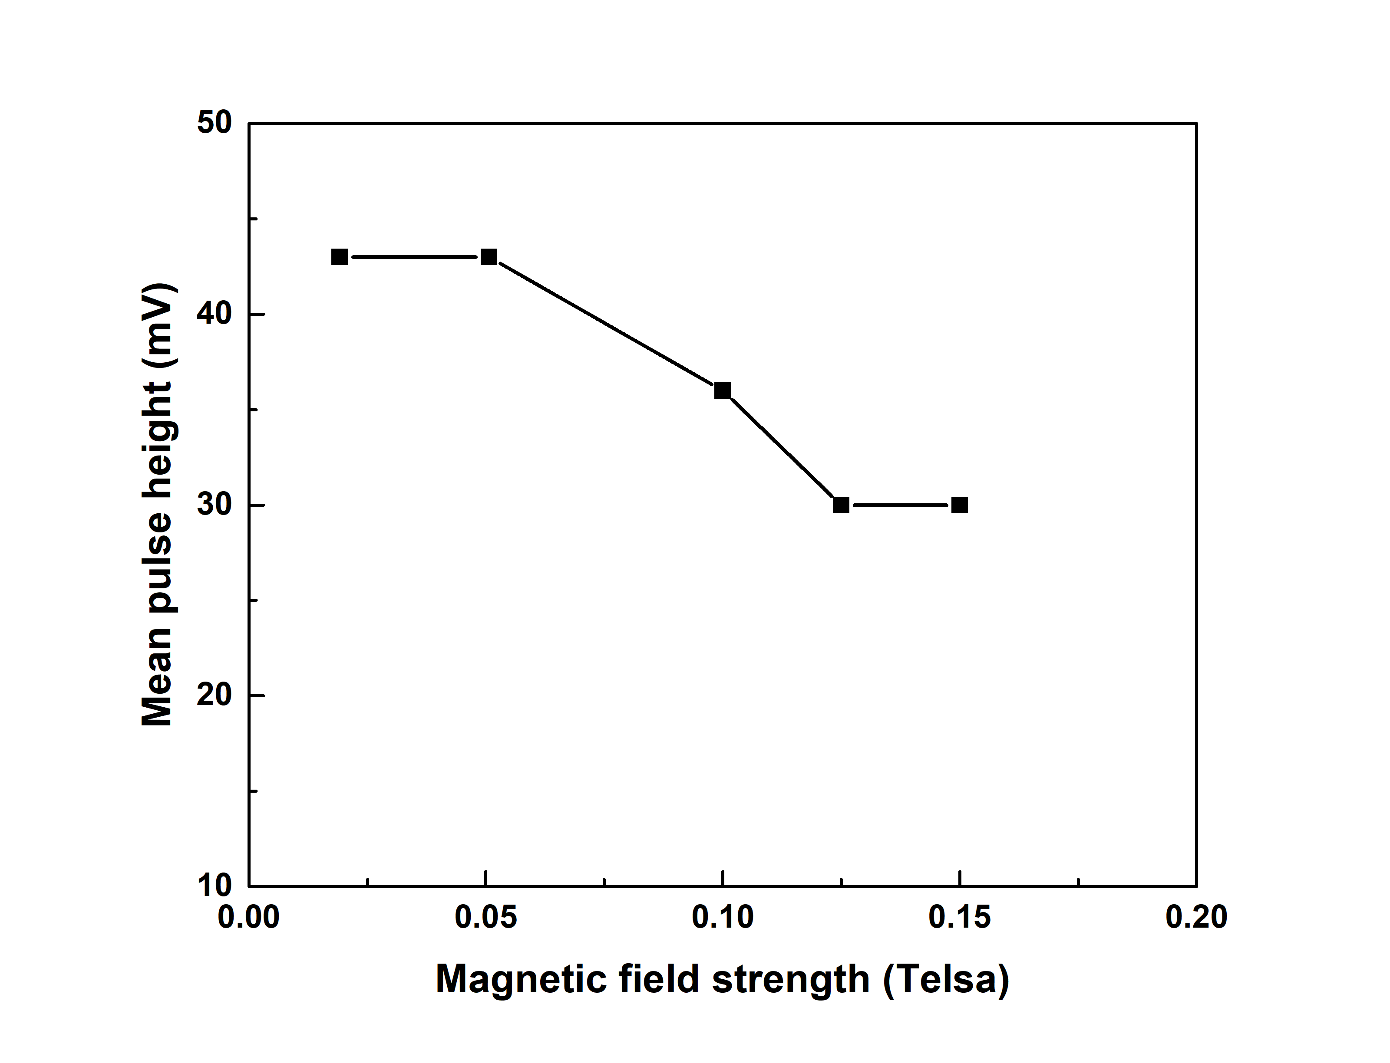
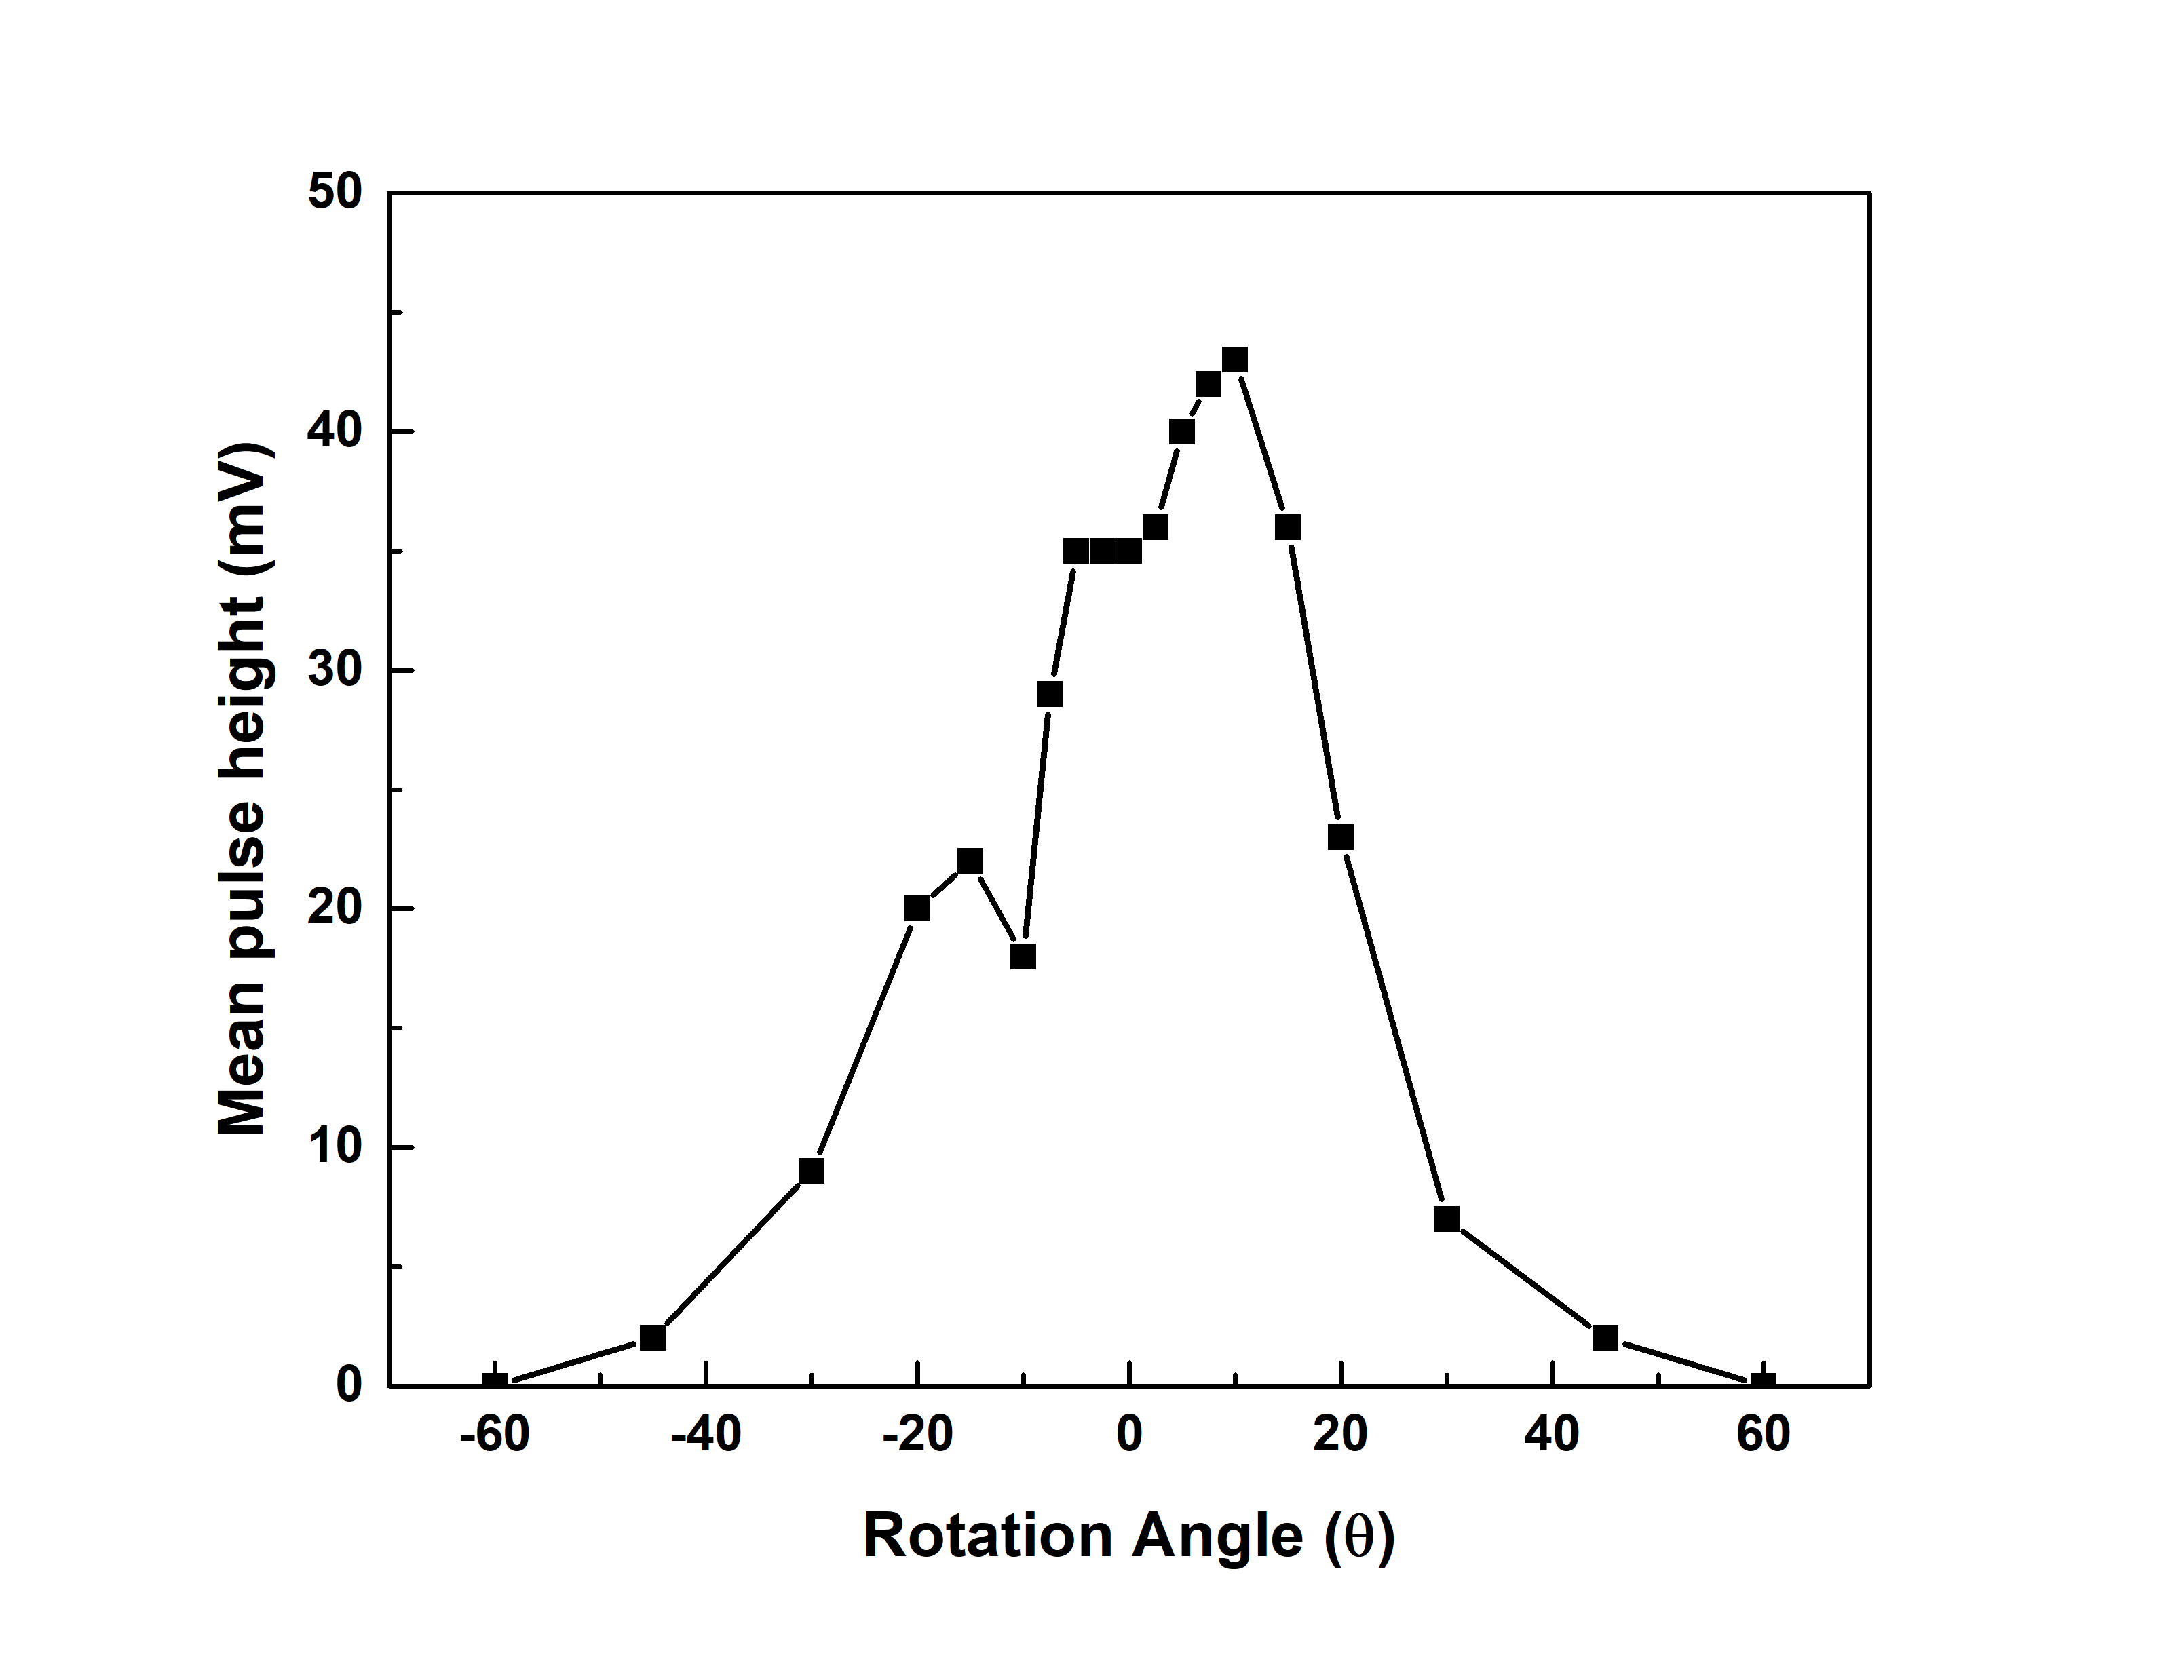
LAPPDs – Characteristics (20 cm) in magnetic fields
Due to the magnetic sensitive components (Kovar is used as shims in the current LAPPDTM), we can not go to high magnet field test, a new LAPPDTM with non-magnet components is scheduled to be fabricated and tested in Sep. 2018. The results here demonstrate the capability of the facility for 20 cm LAPPDTM.
θ = 0º
13º MCP bias angle
B = 0.1 T
Similar behavior as 6 cm MCP-PMT: gain decrease as the magnetic field increases
Two local gain maximum corresponding to the 13º bias angle of MCPs used in LAPPDTM

Slide 6
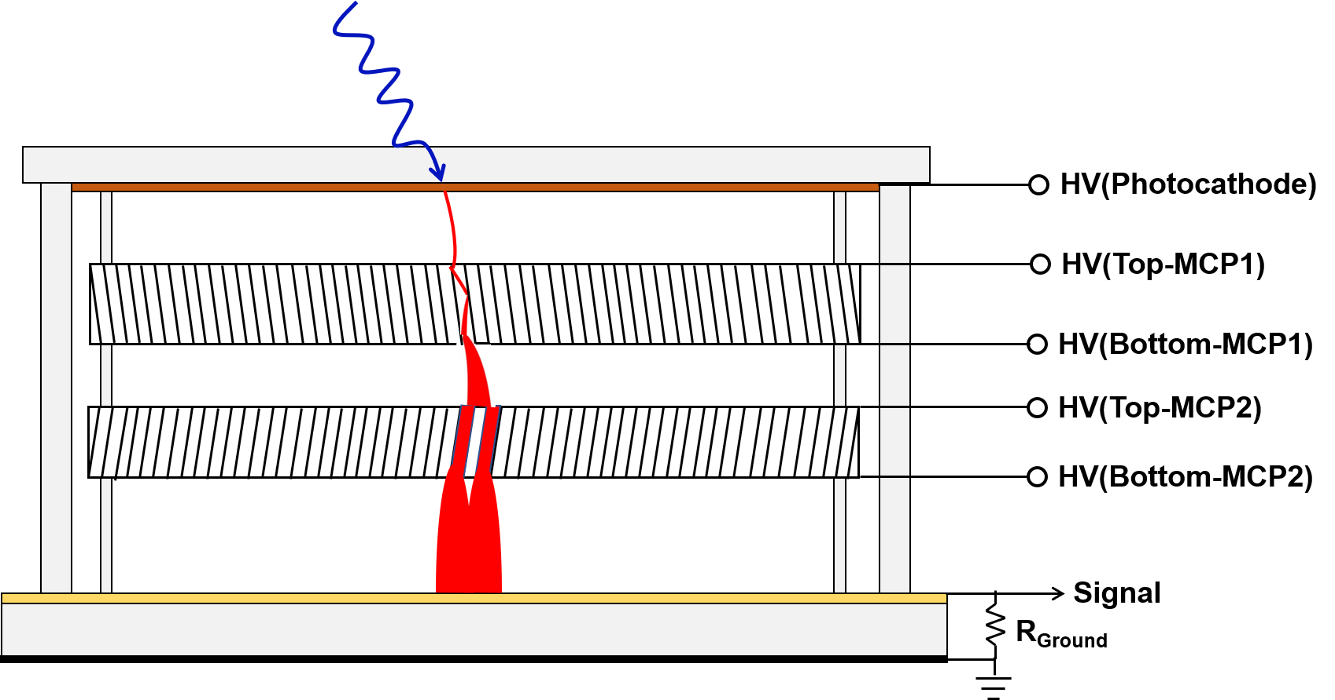
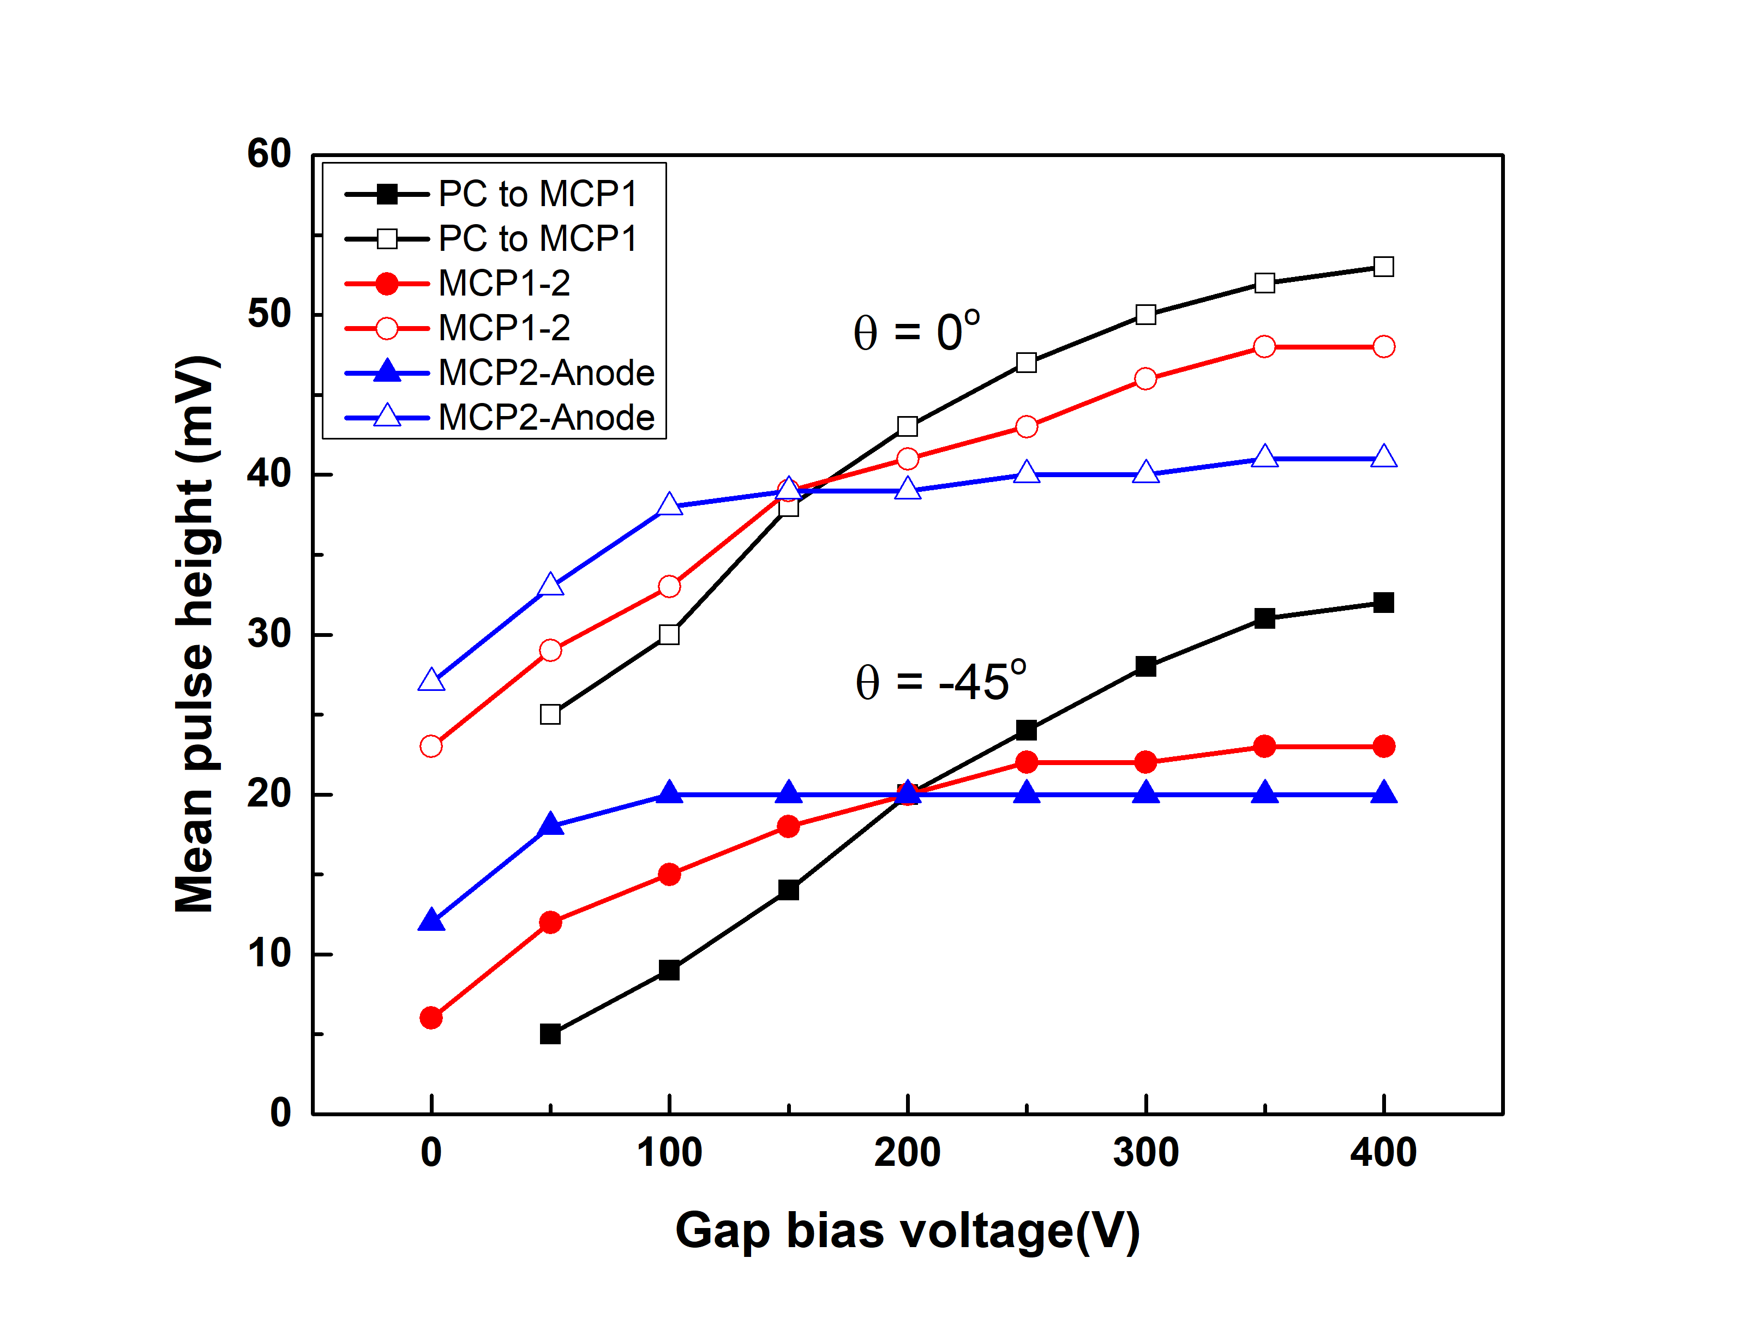
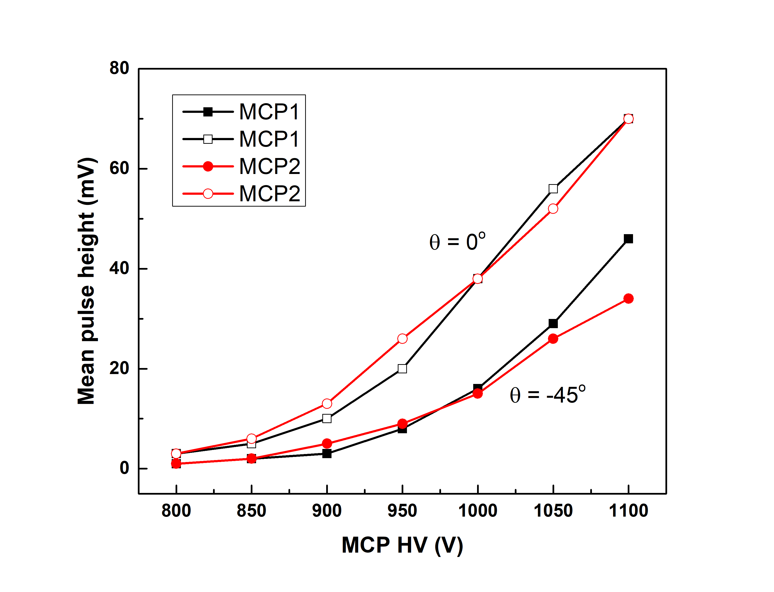
LAPPDs – Characteristics (20 cm) in magnetic fields
Gap and MCP ΔHV dependence
Gap ΔHV
MCP ΔHV
HV applied to all three gaps affects the gain of the LAPPD
HV between the photocathode and MCP1 gap has the greatest slope, indicating the strongest effect
LAPPD gain becomes a constant with the MCP2-Anode bias HV above a threshold
HV applied to MCPs seems to have NO preference, equally affects the LAPPD gain

Slide 7
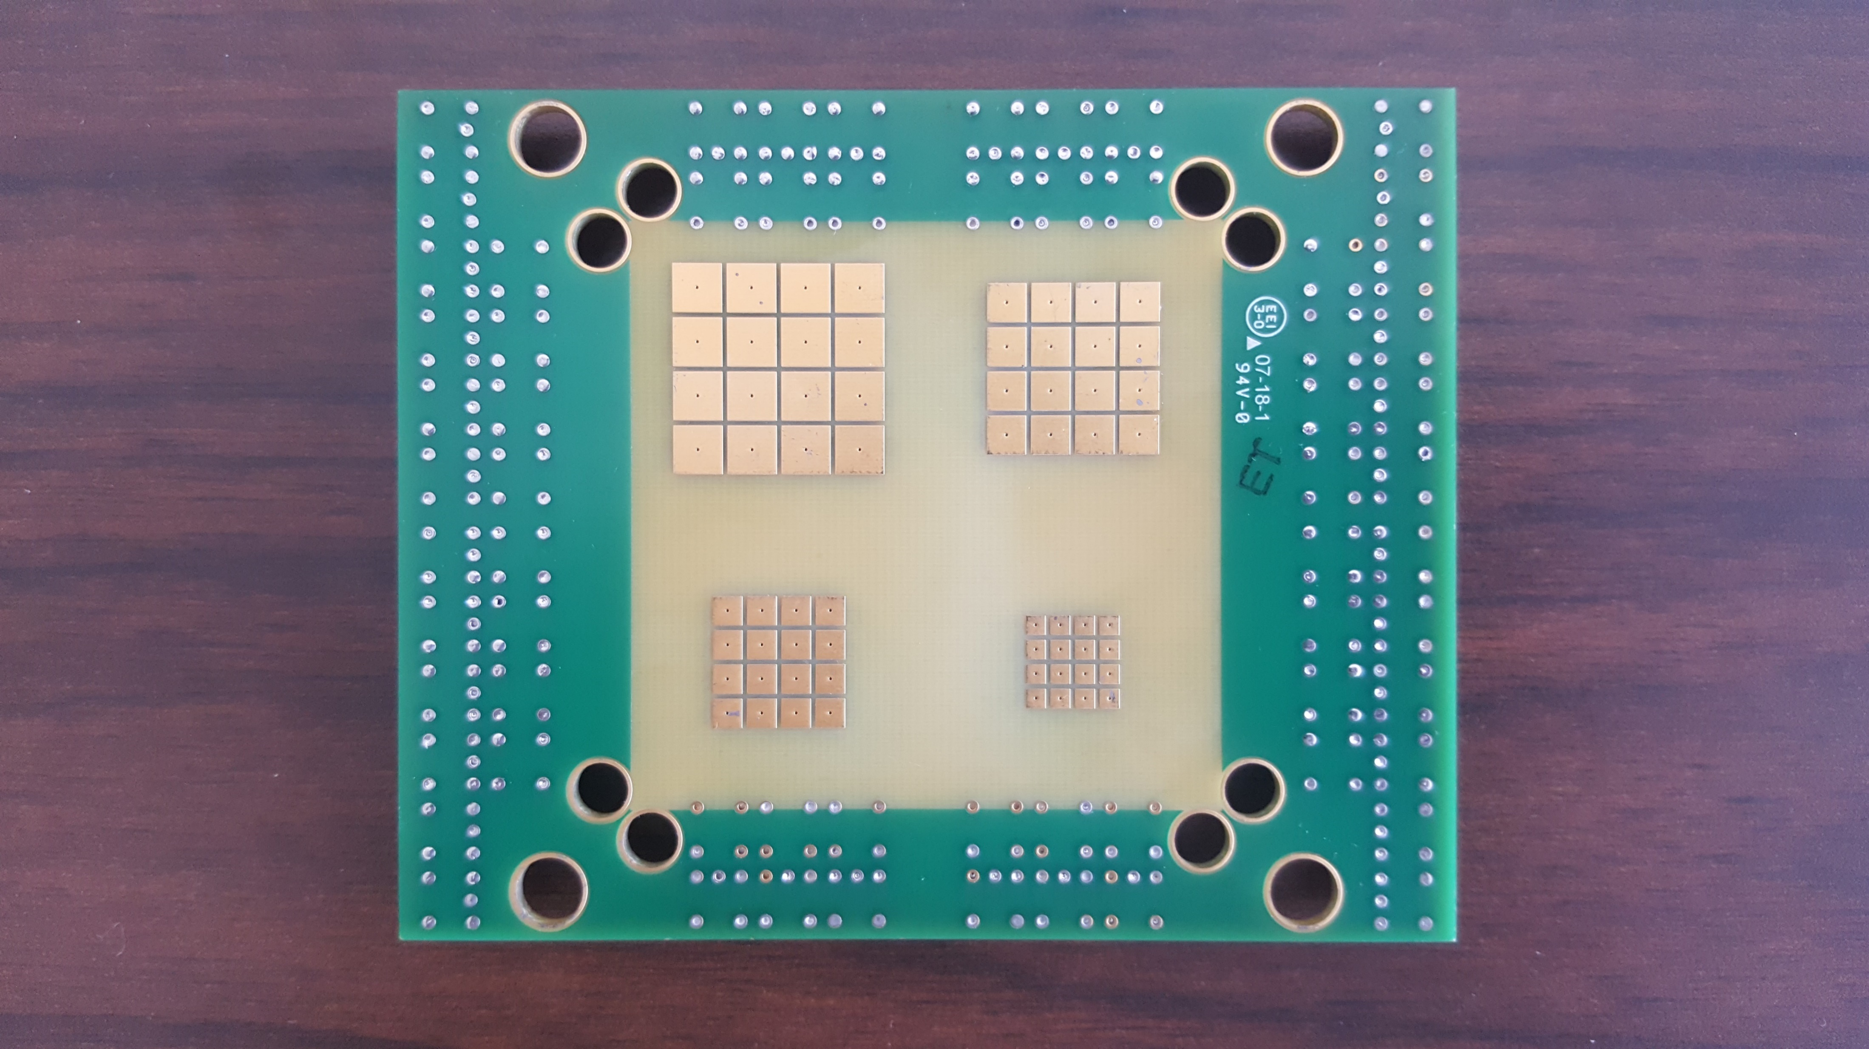
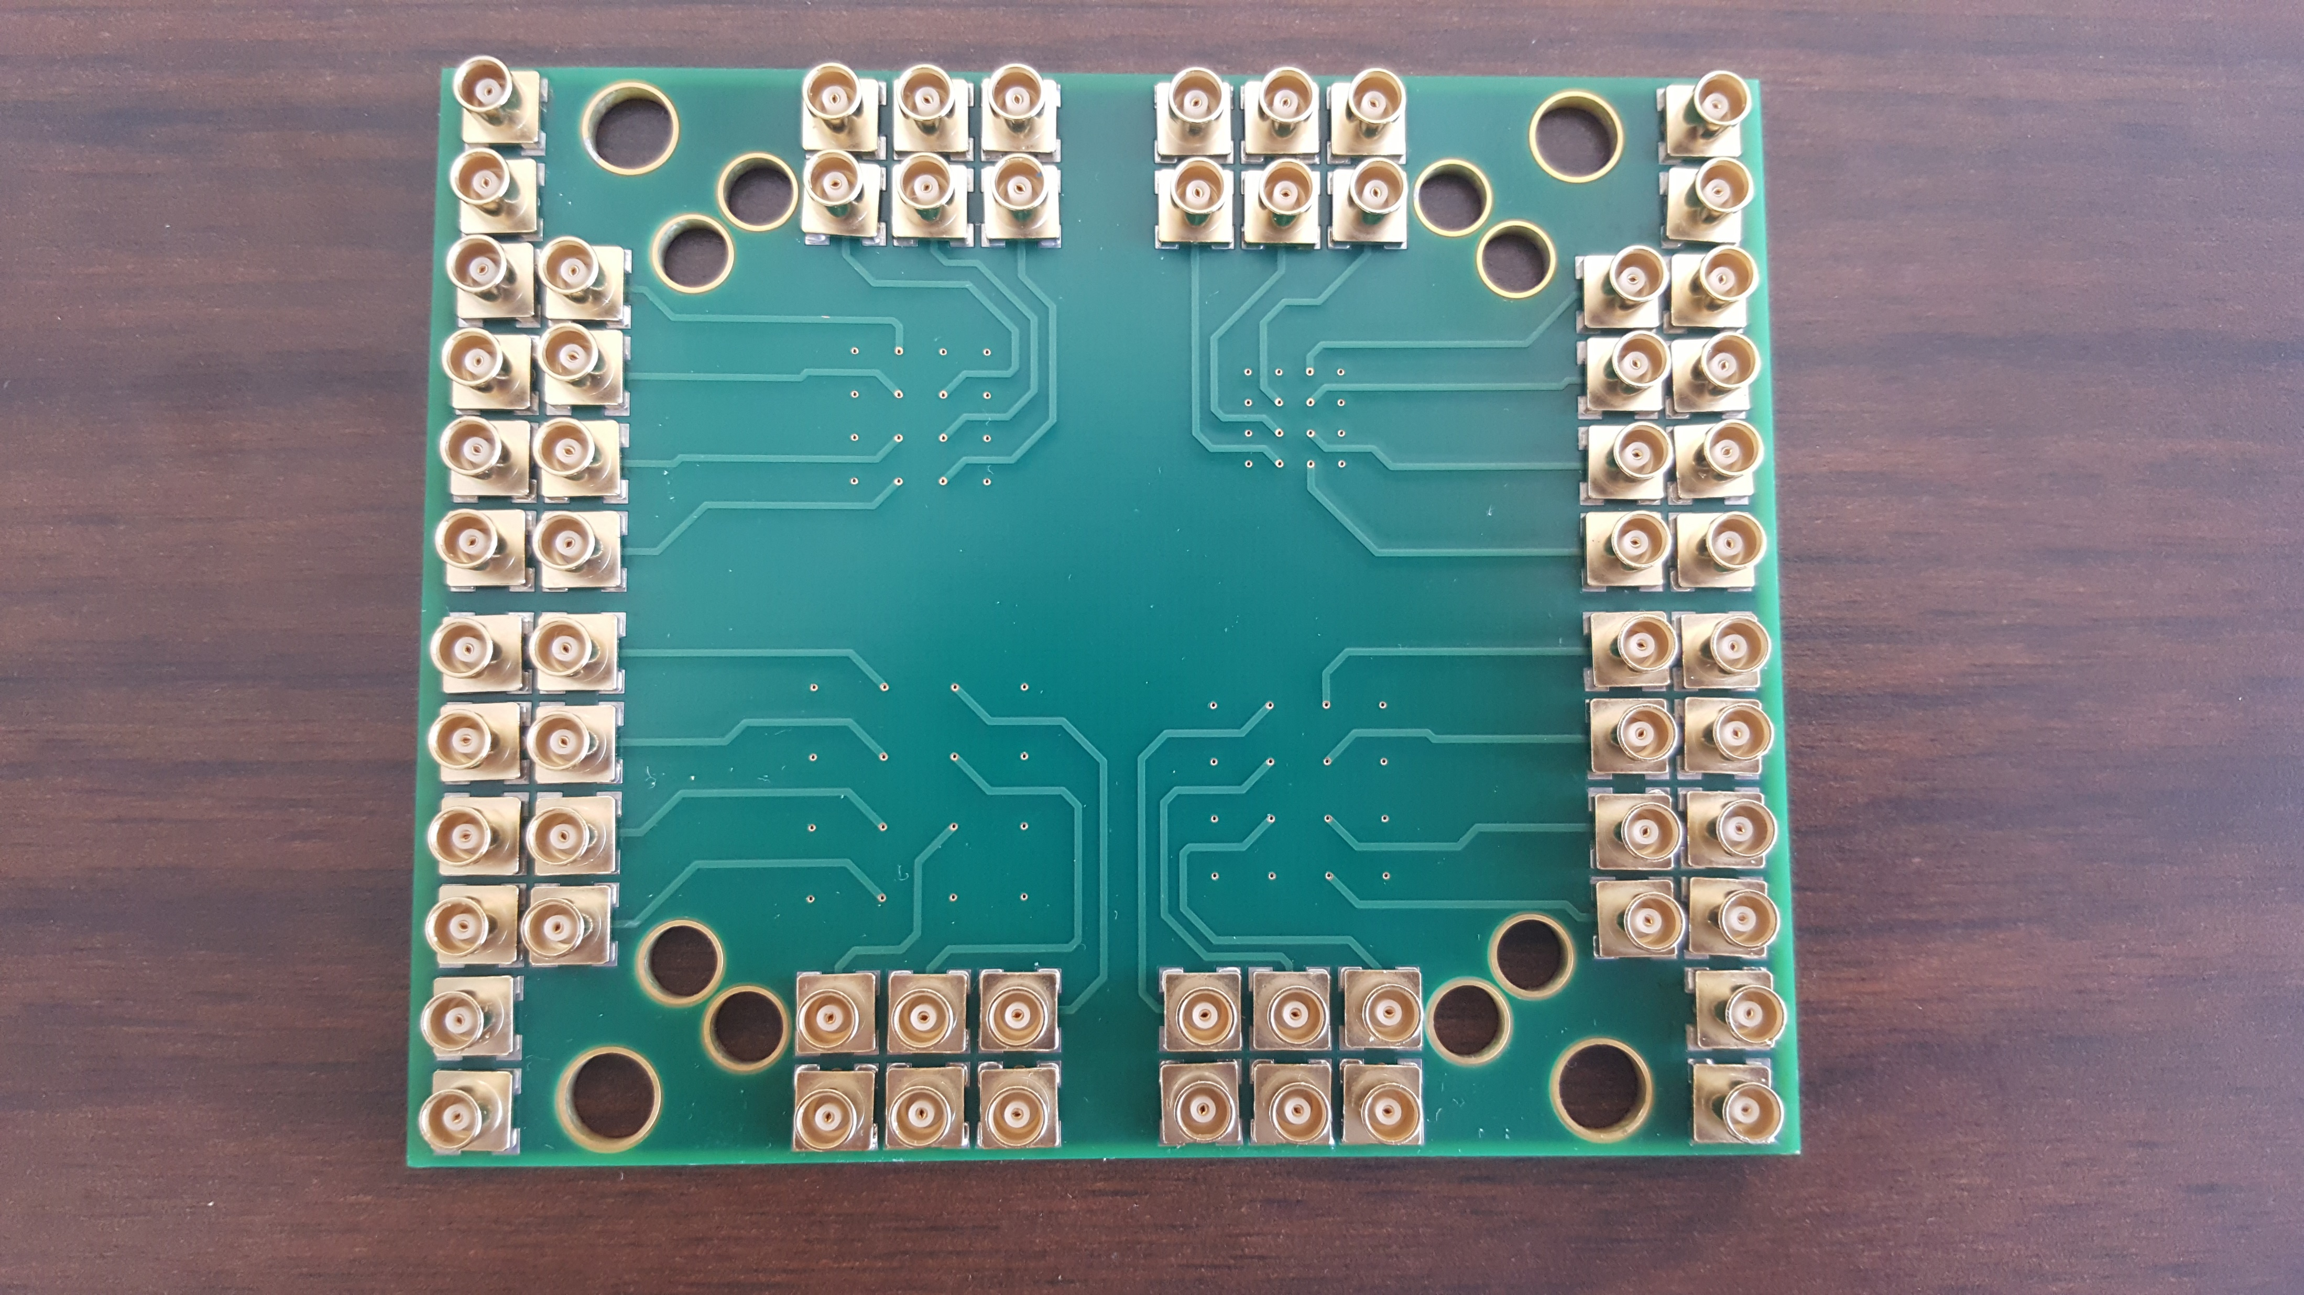
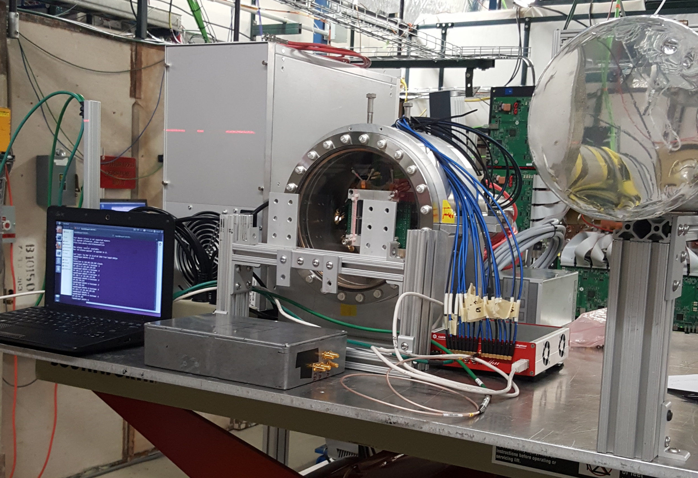
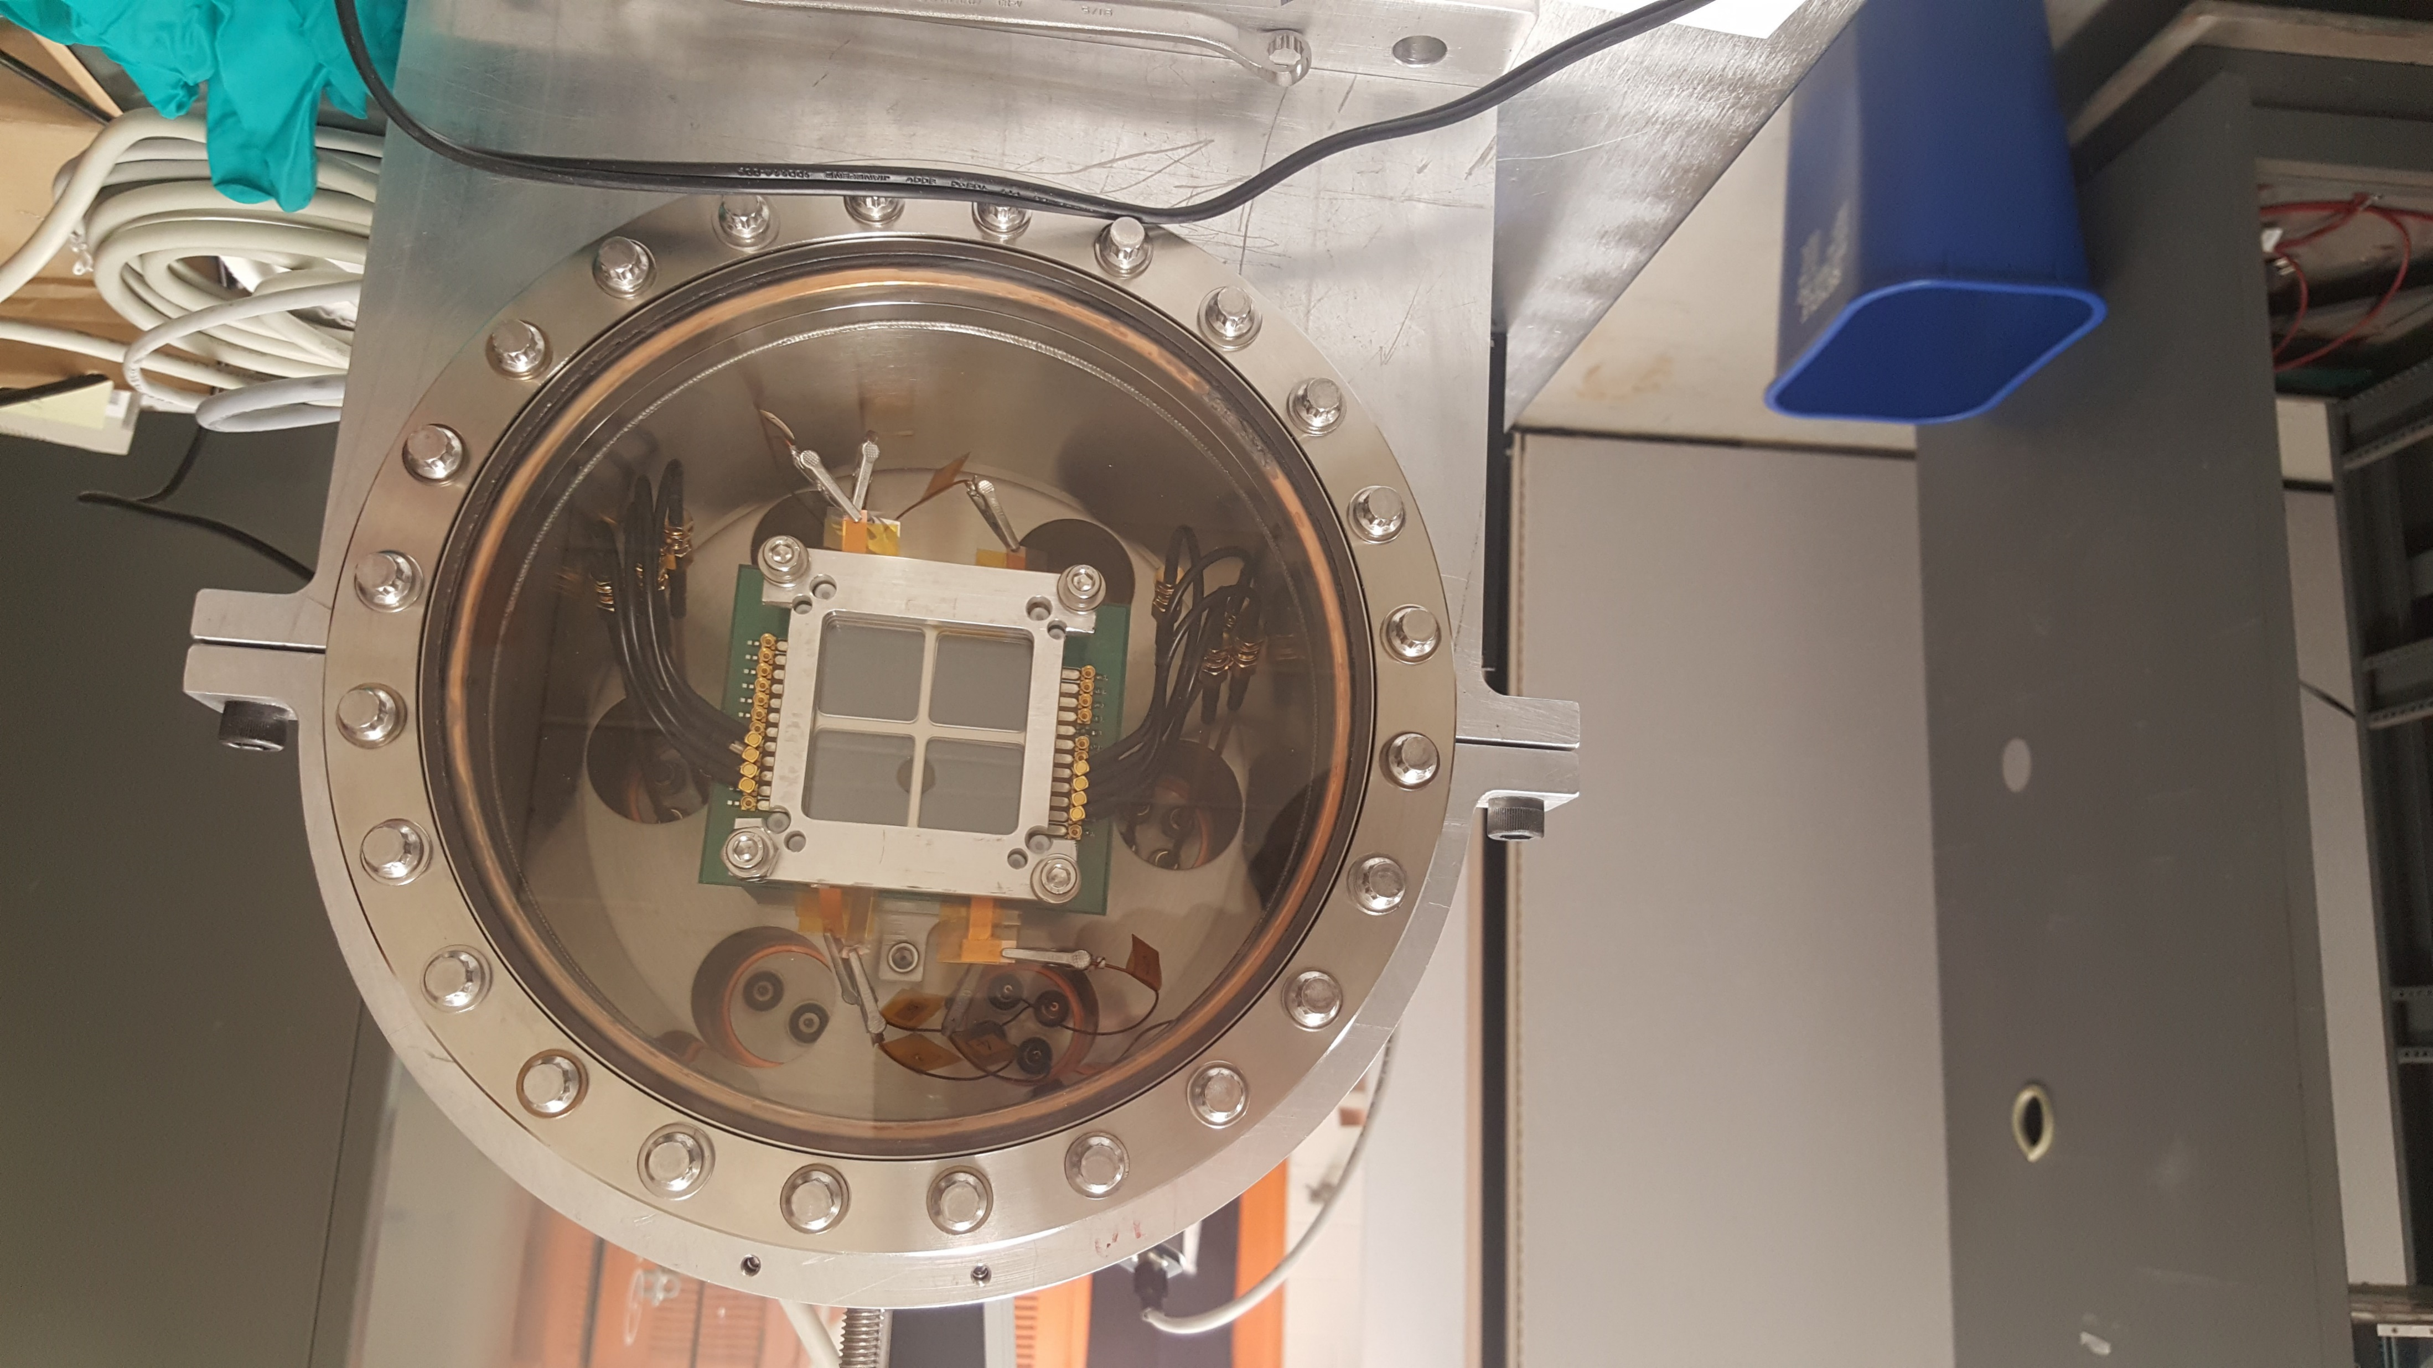
LAPPDs – Pixelated readout
Demountable chamber installed on the stage of Fermilab Test Beam Facility MT6.2C
Pad sizes:
2mm x 2mm
3mm x 3mm
4mm x 4mm
5mm x 5mm
Spacing between pads:
0.5 mm

Slide 8
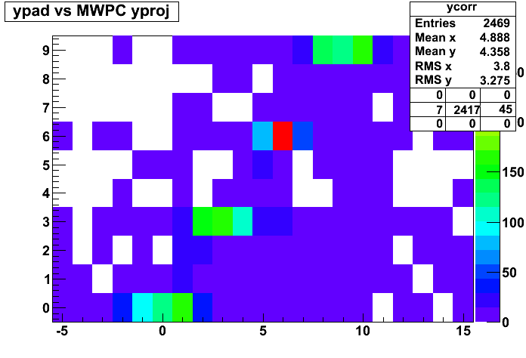
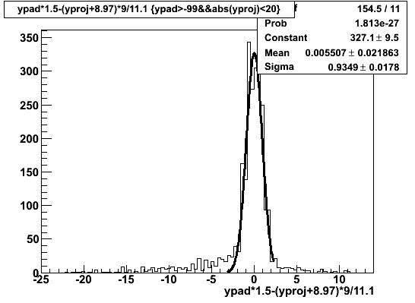
LAPPDs – Pixelated readout
Example correlation between the y-axis of a 3 mm x 3 mm pad and the MWPC projection
Pixel size | 2 mm x 2 mm | 3 mm x 3 mm | 4 mm x 4 mm
σ (x) | - | 1.01 mm | 1.11 mm
σ (y) | 0.73 mm | 0.93 mm | 1.43 mm
σ (expected) | 0.6 mm | 0.9 mm | 1.2 mm
Expected position resolution σ (expected) = pixel size/√12
Beamline experiment preliminary results show that experimental position resolutions are close to the expected position resolutions

Slide 9
LAPPDs – Conclusion
LAPPD/MCP-PMTs were characterized in details in magnetic fields
Further development of magnetic field tolerant LAPPD progresses well
Pixelated readout development for LAPPD was started, will be the next focus
LAPPD R&D, DIRC R&D, electronics R&D are well aligned with each other for demonstration of DIRC prototype with LAPPDTM sensors

