Slide 1
RHIC Run-19 performance
Chuyu Liu
BNL NPP 2019 PAC Meeting
06/10/2019

Slide 2
Outline
Overview of RHIC Run-19
Run-19 performance at 9.8 GeV/nucleon
Run-19 performance at 7.3 GeV/nucleon
Run-19 fixed target experiments
Projections for Run-20
Summary

Slide 3
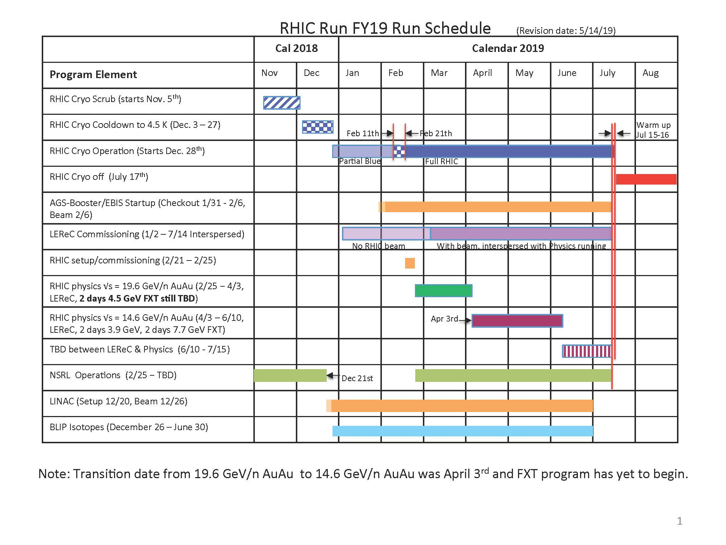
Overview of Run-19
LEReC electron beam commissioning before RHIC started on Feb. 11th.
Interleave of physics program and LEReC commissioning.
Physics at 9.8 GeV/nucleon went smoothly. STAR was flexible on LEReC dedicated time allocation.
Physics at 7.3 GeV/nucleon went smoothly as well with physics running during weekends.
Fixed target experiments at 7.3 GeV/nucleon beam energy was greatly improved with large beta star.
Physics at 3.85 GeV/nucleon and more are planned for the rest of the Run-19.

Slide 4
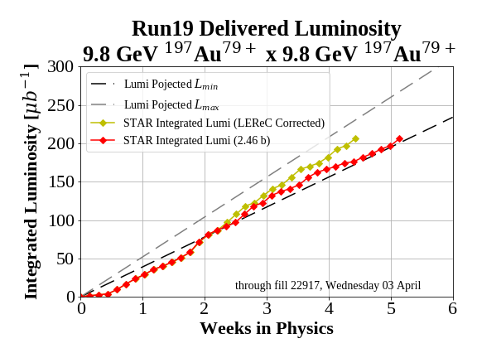
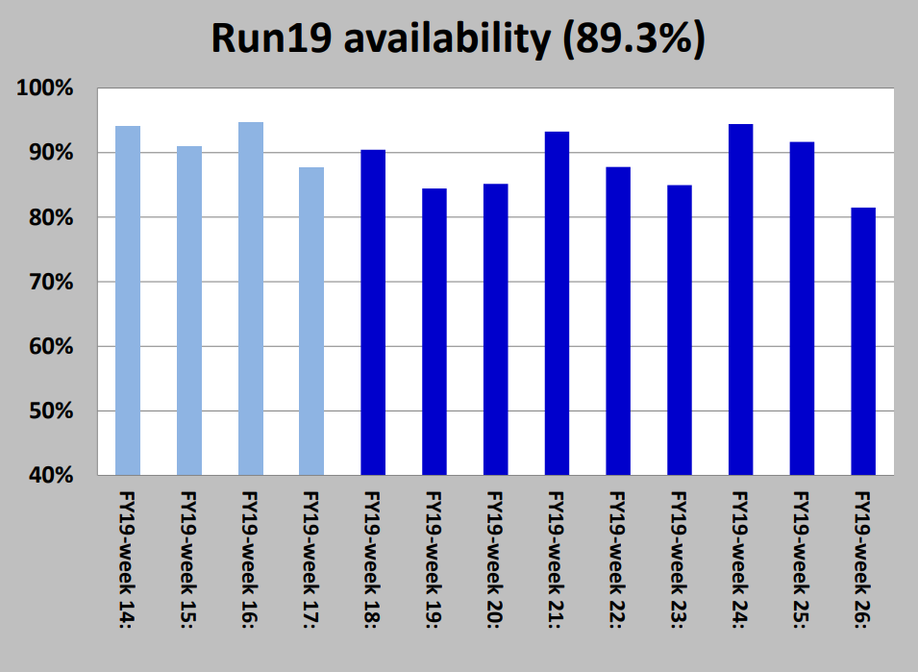
Performance at 9.8 GeV/nucleon
Parameters | Unit | Value | Note
Bunch intensity | ppb | 1.8E9 | Bunched, at collision, limited by beam-gas
Beta star | m | 2 | Started with 3
Working point |  | (0.09, 0.085)
f_RF | MHz | 28
Setup time | days | 7 | Include other energies
Time between stores | minutes | 20
Store length | minutes | 60
Peak luminosity | 10²⁴cm⁻²s⁻¹ | 500
Average luminosity | 10²⁴cm⁻²s⁻¹ | 130

Slide 5
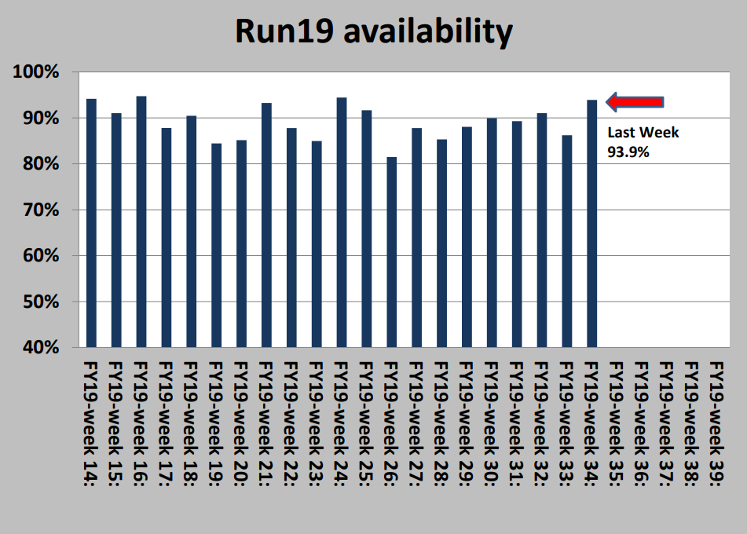
Performance at 7.3 GeV/nucleon
Parameters | Unit | Value | Note
Bunch intensity | ppb | 1.8E9 | Bunched, at collision, limited by bucket area
Beta star | m | B: 2.5, Y: 3 | Comprise bwt lumi verus background
Working point |  | (0.09, 0.085) | Low loss with collision
Setup time | days | 2 | AGS RHIC synchro
f_RF | MHz | 28
Time between stores | minutes | 20
Store length | minutes | 45
Peak luminosity | 10²⁴cm⁻²s⁻¹ | 240
Average luminosity | 10²⁴cm⁻²s⁻¹ | 60
7.3 GeV

Slide 6
What’s new compared to Run-11
For physics at 9.8 and 7.3 GeV/nucleon:
  Wiggle (demagnetization) ramp for RHIC superconducting magnets to reduce persistent current effects.
  New betatron working point at 0.09/0.08.
  Beta squeeze at IP6 for higher luminosity.
  Upgrade of corrector control from 12 to 16 bit.
  ATR re-alignment, additional BPM at WD4.
For LEReC cooling commissioning:
  New 9 MHz cavities for 3.85 GeV/nucleon, much improved lifetime.
  Improved lifetime due to wiggle (demagnetization) ramp.
  Flat orbit in LEReC cooling section with g1-tvx separation bump.

Slide 7
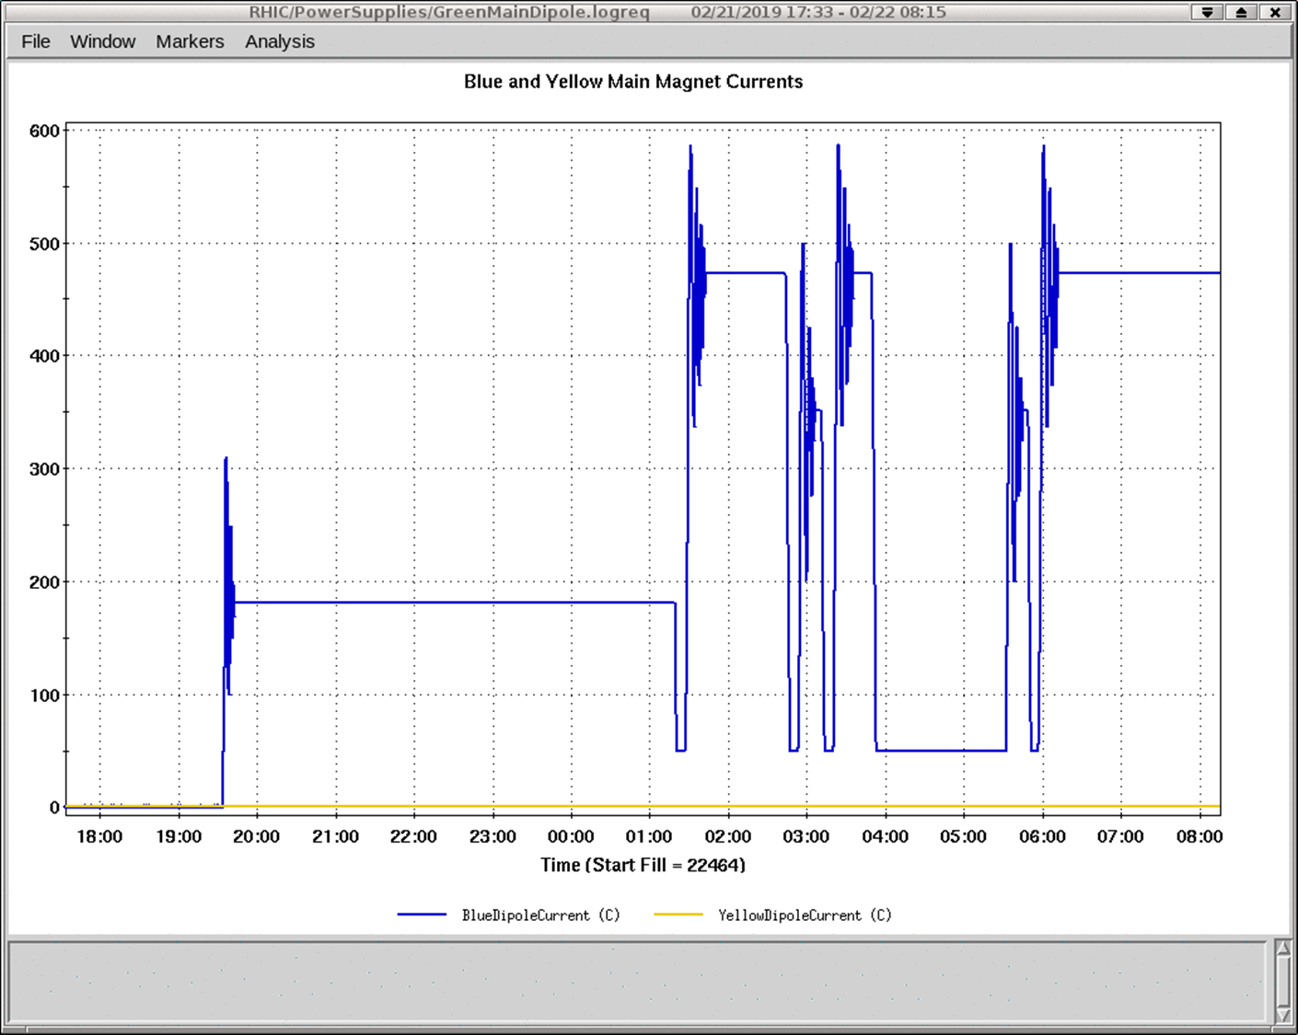
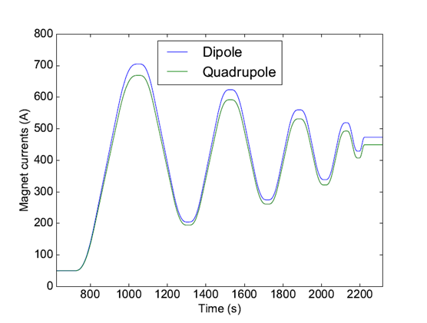
Mode-switching and wiggles
Benefits: quickly switch between energies, zero wait time for persistent currents to settle down; Orbit, tune and chromaticity stability much improved; automatically restore correct settings for systems.
9.8GeV
9.8GeV
9.8GeV
7.3GeV
7.3GeV
3.85GeV

Slide 8
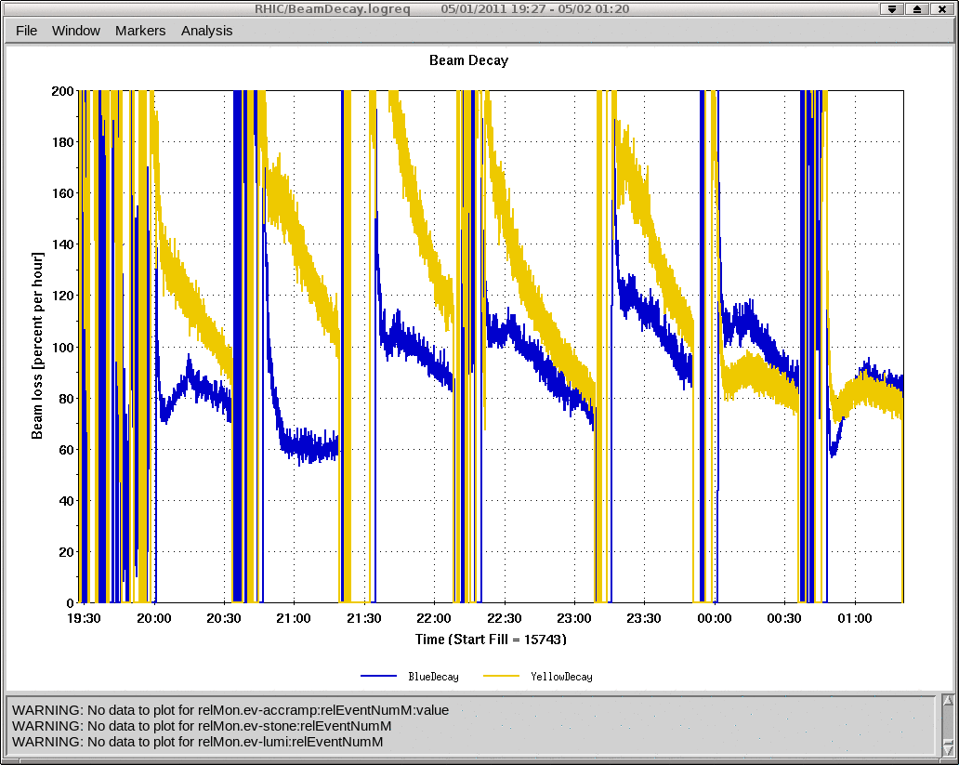
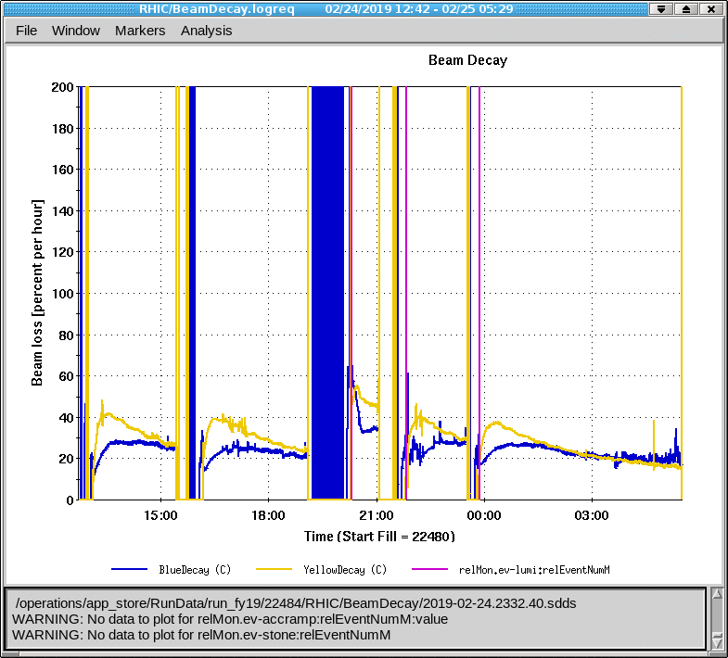
Less beam loss with the new working point at 9.8 GeV
2011
Now

Slide 9
Operational challenges for physics at 9.8 and 7.3GeV
Beam-gas interaction induced background, beam scrubbing was not quite effective at 9.8 GeV.
Limited bucket acceptance at 7.3 GeV: tight tolerance on injection matching, more de-bunched beam.
Background control: injection kicker kicking de-bunched beam; beam scraping in the triplets with squeezed beta star.
Run gap cleaning at the end of stores to avoid generating background and hurting bunched beam.

Slide 10
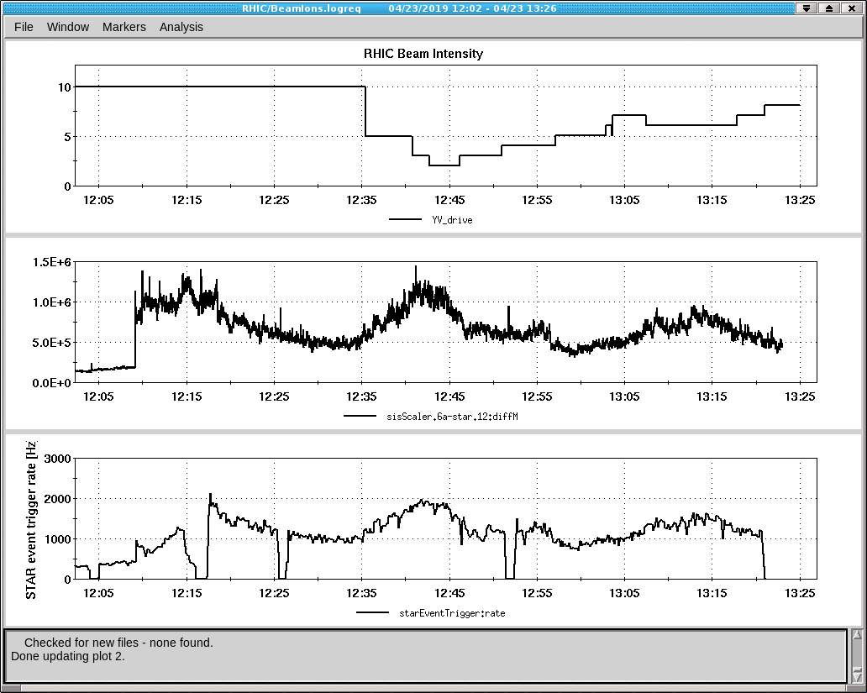
Fixed target test run at 7.3 GeV/nucleon
Beta star at IP6 was designed 10 m, lattice with even larger beta function was available.
Required orbit shift was ~9 mm. Event rate was very sensitive to orbit in this neighborhood.
Background was well under controlled.
BBQ kicker, engaged to improve event rate, was very effective.

Slide 11
Projections for Run-20
Plan to have LEReC cooling operational for 3.85 and 4.55 GeV/nucleon, but not for 5.75 GeV/nucleon because electron beam energy is limited by RF system.
The improvement of luminosity at 5.75 GeV is expected from more bunch intensity, better lifetime, more stable machine condition.
Smooth running for all fixed target energies are expected.
O+O collision at 100 GeV requires 2e28 cm^-2s^-1 average luminosity (RHIC can provide lumi 8 times of that).

Slide 12
Summary
RHIC physics running and LEReC commissioning coexisted near perfectly during 2019.
RHIC performance at 9.8 and 7.3 GeV were substantially improved with new developments compared to previous running.
LEReC team achieved their tremendous goals during cooling commissioning in 2019, and demonstrated for the first time cooling of ion bunches with RF accelerated electron bunches.
Fixed target experiments running conditions were improved with larger beta star. Future FXTs will benefit as well.
We are planning for a challenging RHIC running with operational LEReC next year.

