Slide 1


Coherent electron Cooling Proof-of-Principle Experiment:
Status and Plans
Vladimir N Litvinenko for CeC team
Collider-Accelerator Department, BNL
Department of Physics and Astronomy, SBU
Center for Accelerator Science and Education
CeC is currently supported by SBU NSF grant “Center for Accelerator Science and Education”.
In the past it was supported by DoE office of Nuclear Physics grants, as well as by BNL’s LDRDs and PD awards.

Slide 2
Outline
Proof-of-principle CeC experiment
Summary of CeC Run 18 and activities during Run 19
Status and plans
CeC activities outside CeC collaboration
Conclusions
2018 NAS Assessment of U.S.-Based Electron-Ion Collider Science: The accelerator challenges are two fold: a high degree of polarization for both beams, and high luminosity.
April 2018 eRHIC pCDR review committee report: “The major risk factors are strong hadron cooling of the hadron beams to achieve high luminosity, and the preservation of electron polarization in the electron storage ring. The Strong Hadron cooling [Coherent Electron Cooling (CeC)] is needed to reach 10³⁴/(cm²s) luminosity. Although the CeC has been demonstrated in simulations, the approved “proof of principle experiment” should have a highest priority for RHIC.”

Slide 3
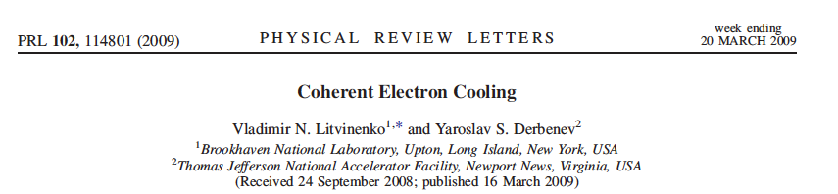
What is Coherent electron Cooling
Short answer – stochastic cooling of hadron beams with bandwidth at optical wave frequencies: 1 – 1000 THz
Longer answer :
Amplification
Momentum correction
Imprint by hadrons

Slide 4
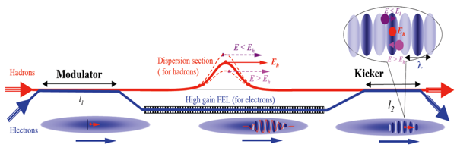
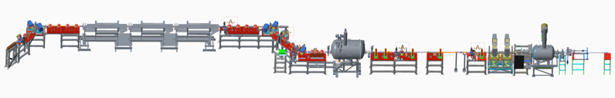


Proof-of-principle CeC experiment
eRHIC review committee: Although the CeC has been demonstrated in simulations, the approved “proof of principle experiment” should have a highest priority for RHIC.
Possible CeC schemes
Possible CeC PoP experiments
RHIC Run 18
High gain FEL amplifier
with low-K wigglers
Requires serious modification of the RHIC
lattice & superconducting magnets +$20-30M
Part of the eRHIC pCDR; requires serious modification of the RHIC lattice & superconducting magnets +$20-30M
Plasma cascade
micro-bunching amplifier
RHIC Runs 20-22
Plasma-Cascade
Amplifier
Requires serious modification of the RHIC
lattice & superconducting magnets +$20-30M

Slide 5
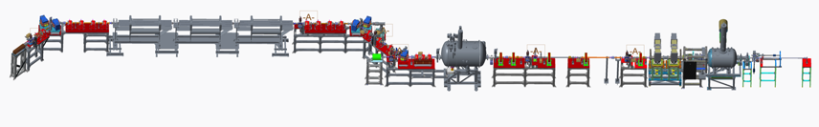
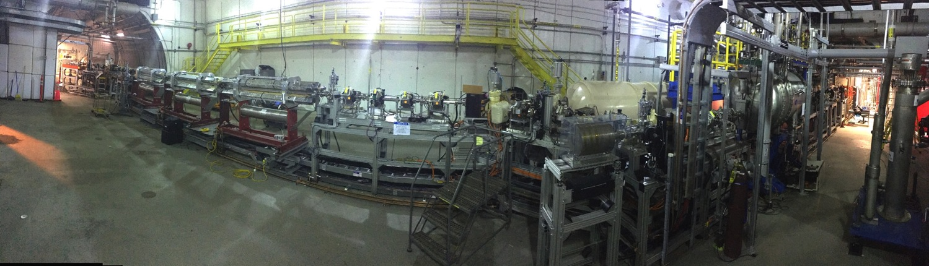
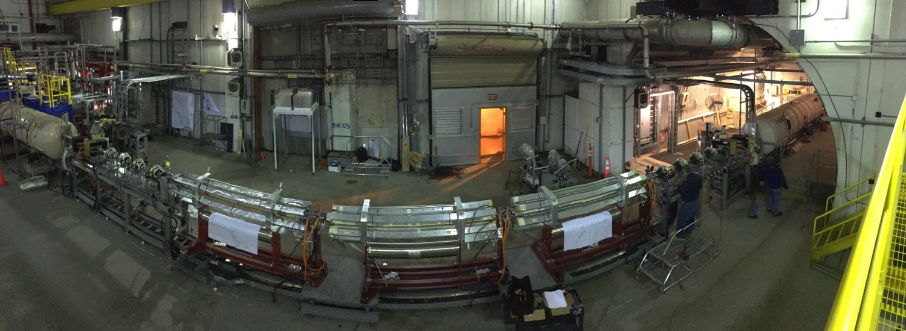
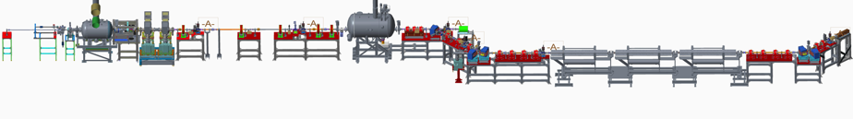
CeC system’s panoramic views (before LEReC has been installed)
Kicker
Modulator
FEL amplifier
CeC
accelerator
Dogleg
From inside RHIC ring
Cryo
system
Kicker
Modulator
FEL amplifier
From outside RHIC ring
Circa 2017

Slide 6
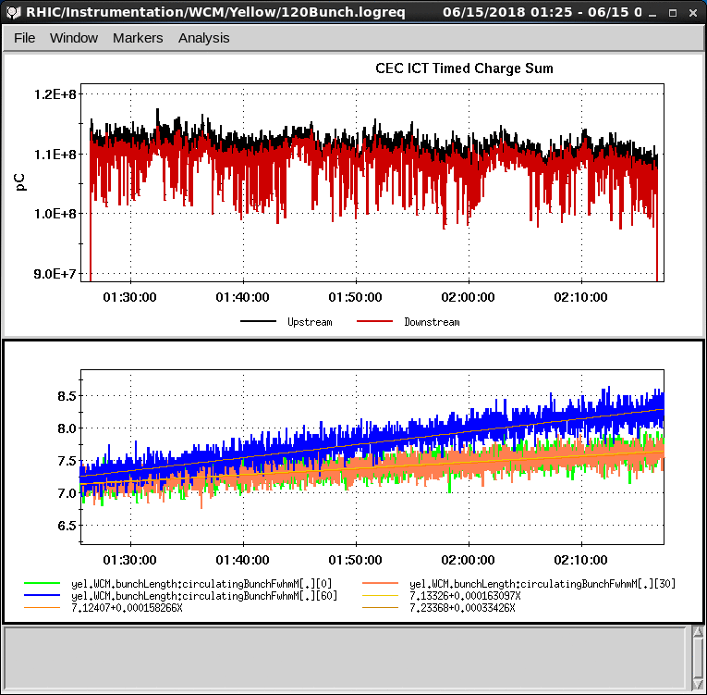
Puzzle of the CeC Run 18
Main result = Big disappointment
We run out of time to demonstrate the CeC during Run 18 with RHIC run finished in mid-June. We stumbled on the important step of the experiment: observation & optimization of the ion imprint in the shot noise (e.g. radiation) of electron beam.
We clearly observed interactions of the ion and electron beams, but run our of time to resolve “imprint puzzle”
Heating of ion beam by lasing e-beam
Search for ion’s imprint
+/- 3 σ
Top plot :electron beam current through the CeC ~ 110 μΑ or 1.4 nC per bunch at 78 kHz. Bottom plots: evolution of the bunch lengths for interacting (blue trace) and witness bunches (orange and green traces)
Expected and measured relative change in the FEL signal with overlapping and separated beams. Each point corresponds to 16 or cycles of 20 FEL power measurements for overlapped and separated beams. Data analysis indicate RMS error of 2%.
Heating of ion beam was occurring only with a perfect overlap of the beams and high FEL gain. Reducing the FEL gain eliminated the heating.
Notes:
Proving expectations wrong is one of important roles played by experiment

Slide 7
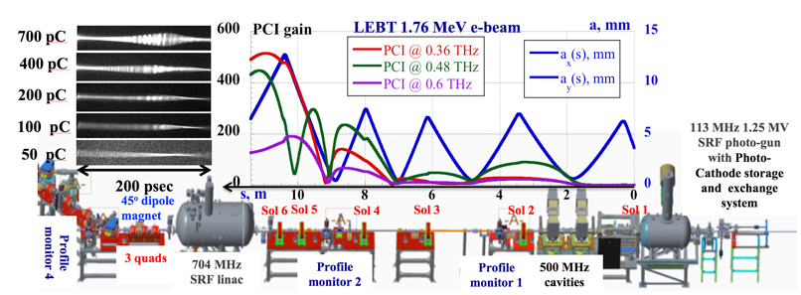
Solving the Puzzle and activities during Run 19
We took advantage of LEReC extending operation of RHIC cryo system till mid-September and solved the puzzle. We eliminated a half-of-a-dozen of possible explanations and found the culprit – excessive THz noise in the electron beam: increase of beam radiation by x 300 fold
(a)
Uncompressed bunch:
simulations and experiment in Sept 2018
Compressed beam simulation in CeC accelerator using Impact-T code @ NERSC
20-X compression
Blue line – Run 18 lattice
Red line – new lattice with suppressed PCI
We showed it in simulations, now we want to confirm this in the experiment:
goal of Run 19
(a) Measured time profiles of 1.75 MeV electron bunches with 0.45 nC to 0.7 nC; (b) Seven measured overlapping spectra and PCI spectrum simulated by SPACE (slightly elevated yellow line); (c) Clip shows a 30-psec fragment of seven measured relative density modulations.

Slide 8

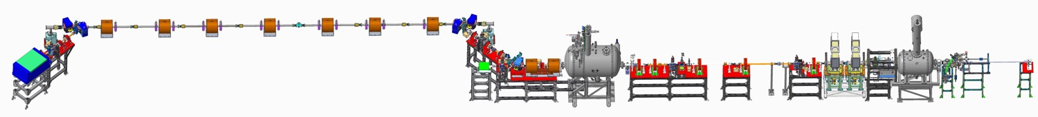
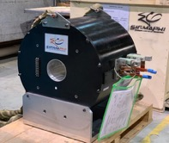
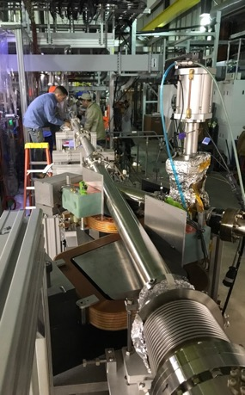
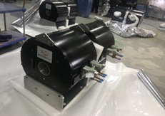
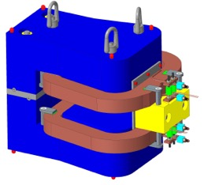
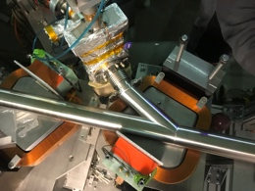
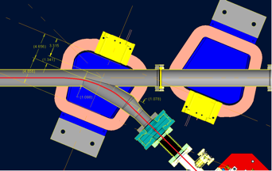
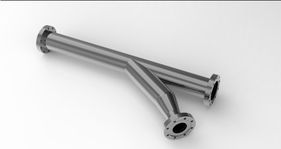
Changing CeC amplifier from FEL to PCA
Small gap in FEL wigglers is not compatible with low energy RHIC operations of the Beam Energy Scan (BES-II) program
CeC SRF accelerator
Unchanged
Kicker
Modulator
4-cell PCA
Unchanged
Mechanical design new of the CeC system is completed. We used SBU NSF “Center for Accelerator Science and Education” grant to procure new hardware
We procured and commissioned new laser system with controllable pulse structure
All new vacuum chambers with beam diagnostics are built and installed
All supports are built and installed
All solenoids are designed, manufactured, delivered and undergo magnetic measurements
Assembly of the plasma-cascade based CeC can be completed during this year’s RHIC shut-down

Slide 9
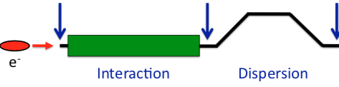
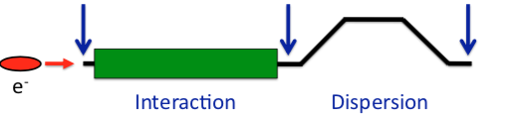
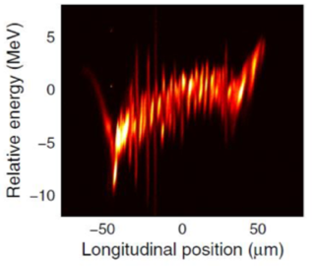
What is Plasma-Cascade Instability (PCI)?
How is it different from the previously known micro-bunching instability (MBI)?
Kick
Drift
Kick
Drift
Kick
Drift
a(s)
R₅₆=L_{b}θ²
© D. Ratner
Kick
Drift
Kick
Drift
R ₅₆ =L_{d}/γ²
Interaction
Interaction
Dispersion
Dispersion
Dispersion
MBI
PCI
Cold beam model
MBI: modulate effective mass (s-mobility) by bending beam trajectory (θ)
Modulate beam density
by changing beam radius a:
CeC
LCLS
Plasma frequency does not dependent on the shape of modulation

Slide 10
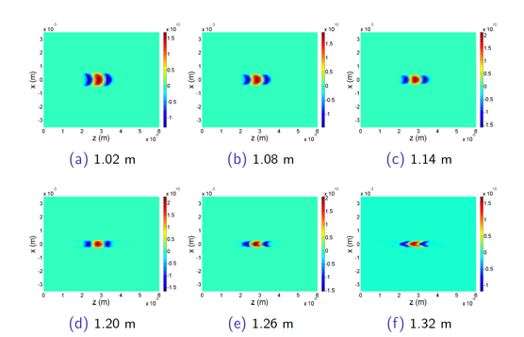
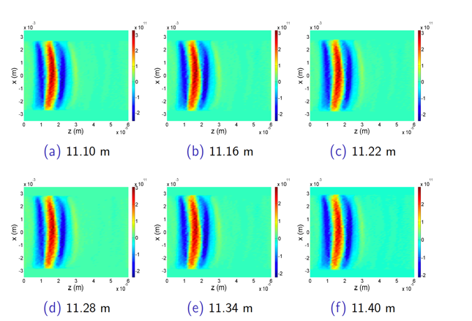
Simulated performance: 26.5 GeV Au ion bunch in RHIC
We had developed a suite of codes to simulate the complete beam dynamics in the CeC accelerator, the interaction with ion beam and the cooling of the ion beam with CeC using any type of amplifier. It is done without relying on any model: standard codes use 3D PIC simulations and super-computers.
40 mins of PCA CeC
Cooled by e-bunch
with normal
(shot noise
Initial
bunch shapes
By e-bunch
with 100-fold increase noise power
Witness
bunch in 40 mins
By e-bunch
with 225-fold increase noise power
By e-bunch
with 900-fold increase noise power
Black – initial profile, red – witness (non-interacting) bunch after 40 minutes. Profiles of interacting bunches after 40-minutes in PCA-based CeC for various levels of white noise amplitude in the electron beam: dark blue – nominal statistical shot noise, magenta – 10 fold, light blue – 15 fold and green – 30 fold - higher than the statistical level.
Cooling will occur when electron beam micro-bunching power (e.g. bending magnet radiation) does not exceed that of spontaneous (shot noise) radiation by more than 200-fold

Slide 11
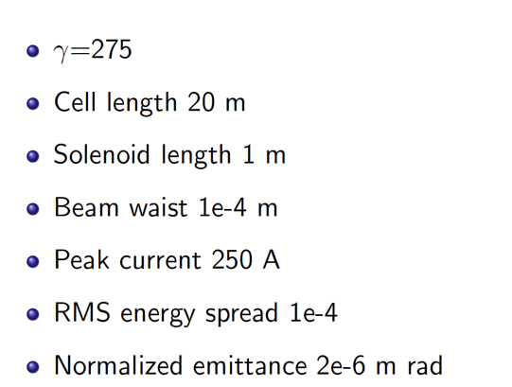
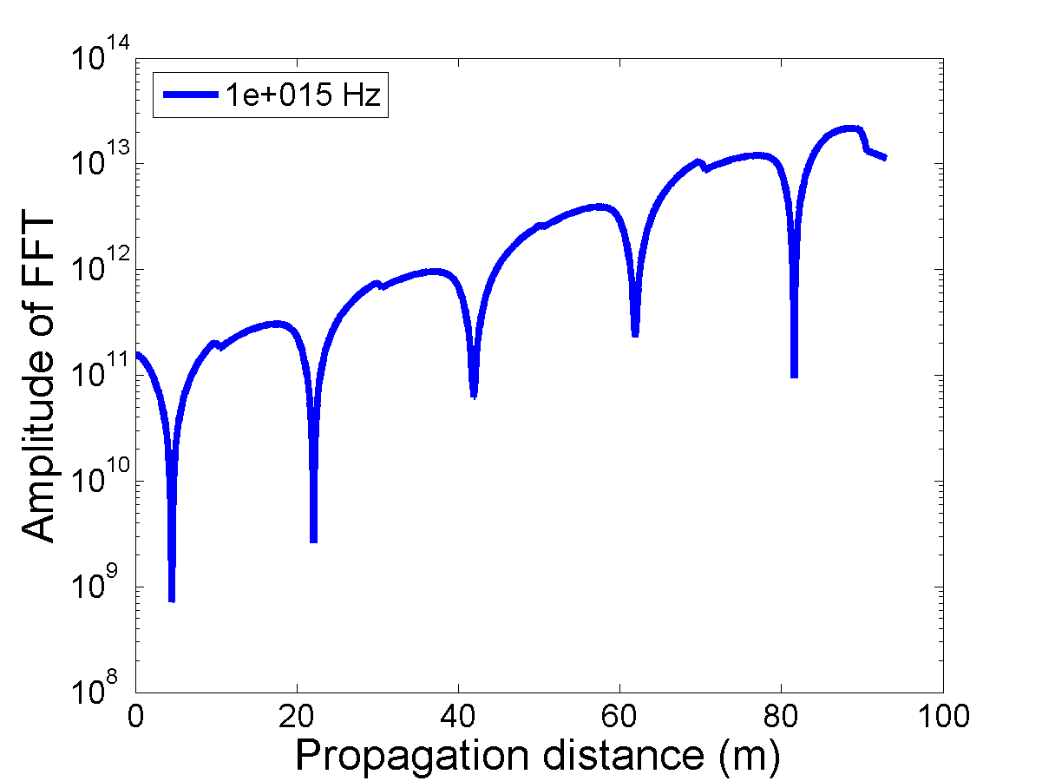
eRHIC cooler simulations
We did full scale simulations for CeC with 4-cell PCA for our proposed test experiment as well as for eRHIC energy range – it proved that our expectations are correct and this system will have high gain (>100) and very large bandwidth: 25 THz for test experiment and 1,000 THz (1 PHz*) for CeC cooling 275 GeV protons
This cost effective system – it does not need expensive separation system for hadrons - would be capable of 3D, e.g. longitudinal and transverse cooling of cooling hadron beams in RHIC and eRHIC independently of the design choice. Cooling time is ~ 10 minutes for protons. CeC will operate at all eRHIC hadron energies currently under consideration
Still, it will be important to demonstrate untested micro-bunching cooling technique experimentally
Plasma-Cascade Amplifier gain
For 275 GeV protons in eRHIC
* RHIC stochastic cooling system has bandwidth of ~ 10 GHz (0.01 THz)

Slide 12
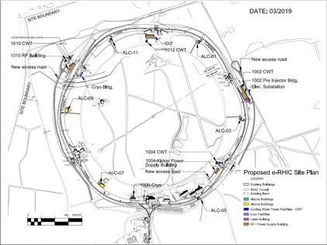
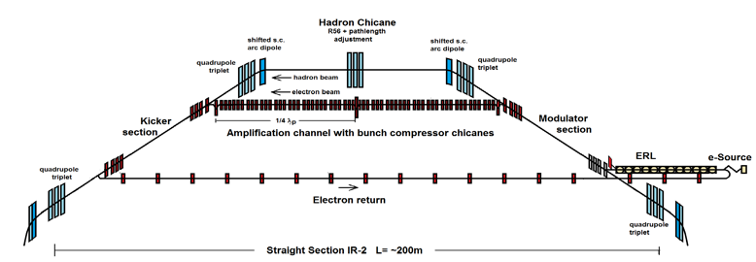
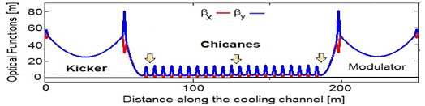
Strong Hadron Cooling for eRHIC
Coherent electron Cooling studies by others: 1D charged discs impedance model, G. Stupakov (SLAC)*
Requirements: eRHIC Peak Luminosity of 10³⁴cm⁻²s⁻¹ requires 6·10¹⁰ protons per bunch, 6 cm bunch length and small emittances of ε_{x}= 9.2 nm, ε_{y} = 1.3 nm ➔ beam subject to IBS, initial growth time of >2h in the hor. and long. direction
Method: Strong Hadron Cooling using coherent electron cooling with micro-bunched beams, bunching enhancement with 2 plasma amplification sections with a total of 3 bunching chicanes. Plasma wavelength as low as λ_{p} =40 m
Cooling rate for short flat bunches ~1 h for longitudinal and transverse oscillations (theory & simulations)
Need an electron beam with 1nC bunches (100 mA CW) , Δp/p~10⁻⁴ , normalized horizontal emittance ~2.5 μm
Layout:
DC electron photoinjector with round-to-flat beam transformation
150 MeV superconducting energy recovery linac with 591 MHz 5-cell s.c. acc.-struct.
Strongly focusing micro-bunching channel
Cooling location: IR-2
150 MeV ERL together with 400 MeV injector linac in existing spur-tunnel
Schematic layout: Low cost hadron chicane for pathlength and R5 adjustment using displaced s.c. arc magnets
IR-2
ERL
RHIC Tunnel
Electron-optics
Curtesy of F. Willeke
*G. Stupakov and P. Baxevanis, PHYSICAL REVIEW ACCELERATORS AND BEAMS 22, 034401 (2019)

Slide 13
Conclusions
Learned from our experience in Run 18 how to generate a low noise electron beam
Found the reason for the increased noise in the electron beam and learned how to avoid it.
Simulations are finished – now it is time for experiment
Small aperture of CeC FEL wigglers was incompatible with aperture requirements for for low energy RHIC operation during the Beam Energy Scan (BES-II) program
Developed new design of CeC with plasma-cascade amplifier and completed all necessary simulations of the cooling process . It is less known that FEL-based system but has significant advantages:
  Very large bandwidth (~ 25 THz for PoP, ~ 1,000 THz for eRHIC)
  Cooling of ions with any amplitudes of oscillations (e.g. full acceptance)
  The best approach for future eRHIC cooler: fast cooling, low cost
Procured all long lead components of the system using SBU NSF funds and partially install it onto RHIC IP2. The system in fully compatible with BES II and RHIC operation at any energy.
The CeC system can be completed during upcoming RHIC shutdown. We propose three year program to fully evaluate the CeC performance:
  Year 1 (Run 20) – commissioning new CeC system
  Year 2 (Run 21) – longitudinal cooling of 26.5 GeV/u ion beam
  Year 3 (Run 22) – simultaneous transverse and longitudinal cooling
Submitted LDRD proposal and requesting dedicated time for this experiment in Runs 20-21
  Run 20 – 8 days
  Run 21 – 14 days
If successful, we will ask for 2 week of dedicated time in Run 22

Slide 14
Back-up slides

Slide 15
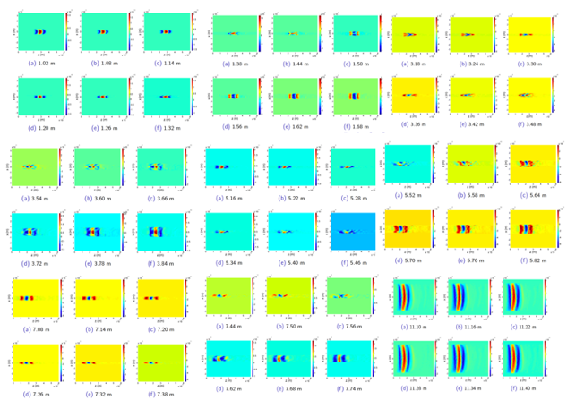
Simulated performance: full 3D treatment
In last 10 years we developed a self-consistent 3D theory of the process and used it for benchmarking our simulations codes.
We had developed a suite of codes to simulate the complete beam dynamics in the CeC accelerator, the interaction with ion beam and the cooling of the ion beam without relying on any model: standard codes use 3D PIC simulations and super-computers.
The CeC group developed both the theory and simulation of
CeC with any type of amplifier: FEL, MBI or PCA – about two dozens of published papers regarding this methods
Predicted evolution of the 26.5 GeV/u
ion bunch profile in RHIC
In real modulator
Cooling bunch
Witness
bunch
Initial
Bunch (t=0)
Cooling will occur if electron beam has micro-bunching with power (e.g. BM radiation power) does not exceed that of spontaneous (shot noise) radiation by more than 225-fold
Plasma-cascade micro-bunching amplifier
40 mins of
PCA CeC
Black – initial profile, red – witness (non-interacting) bunch after 40 minutes. Profiles of interacting bunches after 40-minutes in PCA-based CeC for various levels of white noise amplitude in the electron beam: dark blue – nominal statistical shot noise, magenta – 10 fold, light blue – 15 fold and green – 30 fold - higher than the statistical level.
In the kicker

Slide 16
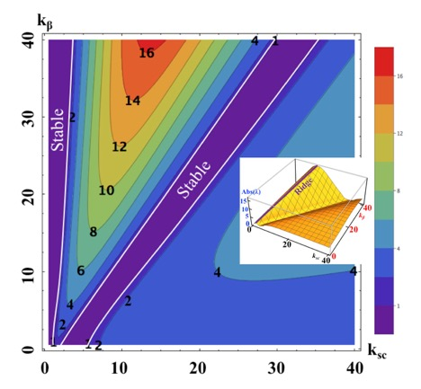
What is Plasma-Cascade Amplifier
It is a parametric instability driven by variation of the plasma frequency and driven by the variation of the transverse electron beam size
We do it by creating dramatic variations of plasma density using modulation of the transverse beam size
Important questions – when exponential growth occurs and how fast it is? Hence, we developed a self-consistent 3D theory and simulations*
* Plasma-Cascade micro-bunching Amplifier and Coherent electron Cooling of a Hadron Beams, V.N. Litvinenko, G. Wang, D. Kayran, Y.Jing, J. Ma, I. Pinayev, arXiv preprint arXiv:1802.08677, https://arxiv.org/pdf/1802.08677.pdf , 2018

Slide 17
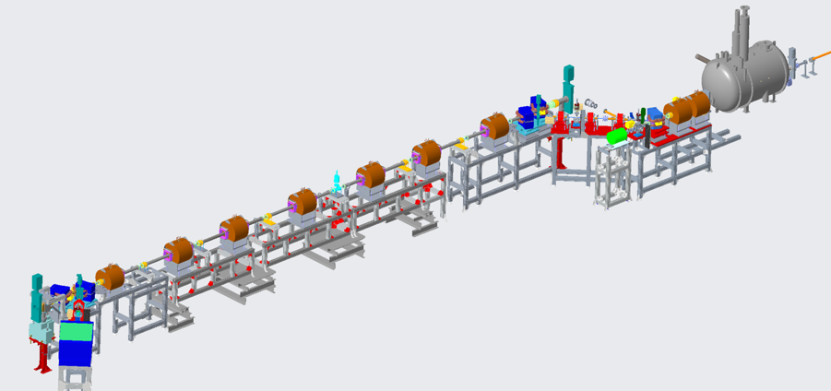

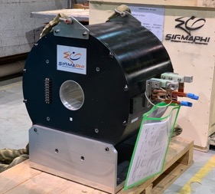


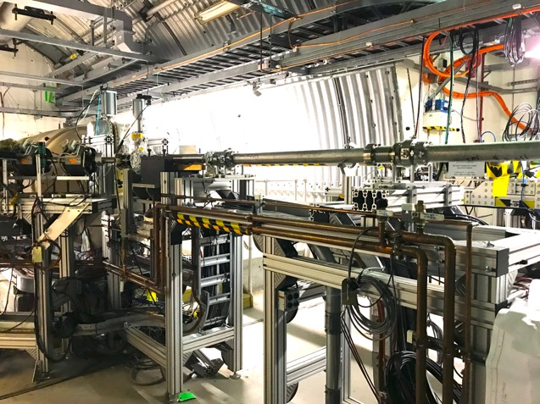
CeC with PCA
Mechanical design new CeC system is completed
We procured and commissioned new laser system with controllable pulse structure
All new vacuum with beam diagnostics are built chambers are installed
All supports are built and installed
All solenoids are designed, manufactured, delivered and undergo magnetic measurements
Assembly of the plasma-cascade based CeC can be completed during this year’s RHIC shut-down period
RHIC beam
Design of CeC section
using Plasma-Cascade Amplifier

Slide 18
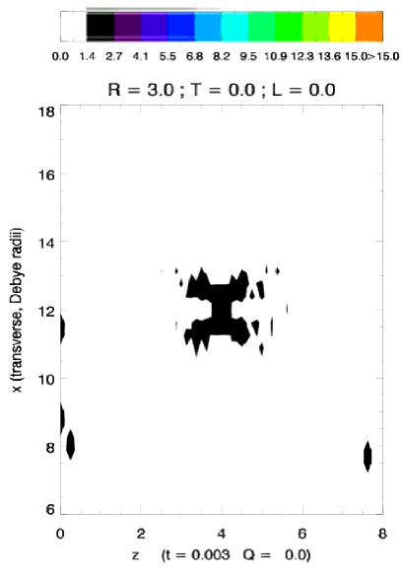
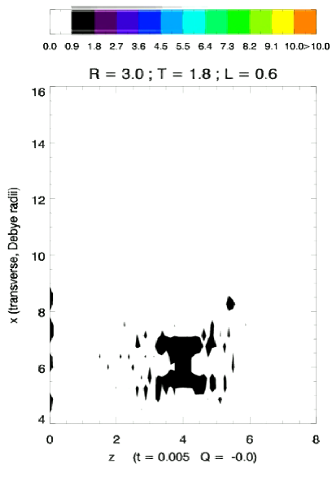
Imprinting ion signature into the electron beam
Interaction with ions double the intensity of spontaneous radiation: we are using this dependence to tune the energies of the beams to exact synchronism.

Slide 19
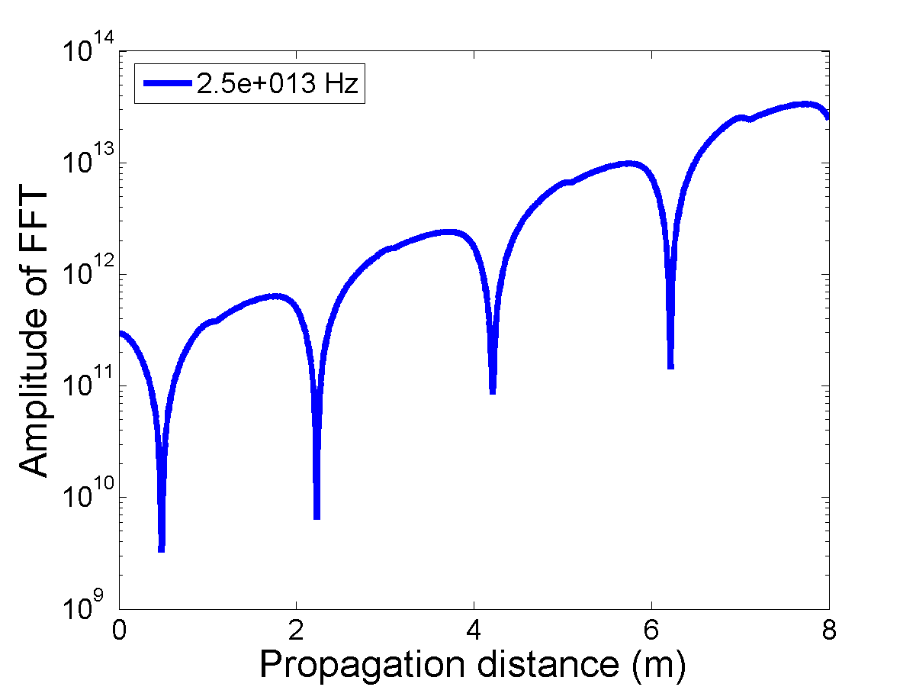
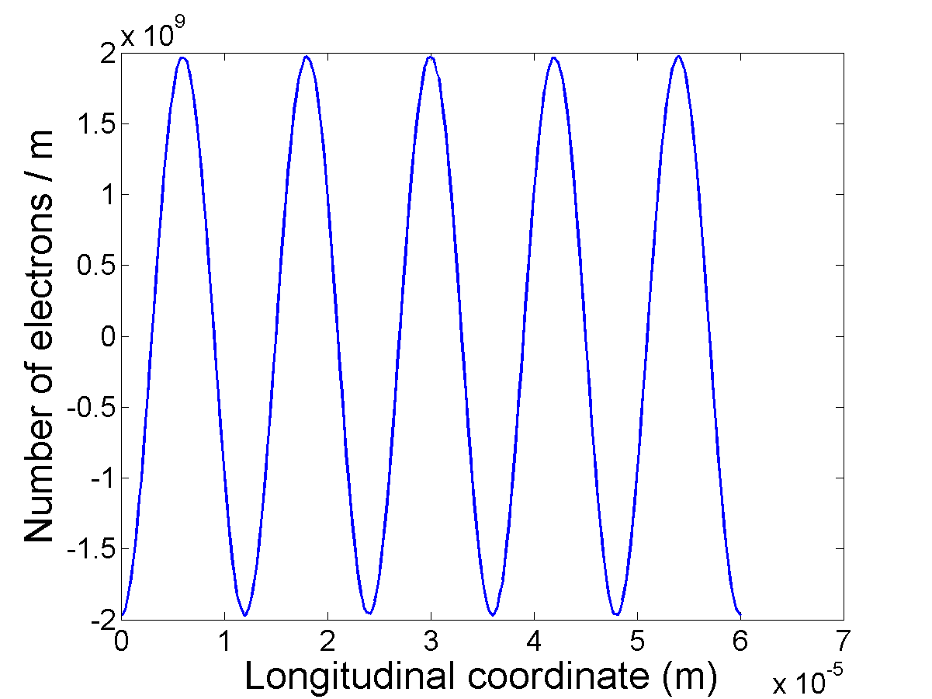
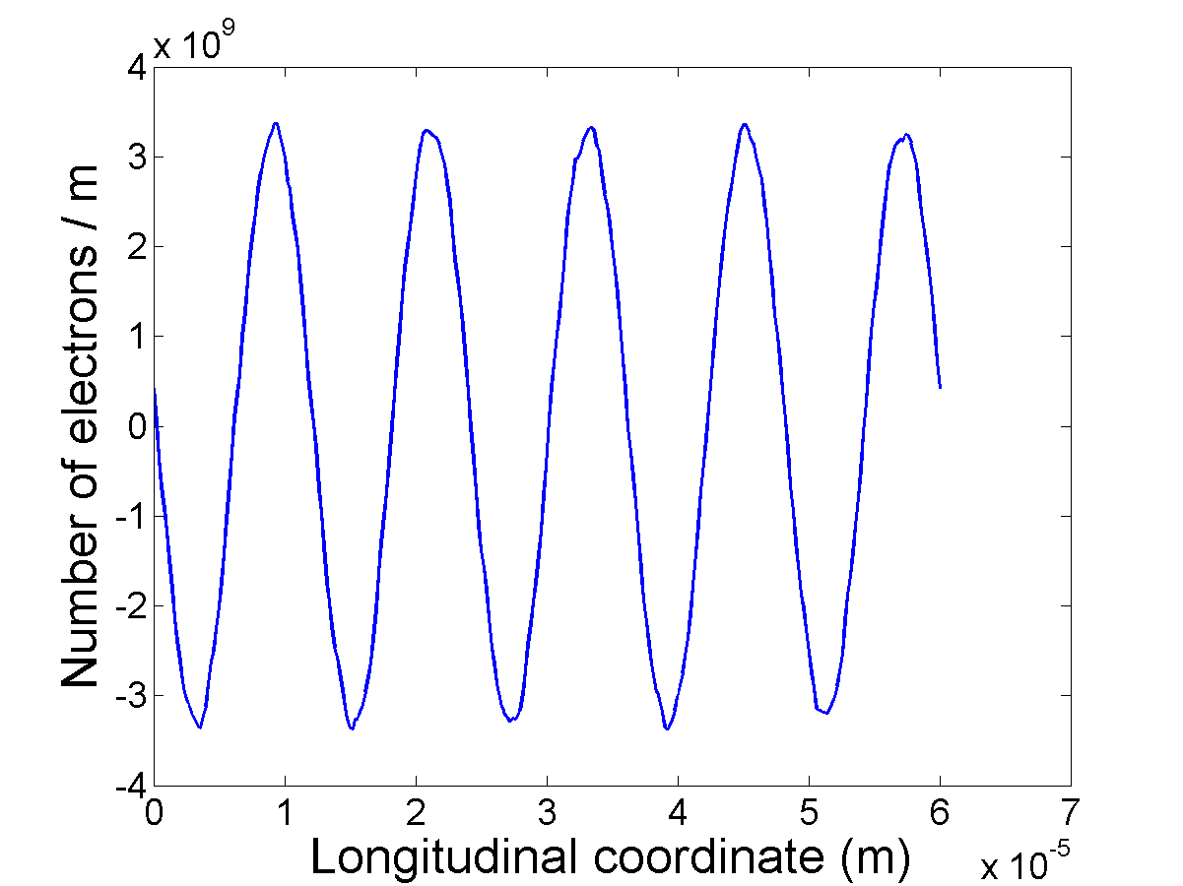
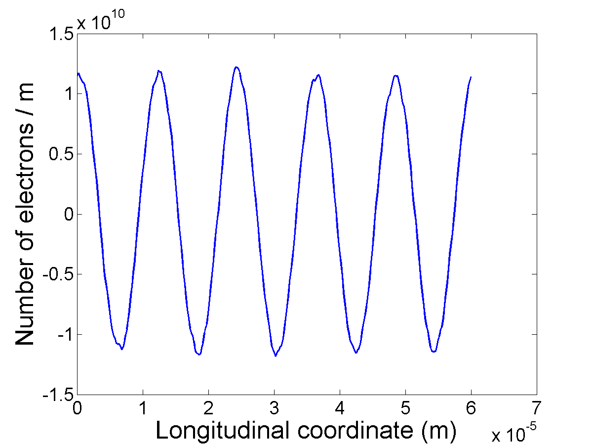
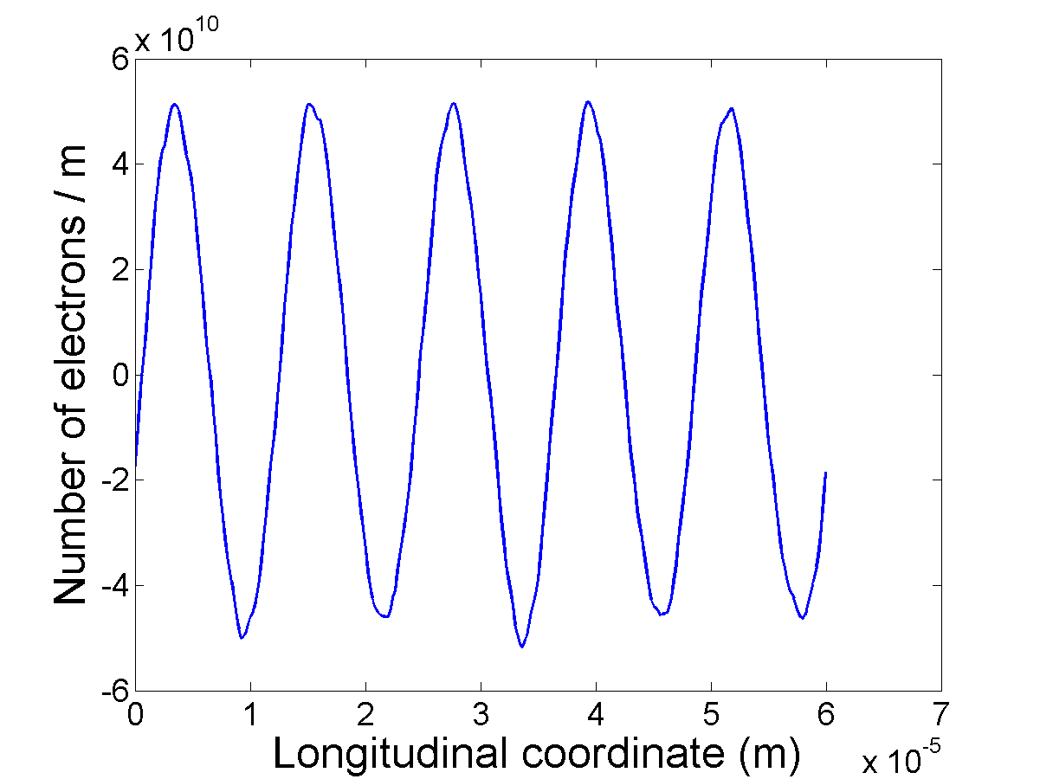
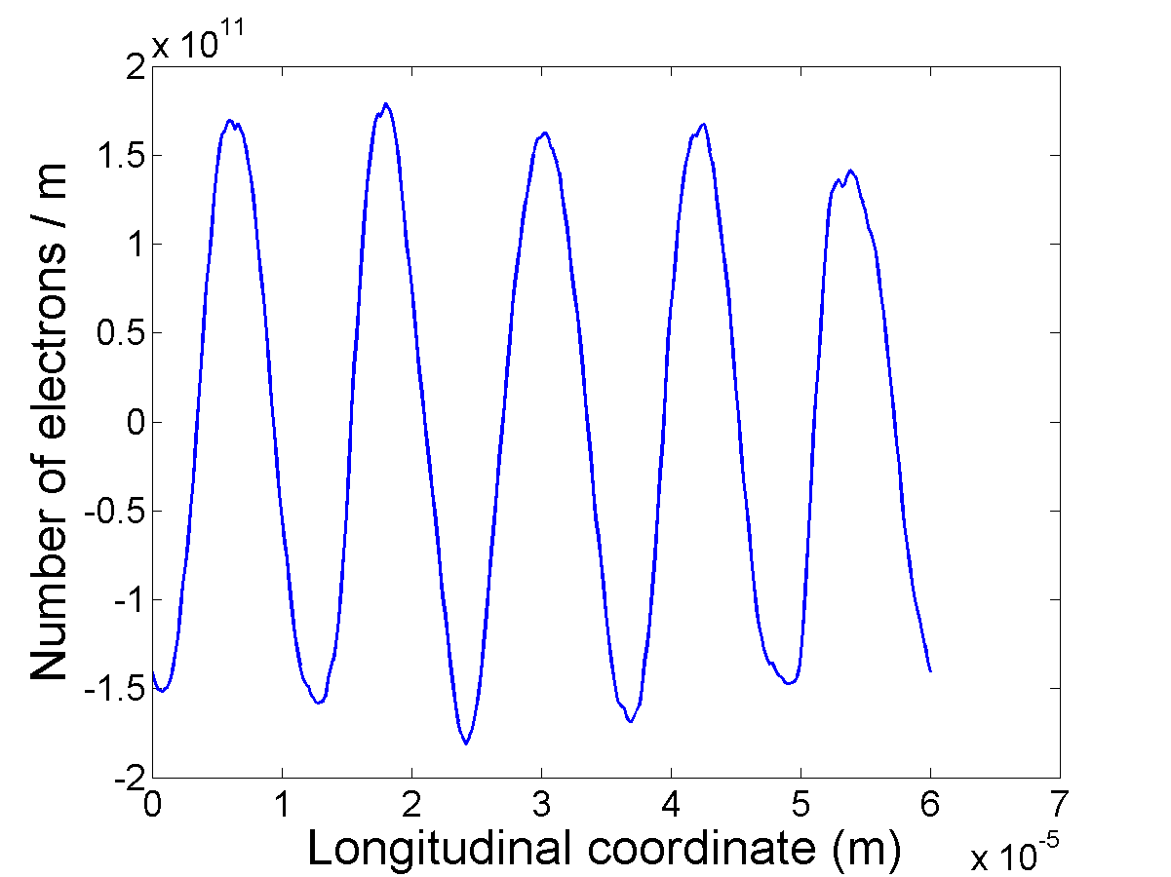
γ=28.5 test. Amplification at 25 THz
Initial density modulation
1 cell - 2 m
2 cells - 4 m
3 cells - 6 m
4 cells - 8 m
Jun Ma

Slide 20
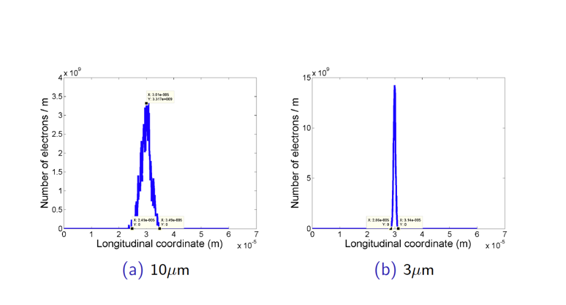
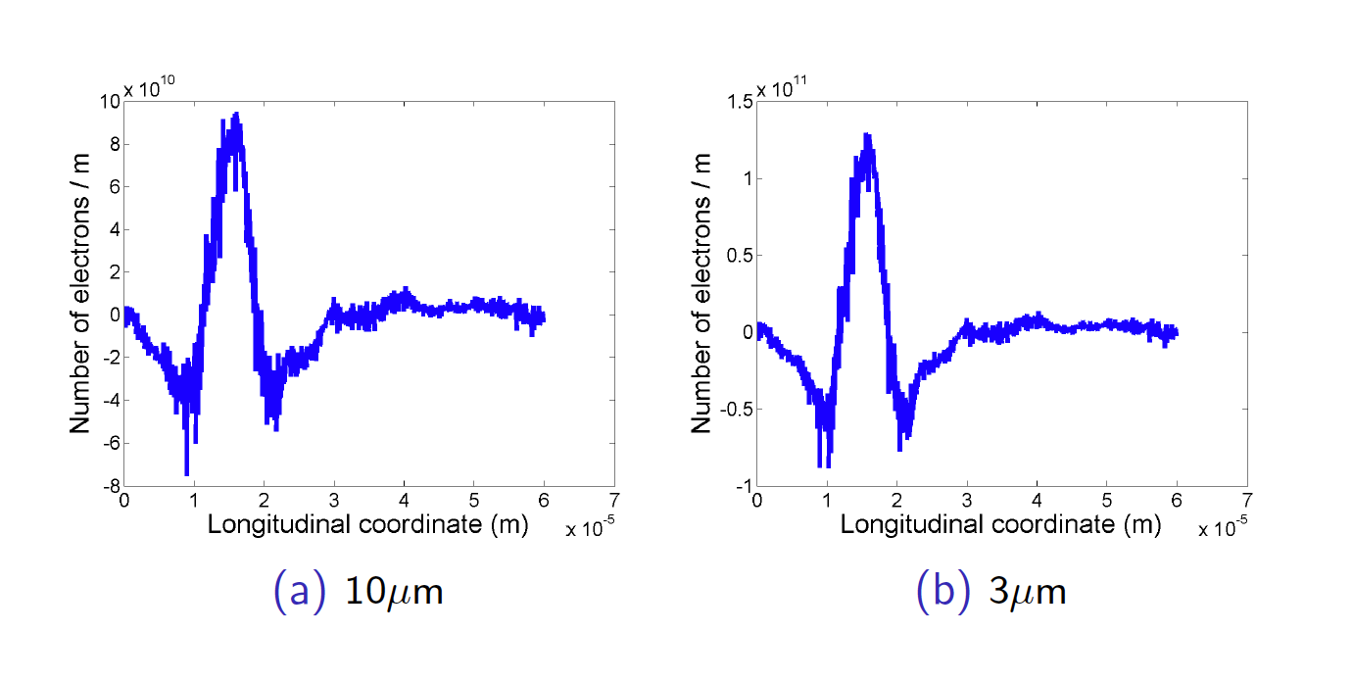
Amplifying single hadron imprint

Slide 21
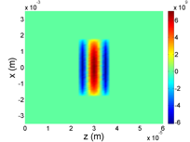
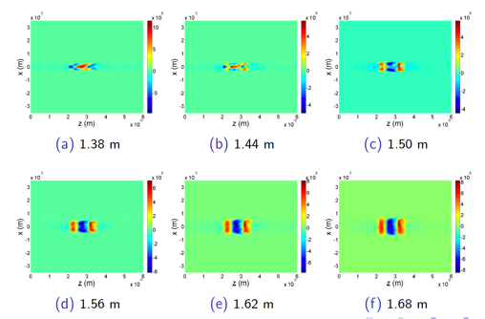
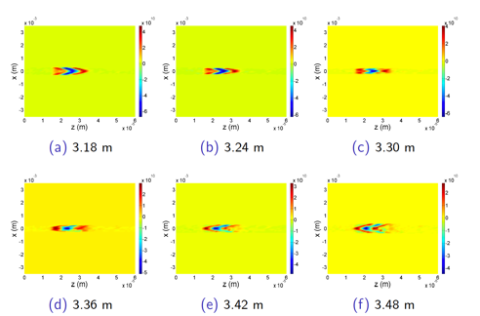
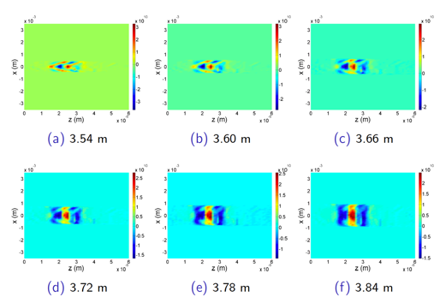
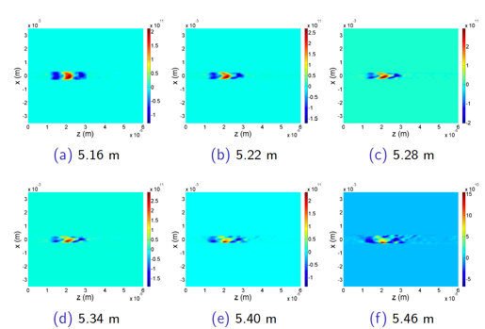
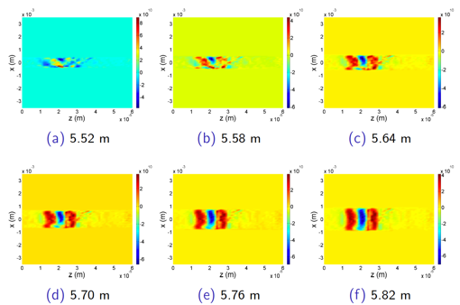
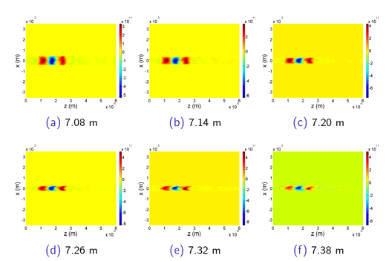
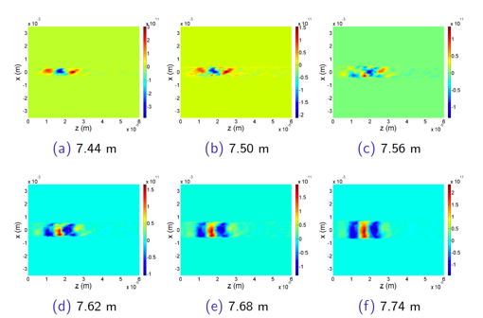

4-cell PCA and 3D Langmuir waves

Slide 22


4-cell PCA and 3D Langmuir waves
... and the kicker

Slide 23


Critical conditions for the stochastic cooler
Linearity: Amplifier must be linear (no saturation) and low noise
Overlapping: Amplified signal induced by individual particle in the modulator (pick-up, sensor) must overlap with the particle in the kicker
Bandwidth: Does not matter how high is the gain of amplifier, cooling decrement per turn can not exceed 1/N_{s}, where is number of the particles in fitting inside the response time of the system: τ~ 1/Δf
S. van der Meer
1984 Nobel physics prize
RF stochastic cooling is reaching its limits at ~ 10 GHz bandwidth
S. van der Meer, Rev. Mod.Phys. 57, (1985) p.689
S. van der Meer, 1972, Stochastic cooling of betatron oscillations is ISR, CERN/ISR-PO/72-31
Notes:
Can it work for a bunched beam?

