Slide 1

NPP Program Advisory Committee Meeting
BNL, June 2019
Status Update of the
STAR Forward Upgrade
E.C. Aschenauer

Slide 2
The 2021+ Physics program with fSTAR
Forward-rapidity 2.8<η<4.2
A+A
p+p & p+A
Observables:
inclusive and di-jets
hadrons in jets
Lambda’s
correlations mid-forward & forward-forward rapidity
Requirements:
good e/h separation
hadrons, photon, π⁰ identification
Beam:
Full Energy AuAu
Physics Topics:
Temperature
dependence of
viscosity through
flow harmonics up
to η~4
Longitudinal
decorrelation up to
η~4
Global Lambda
Polarization
→ strong rapidity
dependence
Beam:
500 GeV: p+p
200 GeV: p+p and p+A
Physics Topics:
TMD measurements at
high x
transversity → tensor
charge
Improve statistical
precision for Sivers
through DY
Δg(x,Q²) at low x through Di-jets
Gluon PDFs for nuclei
R_{pA} for direct photons & DY
Test of Saturation
predictions through
di-hadrons, γ-Jets
2021/22: 500 GeV polarized pp run
All other data taking in parallel to sPHENIX data taking campaign: AA, pA, pp

Slide 3
Key Performance Requirements
Requirements from Physics:
Detector | pp and pA | AA
ECal | ~10%/√E | ~20%/√E
HCal | ~50%/√E+10% | ---
Tracking | charge separation photon suppression | 0.2<p_{T}<2 GeV/c with 20-30% 1/p_{T}
Global Requirements:
RHIC operations schedule requires
  Installation needs to be done without rolling STAR into assembly hall
  use currently installed inner TPC cone and the “non-HFT” beam pipe
Si-tracker installation and maintenance need to be done without breaking the beam vacuum
  avoid time consuming beamline bake out
sTGC: electronics needs to be as much as possible outside the acceptance of the event plane detector and the forward calorimeters
  sTGC needs to have a simple mounting scheme → fast access to Si-detector
HCal and ECal need to be movable to allow access to the pump and the RHIC beam pipe
ready for physics data taking starting September 2021

Slide 4
High-Level Summary: Scope ECal & HCal
Location: 7 m from the IP on the “FMS platform”
Readout: SiPMs
Used in Trigger
Split in 2 movable halves inside and outside of ring
Slightly projective
ECal:
reuse PHENIX PbSC calorimeter with new readout on front phase → 1496 channels
  Secured one Sector (2592 towers) PbSc towers: 5.52 x 5.52 x 33 cm³ (18 X₀)
66 sampling cells with 1.5 mm Pb,
4 mm SC & Wavelength shifting fibers
HCal:
Fe/Sc (20mm/3 mm) sandwich.
520 readout channels
Lateral tower size 10 x 10 cm², ~ 4.5 λ
  in close collaboration with EIC R&D
Preshower
Reuse 2 of the existing planes from the FMS-pre-shower operated in 2015 & 2017
SC-slats with SiPM readout

Slide 5
High-Level Summary: Scope Si & sTGC
3 Silicon disks: at 139.9, 163.2, and 186.5 cm from IP
Built on successful experience with STAR IST
Single-sided double-metal mini-strip sensors
  Granularity: fine in φ and coarse in R
  Si from Hamamatsu
Frontend chips: APV25-S1 → IST all in hand
Material budget: <1% per disk
Reuse
  IST DAQ system for FTS
  IST cooling system
Si + sTGC
4 sTGC disks: at 273, 303, 333 and 363 cm from IP
location inside Magnet pole tip opening
  inhomogeneous magnetic field
4 quadrants double sided sTGC → 1 layer
  x,y and diagonal strips
Position resolution: ~100 μm
Material budget: ~0.5% per layer,
Readout: based on SAMPA (iTPC) or VMM (ATLAS)
  22000 channels

Slide 6

Technical, Cost, Risk and Schedule Review
OUTCOME
A five-member review panel (S. Boose, C. Miraval, G. van Nieuwenhuizen,
Tricoli, and chaired by G. Young) conducted a review of the resource
requirements for the proposed forward upgrades to the STAR detector on
November 19, 2018. The panel noted good progress on the proposed concept
for a cold-QCD experiment to run in late 2021 at RHIC, with plausible plans for
funding and conservative designs for all detector components, electronics, and
support infrastructure. The panel opined that the major project risks are
identified and that the experiment appears positioned to be ready for first
operation in 2021, with the caveat that the critical path, which is the silicon
detector, presently has very little float. BNL management has begun
discussions with ONP about the implementation of the proposed upgrade.

Slide 7
Schedule: Important Milestone Dates
Shutdowns for Installation:
1st: August 2019 to January 2020
2nd: August 2020 to January 2021
3rd: May 2021 to August 2021
Calorimeter platform modification and ECal stacking during 1st shutdown
  towers ready for installation
HCal, SiPMs and all readout electronics (FEE, DEP and Trigger) installation during 2nd shutdown
sTGC installation during 2nd shutdown
system check during spring 2021 running
Silicon detector installation Summer 2021
  building and testing prototype modules in 2019
  start of detector production 2020 and completed in early 2021,
  defines critical path
Start of data 500 GeV pp taking in coordination with sPHENIX
  minimize impact
ECal
HCal
FEE
Electronics
sTGC
Silicon
Integration

Slide 8
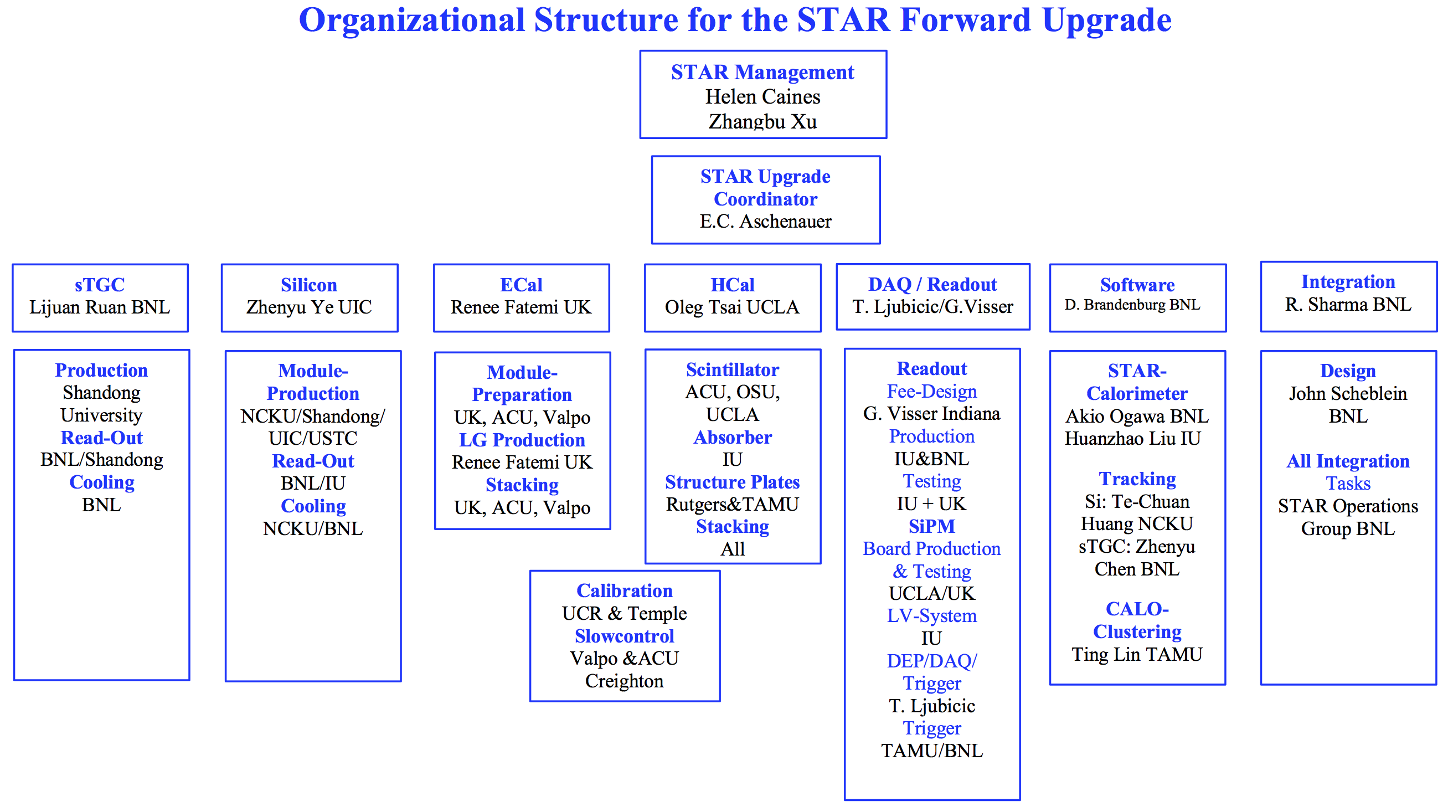
Organizational Structure STAR Forward Upgrade
and the STAR collaboration, which stands enthusiastically behind the upgrade

Slide 9







Organizational Structure STAR Forward Upgrade
Dedicated manpower with large expertise for each subsystem
sTGC
Silicon
ECal
HCal
DAQ/Readout
Software
Integration
Calibration
Slow Controls
and the STAR collaboration, which stands enthusiastically behind the upgrade

Slide 10
Funding Sources
utilize different funding sources
NSF MRI (Lead University IU) submitted to NSF January 2019
  Calorimetry, Readout & Trigger Electronics M&S and large fraction of labor
  very positive feedback from NSF suggest to fund 92% of request
  Awaiting final response from NSF Division of Grants and Agreements
    fully expect funding
International Funding sources
  sTGC through Shandong University & BNL-LDRD
  Silicon detector M&S and large fraction of labor through
    NCKU in Taiwan
    start up funds Shandong University (Prof. Li)
    Proposal to NSFC
BNL → keep cost to BNL at a minimum

Slide 11

STATUS

Slide 12
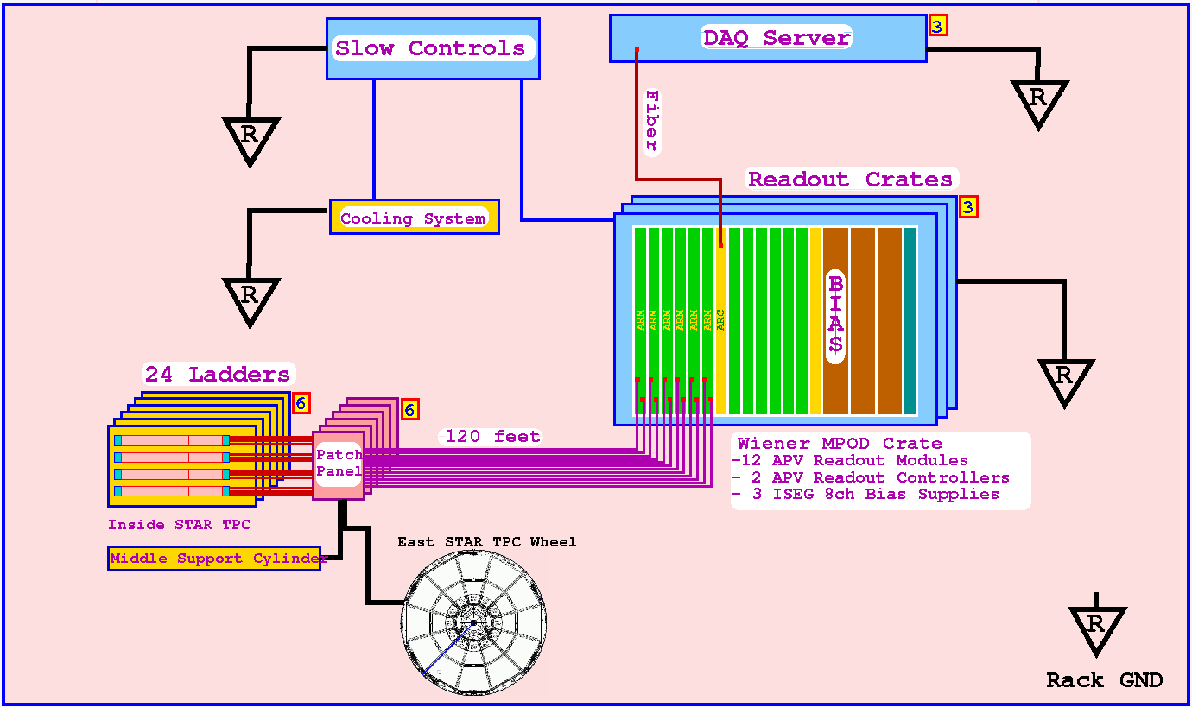
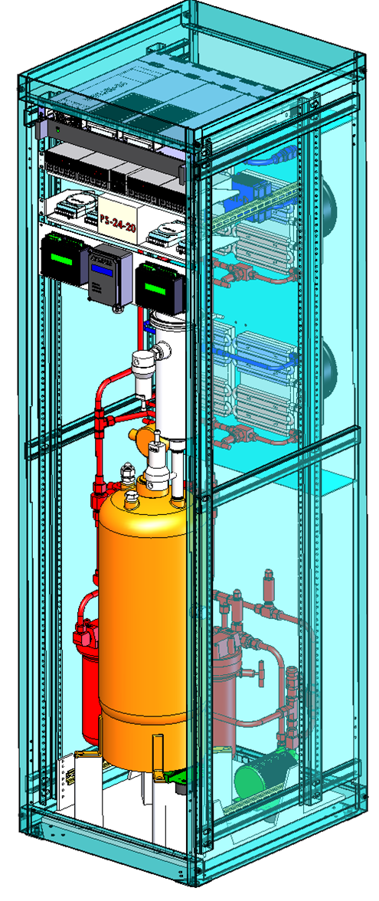
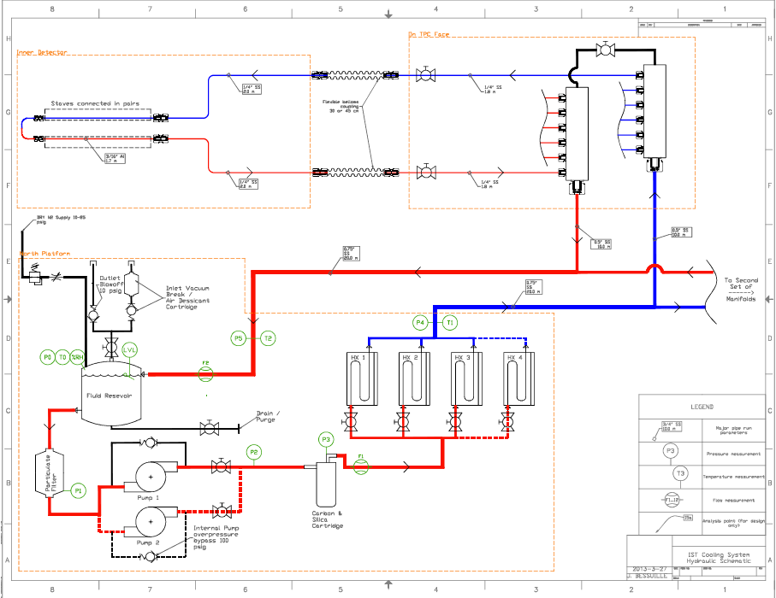
STAR Forward Silicon Tracker
Three layers of identical Silicon disks
  Silicon microstrip sensors
  APV25 frontend readout chips
  Flexible hybrid
  Mechanical structure
DAQ system
  Inner signal cables
  Outer signal cables, patch panel boards, readout modules, readout controllers, crates
Cooling system
  cooling manifold, cooling lines
  rack (cooler, pumps)
Integration
  supporting structure
Current Focus
The project is currently in the R&D phase to build prototype detector modules,
including Silicon sensors, hybrids, mechanical structures, T-boards, inner signal cables.
.
Blue: existing Red: new
Notes:
Let me describe how the FST looks like and how it will be built.

Slide 13
STAR Forward Silicon Tracker – Module Design
cooling tube
T-board
Silicon sensor:
SDU/UIC
APV25:
UIC
Hybrid, T-board:
SDU/BNL
Mechanical structure:
NCKU
outer hybrid
inner hybrid
outer silicon sensor
APV25 chips
Supporting structure:
BNL
Cooling system:
BNL/NCKU
DAQ system:
BNL/Indiana
inner silicon sensor
mechanical structure

Slide 14
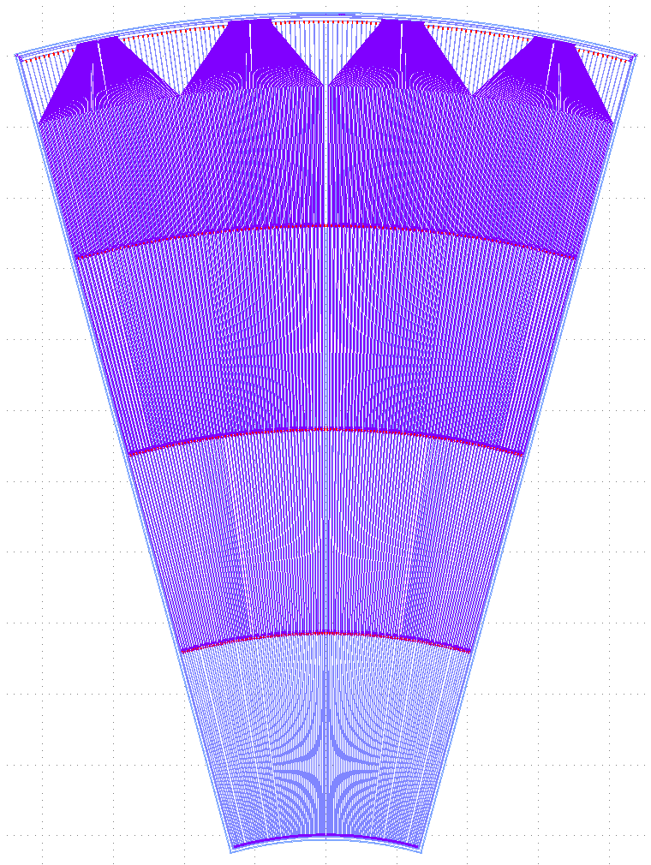
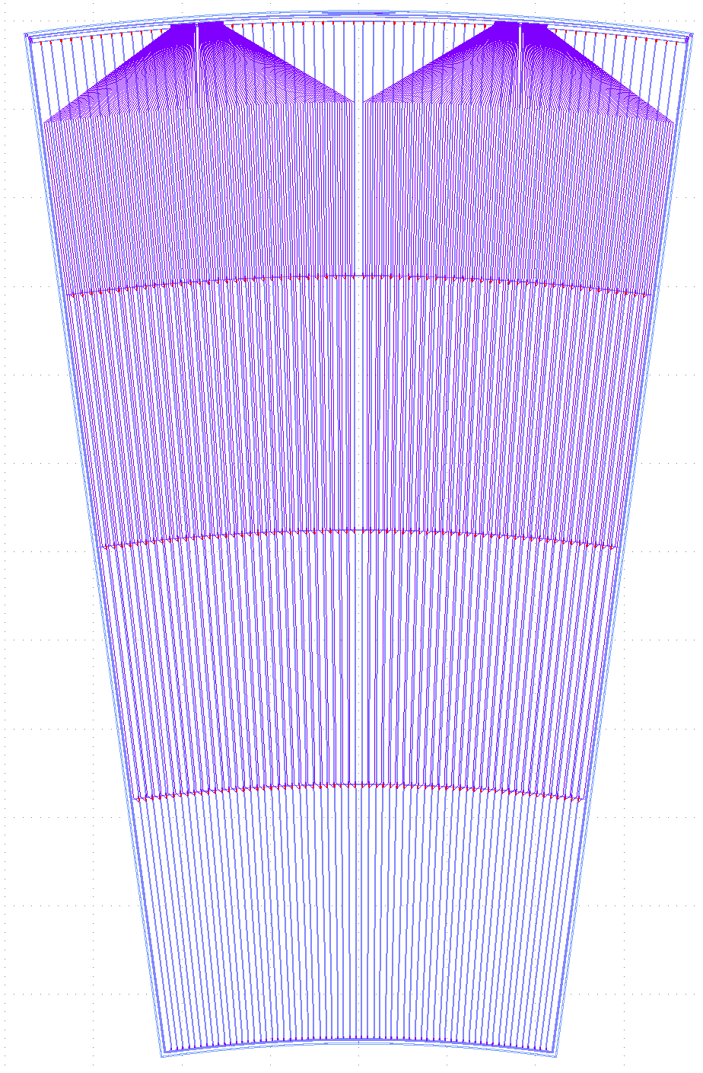
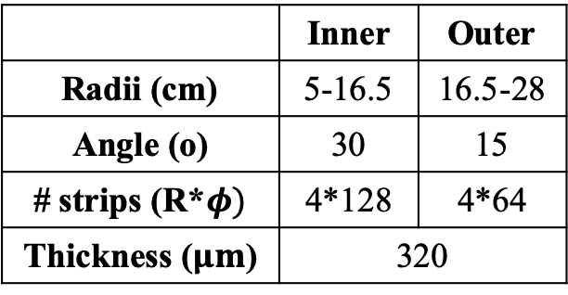
STAR Forward Silicon Tracker – Silicon Sensor
Hamamatsu Sensors
 | Inner | Outer
Radii (cm) | 5-16.5 | 16.5-28
Angle (o) | 30 | 15
# strips (R*$φ)$ | 4*128 | 4*64
Thickness ($μm$) | 320
~ 12 cm
Design completed at UIC in 2019/1
4+6 prototype sensors ordered in 2019/2
Prototype sensor delivery in 2019/8
48+96 production sensors in 2020/8
Performance and QA tests at SDU/UIC
inner sensor
outer sensor
NDL Sensors
Investigation into Si sensor production capability via National Nano Device Lab
Design completed in 2018/7
1st batch received in 2019/1
2nd batch expected in 2019/7
Performance tests at NCKU/SDU/UIC

Slide 15
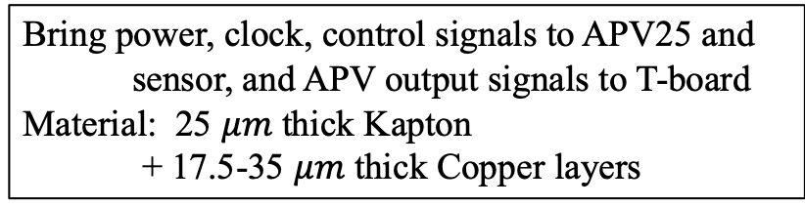
STAR Forward Silicon Tracker – Flexible Hybrid
inner hybrid
outer hybrid
~ 25 cm
design
photograph
Bring power, clock, control signals to APV25 and
sensor, and APV output signals to T-board
Material: 25 $μm$ thick Kapton
+ 17.5-35 $μm$ thick Copper layers
design
photograph
1st version design completed at SDU in 2019/2
hybrids received from BLAN Technology @ Shanghai in 2019/3
2nd version design on-going at SDU: small adjustment of size and connector
new hybrids to be received in 2019/6
Final version hybrids to be received in 2020/3

Slide 16
STAR Forward Silicon Tracker – Mechanical Structure
Solidwork Drawings
Photographs
1st version design completed at NCKU in 2019/2
structures with uneven surface received from AIDC in 2019/3
2nd version design on-going at NCKU: change material and thickness; thermal-stress
simulation and mock setup to study air cooling option
assembled structures to be delivered in 2019/7
Final version mechanical structures to be received in 2020/5

Slide 17
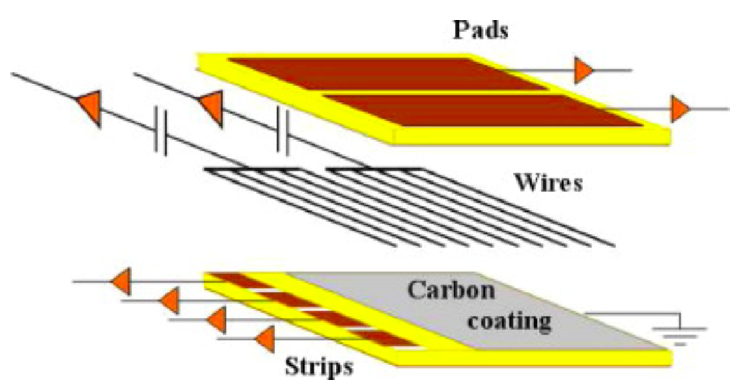
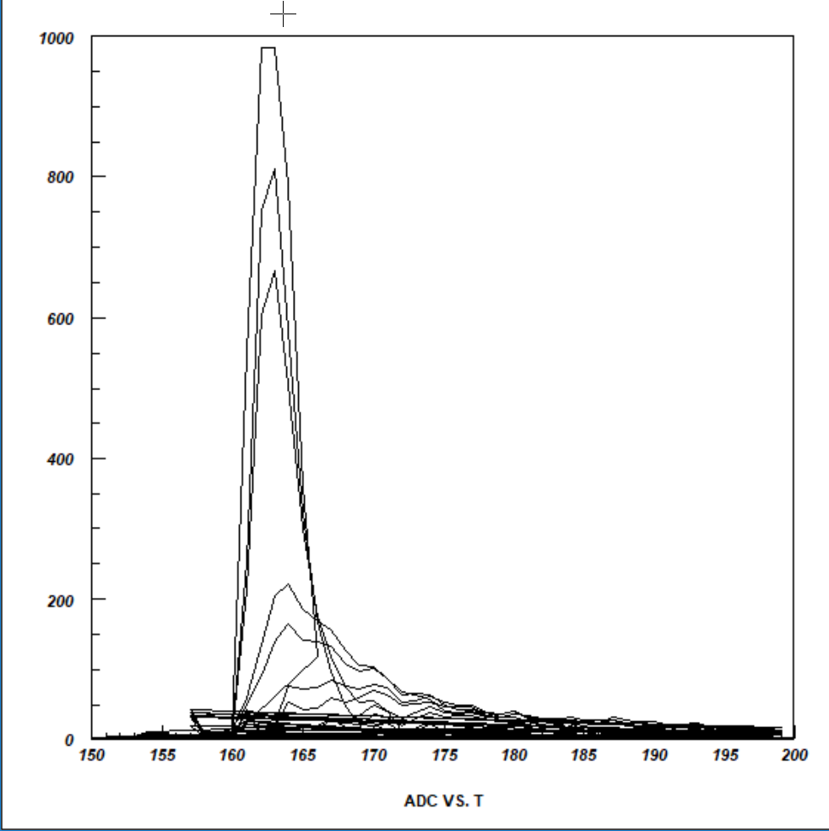
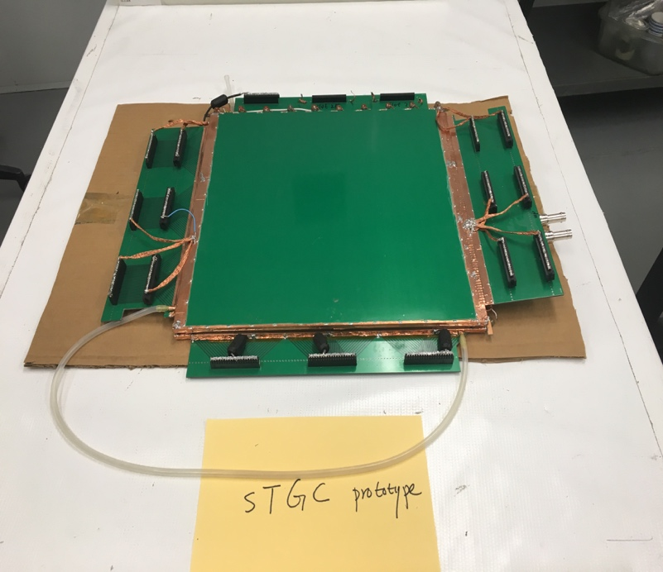
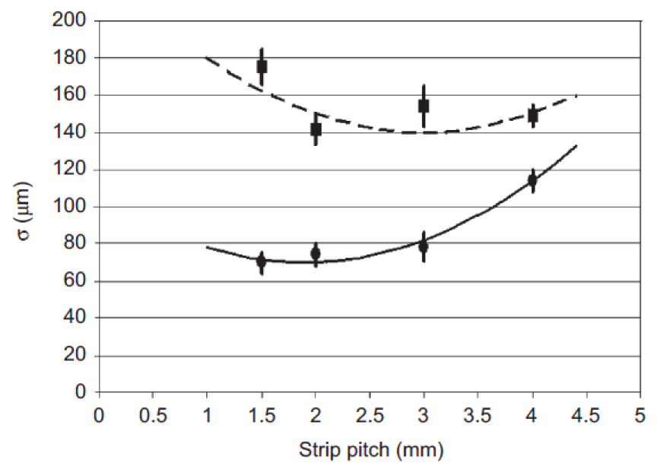
sTGC module production
Modules produced at Shandong University (SDU)
  the same group, which just finished the iTPC module production
  established procedure to build and test an sTGC module for STAR
  funds are available now.
30 cm x 30cm prototype built and tested with TPX electronics at SDU last year,
prototype shipped to BNL in Jan. 2019 → installed to STAR on June 5, 2019.
SDU: currently building another 3 prototypes of 60 cm x 60 cm.
  performance results such as position resolution, efficiency with different gas mixtures this summer.
20-30º
0-10º

Slide 18
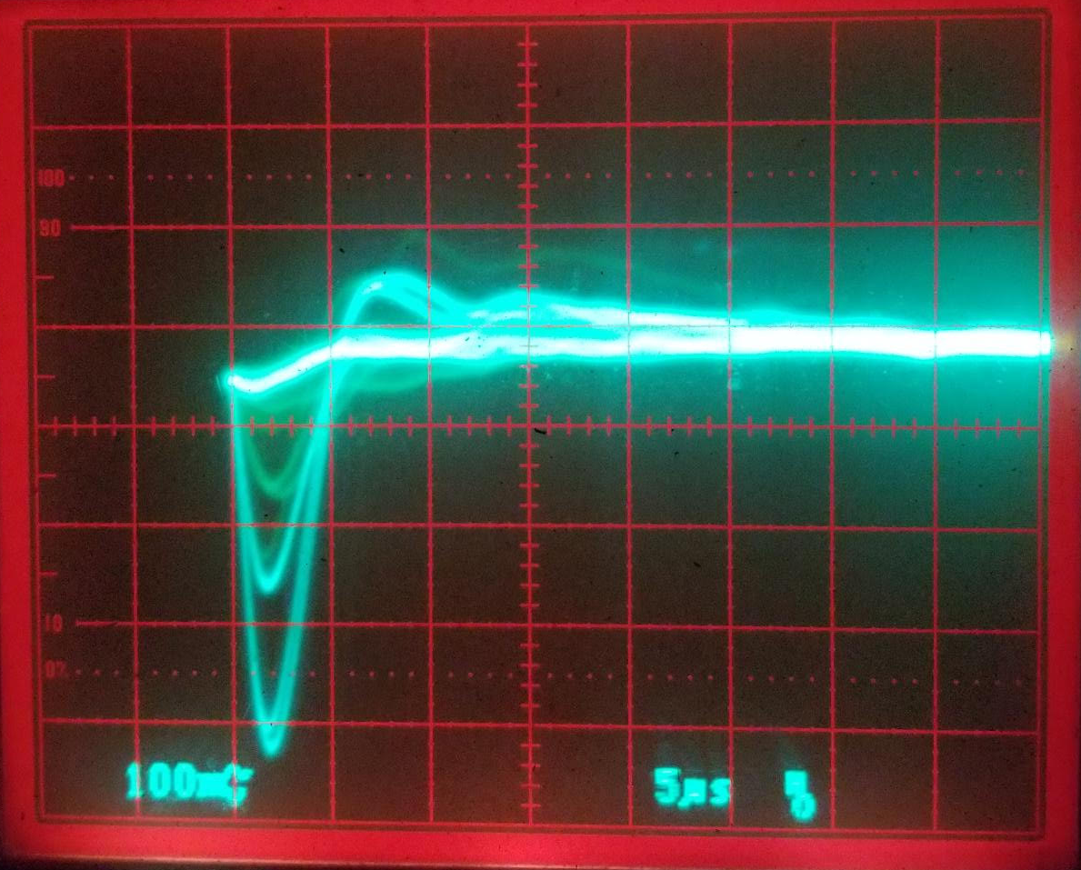
sTGC gas
Optimal sTGC gas mixture: 45% n-pentane and 55% CO2
→ n-pentane is flammable.
→ Gas flow rate: less than 400 ccm.
The review committee in Nov. 2018 recommended us to look for alternative options.
BNL:
tried different gas mixtures → chose C10 (90% Argon + 10% CO2) for run19 test.
→ good signal however the efficiency is as low as 10%.
→ SDU: test of 3 new prototypes with different gas mixtures this summer.
contacted ATLAS experts and are working on solutions for running n-pentane gas.
  plan to finalize the gas option this summer.
Strips 1325 V (Pre+post) amp

Slide 19
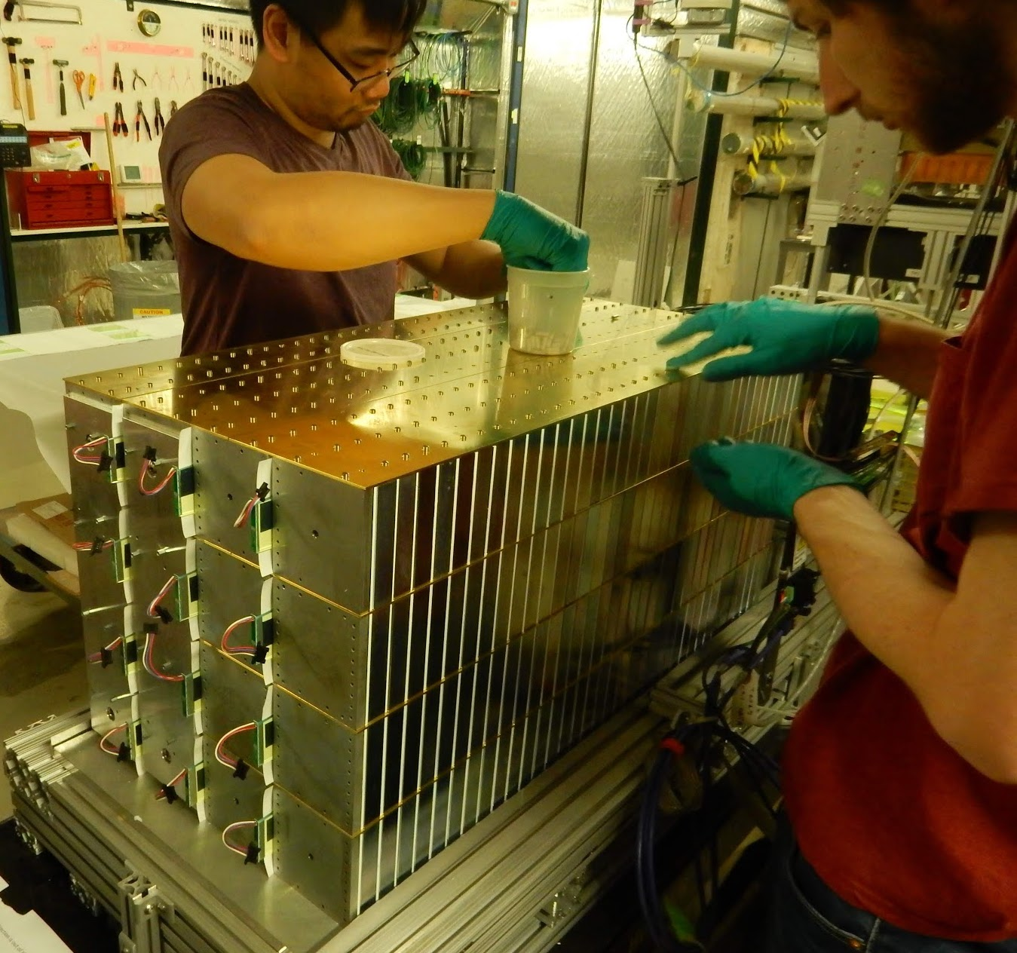
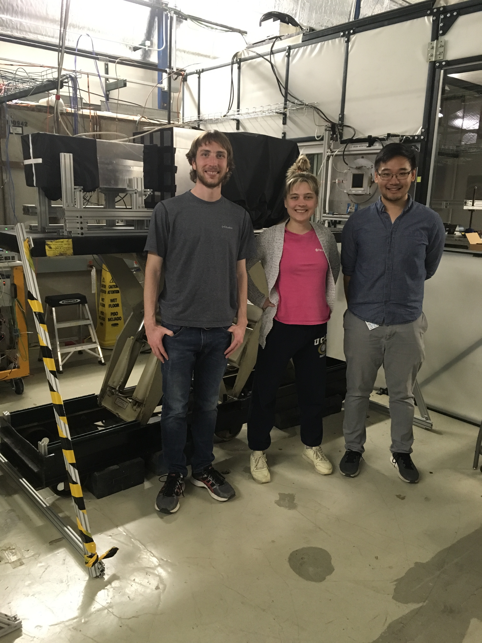
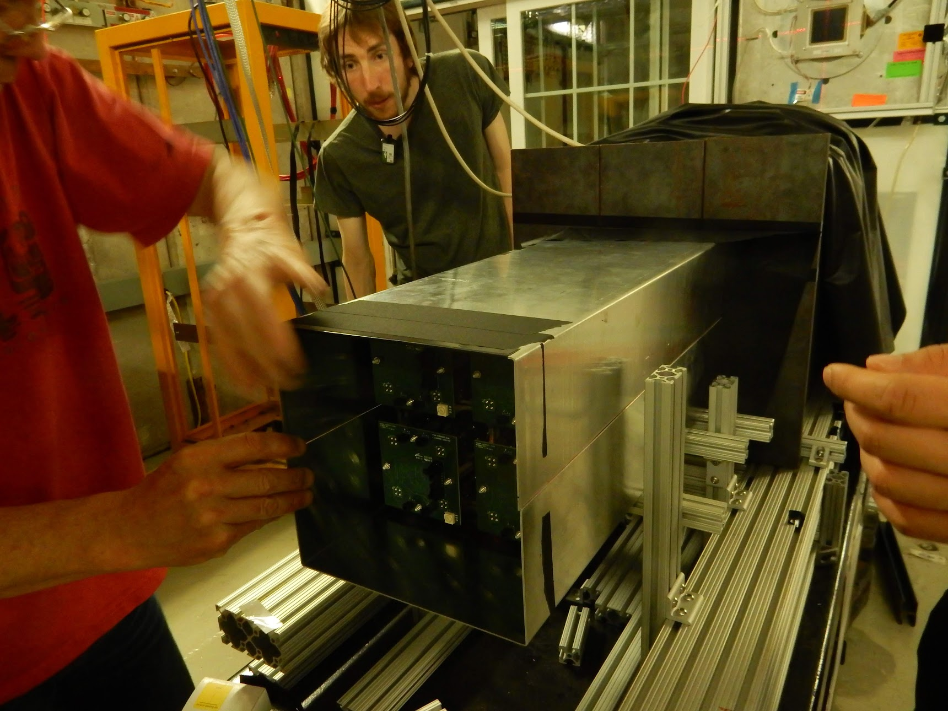
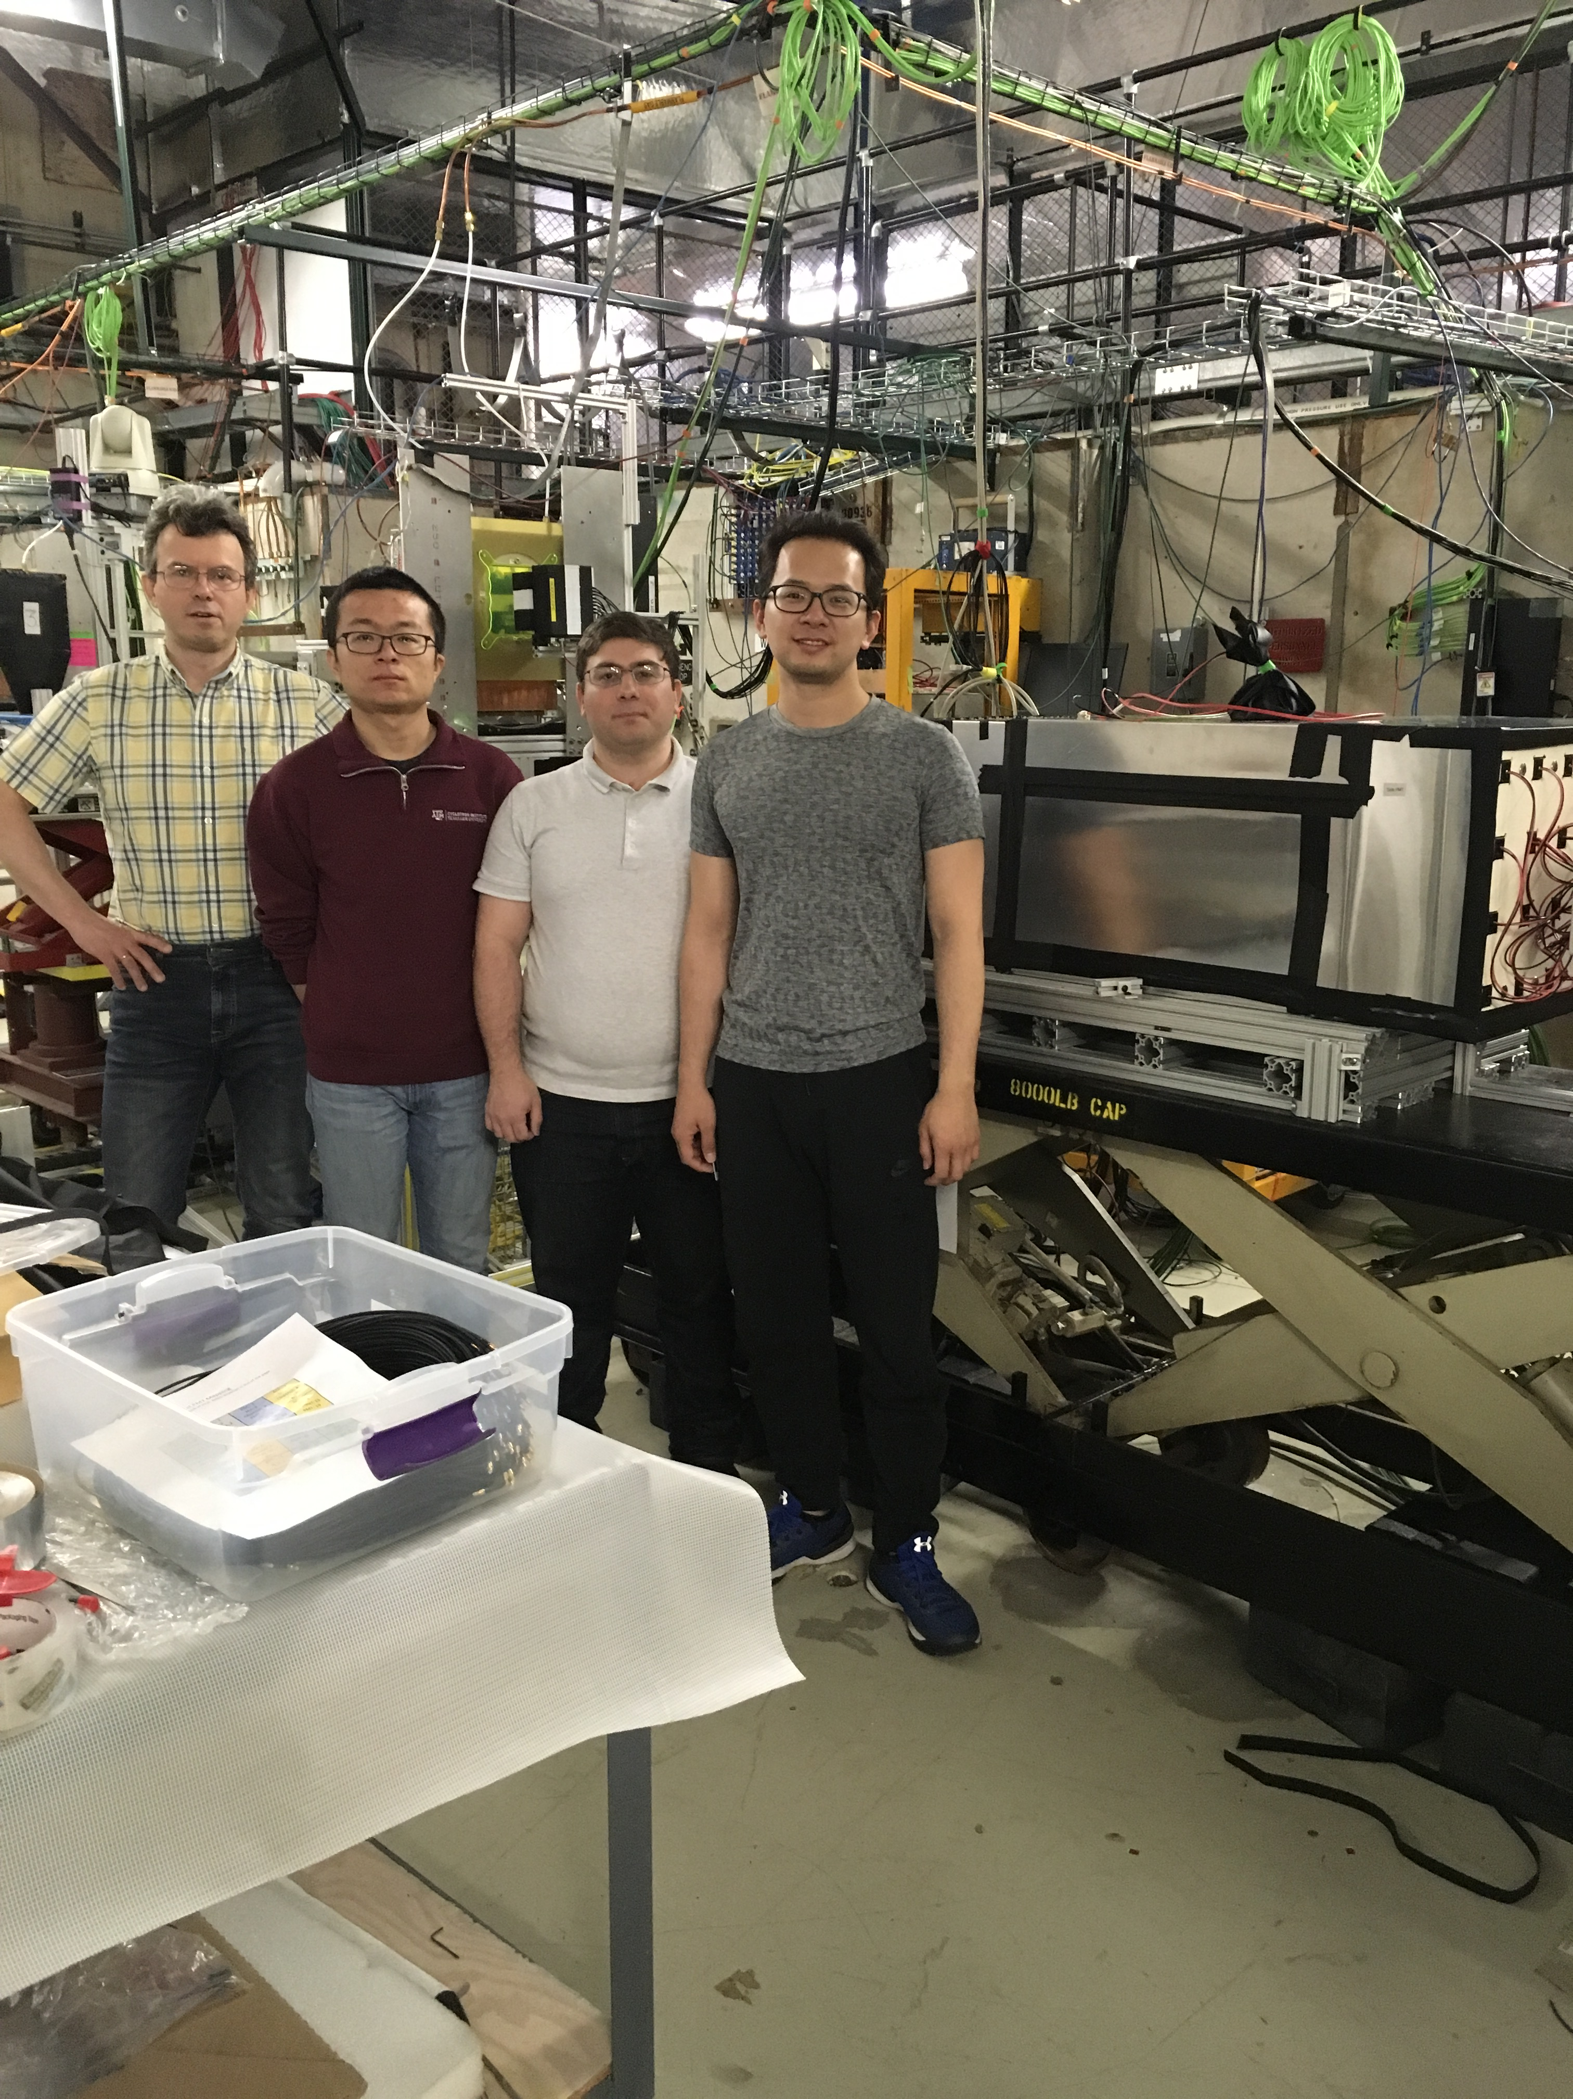
Forward Calorimeter System
FNAL Test Beam
4x4 Ecal, 4x4 HCal
April 2019
ECal
HCal
A. Kiselev (BNL)
T. Lin (TAMU)
D. Kapukchyan (UCR)
D. Chen (UCR)
G. Visser (IUCF)
O. Tsai (UCLA)
D. Neff (UCLA)
M.Sergeeva (UCLA)
B. Chan (UCLA)

Slide 20
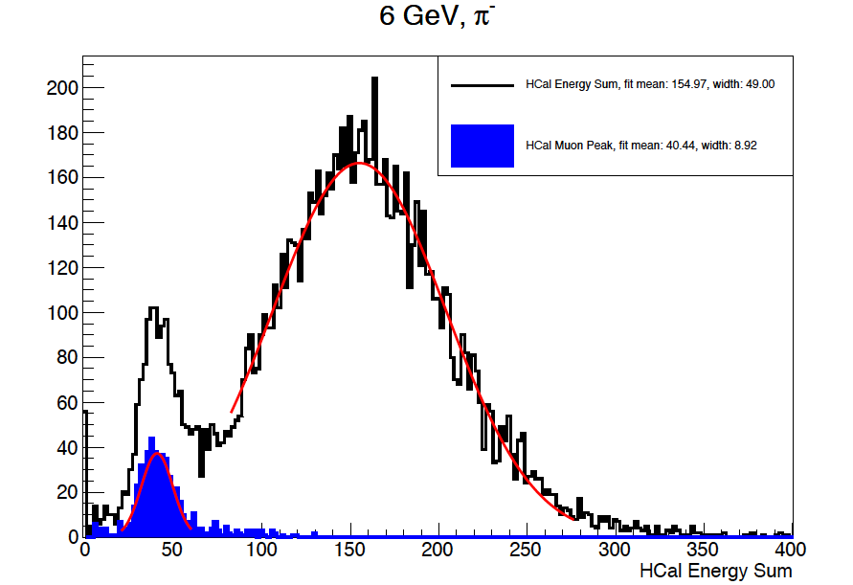
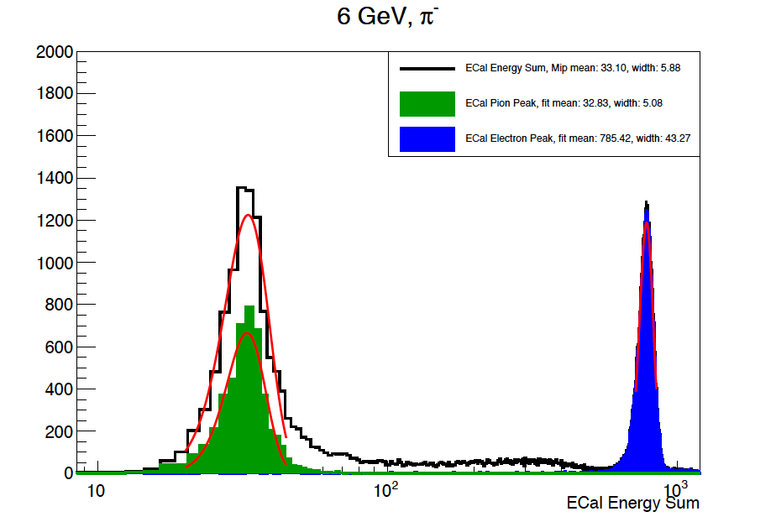
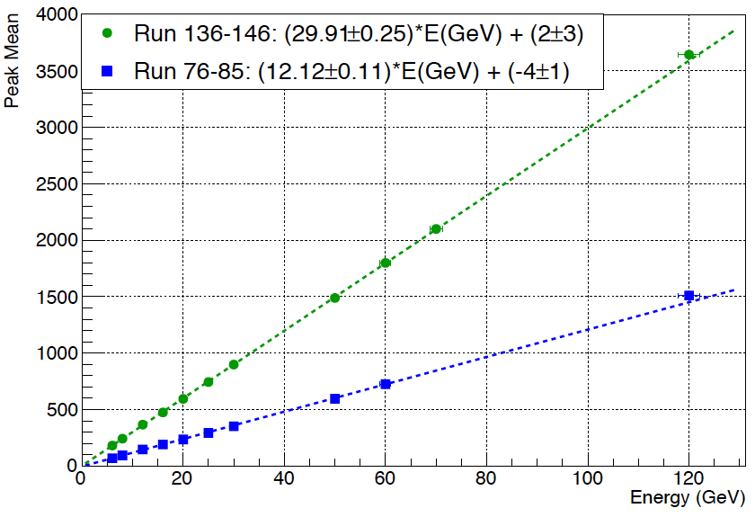
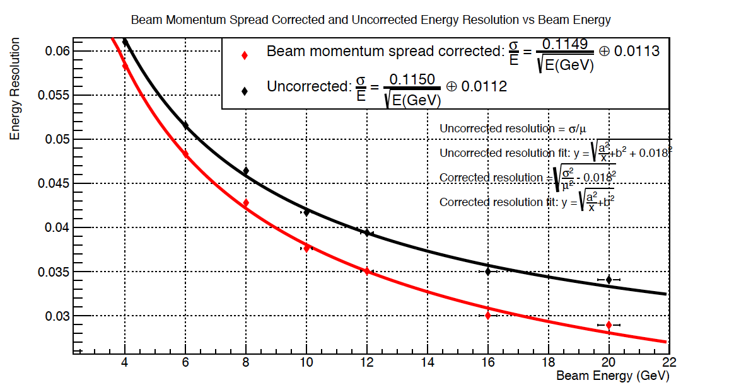
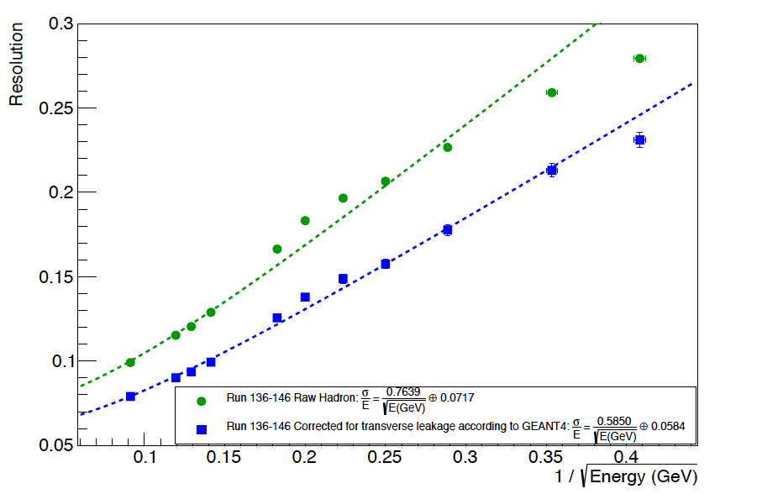
FNAL: ECAL & HCAL
Responses to e/h/MIP/mu.
Good linearity up to 120 GeV
EM resolution as expected
HAD resolution reasonable, will be improved with better light collection system.
6 GeV π-
6 GeV π-
Hadron E linearity

Slide 21
Current Status and near term Plans
Mechanical designs of ECal and HCal assemblies basically completed.
One Phenix ECal supersector prepared for modifications of all ECal towers needed for FCS.
EJ Light Guide gluing will start on June 17’th
‘Factories’ are preparing for mass production.
10% of scintillation sheets from EJ spread between UCLA/ACU/OSU machine
shops (some test production runs done already).
Machining of first batch of sc. tiles will be finished by mid July.
Painting polishing sc. tiles edges will be done by mid Aug.
10% of SiPMs will arrive from HPK mid. Aug.
Assembly and testing of ~ 10% of ECal SiPM boards Aug.- Sep.
Stacking of ECal in alcove early fall 2019.
Involve undergrads and PhD students in all activities

Slide 22
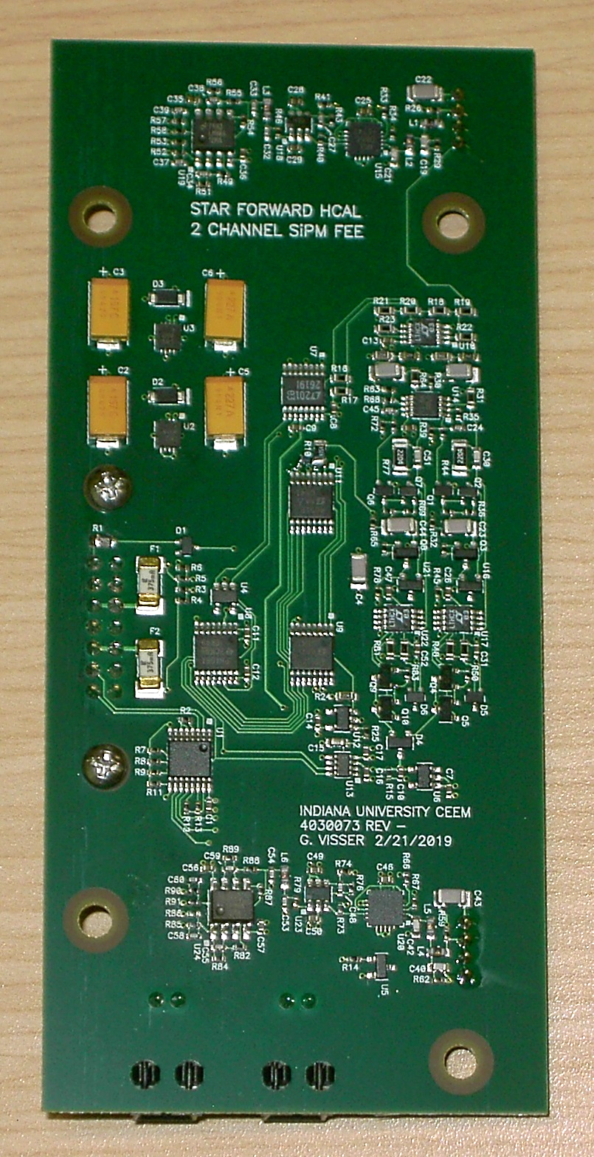
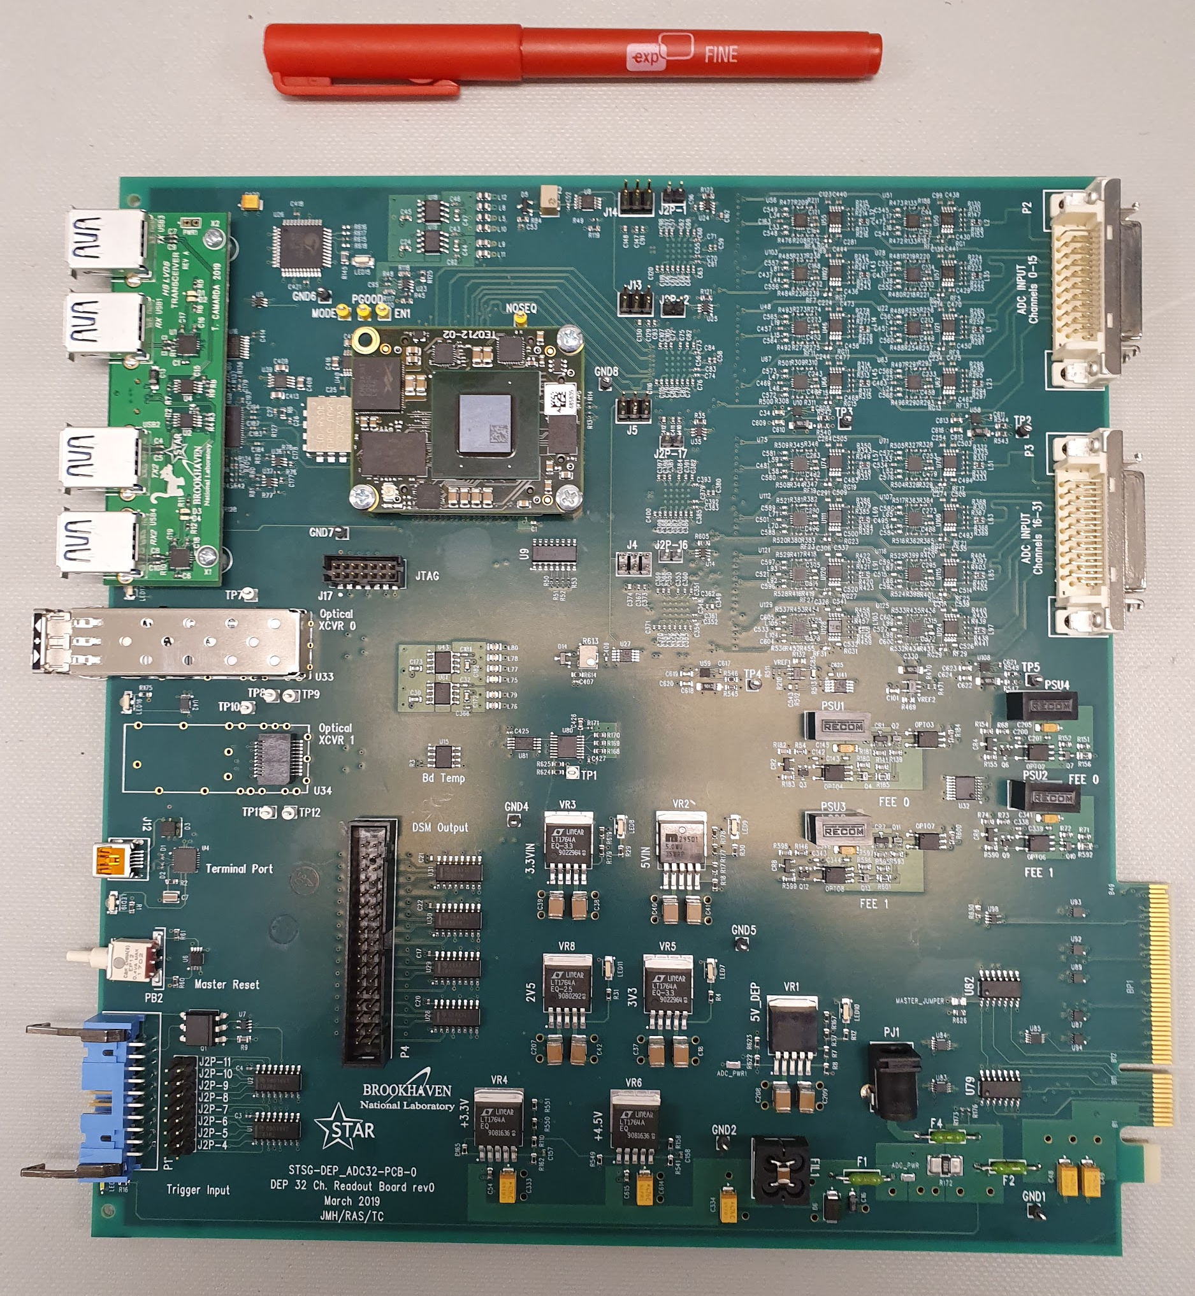
Electronics Status
“Final” Frontend Electronics Cards (“FEE”) Developed
    based on 2017 ECAL FEE, and FPS, FPOST, EPD
    local temperature compensated SiPM bias voltage regulator and current monitor ‒ improved noise and resolution
    full DC coupled signal path for stable baseline
    new high-linearity preamplifier scheme
    gain-switchable preamplifier for high-gain calibration mode
    2 different flavors designed & prototypes manufactured
        HCAL FEE (2 channels/card, built 12)
        ECAL FEE (4 channels/card, built 22)
        ECAL uses new pogo-pin interconnect to SiPM boards ‒ simplified installation and lower cost
HCAL FEE
New Digitization Boards (“DEP boards”) designed & prototyped
  32 ADC channels/board (“final version”)
  each equipped with a fast fiber link
  with fast copper links for trigger primitives
6 boards made
  5 are installed in STAR for the FCS FY19 test
Trigger Logic → fully simulated in Geant:
  Each Ecal and Hcal trigger patch is created by 4x4 towers;
  For each Ecal patch, looking at its closest 2x2 Hcal trigger patches, match to the HCal patch with maximum energy;

Slide 23
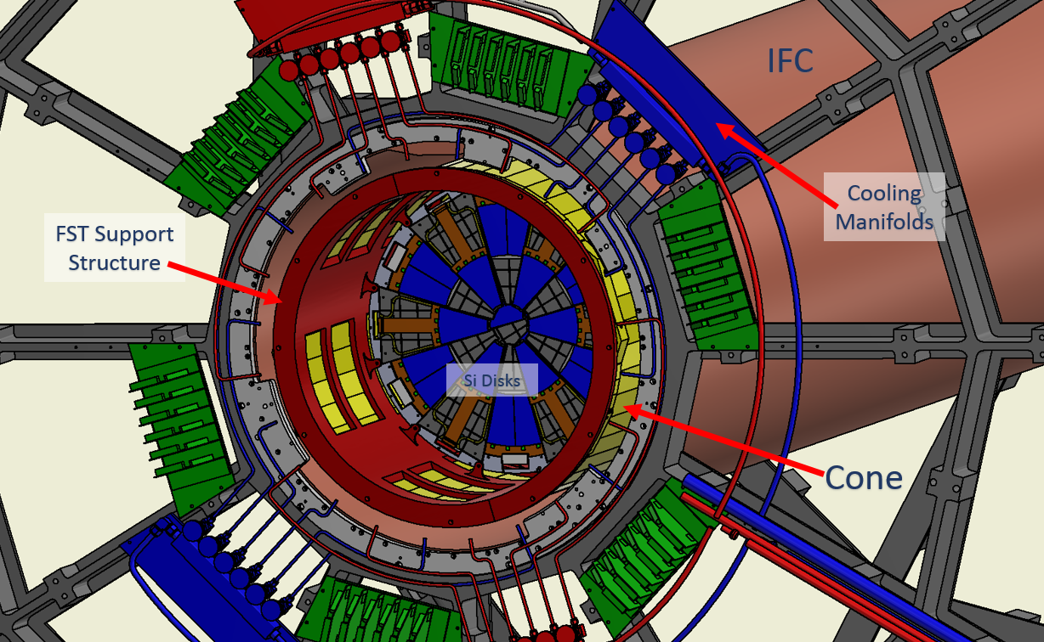
Integration: Silicon
Preliminary Design exists → needs to get finalized by Autumn

Slide 24
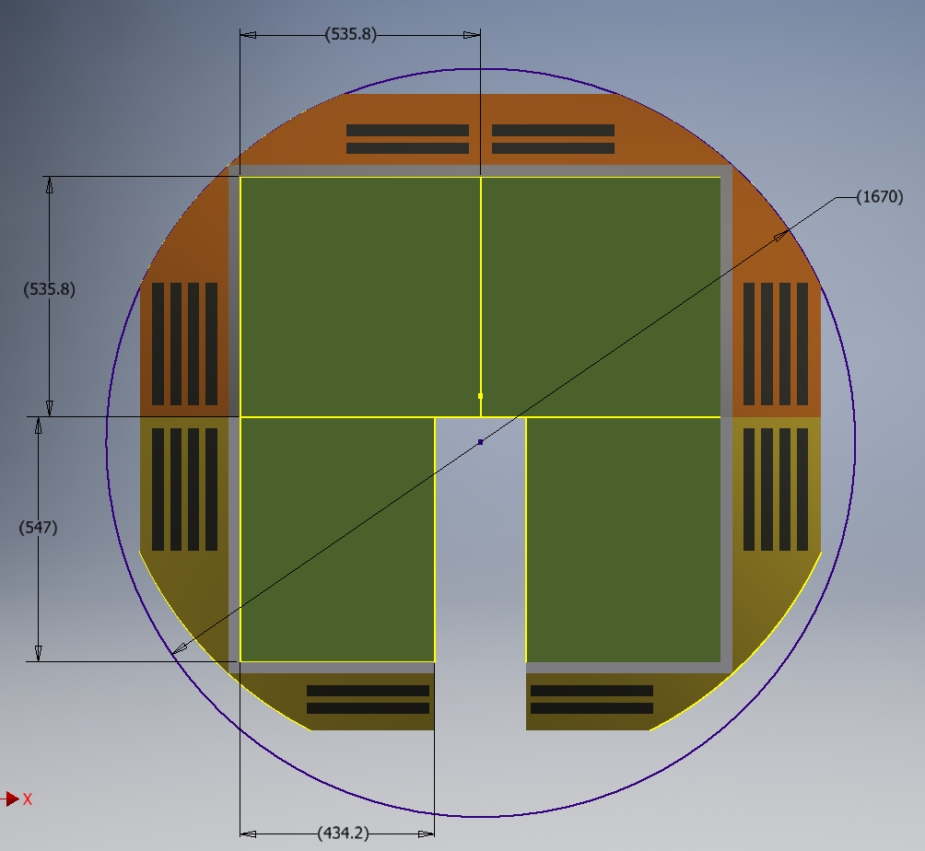
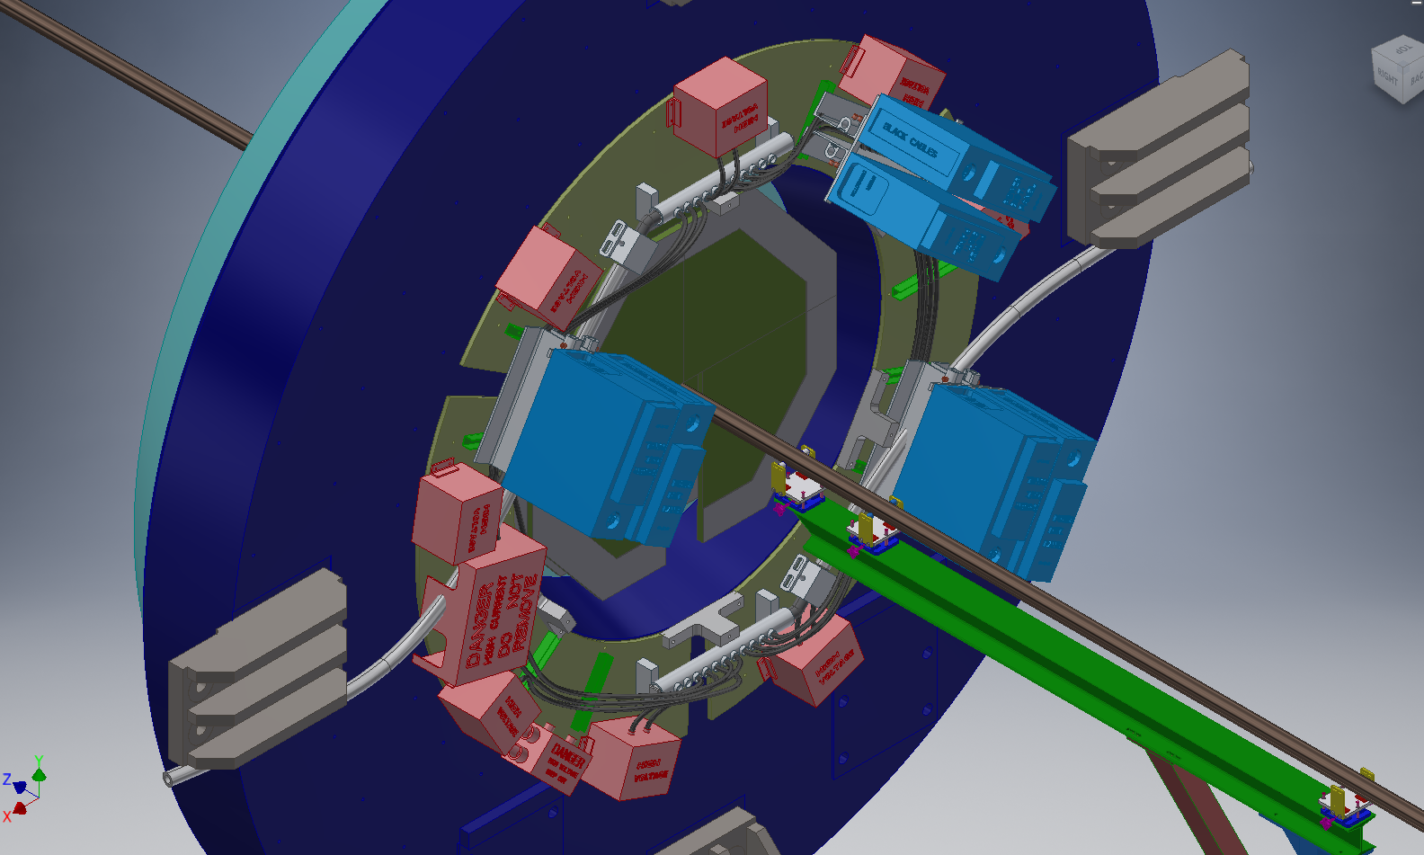
Integration: sTGC
Challenging integration task:
Cutout for clearing beampipe and I beam is need to open West poletip without uninstalling the STSG detector.
Detector design including structure, electronics etc. should fit within the diameters for the planes as shown.

Slide 25
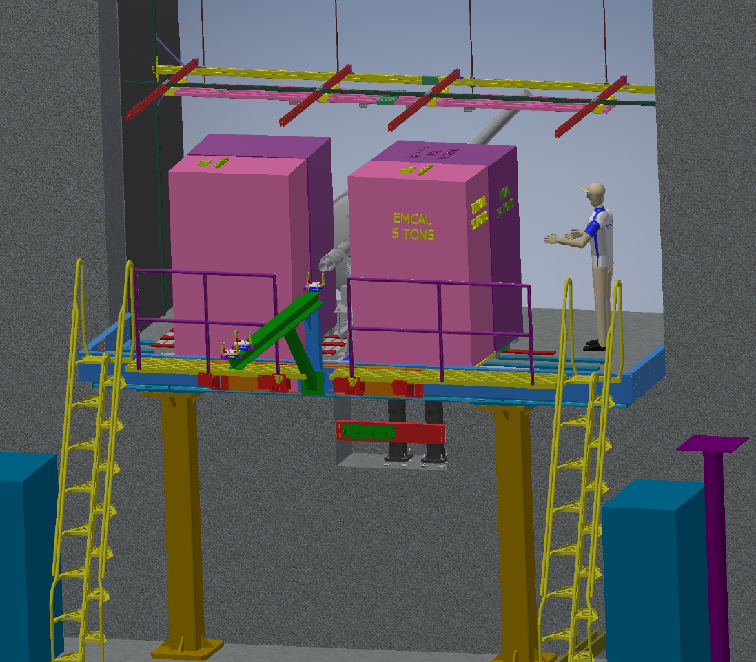
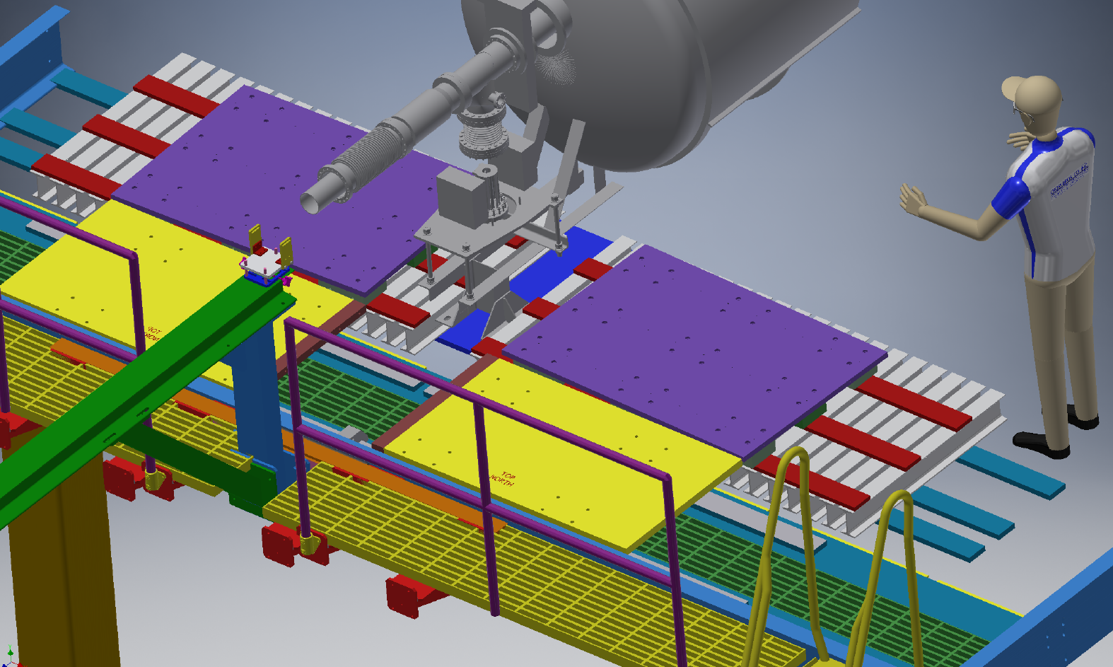
Integration: ECal and HCal
Four new detectors will be installed as a part of Forward Upgrade project at STAR:
HCAL will be on the west wall behind FMS platform towards cryostat. It will weigh ~30 tons.
EMCAL will be at same space as FMS and will weigh approximately same as FMS detector ~10 tons.
Design final
safety review done
last outstanding task before installation a seismic analysis
HCAL Plate and Rollers
5 inch I Beams
and Rails
Existing FMS
Plate
HCAL Plate
and Rollers
Existing FMS
Plate

Slide 26
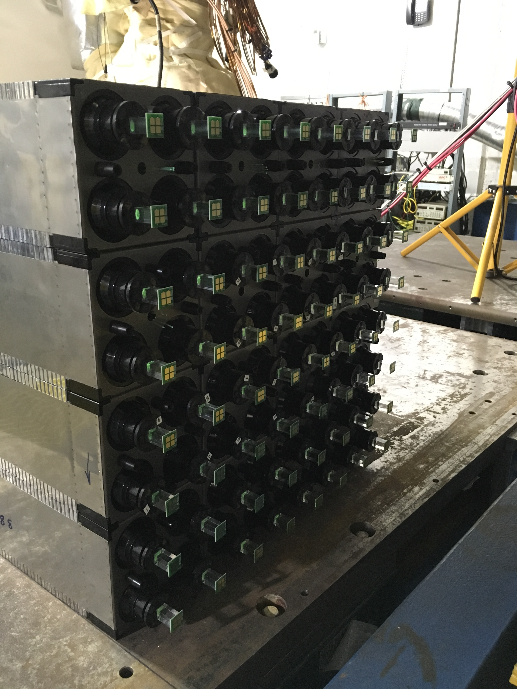
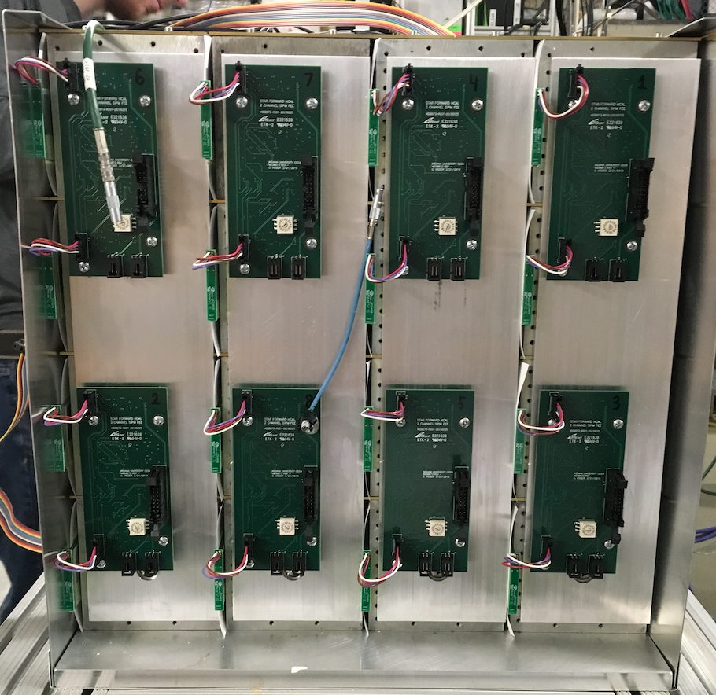
Run 2019 and 2020
Pass to successful Run21 – comprehensive, integrated system testing and operation during RHIC Runs 19, 20.
STAR Run 19
Fully instrumented FCS on May 22’nd
New DEP32 Readout System
8x8 Ecal
4x4 Hcal (arrived in May from FNAL)
Preshower
SiPM readout with new FEEs
LED monitoring system.
Fully instrumented sTGC prototype
Presently:
Commissioning of DEP32 system.
Development of on-line/off-line software.
Development of slow control.
students will be involved in data analysis from this system during summer.
study sTGC operations parameters, i.e. HV
Will operated system also during APEX with 200 GeV AuAu
ECAL Front Side
HCAL Back Side

Slide 27
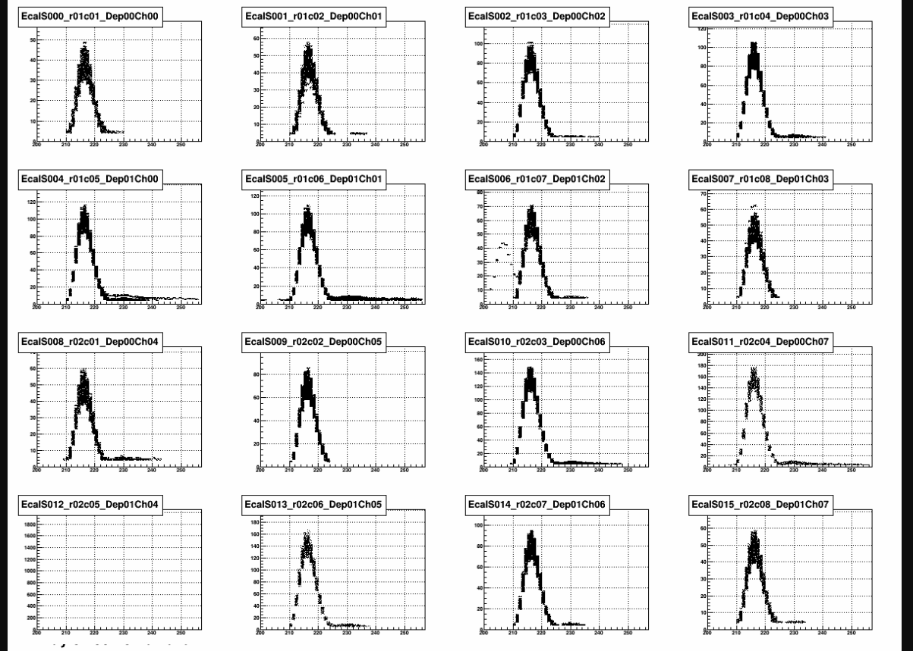
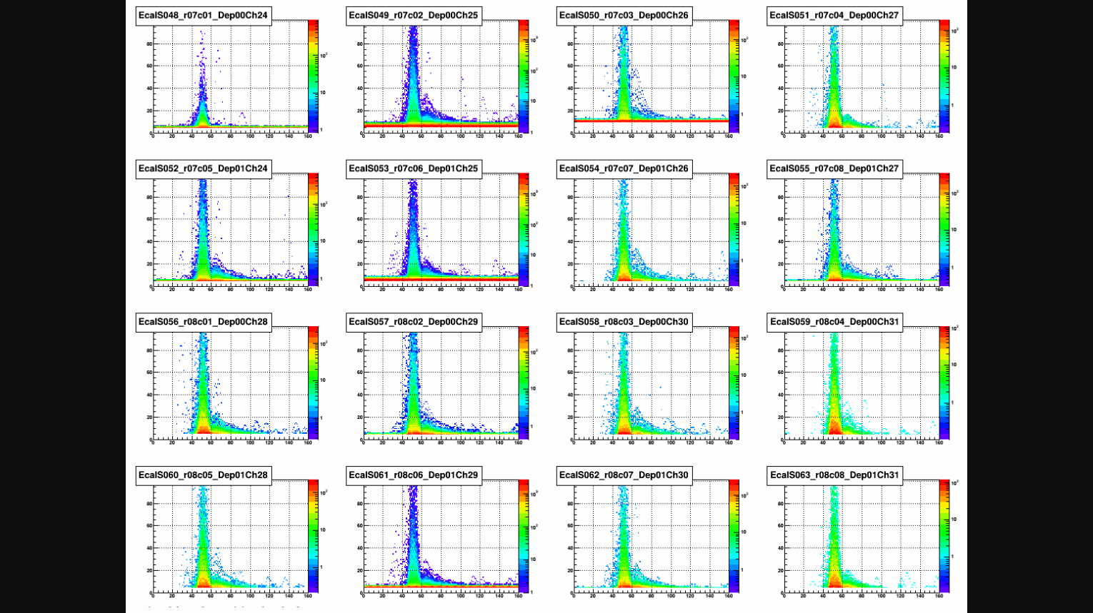
First Run-19: Detector Responses
DAQ data decoders written
Q&A Package under development
  basic features already exist
LED pulser installed and working
LED pulse
physics events

Slide 28
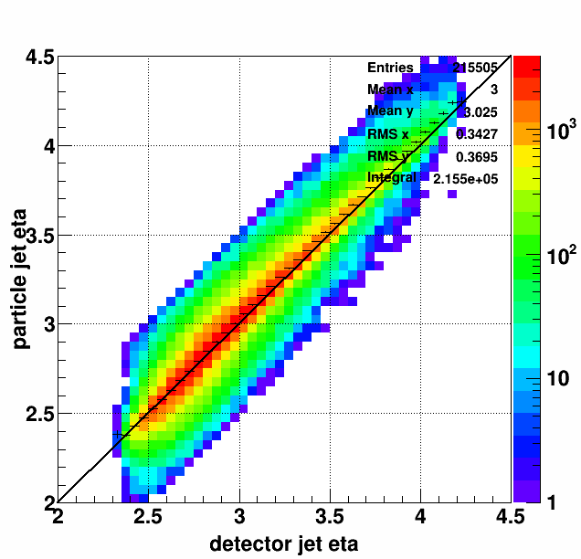
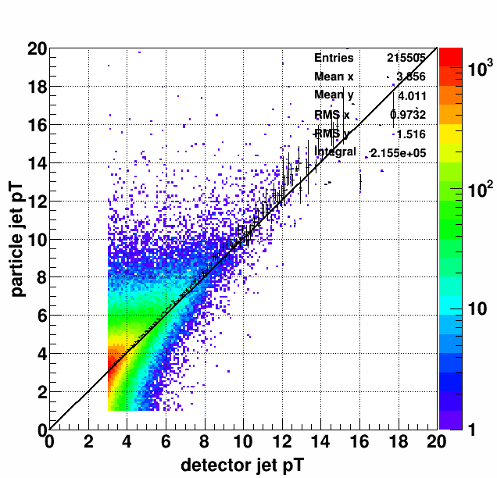
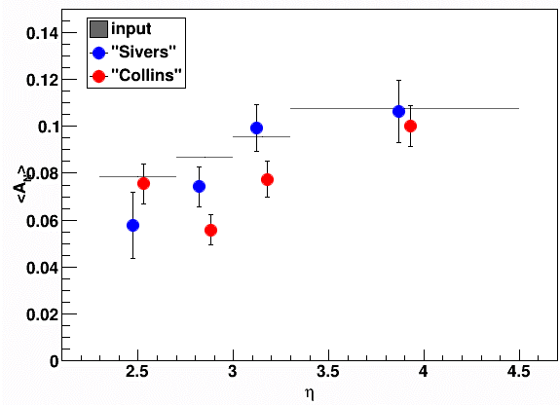



Software Development
GEANT calorimeter response simulation based on test-beam performance
Particle jet has to match
with the detector with
δR < 0.5
“Sivers” asymmetry = $1+A_{N}∙\cos\left(φ^{jet}\right)$
“Collins” asymmetry = $1+A_{N}∙\sin\left(φ^{C}\right)$
$$A_{N}=0.03∙η^{jet}$$
Input-etabin = $0.03 \left\langle η^{jet}\right\rangle jet_etabin$
Radial Polarization

Slide 29
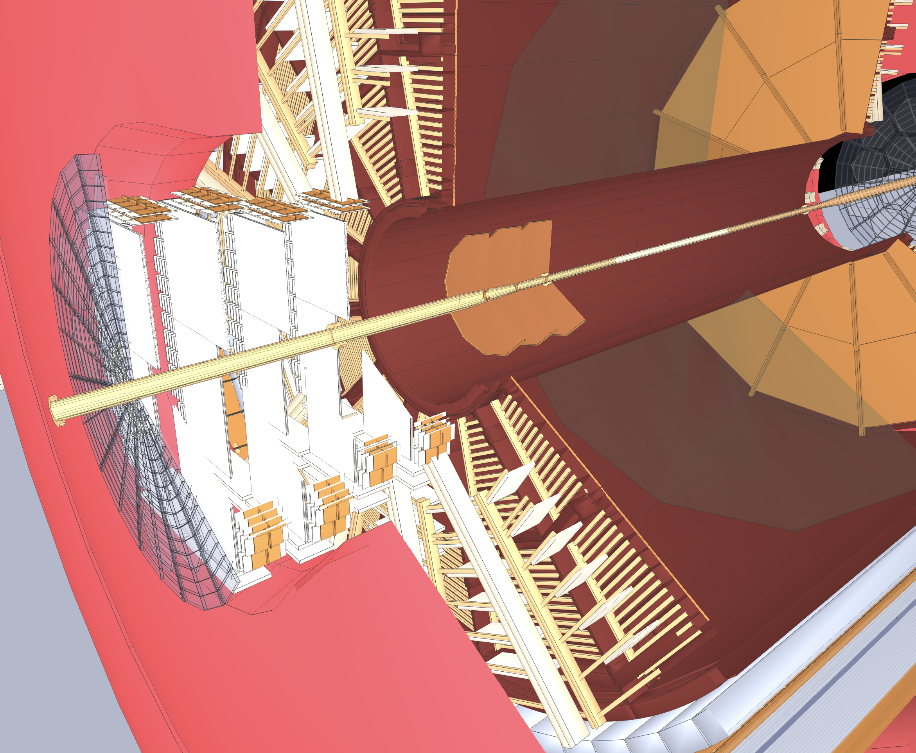


Software Development
New Tracking algorithms
  Develop track fitting model for non-uniform magnetic field (cannot use an ideal helix in non-uniform fields)
  Study primary vertex fitting with forward tracking only (without TPC) → critical for forward jet-physics
Refine geometry model for sTGC and Silicon to account for all material → critical to study background for EPD and calorimetry
Pythia-6 p+p at $\sqrt{s}$ = 500 GeV 3Si + 4sTGC
Mis-ID : $≈$3%

Slide 30
Summary
Large progress since 2018 PAC meeting
  passed ALD’s Technical, Cost, Risk and Schedule Review
  Funding under control
  finalized ECal and HCal designs as well as their readout (FEE + DEP)
    Ready for platform modification and ECal installation during upcoming shutdown
  Silicon design well progressing first full prototype in September 2019
  sTGC module design close to final
    several design by September: final gas mixture, readout based on SAMPA or VMM
  Integration of ECal and HCal final, sTGC and Silicon detector progressing very, will be final by the end of the year
  already well integrated in STAR offline software framework
Full in-situ system system check of Preshower + ECal + HCal + Readout and triggering in combination with sTGC
  fully integrated into STAR DAQ
  online and offline software as well as slow control development
Project well on track for start of data-taking in fall CY2021

Slide 31
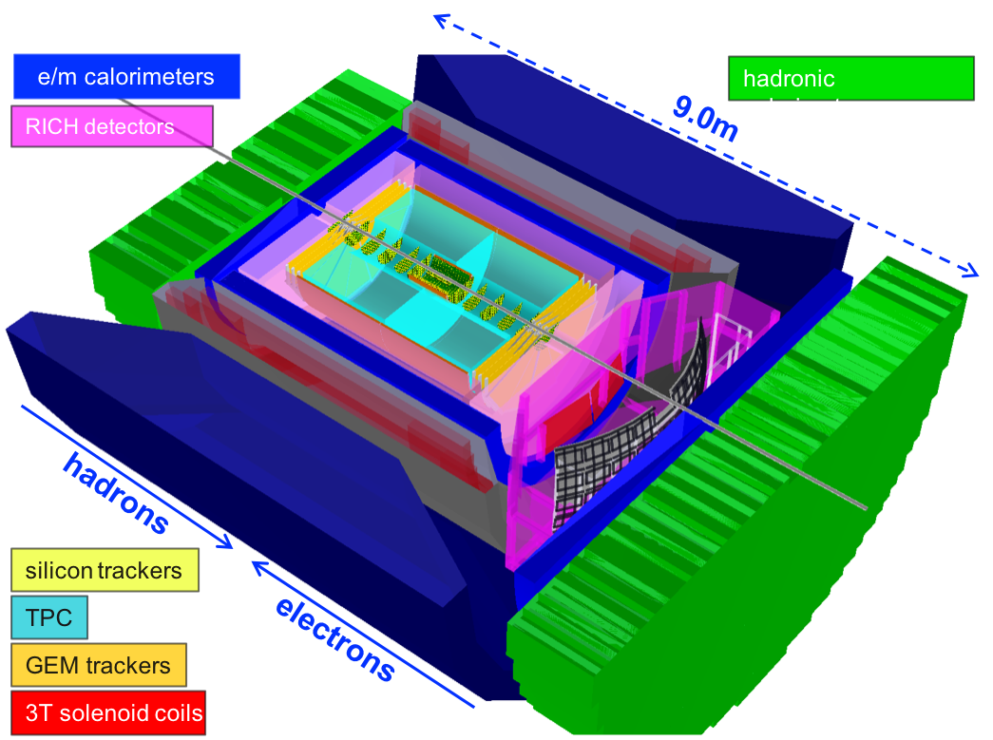
Outlook
Important impact on EIC technology choices
  develop new Silicon producer in Taiwan
  “EIC” ECal and HCal with SiPM and readout at identical rapidity and beam energies
  sTGC alternative detector technology to GEM-trackers

Slide 32


Slide 33
The sTGC
We plan to use 4 double-sided small-strip Thin Gap Chamber (sTGC) disks in addition to
3 silicon disks to provide tracking for charged particles, for the cold QCD and peripheral
heavy ion physics program.
For the sTGC, the size will be around 60 cm ✖️ 60 cm. Four double-sided sTGC with x, y, and diagonal-direction readouts will form a disk.
We will have 22000 readout channels in total.
The sTGC module is much smaller than ATLAS sTGC.
All the PCB boards can be fabricated in China.
20-30º
0-10º

Slide 34
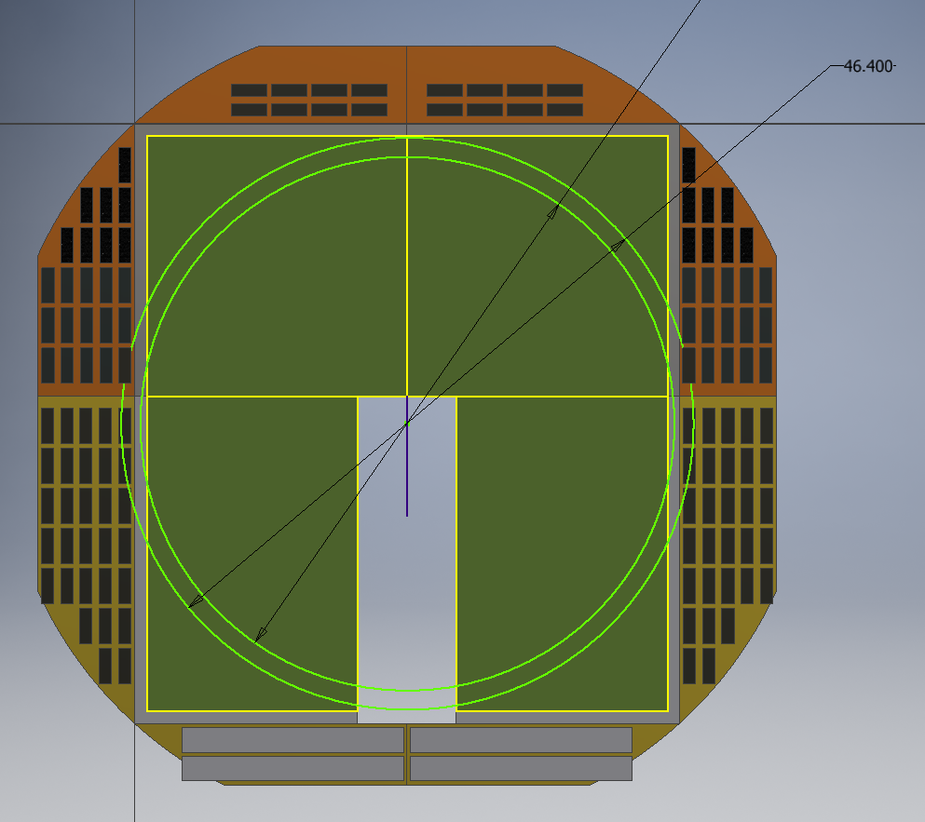
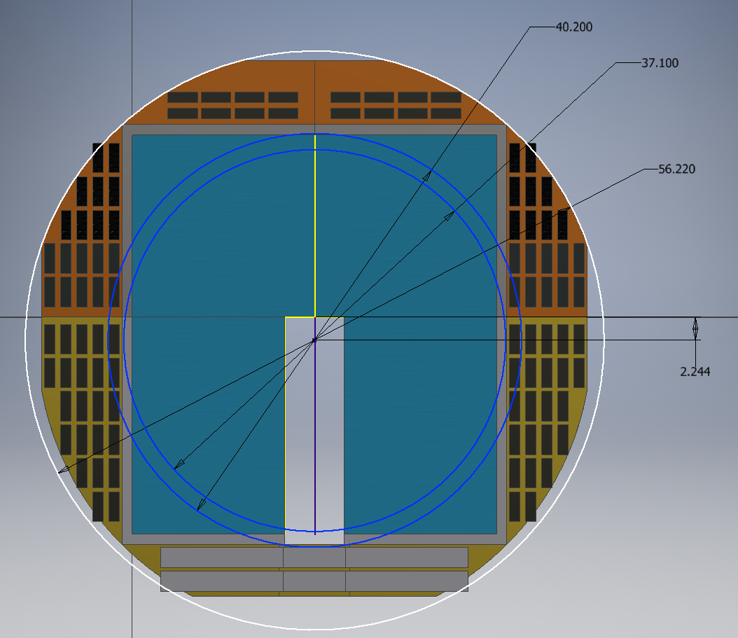
sTGC electronics readout
Each double module need 30 TPX FEEs and 1 RDO. The length of ribbon cable from FEE to RDO need to be less than 75 cm. No enough space for FEEs and RDOs if using old TPX electronics!!!
Solution: use ALTAS electronics based on VMM trips or use electronics boards based on SAMPA chips designed for sPHENIX. Cost: 150 k USD in total. USTC will apply MOST funds in China for VMM option while BNL has to pay for SAMPA option. Finalize the option this summer.

Slide 35
FY19 System Test
A “slice” of the entire FCS implemented in STAR
  16 channels of HCAL with corresponding FEEs & digitizers
    8 FEEs, 1 DEP
  64 channels of ECAL with FEEs & digitizers
    16 FEEs, 2 DEPs
  9 channels of fPRE with FEEs & digitizers
    9 FEEs, 1 DEP
  1 Trigger Process with connection to STAR Trigger System
    1 special DEP
Readout into 1 “DAQ PC” with custom PCIe fiber Receiver Boards
  2 Receiver Boards, each with 4 fibers
System is currently in commissioning
  integrated into STAR DAQ
  all working well so far

Slide 36
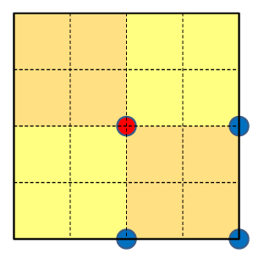
Trigger Logic
Each Ecal and Hcal trigger patch is created by 4x4 towers;
For each Ecal patch, looking at its closest 2x2 Hcal trigger patches, match to the Hcal patch with maximum energy;
If Hcal patch/Ecal patch energy ratio < 1/8 -> EM Trigger;
If Hcal patch/Ecal patch energy ratio > 1/4 -> Hadron Trigger;
We performed GEANT simulations to optimize the FCS trigger response for single particles.
Closest Hcal patch
Ecal patch center
Blue dots are the nearby Hcal patch centers

Slide 37
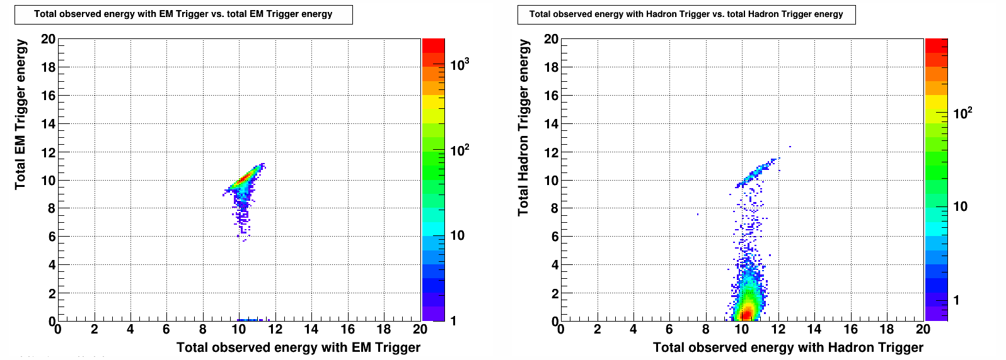
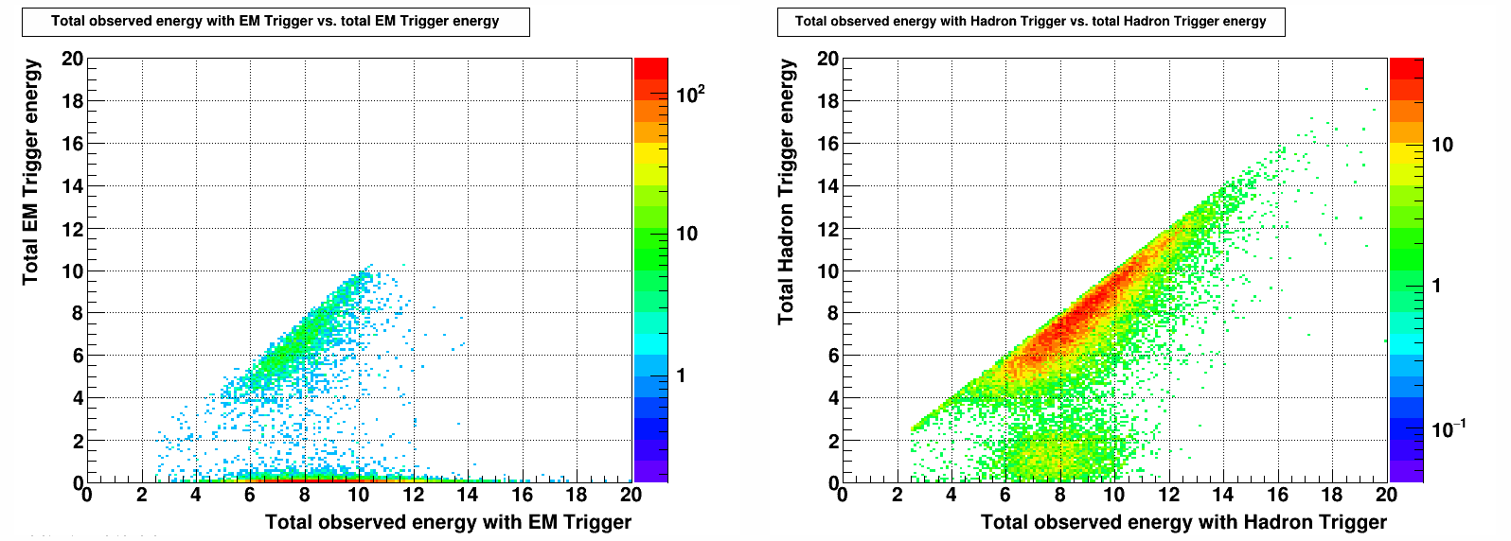
10 GeV Photon (top) and π- (bottom): total energy (sum of ECal and HCal) vs. trigger energy (sum of ECal and HCal trigger patch)

Slide 38
Trigger threshold and Fraction of Events Passing trigger
 | Fraction of Events Passing EM Trigger with |  |  |  |  | Fraction of Events Passing Hadronic Trigger with
Particle/Energy | EM_thr > 8 | EM_thr > 16 | EM_thr > 32 | EM_thr > 64 |  | Had_thr > 6 | Had_thr > 12 | Had_thr > 24 | Had_thr > 48
Photon/10 GeV | 0.99 | 0.00 | 0.00 | 0.00 |  | 0.01 | 0.00 | 0.00 | 0.00
Photon/20 GeV | 0.99 | 0.99 | 0.00 | 0.00 |  | 0.05 | 0.02 | 0.00 | 0.00
Photon/40 GeV | 0.98 | 0.98 | 0.98 | 0.00 |  | 0.31 | 0.09 | 0.04 | 0.00
Photon/80 GeV | 0.96 | 0.96 | 0.96 | 0.96 |  | 0.88 | 0.44 | 0.13 | 0.06
Pion/10 GeV | 0.05 | 0.00 | 0.00 | 0.00 |  | 0.74 | 0.09 | 0.00 | 0.00
Pion/20 GeV | 0.09 | 0.05 | 0.00 | 0.00 |  | 0.91 | 0.83 | 0.10 | 0.00
Pion/40 GeV | 0.04 | 0.03 | 0.02 | 0.00 |  | 0.98 | 0.95 | 0.90 | 0.10
Pion/80 GeV | 0.01 | 0.01 | 0.01 | 0.01 |  | 0.99 | 0.98 | 0.97 | 0.91
For photons, when the trigger threshold is placed at 80% of the true photon energy, the trigger is predicted to be 99% efficient at low energy, dropping to 96% efficient for 80 GeV photons. For pions, when the trigger threshold is placed at 60% of the true hadron energy, the efficiency is only 74% at 10 GeV.

Slide 39
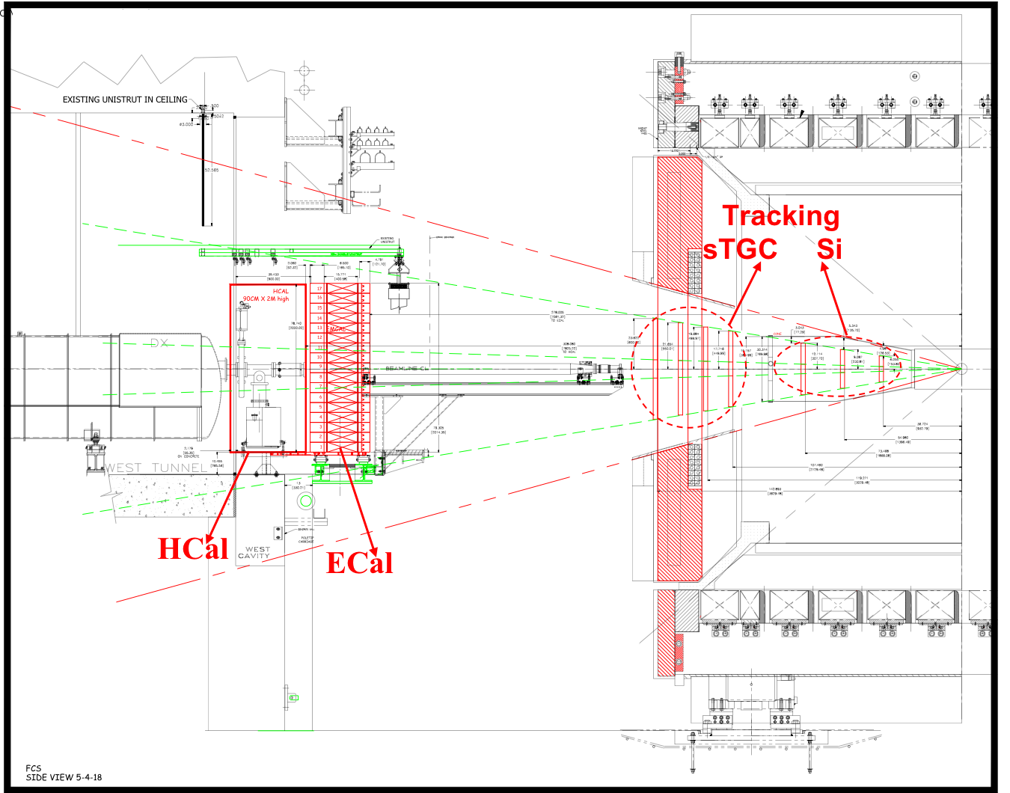
High-Level Summary: Scope
STAR forward upgrade:
located at the West side of STAR
coverage: 2.5 < η < 4
facing the blue RHIC beam
combines:
Calorimetry:
Electromagnetic and Hadronic
with Tracking
Silicon detectors and
small-strip Thin Gap Chambers (sTGC)
Operation:
pp, pA and AA data taking in FY2021/22 and parallel with sPHENIX data taking period
General Philosophy:
reuse as much as possible of existing equipment
built on vast experience
Side View

Slide 40
Funding Sources
 | ECal | HCal | Calo-FEE et al. | Readout & Trigger | Si | sTGC | Integration
M&S Cost | $159,348 | $ 1,087 M | $ 255,363 | $ 427,596 | $ 1.070 M | $220,000 | /
Labor Cost | $103,218 | $ 318,353 | $168,090 | / | / | / | /
M&S Cost to BNL | $ 18,755 | / | / | $ 15,000 | $ 10,560 | $ 40,820 | $ 195,000
Ext. Labor Cost to BNL | $ 14,625 | / | / | / | $ 115,200 | / | /
utilize different funding sources
NSF MRI (Lead University IU) submitted to NSF January 2019
  Calorimetry, Readout & Trigger Electronics M&S and large fraction of labor
  very positive feedback from NSF suggest to fund 0.92% of request
  Awaiting final response from NSF Division of Grants and Agreements
    fully expect funding
International Funding sources
  sTGC through Shandong University & BNL-LDRD
  Silicon detector M&S and large fraction of labor through
    NCKU in Taiwan
    start up funds Shandong University (Prof. Li)
    Proposal to NSFC
BNL → keep cost to BNL at a minimum

