Slide 1
Coherent electron Cooling Proof-of-Principle Experiment:
Beam Use Request
Vladimir N Litvinenko for CeC team
Collider-Accelerator Department, BNL
Department of Physics and Astronomy, SBU
Center for Accelerator Science and Education

Slide 2
Outline
Why cooling is needed?
Proof-of-principle CeC experiment
CeC during Run 19
Plan for continuation of CeC experiment
Beam Use Request
Conclusions

Slide 3
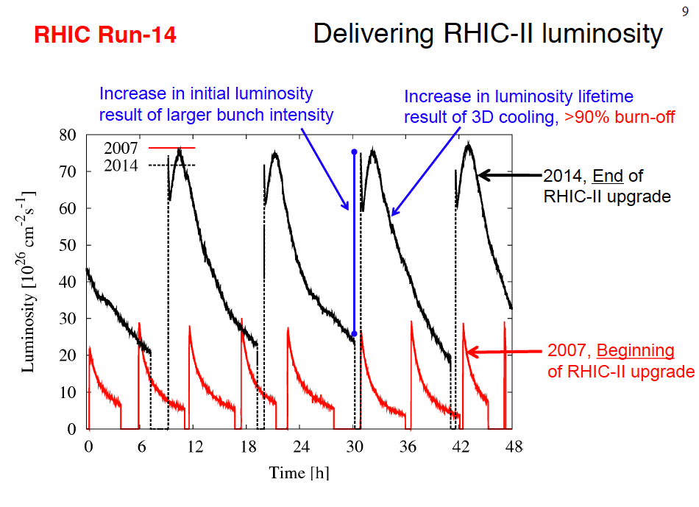
Why cooling of hadron beam is needed?
To boost collider’s luminosity
To create better beams
To extend stores
To reduce background
  In other words – to better the physics
  Courtesy of W. Fischer
2018 NAS Assessment of U.S.-Based Electron-Ion Collider Science: The accelerator challenges are two fold: a high degree of polarization for both beams, and high luminosity.
April 2018 eRHIC pCDR review committee report: “The major risk factors are strong hadron cooling of the hadron beams to achieve high luminosity, and the preservation of electron polarization in the electron storage ring. The Strong Hadron cooling [Coherent Electron Cooling (CeC)] is needed to reach 10³⁴/(cm²s) luminosity. Although the CeC has been demonstrated in simulations, the approved “proof of principle experiment” should have a highest priority for RHIC.”

Slide 4
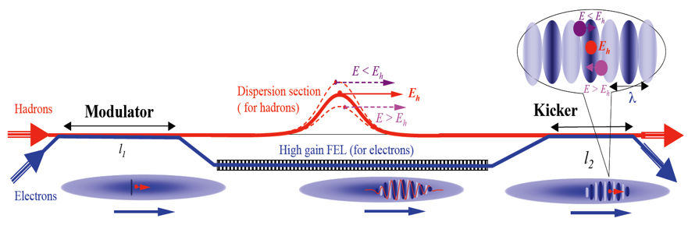
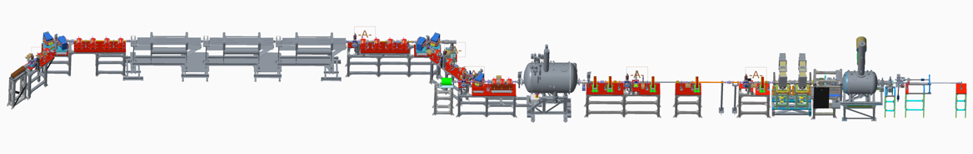
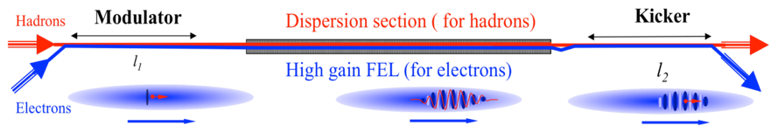
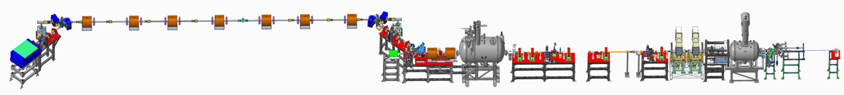
Proof-of-principle CeC experiment
eRHIC review committee: Although the CeC has been demonstrated in simulations, the approved “proof of principle experiment” should have a highest priority for RHIC.
Possible CeC schemes
Possible CeC PoP experiments
RHIC Run 18
High gain FEL amplifier
with low-K wigglers
Small gap in wiggler is not compatible with low energy RHIC operations!
Requires serious modification of the RHIC
lattice & superconducting magnets +$20-30M
Requires serious modification of the RHIC
lattice & superconducting magnets +$20-30M
Plasma cascade
micro-bunching amplifier
RHIC Runs 20-22
Plasma-Cascade
Amplifier
Requires serious modification of the RHIC
lattice & superconducting magnets +$20-30M

Slide 5
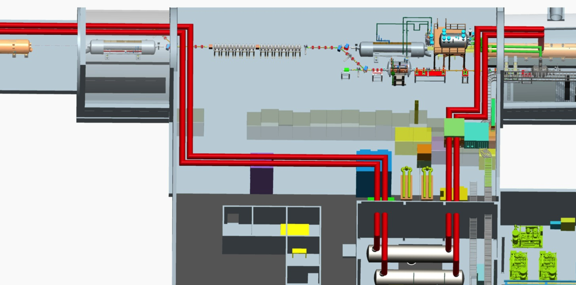
The only possible demonstration site in the world:
The CeC Proof-of-Principle Experiment at RHIC’s IP2
Coherent Electron Cooler

Slide 6
CeC goals during RHIC Run 19
We uncovered that CeC experiment during RHIC Run 18 was impeded by excessive noise in electron beam resulting from previously unknown plasma-cascade instability occurring in the CeC accelerator
We found – in simulations – CeC accelerator lattice which suppresses this instability and would provide necessary beam quality. We want to demonstrate it experimentally during Run 19. Hence our goal is to demonstrate generation of electron beam with beam parameters satisfying requirements for CeC demonstration experiment
          * minimal goal
Other goals are: Demonstrate control of newly discovered Plasma-Cascade Instability (PCI) and develop means of its suppression in the ballistic compression beam-lines and collect data for PhD thesis of three SBU graduate students
Parameter | Value
Relativistic factor, γ | 28.5
RMS energy spread | 3 10⁻⁴
Normalized beam emittance, mm mrad | 8
Electron beam peak current, A | 50-100
Relative energy spread | 0.1%
Noise level at 10 THz/Poisson shot noise | ~ 2 (<100*)
Notes:
Proving expectations wrong is one of important roles played by experiment

Slide 7
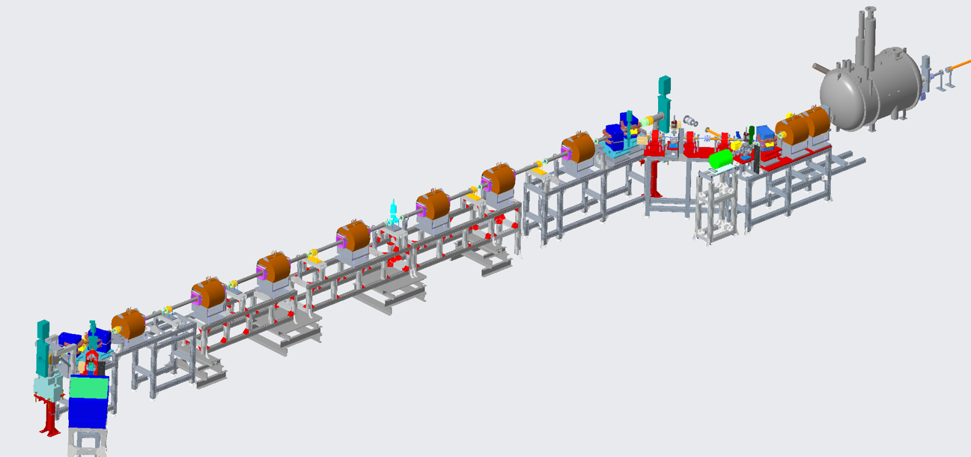
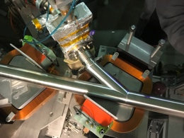
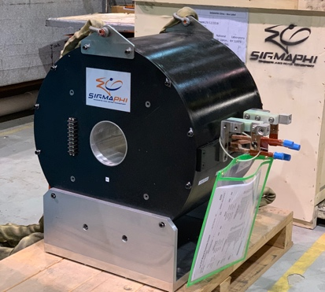
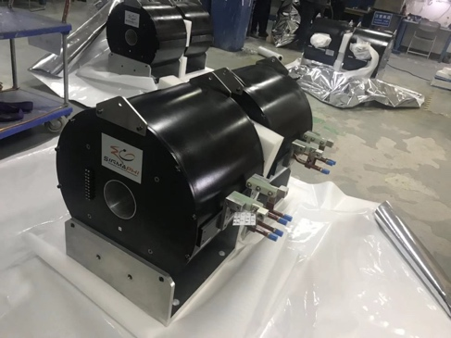
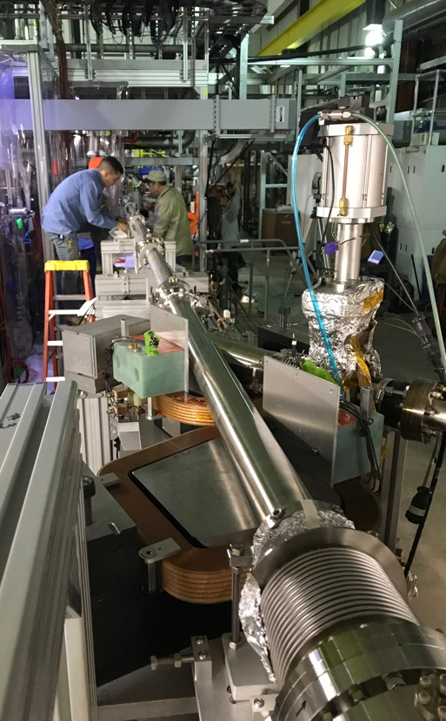
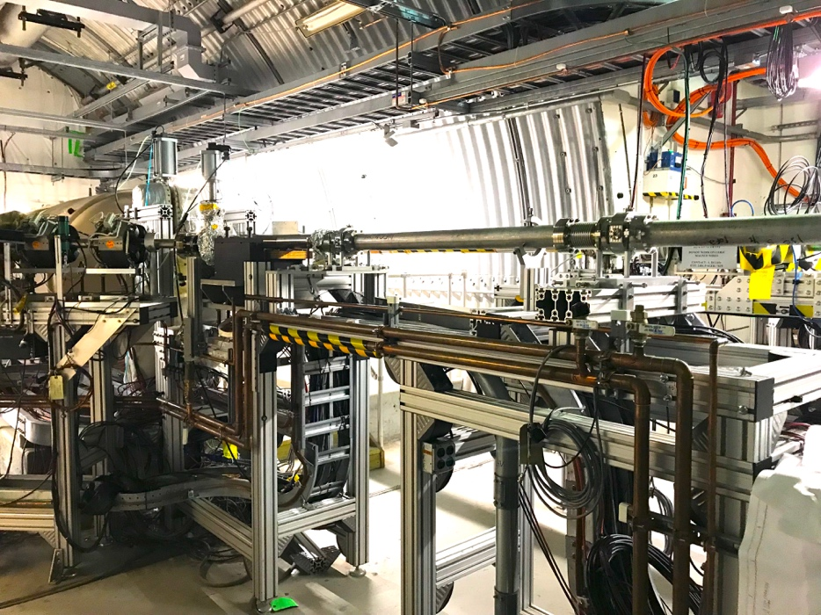
Status: more details in my afternoon talk
Mechanical design of the new CeC system is completed
We procured and commissioned new laser system with controllable pulse structure
All new CeC vacuum chambers with beam diagnostics are built and installed
All supports are built and installed
All solenoids are designed, manufactured, delivered and undergo magnetic measurements
Assembly of the plasma-cascade based CeC can be completed during this year’s RHIC shut-down period
RHIC beam
Design of CeC section
using Plasma-Cascade Amplifier

Slide 8
Simulated performance: 26.5 GeV Au ion bunch in RHIC
We had developed a suite of codes to simulate the complete beam dynamics in the CeC accelerator, the interaction with ion beam and the cooling of the ion beam with CeC using any type of amplifier. It is done without relying on any model: standard codes use 3D PIC simulations and super-computers.
40 mins of PCA CeC
Cooled by e-bunch
with normal
(shot noise
Initial
bunch shapes
By e-bunch
with 100-fold increase noise power
Witness
bunch in 40 mins
By e-bunch
with 225-fold increase noise power
By e-bunch
with 900-fold increase noise power
Black – initial profile, red – witness (non-interacting) bunch after 40 minutes. Profiles of interacting bunches after 40-minutes in PCA-based CeC for various levels of white noise amplitude in the electron beam: dark blue – nominal statistical shot noise, magenta – 10 fold, light blue – 15 fold and green – 30 fold - higher than the statistical level.
Cooling will occur when electron beam micro-bunching power (e.g. bending magnet radiation) does not exceed that of spontaneous (shot noise) radiation by more than 200-fold

Slide 9
Coherent electron Cooling Beam Use Request for Run-20 Run-21
Preparing CeC system for the demonstration experiment
To commission the accelerator and the new CeC section, to demonstrate the plasma-cascade microbunching amplifier, interaction of the electron and ion beams and amplification of the ion’s imprint on the electron beam.
Most of the preparations can be realized in parallel with regular RHIC physics runs, but a small portion of the CeC program requires dedicated time (1 shift is 8 hrs):
Low loss propagation of CW electron beam 4 shifts
Demonstration of plasma-cascade amplifier 4 shifts
Lattice and orbit for 26.5 GeV/u ion beam 3 shifts
Interaction of electron and ion beams 3 shifts
Demonstrate Plasma-Cascade Amplification of ion’s imprint 6 shifts
Contingency 4 shifts
Total 24 shifts (8 days)
Demonstration of longitudinal ion beam cooling using the PCA-based CeC
Re-establish the Run 20 mode of operation
CeC demonstration experiment: longitudinal cooling of 26.5 GeV/u Au ion beam
Most of the preparations can be realized in parallel with regular RHIC physics runs, but a small portion of the CeC program requires dedicated time (1 shift is 8 hrs):
Re-establish Run-20 operation 6 shifts
Re-establish and optimized ion’s imprint amplification 6 shifts
Demonstrate longitudinal cooling of 26.5 GeV/u Au ion beam 25 shifts
Contingency 5 shifts
Total 42 shifts (14 days)

Slide 10
Conclusion: Beam Use Request
We propose to complete Coherent electron Cooling demonstration experiment using the unique and the only facility located at RHIC IP2
We develop new design of CeC system based on plasma-cascade amplifier, procured all long lead components of the system and partially install it onto RHIC IP2. The system in fully compatible with BES II and RHIC operation at any energy
We completed simulations of the cooling process in this PoP system and we propose three year program to fully evaluate its performance:
  Year 1 (Run 20) – commissioning new CeC system
  Year 2 (Run 21) – longitudinal cooling of 26.5 GeV/u ion beam
  Year 3 (Run 22) – simultaneous transverse and longitudinal cooling
We request dedicated time for this experiment in Runs 20-21
  Run 20 – 8 days
  Run 21 – 14 days
If successful, we will ask for 2 week of dedicated time in Run 22

Slide 11
Back-ups

Slide 12
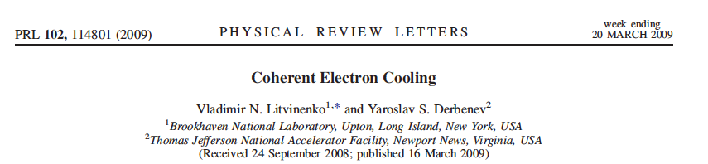
What is Coherent electron Cooling
Short answer – stochastic cooling of hadron beams with bandwidth at optical wave frequencies: 1 – 1000 THz
Longer answer:

Slide 13
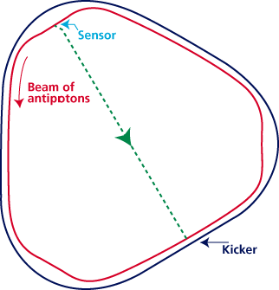
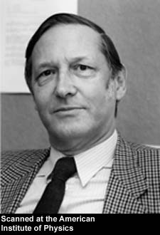
Critical conditions for the stochastic cooler
Linearity: Amplifier must be linear (no saturation) and low noise
Overlapping: Amplified signal induced by individual particle in the modulator (pick-up, sensor) must overlap with the particle in the kicker
Bandwidth: Does not matter how high is the gain of amplifier, cooling decrement per turn can not exceed 1/N_{s}, where is number of the particles in fitting inside the response time of the system: τ~ 1/Δf
S. van der Meer
1984 Nobel physics prize
RF stochastic cooling is reaching its limits at ~ 10 GHz bandwidth
S. van der Meer, Rev. Mod.Phys. 57, (1985) p.689
S. van der Meer, 1972, Stochastic cooling of betatron oscillations is ISR, CERN/ISR-PO/72-31
Notes:
Can it work for a bunched beam?

