Slide 1

STAR BUR 2022: 500 GeV $p+p$ Run
Jim Drachenberg
BNL NPP PAC Meeting
June 10, 2019
OUTLINE
Open Questions in Cold QCD
Timeframe and Vital Stats
Transversity
Gluon Helicity
Summary

Slide 2
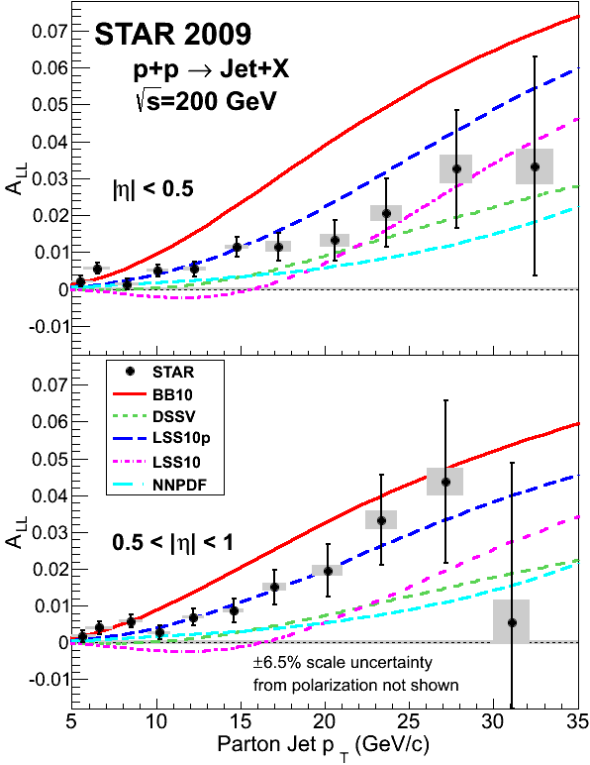
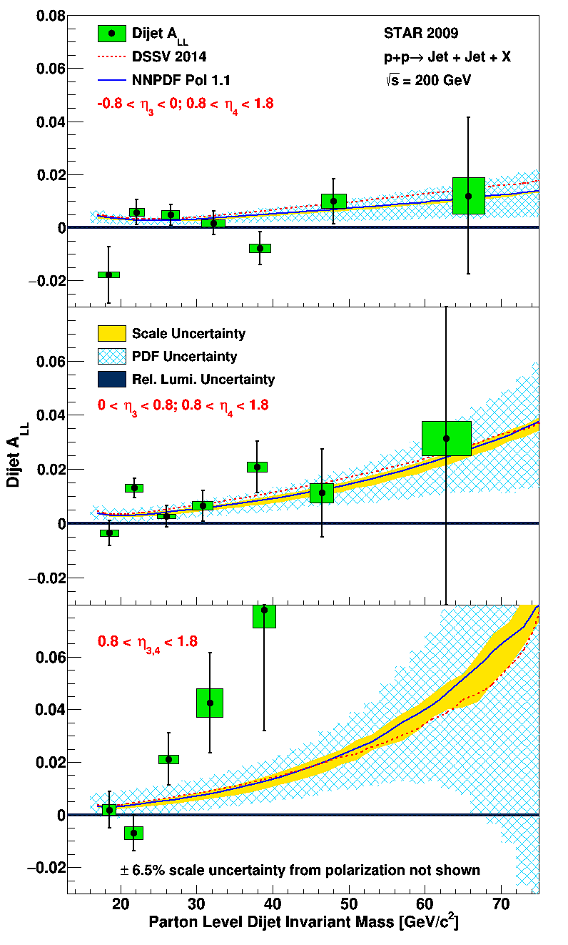
STAR Cold QCD results have significant impact!
Worldwide first hint of Sivers sign change
PRL 115, 092002 (2015)
PRD 99, 51102 (2019)
PRL 116, 132301 (2016)
First evidence of polarized gluons
Positive flavor asymmetry in the polarized sea
PLB 780, 332 (2018)
PRD 98, 32011 (2018)
PRD 97, 032004 (2018)
Transversity via IFF
Fascinating questions remain…
First Collins effect in $p+p$
STAR dijets

Slide 3
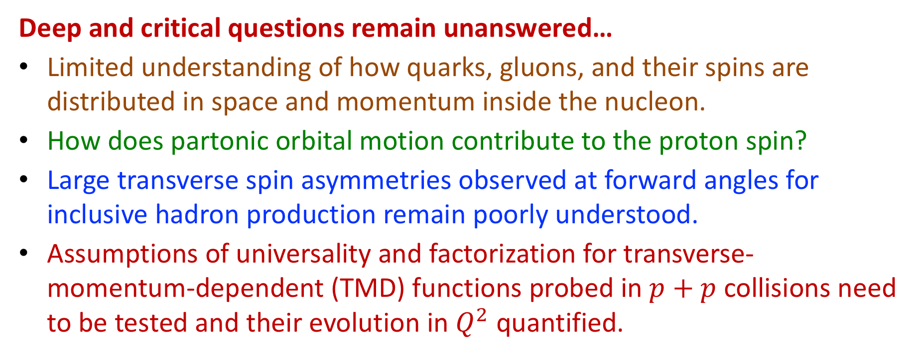
Open Questions in Cold QCD
Deep and critical questions remain unanswered…
Limited understanding of how quarks, gluons, and their spins are distributed in space and momentum inside the nucleon.
How does partonic orbital motion contribute to the proton spin?
Large transverse spin asymmetries observed at forward angles for inclusive hadron production remain poorly understood.
Assumptions of universality and factorization for transverse-momentum-dependent (TMD) functions probed in $p+p$ collisions need to be tested and their evolution in $Q^{2}$ quantified.

Slide 4
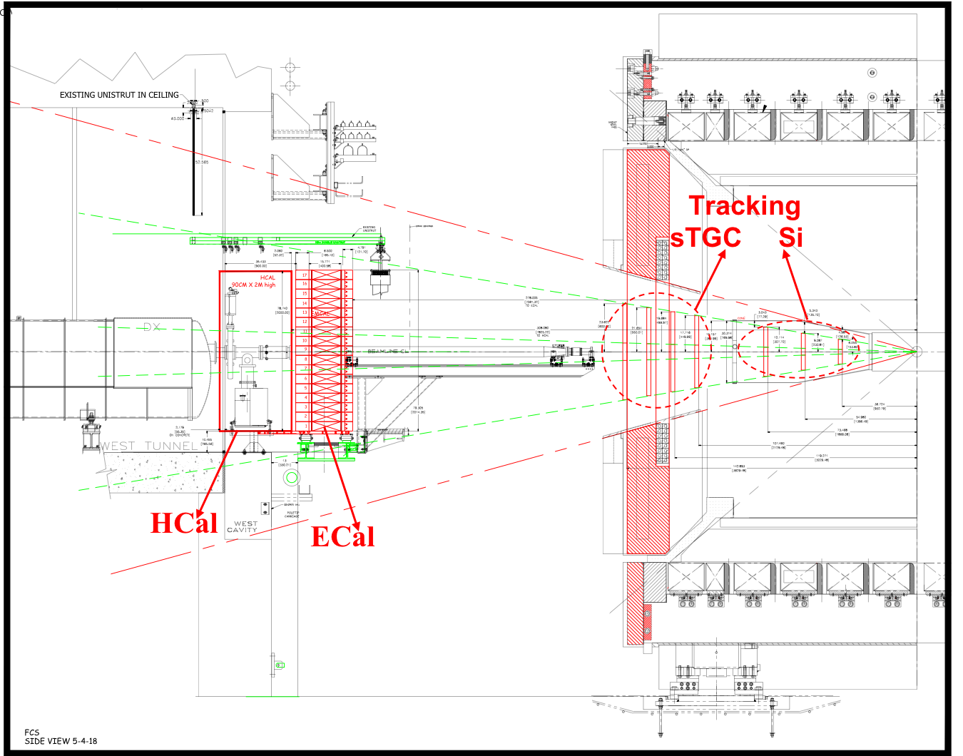
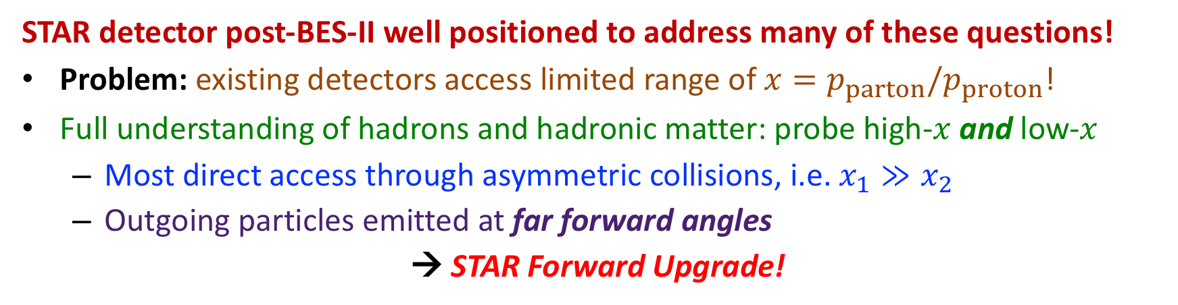
Open Questions in Cold QCD
STAR detector post-BES-II well positioned to address many of these questions!
Problem: existing detectors access limited range of $x=p_{parton}/p_{proton}$!
Full understanding of hadrons and hadronic matter: probe high-$x$ and low-$x$
  Most direct access through asymmetric collisions, i.e. $x_{1}≫x_{2}$
  Outgoing particles emitted at far forward angles
→ STAR Forward Upgrade!

Slide 5
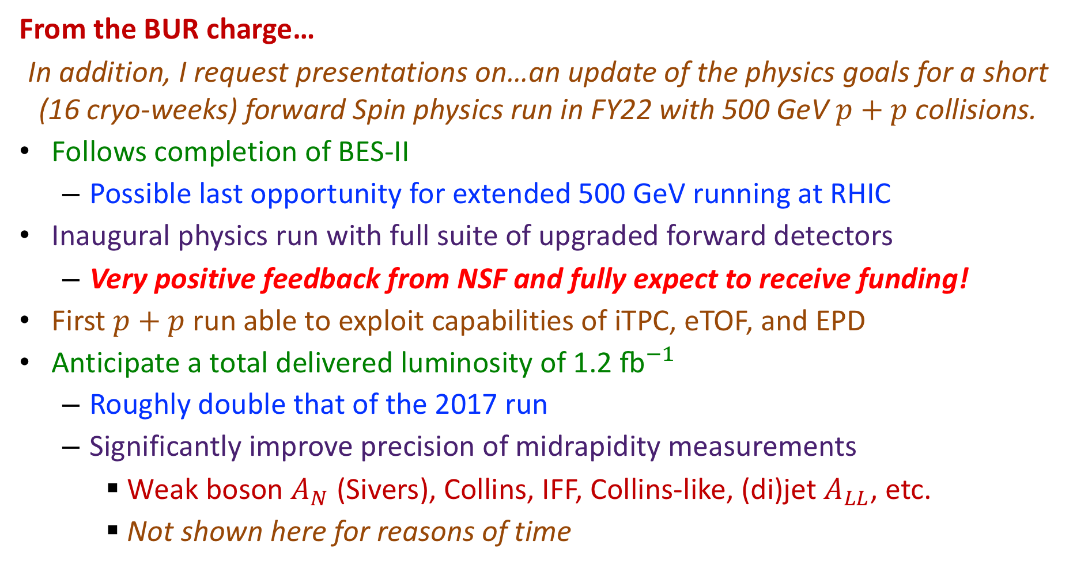
Timeframe and Vital Stats
From the BUR charge…
In addition, I request presentations on…an update of the physics goals for a short (16 cryo-weeks) forward Spin physics run in FY22 with 500 GeV $p+p$ collisions.
Follows completion of BES-II
  Possible last opportunity for extended 500 GeV running at RHIC
Inaugural physics run with full suite of upgraded forward detectors
  Very positive feedback from NSF and fully expect to receive funding!
First $p+p$ run able to exploit capabilities of iTPC, eTOF, and EPD
Anticipate a total delivered luminosity of 1.2 ${\text{fb}}^{−1}$
  Roughly double that of the 2017 run
  Significantly improve precision of midrapidity measurements
    Weak boson $A_{N}$ (Sivers), Collins, IFF, Collins-like, (di)jet $A_{LL}$, etc.
    Not shown here for reasons of time

Slide 6

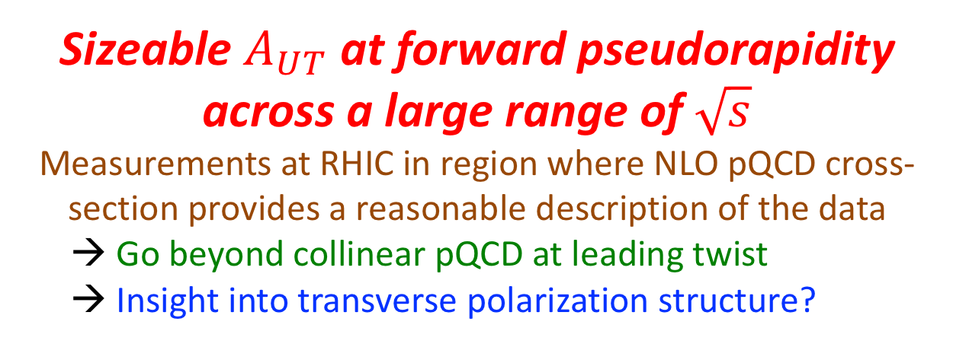
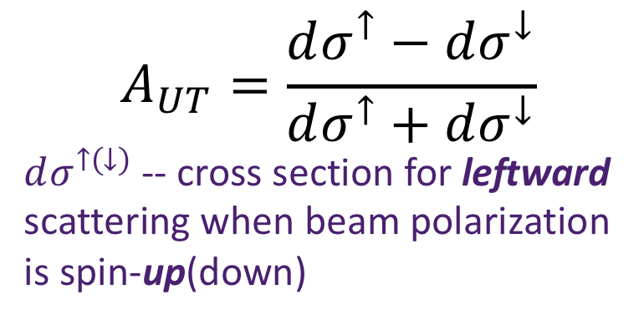

A Surprise from Transverse Single-spin Asymmetries
$$A_{UT}=\frac{dσ^{↑}−dσ^{↓}}{dσ^{↑}+dσ^{↓}}$$
$dσ^{↑\left(↓\right)}$ -- cross section for leftward scattering when beam polarization is spin-up(down)
$$A_{UT}$$
Collinear pQCD at leading twist: very small $A_{UT}$
Sizeable $A_{UT}$ at forward pseudorapidity across a large range of $\sqrt{s}$
Measurements at RHIC in region where NLO pQCD cross-section provides a reasonable description of the data
  Go beyond collinear pQCD at leading twist
  Insight into transverse polarization structure?
Shown results from
E704, PLB 261, 201 (1991)
STAR, PRL 101, 222001 (2008)
STAR, PRD 89, 012001 (2014)
PHENIX, PRD 90, 012006 (2014)

Slide 7




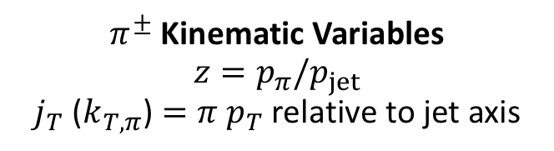


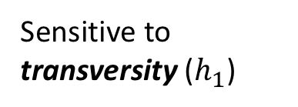

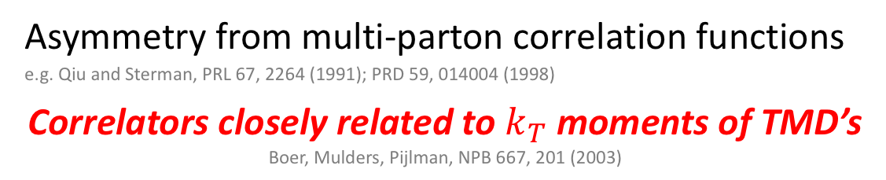


Mechanisms for Transverse Single-spin Asymmetries
Transverse Momentum Dependent (TMD) Distributions and FFs
Sivers mechanism: asymmetry in the jet or $γ$ production
D. Sivers, PRD 41, 83 (1990); 43, 261 (1991)
Collins mechanism: asymmetry in the jet fragmentation
J. Collins, NP B396, 161 (1993)
$$S_{P}$$
$$\left\langle S_{P}⋅\left(p×k_{T,parton}\right)\right\rangle ≠0$$
$$S_{P}$$
$$\left\langle S_{q}⋅\left(p×k_{T,π}\right)\right\rangle ≠0$$
$$k_{T,parton}$$
Sensitive to transversity ($h_{1}$)
$$p$$
$$p$$
Sensitive to proton spin–parton transverse motion correlations (needs orbital motion)
$$p$$
$π^{±}$ Kinematic Variables
$$z=p_{π}/p_{jet}$$
$j_{T}$ ($k_{T,π}$) $=π$ $p_{T}$ relative to jet axis
$$p$$
$$S_{q}$$
$$k_{T,π}$$
Twist-3 Distributions and FFs
Asymmetry from multi-parton correlation functions
e.g. Qiu and Sterman, PRL 67, 2264 (1991); PRD 59, 014004 (1998)
Correlators closely related to $k_{T}$ moments of TMD’s
Boer, Mulders, Pijlman, NPB 667, 201 (2003)
Y. Koike, RSC Discussion (2004)

Slide 8
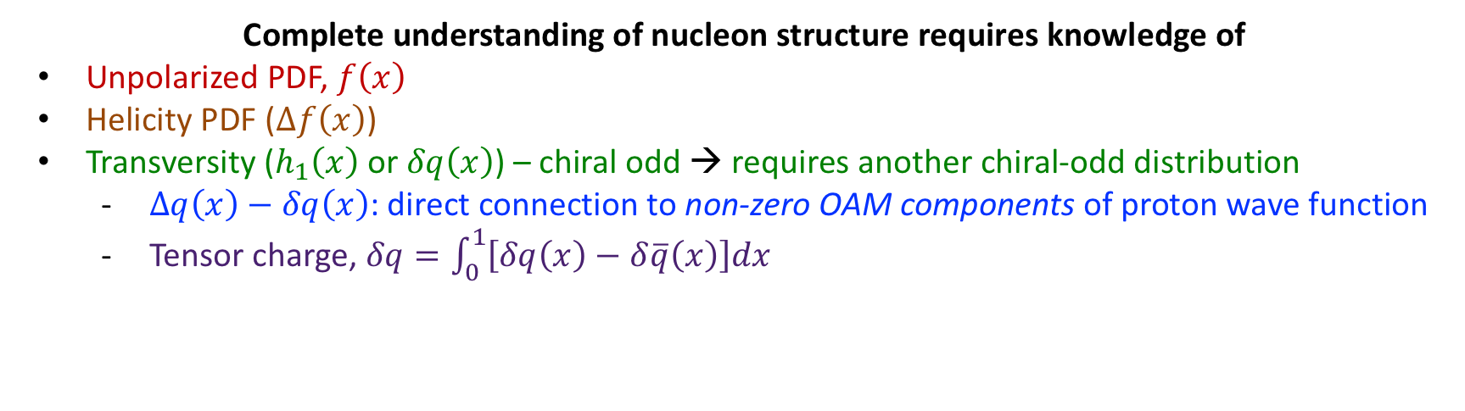
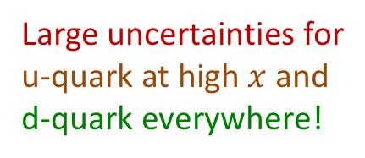
Transversity
Complete understanding of nucleon structure requires knowledge of
Unpolarized PDF, $f\left(x\right)$
Helicity PDF ($Δf\left(x\right)$)
Transversity ($h_{1}\left(x\right)$ or $δq\left(x\right)$) – chiral odd → requires another chiral-odd distribution
  $Δq\left(x\right)−δq\left(x\right)$: direct connection to non-zero OAM components of proton wave function
  Tensor charge, $δq=\int_{0}^{1}{\left[δq\left(x\right)−δ\overline{q}\left(x\right)\right]dx}$
PRD 93, 014009 (2016)
Large uncertainties for
u-quark at high $x$ and
d-quark everywhere!
Anselmino et al: PRD 87, 094019 (2013)
Kang et al: PRD 93, 014009 (2016)
Radici et al: JHEP 05, 123 (2015)
Global analyses access in SIDIS + $e^{+}e^{−}$, e.g. via “Collins” or IFF asymmetries
Currently limited reach in $\left(x,Q^{2}\right)$

Slide 9
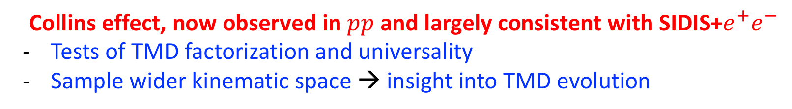
Transversity
Complete understanding of nucleon structure requires knowledge of
Unpolarized PDF, $f\left(x\right)$
Helicity PDF ($Δf\left(x\right)$)
Transversity ($h_{1}\left(x\right)$ or $δq\left(x\right)$) – chiral odd → requires another chiral-odd distribution
  $Δq\left(x\right)−δq\left(x\right)$: direct connection to non-zero OAM components of proton wave function
  Tensor charge, $δq=\int_{0}^{1}{\left[δq\left(x\right)−δ\overline{q}\left(x\right)\right]dx}$
STAR Collaboration, PRD 97, 032004 (2018)
Collins effect, now observed in $pp$ and largely consistent with SIDIS+$e^{+}e^{−}$
Tests of TMD factorization and universality
Sample wider kinematic space → insight into TMD evolution

Slide 10

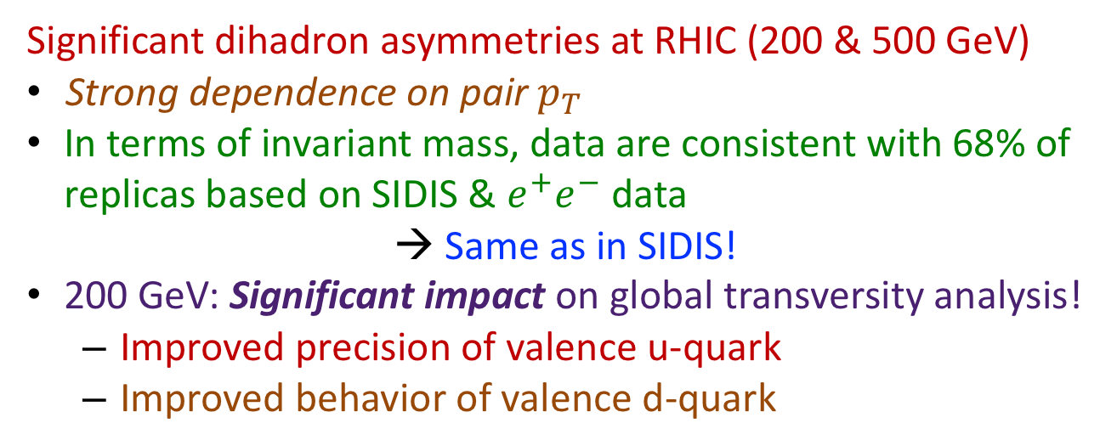
Transversity
$$xh_{1}^{u_{v}}$$
Radici and Bacchetta, PRL 120, 192001 (2018)
Significant dihadron asymmetries at RHIC (200 & 500 GeV)
Strong dependence on pair $p_{T}$
In terms of invariant mass, data are consistent with 68% of replicas based on SIDIS & $e^{+}e^{−}$ data
→ Same as in SIDIS!
200 GeV: Significant impact on global transversity analysis!
  Improved precision of valence u-quark
  Improved behavior of valence d-quark
STAR Collaboration, PLB 780, 332 (2018)

Slide 11
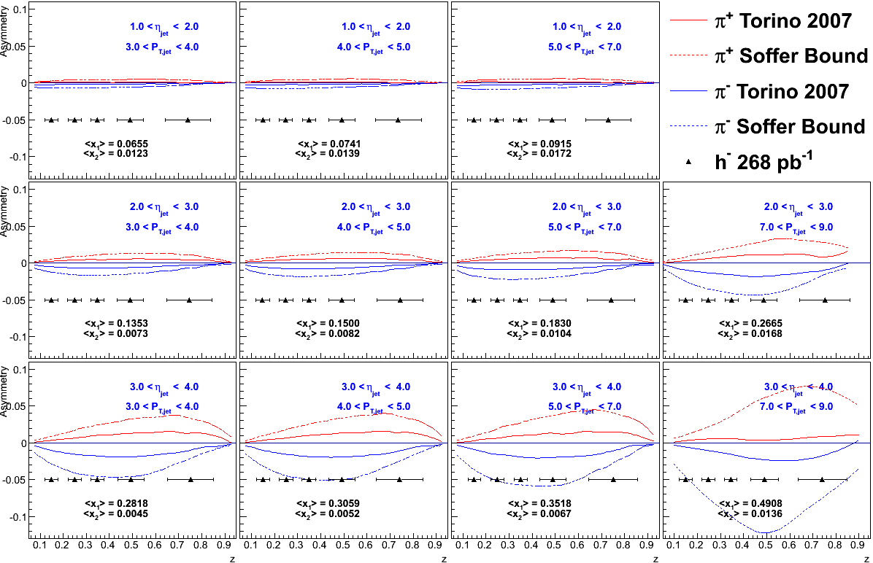


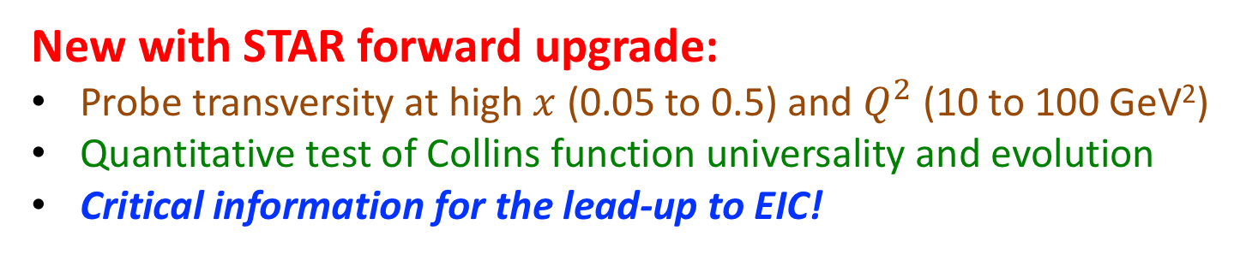
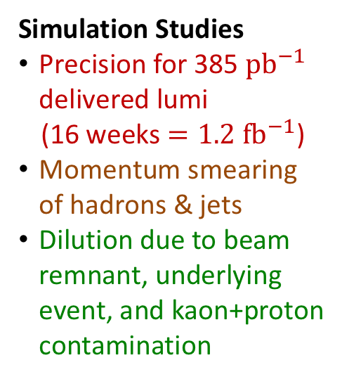
Transversity
Utilize $p+p→jet\left(h^{±}\right)$, as at midrapidity
Pushing forward = higher $x$:
Simulation Studies
Precision for 385 ${pb}^{−1}$ delivered lumi
(16 weeks $=1.2 {fb}^{−1}$)
Momentum smearing of hadrons & jets
Dilution due to beam remnant, underlying event, and kaon+proton contamination
500 GeV: $1<η<4$
New with STAR forward upgrade:
Probe transversity at high $x$ (0.05 to 0.5) and $Q^{2}$ (10 to 100 GeV²)
Quantitative test of Collins function universality and evolution
Critical information for the lead-up to EIC!

Slide 12
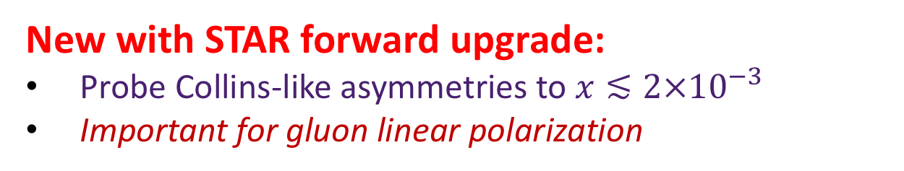
Gluon Linear Polarization
Collins-like asymmetries
Sensitive to linearly polarized gluons in a transversely polarized proton
Asymmetries consistent with zero in 500 GeV (shown) and (preliminary) 200 GeV
STAR data provide first-ever constraints
New with STAR forward upgrade:
Probe Collins-like asymmetries to $x≲2×{10}^{−3}$
Important for gluon linear polarization
STAR Collaboration, PRD 97, 032004 (2018)

Slide 13
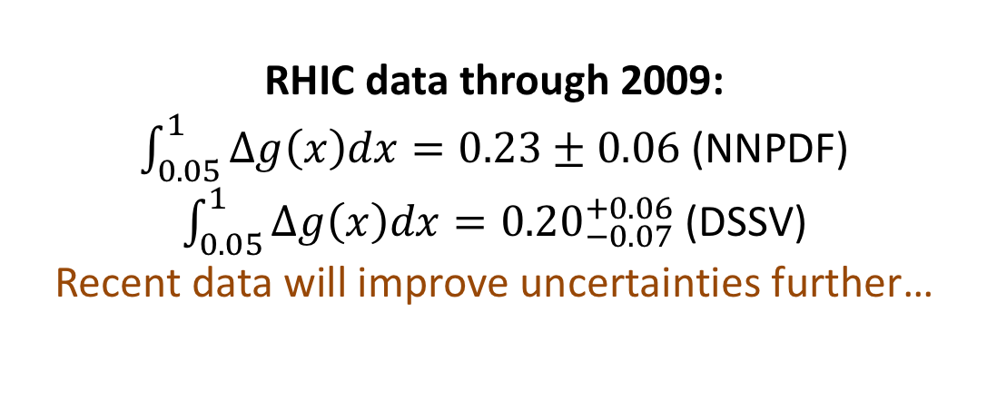
Gluon Helicity
PRD 95, 071103(R) (2017)
PRL 115, 092002 (2015)
RHIC data through 2009:
$\int_{0.05}^{1}{Δg\left(x\right)dx}=0.23±0.06$ (NNPDF)
$\int_{0.05}^{1}{Δg\left(x\right)dx}={0.20}_{−0.07}^{+0.06}$ (DSSV)
Recent data will improve uncertainties further…

Slide 14
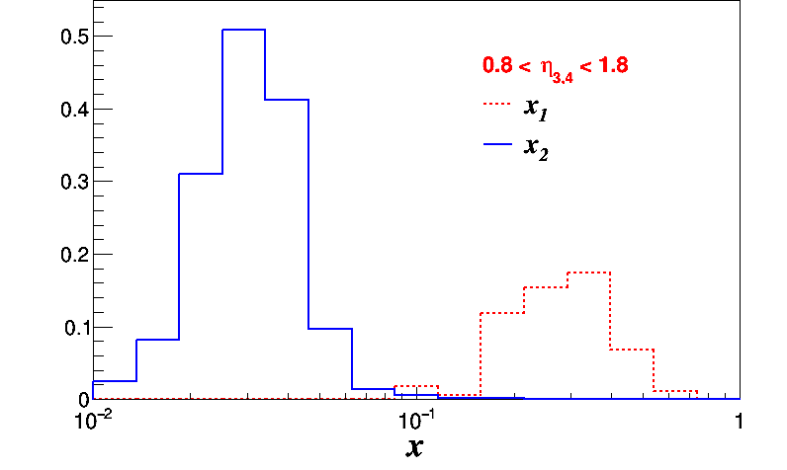
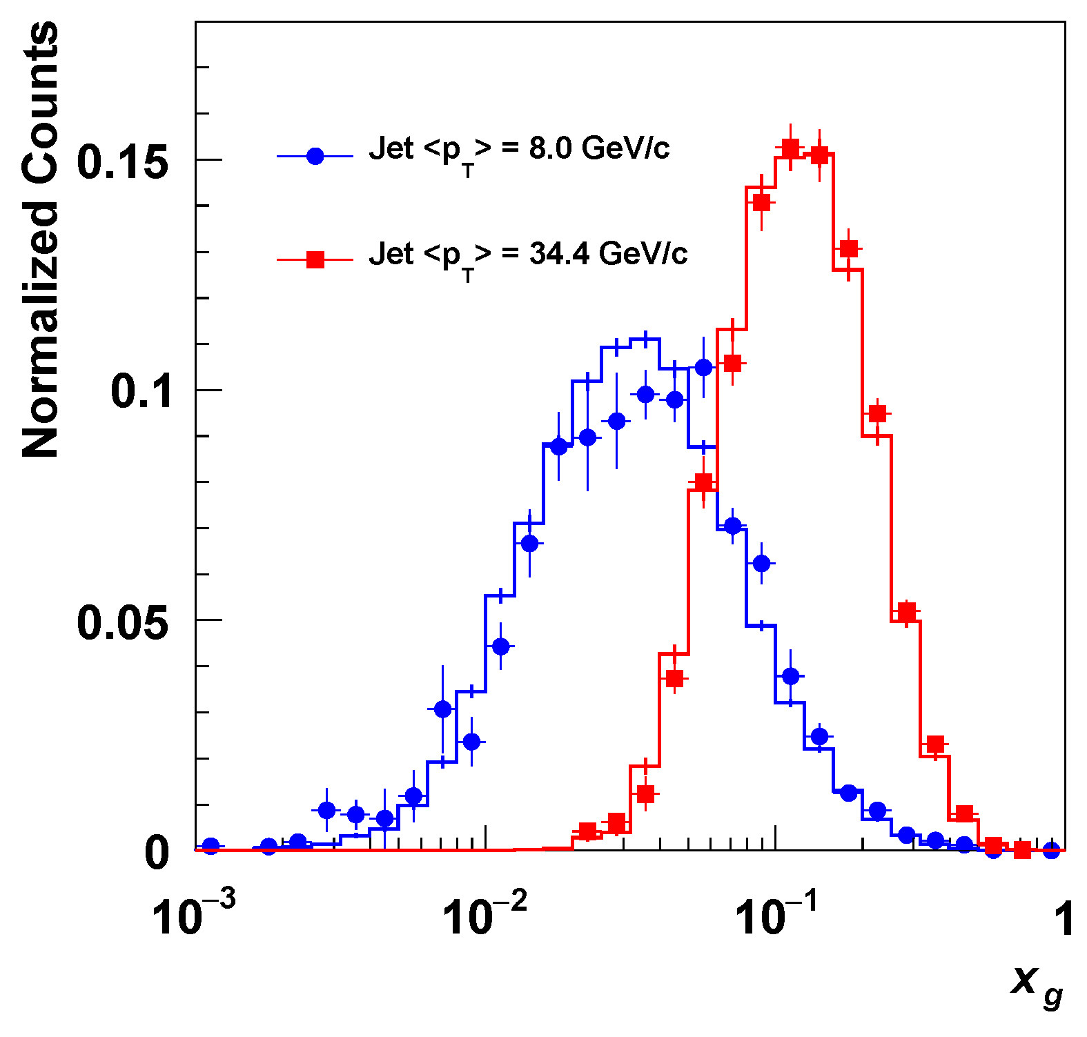


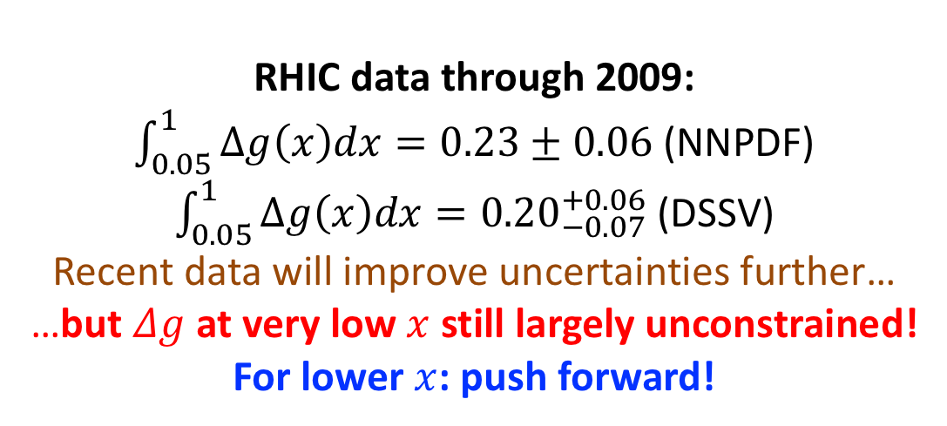
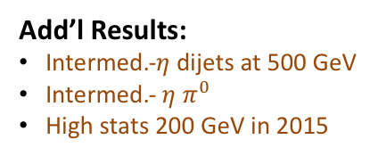


Gluon Helicity
$$p+p→Jet+Jet+X$$
$\sqrt{s}=200$ GeV
$16.0<M<19.0$ GeV$/c^{2}$
Dijet $A_{LL}$
PRD 98, 32011 (2018)
PRD 98, 32013 (2018)
$$p+p→Jet+Jet+X$$
$\sqrt{s}=500$ GeV
arXiv:1906.02740
RHIC data through 2009:
$\int_{0.05}^{1}{Δg\left(x\right)dx}=0.23±0.06$ (NNPDF)
$\int_{0.05}^{1}{Δg\left(x\right)dx}={0.20}_{−0.07}^{+0.06}$ (DSSV)
Recent data will improve uncertainties further…
…but $Δg$ at very low $x$ still largely unconstrained!
For lower $x$: push forward!
arXiv:1906.02740
Add’l Results:
Intermed.-$η$ dijets at 500 GeV
Intermed.- $η$ $π^{0}$
High stats 200 GeV in 2015

Slide 15
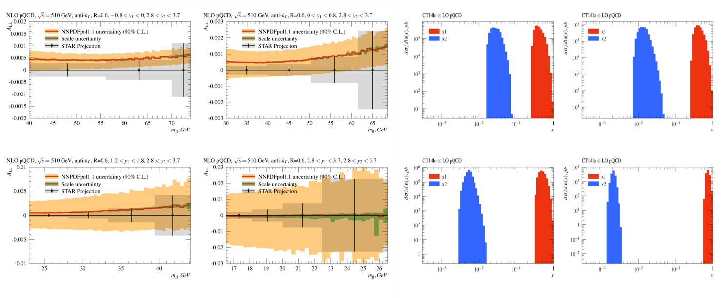

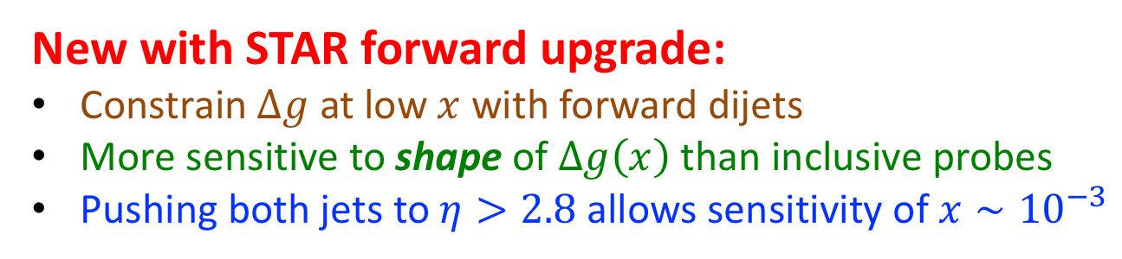
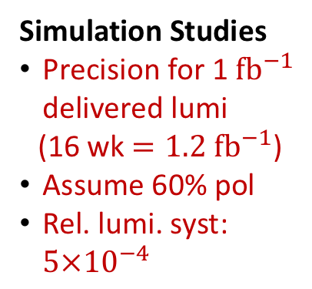
Gluon Helicity
Simulation Studies
Precision for 1 ${fb}^{−1}$ delivered lumi
(16 wk $=1.2 {fb}^{−1}$)
Assume 60% pol
Rel. lumi. syst: $5×{10}^{−4}$
Forward jet correlated with associated jet in different rapidity ranges samples a varied range of $x$
New with STAR forward upgrade:
Constrain $Δg$ at low $x$ with forward dijets
More sensitive to shape of $Δg\left(x\right)$ than inclusive probes
Pushing both jets to $η>2.8$ allows sensitivity of $x∼{10}^{−3}$

Slide 16
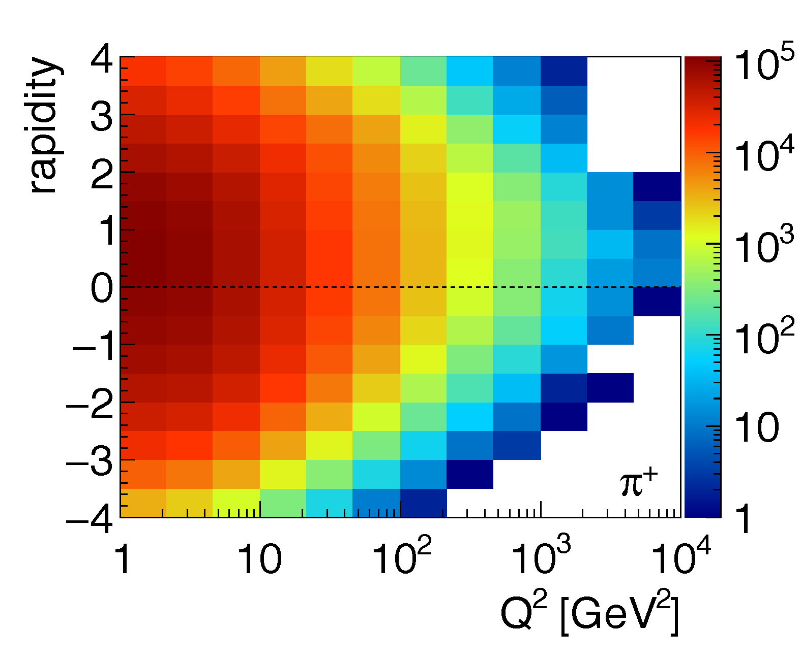
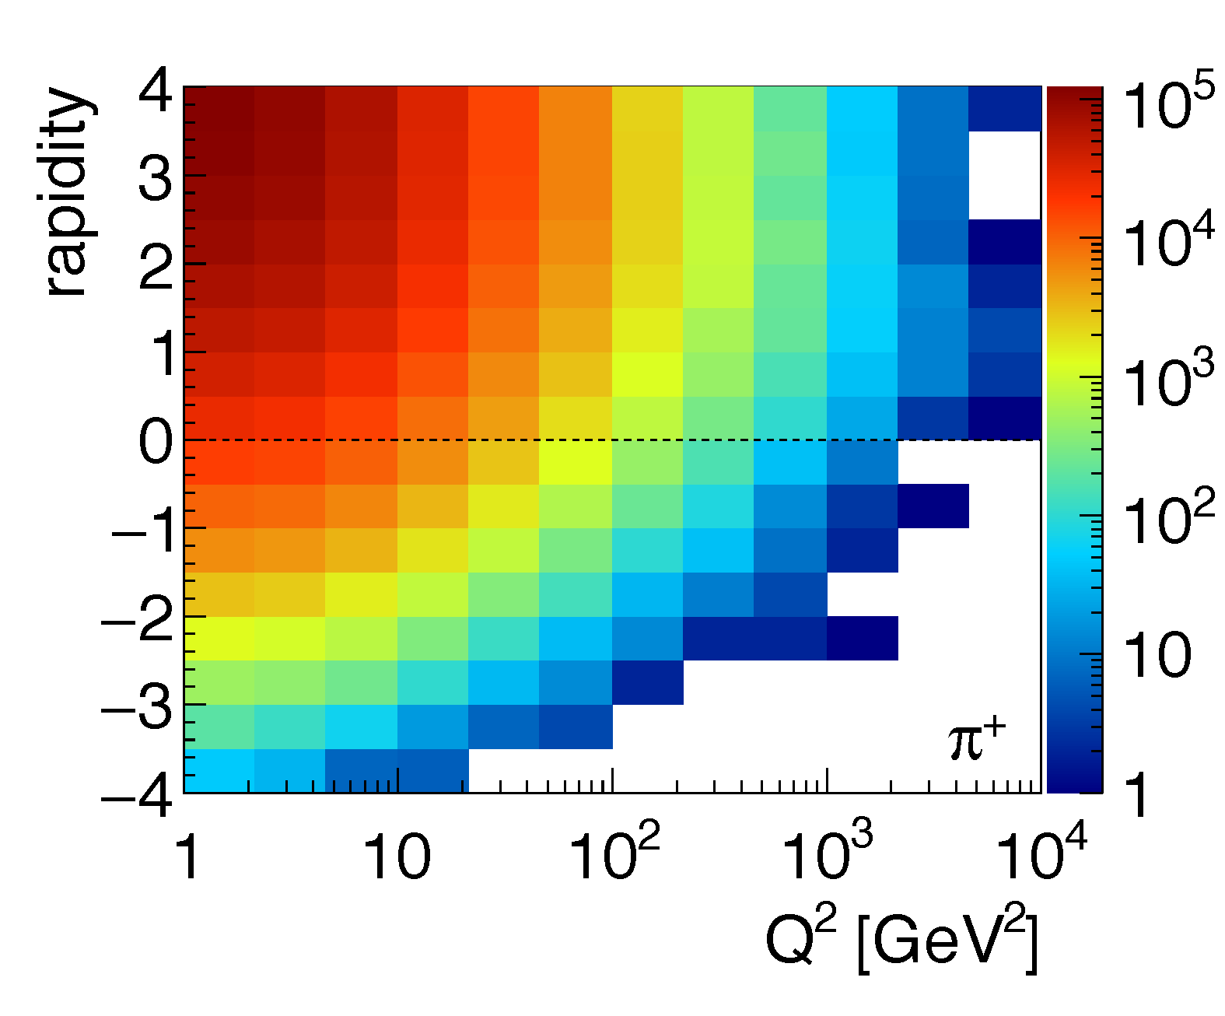
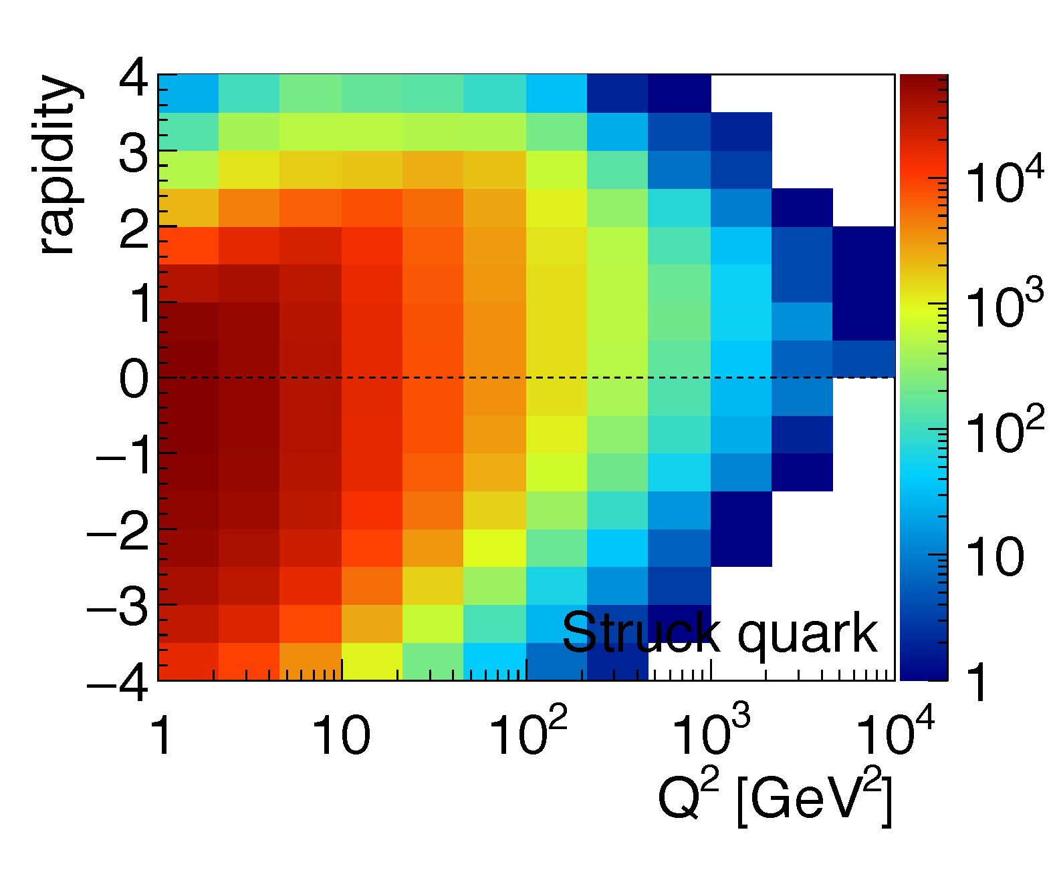
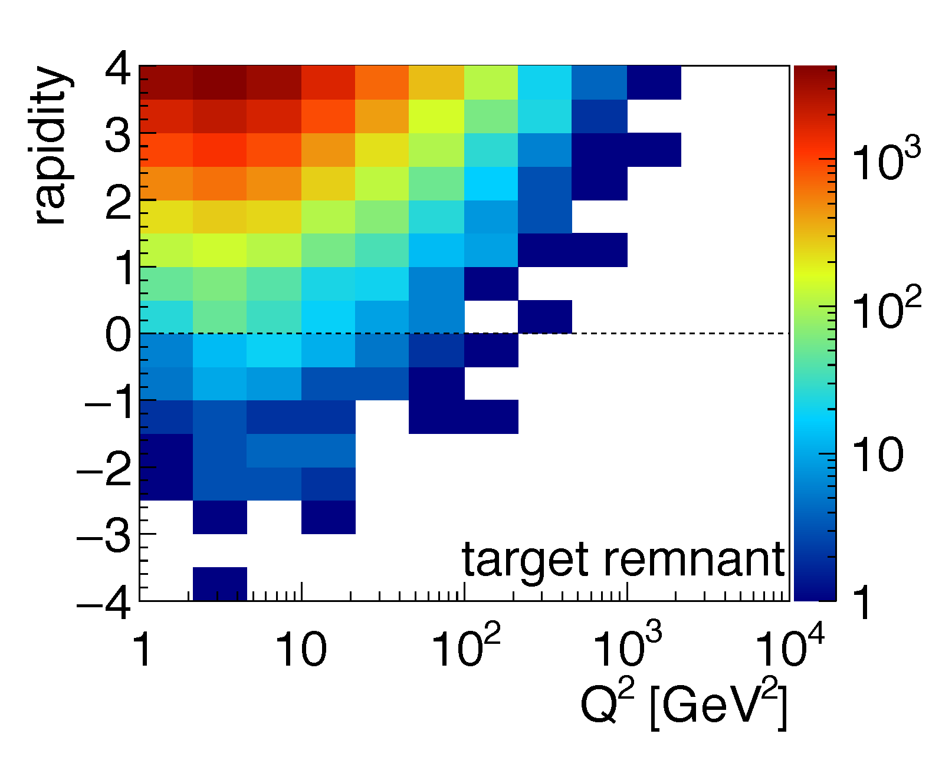
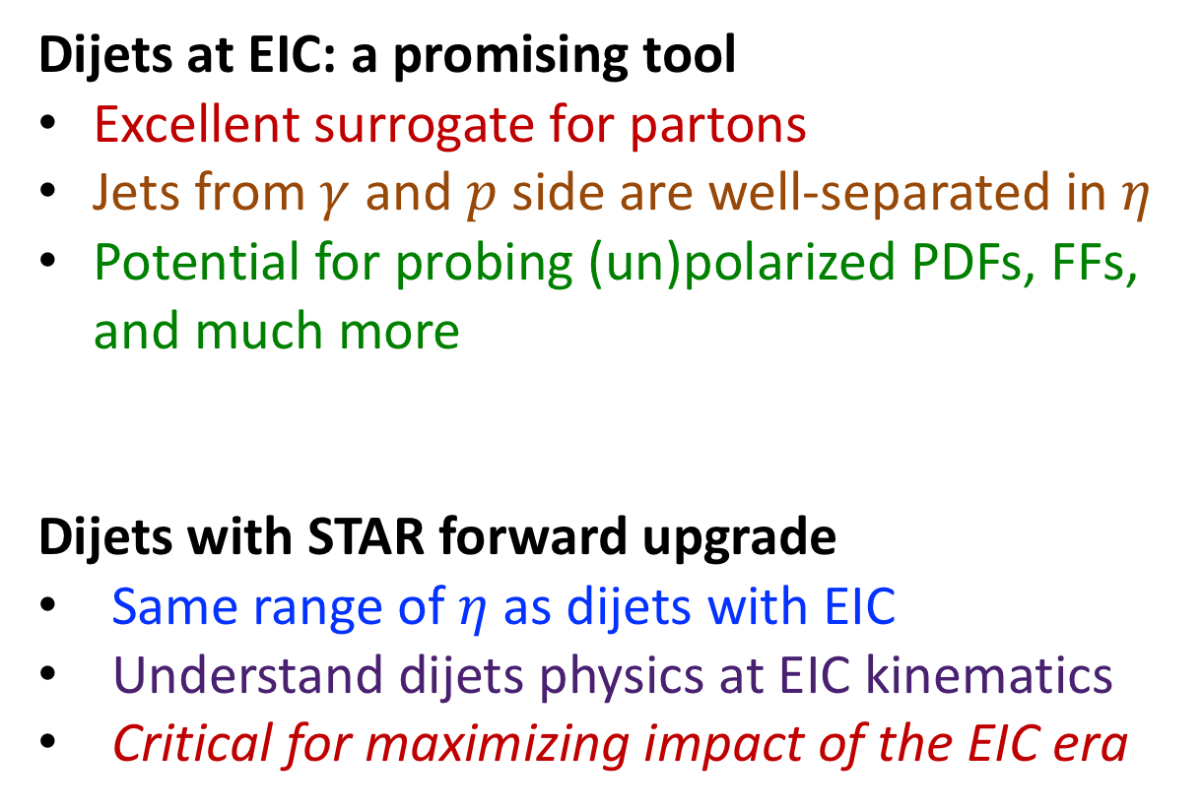
Forward Dijets: Prelude to the EIC
Dijets at EIC: a promising tool
Excellent surrogate for partons
Jets from $γ$ and $p$ side are well-separated in $η$
Potential for probing (un)polarized PDFs, FFs, and much more
Dijets with STAR forward upgrade
Same range of $η$ as dijets with EIC
Understand dijets physics at EIC kinematics
Critical for maximizing impact of the EIC era

Slide 17
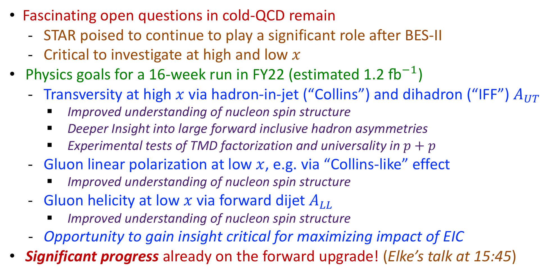
Summary
Fascinating open questions in cold-QCD remain
  STAR poised to continue to play a significant role after BES-II
  Critical to investigate at high and low $x$
Physics goals for a 16-week run in FY22 (estimated 1.2 ${\text{fb}}^{−1}$)
  Transversity at high $x$ via hadron-in-jet (“Collins”) and dihadron (“IFF”) $A_{UT}$
    Improved understanding of nucleon spin structure
    Deeper Insight into large forward inclusive hadron asymmetries
    Experimental tests of TMD factorization and universality in $p+p$
  Gluon linear polarization at low $x$, e.g. via “Collins-like” effect
    Improved understanding of nucleon spin structure
  Gluon helicity at low $x$ via forward dijet $A_{LL}$
    Improved understanding of nucleon spin structure
  Opportunity to gain insight critical for maximizing impact of EIC
Significant progress already on the forward upgrade! (Elke’s talk at 15:45)

Slide 18
Back-up Slides

Slide 19
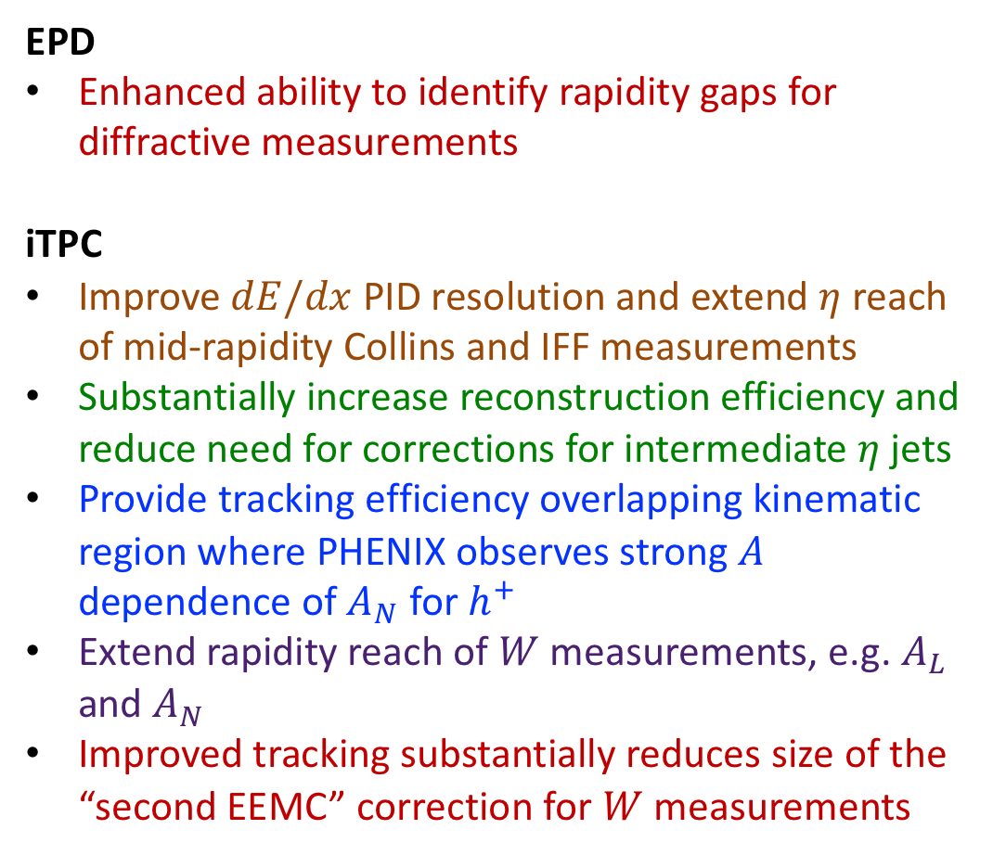
Cold-QCD Physics with Existing Upgrades
EPD
Enhanced ability to identify rapidity gaps for diffractive measurements
iTPC
Improve $dE/dx$ PID resolution and extend $η$ reach of mid-rapidity Collins and IFF measurements
Substantially increase reconstruction efficiency and reduce need for corrections for intermediate $η$ jets
Provide tracking efficiency overlapping kinematic region where PHENIX observes strong $A$ dependence of $A_{N}$ for $h^{+}$
Extend rapidity reach of $W$ measurements, e.g. $A_{L}$ and $A_{N}$
Improved tracking substantially reduces size of the “second EEMC” correction for $W$ measurements

Slide 20
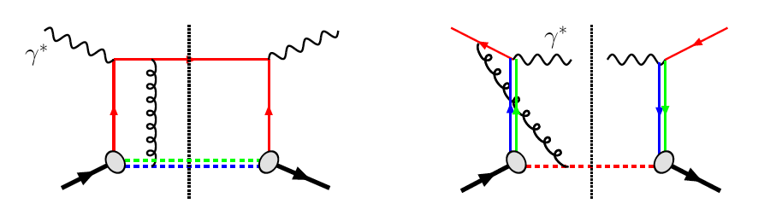

Sivers Effect
Color interactions in QCD
“Modified-universality” of the “Sivers” function
QCD:
DIS:
Final-state interaction
Drell-Yan or W:
Initial-state interaction
Sivers_{DIS} = −Sivers_{Drell-Yan} or Sivers_{W}
$A_{N}$ for direct photon also has a closely related “sign change”
Opportunity to see the repulsive interaction between like color charges for the first time!
Can explore all of these observables in 500 GeV $p+p$ collisions at RHIC!

Slide 21
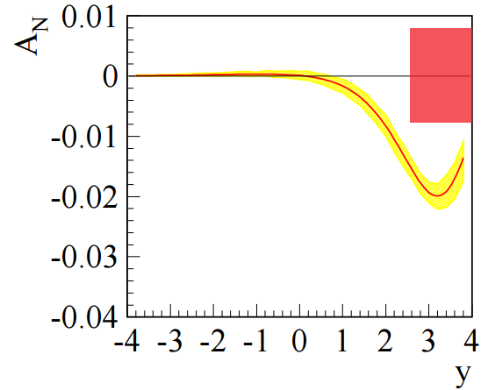
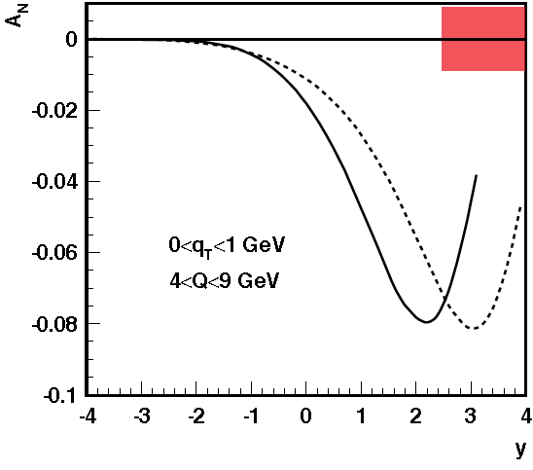
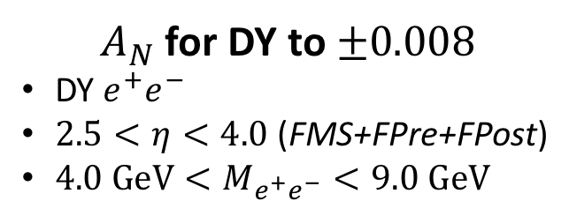
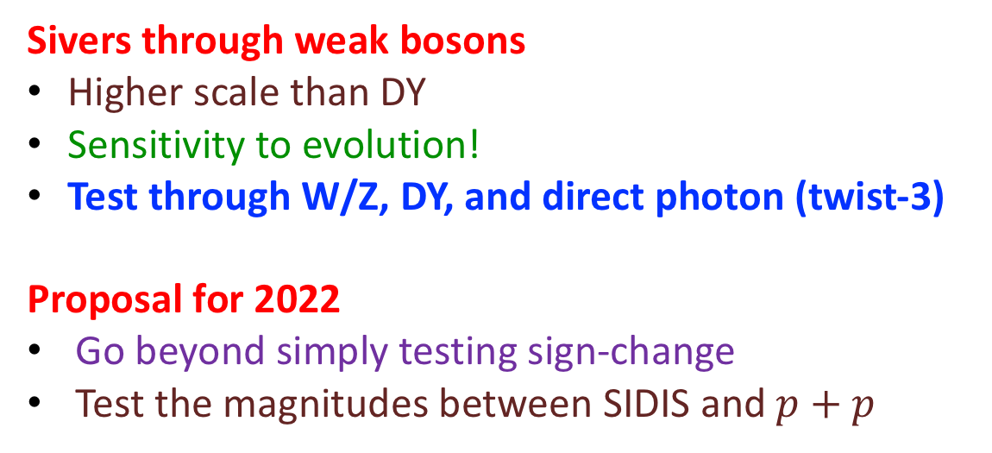
Sivers Effect at RHIC
PRL 116, 132301 (2016)
$A_{N}$ for DY to $±0.008$
        DY $e^{+}e^{−}$
        $2.5<η<4.0$ (FMS+FPre+FPost)
        $4.0 GeV<M_{e^{+}e^{−}}<9.0 GeV$
Sivers through weak bosons
Higher scale than DY
Sensitivity to evolution!
Test through W/Z, DY, and direct photon (twist-3)
Proposal for 2022
Go beyond simply testing sign-change
Test the magnitudes between SIDIS and $p+p$

Slide 22
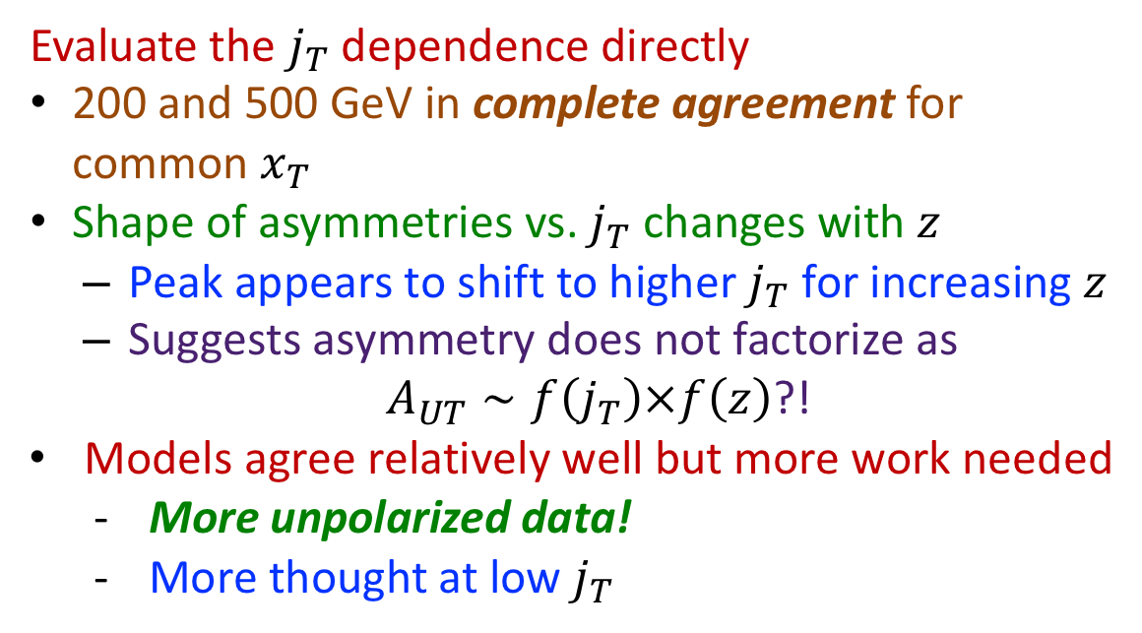
Collins Effect at RHIC
Evaluate the $j_{T}$ dependence directly
200 and 500 GeV in complete agreement for common $x_{T}$
Shape of asymmetries vs. $j_{T}$ changes with $z$
  Peak appears to shift to higher $j_{T}$ for increasing $z$
  Suggests asymmetry does not factorize as
  $A_{UT}∼f\left(j_{T}\right)×f\left(z\right)$?!
  Models agree relatively well but more work needed
    More unpolarized data!
    More thought at low $j_{T}$
PLB 774, 635 (2017)
500 GeV: STAR Collaboration, PRD 97, 032004 (2018)
200 GeV: Int. J. Mod. Phys. Conf. Ser. 40, 1660040

Slide 23
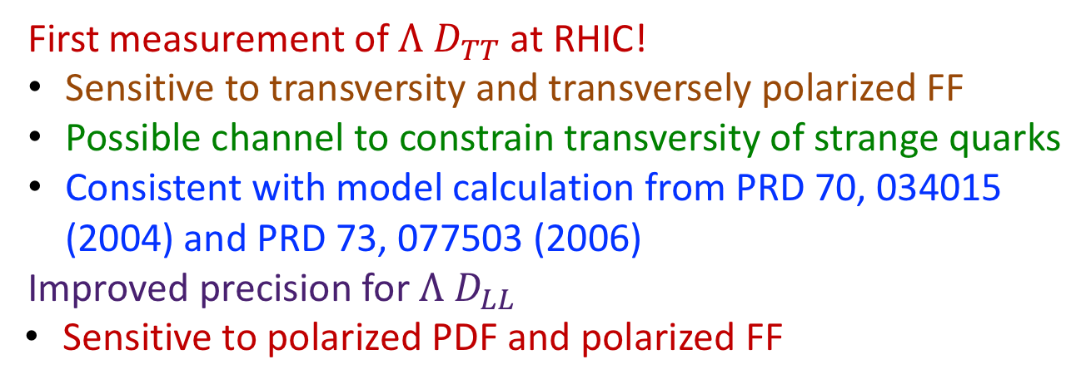
Hyperons
First measurement of $Λ$ $D_{TT}$ at RHIC!
Sensitive to transversity and transversely polarized FF
Possible channel to constrain transversity of strange quarks
Consistent with model calculation from PRD 70, 034015 (2004) and PRD 73, 077503 (2006)
Improved precision for $Λ$ $D_{LL}$
Sensitive to polarized PDF and polarized FF
STAR Collaboration, PRD 98, 91103 (2018)
STAR Collaboration, PRD 98, 112009 (2018)

Slide 24
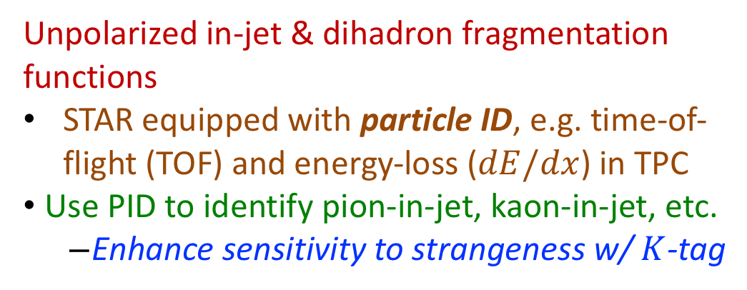
Hadron-in-jet Fragmentation Functions
Unpolarized in-jet & dihadron fragmentation functions
STAR equipped with particle ID, e.g. time-of-flight (TOF) and energy-loss ($dE/dx$) in TPC
Use PID to identify pion-in-jet, kaon-in-jet, etc.
  Enhance sensitivity to strangeness w/ $K$-tag
The RHIC Spin Collaboration, arXiv:1602.03922

Slide 25
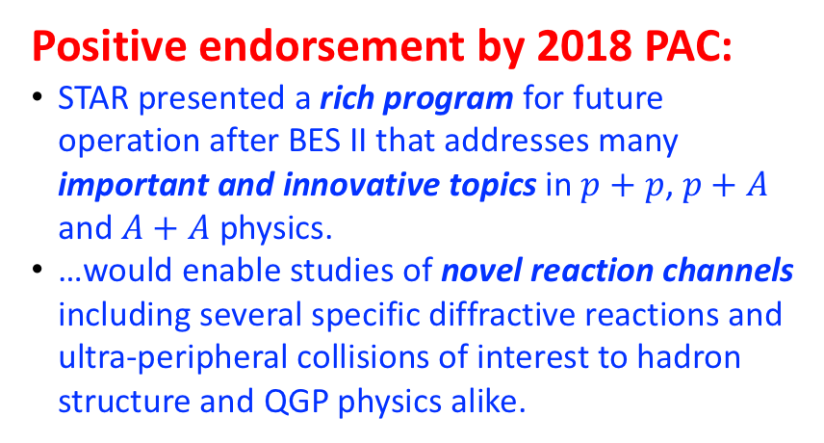
pp/pA Physics in 2020+
RHIC Cold QCD physics after BES-II at Mid & Forward Rapidities:
The RHIC Cold QCD Plan for 2017 to 2023: A Portal to the EIC (arXiv:1602.03922)
Critical to the mission of the RHIC physics program
Fully realize the scientific promise of the EIC
Midrapidity: https://drupal.star.bnl.gov/STAR/starnotes/public/sn0669
Based on existing STAR detectors, utilizing recent BES II upgrades (iTPC, eTOF, EPD)
Forward-rapidity: https://drupal.star.bnl.gov/STAR/starnotes/public/sn0648
Upgrades consist of HCal + ECal + Tracking in range of $2.5<η<4.5$
Positive endorsement by 2018 PAC:
STAR presented a rich program for future operation after BES II that addresses many important and innovative topics in $p+p$, $p+A$ and $A+A$ physics.
…would enable studies of novel reaction channels including several specific diffractive reactions and ultra-peripheral collisions of interest to hadron structure and QGP physics alike.

