Slide 1




Physics Capability of JETSCAPE
JETSCAPE Winter School 2019
Shanshan Cao
Wayne State University

Slide 2
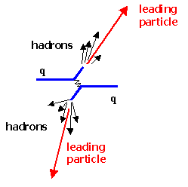
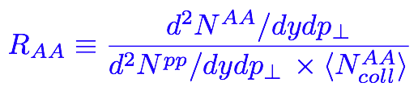
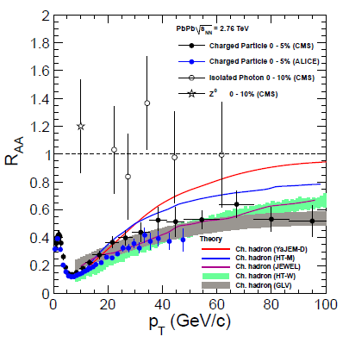
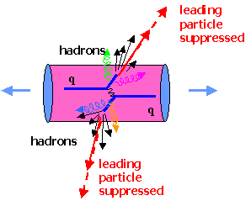
Probing QGP with jets
Nuclear Modification Factor:

Slide 3
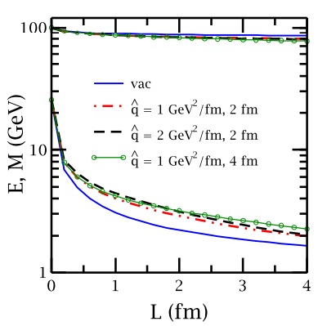
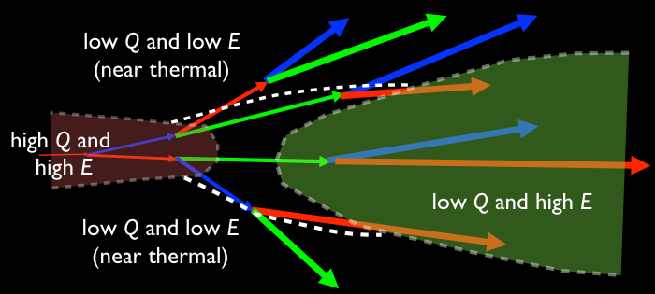
Multistage jet evolution in heavy-ion collisions
Stage 1: High Q and high E (DGLAP, higher-twist); lose Q faster than E [ Majumder and Putschke, PRC 93 (2016) ]
Stage 2: low Q and high E (Transport, higher-twist, AMY)
Stage 3: low Q and low E (near thermal) (strongly coupled approach)
However, one usually applies a single theory through all stages

Slide 4
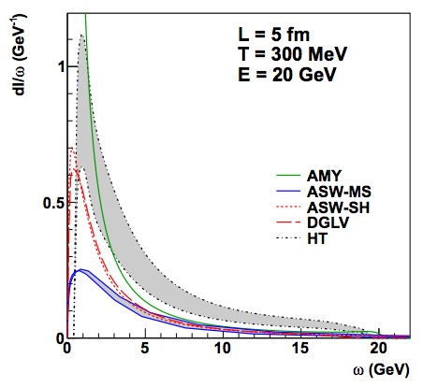
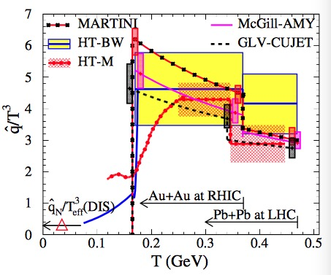
Goals of different collaboration work
[ TECHQM: PRC 86 (2012) 064904 ]
[ JET: PRC 90 (2014) 014909 ]
TECHQM: comparison of medium-induced gluon spectra in a brick
JET: constraint on q in realistic hydro medium using different theories
^
JETSCAPE: to combine theories from different stages into a unified approach: DGLAP (high Q) + transport (low Q) + strongly coupled (thermal) [PRC 96 (2017)]

Slide 5
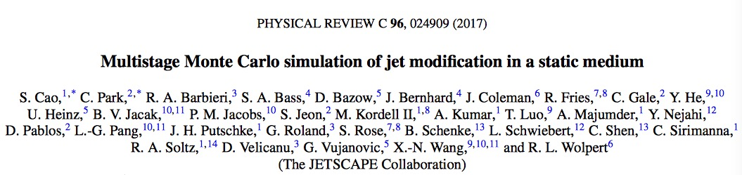
Part I: A multi-stage approach for jet evolution

Slide 6
Stage 1: high Q and high E
DGLAP evolution for parton fragmentation function at high Q:
Sudakov form factor ( probability of NO splitting in [ Q , Q_{max} ] ):
Splitting function:
[ higher-twist energy loss formalism: Guo and Wang (2000), Majumder (2012) ]
jet transport coefficient, due to elastic scattering

Slide 7
Stage 1: high Q and high E
MATTER (The Modular All Twist Transverse-scattering Elastic-drag and Radiation) [Wayne: PRC 88, 014909, arXiv:1702.05862)]
Monte-Carlo Implementation:
splitting happens above Q₀ (min. allowed virtuality)
no splitting above Q
splitting happens at (or below) scale Q
For a given splitting, the p⁺ fraction of the two daughter partons are determined by P(z), and p_{T} w.r.t. the parent parton is determined by the difference in invariant mass between the parent and daughters.
This Q also determines the new Q_{max} for the next splitting (iteration)
a virtuality-ordered parton showers from initial Q_{max} to Q₀

Slide 8
Stage 2: low Q and high E
LBT or MARTINI (time-ordered transport model) simulates parton showers at (or below) Q₀ (with on-shell approximation)
LBT (Linear Boltzmann Transport)
[LBL-CCNU: PRL 111 (2013) 062301, PRC 94 (2016) 014909, arXiv:1704.03648]
Evolution of jet parton “1”:
Elastic Scattering rate:
Inelastic scattering rate (average gluon number per Δt):
Medium-induced gluon spectrum is taken from HT (same as MATTER)
Multiple gluon emission in Δt is allowed – Poisson distribution of <N_{g}>

Slide 9
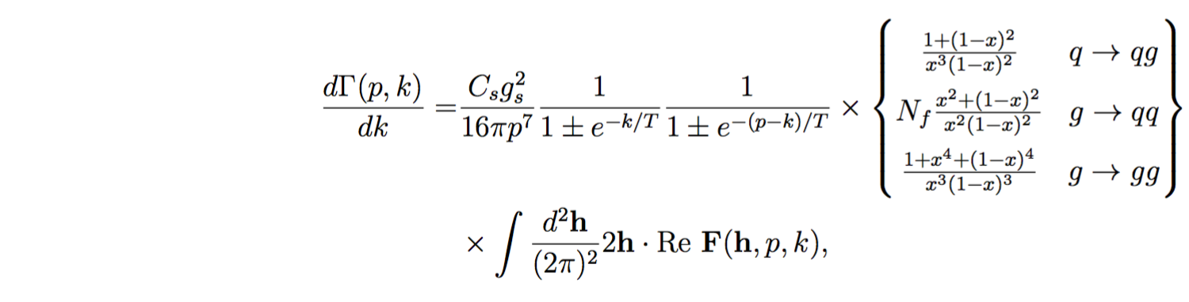
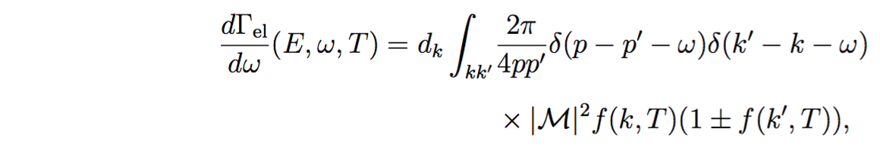
Stage 2: low Q and high E
MARTINI (Modular Algorithm for Relativistic Treatment of heavy IoN Interactions) [McGill: PRC 80 (2009) 054913, arXiv:0909.2037]
Energy loss mechanism in MARTINI is based on the AMY radiative formalism coupled with collisional energy loss
AMY formalism for 1->2 splittings where LPM effect is included:
F(h, p, k) [p – jet parton, k – emitted gluon, h = p × k] is the solution of an integral (Schwinger-Dyson) equation describing how |p − k; k⟩⟨p| evolves with t due to collisions and the energy difference between the two states.
Elastic scattering rate for 2->2 scattering process is included:
[S. Jeon and G. Moore PRC 71 (2005) 034901, S. Jeon NPA 830 (2009) 107 ]

Slide 10
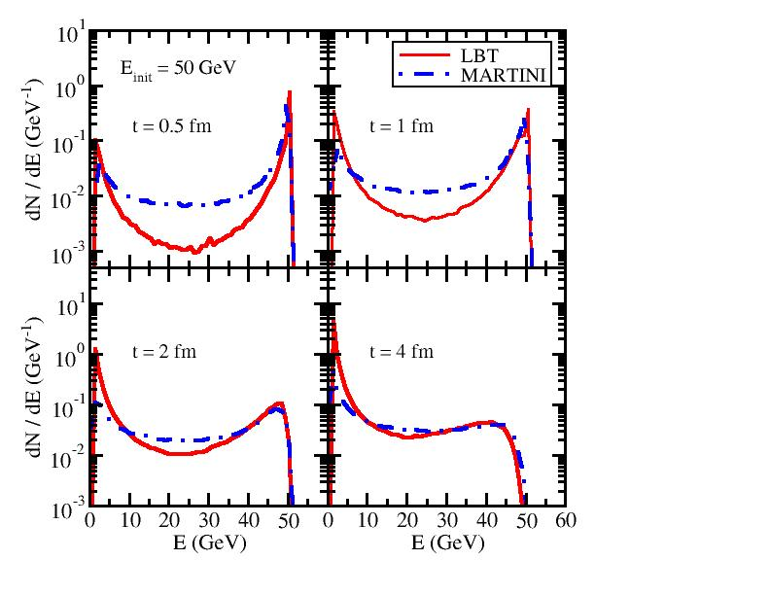
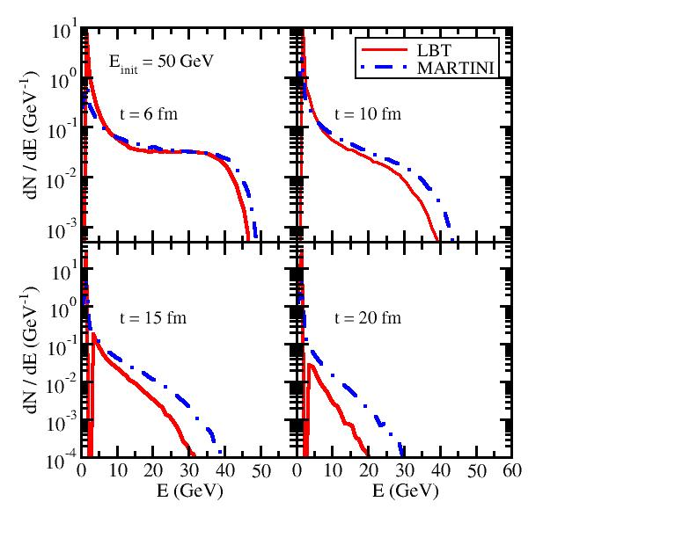
LBT vs. MARTINI at different times
Energy spectra of daughter partons initiated by a single quark at 50 GeV
brick
T = 250 MeV
Parton energy loss in LBT (HT) is weaker than in MARTINI (AMY) at early t, but catches up and becomes stronger when t is large
At t around the QGP lifetime, LBT and MARTINI are indistinguishable

Slide 11
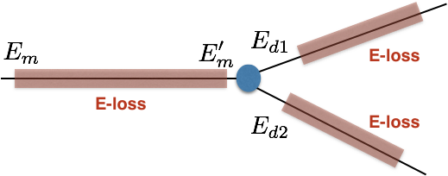
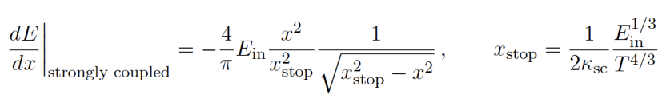
Stage 3: low Q and low E (near thermal)
Strongly coupled approach (AdS/CFT based model) [JHEP 03 (2016) 053, JHEP 10 (2014) 019]
Apply strongly coupled drag on partons
strong coupling parameter
[P. Chesler and K. Rajagopal PRD 90 (2014) 025033, JHEP 1605 (2016) 098]

Slide 12
Separation scales
1. MATTER (virtuality-ordered) evolves partons (Q>Q₀, E>E₀)
2. LBT/MARTINI (time-ordered) continues parton evolution (Q<Q₀, E>E₀)
3. AdS/CFT drag (time-ordered) is introduced when (Q>Q₀, E<E₀)
Virtuality separation scale Q₀
Fixed Q₀: 1, 2 or 3 GeV will be used and compared.
Dynamical Q₀ (virtuality gain from scattering with the medium):
Extracted from model to data comparison (see Part III)
Energy separation scale E₀
Under investigation

Slide 13
Separation time between MATTER and LBT/MARTINI
when a given parton hit Q₀ after multiple splittings
medium length (4 fm)
The multi-stage approach is necessary: the switching time between MATTER and LBT/MARTINI varies with E and Q₀.

Slide 14
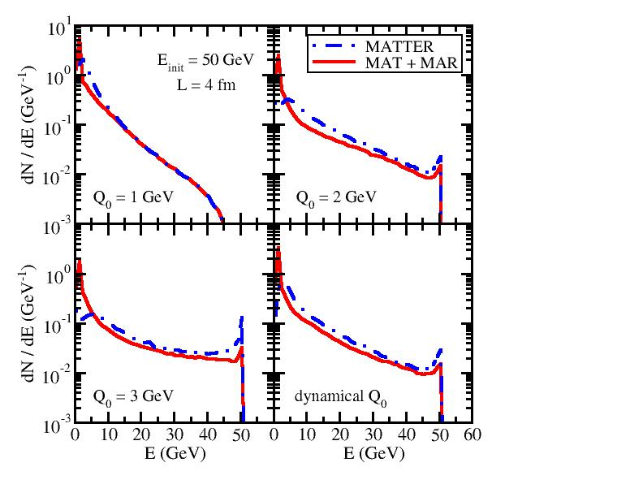
MATTER vs. LBT/MARTINI contribution
Energy spectra of daughter partons initiated by a single quark at 50 GeV
Recall: It takes longer time for high E partons to hit Q₀ in MATTER and leaves shorter time for the subsequent LBT/MARTINI.
Energy loss from LBT/MARTINI in MATTER + LBT/MARTINI is weak for high E partons, but becomes stronger for low E ones.

Slide 15
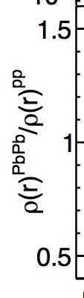
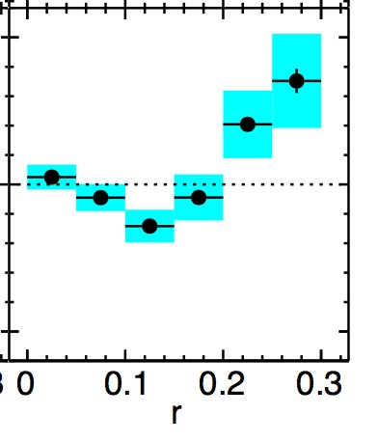
dE/dθ of daughter partons (jet shape)
In-medium evolution changes the jet shape – depletes energy in small cone and enhances energy in large cone.
LBT is more effective than MATTER in shifting energy distribution into larger angle since elastic scattering is included in LBT.
Interesting non-monotonic behavior at Q₀ = 1 GeV -- enhanced Sudakov type splitting at very small r in MATTER and LBT scattering at large r. (Jet shape can be partially understood even with a brick.)

Slide 16
Part II: Physics results from JETSCAPE 1.0
Kolja Kauder, QM 2018, arXiv: 1807.09615
Yasuki Tachibana, HP 2018, arXiv: 1812.06366
Chanwook Park, HP 2018

Slide 17
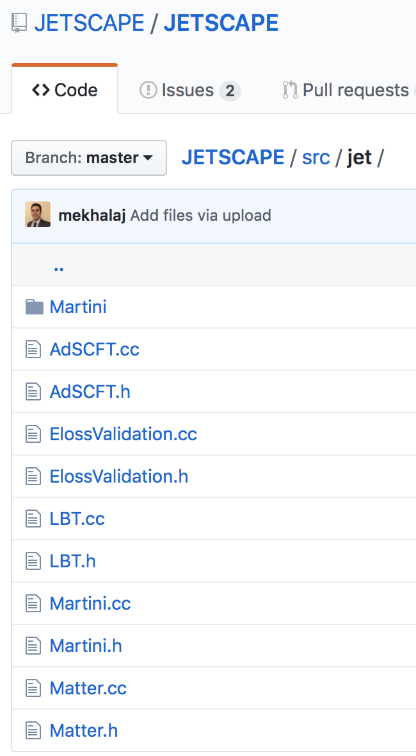
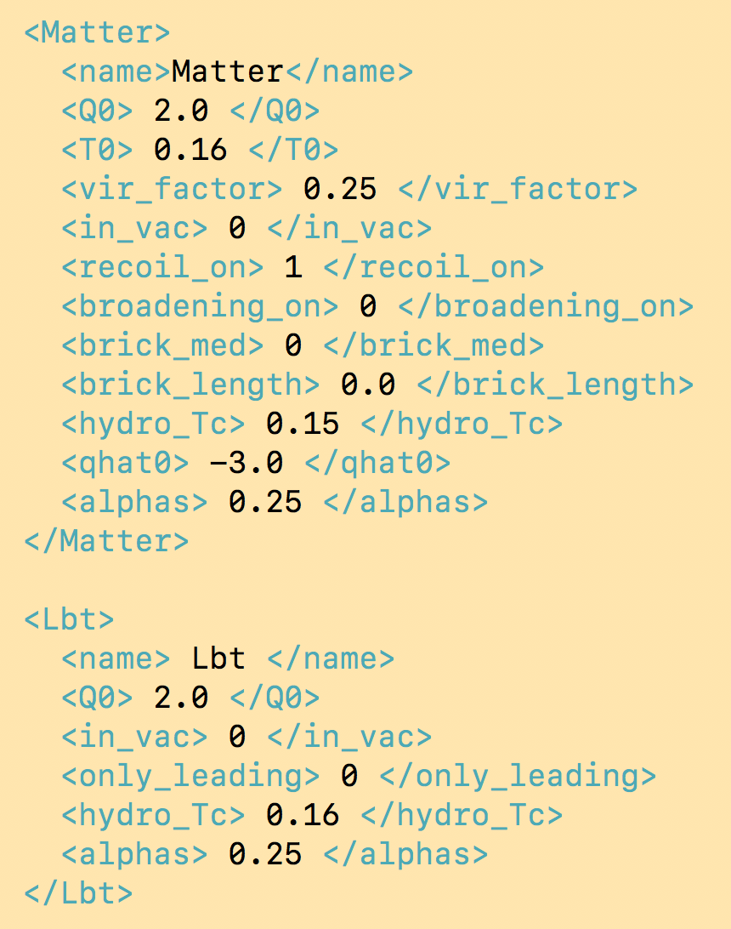
Embed 4 energy loss modules into JETSCAPE
Realize multi-stage jet evolution using the xml input file
separation scale Q₀
AdS/CFT
coupling const. ⍺_{s}
LBT
separation scale Q₀
MARTINI
MATTER
coupling const. ⍺_{s}

Slide 18
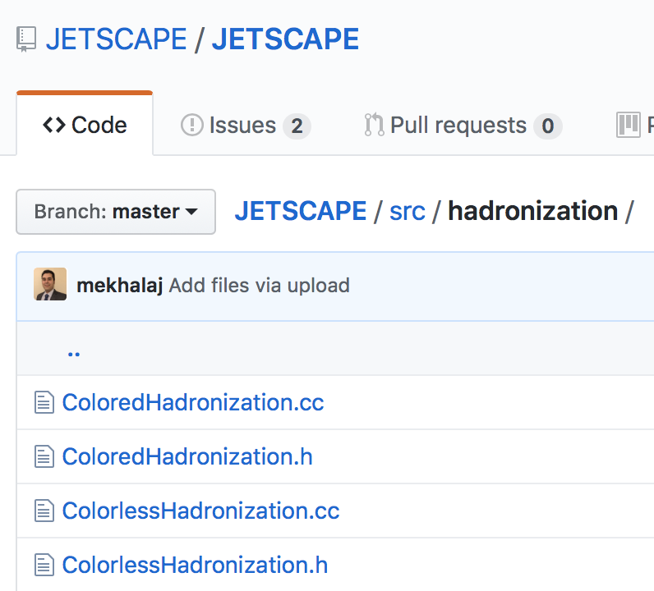
Embed 2 hadronization modules into JETSCAPE
Colored
Colorless
Colored hadronization: track color information during parton showers and construct string for Pythia fragmentation in the end
Colorless: assign colors to final state partons based on their phase space configuration (more flexible for A-A collisions)

Slide 19
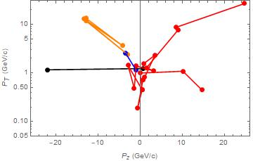
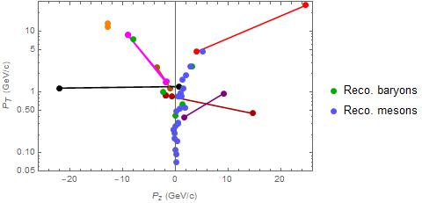
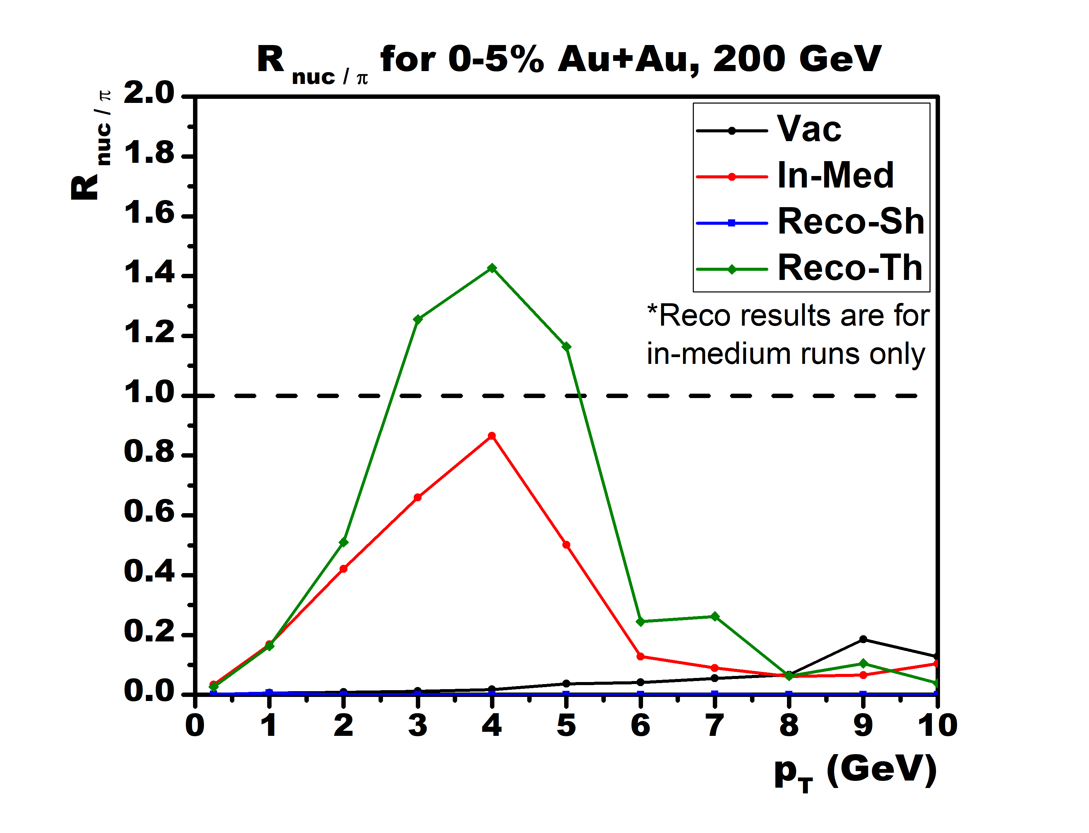
Hybrid hadronization (recombination-string)
Recombination (dense parton limit), string fragmentation (dilute parton limit), relative probability from parton-hadron wavefunction overlap
Finished v2.2 (“patch code / benchmark version”): FORTRAN & PYTHIA 6
Original string structure
After recombination step
Jets
J
Diquark
Junction
v2.2 PRELIMINARY
  Full color flow p+p events
  Add thermal medium: enhance nucleon to pion ratio
v3.0 (C++&PYTHIA 8): ready to be embedded into JETSCAPE
MATTER jets embedded in hydro

Slide 20
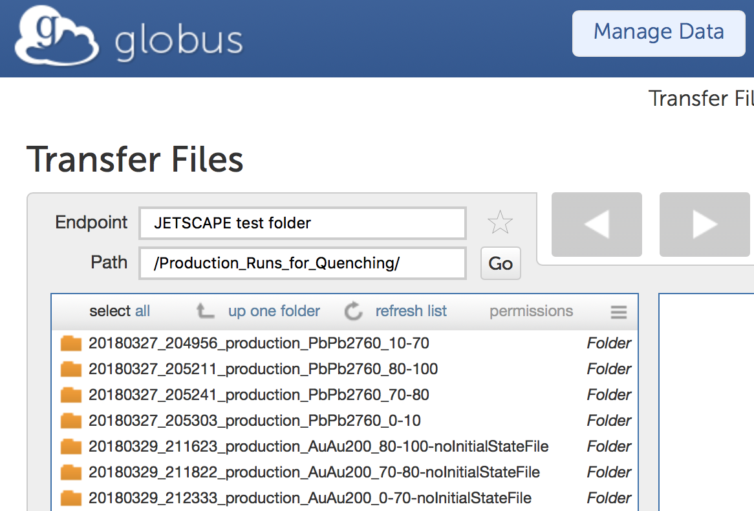
Bulk profiles of the hot nuclear matter
Local (T, s, v, …) of the nuclear matter is provided by Trento (initial condition) + free streaming (pre-equilibrium) + VISHNEW hydrodynamic model (QGP)
Data files of the bulk profiles have been prepared by SIMS and shared through OSIRIS
bulk profiles for various collision systems

Slide 21
Flow chart of p-p and A-A simulations
Colored hadronization
(more rigorous)
Pythia hard scattering
(no Final State Radiation)
MATTER vac. shower
(easy to extend to AA)
p-p
Colorless hadronization
(flexible to extend to AA)
* can be replaced by pure Pythia with FSR on
Pythia hard scattering
(no Final State Radiation)
P
MATTER med. modified shower + LBT/MARTINI + AdS/CFT
A-A
Colorless hadronization
X
Trento Initial condition
bulk (T, v, …)
initial s(X)
Free-streaming (pre-thermal)
Hydrodynamics (QGP)

Slide 22
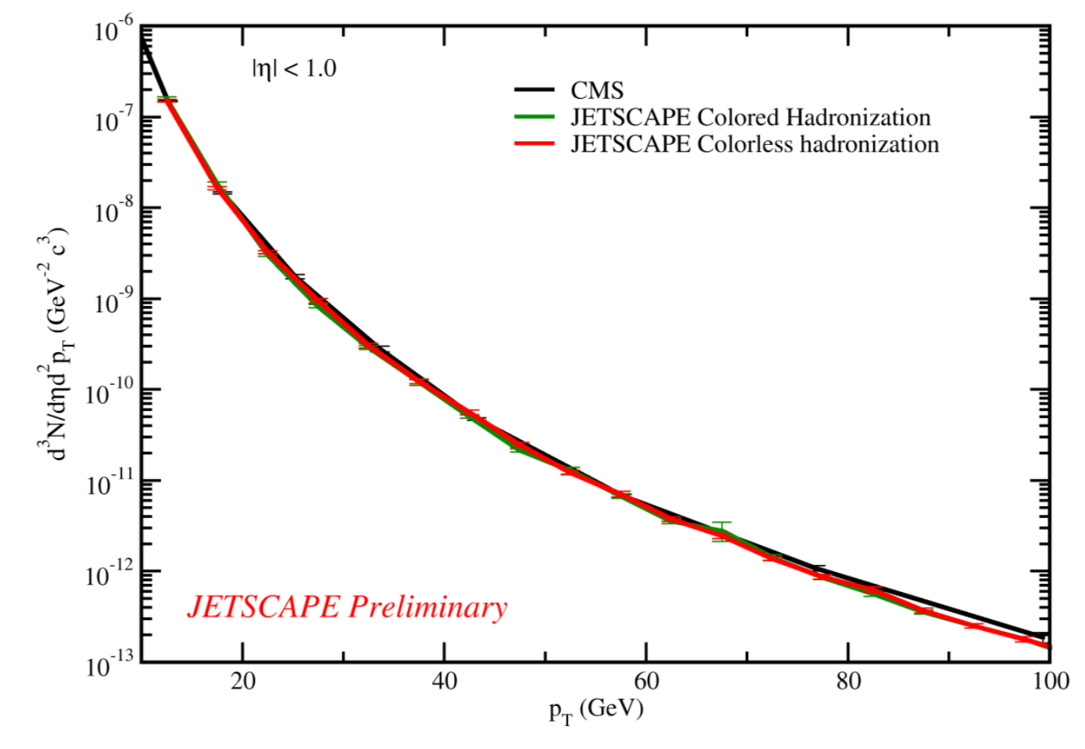
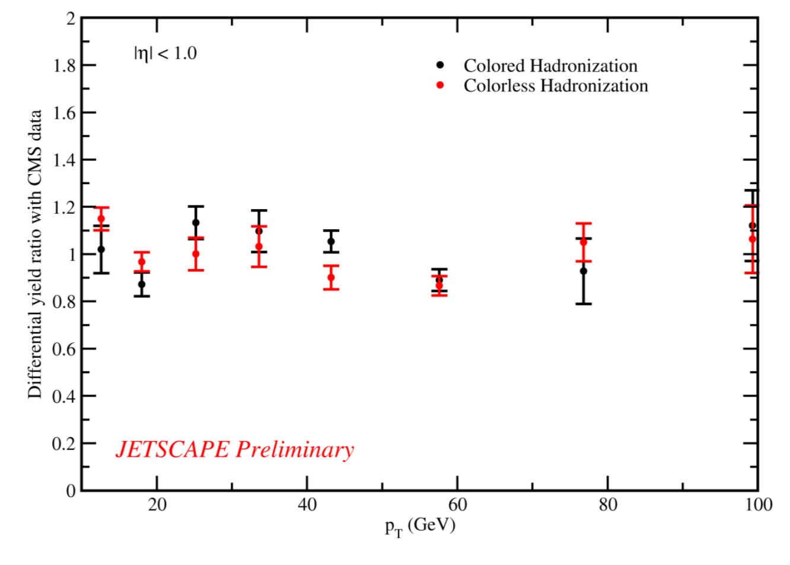
Jet observables in p-p collisions
Pythia hard scattering (FSR off) + MATTER vacuum showers
Parameter tuning
Maximum possible virtuality:
Scale parameter in the running coupling:
Charged hadron spectra
Good agreement with data [EPJ C72,1945 (2012)]
No significant differences between the two hadronization models

Slide 23
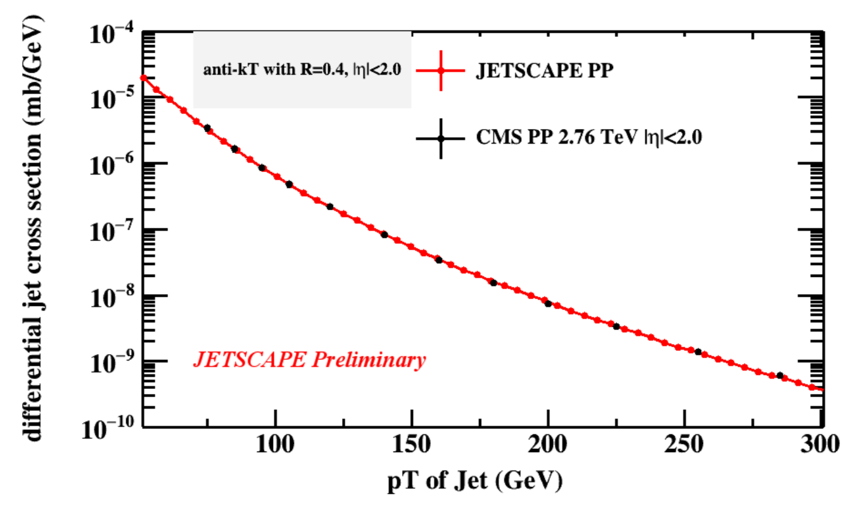
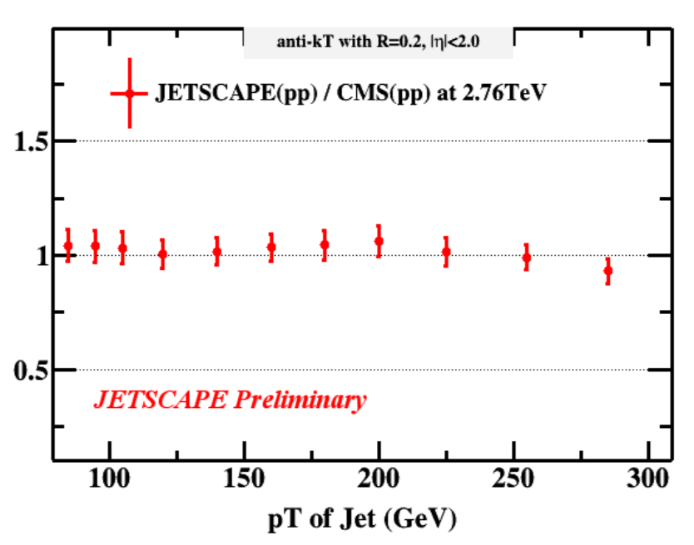
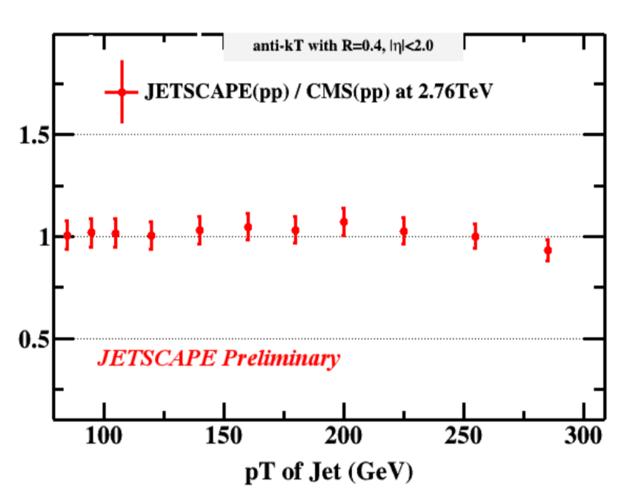
Single inclusive jet spectra
X ALICE
X partonic
X hadronic
Anti-k_{T}, |η|<2
R=0.4
σ(R=0.2) / σ(R=0.4)
Good agreement with data [PRC 96, 015202 (2017)]
Necessary to include proper hadronization scheme for the cone size dependence
R=0.2
R=0.4

Slide 24
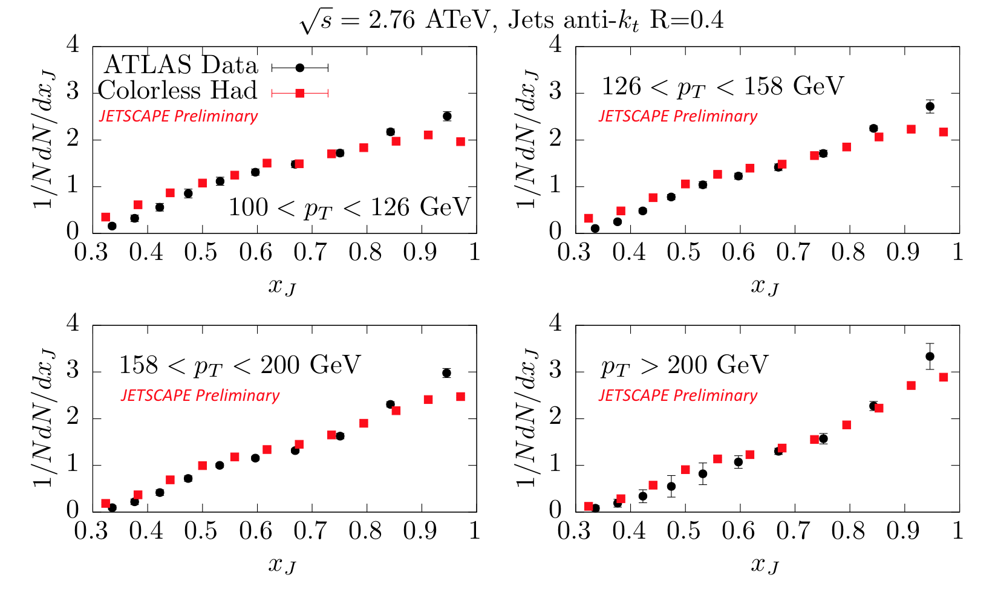
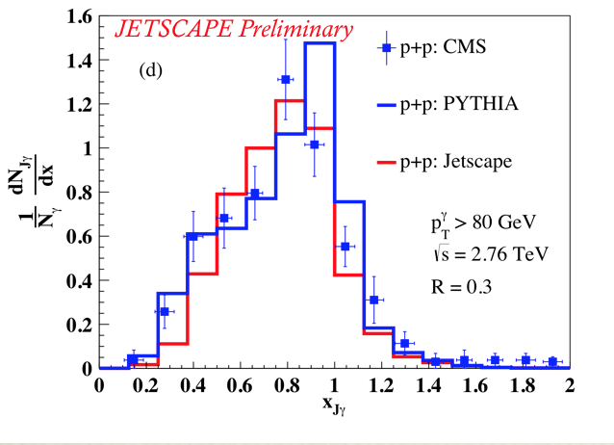
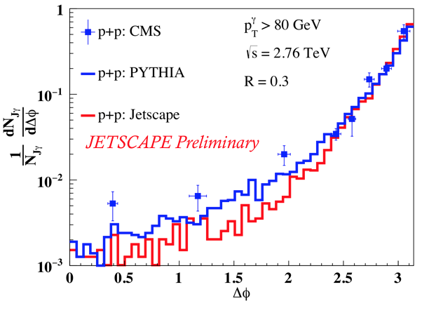
Dijets and γ-jets
di-jet asymmetry
𝛾-jet asymmetry
Di-jet asymmetry in good agreement with data [ATLAS, PLB 774, 379 (2017)]
𝛾-jet asymmetry consistent with Pythia (smearing to be added to compare to data) [CMS-PAS-HIN-13-006]

Slide 25
Jet substructures - jet Shape
Further parameter tuning or physics improvement is required.

Slide 26
Jet substructures - jet fragmentation function
Further parameter tuning or physics improvement is required.

Slide 27
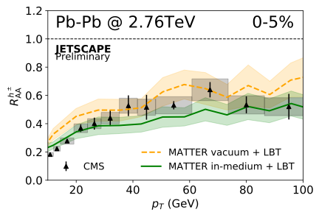
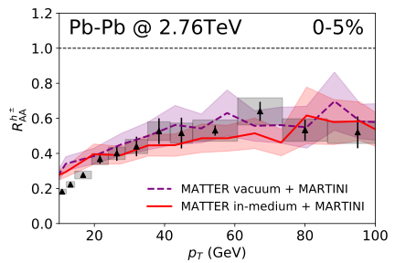
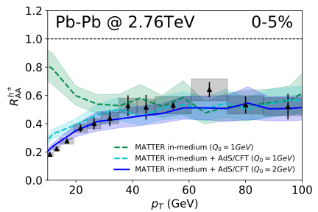
Nuclear modification of hadrons in A+A collisions
MATTER + LBT/MARTINI/AdS within JETSCAPE 1.0, Q₀ = 2 GeV, ⍺_{s} = 0.25
Reasonable descriptions of charged hadron R_{AA}
Effects of medium modification in the MATTER stage
High-Q model dominates high p_{T} R_{AA}, low-Q models dominate low p_{T}
Q₀ is more constrained by the low p_{T} data

Slide 28
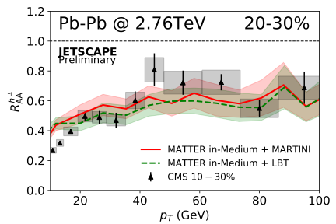
Nuclear modification of hadrons in A+A collisions
Reasonable centrality dependence of R_{AA}

Slide 29
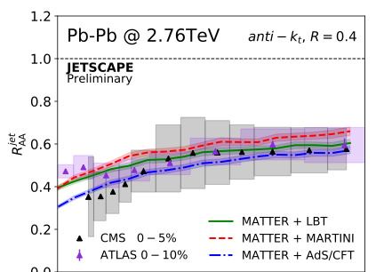
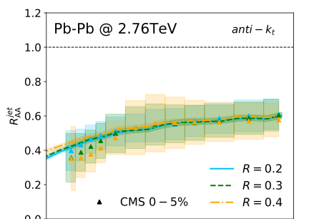
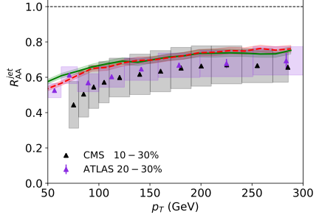
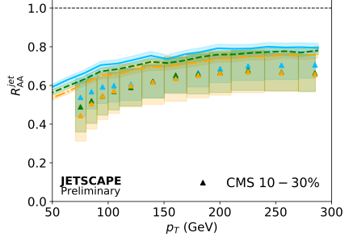
Nuclear modification of jets
Construct Jets with anti-k_{T} algorithm
Reasonable description of jet R_{AA} with different model setups
Weak dependence on R in both theory and data

Slide 30

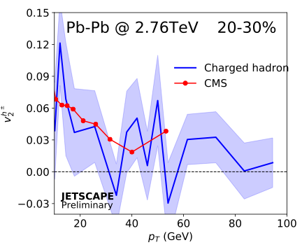
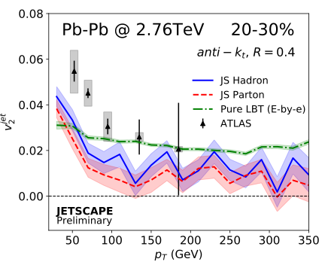

Elliptic flow coefficient of hadrons and jets
Leading hadron
Jet
MATTER+LBT
Low statistics, but general trend in the right direction
Hint of stronger jet v2 after hadronization: contribution from recoil?
Used event-averaged hydro – needs event-by-event for improvement

Slide 31
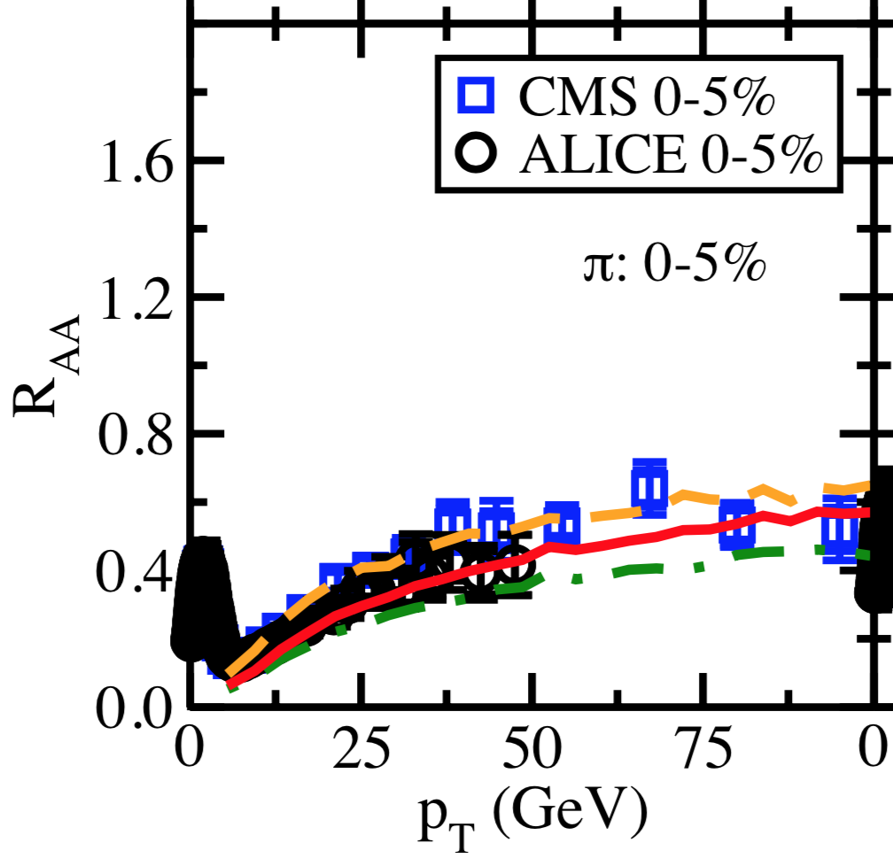
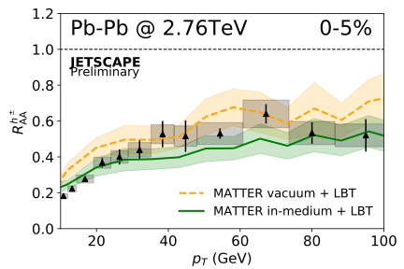
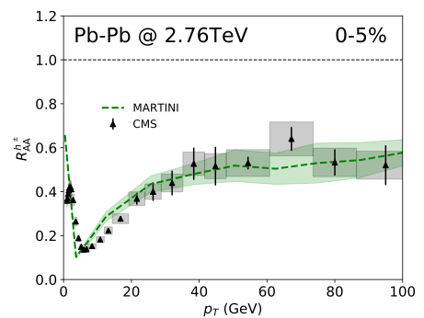

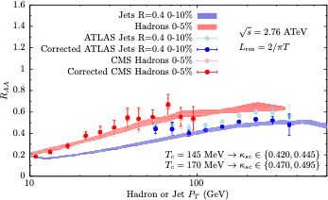

Consistency with original models
More flexible physics exploration
LBT
MARTINI
AdS

Slide 32
Medium modification of jet Shape
Pure MATTER splitting without scattering (recoil) with the medium fails
Recoil significantly enhances the in-medium jet shape at large r

Slide 33
Medium modification of jet Shape
Medium effect during virtuality-ordered splitting cannot be seen in jet shape

Slide 34
Medium modification of jet fragmentation function
Pure MATTER splitting without scattering (recoil) with the medium fails
Recoil significantly enhances the medium-modified jet FF at small z

Slide 35
Medium modification of jet fragmentation function
Medium effect during virtuality-ordered splitting suppresses the jet fragmentation function at large z – splitting of hard partons

Slide 36
Summary
Developed a multi-stage approach that combines jet evolution at high and low virtuality into a unified approach
Embedded the multi-stage jet evolution together with two hadronization models into JETSCAPE 1.0
Obtained good descriptions of jet observables with JETSCAPE 1.0 in both p-p and A-A collisions
Found high-Q evolution dominates high p_{T} observables (R_{AA} at high p_{T} and jet FF at large z), low-Q evolution (especially recoil) dominates low p_{T} observables (R_{AA} at low p_{T}, jet shape at large r and jet FF at small z)

