Slide 1
Non-Perturbative Effects on Heavy Quark Radiative Energy Loss?
Shuai Liu, Ralf Rapp
Cyclotron Institute + Department of Physics and Astronomy Texas A&M University
College Station

Slide 2
Outline
1) Background and Motivation
2) Many-Body Approach to Radiative Process
3) Study the Non-Perturbative (NP) Effects on Radiative Process
4) Conclusion

Slide 3
Outline
1) Background and Motivation
2) Many-Body Approach to Radiative Process
3) Study the Non-Perturbative (NP) Effects on Radiative Process
4) Conclusion

Slide 4
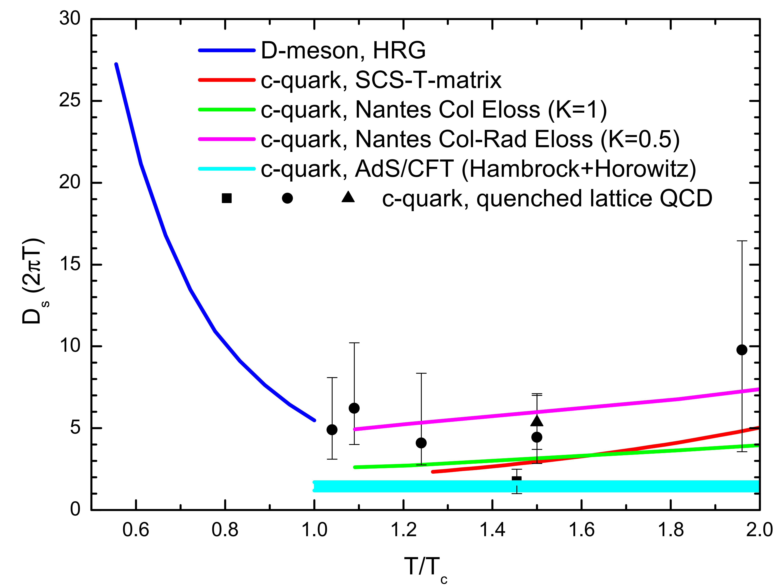
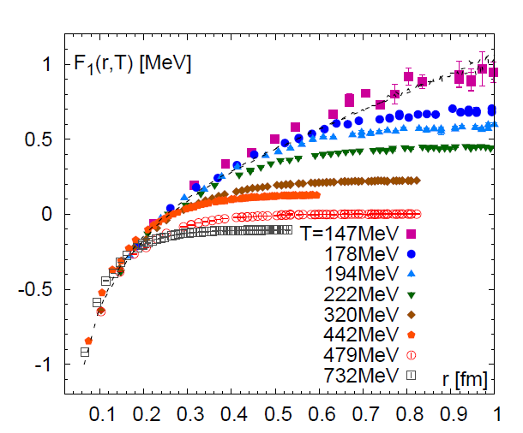
Non-Perturbative Effects for High Energy Partons?
A multi-scale problem
Gluons emitted at soft scale
Interactions at soft scale, strong!
Soft
Hard
Remnant of confining force,
Resummation,
No quasi particles
Courtesy M. He

Slide 5
Strategy to Study Non-Perturbative(NP) Effects
Suitable approach
Scenarios containing different NP effects
Manifestation of the different scenarios
T-matrix approach
Remnant confining force,
resummation,
non quasi-particles effects
Spectral functions, power spectrum, drag coefficient, energy loss…

Slide 6
Outline
1) Background and Motivation
2) Many-Body Approach to Radiative Process
3) Study the Non-Perturbative (NP) Effects on Radiative Process
4) Conclusion

Slide 7
T-matrix Approach
$$p$$
$$p′$$
$$−p$$
$$−p^{′}$$
$$T\left(E, p, p′\right)=V\left(p,p^{′}\right)+\int{\frac{d^{3}p}{{\left(2π\right)}^{3}}}V\left(p,k\right)G_{(2)}(E,k)T\left(z,p, p^{′}\right)$$
Incorporates: large confining force, resummation, broad spectral functions
Inputs: color potential and in-medium masses
Constrained by lattice: EoS, free energy, quarkonium correlators, $\left(2πT\right)D_{s}$
Predict: shear viscosity, emerging resonances, parton spectral functions

Slide 8
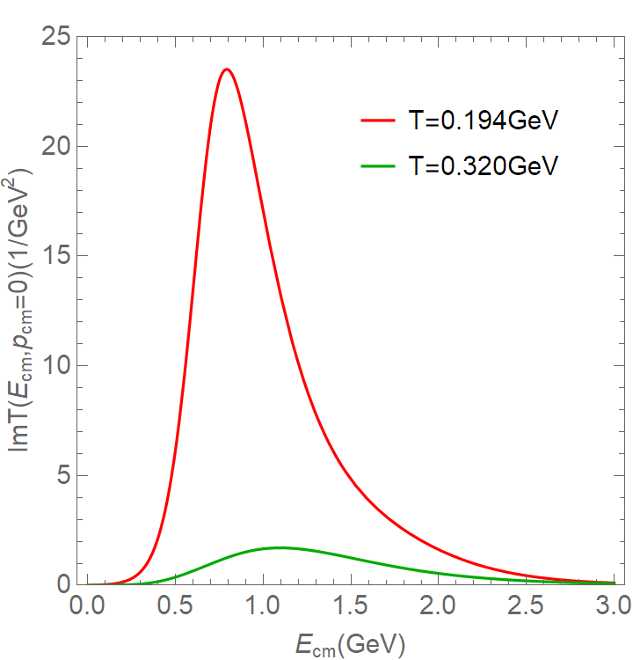
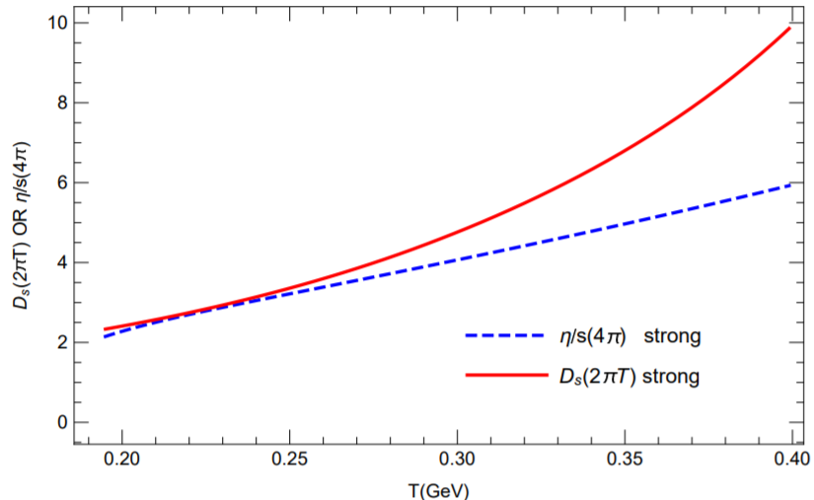
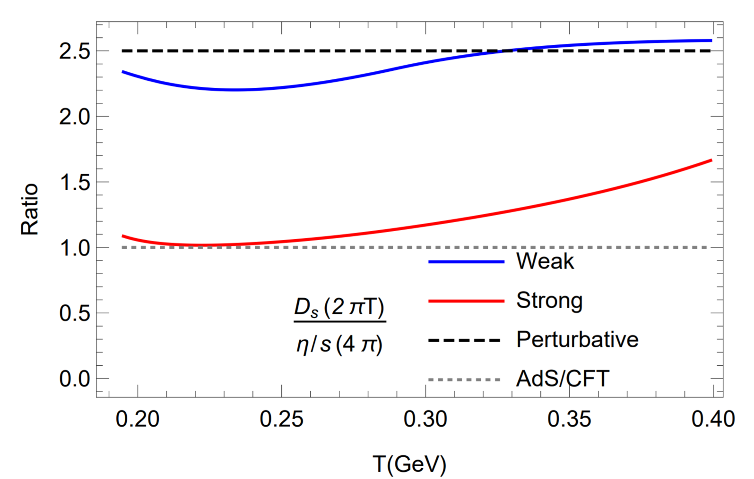
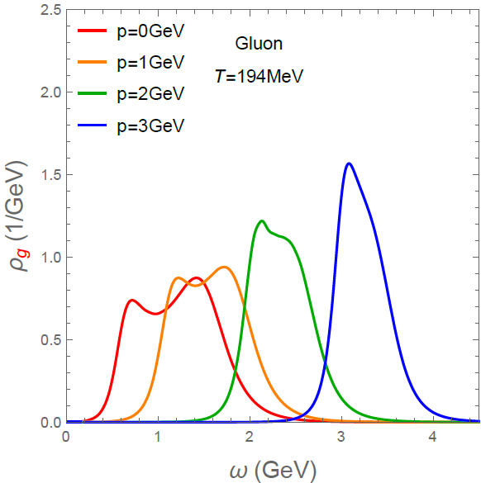
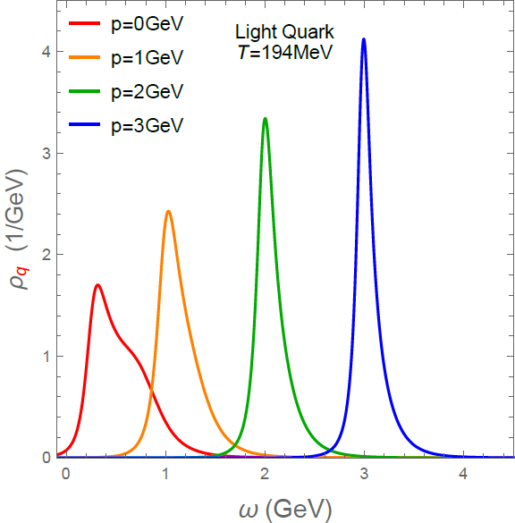
Non-Perturbative Effects in Strongly Coupled QGP
$\overline{Q}Q$ Singlet Potential
ImT(E) for mesonic resonance
Remnant confining force
Ladder resummation resonances
Melts low-momentum quasiparticles
(T-matrix)
1.2 T_{c}
r [fm]
Lower Bound
Liquid
Quasiparticle

Slide 9
T-matrix Approach for Energy Loss
k
Leading skeleton order radiation:
Main idea:
Momentum transition rate:
Spectral functions
p
Q
Q
p-k
$$OnShell δ(ε_{p}−ε_{k}−ε_{p−k})$$
$$OffShell ∫dωdvδ\left(ε_{p}−ω−v\right)ρ\left(ω,k\right)ρ\left(v,p−k\right)$$
Encode Medium Effects

Slide 10
Outline
1) Background and Motivation
2) Many-Body Approach to Radiative Process
3) Study the Non-Perturbative (NP) Effects on Radiative Process
4) Conclusion

Slide 11
Four Cases with Different NP Effects
Self-energy $Σ_{Q}$ for different cases (same diagram set for gluon)
Close to pQCD
Add confining Interaction
Add the t-Channel resummation
Add off-shell medium partons; our full T-matrix prediction

Slide 12
Four Different Cases with Different NP Effects
Self-Energy $Σ_{Q/g}$ for different cases:
Medium color charge density: readjusted by fit to lattice EoS

Slide 13
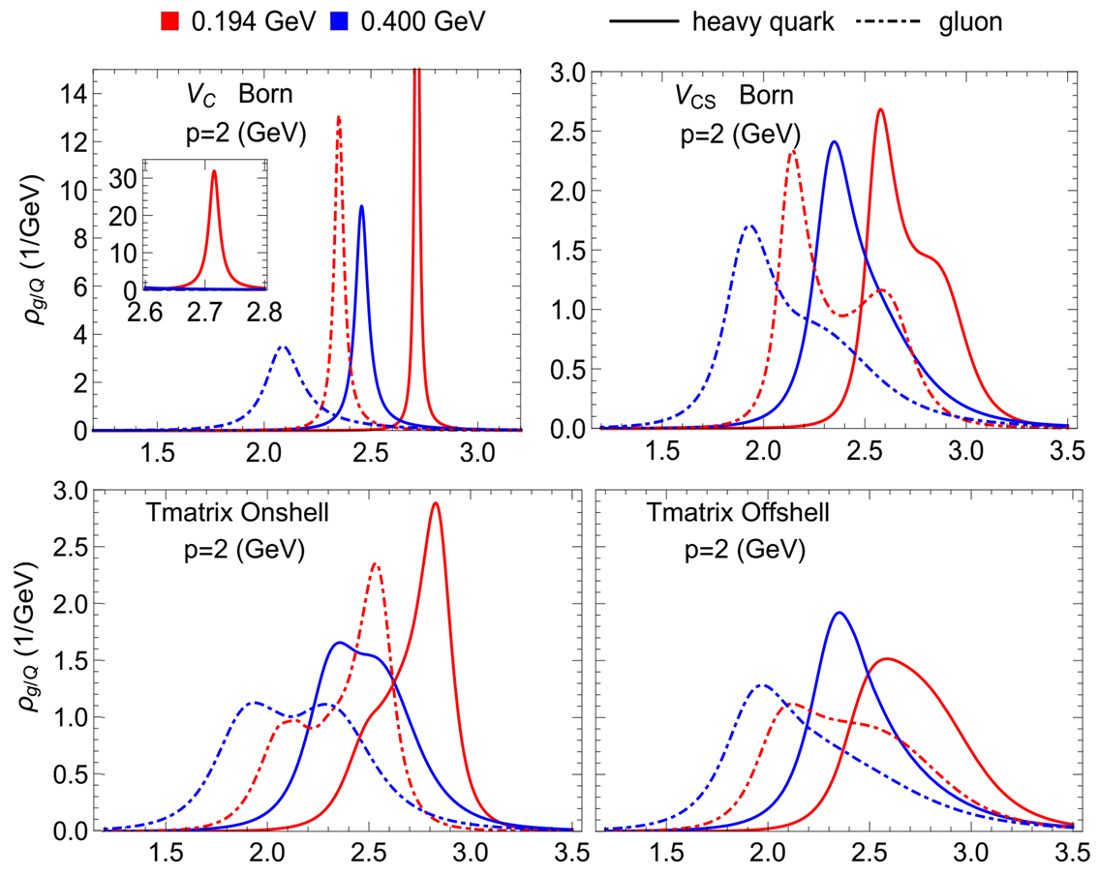
Spectral Functions at Low Momentum
Broad parton spectral function with NP effects
Low temperature:
High temperature: NP effects suppressed, confining interaction still relevant
More NP effects
More space like phase space
$$ω (GeV)$$
$$ω (GeV)$$

Slide 14
Spectral Functions at Low Momentum
Broad parton spectral function with NP effects
Low temperature:
High temperature: NP effects suppressed, confining interaction still relevant
More NP effects
More space like phase space
$$ω (GeV)$$
$$ω (GeV)$$

Slide 15
Spectral Functions at High Momentum
Quasi-particle like spectrum
Low temperature: NP effects suppressed, confining interaction still relevant
High temperature: NP effects (including Confining effects) suppressed
$$ω (GeV)$$
$$ω (GeV)$$

Slide 16
Radiative Power Spectrum
Power spectrum$\frac{\left(k/p\right)dN_{g}}{dt d\left({k_{L}}/p\right)}≈\frac{xdN_{g}}{dt dx}$
Low p low T: NP effects at all x
High p low T: NP enhancement at small/large x
High T low p: confining effects at all x, others not significant
High T low p: confining effects at small/large x, others not significant
$$≈x$$
$$≈x$$

Slide 17
Scrutinize the Phase Space of Radiation Spectrum
Red region: all NP Effects important
Yellow region : quasi-particle applicable but other NP effects important
Green region: quasi-particle+ leading order + confining force
Blue region: quasi-particle+ leading order +Coulomb force; perturbative region
$$≈x$$
$$≈x$$

Slide 18
Radiative Contribution to Drag Coefficients
$A\left(p\right)≈{\left(E^{−1}dE\right)}/{dt} (1/fm)$ percentage of energy loss per (fm) time
(1/fm)

Slide 19
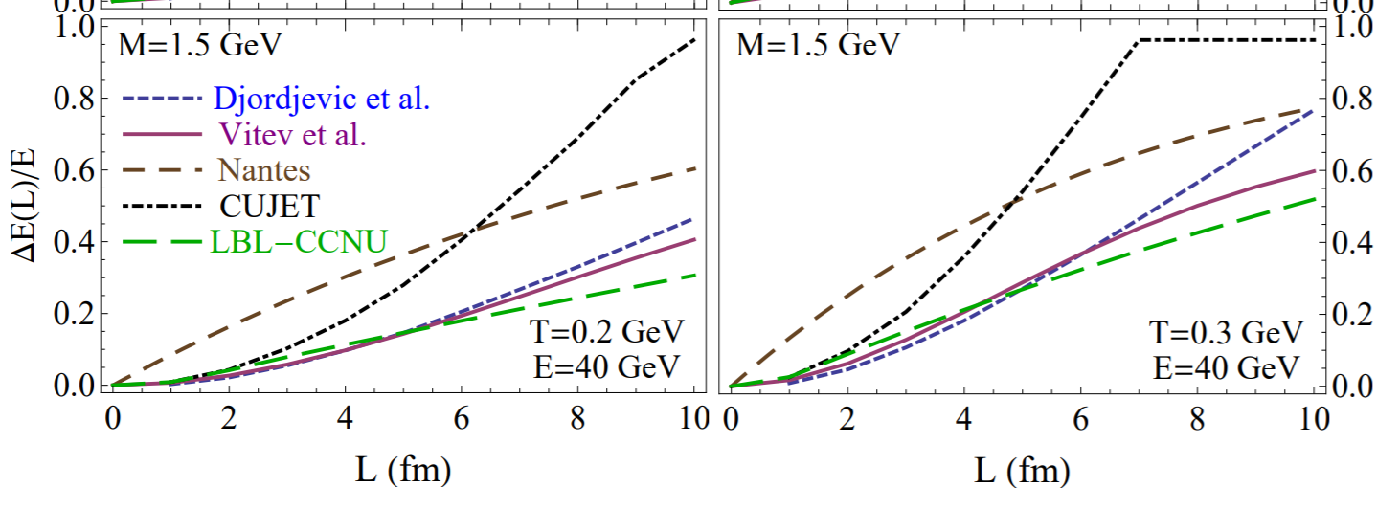
Energy loss of Heavy Quark in Static Medium
EMMI, 2018
Significantly smaller at low momentum and low temperature.
Comparable at high temperature and high momentum.

Slide 20
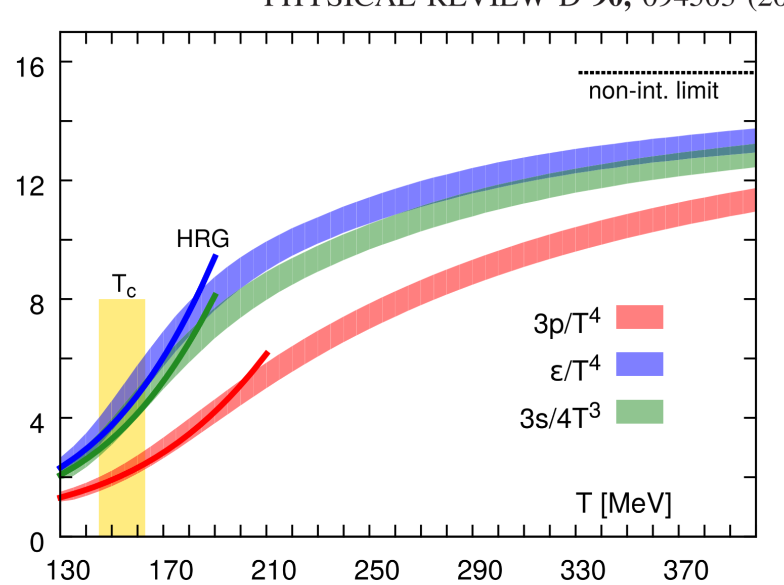
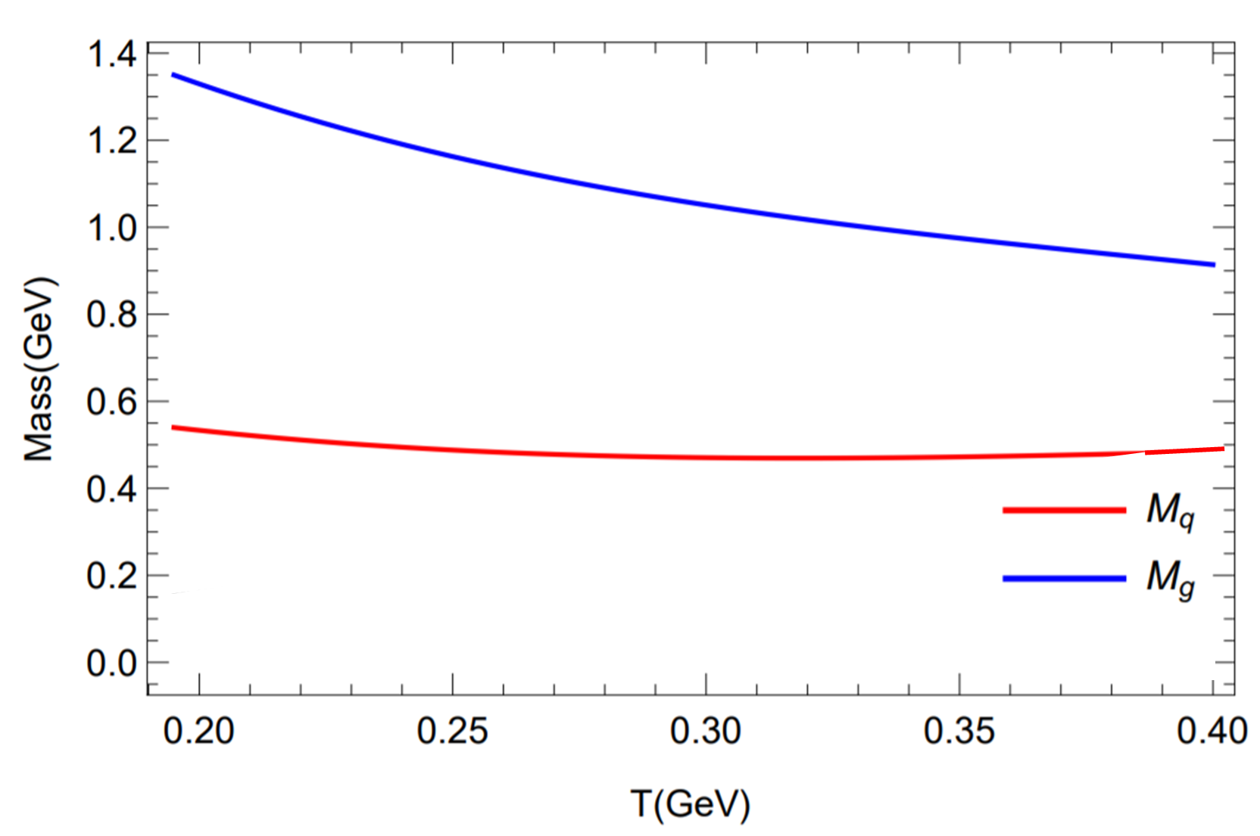
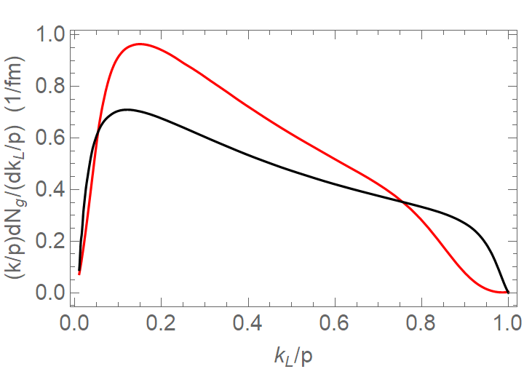
Difference to pQCD Based Approaches
EoS
Large parton mass, larger than 1GeV for gluons (strongly suppress)
No LPM effects (enhance)
No initial Off-Shell effects (suppress)
Gluon Mass
HotQCD, 14
Quark Mass
Djordjevic 08
T=225 MeV
$V_{C}$ Born (pQCD parton masses)
p=20 GeV
$V_{C}$ Born (masses fit EoS)

Slide 21
Conclusion
Developed Many-Body Approach to Study the Non-Perturbative Effects for Radiative Energy Loss:
At low T and low p: confining force effect (large), resummation effect (moderate), non-quasi-particle effects (significant) are all important
As low T and p increase: all effects suppressed; non-quasi-particle effects disappear first, then resummation effects disappear.
At high T and high p: pQCD should work in most of phase space. But for small/large x, effects from the confining force are still visible.

Slide 22
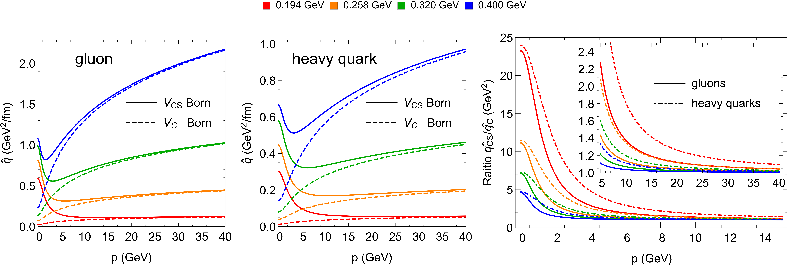
q-hat for two cases
Strongly enhanced q-hat at low momentum region
Using momentum dependent q-hat to include the NP effects?

Slide 23
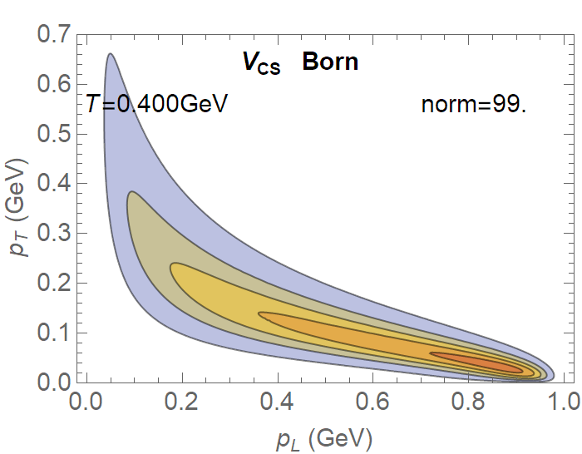
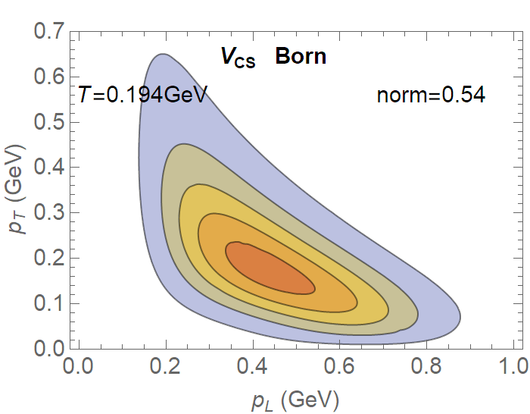
2D power spectrum
$$k_{T}/k$$
Soft
Soft
$$k_{T}$$
$$k_{T}/k$$
Collinear
Collinear
$$k_{L}(GeV)$$
$$k_{L}/p≈x$$
$$k_{L}/p≈x$$
Dead-Cone
soft or collinear expansion good at high momentum

