Slide 1


Direct observation of in-medium jet deflection: experiment and theory
…plus some other stuff…
Peter Jacobs
Lawrence Berkeley National Laboratory
University of California, Berkeley

Slide 2
In-medium modification of QCD shower
Jet shower in-medium
Jet shower in vacuum
Evolution of highly virtual parton via gluon radiation
Quantum interference → angle-ordering
hardest radiation is most collinear with jet axis
Precise understanding in pQCD
Accurately calculable with QCD-based Monte Carlo models
Superposition of
vacuum shower
medium-induced gluon emission
These processes happen simultaneously and interfere
Angle-ordering is modified or destroyed

Slide 3
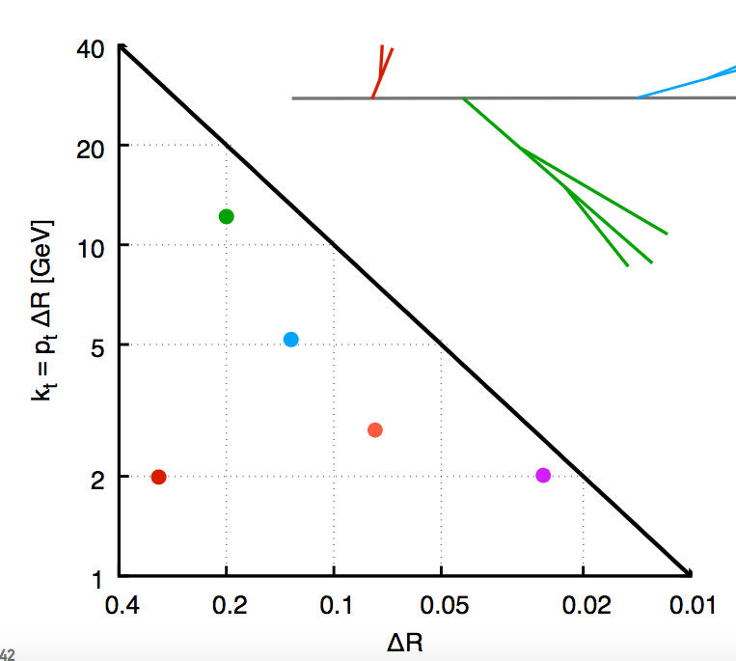
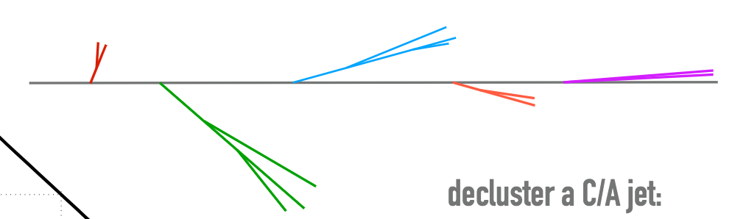
Mapping in-vacuum jet shower: Lund Plane
G. Salam, QM18
Altareli-Parisi splitting function
Soft large-angle radiation
Each radiated gluon corresponds to a point in the Lund Plane:
Hard collinear radiation
ΔR
non-perturbative region
k_{T}
Fixed α_{S}: Lund diagram is uniformly populated

Slide 4
Mapping in-medium jet shower: Lund Plane
K.Tywoniuk et al, arxiv:1808.03689
Additional length/time scales:
L: length of medium
t_{f}: formation time of radiation
t_{d}: “decoherence” time due to interaction with medium
t_{f}<t_{d}<L
vacuum splittings inside medium
both prongs lose energy independently
t_{d}>L
in-medium splittings not resolved by in-medium interactions
t_{d} ≲ t_{f}
splitting affected by medium
region not populated uniformly
t_{f}>L
No splitting in-medium

Slide 5
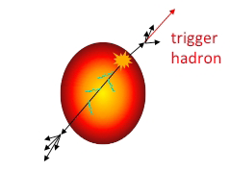
Probing the micro-structure of the QGP with jets
(…second goal is RHIC Beam Energy scan)
Related but distinct jet observables to probe the structure of the QGP:
in-medium modification of jet substructure
in-medium coherent jet scattering
Δφ

Slide 6
Measurement of jet modification: Lund Plane
Additional length/time scales:
L: length of medium
t_{f}: formation time of radiation
t_{d}: “decoherence” time due to interaction with medium
t_{f}<t_{d}<L
vacuum splittings inside medium
both prongs lose energy independently
t_{d}>L
in-medium splittings not resolved by in-medium interactions
t_{d} ≲ t_{f}
splitting affected by medium
region not populated uniformly
t_{f}>L
No splitting in-medium
Δφ
Jet sub-structure modification and jet deflection are closely linked
Measure both ➞ must be understood in same theory framework

Slide 7
Interlude: considerations for measuring jets in heavy ion collisions

Slide 8
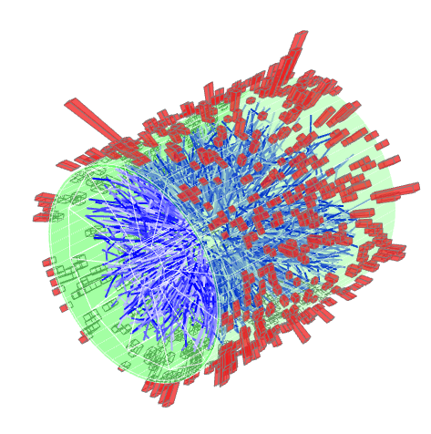
Factorizing jet signal and uncorrelated background in practice
Heavy ion collisions
Multiple hard processes generating jets
Copious soft hadron production
Many such processes contribute to each reconstructed jet candidate
Define the signal jet population
require linear response in bkgd environment
    → must be rare << 1/event
can then correct for p_{T}-smearing via unfolding
Discriminate hard jet candidates from bkgd
Inclusive distributions:
  hard core (high p_{T} hadron or cluster) - bias?
  or high jet p_{T} relative to bkgd fluctuations
Coincidence distributions:
  Trigger on a hard process (hadron, jet, gamma, Z)
  Measure correlated energy-momentum distribution recoiling from the trigger
Jet substructure: grooming – bias?

Slide 9
Semi-inclusive distributions
projection
Select events based on trigger
Count all recoil jets in acceptance (no rejection)
Normalize per trigger
Other analyses:
jet-wise rejection
pair-wise normalization

Slide 10
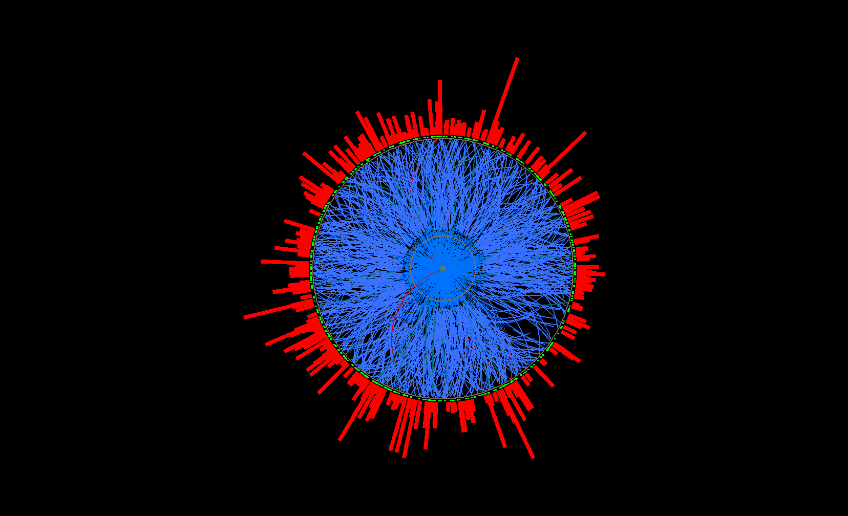
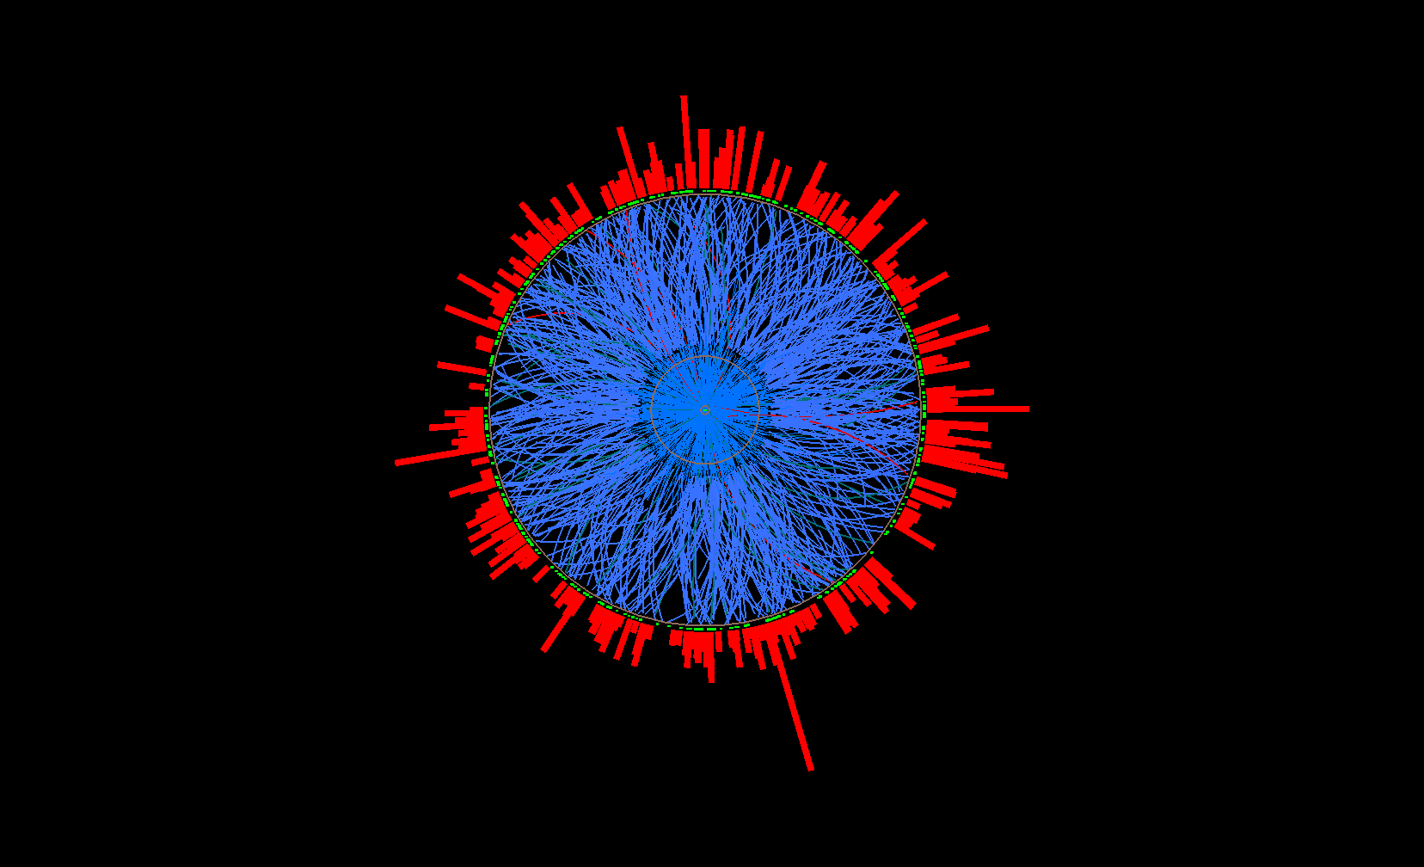
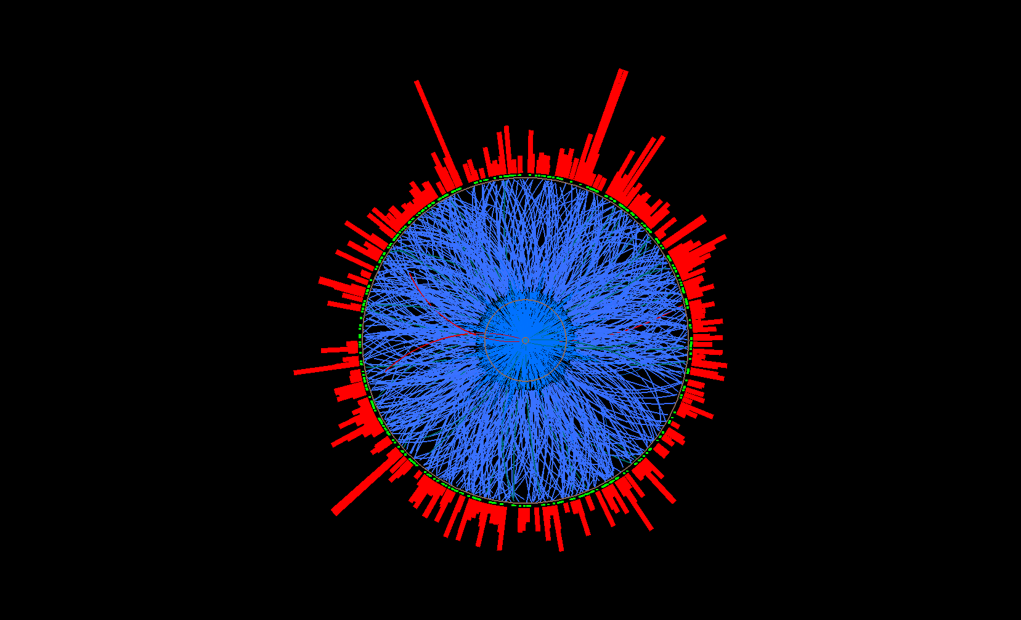
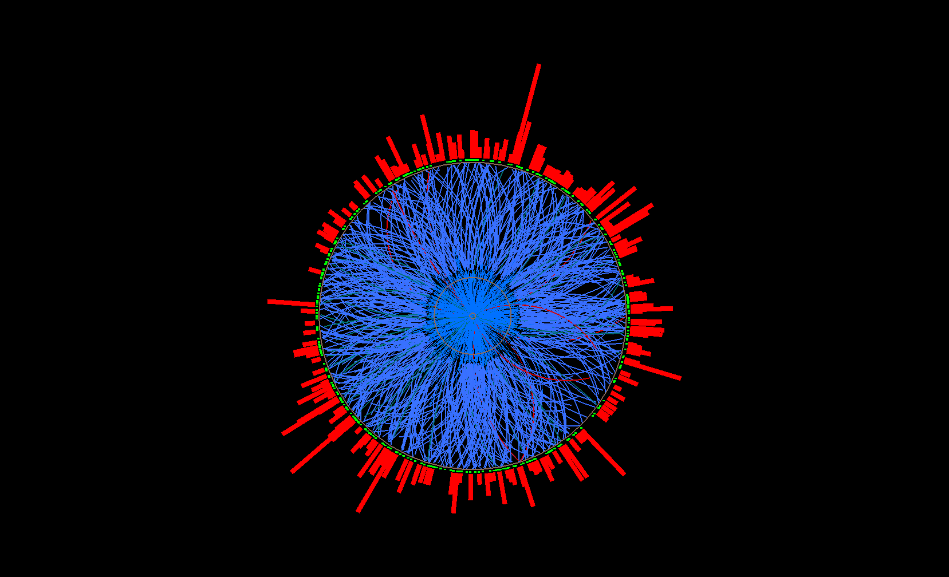
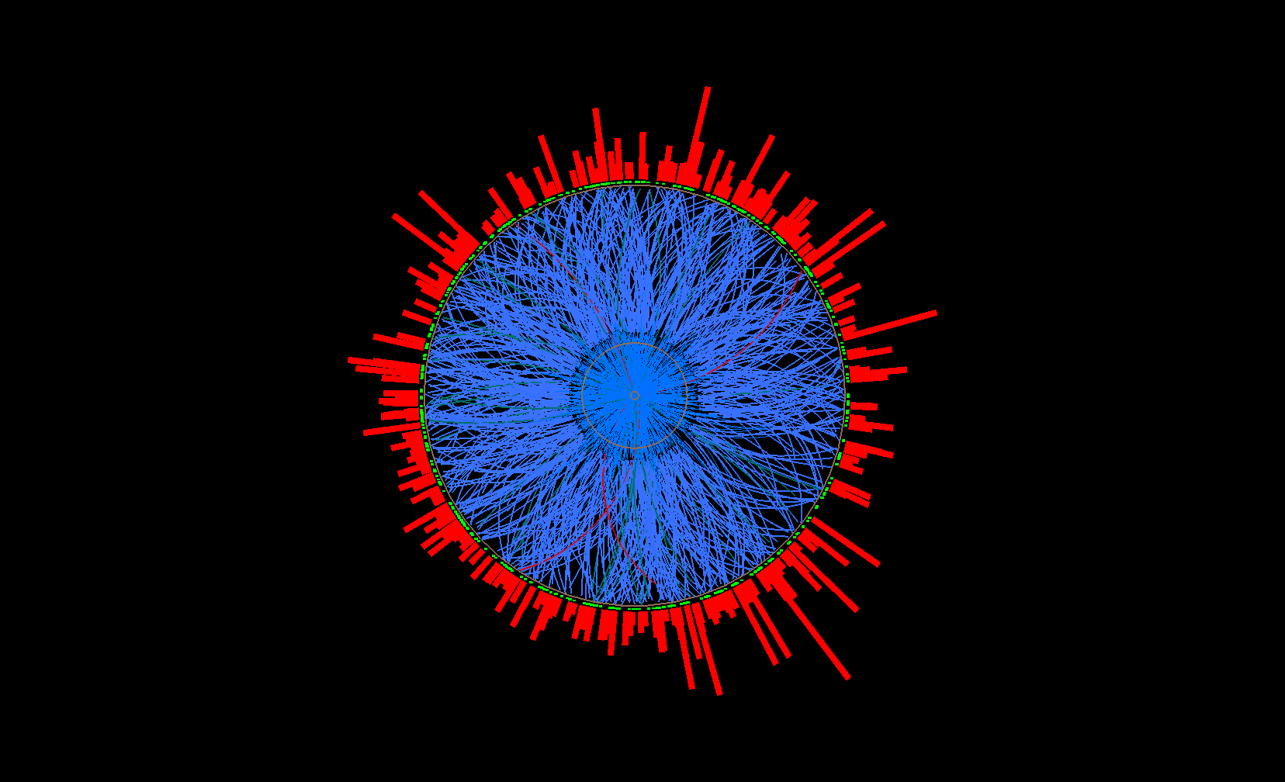
Uncorrelated background: mixed events
STAR Collaboration,
Phys. Rev. C 96 (2017), 024905
Destroys all multi-hadronic correlations, including jets
Mixed event
Mix only similar centrality, Ψ_{EP} ,
z-vertex position
Pick one random
track per real event
→ add to mixed
event
…
Ev. 1
Ev. 2
Real events
Ev. 3
Ev. 765

Slide 11
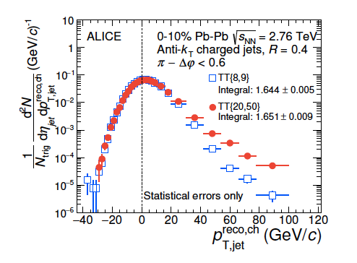

Key assertion: correlations cannot be determined event-by-event
you cannot know with certainty whether any given hadron (or hadron cluster) arises from the same high-Q² process as the trigger
Strictly speaking: “uncorrelated yield” only has meaning for ensemble-averaged distributions
Phys. Rev. C 96 (2017) 024905
JHEP 09 (2015) 170
Signal+
bkgd
uncorrelated
background
Precise, unbiased correction of uncorrelated jet background yield is a solved problem

Slide 12
End of interlude

Slide 13
Jet sub-structure via z_{g}
Jet “grooming: select two hardest prongs → first hard splitting
  grooming suppresses soft background
Location on Lund Plane depends on specific kinematics
Harry Andrews, QM18
p+p:
z_{g} calculable precisely
measures α_{S}
Pb+Pb:
Compare to p+p to measure in-medium effects
PbPb/p+p
PbPb/p+p
In-medium: suppression of symmetric subjets

Slide 14
z_{g}: ΔR dependence
Main effect: suppression of symmetric splittings at large opening angle

Slide 15
z_{g:} compare ALICE & CMS
CMS, Phys. Rev. Lett. 120 (2018) 142302
Harry Andrews, QM18
ΔR>0.1
Normalized to inclusive jet population
Normalized to groomed jet population (“self-normalized”)
Different physics message
It matters how you normalize the distribution

Slide 16
PbPb/p+p
PbPb/p+p
t_{f}<t_{d}<L
vacuum splittings inside medium
both prongs lose energy independently
t_{d} ≲ t_{f}
splitting affected by medium
region not populated uniformly
Subjet
suppression

Slide 17
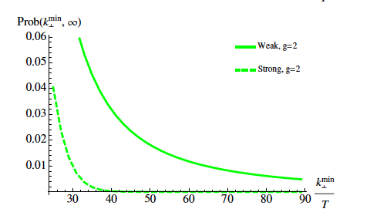
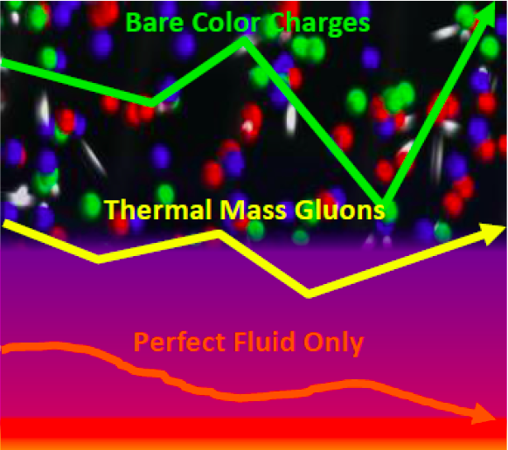
Jet deflection a.k.a. secondary scattering off the QGP
Discrete scattering centers or effectively continuous medium?
d’Eramo et al., JHEP 1305 (2013) 031
Distribution of momentum transfer k_{T}
Strong coupling:
Gaussian distribution
What are the quasi-particles?
high Q²: bare q and g
low-ish Q²:
  thermal-mass glue
  magnetic monopoles
  …?
?
Δφ

Slide 18
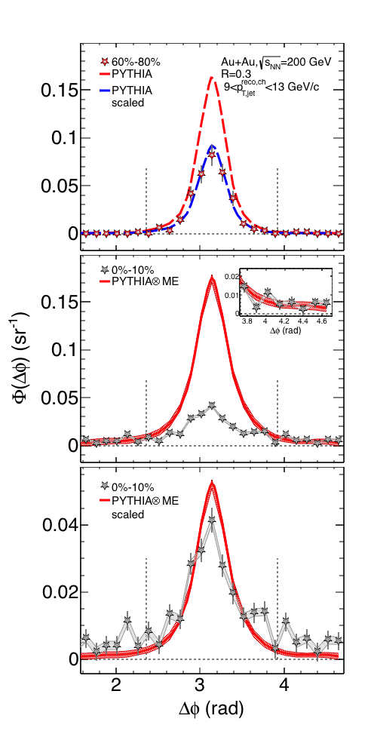
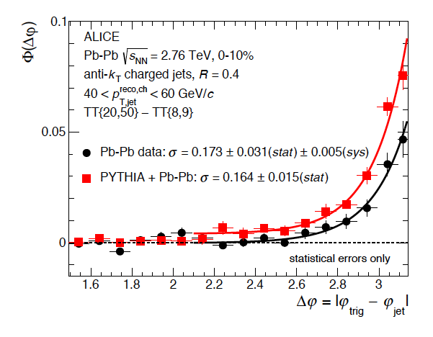
Coherent jet scattering → acoplanarity
AuAu √s_{NN}=200 GeV
PbPb √s_{NN}=2.76 TeV
STAR,PhysRev C96 (2017) 024905
ALICE, JHEP 09 (2015) 170
Δφ
Low jet p_{T} of special interest: largest effects expected
  → statistical bkdg correction in 2-d (p_{Τ},φ)
Medium-induced acoplanarity effects (if any) are near or below statistical precision of current measurements

Slide 19
Phys.Lett. B773 (2017) 672-676
Vacuum parton shower: Sudakov resummation
➞broadening of main recoil peak at |Δφ-π|~small
Medium-induced broadening: <qhat*L>
Optimal kinematics: low jet p_{T} ~ 10-20 GeV
Δφ
R=0.3
R=0.3
R=0.4
Predicts small but observable effect
→ direct measurement of <qhat*L>…?
Challenging measurement but techniques+data in place
Needs precise reference from p+p

Slide 20
L: in-medium path length
λ: mean free path
𝜒: opacity = L/λ
μ: color screening length
Q_{S}: medium saturation momentum
Relative to CCNU calculation:
  more complete theoretical treatment of quenching

Slide 21
In-medium acoplanarity: GLV vs BDMPS
Gyulassy et al. QM18
BDMPS: multiple soft scatterings
GLV: few hard scatterings
→ vary model of in-medium interaction
Δφ
Ratio to vacuum distribution
GLV
BDMPS
Systematic
checks
Both models: significant yield suppression relative to vacuum → jet quenching
Acoplanarity may discriminate pictures of the medium
  need ~few percent precision in angular distribution: possible with current STAR data, ALICE Run 2/3 data

Slide 22
See Yi’s talk yesterday
……..

Slide 23
d’Eramo et al.
arxiv:1808.03250
Simplified problem: parton of type C with initial momentum p_{in} scatters in a static QGP brick with temperature T
Calculate the probability distribution for outgoing parton of type A with angle θ and momentum p
LO matrix elements
Temperature = T

Slide 24
Scattering probability P(θ) for incident gluon
T~300 MeV
d’Eramo et al.
arxiv:1808.03250
p_{out}>3 GeV/c
p_{in}~7.5 GeV
Black curves:
Gaussian broadening (multiple soft scattering)
p_{in}~30 GeV
Qualitative result: significant contribution of single-hard scattering in selected phase space regions
To do: embed in realistic model of medium with dynamical evolution
  →JETSCAPE
p_{in}~75 GeV

Slide 25
arXiv:1812.06772
Δφ
Projection of high precision deflection measurements
Low p_{T} recoil (~10 GeV) techniques in place; LHC application in progress

Slide 26
Summary
Next-generation jet measurements:
Jet substructure modification and jet deflection are intimately linked
Complementary probes of in-medium jet interactions
Experiment:
Significant developments
Techniques in place for excellent systematic control over broad phase space
Frontier is statistics/int lumi – that’s a good thing
Theory:
Rapid development, many new ideas
Calculations to date: mainly schematic (fine and appropriate to understand the key physics)
TBD: realistic calculations and data/theory confrontation
          ➞JETSCAPE

Slide 27
Backup

Slide 28
Heavy ion jet measurements: general considerations
All discussions of jet quenching implicitly assume factorized process:
Initial hard (high Q²) production: generation of virtual parton at small length scale, uncorrelated with rest of the event
Shower evolves and its components interact with the medium on longer length scales
Seen in the detector: total energy-momentum vector of initial parton is conserved but distribution of shower is modified → jet quenching

Slide 29
arXiv:1806.08708
arXiv:1811.05519

Slide 30
ATLAS data
central Pb+Pb
peripheral Pb+Pb
Theory: in vacuum
Theory: in-medium scattering

Slide 31
Medium induced acoplanarity: QCD vs QED
ATLAS, arXiv:1806.08708
arXiv:1811.05519
Phys.Lett. B773 (2017) 672-676

