Slide 1
Collaborative Nuclear Data Measurements
BD Pierson
LR Greenwood
L Arrigo
SC Stave
AM Prinke
L Metz
JI Friese
JT Burke
SW Padgett
JJ Ressler
GW Slavik
A Tamashiro
A Tonchev
W Younes
T Bredeweg
W Oldham
Notes:
Hello, My name is Bruce Pierson, I am from Pacific Northwest National Laboratory. PNNL is part of a venture that includes LLNL and LANL. We are an experimental group conducting integral fission product yields using a variety of well characterized neutron sources.

Slide 2
Outline
Short-lived Fission Yields
Long-lived Fission Yields
ENDF/ENSDF Databases
EXFOR Databases
Discussion
Notes:
I’ll share a brief history of measurements conducted in collaboration with Washington State University and the University of Michigan before discussing current efforts underway using critical assemblies at NCERC. I was asked to provide comments regarding ENDF, ENSDF, and EXFOR and will review comments I aggregated from colleagues at the lab.

Slide 3
Short-lived Isotopes: 2008-2010
Neutron spectrum energies used for each target
Actinides irradiated at WSU TRIGA
Erin C Finn et al., “Methods to Collect, Compile, and Analyze Observed Short-lived Fission Product Gamma Data,” Pacific Northwest National Laboratory, Richland, WA, Formal Report PNNL-20141, 2011.
E. Finn et al., “Short-lived fission product measurements from ≥0.1 MeV neutron-induced fission using boron carbide,” Journal of Radioanalytical and Nuclear Chemistry, vol. 293, no. 1, pp. 267–272, Feb. 2012.
B. D. Pierson et al., “Identifying and quantifying short-lived fission products from thermal fission of HEU using portable HPGe detectors,” Journal of Radioanalytical and Nuclear Chemistry, vol. 295, no. 3, pp. 1881–1885, 2012.
R. F. Payne et al., “Neutron fluence and energy reproducibility of a 2-dollar TRIGA reactor pulse,” Journal of Radioanalytical and Nuclear Chemistry, vol. 282, no. 1, pp. 59–62, 2009.
L. A. Metz, R. F. Payne, J. I. Friese, L. R. Greenwood, J. D. Kephart, and B. D. Pierson, “Experimental measurements of short-lived fission products from uranium, neptunium, plutonium and americium,” Journal of Radioanalytical and Nuclear Chemistry, vol. 282, no. 2, pp. 373–377, 2009.
L. R. Greenwood et al., “Design and Testing of a Boron Carbide Capsule for Spectral Tailoring in Mixed-Spectrum Reactors,” vol. 9, no. 3, pp. 1–5, 2013.
Notes:
A relatively exhaustive campaign of irradiations were conducted at the WSU TRIGA reactor. A collection of neutron spectrum tailoring enclosures were designed for out-of-core irradiations of prominent, long-lived actinides. Samples were pulse irradiated and quickly retrieved from reactor for gamma spectroscopic analysis. Much of this raw data is available through an online portal. If you have any questions please talk with me after and we can setup an account for access if interested.
At the end of this work, PNNL made an effort to push towards 14MeV measurements; however, the total neutron intensity of 1e8 neutrons/second at full power from the Thermo-Scientific MP320 variant at PNNL was too small to measure beyond the peak fission product yields.

Slide 4
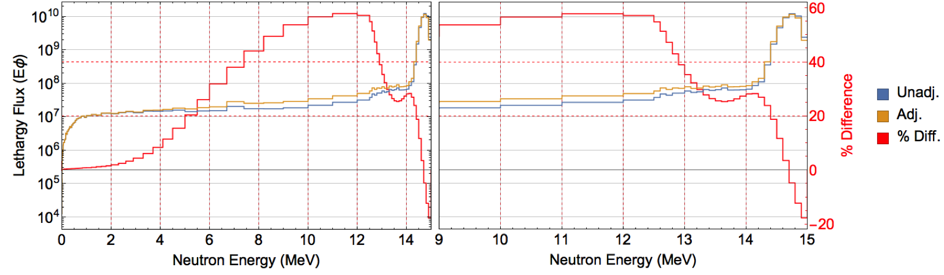
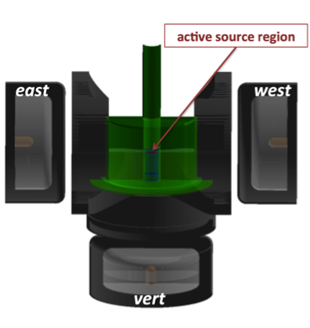
Short-lived Isotopes: 2010-2015
Neutron energy spectrum est.
Actinides irradiated at UofM Neutron Science Lab
B. D. Pierson, L. R. Greenwood, M. Flaska, and S. A. Pozzi, “Fission Product Yields from ²³²Th, ²³⁸U, and ²³⁵U Using 14 MeV Neutrons,” Nuclear Data Sheets, vol. 139, pp. 171–189, Jan. 2017.
B. D. Pierson, L. R. Greenwood, M. Flaska, and S. A. Pozzi, “Characterization of a fusion neutron generator and γ-γ coincidence detector for short-lived fission product yield,” Nuclear Instruments and Methods in Physics Research Section A, vol. Manuscript submitted for publication.
B. D. Pierson, H. C. Griffin, M. Flaska, J. A. Katalenich, B. B. Kitchen, and S. A. Pozzi, “Benchmarking the repeatability of a pneumatic cyclic neutron activation analysis facility using 16O(n,p)16N for nuclear forensics,” Applied Radiation and Isotopes, vol. 96, pp. 20–26, Feb. 2015.
Radiation Detector Model
Notes:
A collaboration was struck between a Professor at the University of Michigan and PNNL to continue the short-lived isotopes work under the Nuclear Forensics Junior Faculty Reward program. A pneumatic system was designed and built for cyclic neutron activation of actinide targets. A collection of activation targets were used to characterize the neutron source and a multi-detector system for increased detection efficiency and coincident gamma spectroscopy. From this work, 87 fission product yields were published from the three actinides highlighted in red in the half-life range from 1 second to 3 minutes.

Slide 5
Short-lived/Long-lived Fission Yields: 2015-Present
Neutron energy spectrum covariance est.
Actinides irradiated at NCERC Neutron Science Lab
B. D. Pierson et al., “Improved Cumulative Fission Yield Measurements with Fission Spectrum Neutrons on ²³⁵U,” Nuclear Data Sheets, vol. submitted, Jan. 2019.
B. D. Pierson et al., “Improved Cumulative Fission Yield Measurements with Fission Spectrum Neutrons on ²³⁸U,” under development
Neutron energy spectrum est.
NCERC Godiva
Notes:
Currently, PNNL, LLNL, and LANL are working together conduct integral fission product yields of short and long-lived fission products. The short-lived measurements are conducted using pulsed neutron irradiations at Godiva. The irradiated actinide samples are rapidly retrieved from in-core and counted using two broad-energy germanium detectors with excellent energy resolution (1.6keV at 1332keV) operated in coincidence. From this work we’ve improved the precision of 14 different fission products and observed statistically significant differences in the fission yields of tbree fission products relative to the estimates provided in ENDF. These isotopes are yttrium-94, iodine-134, and tellurium-134.

Slide 6
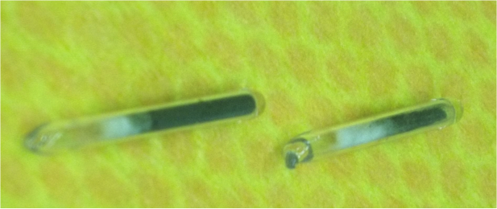
Short-lived Isotope Measurements Methodology
Gamma-ray + Mass Spectrometry, unirradiated material
Irradiate target under controlled conditions with witness foil package
Fission normalization
  “boot strapping” using well known fission products: ^{85m}Kr, ⁸⁷Kr, ⁸⁸Kr, ⁹²Sr, ⁹⁵Zr, ⁹⁷Zr, ⁹⁹Mo, ¹⁰³Ru, ¹³²Te, ¹³⁵Xe, ¹⁴⁰Ba, ¹⁴³Ce, ¹⁴⁹Nd, and ¹⁵¹Pm
  Fission-rate verification using STAYSL_PNNL code
Time-series gamma count decaying actinide sample
Analyze gamma-ray self-shielding using fission products and unirradiated material data
Analyze fluence intensity/energy profile
Analyze fission yields using Bateman equations
Targets irradiated at NCERC ²³⁵U
Measurements of the ¹³⁴Te/I pair
Notes:
For the short-lived measurements, we use well characterized, isotopically pure targets (3-4N). These targets are irradiated using a controlled pulsed irradiation to avoid in-growth during irradiation corrections. The targets are counted over a two week period using list-mode acquisition. The data stream is analyzed using time-sliced spectra and the total fission are estimated using a collection of well measured fission yields and verified using the fission cross-section with STAYSL PNNL. Given this methodology, our short-lived fission product measurements are relative measurements. The acquired gamma spectra are corrected for gamma-ray self-shielding and using a detection efficiency measured with a set of NIST traceable gamma-standards from LLNL and Eckert & Zeigler.
Here you can see a photo of a set of ampoulized targets and the simultaneous fitting of the parent/daughter decay chain from tellurium-134 to iodine. Using the measured data from both parent and daughter, measurements of the fission yields were conducted by fitting both data sets together rather than separately to enforce continuity.

Slide 7
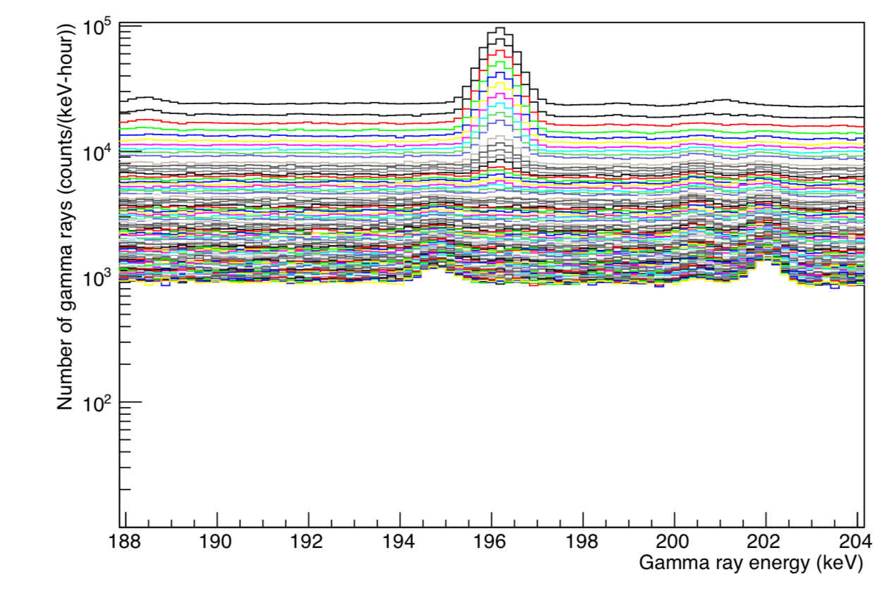
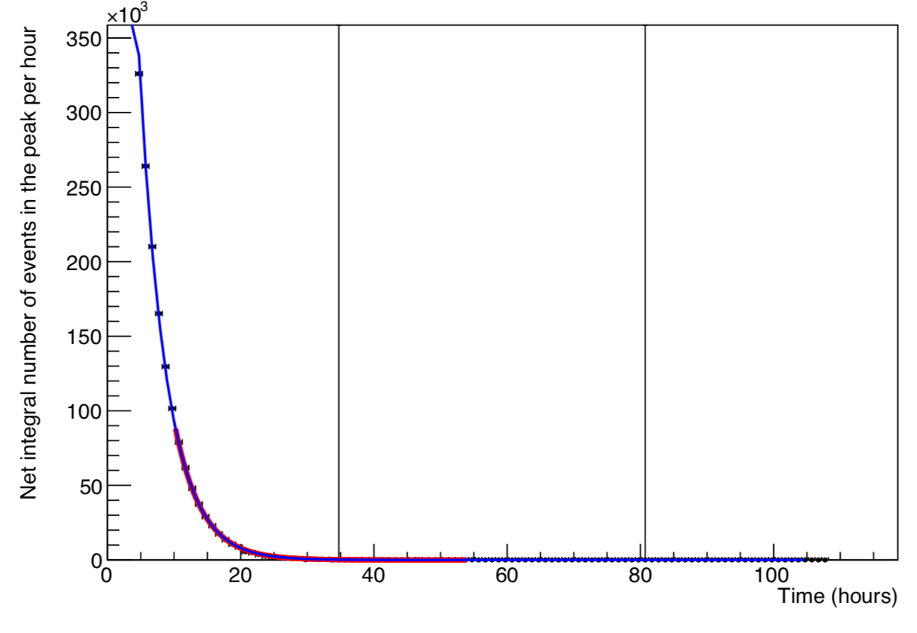
Short-lived Isotope Methodology
List-mode time-series data extraction
Bateman Equation Fitting
Fission normalization
  “boot strapping” using well known fission products: ^{85m}Kr, ⁸⁷Kr, ⁸⁸Kr, ⁹²Sr, ⁹⁵Zr, ⁹⁷Zr, ⁹⁹Mo, ¹⁰³Ru, ¹³²Te, ¹³⁵Xe, ¹⁴⁰Ba, ¹⁴³Ce, ¹⁴⁹Nd, and ¹⁵¹Pm
Independent data evaluation for fission yield measurements
⁸⁸Kr 196.3keV
gamma-line over time
Jason Burke LLNL-TR-657064
Notes:
Livermore has developed ROOT-based time-series data extraction utilities for list-mode gamma-ray data. They have been evaluating multiple gamma-lines from fission product isotopes studying sources of gamma-ray interference and possible issues in the decay branching ratios.

Slide 8
Integral Fission Product Yields
Improvements in nuclear data
IFPY ENDF/B-VII.1 uncertainties (Cs, Y, etc.)
  ¹³⁶Cs – 64%
  ⁹¹Y – 64%
Recent Experiment:
  Fabricated an appropriate DU target for the 14 MeV neutron generator
  Irradiated the target to achieve sufficient fissions for radiochemical separations
  Dissolved the target and performed separations
  Separations and analyses were performed quickly enough to quantify multiple short-lived fission products
Notes:
PNNL is also using radiochemistry to isolate and measure fission yields of difficult to measure fission products like cesium-135 or yttrium-91. At 14 MeV, ENDF suggests their fission yield uncertainties are 64% which is odd given their parent fission yields are known to a few percent.

Slide 9
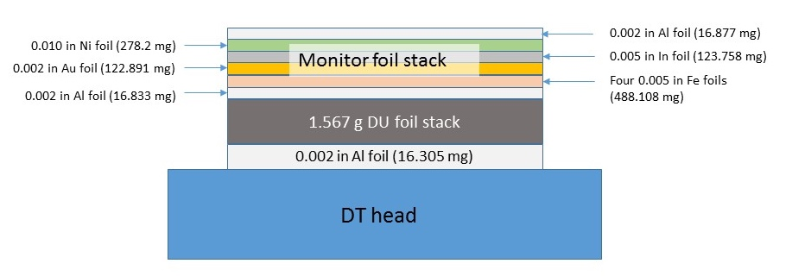
DU Target: SLFY+IFPY
Fluence foils: activation results were used to calculate reaction rates which were used in determining the fast neutron fluence as well as the geometrical attenuation in the target
Notes:
A target stack containing a large mass of 4N depleted uranium and a stack of witness foils using a fusion neutron generator.

Slide 10
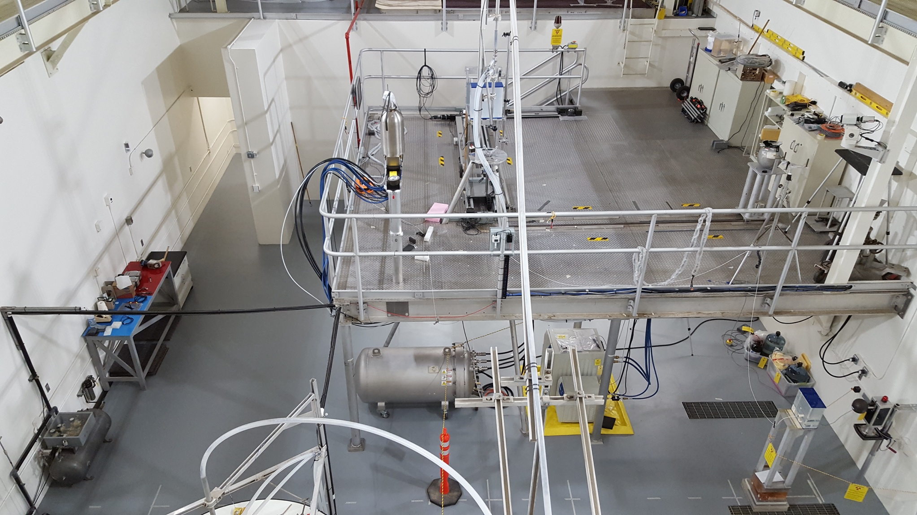
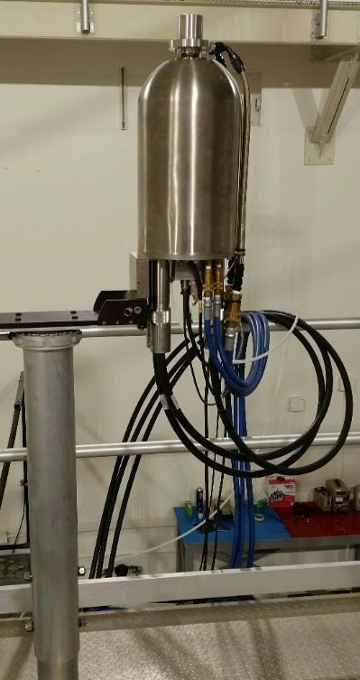
Sample Irradiation: SLFY+IFPY
Thermo-Scientific D711 DT neutron generator in the PNNL low scatter facility
DU target was irradiated for 24 hours with a nominal neutron flux of 1x10⁹ n/cm²/s
Total fissions of 4.60x10¹¹ ± 5% using gamma spectroscopy
Low scatter facility with DT neutron generator
DT neutron generator
Notes:
Our new fusion neutron generator has a total neutron output of 2e10 n/s. Within the target stack, a nominal flux of 1e9 n/cm2/sec can be obtained. This source is, effectively, suspended 18 feet from all sources of hydrogenous media to minimize the impact from room backscatter.

Slide 11
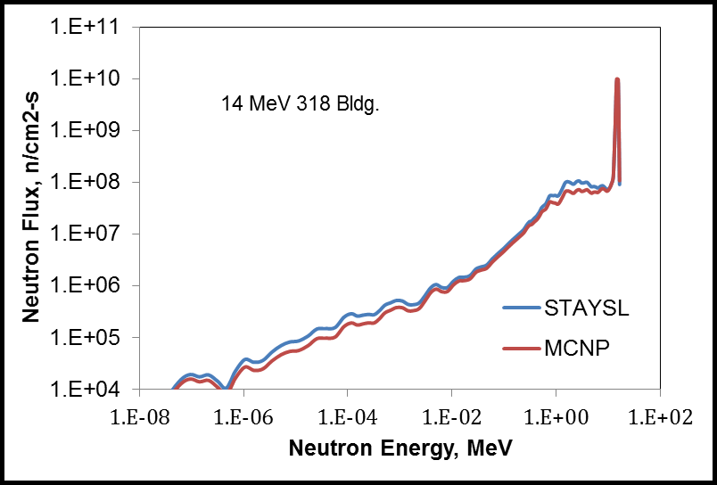
Neutron Spectrum: SLFY+IFPY
The use of the low scatter facility minimizes the thermal neutron return keeping the overall neutron energy as close to 14 MeV as possible
STAYSL PNNL was used to determine the fast neutron fluences
Results were compared to a MCNP calculation using the fluence foil reaction rates
Measured neutron spectrum vs MCNP model
Notes:
Using activity measurements of the witness foils and STAYSL PNNL, estimates of the neutron spectrum on target were made. This spectrum is in contrast to the flux-energy distribution observed at UofM. Maintaining an extended distance from the concrete shielding walls provides nearly 2 orders of magnitude fewer neutrons at the down-scatter step and a little more than 6-orders of magnitude between thermal neutrons and the 14MeV peak.

Slide 12
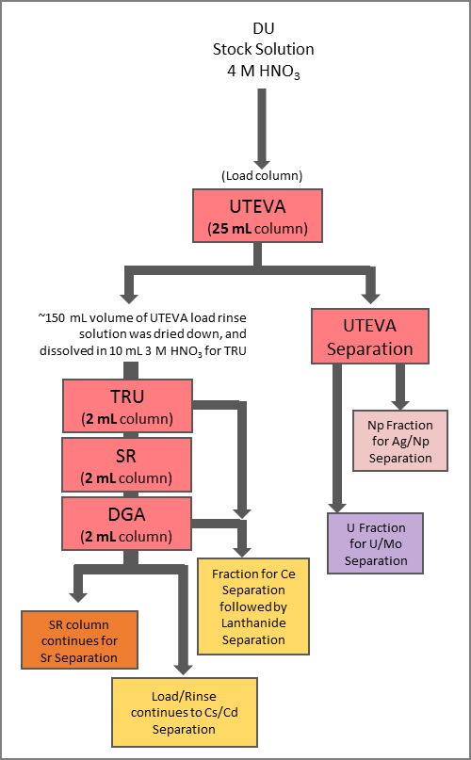
Radiochemical Separations: IFPY
Some analytes can be quantified directly from an aliquot of the stock solution: ⁹¹Y, ⁹⁵Zr, ⁹⁷Zr, ⁹⁹Mo, ¹⁰³Ru, ¹³²Te, ¹⁴⁰Ba, ¹³⁷Cs, ¹⁴¹Ce, ¹⁴³Ce, ¹⁴⁴Ce, and ¹⁴⁷Nd
Eichrom extraction resins, anion exchange resin, and precipitations were used to separate the analytes of interest: ⁸⁹Sr, ⁹¹Y, ¹¹¹Ag, ¹¹⁵Cd, ^{115m}Cd, ¹³⁶Cs, ¹³⁷Cs, ¹⁴⁴Ce, ¹⁵³Sm, ¹⁵⁶Eu, ¹⁶¹Tb
Notes:
Some analytes are measured in both the “A” solution and the separated fractions and the results were compared.

Slide 13
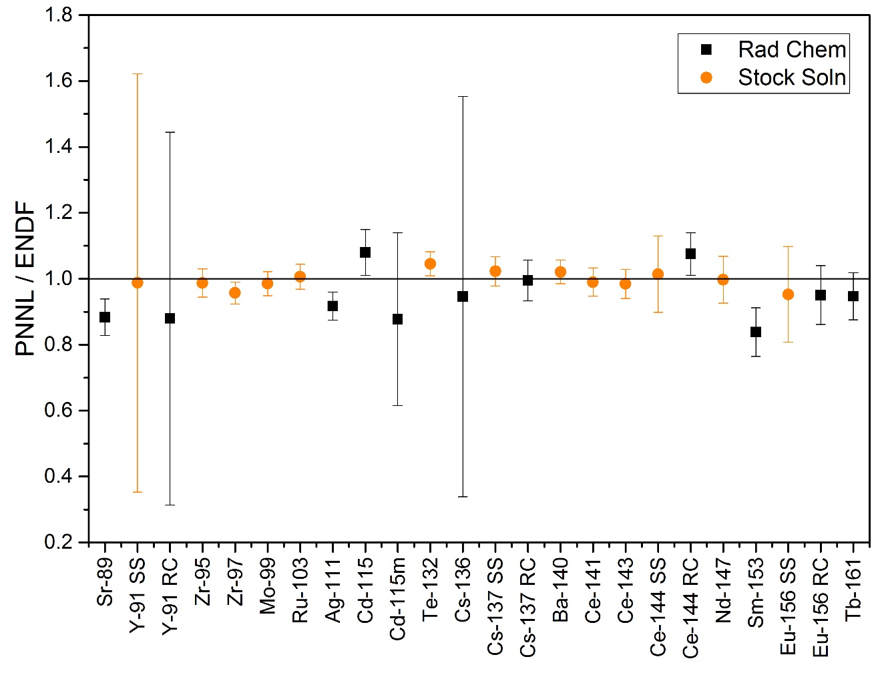
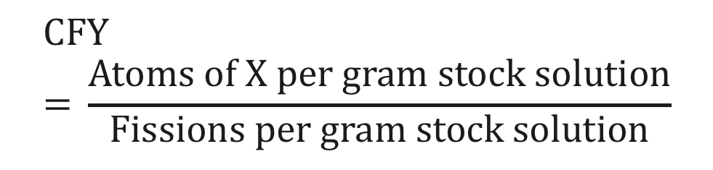
Cumulative Fission Yields: IFPY
Fissions/g stock solution was calculated based on the average of the decay-corrected atoms of X/g stock and the ENDF/B-VII.1 14 MeV CFY using ^{95/97}Zr, ⁹⁹Mo, ¹⁰³Ru, ¹³²Te, ¹⁴⁰Ba, ^{141/143}Ce, and ¹⁴⁷Nd
$$\text{CFY}\text{ = }\frac{\text{Atoms} \text{of} \text{X} \text{per} \text{gram} \text{stock} \text{solution}}{\text{Fissions} \text{per} \text{gram} \text{stock} \text{solution}}$$
Uncertainties are 1σ, ^{115m}Cd CFY is from JEFF-3.1.1
Notes:
PNNL is working to reduce the uncertainties in the long-lived fission products in collaboration with the short-lived fission product measurement efforts.

Slide 14
Conclusions: SLFY+LLFY
Radiochemical separations allow for analysis of radionuclides with low fission yields, interferences in the whole solution, or pure beta emission
Nuclear data improvements
  Including ⁹¹Y, ^{115m}Cd, ¹³⁶Cs
Analysis of additional 14 MeV irradiations would be beneficial for investigating the trend of increasing difference between the measured and ENDF CFY across the lanthanide series.
The experiment has been repeated in late April 2018 and to be in FY19.

Slide 15
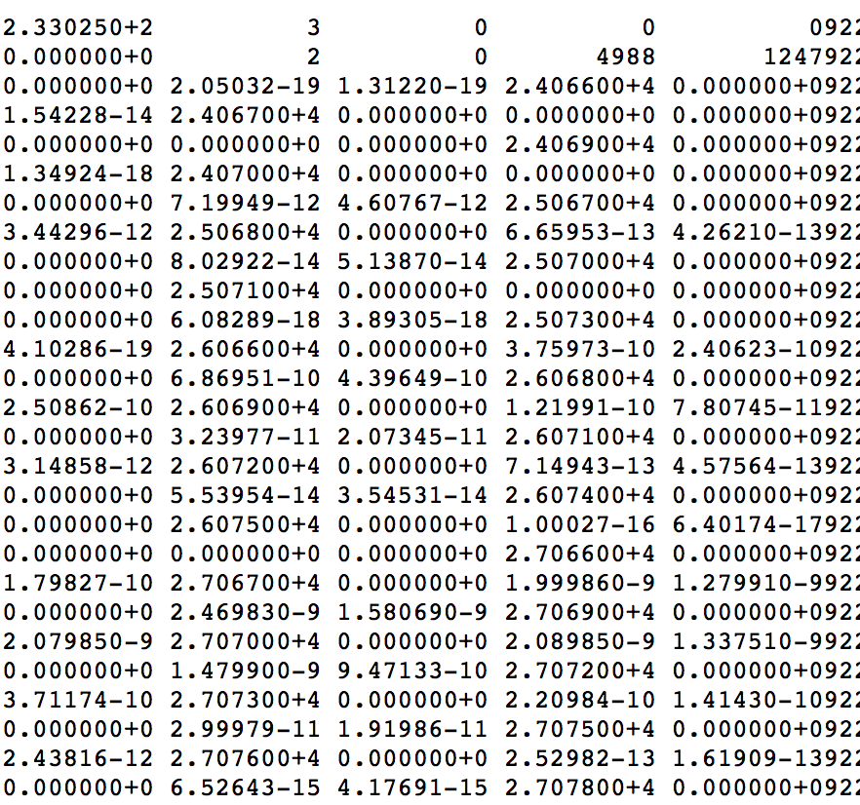
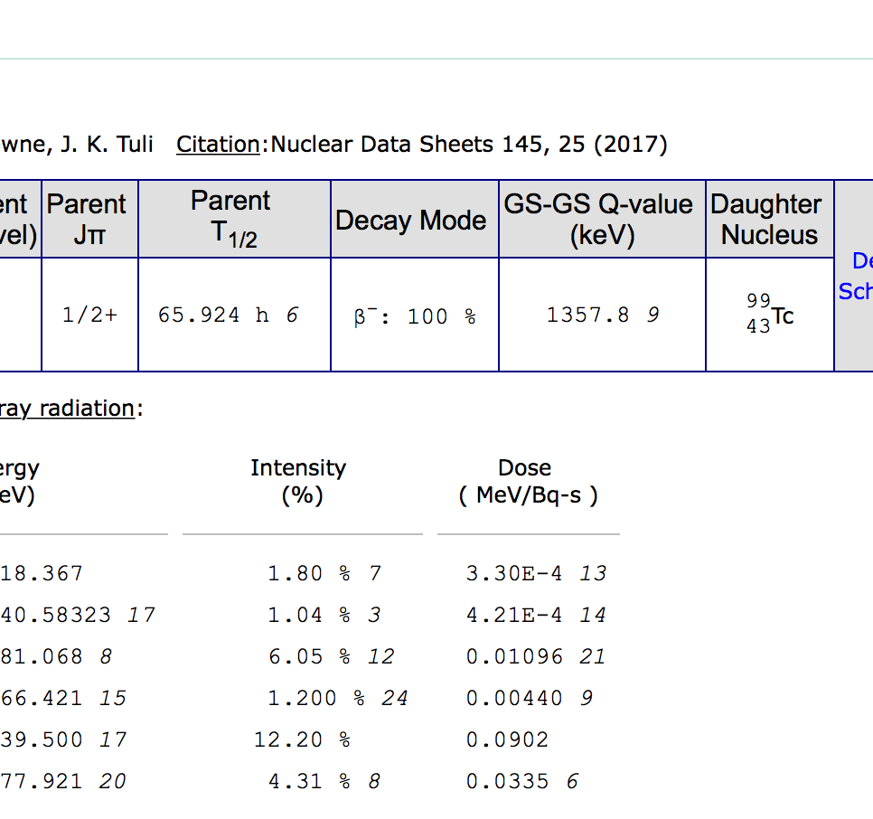
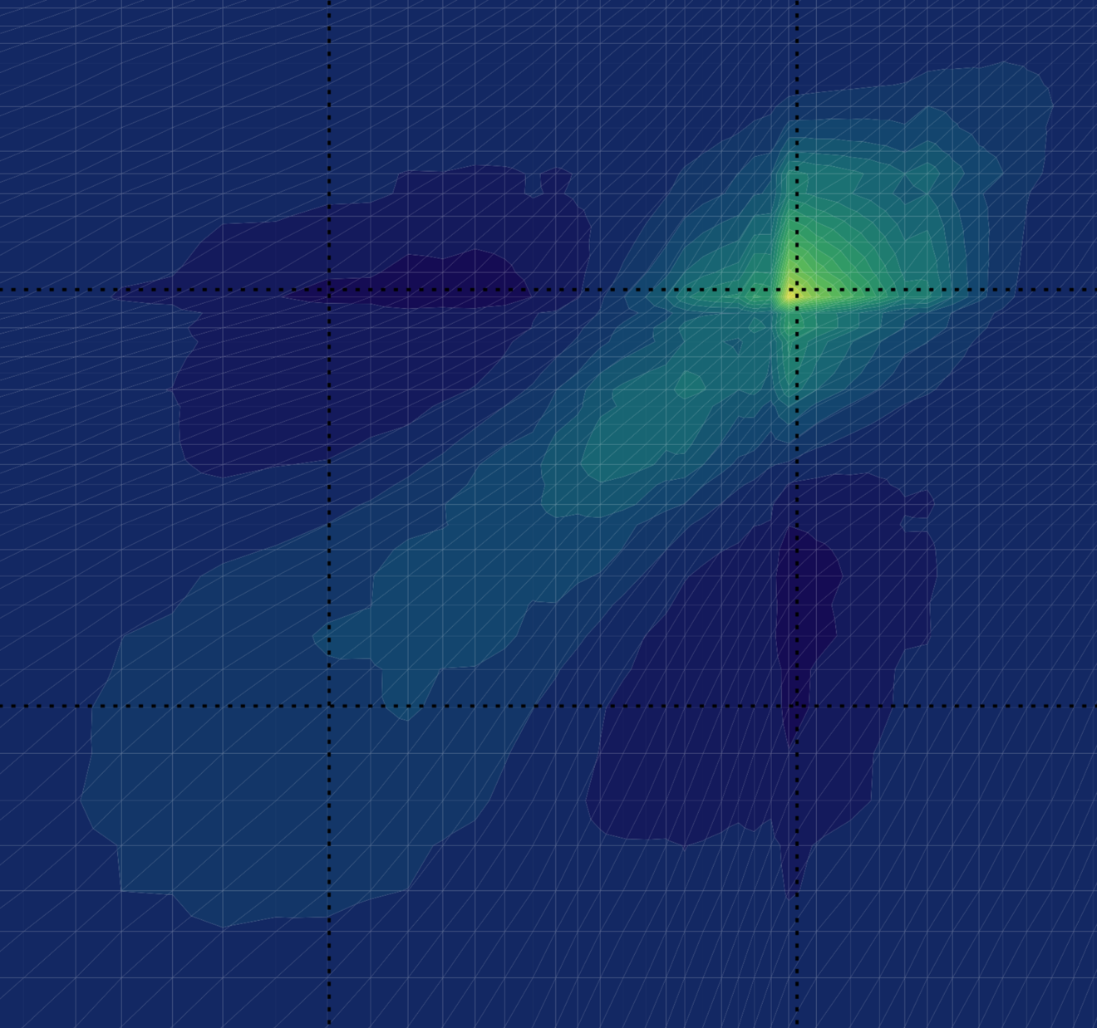
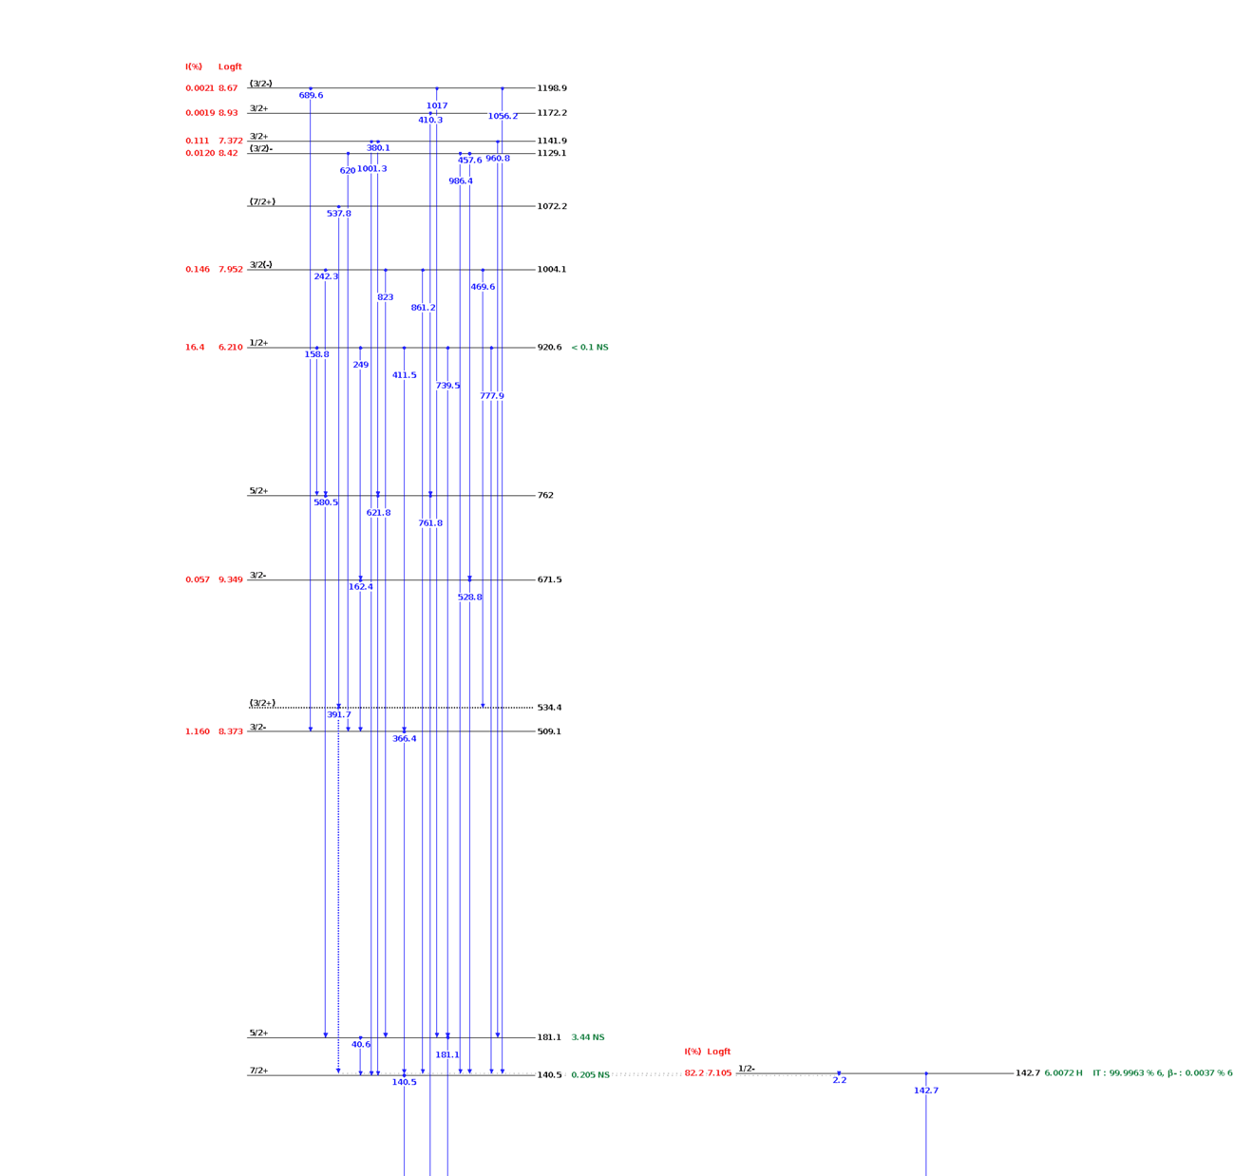
ENDF/ENSDF Comments
ENDF Format Fission Yields (no covariance)
Nudat2 Main Gamma-line Uncertainty Missing
Current:
  PNNL’s go-to site for nuclear data
  NEA database JANIS 4.0 becoming more prominent
Future Ideas:
  Standalone offline resource(s)
  Database change-log
Covariance Requirements for Cross-sections (¹⁶⁵Ho)
Nudat2 Coincident Gamma-line Branching Ratios

Slide 16
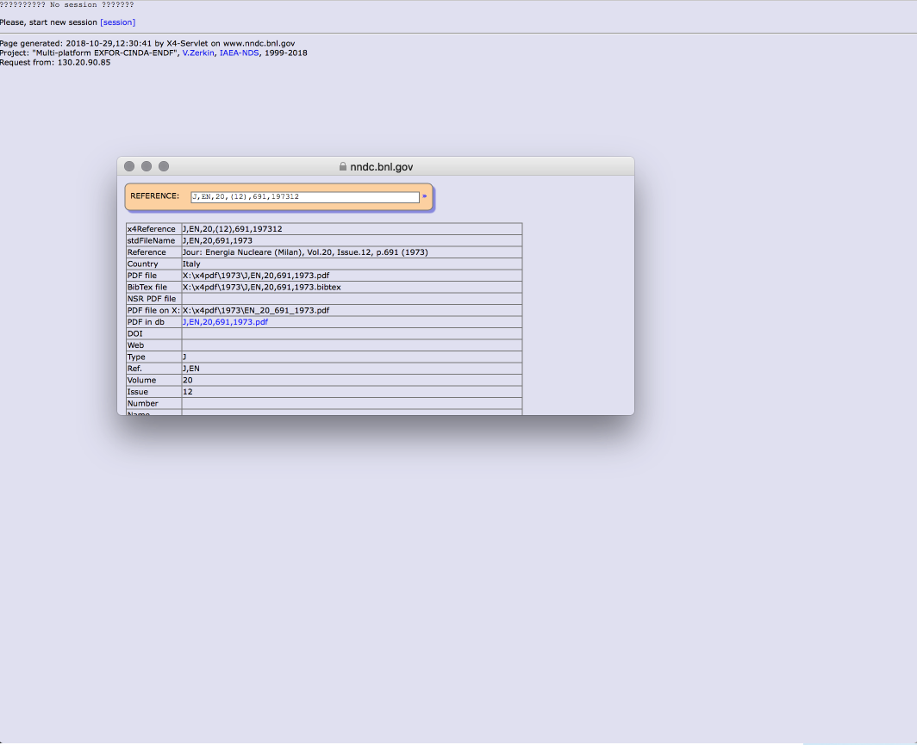
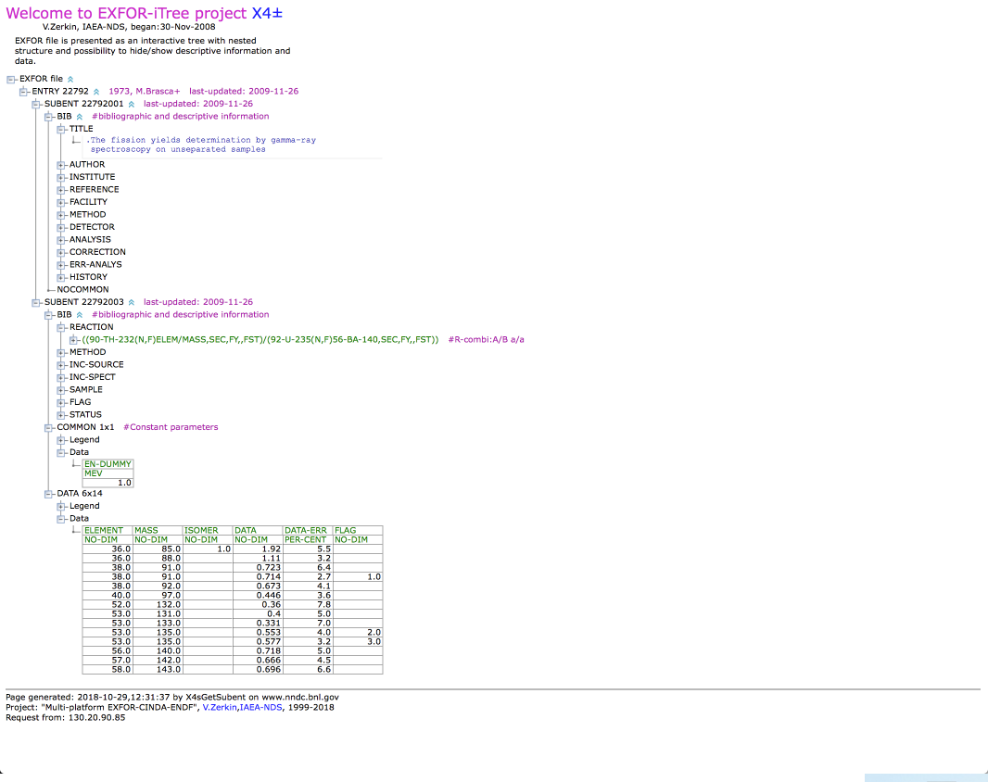
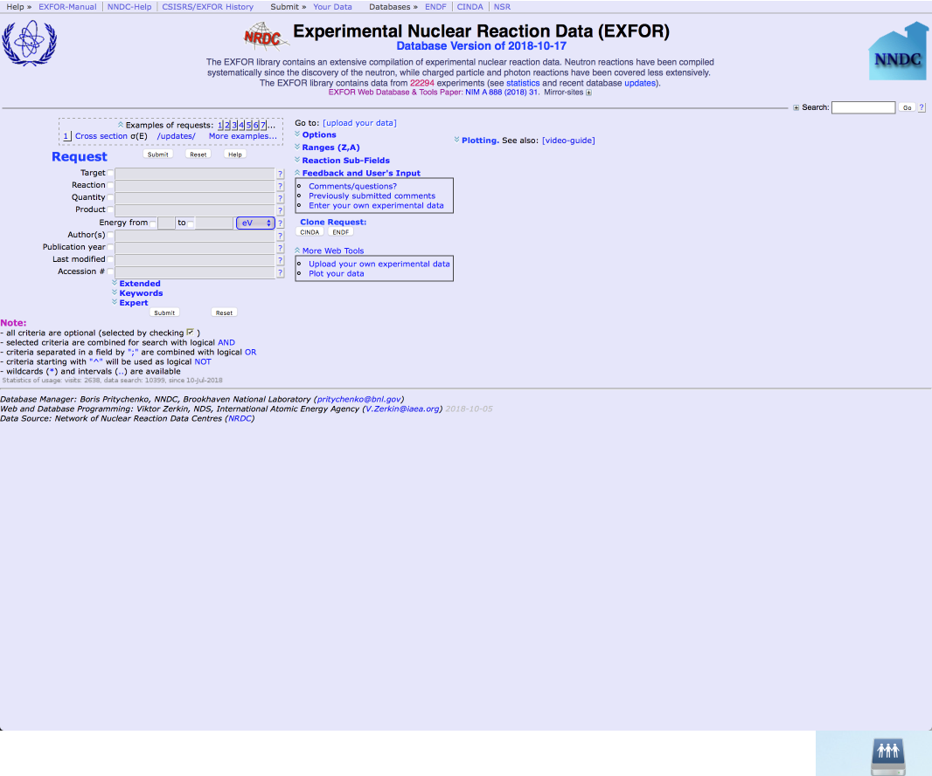
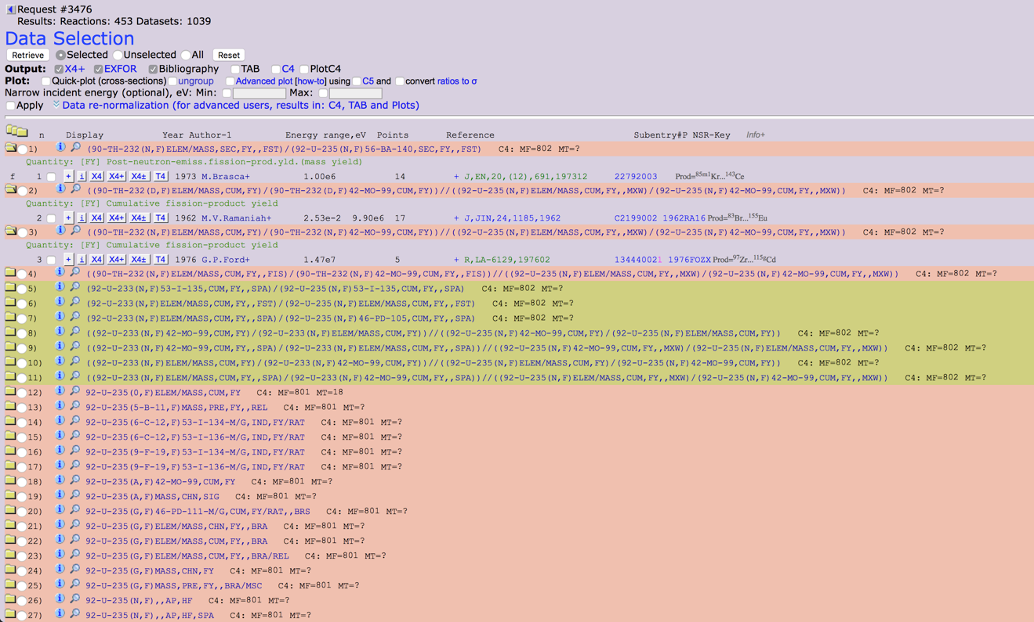
EXFOR Comments
Current:
  Becoming more prominent in nuclear chemistry community
  Prominent with physicists
Personally:
  NNDC/EXFOR #1 go-to database
  Linked publications generally linked to citing work
  Fastest way to start the literature review
Broken Links (pdf in db)
Element Abbrev.
(Faster Recognition)
Hard-to-navigate/
digest query data returns
Dated Interface

Slide 17
Discussion

