Slide 1
Some of the Latest Developments on Nuclear Reactor Antineutrinos
A.A. Sonzogni, E.A. McCutchan, M. Nino, D. Sundy
National Nuclear Data Center

Slide 2
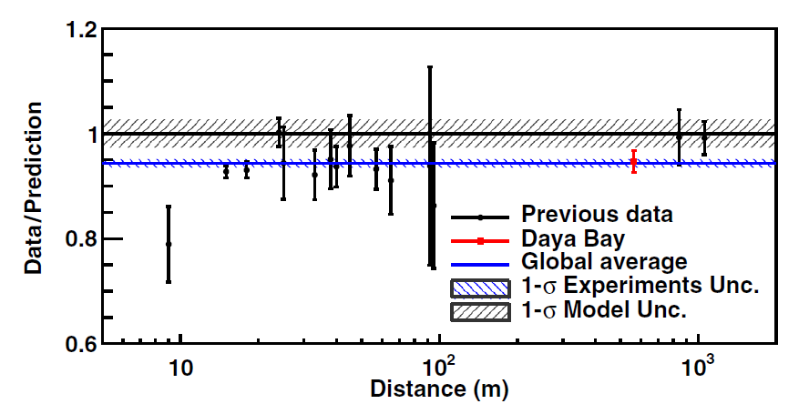
Are there more neutrinos beyond e, μ, τ?
There is a ~5% deficit in the number of electron antineutrinos emitted by a nuclear reactor at short distances
Daya Bay, PRL 116, 061801 (2016)

Slide 3
3+1 Model
A fourth sterile neutrino is proposed, with the electron surviving probability given as:
A recent analysis by Mention et al, obtained:
sin²2θ=0.1 and Δm²₄₁= 1 to 2 eV²
PRD 83, 073006 (2011)

Slide 4
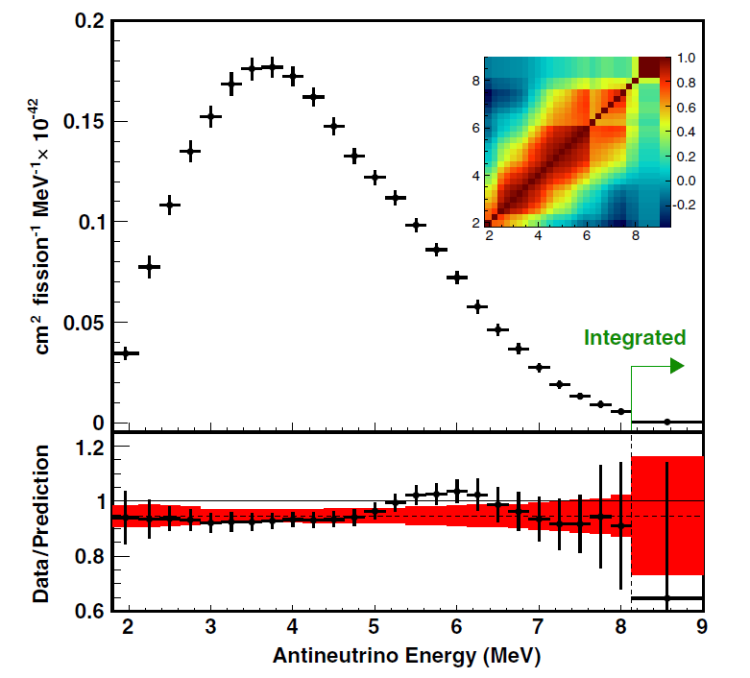
There is also an excess of antineutrinos, “the bump”, at ~6 MeV with respect to the Huber-Mueller model.

Slide 5
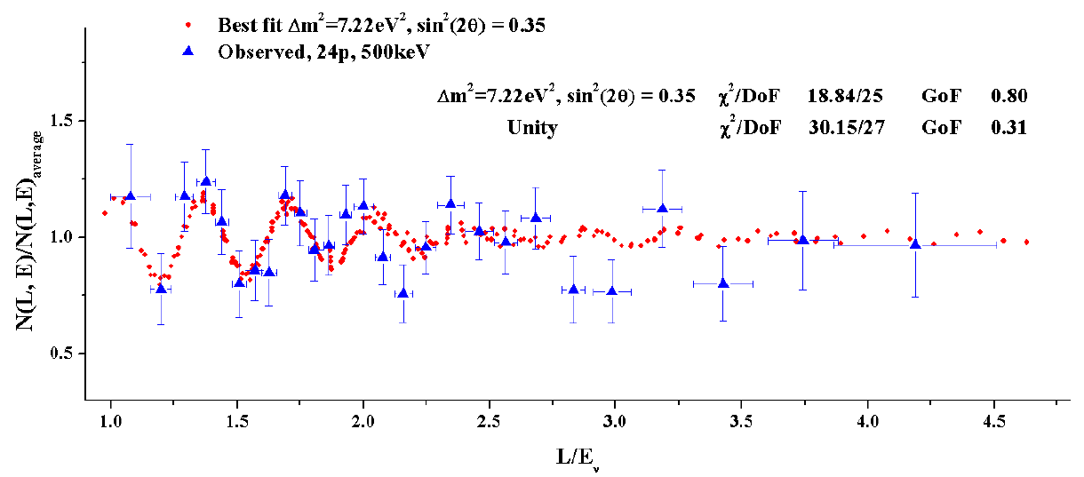
This has triggered a myriad of new experiments, among them, Neutrino-4
Segmented detector, at ~10 meters from a HEU reactor in Gatchina, Serebrov et al, arXiv:1806.02784
Beautiful oscillation pattern reported, and authors mention observation of “the bump”

Slide 6
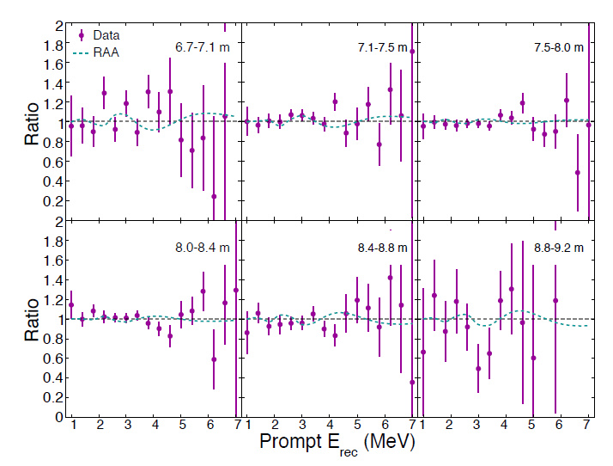
PROSPECT at ORNL
They have recently reported, arXiv:1806.02784, no oscillation, and at the DNP meeting two weeks ago, announced that they don’t see “the bump” and agreement with Huber.

Slide 7
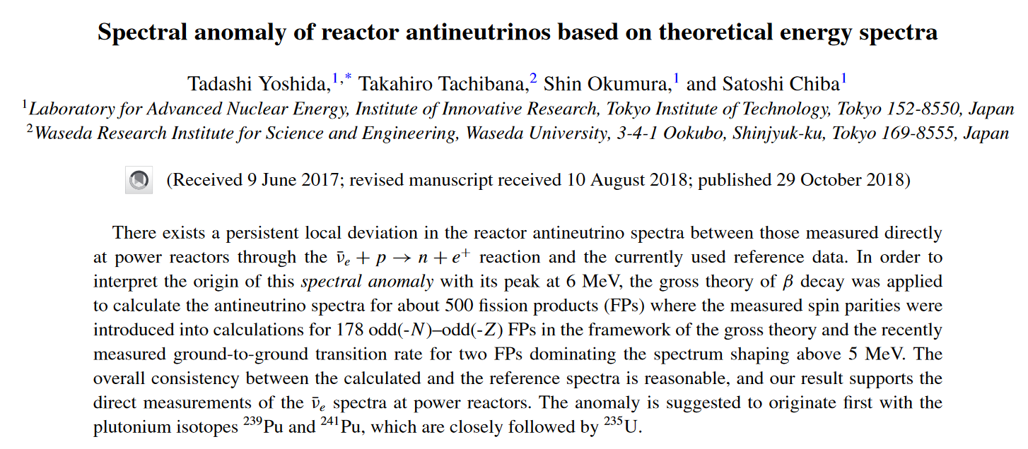
A few more pieces for this jigsaw puzzle…
Last sentence: The anomaly is suggested to originate first with the plutonium isotopes ²³⁹Pu and ²⁴¹Pu, which are closely followed by ²³⁵U.

Slide 8
A few more pieces for this jigsaw puzzle…
Daya Bay 2017:
A 7.8% discrepancy between the observed and predicted ²³⁵U yield suggests that this isotope may be the primary contributor to the reactor antineutrino anomaly.
PRL 118, 251801 (2017)
RENO 2018:
Reevaluation of the ²³⁵U IBD yield per fission may mostly solve the reactor antineutrino anomaly while ²³⁹Pu is not completely ruled out as a possible source of the anomaly. We also report a 2.7 σ significant hint of correlation between the 5 MeV excess in observed IBD spectrum and the reactor fuel isotope fraction of ²³⁵U. arXiv:1806.00574

Slide 9
In Summary, very active field, important number (~20!) of experiments going on (by country):
Brazil: Angra
China: Daya Bay, JUNO
France: Double Chooz, Nucifer, Solid, Stereo
Germany: CONUS
India: ISMRAN
Japan: PANDA, SuperK-Gd
Korea: RENO, NEOS
Russia: DANSS, Neutrino-4, RED-100
UK: VIDAAR, Watchman, NuLat
US: CHANDLER, PROSPECT
Additionally, neutral-current interactions recently observed in Germany using reactor antineutrinos.

Slide 10
Our latest work
Using nuclear databases to:
Signature of Individual
Rule out parameters in the 3+1 model

Slide 11
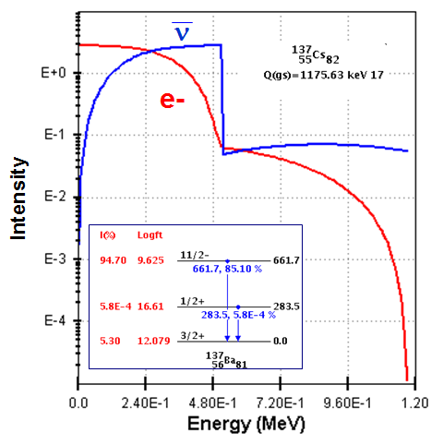
Summation Method
Electron and antineutrino spectra from a reactor can be calculated as
Cumulative Fission Yields
Individual Spectra
First calculation of this type performed by P. Vogel et al. in 1981 using ENDF/B-V.
In this work, we are using:
ENDF/B-VIII.0 Decay Data together with the JEFF-3.1.1 Fission Yields
JEFF-3.1.1 FY implicit nuclear structure data fairly compatible with ENDF/B-VIII.0
ENDF/B-VIII.0 includes the latest TAGS data relevant to antineutrino applications. Simplified versions of the library available on request.

Slide 12
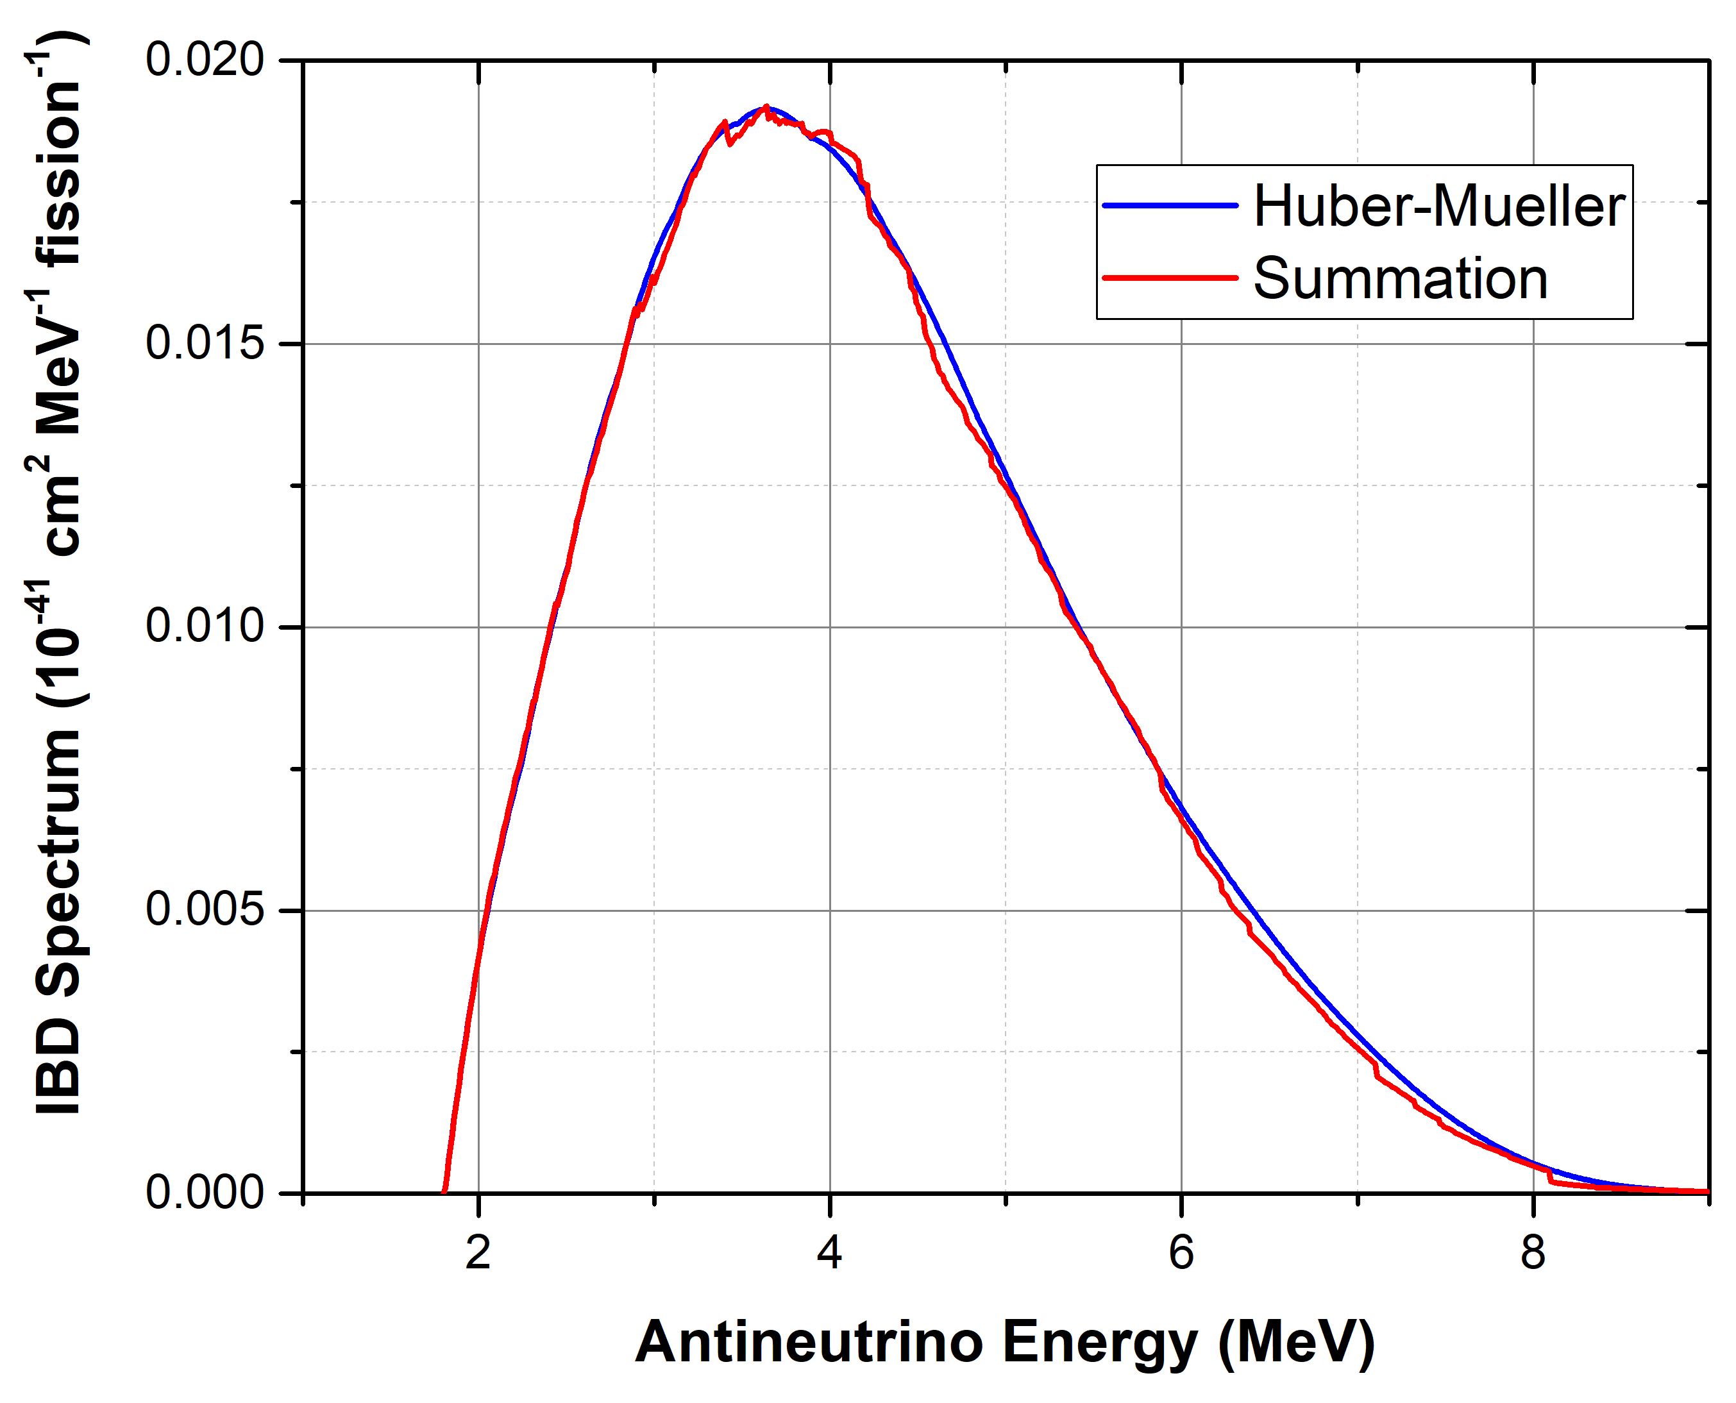
Comparison with Huber-Mueller

Slide 13
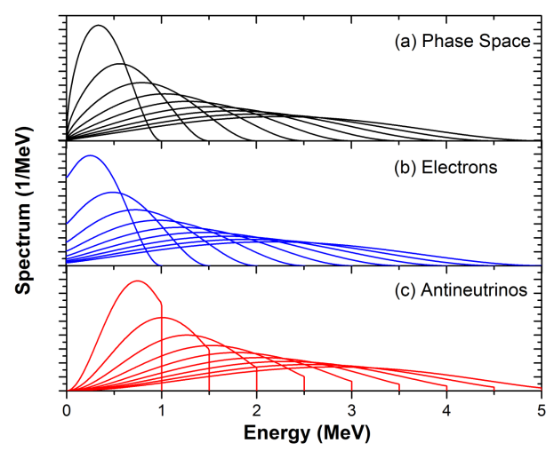
Fine Structure
As the reactor spectrum is the sum of ~800 individual spectra, can we seen individual effects?
Sharp cutoffs that can be seen with 0.1 MeV binning or less
Shoulder spanning several 100s keV

Slide 14
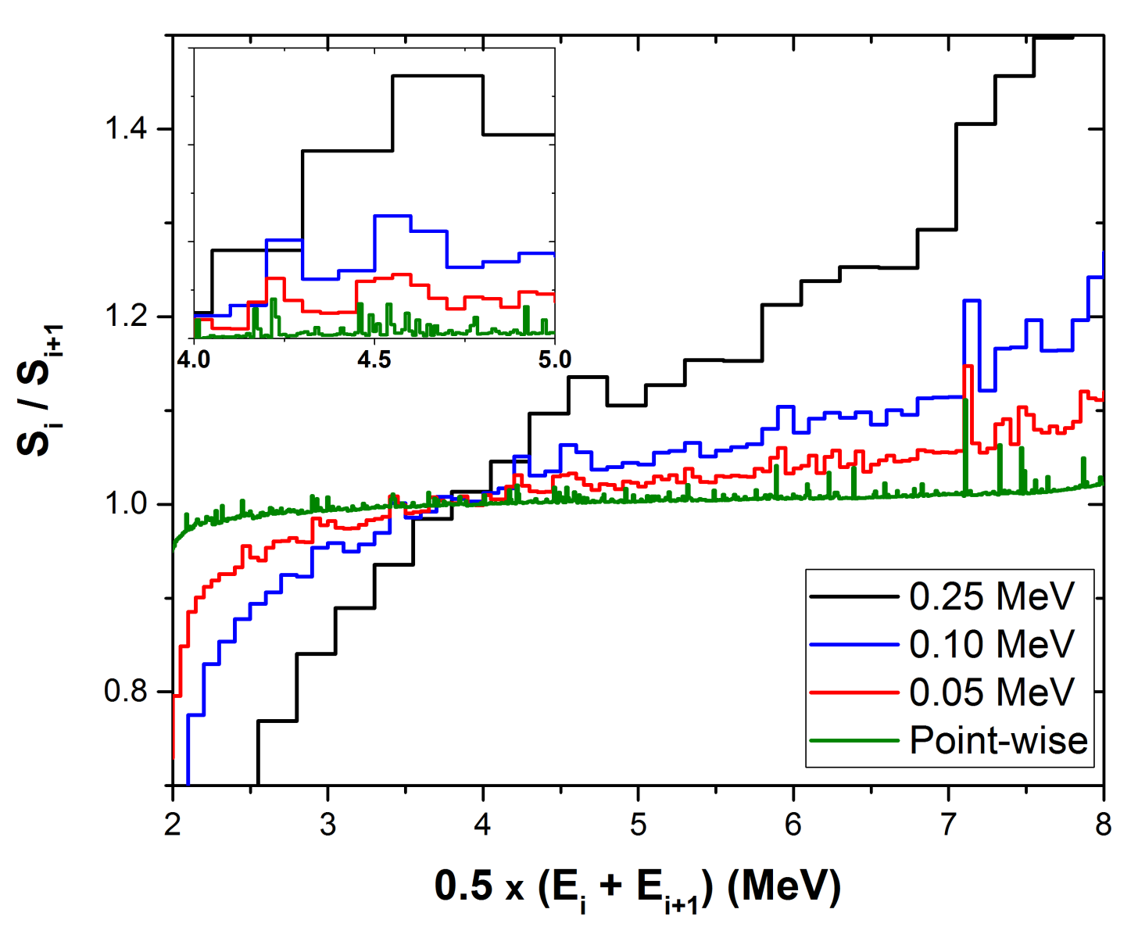
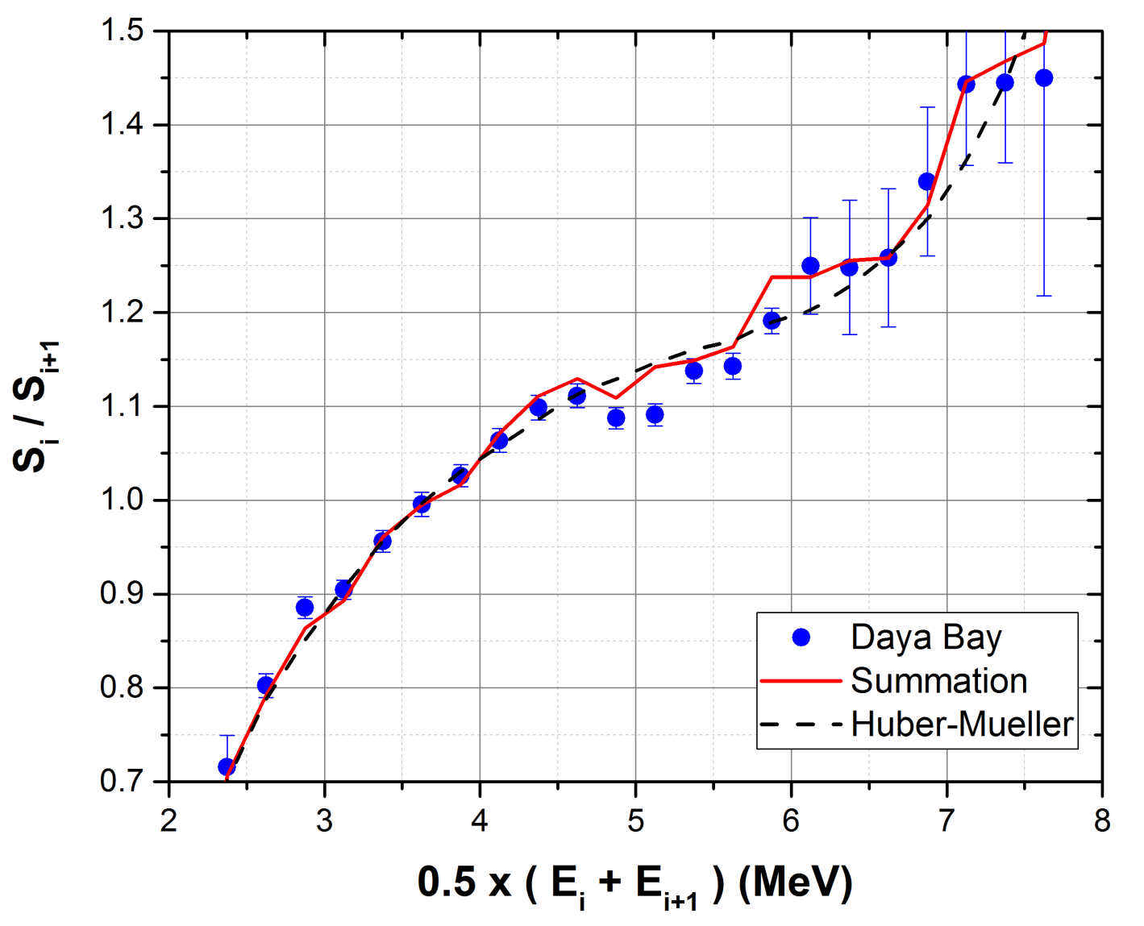
How to reveal Fine Structure?
Ratio of adjacent points:
R_{i} = S_{i} / S_{i+1}
Surprisingly, even with a 0.25 MeV binning a structure can be seen.
Structure observed in Daya Bay data, covariance matrix crucial for analysis.

Slide 15
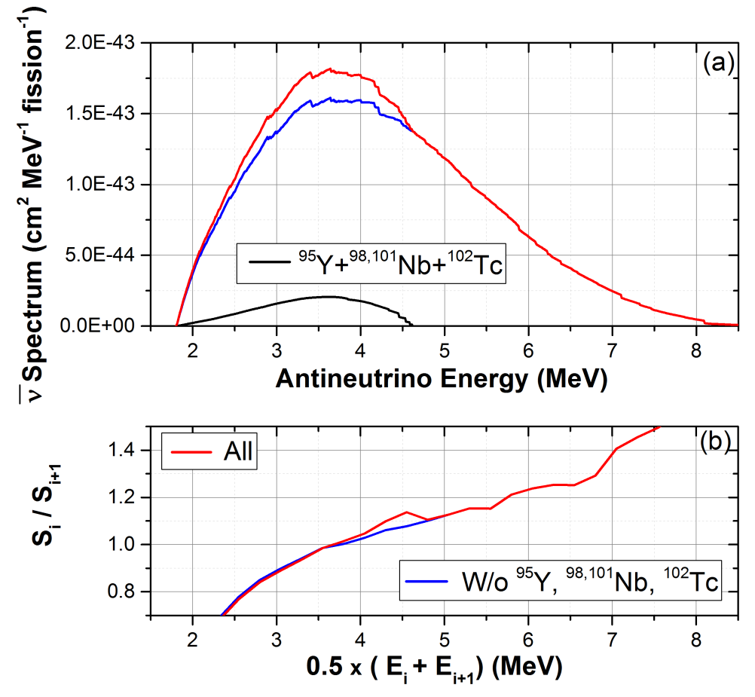
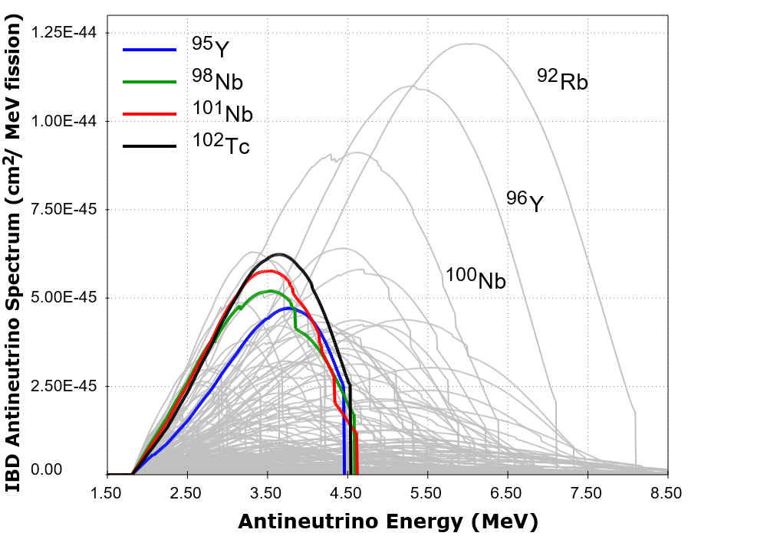
Nuclides behind fine structure
Looking for trees in the forest
This “Fine structure” can be attributed to just 4 nuclides
For more details, see:
A.A. Sonzogni, M. Nino, E.A. McCutchan PRC98, 014323 (2018)
We need to confirm this finding by other means.
Also, could this be a low value Δm²₄₁ ( < 0.1 eV² ) effect?

Slide 16
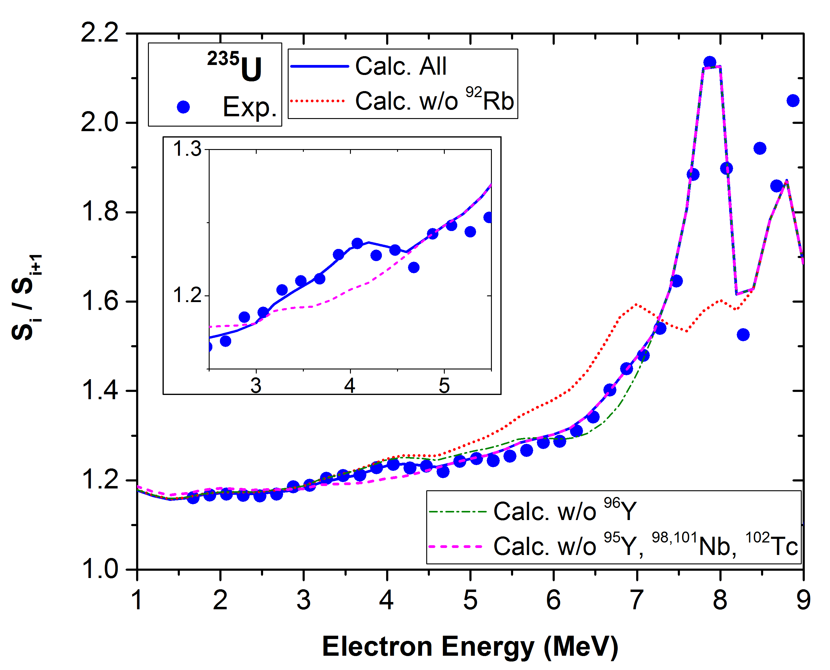
Fine Structure in ²³⁵U electron spectrum
The structure at around 7.8 MeV is basically due to ⁹²Rb
The shoulder at around 7 MeV due to ⁹⁶Y
And the structure at around 4 MeV due to ⁹⁵Y, ^{98,101}Nb,¹⁰²Tc.
Therefore, the structure at 4.5 MeV antineutrino energy is due to the decay of individual fission products

Slide 17
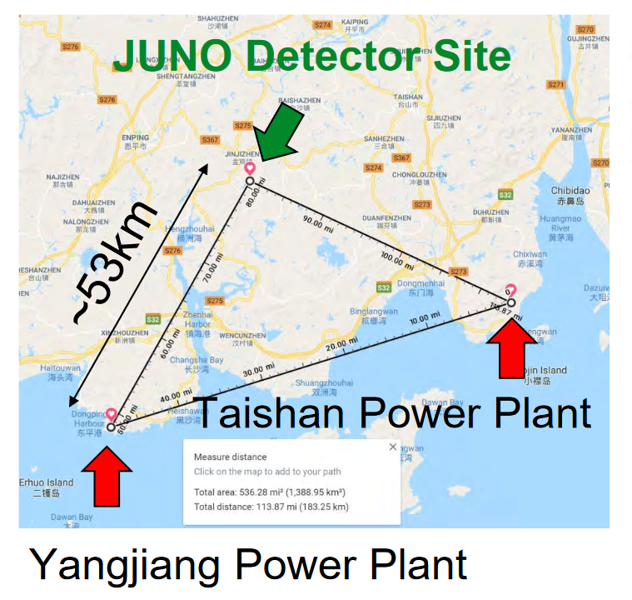
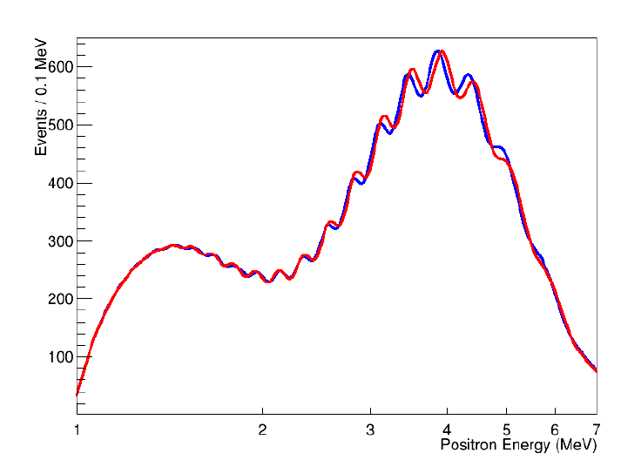
Why is this relevant, you may ask…
Expected spectrum for JUNO
20 kT detector (1000 x bigger than Daya Bay) to measure neutrino mass hierarchy and oscillation parameters
See for a discussion on the effect of Inverted or Normal ordering using nuclear databases:
D.L. Danielson, A.C. Hayes, G.T. Harvey, arXiv:1808.03276

Slide 18
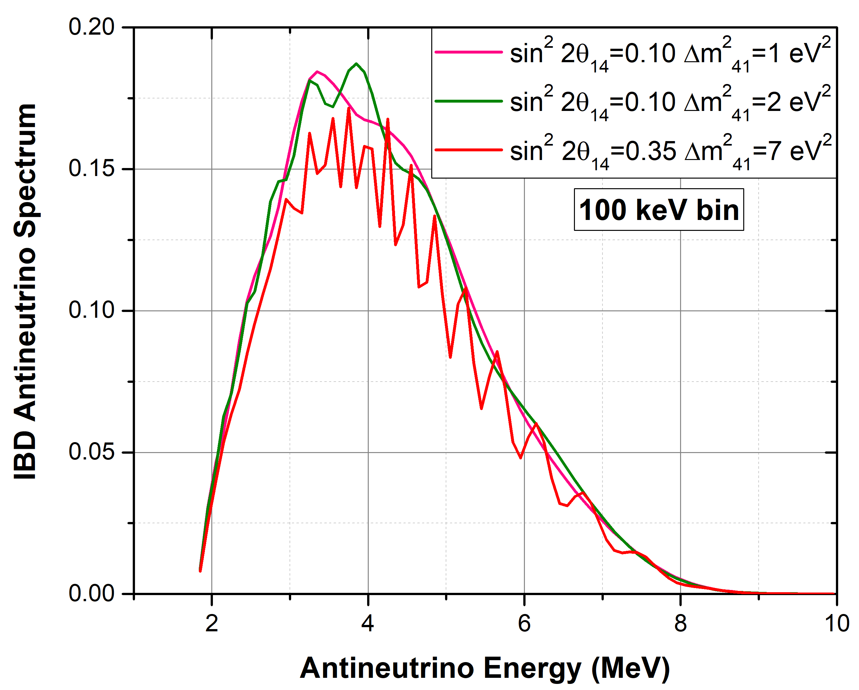
Why is this relevant, you may ask…
Signature of sterile neutrino in short baseline experiments
RAA, Mention et al, PRD 83, 073006 (2011)
Neutrino-4, Serebrov et al., arXiv:1809.10561

Slide 19
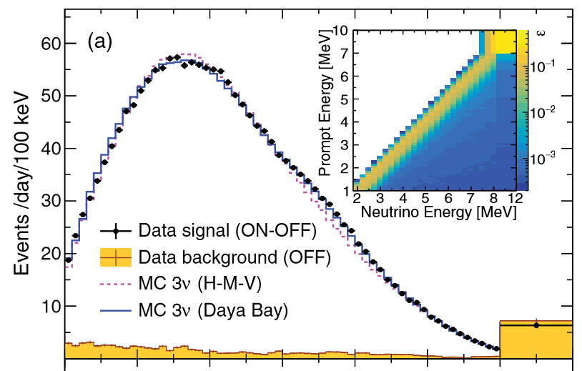
Fine Structure at the top of the spectrum
NEOS data, 30 m from a power reactor
There seems to be structure?
Ko et al, PRL 118, 121802 (2017)

Slide 20
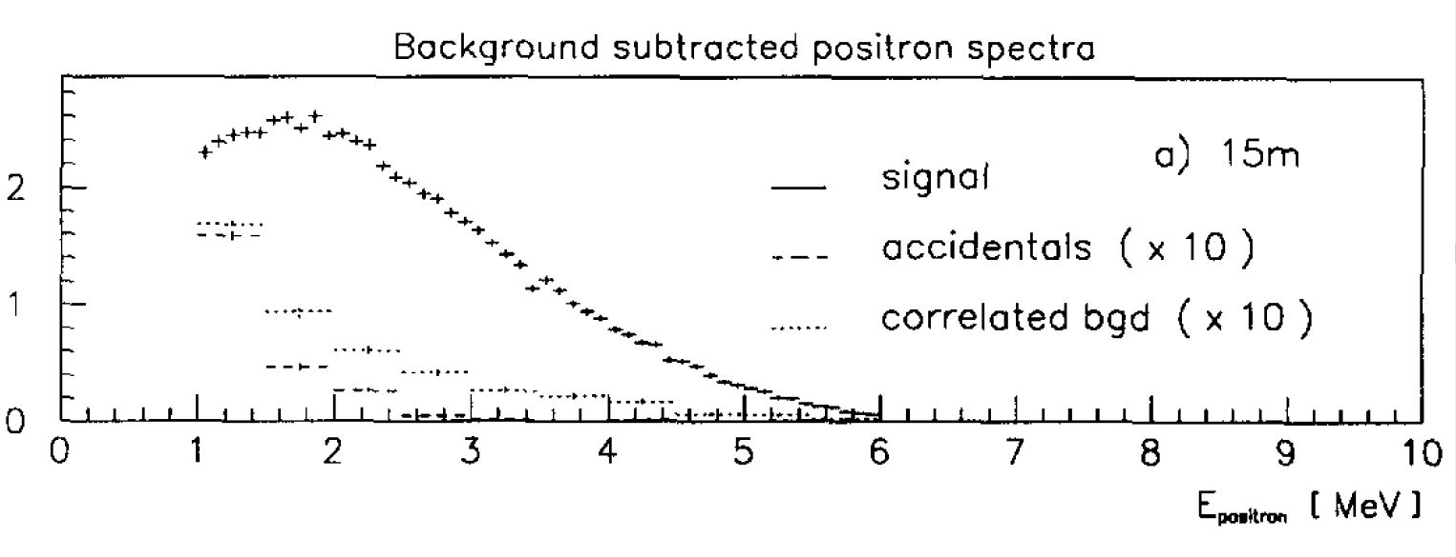
Fine Structure at the top of the spectrum
We found only one other measurement with 100 keV bins,Bugey-3, B. Achkar et al., NPB 434, 503 (1995).
Structure!
Unfortunately, NEOS & Bugey-3 data are not available and given as function of positron energy → Must digitize and shift!

Slide 21
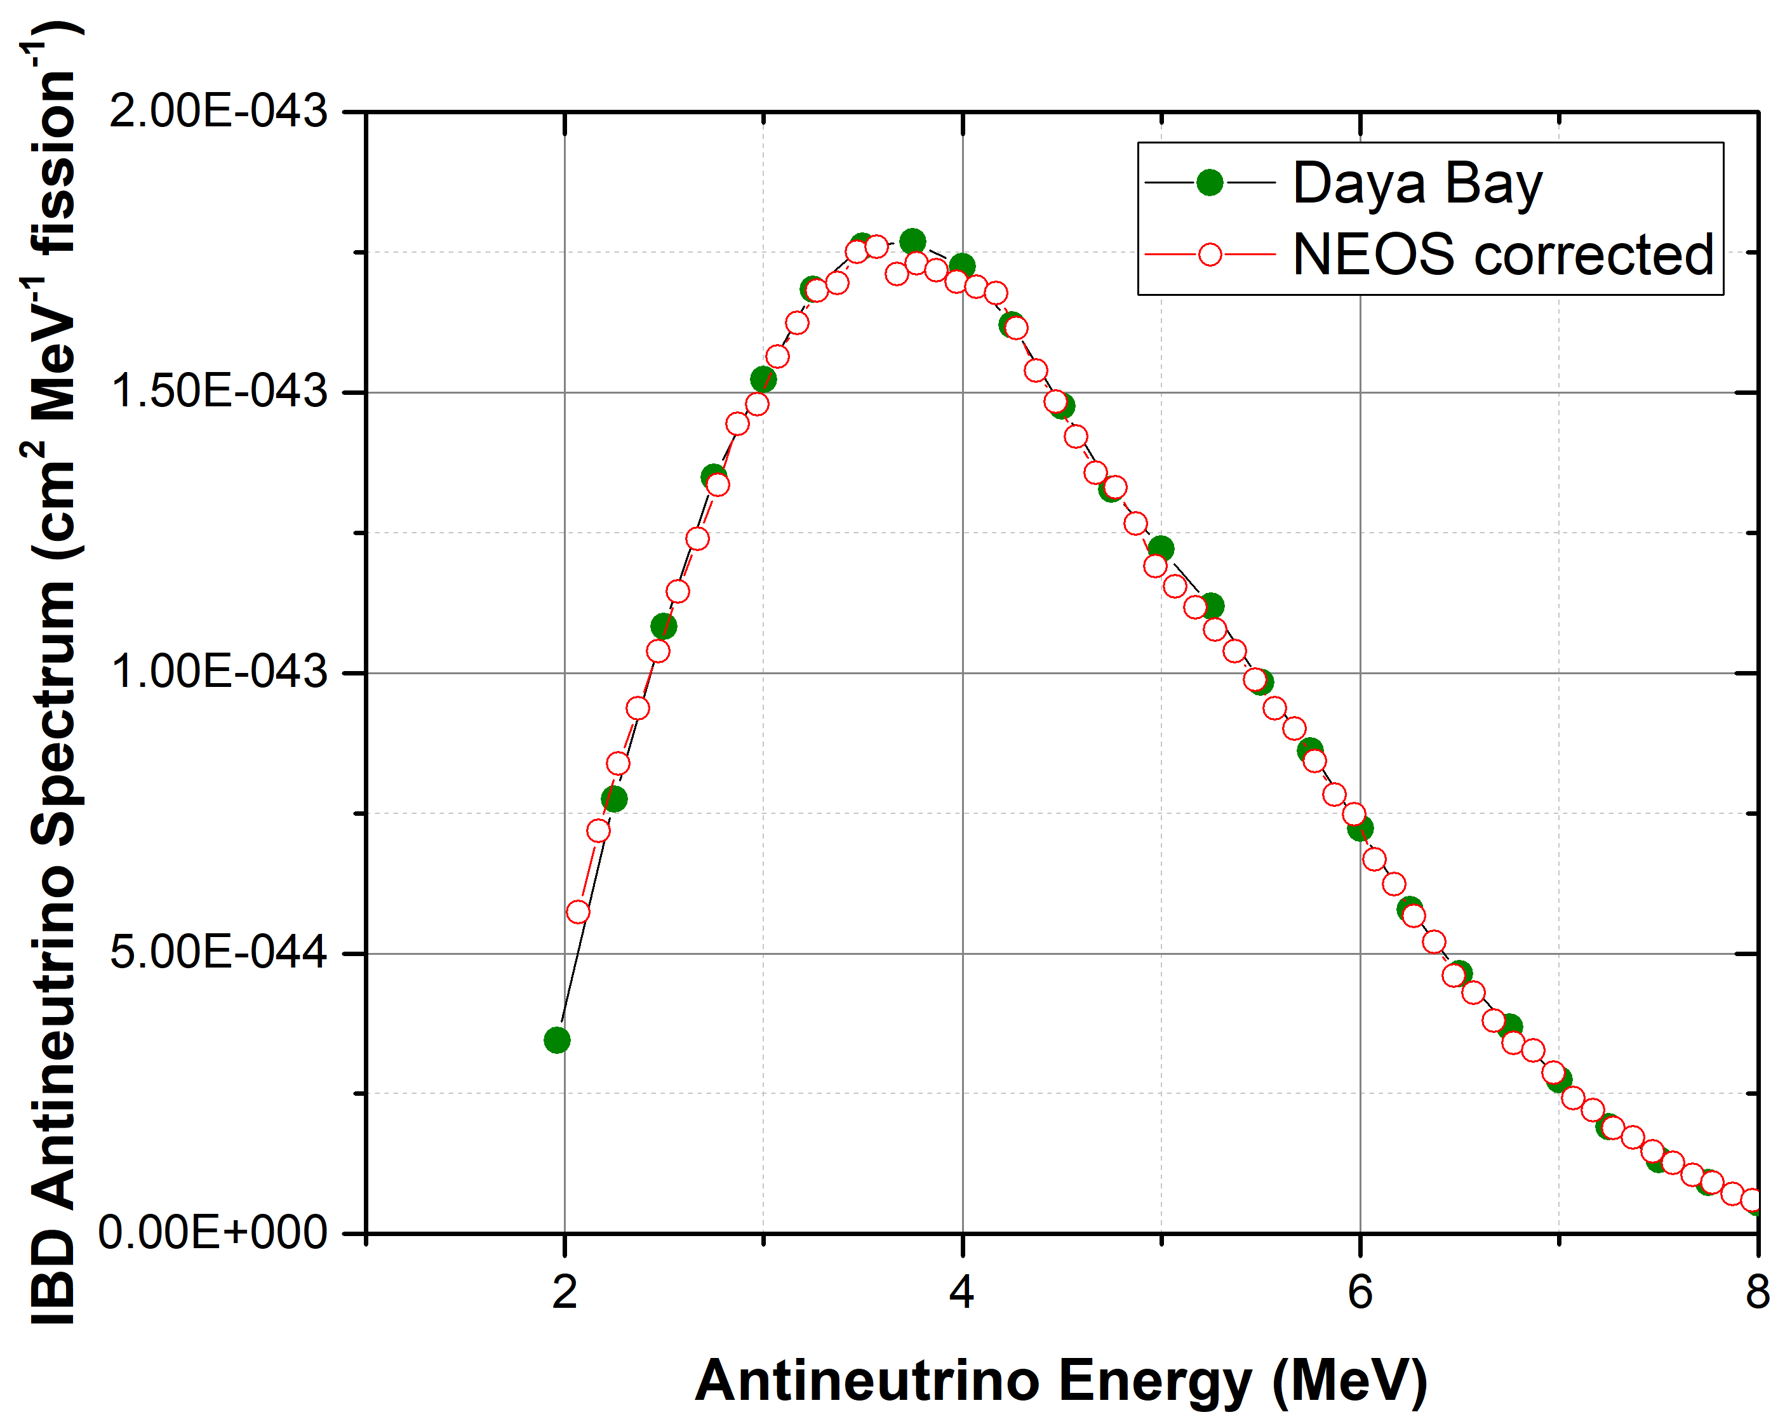
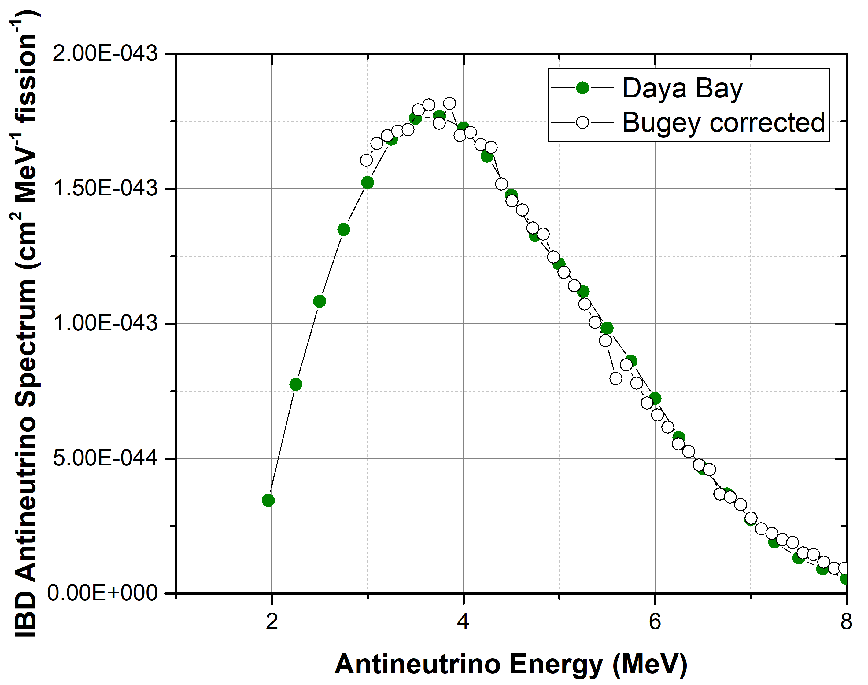
Digitizing and Energy matching
NEOS data was digitized and an energy shift aligned it nicely with Daya Bay
Bugey data was digitized, alignment with Daya Bay also required a linear term.

Slide 22
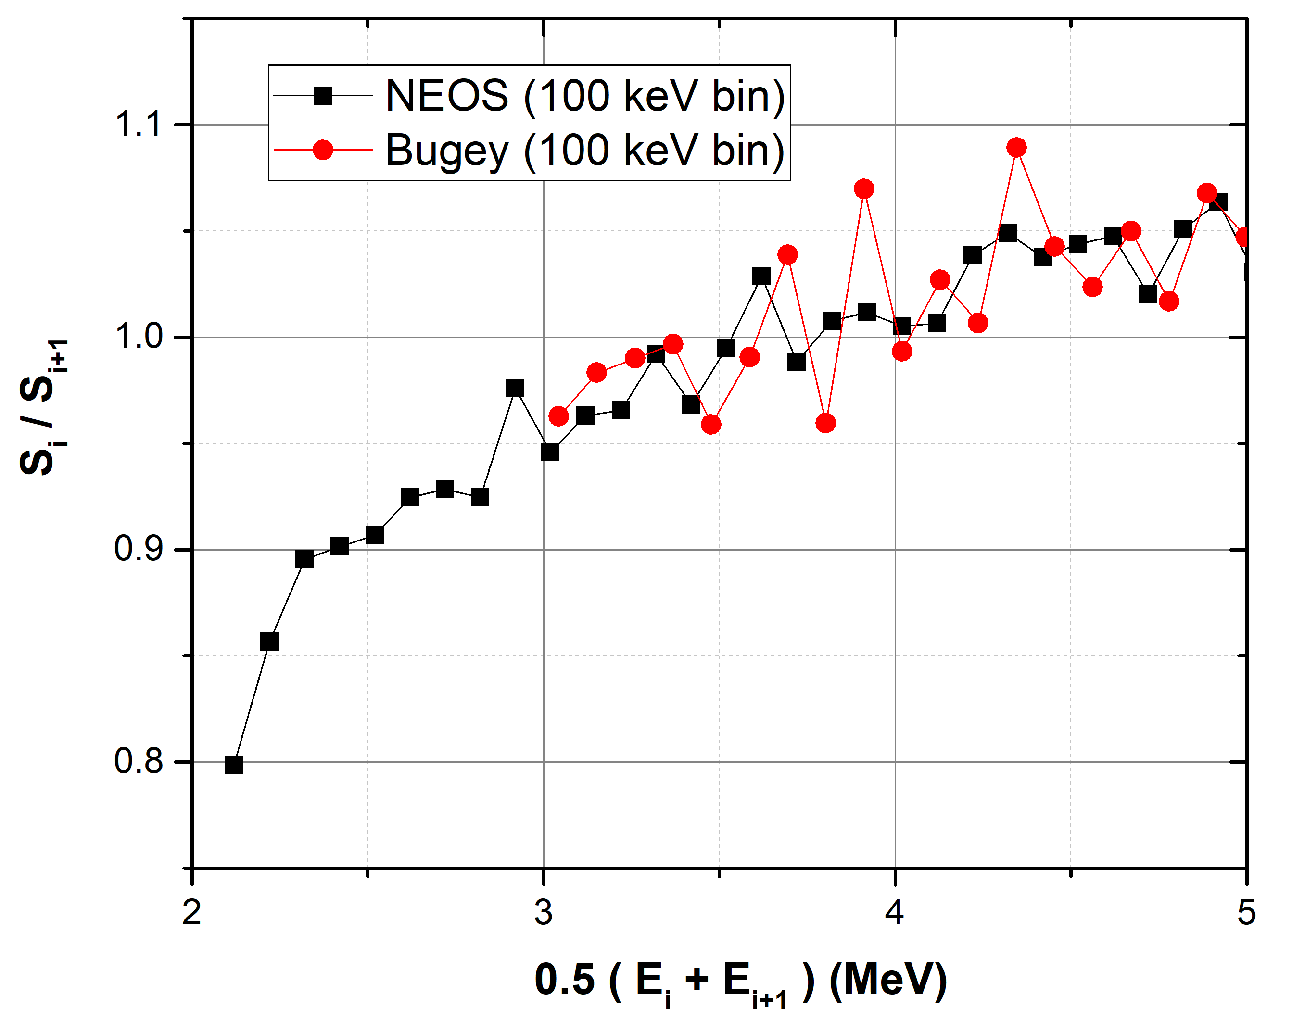
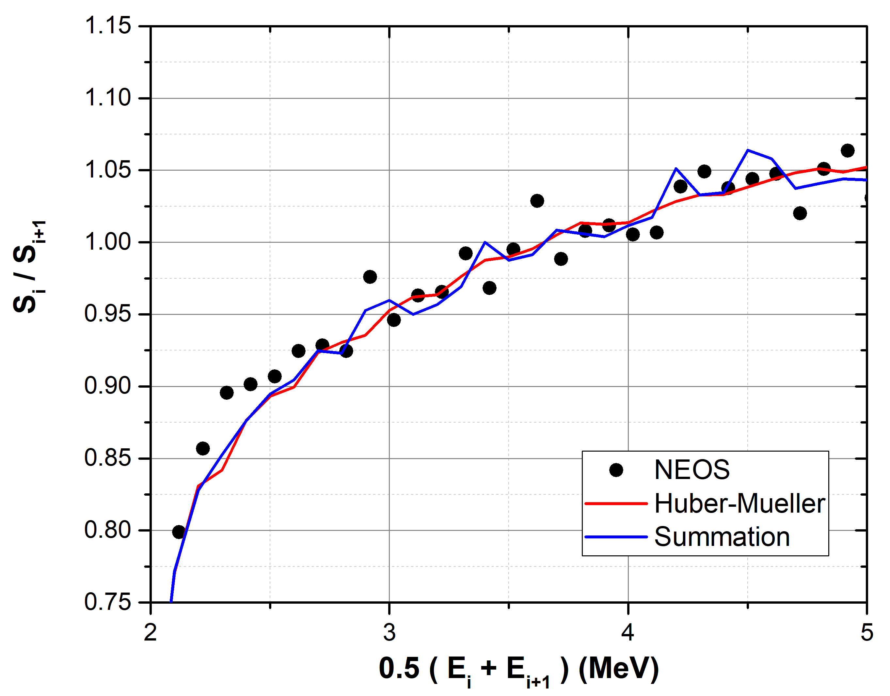
The agreement between NEOS and Bugey-3 ratios is quite good, all considered
As well as the agreement between NEOS and the summation calculation

Slide 23
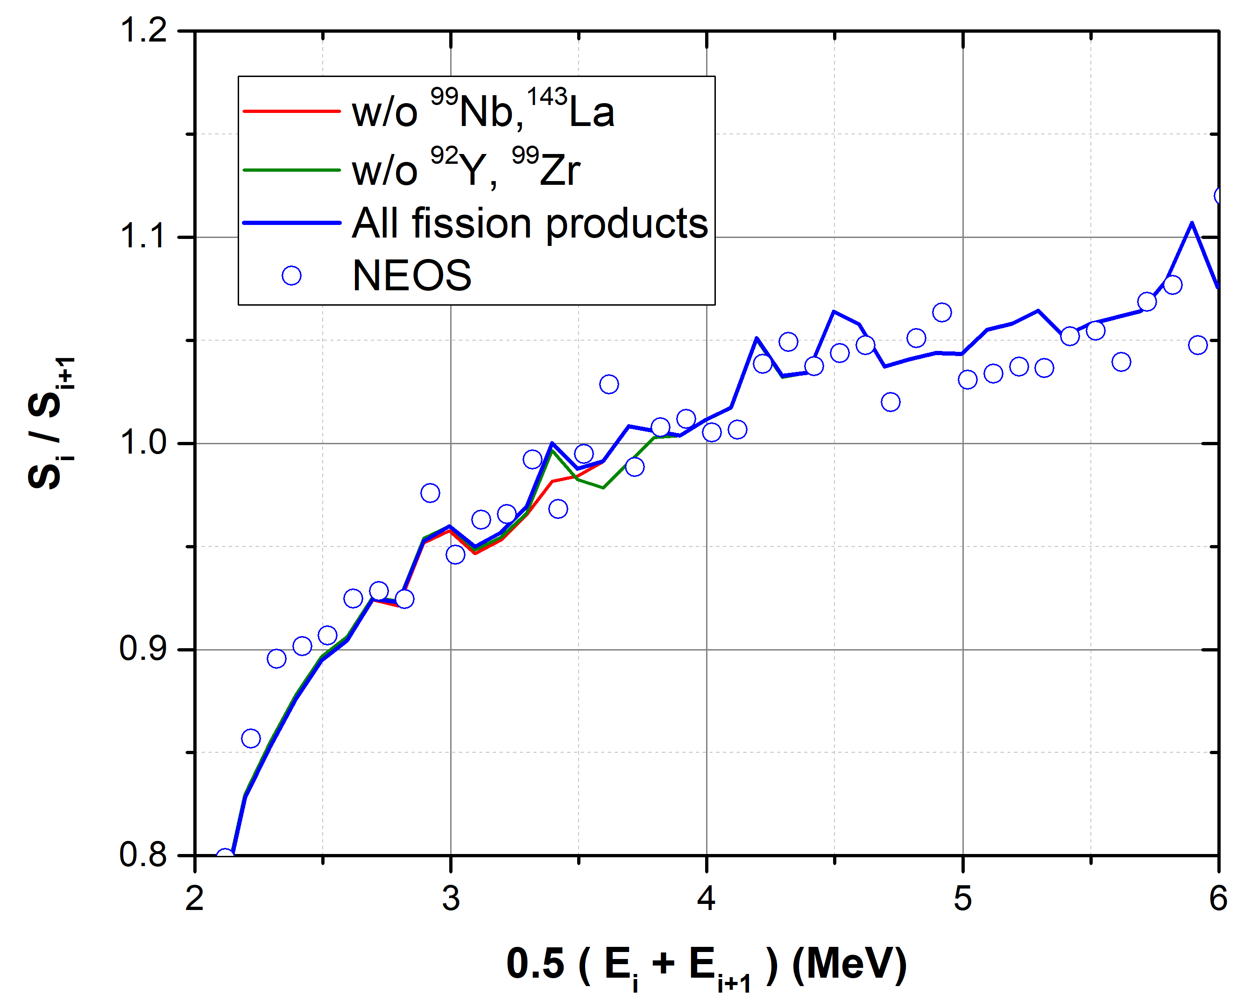
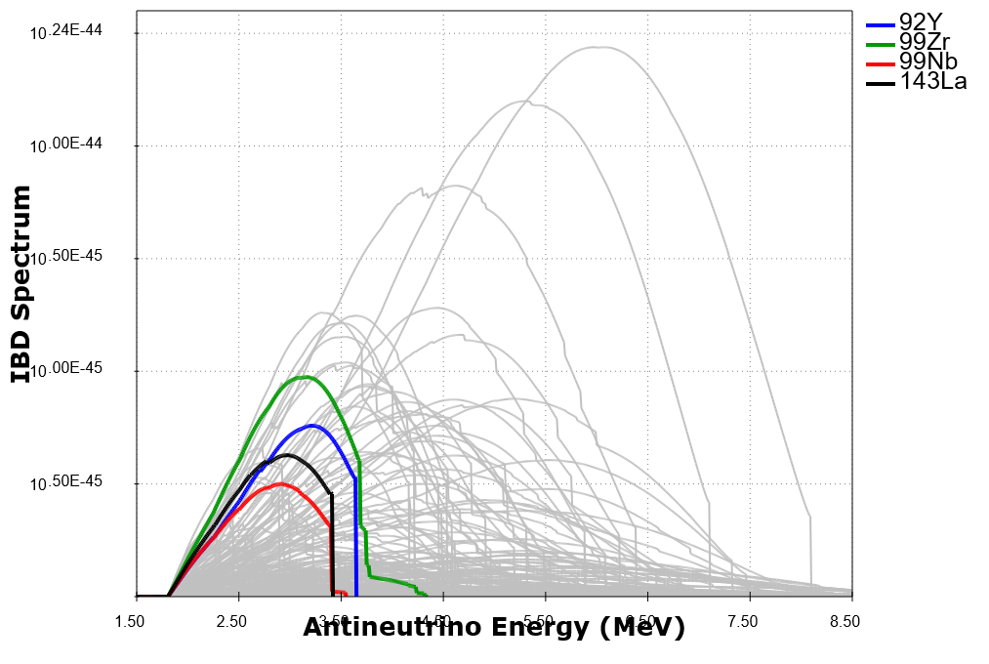
Nuclides behind fine structure at the top

Slide 24
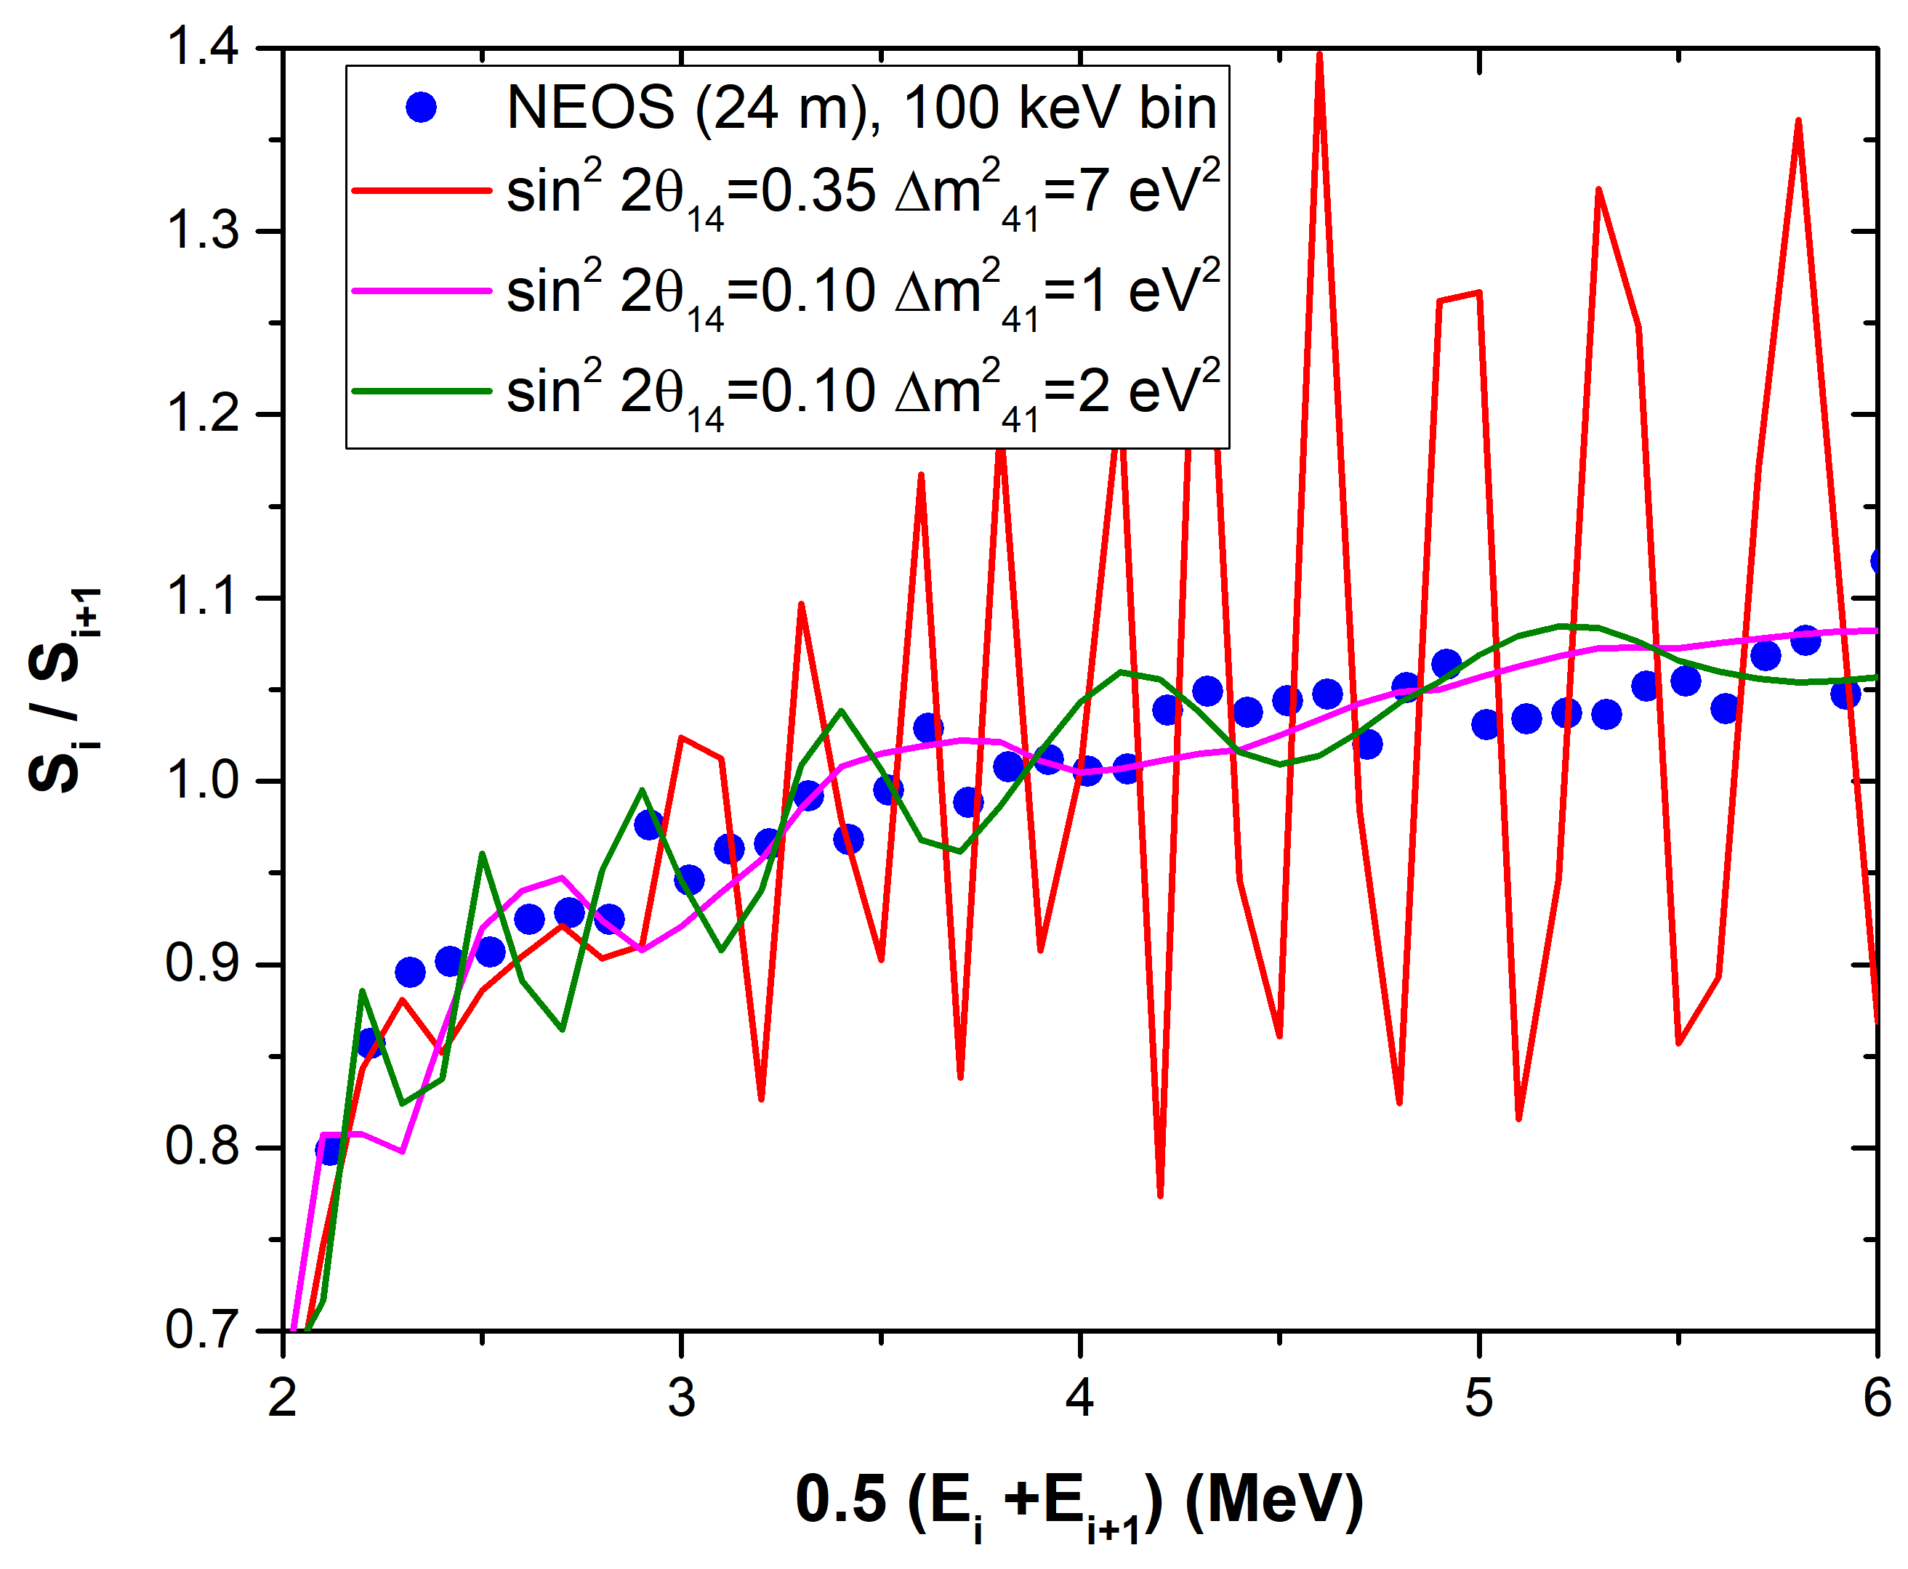
NEOS adjacent points ratio plot more consistent with databases than with 3+1 model
Assuming 2.0% uncertainty in the 2.7 – 5 MeV region
Method | χ2/point
Sum | 0.59
0.35, 7 | 30.50
0.1, 1 | 1.35
0.1, 2 | 2.56

Slide 25
Conclusions
With better resolution and smaller bin intervals, contributions from individual nuclides, not captured in the conversion, begin to appear. Must rely on nuclear databases to understand them.
Nuclear databases have not been tweaked / fine tuned to match ILL electron nor Daya Bay antineutrino spectra.
Individual fission product effects (fine structure, sharp cutoffs) were most likely first observed by Bugey-3, but not recognized as such until now.
While summation calculations are less precise than conversion ones, they are nevertheless more reliable as they contain contributions from more than 500 experiments.
The latest pieces added to the puzzle have not helped resolve it, they are instead hinting at a much more complex puzzle.

