Slide 1
NSR & EXFOR Compilation Databases
Boris Pritychenko
National Nuclear Data Center, BNL, Upton, NY 11973

Slide 2
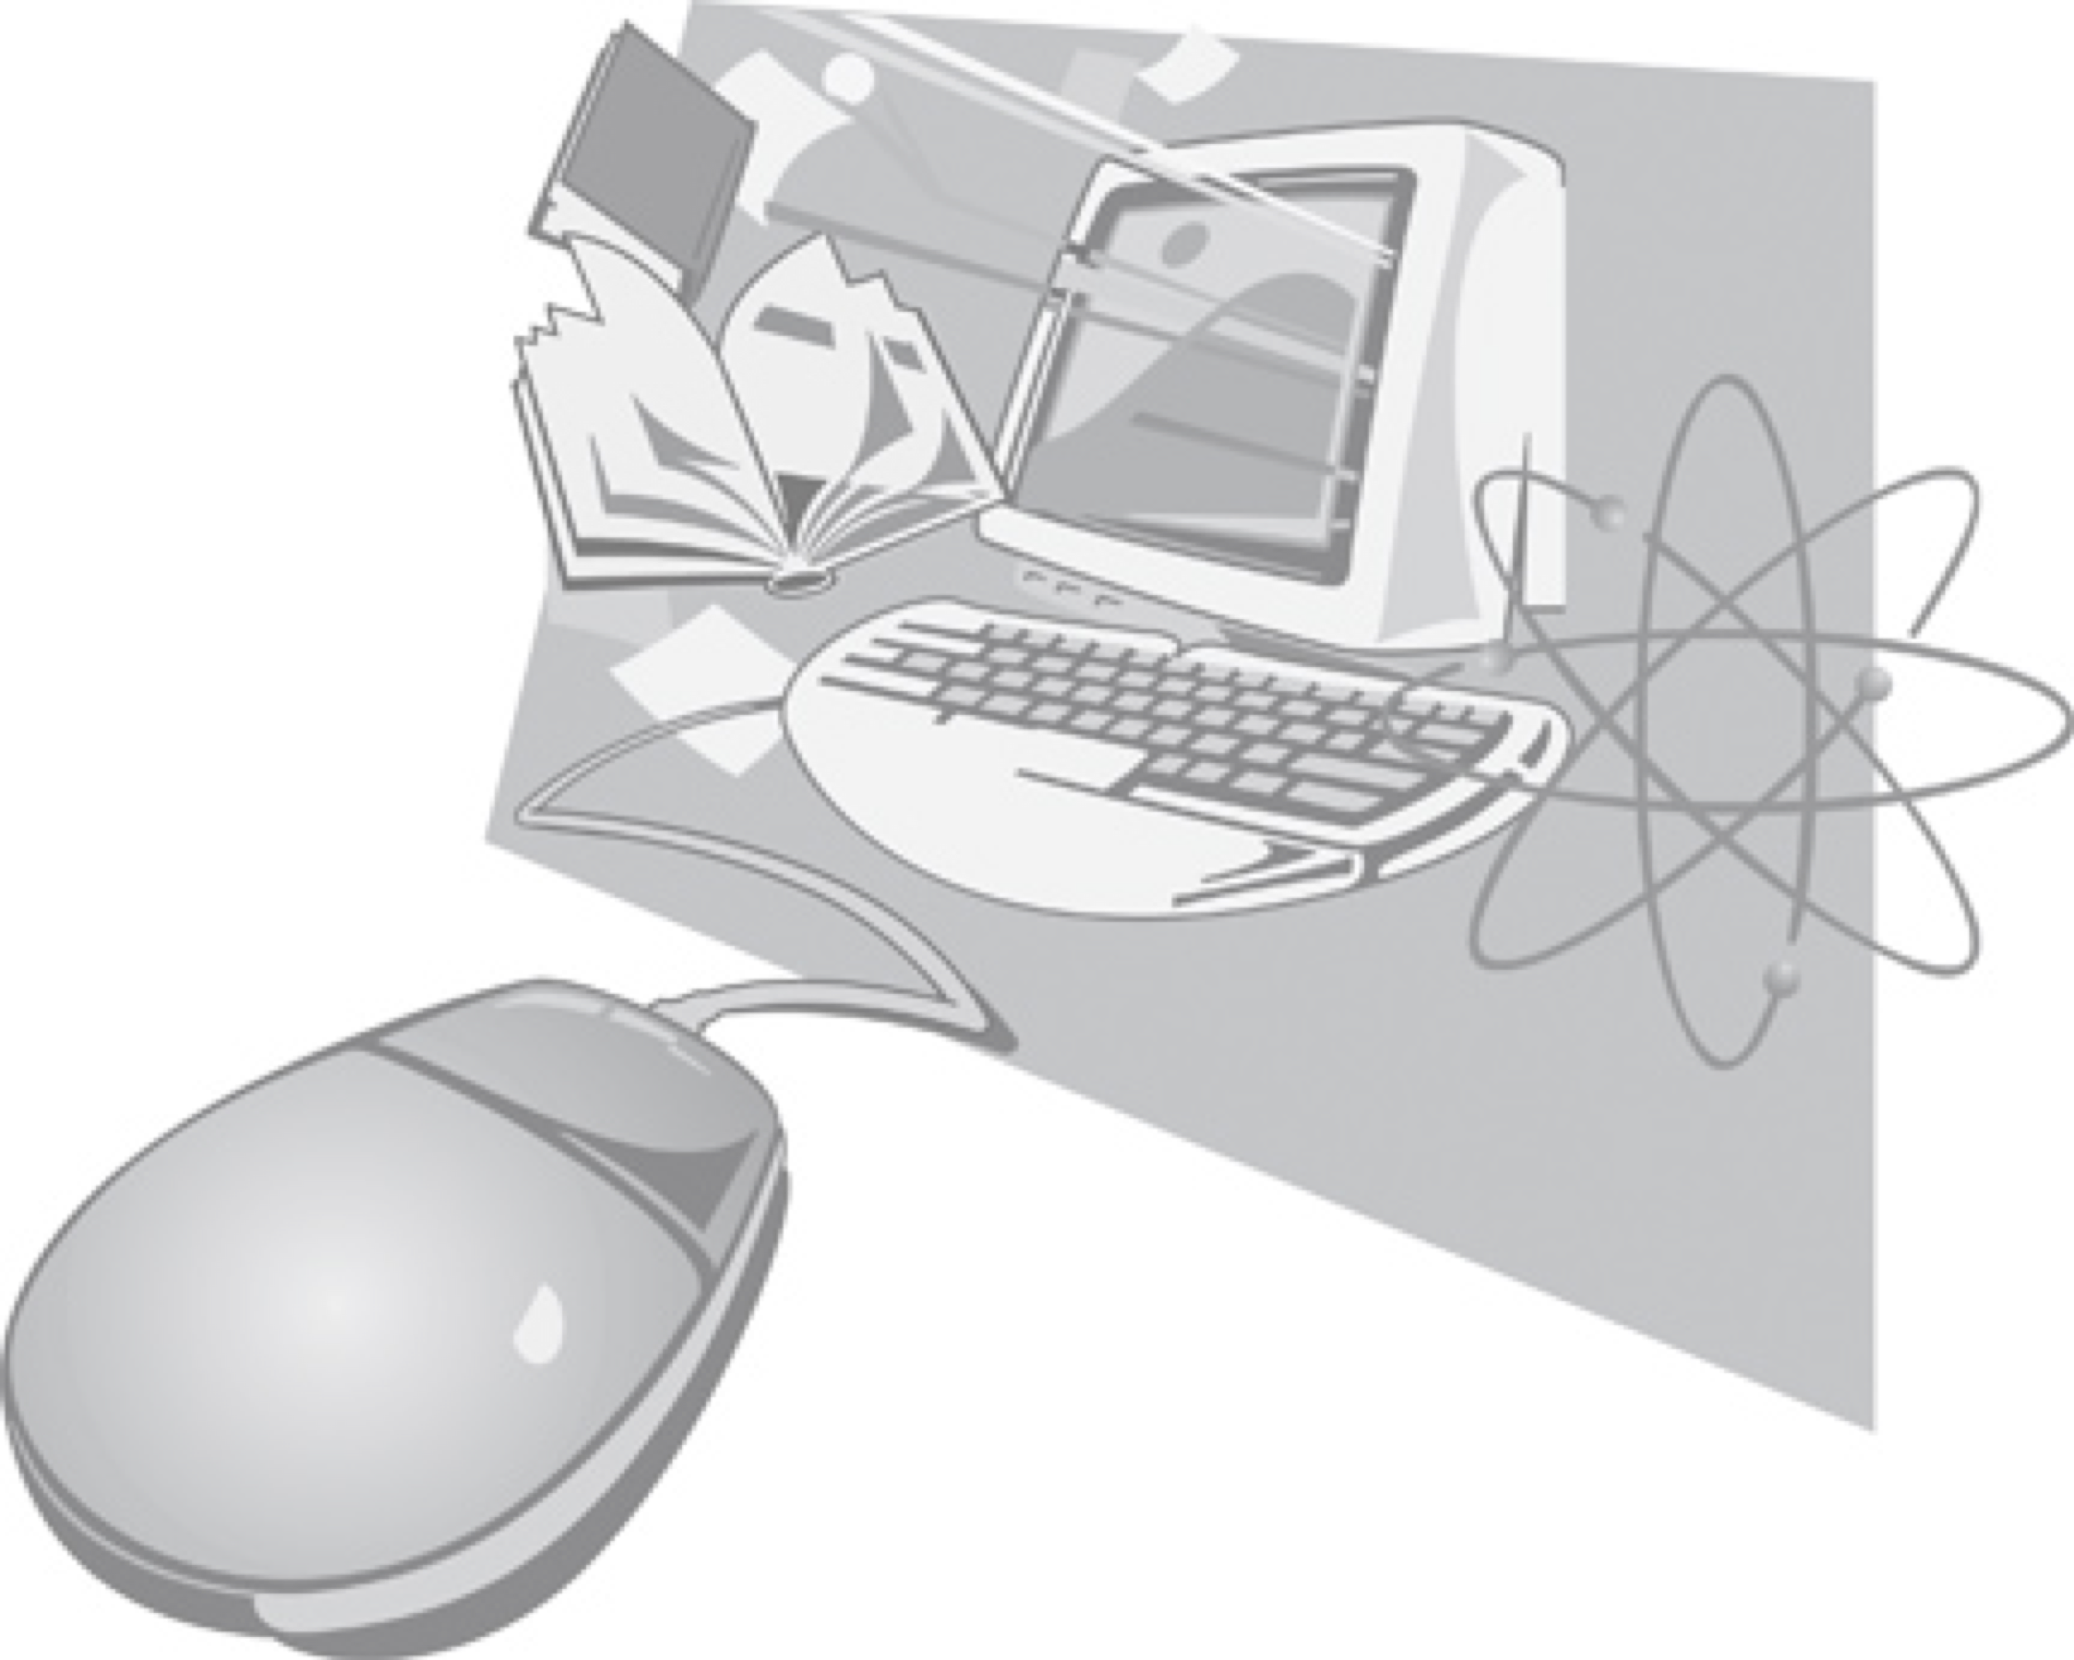
Compilation Databases
There are three major and two minor compilation databases at NNDC: NSR, EXFOR, XUNDL and B(E2)↑, ββ-decay.
In this presentation, we will concentrate on NSR and EXFOR databases:
Nuclear Science References (NSR): all low- and intermediate-energy references for a broad use, not just nuclear structure and decay as before 90ies.
Experimental Nuclear Reaction Data (EXFOR): all low- and intermediate-energy reaction data sets for neutron-, charged- and photo-induced reactions, not just neutron-induced as before 80ies.
The compilation scope and quality controls for NSR and EXFOR database have evolved over the many years of operation. These facts plus lack of advanced computer tools in the past are responsible for missing references and data sets.

Slide 3
NSR Compilations
Nuclear Science References compilation creates a foundation for nuclear structure, decay and reaction data efforts and impacts research activities.
FY 2018 NSR team: 1.5 NNDC (B. Pritychenko, J. Totans), 2 contractors (B. Singh, E. Betak) and 1 IAEA collaborator (V. Zerkin).
Our goal is provide the coverage for current publications; we are also proactively recovering previously missed references.
One of our major requirement is speed, prompt creation of entries and quality keywords for ENSDF: NSR is always up-to-date (it is updated 2-3 times a week).
NSR Quality Assurance: Manager + Users + Evaluators + Compilers inputs. We do not have a bug database, we just fix bugs immediately.
Direct communication with Phys. Rev. C: ~10% of authors submit keywords to NSR.

Slide 4
FY 2017 NSR Statistics
NSR References:
3,714 new article entries, total NSR: 229,594 (10 times bigger than EXFOR).
320 previously missed references were added.
275 modified (corrected) article entries.
1,911 keyworded article abstracts (September 30, 2018) => 2,021 (November 2, 2018), takes time to prepare the keywords.
NSR Dictionary updates:
2,185 new authors, total NSR: 100,653
19 new journals, total NSR: 538
233 new reactions, total NSR: 8,409
279 new nuclides, total NSR: 7,050
105 new decays, total NSR: 734
NSR Database updates: 135 in FY 2018.
NSR Web retrievals: 219,474, or 45 references/retrieval.
Total number of retrieved references was 10,028,327.

Slide 5
EXFOR Effort in the U.S. and Canada
EXFOR Team: B. Pritychenko, S. Hlavac, O. Schwerer and V. Zerkin (IAEA).
NNDC: Overall database and contracts management, website support, compilation and correction of missing and older references.
Bratislava: Mainly new references compilation.
Vienna: Overall quality assurance and transmission handling.
IAEA: Web and database software development.
Smooth operation based on efforts of BNL stuff, contractors and collaborators.
Contractors (S. Hlavac and O. Schwerer) are essential for the overall success of the NNDC EXFOR effort.

Slide 6
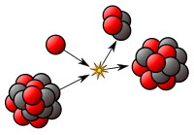
EXFOR Statistics
en.wikipedia.org
New entries: 43 + 87 (BNL) = 130.
Corrected entries: 158 + 53 (BNL) = 211.
24 Preliminary and 24 final data transmissions (Preliminary transmissions go through the NRDC network quality assurance system, after implemented corrections final transmission are loaded into the database).
EXFOR database was updated 24 times, and CINDA database was updated 10 times.
More compilation details in the IAEA system based on calendar years: http://www-nds.iaea.org/exfor-master/x4compil/.
Fission yields compilation pilot project was completed.

Slide 7
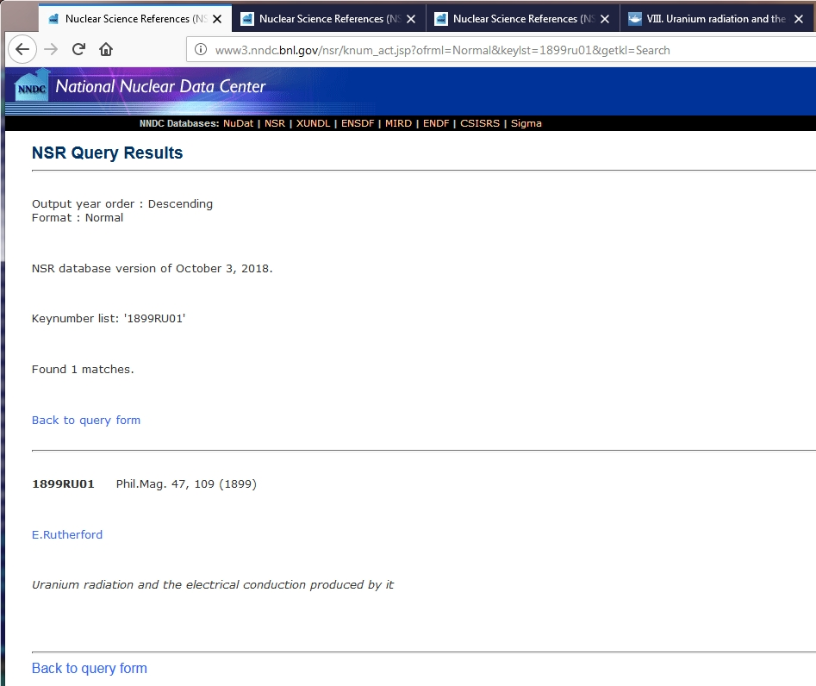
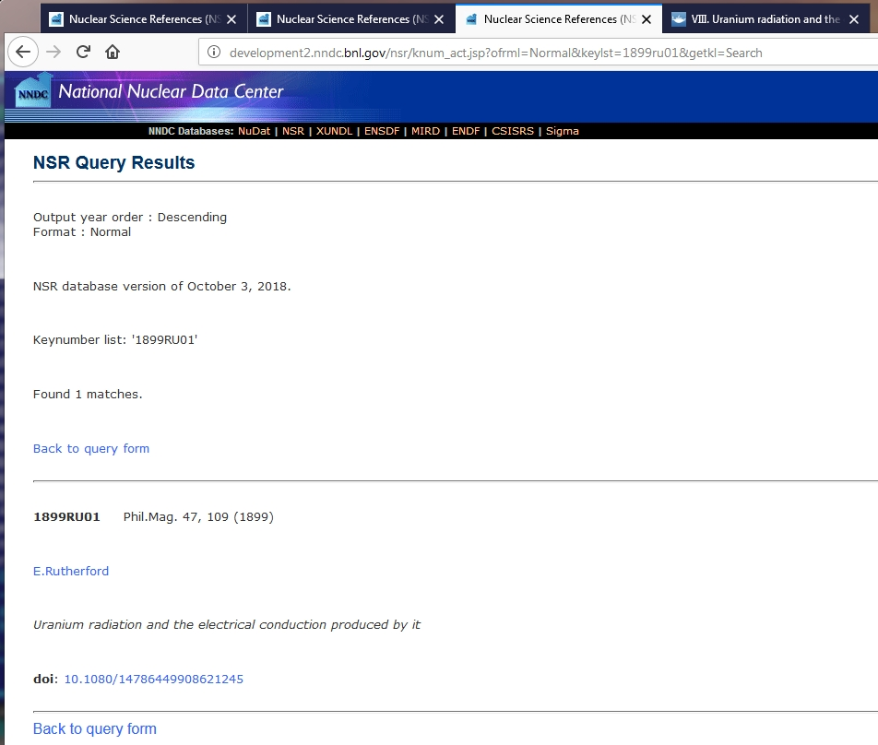
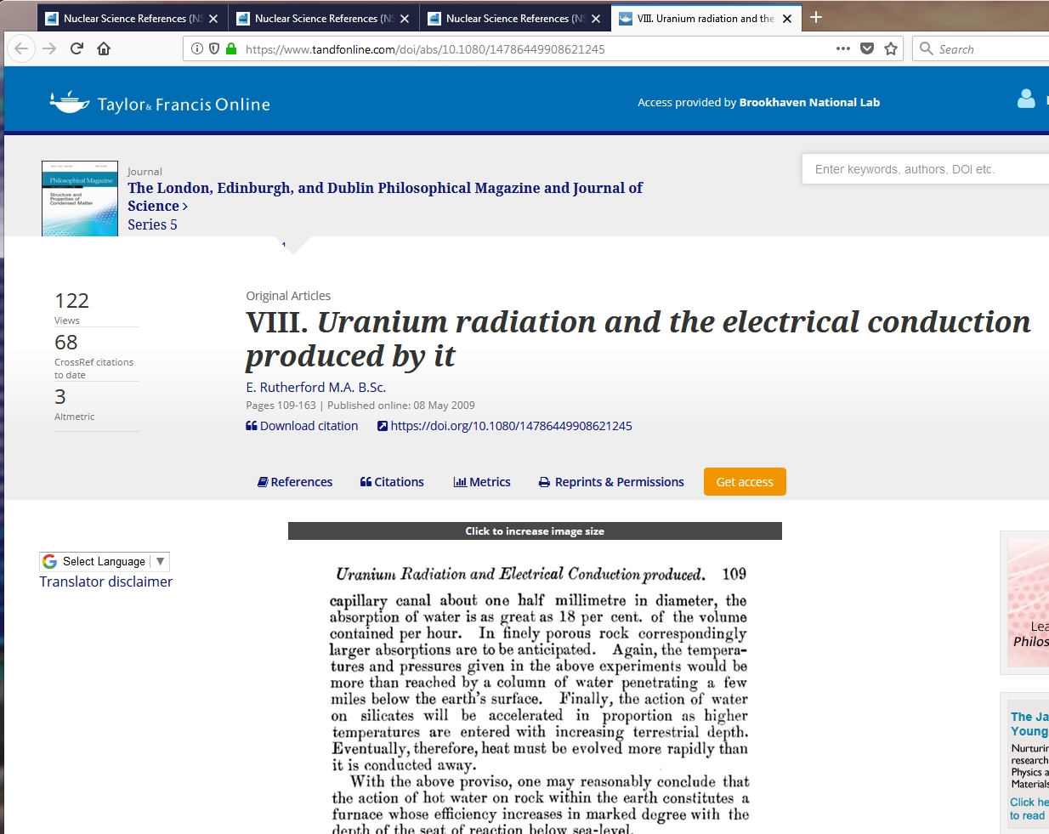
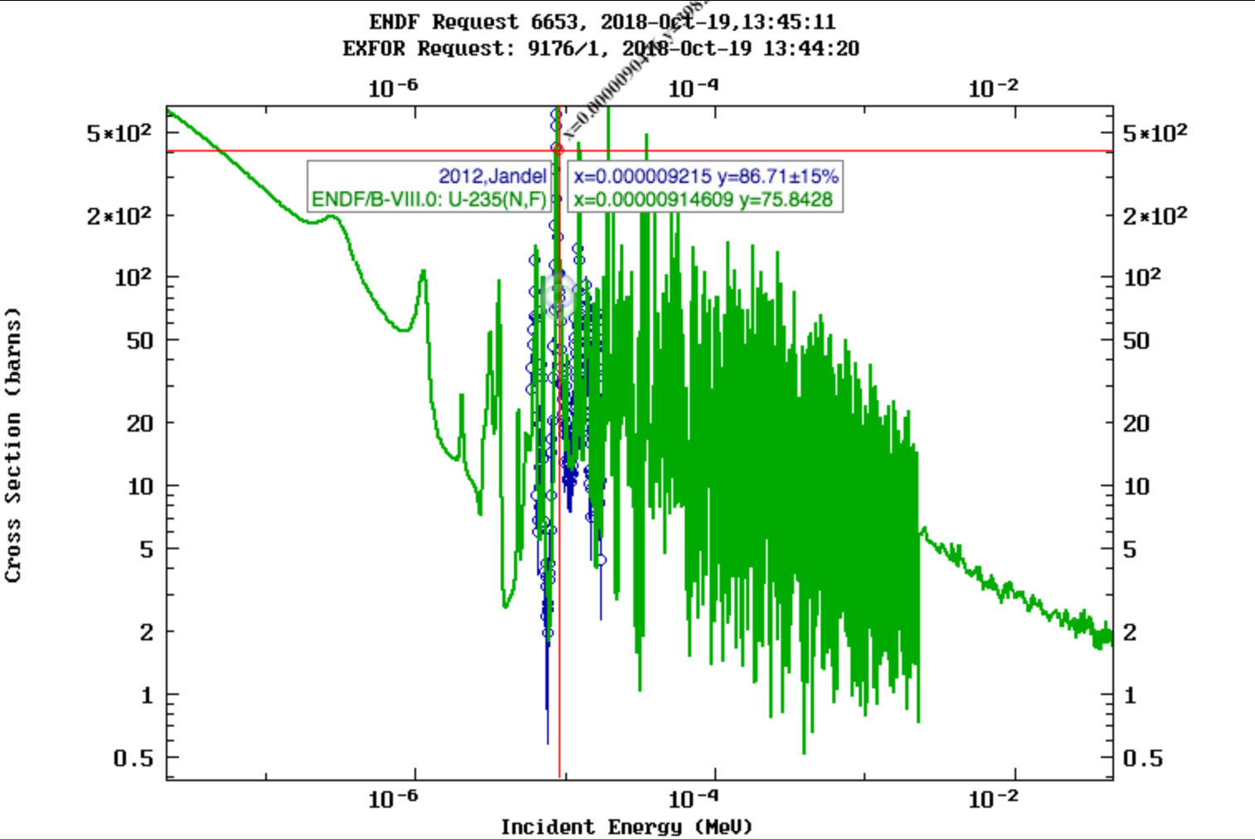
Computer & Software Upgrades
NSR/EXFOR data were transferred from MySQL to MariaDB database software.
Web, database and maintenance software were migrated to new servers. In fact, we tested the whole new system.
We are moving compilation process to Macintosh from Windows OS, and Mac environment works well.
We worked with Viktor Zerkin (IAEA) on doi links in NSR:
Number of doi links was increased from 128,292 to 145,146
NSR Web application was modified, it takes doi links from ref_tbl presently instead of exch_tbl
Finally, the latest version of EXFOR Web application was installed at NNDC.
Improved Zoom & Cursor functions

Slide 8
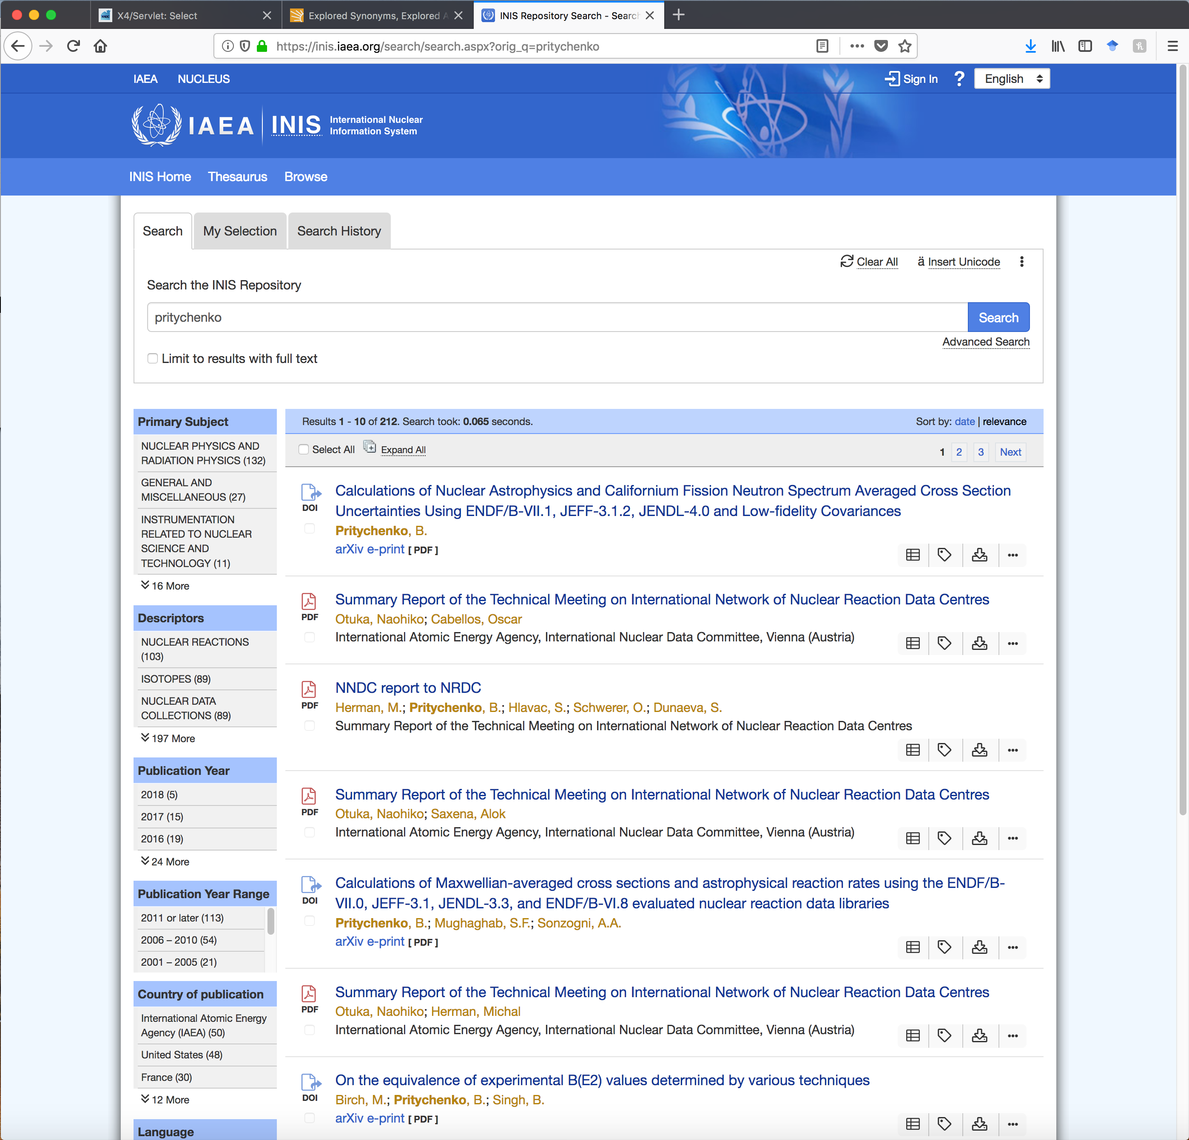
Compilation Developments
NSR/EXFOR compilation effort relies strongly on contractors: NSR (B.Singh, E.Betak), EXFOR (S. Hlavac, O. Schwerer)
It is an efficient and cost-effective way of doing business.
Dr. Balraj Singh is retiring from NSR keywording. I would like to acknowledge his large contributions to the NSR project, and now we are looking for USNDP volunteers to fill the void. We hope that Balraj would continue collaborate with NSR project as a user.
We also need an additional contractor for FY compilation; this person has been identified and we ready to proceed.
Related Development: Viktor Zerkin(IAEA) and I are now in contact with Dr. Zaven Hakopov (INIS Coordinator), and we hope to collaborate with INIS in order to provide almost complete PDF coverage for NSR/EXFOR databases.

Slide 9
Conclusions
NSR & EXFOR projects are in a good shape, and we collaborate with the IAEA on these projects.
We will continue compilation support for nuclear structure and reaction research, evaluations, and theory.
We add new and previously missing references & experiments to NSR & EXFOR databases.
Contractors are essential for the overall success of the NNDC compilation effort.
We are looking for volunteers among the USNDP community for NSR compilations.

Slide 10
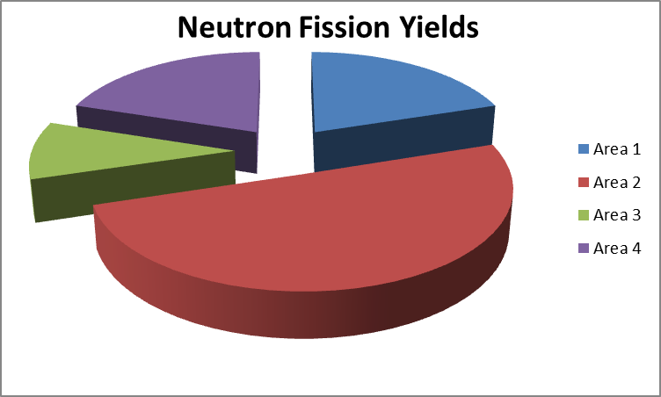
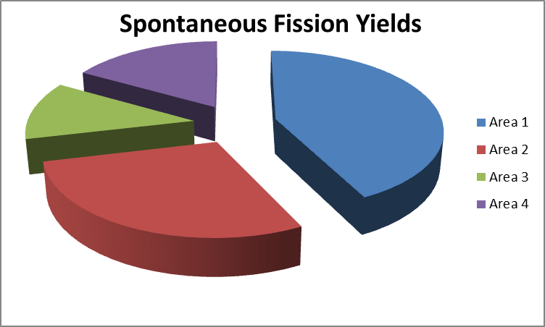
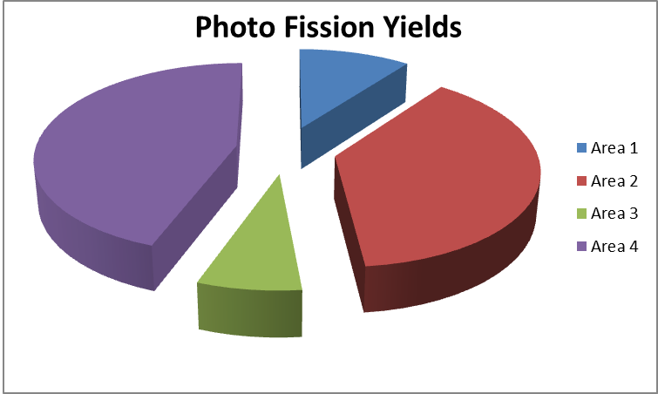
FY Compilation Completeness
Fission Yields (FY) are fundamental for many applications.
Do we have a complete FY record in EXFOR?
The completeness of EXFOR (22,294 experiments) was verified using the NSR database (229,594 references) by NNDC team (B. Pritychenko, O. Schwerer) with help of V. Zerkin (IAEA).
Nuclear structure-like search for FY NSR references was conducted at NNDC:
Potentially Missing Neutron FY: 384
Potentially Missing Spontaneous FY: 142
Potentially Missing Photo FY: 126
Non-uniform findings in the areas: #3 small (IAEA), #2 large (NEA)
Data were sorted by EXFOR areas, #1 is US and Canada, #2 Western Europe + Japan, … and verified by O. Schwerer.
This work would provide a foundation for a future BNL-LANL evaluation.

