Slide 1
USNDP Dissemination
Tim Johnson
National Nuclear Data Center

Slide 2
Dissemination Outline
New NNDC infrastructure
NNDC dissemination statistics
Other work
Challenges and opportunities

Slide 3
BNL Server Infrastructure Modernization
All servers and cluster moved to two new secure racks, $57K at no direct cost.
New power distribution units for clean, steady power ($30K), but shared with RHIC-ATLAS.
Five servers were bought to replace five servers from 2013 ($60K). Each new server:
PowerEdge R640, 20 core Intel Xeon, rack mounted (1U), 6 900 GB 15K RPM disks in RAID level 5 configuration. 4.5 TB disk space after formatting.
Web servers and new development server: 192 GB RAM
Database servers: 128 GB RAM
Four 2013 web servers are not retiring, but put in cluster. The other will be a quarantine server.

Slide 4
BNL Server Infrastructure Modernization
New ADVANCE server set up and running . PowerEdge 640. 24 cores. 2 480 GB solid state drives for OS and 6 900 GB hard disk drives for user space.
Gforge server from 2011 will be replaced soon.
Upgraded from Tomcat 6 to Tomcat 7 for the Java based web container, and from Java 7 to Java 8.
Upgraded from mysql 5.6 to MariaDB.

Slide 5
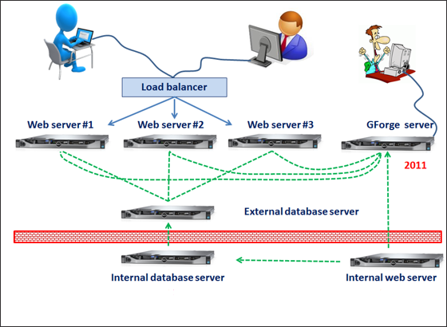
New BNL Server Layout

Slide 6
USNDP Web Retrieval Statistics
(2018 is preliminary)

Slide 7
Country Distribution

Slide 8
Web work
Continuing routine updates
Enhancements and fixes for vulnerability checks, ENSDF, NuDat, logft, Sigma, ENDF, EXFOR, and others.
Increased involvement in maintaining deployment scripts.

Slide 9
NNDC Dissemination Challenges & Opportunities
Maintain 99.9 % reliability.
Continue to identify and fend off hackers and cyber attacks.
Continue to pass cyber-security audits. An evolving target.
Update services, keep up with evolving technology.
Respond to user needs with enhancements and new applications. Includes more flexible search of nuclear properties, visualization, and mobile applications.

