Slide 1


LBNL/UCB Site Report
USNDP Meeting
8 November 2018
Lee Bernstein
Nuclear Science Division
Lawrence Berkeley National Laboratory
Department of Nuclear Engineering
University of California - Berkeley
Andrew S. Voyles
13 June 2018 – Program Review for NSSC2 – TA1
Notes:
Emerging trends for next-generation (targeted & personalized) nuclear medicine:
Targeted alpha therapy (5-10 MeV)
40-80 μm range → single cell
Targeted Auger therapy (20 eV – 1 keV)
1 nm – 2 μm → cellular nucleus
Theranostic medicine
Simultaneous imaging and therapy

Slide 2
FY18 Personnel & FTE Breakdown
Name | Position | USNDP Activity | USNDP fraction | Other support
L.A. Bernstein | Staff | Coord, Measure., (n,n’γ) | 75% | NA-22, UC, Isotopes
M.S. Basunia | Staff | ENSDF, XUNDL | 95% | Isotopes
A.M. Hurst | Staff (UC) | (n,γ), (n,n’γ) | 60% → 40% | NA-22
J.C. Batchelder | Staff (UC) | β-p evaluation, ENSDF | 75% | DOE-NE
A.S. Voyles | GS → PD | Reac. measure., comp. | 25% | NRC fellow, Isotopes
J. Morrell | GS | Reac. Measure. | 38% | Isotope Program
A. Lewis | GS | Reaction eval. (n,n’γ) | 0% | Rickover fellow
L. Kirsch | GS | Structure exp. | 0% | SSAA fellow
E.F. Matthews | GS | Fission modeling | 0% | NSSC fellow
I. Kolaja | UG | (n,n’γ) | 10% | UC
K. Song | UG | (n,n’γ) | 10%
R.B. Firestone | Ret. | (n,n’γ), (n,γ), RSF-CRP | 47%
E. Browne | Ret. | ENSDF | 33%
J. Tuli | Ret. | ENSDF | 47%
USNDP Fraction≈63%
(GS limited to 50%)

Slide 3
Structure Evaluation
Nuclides/Mass chain (submitted): total 20 nuclides
  A = 23 (8 nuclides) – Basunia and Chakraborty
  A = 82 (14 nuclides) – Tuli and Browne
  A=229 (nearly complete) - Tuli and Browne
  A=186 (nearly complete) – Batchelder, Hurst, Basunia
XUNDL:
  22 datasets from 17 papers (Basunia)
Mass chain review:
  A = 38 – Basunia
NSD Pipeline actions:
  A=59 – Basunia - Reviewer/Editor’s comments addressed (resubmitted July, 2018) and published.
  A = 170 – Browne, Basunia – some of the Reviewer/Editor’s comments addressed/fixed – (resubmitted Jan, 2018).

Slide 4
Publications (17) (#6 on hidden)
2018Ba32: Nucl. Data Sheets 151, 1 (2018) M.S. Basunia Nuclear Data Sheets for A=59 doi: 10.1016/j.nds.2018.08.001
2018Ba33: Nucl. Data Sheets 151, 334 (2018) C.M. Baglin, E.A.McCutchan Nuclear Data Sheets for A=171 doi: 10.1016/j.nds.2018.08.002
2018Vo05: Nucl.Instrum.Methods Phys.Res. B429, 53 (2018) A.S.Voyles, L.A.Bernstein, E.R.Birnbaum, J.W.Engle, S.A.Graves, T.Kawano, A.M.Lewis, F.M.Nortier Excitation functions for (p,x) reactions of niobium in the energy range of Ep=40-90 MeV https://doi.org/10.1016/J.NIMB.2018.05.028
2018Jo01: Phys. Rev. C 97, 024327 (2018) M.D.Jones, A.O.Macchiavelli, M.Wiedeking, L.A.Bernstein, et al., Examination of the low-energy enhancement of the gamma-ray strength function of 56Fe https://doi.org/10.1103/PhysRevC.97.024327
2018Br05: Nucl.Data Sheets 148, 1 (2018) D.A.Brown, M.B.Chadwick, R.Capote, A.C.Kahler, A.Trkov, M.W.Herman, A.A.Sonzogni, Y.Danon, A.D.Carlson, M.Dunn, D.L.Smith, G.M.Hale, G.Arbanas, R.Arcilla, C.R.Bates, B.Beck, B.Becker, F.Brown, R.J.Casperson, J.Conlin, D.E.Cullen, M.-A.Descalle, R.Firestone, et al., ENDF/B-VIII.0: The 8th Major Release of the Nuclear Reaction Data Library with CIELO-project Cross Sections, New Standards and Thermal Scattering Data.

Slide 5
Publications (17) (continued)
2018Mi03: Phys.Rev. C 97, 054317 (2018) K.Miernik, K.P.Rykaczewski, R.Grzywacz, C.J.Gross, M.Madurga, D.Miller, D.W.Stracener, J.C.Batchelder, N.T.Brewer, A.Korgul, C.Mazzocchi, A.J.Mendez, Y.Liu, S.V.Paulauskas, J.A.Winger, M.Wolinska-Cichocka, E.F.Zganjar beta-delayed neutron emission from 85Ga. http://10.1103/PhysRevC.97.054317
2018Tr07: Phys.Rev. C 98, 034309 (2018) J.L.Tracy, J.A.Winger, B.C.Rasco, U.Silwal, D.P.Siwakoti, K.P.Rykaczewski, R.Grzywacz, J.C.Batchelder, C.R.Bingham, N.T.Brewer, L.Cartegni, A.A.Ciemny, A.Fijalkowska, C.J.Gross, C.Jost, M.Karny, K.Kolos, A.Korgul, W.Krolas, Y.Liu, M.Madurga, C.Mazzocchi, A.J.Mendez, K.Miernik, D.Miller, S.Padgett, S.V.Paulauskas, D.W.Stracener, M.Wolinska-Cichocka, M.M.Rajabali, E.F.Zganjar Updated beta-decay measurement of neutron-rich 74Cu. http://10.1103/PhysRevC.98.034309
“The 88-Inch Cyclotron: A one-stop facility for electronics radiation and detector testing”. M.Kireeff-Covo, R.A.Albright, B.F.Ninemire, M.B.Johnson, A.Hodgkinson, T.Loew, J.Y.Benitez, D.S.Todd, D.Z.Xie, T.Perry, L.Phair, L.A.Bernstein, J.Bevins, J.A.Brown, B.L.Goldblum, M.Harasty, K.P.Harrig, T.A.Laplace, S.B.Cronin. Measurement, Vol. 127, October 2018, Pages 580-587. https://doi.org/10.1016/j.measurement.2017.10.018.
“Proton

Slide 6
Publications (17) (continued)
“Proton light yield in organic scintillators using a double time-of-flight technique”. J. A. Brown, B. L. Goldblum, T. A. Laplace, K. P. Harrig, L. A. Bernstein, D. L. Bleuel, W. Younes, D. Reyna, E. Brubaker, and P. Marleau. J. Applied Physics 124, 045101 (2018). https://doi.org/10.1063/1.5039632
“Design, construction, and characterization of a compact DD neutron generator designed for ⁴⁰Ar/³⁹Ar geochronology”. Mauricio Ayllon, Parker A. Adams, Joseph D. Bauer, Jon C. Batchelder, Tim A. Becker, Lee A. Bernstein, Su-Ann Chong, Jay James, Leo E. Kirsch, Ka-Ngo Leung, Eric F. Matthews, Jonathan T. Morrell, Paul R. Renne, Andrew M. Rogers, Daniel Rutte, Andrew S. Voyles, Karl Van Bibber, Cory S. Waltz. Nucl. Instrum. Methods in Physics Research A 903, 21 September 2018, p. 193-203 ht tps://doi.org/10.1016/j.nima.2018.04.020.
“RAINIER: A Simulation Tool for Distributions of Excited Nuclear States and Cascade Fluctuations”. L.E. Kirsch, L.A. Bernstein. Nucl. Instrum. Methods A 892, Pages 30–40. 1 June 2018. https://doi.org/10.1016/j.nima.2018.02.096,
“FIER: Software for analytical modeling of delayed gamma-ray spectra”, E.F.Matthews, B.L.Goldblum, L.A.Bernstein, B..J. Quiter, J.A.Brown, W.Younes, J.T.Burke, S.W.Padgett, J.J.Ressler, A.P.Tonchev. Nucl. Instrum. Methods A891, Pages 111-117. 21 May 2018. https://doi.org/10.1016/j.nima.2018.02.072

Slide 7
Publications (17) (continued)
“Neutron Spectroscopy for pulsed beams with frame overlap using a double time-of-flight technique”. K.P. Harrig, B.L. Goldblum, J.A. Brown, D.L. Bleuel, L.A. Bernstein, J. Bevins, M. Harasty, T.A. Laplace, E.F.Matthews. Nuclear Inst. and Methods in Physics, A 877 359–366 (2018). https://doi.org/10.1016/j.nima.2017.09.051
“Dynamic high energy density plasma environments at the National Ignition Facility for nuclear science research”. Charles Cerjan, Lee Bernstein, et al.,. J. Phys. G: Nucl. Part. Phys. 45 033003 (111pp) (2018) https://doi.org/10.1088/1361-6471/aa8693
“Extraordinary Biomass-Burning Episode and Impact Winter Triggered by the Younger Dryas Cosmic Impact ∼12,800 Years Ago. 1. Ice Cores and Glaciers”, Wendy S. Wolbach, Joanne P. Ballard, Paul A. Mayewski, Victor Adedeji, Ted E. Bunch, Richard B. Firestone, et al., J.of Geology 126, p. 165–184 (2018)
“Extraordinary Biomass-Burning Episode and Impact Winter Triggered by the Younger Dryas Cosmic Impact ∼12,800 Years Ago. 2. Lake, Marine, and Terrestrial Sediments”, Wendy S. Wolbach, Joanne P. Ballard, Paul A. Mayewski, Andrew C. Parnell, Niamh Cahill, Victor Adedeji, Ted E. Bunch, Gabriela Domínguez-Vázquez, Jon M. Erlandson, Richard B. Firestone, et al., J. of Geology 126, p. 185–205 (2018).
“Impact-related microspherules in Late Pleistocene Alaskan and Yukon “muck” deposits signify recurrent episodes of catastrophic emplacement”, J.T. Hagstrum, R.B. Firestone, A. West, J.C. Weaver and T. E. Bunch, Scientific Reports 7, 16620 (2018).

Slide 8
Submitted Publications (14)
"Possible Evidence of non-statistical properties in the ³⁵Cl(n,p)³⁵S cross section", J. C. Batchelder, S.-A. Chong, J. Morrell, M. Unzueta, P. Adams, J. D.Bauer, T. Bailey, T. A. Becker, L. A. Bernstein, M. Fratoni, A. M. Hurst, et al., submitted to Phys Rev C
"Recommended Values for Beta-Delayed Proton and Alpha Emission"
J. C. Batchelder, submitted to Atomic Data and Nuclear Data Tables
A.M. Hurst, A. Sweet, B.L. Goldblum, R.B. Firestone, M.S. Basunia, L.A. Bernstein, et al.,, “Radiative-capture cross sections for the ¹³⁹La(n,γ) reaction using thermal neutrons and structural properties of ¹⁴⁰La”, arXiv:1810.11565v1 [nucl-ex]; https://arxiv.org/abs/1810.11565
A.M. Hurst and L. A. Bernstein, “Capture and inelastic gamma data for reaction libraries”, Proceedings to INMM 2018 (in press); https://www.inmm.org/INMM-Resources/Proceedings-Presentations/Annual-Meeting-Proceedings.aspx

Slide 9
Invited Talks (9)
“Reaction Cross Sections from Berkeley to Baghdad and the New Nuclear Data FOAs/NDREW” – Nuclear Structure 2018, Lee Bernstein, MSU, East Lansing MI August 10, 2018.
“Workshop Summary”, Lee Bernstein, 14th Nordic Meeting on Nuclear Physics, Longyearbyen, Svalbard, Norway, 22-25 May 2018.
“Deconvolution of the Photon Strength Function, R.B. Firestone, 6th International Workshop on Compound-Nuclear Reactions and Related Topics (CNR*18), 24-28 September 2018, LBNL, Berkeley CA.
“Deconvolution of the Photon Strength Function, R.B. Firestone, 14th Nordic Meeting on Nuclear Physics, May 22, 2018 - May 25, 2018, Longyearbyen.
“Database of Experimental Photon Strengths”, Richard B. Firestone, Database of Experimental, 2nd Research Coordination Meeting (RCM) of the CRP on Updating the Photonuclear Data Library and Generating a Reference Database for Photon Strength Functions, 16-20 October 2017, IAEA, Vienna.
“Capture and inelastic gamma data for reaction libraries”, A.M. Hurst, Institute for Nuclear Materials Management (INMM) Annual Meeting, Baltimore, MD, USA, July 22 – 26, 2018.
“Nuclear Data Needs & Capabilities for Active Interrogation”, L.A. Bernstein, Institute for Nuclear Materials Management (INMM) Annual Meeting, Baltimore, MD, USA, July 22 – 26, 2018.
“Gamma-ray data for nonproliferation”, A.M. Hurst, Nuclear Science and Security Consortium NPP/ND Review (NA-22), Lawrence Berkeley National Laboratory, Berkeley, CA, USA, June 13 – 14, 2018.
“The HPNSRL Website and the Baghdad Atlas”, A.M. Hurst, CRP: Nuclear Data Portal Web Tools, IAEA Headquarters, Vienna, Austria, July 30 – August 1, 2018.

Slide 10
Coordination/Community Service (8)
Committee/conference/workshop leadership activities:
6th Compound Nuclear Reactions Workshop – September 22-27, 2018, Berkeley CA – Co-organizer. - Lee Bernstein – Member of the Organizing Committee
Nuclear Data Roadmapping Enhancement Workshop (NDREW) – January 19-22, 2018, Washington, DC – L.A. Bernstein - Co-organizer and Session Leader.
Nuclear Data Portal Web Tools, IAEA Headquarters, Vienna, Austria, July 30 – August 1, 2018: CRP Chairman - A.M. Hurst
Nuclear Data Roadmapping Enhancement Workshop (NDREW), UCDC Center, Washington DC, USA, January 19-22, 2018 – Rapporteur- A.M. Hurst
Scientific Review Panel Member– R.B. Firestone
Discovery Science Technical Review Committee (TRC) Meeting, November 14 - 16, 2017, National Ignition Facility (NIF) LLNL.
Dissertations (as Principal Advisor): Lee A. Bernstein
“Nuclear Excitation Functions for Production of Novel Medical Radionuclides" - Andrew Stephen Voyles - May 2018.
"Gamma Strength from Quasi-Continuum Lifetimes using ⁵⁶Fe(p,p')" - Leo Edward Kirsch - December 2017.
Website development: A. M. Hurst
“Nuclear Structure Experimental Issues”, formerly known as the “High-Priority Nuclear Structure Request List”: http://nucleardata.berkeley.edu/hpnsrl/

Slide 11
Recent research proposal awards
Nuclear Data Interagency Working Group | Funding | Funding Period
²³⁸U(p,xn) & ²³⁵U(d,xn) ²³⁵⁻²³⁷Np Nuclear Reaction Cross Sections Relevant to the Production of ^{236g}Np (Lead PI: M. Fassbender) (IP) | $225k ($75k/yr) | 6/18-5/21
Improving the double-differential ²³⁸U(n,n’γ) cross section using neutron-gamma coincidences (NE+NP) | $600k ($200k/yr) | 11/18-10/21
Energy Dependent Fission Product Yields (NA-22) (Lead PI: A. Tonchev) | $600k ($200k/yr) | 11/18-10/21
DOE - Isotope Program | Funding | Funding Period
Positron-emitting analogs of ²²⁵Ac (Lead PI: J. Engle) | $110k | 10/16-918
Simultaneous Radionuclide Prod. using (d,2n) and Secondary (n,p) Reactions | $382k | 6/18-5/20
Measurement of charged particle-induced nuclear reaction cross sections important to the Isotope Program at LBNL, LANL, & BNL (Joint Program) | $380k* | 10/18-9/18*
Several other proposals still pending review
*renewable up to 3 more years

Slide 12
Planning/Future
DOE wants an annual Workshop on Applied Nuclear Data Activities (WANDA) in Washington DC
  Lots of outreach and planning
  About $12-$15k + personnel time since the workshop is held in DC
Measurements activities:
  GSs, Postdocs will lead the new experimental activities.
  We need to two (2) new postdocs. Suggestions appreciated
  Significant time will be required from Bernstein, Batchelder
We are looking for students for structure evaluation
  One candidate identified (K. Song) through work on the Baghdad Atlas
  More are welcome (US citizens are easier to fund)

Slide 13
Nuclear Structure Experimental Issues Website (NSEIW)
L.A. Bernstein
(for A.M. Hurst)
Department of Nuclear Engineering
University of California - Berkeley
Andrew S. Voyles
13 June 2018 – Program Review for NSSC2 – TA1
Notes:
Emerging trends for next-generation (targeted & personalized) nuclear medicine:
Targeted alpha therapy (5-10 MeV)
40-80 μm range → single cell
Targeted Auger therapy (20 eV – 1 keV)
1 nm – 2 μm → cellular nucleus
Theranostic medicine
Simultaneous imaging and therapy

Slide 14
The Nuclear Structure Experimental Issues Website (A.M. Hurst)
Formerly known as the High-Priority Nuclear Structure Request List
22nd Technical Meeting of the NSDD Network held at LBNL in Berkeley, California, USA, from May 22-26, 2017
Action #28: Experimental Activities Subcommittee; Create website of high-priority nuclear structure and decay-data measurements for information and guidance
Problem: Platform needed for users of nuclear structure data to raise issues and request improved data (A-chain & nuclides)
Who: Evaluated Nuclear Structure Data File (ENSDF) nuclear data evaluators; nuclear structure; nuclear reactions
Solution: Interactive website developed and hosted at UC Berkeley
  http://nucleardata.berkeley.edu/hpnsrl
Notes:
Emphasis on the last sentence

Slide 15
Objective of the NSEIW*
Purpose of NSEIW is to provide mechanism for nuclear data evaluators and the low-energy community, in general, to raise awareness of issues in nuclear structure data
Users can enter a brief description of the issue they want to raise
Requests will be moderated and assigned to experts
Follow-up for requests is required!
A committee working under the auspices of the NSDD Network of the IAEA will make researchers in the ﬁeld who might be interested in helping to resolve the problem aware of the issue
Initial committee co-chairs: Dr. Alexandru Negret <alnegret@tandem.nipne.ro> and Dr. Lee Bernstein <labernstein@lbl.gov>
Thanks to Libby McCutchan for suggesting the idea at the 22nd NSDD meeting!
Notes:
Emphasis on the last sentence

Slide 16
Using the website
First time users: contact committee co-chairs for user credentials and password
New experimental request: “Add a request” on homepage Fill out form (mandatory ﬁelds)Nucleus of interest; subject line; concise description of problem; suggestions for reconciliation
Attachments can be uploaded: pdf, doc, txt, jpeg, jpg, gif, png; MAX FILE SIZE == 2 Mb
Send message ⇒ email sent to moderator and new experimental request will be posted
Committee co-chairs will raise issue and try to assign task
Notes:
Emphasis on the last sentence

Slide 17
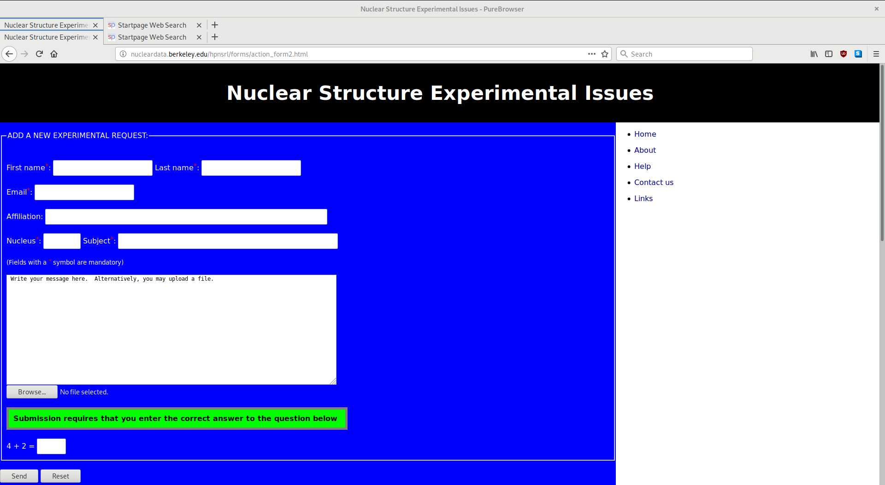
Request Page
Notes:
Emphasis on the last sentence

Slide 18
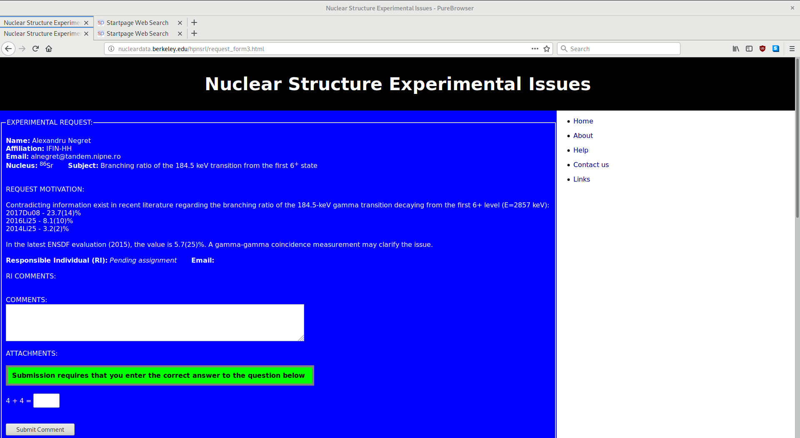
Existing Request Page: ⁸⁶Sr
  “Hopefully someone will have the time, interest and support to address this problem”
Notes:
Emphasis on the last sentence

Slide 19
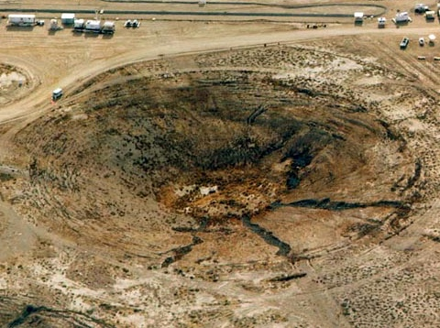
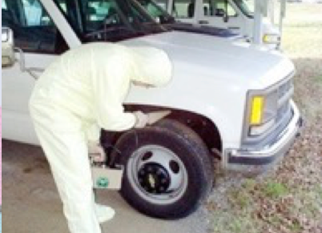
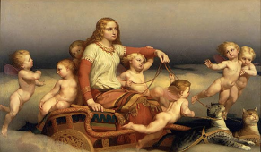
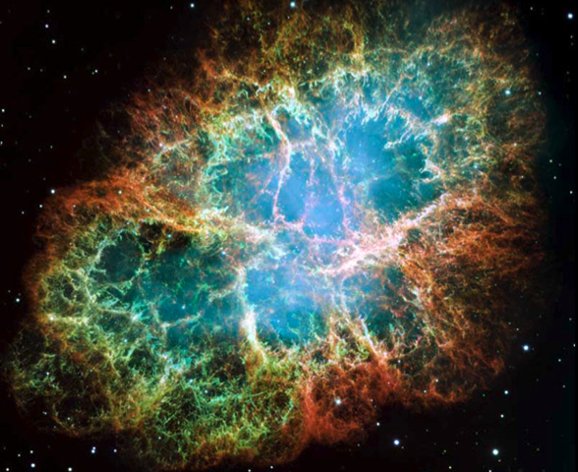
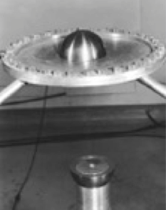

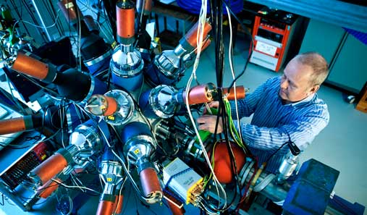
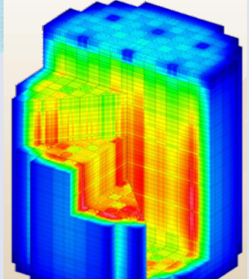
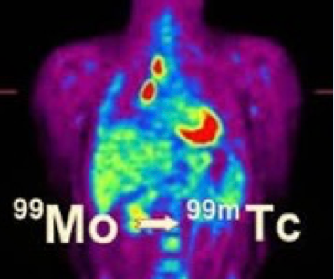
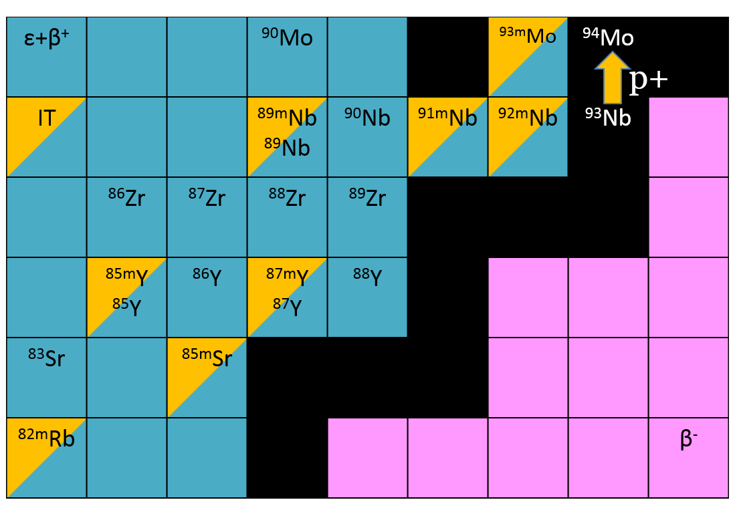
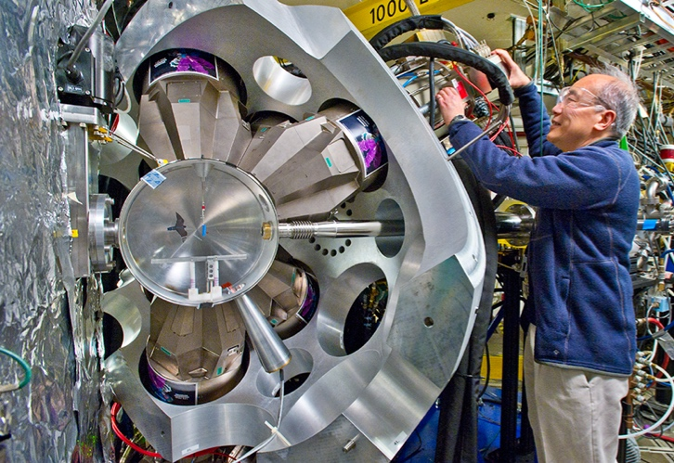
The LBNL/UC Nuclear Data Group is working to address nuclear data needs across much of nuclear science
FIER & FREYA codes (Matthews)
FREYA event generator (Jackson/Vogt)
Stewardship Science
Nonproliferation
Astrophysics
Radiative Strength Database
(Firestone)
Criticality
Baghdad Atlas (Hurst, Song)
Nuclear Data
Nb,La(p,x)
(Voyles, Morrell)
³⁵Cl(n,p)
(Batchelder)
Isotope Program
Energy
ENSDF XUNDL
(Basunia, Hurst, Batchelder, Tuli, and Browne)
Nuclear Science
HFNG
Notes:
Emphasis on the last sentence

