Slide 1
New/Updated ENSDF codes
Jun Chen
2018 USNDP Data Week

Slide 2
Code developments at MSU in FY18
Java-RULER
written in Java with all functions as in the old Fortran version
Solve issues with error propagations of large and asymmetric uncertainties
KeynumberCheck
Check all NSR keynumbers in datasets for format errors, irrelevant or nonexistent keynumbers (mostly due to mistyping)
Excel2ENSDF
A Java version of the Python codes xls2ens and ens2xls combined, with easier usage
Convert a tabulated Excel table to an ENSDF file, and vice versa
Also useful for multiplying a factor or adding a constant (or both) to all values of a record in an ENSDF file, e.g., adding S(n) to E(n)
ConsistencyCheck
Check data consistency among datasets, e.g., JPI, MULT, XREF, T1/2, etc.
Group levels and gammas to assist in preparing Adopted dataset
Average EG, RI, T1/2 and generate averaging comments in ENSDF
Other functions: setting up evaluation folders, sorting, merging/splitting datasets, etc.

Slide 3
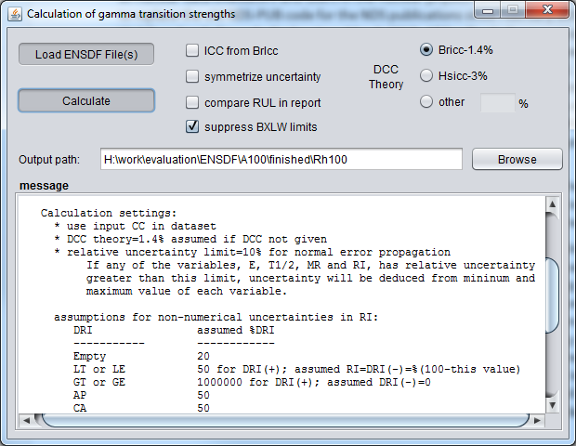
Java-RULER
Questions on proper error propagation of large/asymmetric uncertainties (e.g., in T_{1/2} and mixing ratio)

Slide 4
Java-RULER: some assumptions
Assumptions for non-numerical uncertainties in RI:
∆RI assumed %∆RI
----------- ------------
Empty 20
LT or LE 50 for ∆RI(+); assumed RI=∆RI(-)=%(100-this value)
GT or GE 1000000 for ∆RI(+); assumed ∆RI(-)=0
AP, CA, SY 50
(same for MR and CC except for empty DCC where theory DCC assumed)
Proposed rule for choosing methods of error propagations
all relative uncertainties <=10% normal error propagation
any relative uncertainty >10% use minimum and maximum
(ANY of the variables: Eg, T1/2, MR, RI, ICC)
normal error propagation for $f\left(x,y\right)$, with $x$ and $y$ independent:
$${\left(\frac{Δf}{f}\right)}^{2}≈{\left(\frac{Δx}{x}\right)}^{2}+{\left(\frac{Δy}{y}\right)}^{2}$$
valid only if $\frac{Δx}{x}$ and $\frac{Δy}{y}$ are small enough

Slide 5
Java-RULER: calculation reports
two approaches for uncertainties

Slide 6
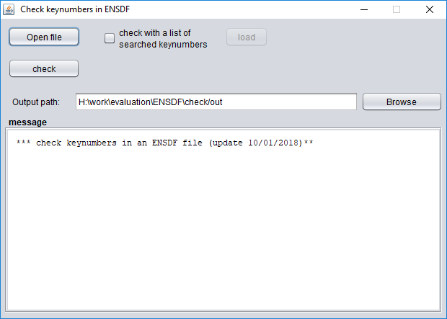
KeynumberCheck
By default, the program will search in the online NSR database for all keynumbers (this could take a while for a large mass-chain file)
Alternatively, a list of known keynumbers can be loaded to be checked against

Slide 7
KeynumberCheck: error reports

Slide 8
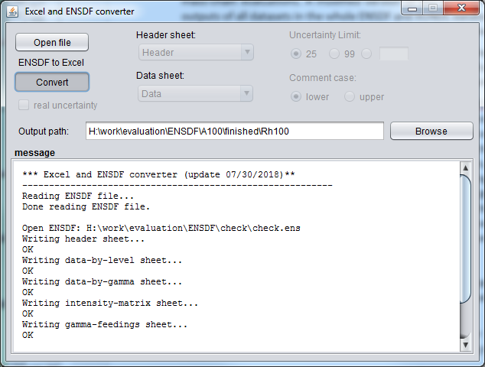
Obtain tabulated data in Excel from ENSDF
Excel2ENSDF: conversion between an ENSDF file and an Excel file
ENSDF to Excel

Slide 9
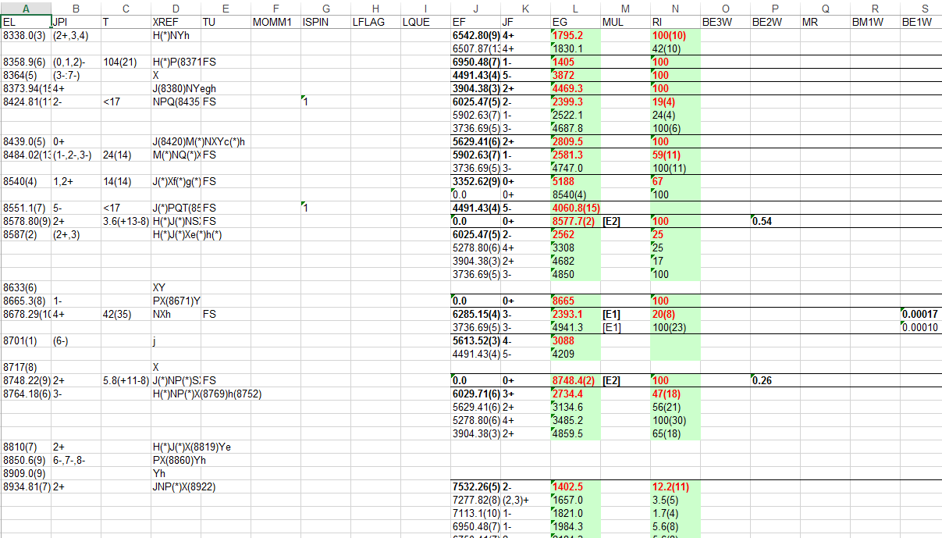
Obtain tabulated data in Excel from ENSDF
Level&Gamma data sheet

Slide 10
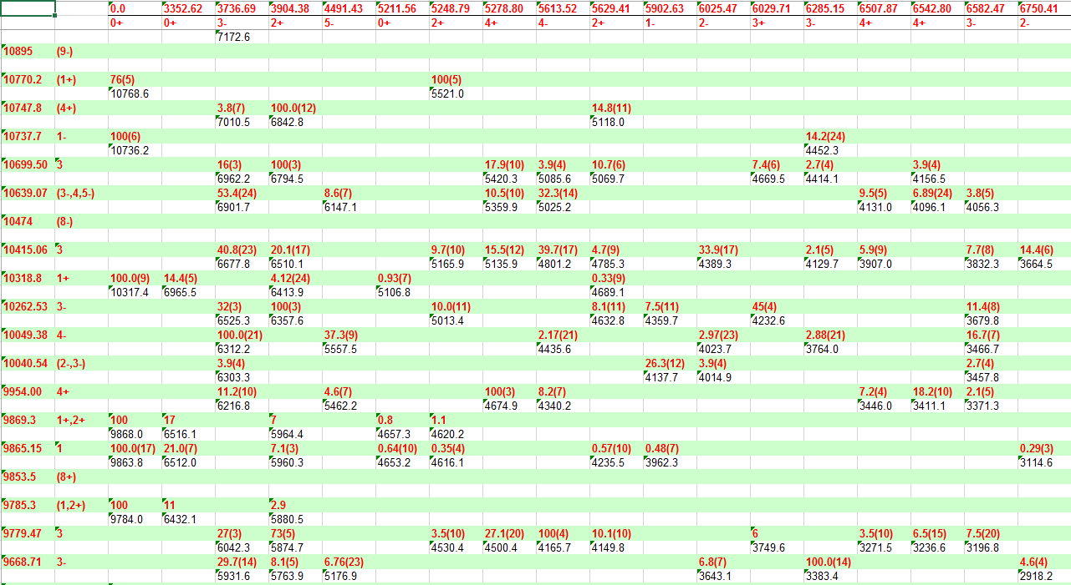
Obtain tabulated data in Excel from ENSDF
Branching matrix sheet
ELI
ELF
Branching
E(gamma)

Slide 11
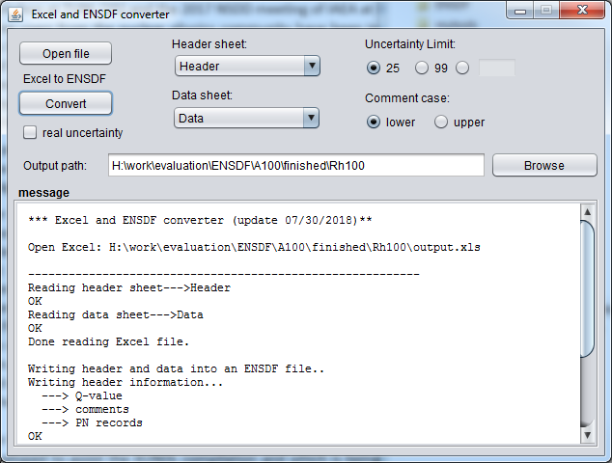
Convert tabulated data in Excel to ENSDF
Excel2ENSDF: conversion between an ENSDF file and an Excel file
Excel to ENSDF

Slide 12
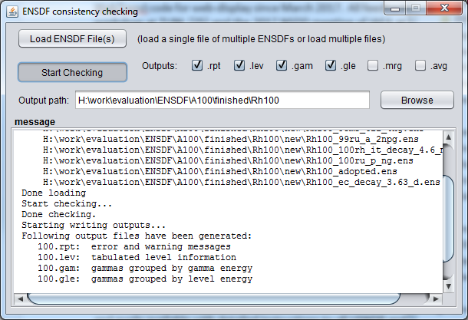
ConsistencyCheck
check data consistency among ENSDF datasets, group levels and gammas, and average values from different datasets

Slide 13
ConsistencyCheck: output files
The usage is simple:
load an ENSDF file containing all datasets to be checked
or
load multiple single-dataset files at one time
(drag and release files into the message window to load files)
Output files: (e.g., for A=73)
73.err: error reports
73.wrn: warning reports
73.lev: tabulated level information
73.gam: gammas grouped by gamma energy
73.gle: gammas grouped by level energy
73.mrg: grouped lines of all datasets
73.avg: average results of records

Slide 14
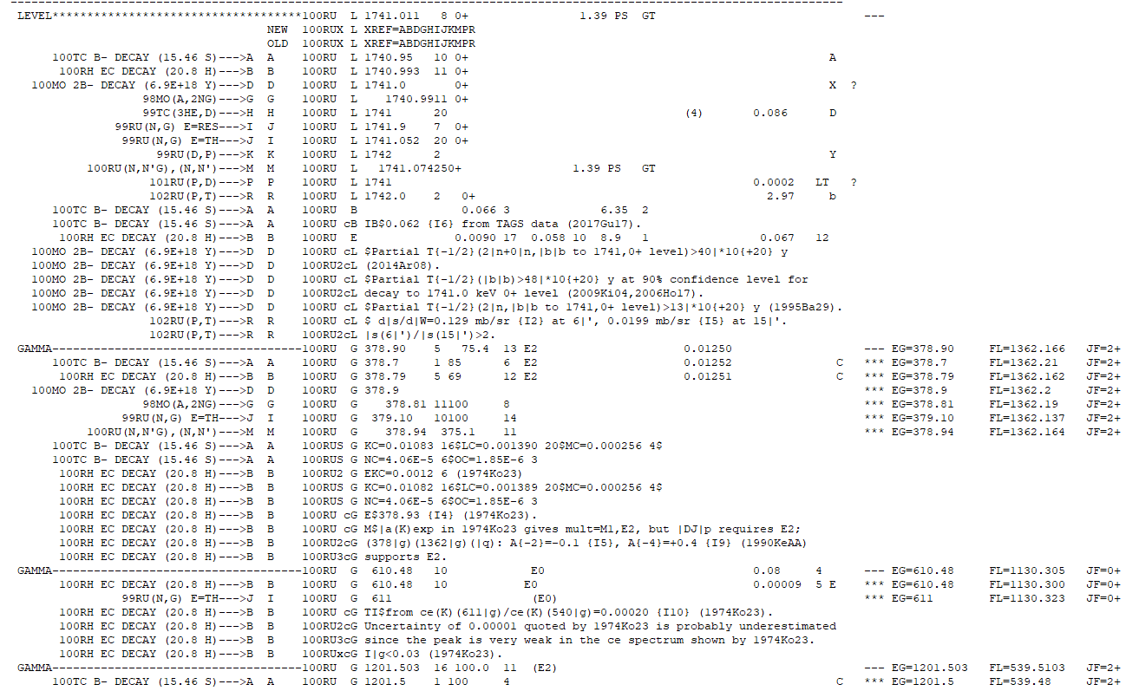
ConsistencyCheck: grouped entries
record lines of the same gamma from different datasets
final levels

Slide 15
ConsistencyCheck: averaging reports
averaging results
for copy and paste

Slide 16
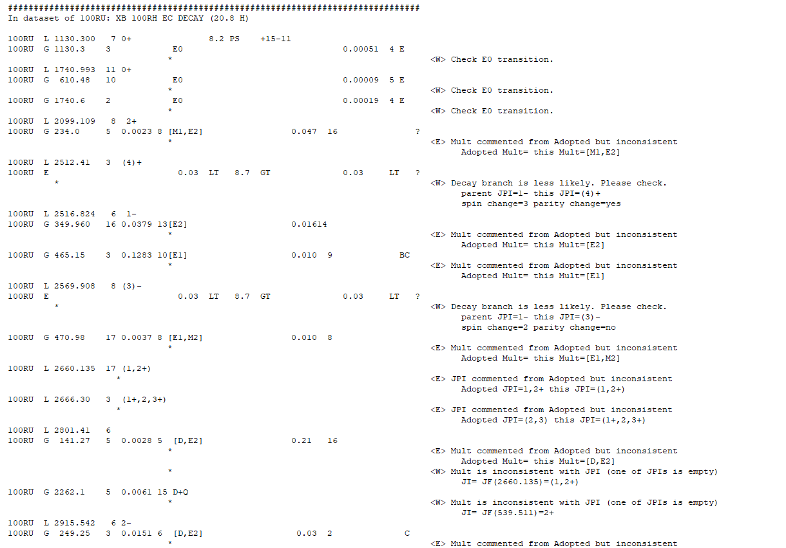
ConsistencyCheck: error reports
error and warning messages

Slide 17
ConsistencyCheck: checklist
This program performs the following checks (PANDORA checks 1-4 plus some others):
check MS flag in column 78-79 for level record with T1/2>0.1 sec
2. check consistency of gamma-ray multipolarity with change of spin and parity between parent and daughter levels
3. check consistency of log ft value with change of spin and parity between parent and daughter levels for beta/EC decay dataset following the rule used in PANDORA:
If 3.6<log ft<5.9, then, Ji-1<=Jf<=Ji+1, no parity change
If log ft>=8.5 and 1U, then, Jf=Ji+/-2, with parity change
4. check consistency of HF value with change of spin and parity between parent and daughter levels for alpha decay dataset following the rule used in PANDORA:
If mass=odd and HF<4, then, Jf=Ji, no parity change
If Jf=0 or Ji=0, then, parity change=(-1)^(Jf-Ji), with +1 for no change and -1 for change
5. check consistency of spin-parity values in Adopted Levels with those in individual datasets if there is any comment stating that they are from Adopted Levels
6. check consistency of information in parent record in decay dataset with the Adopted data for the parent nuclide, like, JPI, T1/2, Q-value

Slide 18
ConsistencyCheck: checklist (cont.)
7. check BXLW values in continuation records with RUL values for Adopted Level, Gammas dataset
8. check if any level from individual datasets is missing in Adopted Levels dataset or if its XREF tag is missing in the “XREF=” field of the corresponding Adopted Level
9. check if the “XREF=” field of an Adopted level has any wrong XREF tag.
10. check 0 to 0 transition, parity-change=yes should not happen
11. check if Ig is normalized to strongest=100 (PN=6) in Adopted Gammas, and that should not normalized to gamma flagged by ?, *, &
12. check decay branch with DJ>2 or (DJ==2 and parity change=no), less likely
13. check if any gamma is missing in Adopted Gammas
14. check if T1/2 as quoted from Adopted is consistent
15. check if MULT and MR as quoted from Adopted is consistent
16. check if BXLW is missing in Adopted Levels when T1/2, Ig, MUL are available
Needs more inputs for items to be checked!

