Slide 1
TUNL Contributions in the US Nuclear Data Program
J.H. Kelley - USNDP Structure Group Leader: (6 months FTE),
J. Purcell (emeritus 0.1 FTE), and G. Sheu (Adm. Assist. 0.75 FTE)
(Kent Leung (post doc 0.5 FTE))
2018 USNDP Meeting

Slide 2
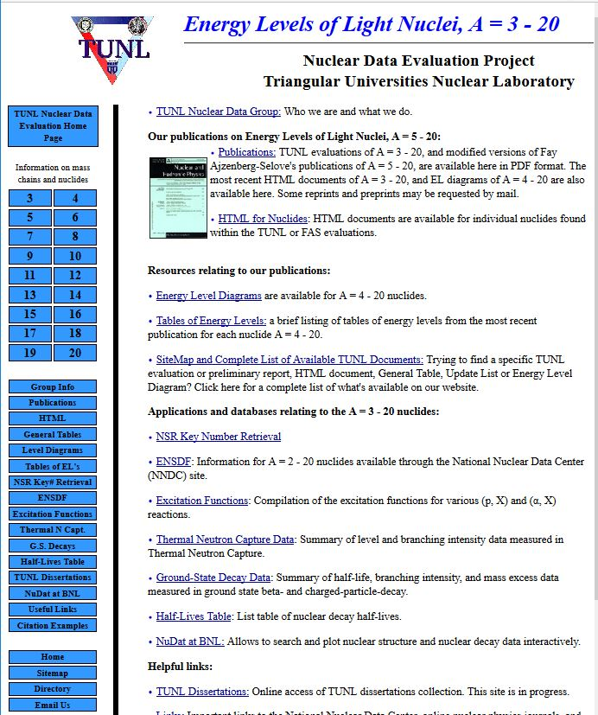
TUNL Primary Responsibilities
We are responsible for nuclear structure evaluation in the A=2-20 mass region
ENSDF files for A=2-20
XUNDL from A=2-20
Web interface for A=3-20 Information
2018 USNDP Meeting

Slide 3
Evaluation Activities
Submitted ENSDF for A=12
Prepared/updated ENSDF datasets for
⁵Be, ¹⁷Ne,
Maintain up-to-date β-decay lifetimes for A=1-20
Work in progress:
Preparing A=13 ENSDF file
Preparing evaluations of ⁵H, ⁸C, ²⁰N, ¹⁹B, ¹⁹N
Update β-decay datasets in ENSDF
¹⁷Ne (β, β-n , β−α)
2018 USNDP Meeting

Slide 4
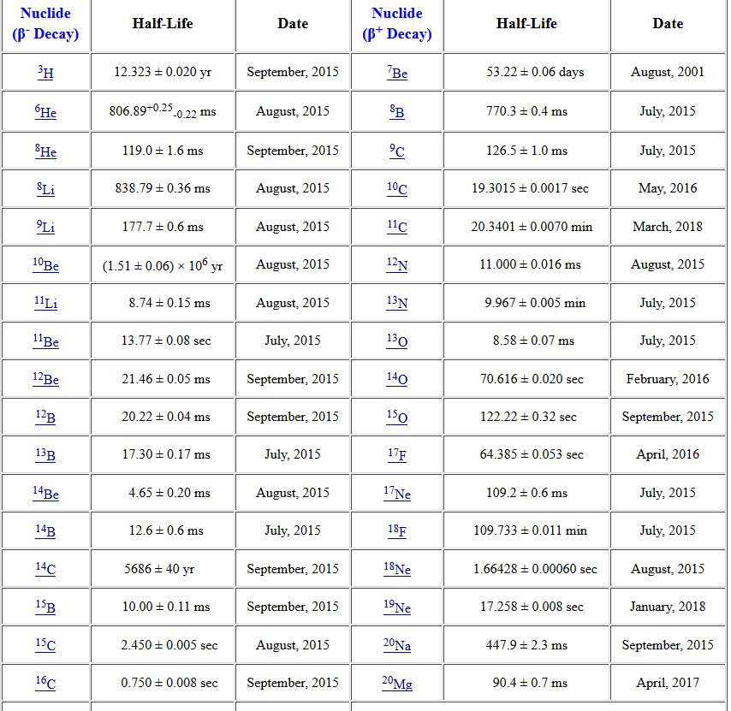
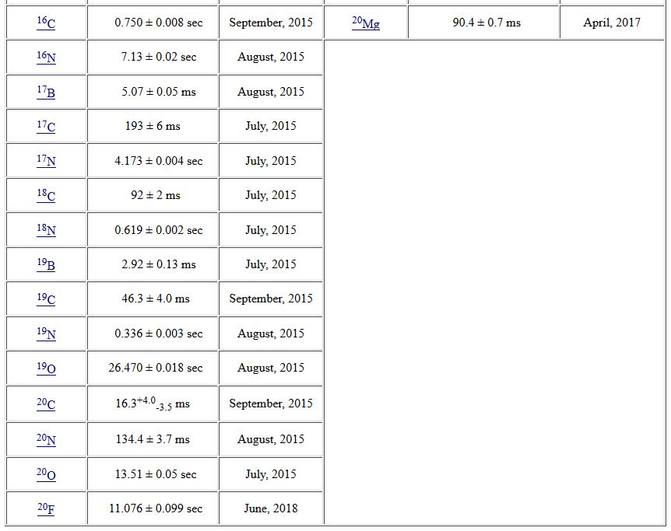
Comments on β-decay lifetimes
Research Experience for Undergraduate Project (Susan Olmstead) in 2015:
Compiled relevant articles
Use McMaster data group’s Java averaging program
Evaluated lifetimes using a variety of averaging methods
Produced a table of recommended values
2018 USNDP Meeting

Slide 5
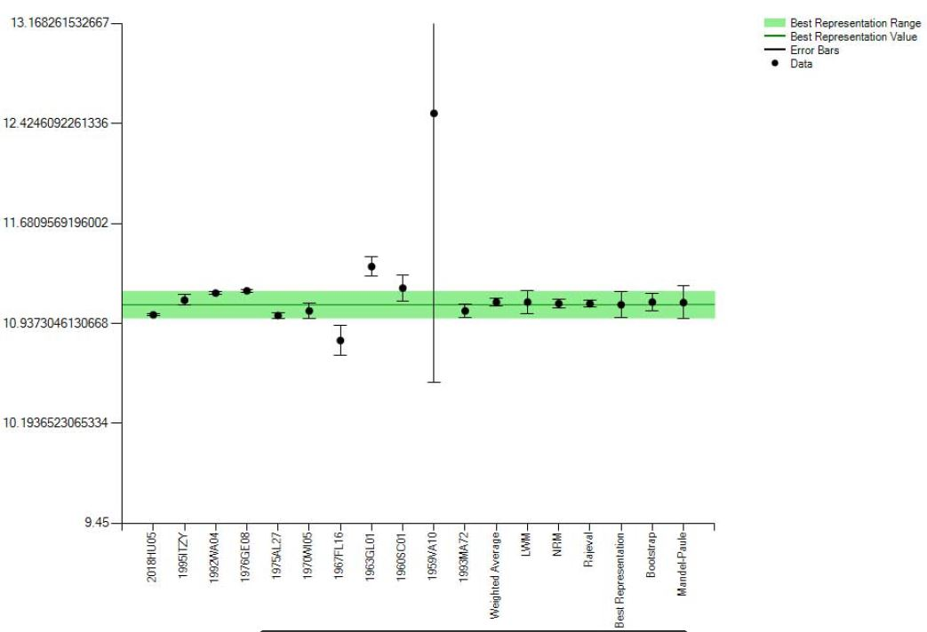
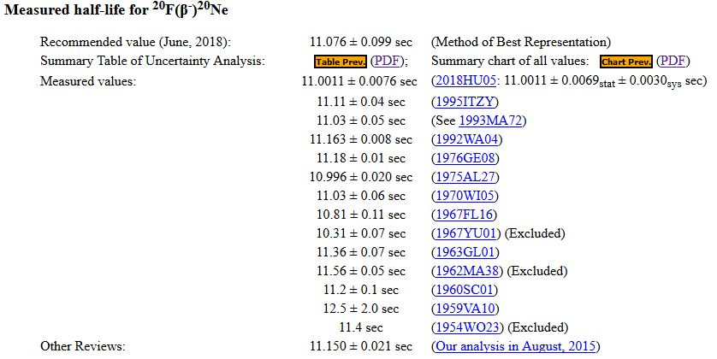
β-decay lifetimes -continued
2018 USNDP Meeting

Slide 6
Compilation Activities
eXperimental Unevaluated Nuclear Data Library
41 data sets/year (~4/month)
Compilation of ground state decay & β-decay references and data
Compilation of (p,X) and (α,X) excitation functions
Compilation of thermal neutron capture references and data
Maintain TUNL Dissertations online
2018 USNDP Meeting

Slide 7
Website metrics (April 2002-present)
2018: Σ=80 k
Using Analog - finding issues with excluding new search engine "robots"
2017 USNDP Meeting

Slide 8
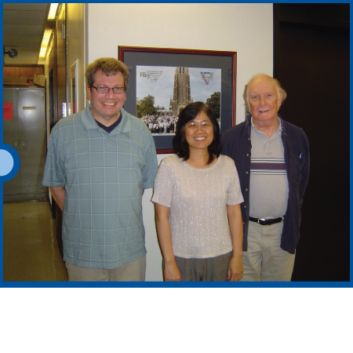
2018 USNDP Meeting

Slide 9
FY 2018 FTE Distribution
FTE Distribution
 | PhD Permanent | PhD Temporary | Technical & Admin. | Graduate Students
I. NNDC Facility Operation | 0 | 0 | 0 | 0
Management | 0 | 0 | 0 | 0
Secretarial/Administrative Support | 0 | 0 | 0 | 0
Library | 0 | 0 | 0 | 0
Computer Operations | 0 | 0 | 0 | 0
II. Coordination | 0.05 | 0 | 0 | 0
National Coordination | 0.05 | 0 | 0 | 0
International Coordination | 0 | 0 | 0 | 0
III. Nuclear Physics Databases | 0 | 0 | 0 | 0
Nuclear Science References, NSR | 0 | 0 | 0 | 0
Exper. Nucl. Structure Data, XUNDL | 0 | 0 | 0 | 0
Eval. Nucl. Structure Data, ENSDF | 0 | 0 | 0 | 0
Numerical Nuclear Data, NuDat | 0 | 0 | 0 | 0
Reaction Data Bibliography, CINDA | 0 | 0 | 0 | 0
Experimental Reaction Data, CSISRS | 0 | 0 | 0 | 0
Evaluated Nuclear Data File, ENDF | 0 | 0 | 0 | 0
Database Software Maintenance | 0 | 0 | 0 | 0
Future Database System Develop. | 0 | 0 | 0 | 0
IV. Information Dissemination | 0 | 0 | 0.5 | 0
Nuclear Data Sheets | 0 | 0 | 0 | 0
Customer Services | 0 | 0 | 0 | 0
Web Maintenance & Development | 0 | 0 | 0.5 | 0
V. Nuclear Structure Physics | 0.45 | 0.6 | 0.25 | 0
NSR Abstract Preparation | 0 | 0 | 0 | 0
Compilation of Exper. Structure Data | 0.1 | 0 | 0.05 | 0
Eval. of Masses & Nuclides for ENSDF | 0.35 | 0.6 | 0.2 | 0
Ground & Metastable State Properties | 0 | 0 | 0 | 0
Radioactive Decay Data Evaluation | 0 | 0 | 0 | 0
Thermal Capture Gamma Data Eval. | 0 | 0 | 0 | 0
Light Mass Eval. for Nucl. Physics A | 0 | 0 | 0 | 0
Nuclear Structure Data Measurement | 0 | 0 | 0 | 0
ENSDF Evaluation Support Codes | 0 | 0 | 0 | 0
VI. Nuclear Reaction Physics | 0 | 0 | 0 | 0
Experimental Data Compilation | 0 | 0 | 0 | 0
ENDF Manuals and Documentation | 0 | 0 | 0 | 0
ENDF Evaluations | 0 | 0 | 0 | 0
Nuclear Reaction Standards | 0 | 0 | 0 | 0
Nuclear Model Development | 0 | 0 | 0 | 0
Nucl. Reaction Data Measurements | 0 | 0 | 0 | 0
Astrophysics Nuclear Data Needs | 0 | 0 | 0 | 0
Covariances development | 0 | 0 | 0 | 0
Reactor anti-neutrino & decay heat calculations | 0 | 0 | 0 | 0
Verification and Validation | 0 | 0 | 0 | 0
DOE-SC Nucl. Data Funded Staff | 0.5 | 0.6 | 0.75 | 0
Staff Supported by Other Funds | 0 | 0 | 0 | 0
TOTAL STAFF | 0.5 | 0.6 | 0.75 | 0
FY 2018 Metrics
NSR Compilations | 0
EXFOR Compilations | 0
XUNDL Compilations | 41 |  | 31 articles
Total Compilations | 41
ENSDF Evaluations | 9 |  | 12He,12Li,12Be,12B, 12C, 12N, 12O, 5Be, 17Ne
ENDF Evaluations | 0
Total Evaluations | 9
Diseminations | 80
Articles | 0
Reports | 0
Invited Talks | 0
2018 USNDP Meeting

