Slide 1
ENDF/B-VIII.0 covariance testing at Oak Ridge National Laboratory
Dorothea Wiarda
William J. Marshall
Vladimir Sobes
Friederike Bostelmann
Andrew Holcomb
Bradley T. Rearden

Slide 2
Outline
Covariance library creation
Differences between ENDF/B-VII.1 and ENDF/B-VIII.0
Covariance testing with VALID
  K_{eff} uncertainties
  c_{k} (similarity)

Slide 3
Work-flow to generate the covariance library
ENDF evaluation
1– D data are broadened to 293 K
To collapse covariance data a Maxwellian-1/E-fission-1/E flux is used.
A 56 neutron group library was generated.
This library is expected to be available in the upcoming SCALE 6.3 beta release.
POLIDENT
(1-D point-wise)
Y12
(Chi data)
BROADEN
(Doppler broadening)
X10
(MG Chi data)
TGEL
(redundant 1-D)
PUFF-IV
(covariance data)
COGNAC
(correct + filter
covariance data)

Slide 4
Corrections applied to SCALE covariance libraries
All redundant covariance matrices are removed, i.e. if <1,2> and <2,1> are present, only <1,2> is retained. (Note: PUFF_IV adds these redundant matrices during processing).
Cross section data without covariance information are removed - i.e. threshold reactions that are above the highest energy group.
Relative uncertainties larger than 1 are set to 1
Correlation values with absolute values larger than 1 are set to +1 or -1.
If a higher energy group has uncertainty data and the lower energy groups do not (but have non-zero cross section data):
  Diagonal elements of the covariance matrix are extended

Slide 5
Data corrected by COGNAC: ²³⁵U
Resolved range: [10⁻⁵ eV, 2250 eV]
Unresolved range: [2250 eV, 25000 eV]
<fission,capture> has two matrices in ENDF file:
First ranges from [10⁻⁵ eV, 2250 eV] – covers RR
Second full range, with second group starting at 2250 eV with 54 groups.
Due to evaluation details, we expect zero in group [1, 1], [1, 2], .. and [2, 1], [3, 1], ..
But have data in: [1,2], [1,3], [1,4], … and not in [2,1], [3,1], …
The elements lead to correlations significantly larger than 1.
Since total is defined as a sum, this also leads to large correlation in the total cross section covariance matrix and other implicitly defined cross correlation matrices.
Note: PUFF_IV has an input parameter that allows to print all File 31/33 covariance data on the evaluator grid in an easy to read format.

Slide 6
Data corrected by COGNAC: ⁷Li
Relative uncertainty for capture is larger than 1, however cross section is very small.
Two covariance matrices in ENDF file for capture, both only diagonal and relative.
High energy one gives the large uncertainties.
There are a few other nuclides with the same behavior.
Note: Close to a threshold, large relative uncertainties often occur due to numerical instabilites, similar to the above case.
Several other nuclides show a similar behavior.

Slide 7
Thermal moderator uncertainties
Since thermal moderators do not have covariance data in the thermal range in ENDF, we use the covariance data from the scatterer.
Thus, the uncertainty of ¹H is reused for ¹H in ¹H2O, ¹H in ¹HZr, …
Since we are reusing sensitivity data (see below), this is relevant for C.
Previously we had covariance data for C in graphite, now we have covariance data for:
  ¹²C in graphite (reusing ¹²C covariance data for all three graphite evaluations)
  ¹³C in graphite (reusing ¹³C covariance data for all three graphite evaluations)
In principle, PUFF-IV could generate a covariance library for C, but it does not currently do that.
Once new sensitivity data are generated this will no longer be an issue

Slide 8
SCALE ENDF/B-VIII.0 covariance library content
All covariance information from ENDF/B-VIII.0
Chi covariance data from JENDL-4.0:
  ²⁴¹Am, ²⁴²Am, ²⁴³Am, ²³⁷Np, ²³¹Pa, ²⁴¹Pu, ²³²Th, ²³³U, ²³⁴U, ²³⁶U, ²³⁷U
SCALE-6.1 data (mainly Lo-Fi) retained for ~215 missing nuclides
SCALE sensitivity tools currently only use the following reactions: 1, 2, 4, 16, 18, 102, 103, 104, 105, 106, 107, 452, 455, 456.

Slide 9
Differences between ENDF/VII.1 and ENDF/VIII.0
¹H

Slide 10
¹H Covariance changes (cont.)
ENDF/B-VII.1 (Rev 586) was very different from previous versions.
ORNL asked for clarification of the change and covariance was changed in Rev. 610,
  Commit message: “covariance data replaced by Hale's high fidelity evaluation”
Commit 1056 changed the covariance data back to ENDF/B-VII.1 values.
  Commit message : “New version with standards cross section, tested in-house at LANL. Documentation and file-33 not updated yet.”
Commit 1347 (ENDF/B-VIII.0): Evaluation by G. M. Hale et al.
  Commit message : “Newly revised 1H+n, with covariances”
Mughabghab Atlas value for thermal elastic: 20.491 ± 0.014 b, or 0.068 % relative uncertainty.
Other References for thermal elastic:
  20.491 ±0.014 b, W. Dilg, Phys. Rev. C 11, 103 (1975) (Atlas value)
  20.4278 ± 0.0078 b, R. W. Hackenburg Phys. Rev. C 73, 044002 (2006)
  20.4288 ± 0.0146 b, Babenko, V.A. & Petrov, N.M. Phys. Atom. Nuclei (2010) 73: 1499
Central value in ENDF/B-VIII.0: 20.436 b

Slide 11
Differences between ENDF/VII.1 and ENDF/VIII.0
²³⁵U
Note: ²³⁵U nubar covariance in SCALE 6.2 is not ENDF/B-VII.1, but Rev. 631 from NNDC SVN repository since nubar in ENDF/B-VII.1 did not have covariance data for low energies.

Slide 12
Differences between ENDF/VII.1 and ENDF/VIII.0
²³⁹Pu
Note: ²³⁹Pu nubar covariance in SCALE 6.2 is not ENDF/B-VII.1, but Rev. 632 from NNDC SVN repository since nubar in ENDF/B-VII.1 did not have covariance data for low energies.

Slide 13
Differences between ENDF/VII.1 and ENDF/VIII.0
²³⁸U

Slide 14
Covariance testing with VALID
Sensitivity data used for testing were generated in SCALE 6.2 using ENDF/VII.1 cross section data
  Covariance library contains relative uncertainty, thus it should be applicable to the current library
  Results support that testing is effective even with old sensitivity data because they are stationary with respect to the data changes – change one thing at a time!
Two categories are compared:
  uncertainty in k_{eff} due to cross section covariance data
    TSUNAMI-IP will calculate k_{eff} uncertainty resulting from covariance data
    Covariance patching for data testing is turned on
    Covariances propagated with sensitivities to determine uncertainty in k_{eff}
  c_{k} (similarity) of a reference set of experiments with reference applications
Covariance data are used as given in ENDF, this should give a direct comparison between changes in ENDF/VII.1 and ENDF/VIII.0. See Vladimir Sobes’ talk for covariance adjustment.

Slide 15
Suggestion to store two types of covariance data
GNDS allows to give more than one representation of nuclear data information.
It should be possible to save two types of covariance information:
  Experimental uncertainties, as currently stored for ENDF/B-VIII.0 and before with label ”eval” (current label for all evaluated data sets)
  Adjusted covariance data (for example, Vladimir Sobes talk) with label “adjusted”
As noted, this talk will only deal with covariance data as given in ENDF/B-VIII.0 to allow to see the direct impact of the changes between ENDF/B-VII.1 and ENDF/B-VIII.0

Slide 17
HEU-MET-FAST Systems
HMF-015 (first case) top contributors:
ENDF/VII.1: ²³⁵U absorption and scattering
ENDF/VIII.0: ²³⁵U fission and nubar
Because we are using ENDF/VII.0 sensitivities, the covariance data for ¹²C and ¹³C are not taken into consideration.
Elemental graphite vs. ¹²C/¹³C

Slide 18
LEU-COMP-THERM System
LCT-001-001 (First case)
Top contributor:
²³⁵U nubar:
  0.36% SCALE 6.2
  0.44% ENDF/B-VIII.0
Second contributor:
²³⁵U chi:
  0.31% SCALE 6.2
  0.05% ENDF/B-VIII.0
The reductions in the uncertainty of ²³⁵U nubar, fission, and chi offset large increases in the ¹H uncertainties in scatter and absorption in the ENDF/B-VIII data

Slide 19
MIX-COMP-THERM Systems
MCT-008-002
Top two contributors in SCALE 6.2:
²³⁹Pu fission 0.297%
²³⁸U inelastic 0.295%
Top two contributors in ENDF/B-VIII.0:
²³⁹Pu capture 0.79%
²³⁹Pu fission 0.50%
The ¹H elastic scattering and capture effects contributes to the increase in data induced uncertainty.

Slide 20
PU-MET-FAST Systems
PMF-001:
The uncertainty in ²³⁹Pu fission jumps from the fourth most important reaction, with an uncertainty contribution of 0.33% using he SCALE 6.2 data, to the most important uncertainty.
The increased uncertainty in the Pu reactions leads to an overall increase in the data induced uncertainty in k_{eff}.
Elemental graphite vs. ¹²C/¹³C

Slide 21



c_{k} (similarity) assessment
Purpose:
  Calculate c_{k} parameter for each experiment in a reference set compared to multiple spent fuel storage/transportation applications
  What is c_{k}?
    Correlation coefficient between an experiment and an application based on shared nuclear data uncertainty
Covariance data
Uncertainty matrix:
Given:
Sensitivity data
σ_{ij}² is off-diagonal term of C_{kk} matrix (aka covariance)
c_{k} (corr. coef.):
Where:
σ_{i} and σ_{j} are square root of diagonal terms (aka standard deviations)

Slide 22
c_{k} (similarity) assessment (2)
Purpose (continued):
  How is it useful in covariance testing?
    c_{k} can indicate which covariance data are important in determining similarity
    Results should be logical result of materials in systems
    Especially helpful for comparison of primary fissile species uncertainty data
Methodology:
  TSUNAMI-IP calculates c_{k} provided sensitivity data files (SDFs) for each application and experiment
  “c” and “values” keywords in parameter block
  “c_long” is also helpful because it provides the c_{k} contribution from each element in the covariance matrix

Slide 23
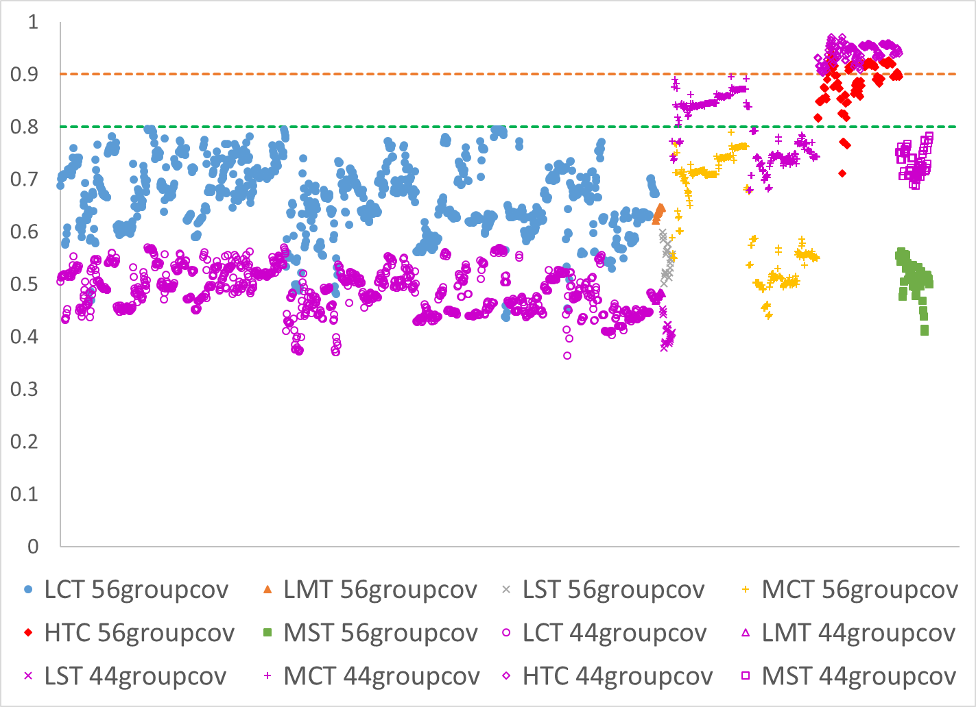
c_{k} results – historical context: SCALE 6.1 to SCALE 6.2
1643 unique critical experiments compared to PWR SNF cask with fuel at representative discharge burnup
SCALE 6.1 (purple)
SCALE 6.2 (various)
This change caused significant turmoil for use of c_{k} to select similar experiments for validation
Difference largely due to Pu-239 nubar covariance update in ENDF/B-VII.1

Slide 24
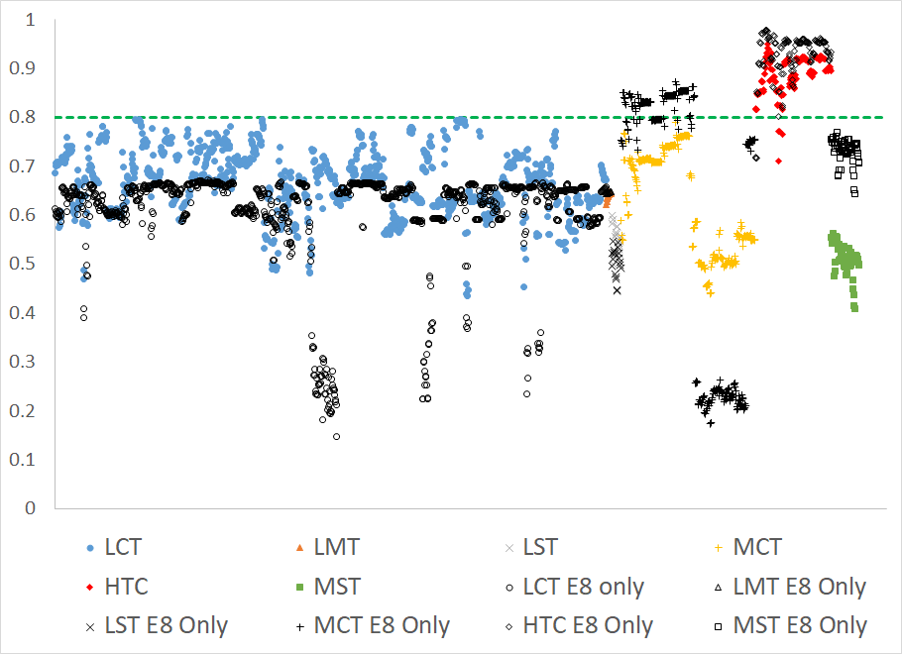
c_{k} results SCALE 6.2 and ENDF/B-VIII.0
HTC experiments are still the most applicable experiments for validation of spent PWR systems.
The variation of applicability of LCT systems has, in general, been reduced compared to the SCALE 6.2 covariance data
Moderator data not updated

Slide 25
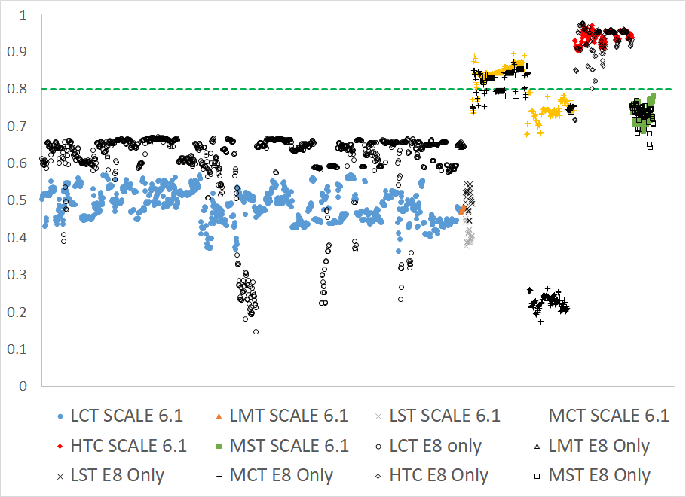
c_{k} results SCALE 6.1 and ENDF/B-VIII.0
The effect of the ENDF/B-VIII data on experiment applicability in PWR burnup credit is largely a return to the SCALE 6.1 assessments.
The details of the applicability determinations differ significantly from those made with the SCALE 6.1 covariance data, but the differences largely cancel and suggest the same types of experiments are useful for validation.
Moderator data not updated

Slide 26
Summary
ENDF/B-VIII.0 covariance library has been prepared for SCALE 6.3
Library will be available in the next SCALE 6.3 beta release
Covariance data show a general increase in the uncertainties in the nuclear data and thus an increase in the estimated nuclear data induced uncertainty in k_{eff} for ENDF/B-VIII.0.

