Slide 1
Uncertainty reduction without using integral data
A. Trkov and R. Capote
Nuclear Data Section, International Atomic Energy Agency
Department for Nuclear Sciences and Applications

Slide 2
Summary
Issues in propagated ENDF/B-VIII.0 evaluation
uncertainties for applications
Basic knowledge of criticality and
typical experimental (integral) uncertainties
Bayesian approach leading to reduced uncertainties for applications
Definition of extreme neutron spectra:
thermal Maxwellian
fast (taken as U-235 PFNS at the thermal)
14 MeV is possible, but can not benefit from this approach (not constrained by exp.)
Possible applications and outlook

Slide 3
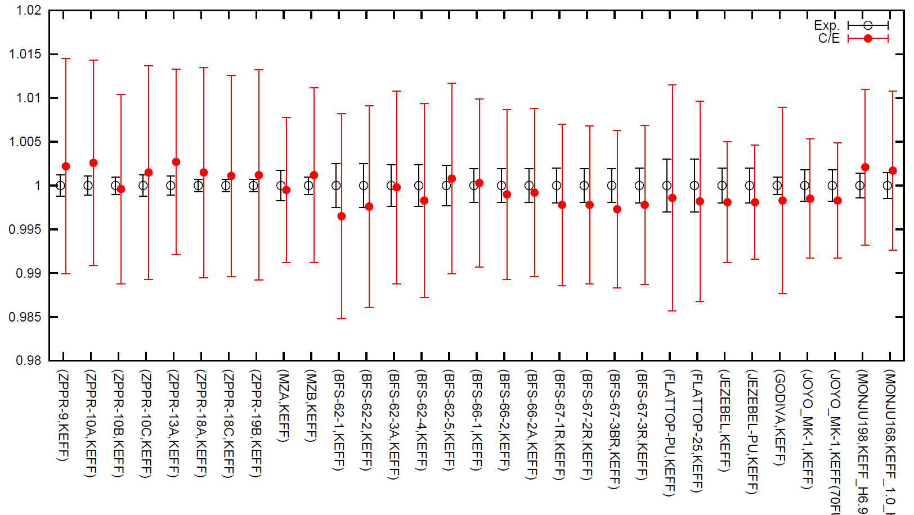
Well known: Evaluated uncertainties in general purpose libraries lead to large uncertainties for k_{eff}
Fast assemblies ICSBEP, JENDL-4 (similar for ENDF/B-VIII.0)
+1%
0
-1%
See INDC(NDS)-0597, IAEA 2011, Fig. 4 by O. Iwamoto
But Δk_{eff}(exp) ~ 0.2% ! Can we do something?

Slide 4
Proposed solutions:
Data adjustment considering integral data (+ reaction rates + …) lead to adjusted library (GLSQ or TMC)
(we know we need adjusted libraries for applications)
Advantages: low uncertainties for applications
Disadvantages:
1) Resulting biases due to compensation effects, if not all relevant quantities have uncertainties & cross-correlations defined in the adjustment input.
The adjusted library is valid for selected benchmarks;
however, due to biases, extrapolations generally fail
=> Repeated warnings by experienced evaluators to avoid “contaminating” evaluations with integral data
(since the very beginning of evaluations)

Slide 5
A new solution to reduce uncertainties (1)
Use additional knowledge to reduce the uncertainties
1) TOY MODEL: 1-group 0-D transport equation
(Universally valid and independent of integral data )
2) Uncertainty of k_{eff} measurements (0.2-0.4%)
Using 1) and 2) we can derive “universal” (anti) correlations (due to the constraint Δk_{eff}=0.2-0.4%)
Derive those correlations for typical spectra:
Maxwellian(<E>=0.0253eV), U-235 PFNS (<E>=2 MeV)
Assume NO correlations between energy regions
$$k_{eff}=\frac{υΣ_{f}}{Σ_{f}+Σ_{c}+Σ_{i}+L}$$
f=fission; c=capture; i=other, L=leakage

Slide 6
A new solution to reduce uncertainties (2)
Use additional knowledge about ALL critical systems
Straightforward implementation in existing general-purpose libraries
- Only (anti)correlations between $υ{, Σ}_{f}$,$Σ_{C}$ for 2-4 spectral groups need to be added (3N numbers, being N the number of energy groups)
- We may also add uncertainty reduction for $υ ?$
Typically we add $υ{−Σ}_{f}$ (anti) and/or $υ{−Σ}_{C}$ correlations
No use of the integral data is made, universally valid within the given spectral region, safe extrapolation
Significant reduction of the predicted uncertainty for integral quantities: Δk_{eff}~0.6-0.8% (in progress)
Derived anti-correlations appear to be independent of the spectrum but short-range

Slide 7
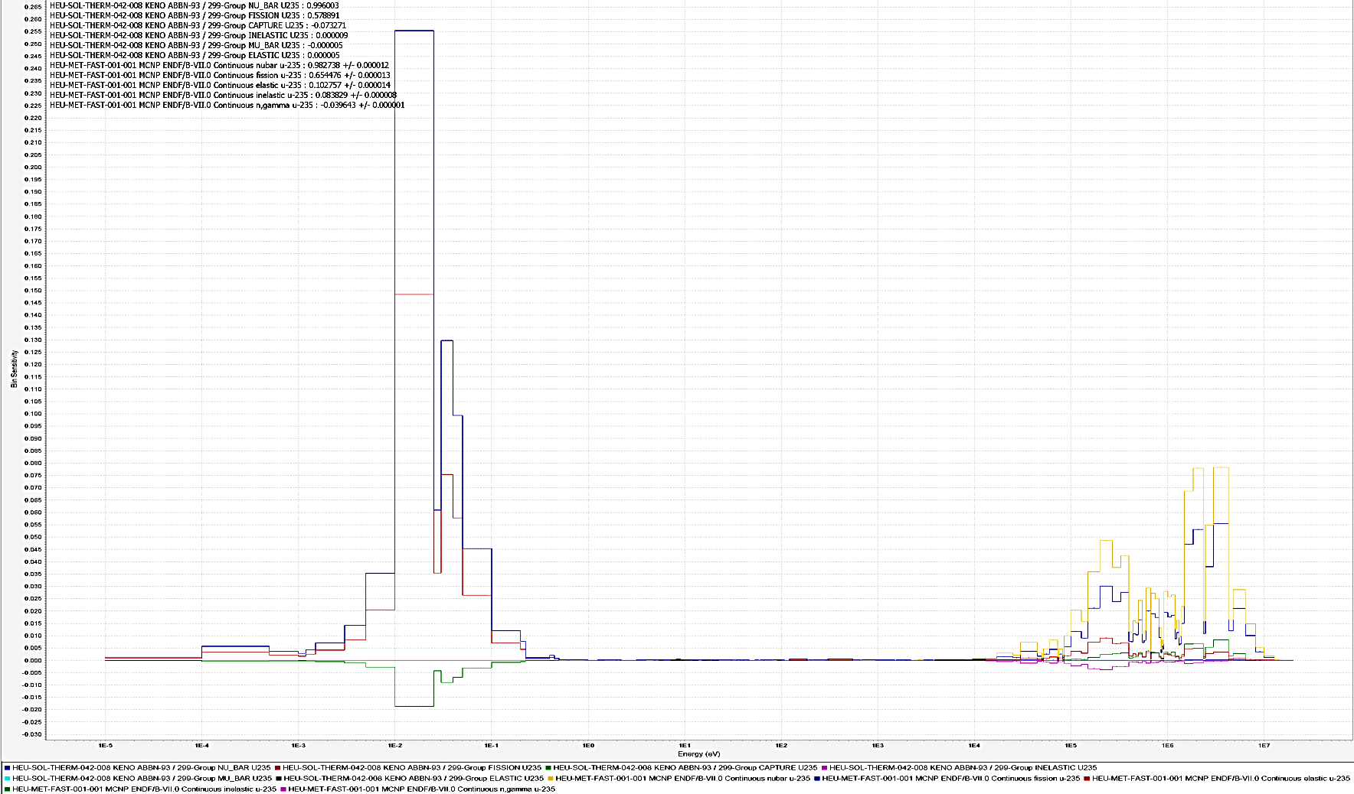
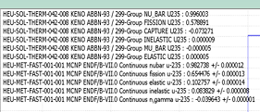
DICE sensitivities: HST042.008 &HMF001
$$υ,Σ_{f} dominates, long range correlations=0$$
HST042.008
(1 of Hardy set)
HMF001
Godiva
0.00001 0.0001 0.01 0.10 1.0 10 100 1000 10000 10^5 10^6 10^7

Slide 8
A new solution to reduce uncertainties:
Thermal Maxwellian spectrum (no integral data)
dk_{eff} unconstrained
Propag. Δk_{eff} = 861 pcm (smaller !!)
INPUT SAMPLED
 | ν | Σ_{f} | Σ_{C} | L
ν | 100
Σ_{f} | -0.04 | 100
Σ_{C} | 0.02 | -0.06 | 100
L | 0 | 0 | 0 | 100
ν | 2.425 (.45%)
Σ_{f} | 587.3 (1.2%)
Σ_{C} | 99.5 (1.3%)
ν | 2.425 (.45%)
Σ_{f} | 587.3 (1.2%)
Σ_{C} | 99.5 (1.3%)
dk_{eff} = 400 pcm
 | ν | Σ_{f} | Σ_{C} | L
ν | 100
Σ_{f} | -82 | 100
Σ_{C} | 5.9 | 14 | 100
L | 0 | 0 | 0 | 100
Small red. unc.
Strong in Δk_{eff}
_{(-600 pcm)}
ν | 2.425 (.39%)
Σ_{f} | 587.3 (0.7%)
Σ_{C} | 99.5 (1.3%)

Slide 9
A new solution to reduce uncertainties:
Fast spectrum ²³⁵U(n_{th},f) PFNS (no integral data)
dk_{eff} unconstrained
Propag. Δk_{eff} = 1100 pcm
INPUT SAMPLED
 | ν | Σ_{f} | Σ_{C} | L
ν | 100
Σ_{f} | -0.04 | 100
Σ_{C} | 0.02 | -0.06 | 100
L | 0 | 0 | 0 | 100
ν | 2.63 (.8%)
Σ_{f} | 1.223 (1.2%)
Σ_{C} | 0.094 (10%)
ν | 2.63 (.8%)
Σ_{f} | 1.223 (1.2%)
Σ_{C} | 0.094 (10%)
dk_{eff} = 200 pcm
 | ν | Σ_{f} | Σ_{C} | L
ν | 100
Σ_{f} | -85 | 100
Σ_{C} | 25 | 24 | 100
L | 0 | 0 | 0 | 100
Small red. unc.
Strong in Δk_{eff}
_{(-1000 pcm)}
ν | 2.63 (.6%)
Σ_{f} | 1.223 (0.9%)
Σ_{C} | 0.094 (9.7%)

Slide 10
Summary
A new solution is proposed to reduce uncertainties in general-purpose libraries introducing
Numerically similar to Rochmann et al (EPJ n 2017, 2018) and
similar approaches but conceptually is very different.
Approach based on the following assumptions:
1) 1-group 1D transport equation is valid to describe critical assemblies
2) Experimental Δk_{eff}=0.2-0.4%
No integral data are used, assumptions applied are universally valid !!
From these two assumptions, correlations are derived
Straightforward implementation in existing general-purpose libraries (only (anti)correlations between $υ{, Σ}_{f}$,$Σ_{C}$ for selected spectral groups are added)
Estimated significant reduction of the predicted uncertainty for integral quantities (in progress)

