Slide 1
Charged Particle Libraries
Review of previous LLNL contributions to ENDF/B-VIII.0
Ian Thompson and Erich Ormand
Nuclear Data and Theory Group
November 5, 2018

Slide 2
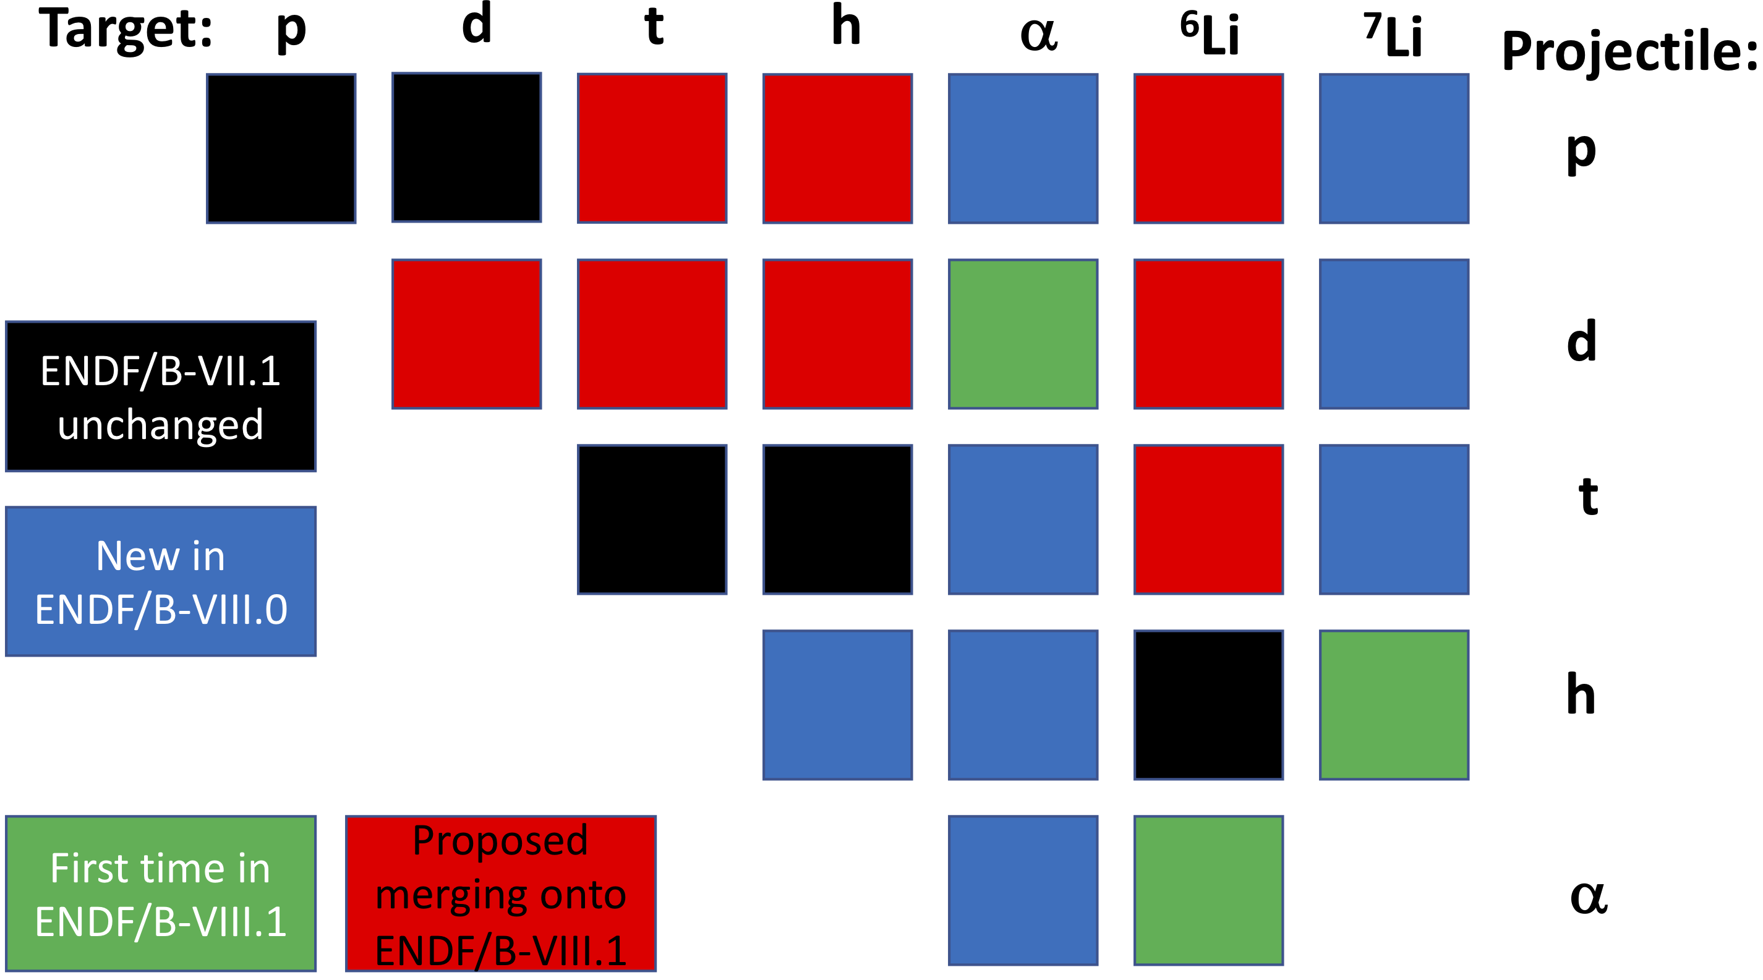
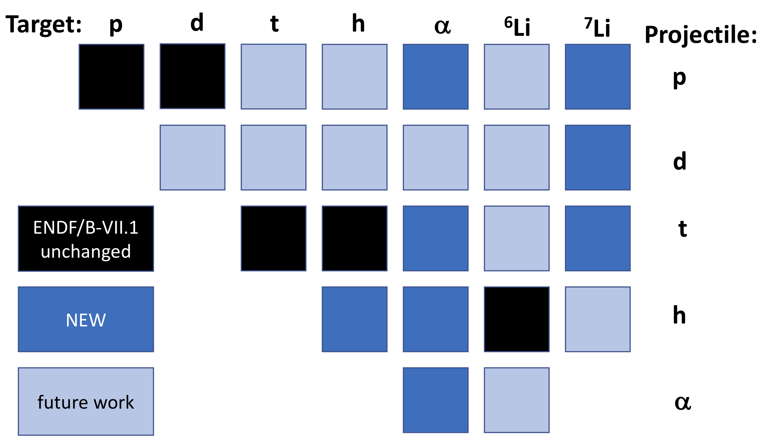
ENDF/B-VII.1
Past, Present and Future Evaluations
Today: talk on 8 Blue and 3 Green = 11 evals
Proposals for adding and merging into ENDF/B-VIII. 1
ENDF/B-VIII.0
The 8 submitted from LLNL in October 2016:
a+a, d+7Li, h+h, h+a, p+a, p+7Li, t+a, t+7Li

Slide 3
Thermonuclear Reaction Library
Legacy ECPL/ENDL99 evaluations
  Incident charged particles (p,d,t,He3,He4), light targets Z<=3 (p,d,t,He3,He4,Li6,Li7)
  R.M. White, D.A. Resler, S.I. Warshaw 'Evaluation of Charged-Particle Reactions for Fusion Applications,' Proc. from Nuclear Data for Sci. and Tech., Ed. S.M. Qaim, Juelich, Fed. Rep. Germany, 13-17 May (1991)
  S.T. Perkins, D.E. Cullen, 'Elastic Nuclear plus Interference cross sections for light-charge particles' Nucl. Sci. Eng. 77, 20-39 (1981)
2010 evaluations at LLNL by Petr Navratil, David Brown & Chris Hagmann
  Main sources for new evaluations
    Descouvemont R-Matrix analysis
      P. Descouvemont, A. Adahchour, C. Angulo, A. Coc, E. Vangioni-Flam, Atomic Data & Nucl. Data Tables 88, 203 (2004)
    NACRE (Nuclear Astrophysics Compilation of REaction rate)
      C. Angulo et al., Nucl. Phys. A656 (1999)3-187
    Experimental data not in EXFOR
Here: assess accuracy of evaluations contributed by LLNL.
Most cross-sections were presented at CSEWG 2016 (supplemental slides below).
So here we focus on the angular distributions of two-body channels vs. EXFOR.
(Future methods will focus on breakup distributions)

Slide 4
Table of LLNL contributed evaluations
 |  |  |  |  | ejectiles:
ENDF/B-VIII version |  | n | 2n | 3n | p | 2p | d | n+p | t | h | a
0 | p + a |  |  |  | elastic |  |  |  |  |  |  |  | p
0 | p + Li7 | 50, 51 |  |  | pt. Coul |  | 650 |  |  |  | 800 |  | p
1 | d + a | 50 |  |  | 600 |  | elastic | 28 |  |  |  |  | p
0 | d + Li7 | 22 | 16 |  | 103 |  | elastic |  | 700 |  |  |  | p
0 | t + a |  |  |  |  |  |  |  |  |  |  |  | p
0 | t + Li7 | 50 | 24 | 17 |  |  |  |  | pt. Coul
0 | h + h |  |  |  |  | 111 |  |  |  | elastic
0 | h + a |  |  |  |  |  |  |  |  | elastic |  |  | p
1 | h + Li7 |  |  |  | 600 |  | 117 | 45 | 105 | pt. Coul | 800, 801 |  | p
0 | a + a |  |  |  |  |  |  |  |  |  | elastic |  | p
1 | a + Li6 |  |  |  | 600 |  | 650, 651 |  |  |  | pt. Coul |  | p
All distributions exist, but most are simple forms extrapolated from limited measurements.
Many of these channels (2n, 3n, 2p, n+p) are too difficult for 2-body R-matrix models.

Slide 5
Evaluation Paths
These from LLNL are temporary evaluations (2010 through 2020?)
  Combination of cross sections and distributions from different sources
  Trying to follow the experimental data evaluated as the best
The future is to use full R-matrix evaluations!!
  Where possible, publish R-matrix evaluations from LANL
  Include all R-matrix parameters (even if relativistic kinematics)
  Include all fitted data normalization factors
Good way: convert from EDA, AZURE, FRESCO, SAMMY, HYRMA formats
to GNDS and then ENDF
  Using Ian’s code Ferdinand.py
  This is being developed with USNDP funding.
Then can encourage, monitor and verify new R-matrix fits to data
  Determine how to fit data above 3-body thresholds
  Supplement with Hauser-Feschbach models above resonance region
International effort through IAEA to verify and validate the above R-matrix codes.
  Soon to be provided: h+α and p+6Li evaluations

Slide 6
d + α :
Good elastic distributions vs. EXFOR data

Slide 7
d + α :
Poor fits to 2-step breakup channels

Slide 8
α + Li6
Elastic is only point Coulomb!
Starts ok at lowest energies & angles, but diverges.
(a,p) and (a,d) distributions plausible

Slide 9
p + α: good elastic distributions (the only channel!)
Should
reduce
N+I cutoff
below 20º!

Slide 10
p + Li7 -> n+Be7 :
From ENDF/B-VII.0 : mostly good!
The p+Li7 elastic
channel is
Pure Coulomb.
Misses all
resonances
0.4, 1, 2.1 MeV . . .

Slide 11
d + Li7: elastic scattering
Elastic scattering ok at lowest energies
But misses resonances if plotted as excitations:

Slide 12
t + α : elastic distributions (only channel) approximate
Elastic is approximate over many energies

Slide 13
h + α : elastic distributions (only channel) plausible
Maybe missing
a resonance
around 9 MeV?

Slide 14
h + Li7:
A primitive evaluation
Li7(h,a)Li6 needs improvements!
Elastic is only point Coulomb!

Slide 15
Summary
Describing data with these ENDF contributions:
  Elastic scattering is often well described for scattering on alpha particles.
  Some principal two-body reaction channels are described
  3-body-channel fits not addressed here.
  There are many channels that should be in ENDF/B evaluations.
  Many of these channels are very sketchily described. For example by point-Coulomb elastic scattering.
Conclusions
  These are definitely temporary evaluations needed because nothing there previously
  (e.g. no evaluations for charged-particle scattering on alphas,
  or missing channels in previous evaluations)
  There are many resonance structures that are often missing in the evaluations
  Used until replaced by something better
We look forward to 2-body R-matrix models!
  Assist LANL in making and checking MF=2 data sections in ENDF6 format libraries.
Even more need for theory development of R-matrix for breakup channels!

Slide 16
h + h and α + α : elastic distributions (only channel) not good!
Have I made a mistake for identical particles?

Slide 18
He3+He3 evaluation (from 2016 talk)
ENDF/B-VII.0 (Hale 2001)
  (He3,el), (He3,2p)
ENDF/B-VIII.b3
(ENDL2011.0, Navratil 2010)
  (He3,el) from ENDF
  (He3,2p)
    NACRE S-factor evaluation [4] that includes LUNA data [5]
    Angle and energy distributions: from ENDF
[4] C. Angulo et al. (NACRE Collaboration), Nucl. Phys. A656 (1999)3-187
[5] The LUNA Collaboration, M. Junker, et al., The cross section of 3He(3He,2p)4He measured at solar energies, Nuclear Physics B - Proceedings Supplements, Volume 70, Issues 1-3, Proceedings of the Fifth International Workshop on topics in Astroparticle and Underground Physics, January 1999, Pages 382-385, ISSN 0920-5632.

Slide 19
d+Li7 evaluation
(from 2016 talk)
ENDF/B-VII.0 (Hale 2003)
  (d,el), (d,na), (d,t₀)
ENDF/B-VIII.b3
(ENDL2011.0, Navratil 2010)
  (d,el) from ENDF, extended up to 30 MeV
  (d,na) from ECPL (but ENDF better fit to data)
  (d,t) from R.L. Macklin [5] data up to 4 MeV; at higher energies scaled ENDF
    Angular distributions: ENDF/B-VII.0
[5] R.L. Macklin, H.E. Banta, Phys. Rev., 97, 753 (1955)

Slide 20
d+Li7 evaluation
(from 2016 talk)
ENDF/B-VII.0 (Hale 2003)
  (d,el), (d,na), (d,t₀)
ENDL2011.0 (Navratil 2010)
  (d,2n) from ECPL
  (d,p)
    < 0.7 MeV from Ref. [3]
    0.7 - 3.4 MeV from Ref. [4]
    > 3.4 MeV educated guess
    Angular distributions: from (d,na) neutron dist.
[3] B.W. Filippone, A.J. Elwyn, W. Ray Jr., D.D. Koetke, Phys. Rev. C, 25, 2174 (1982)
[4] D.W.Mingay, J, SAP, 2, (3), 107 (1979)

Slide 21
p+Li7 evaluation
(from 2016 talk)
ENDF/B-VII.1 (Page 2004)
  (p,el), (p,n’₀), (p,d₀), (p,α₀)
ENDF/B-VIII.b3 (ENDL2011, Navratil 2008)
  7Li(p,n)
  Both ECPL and ENDF/B-VII.0 cross-sections were discarded. Evaluation is based purely on data
  (p,n₀) [ground state]:
    NIMPR 133, 253 (1976) for 0-2.35 MeV
    PRC 10, 1299 (1974) for 2.4-3.6 MeV
    VANT YK 4, 17 (1984) for 3.6-25 MeV
    PRC 14, 438 (1976) for 25-26 MeV
    Datasets matched with splines.
  (p,n₁) [0.4291 MeV excited state):
    NPA 182, 2, 321 (1972) for 2.3-5 MeV
    VANT YK 4, 17 (1984) for 5-25 MeV
    PRC 14, 438 (1976) for 25-26 MeV
    Datasets matched with splines
  Angular distributions
    Taken from Page's ENDF/B-VII.0 evaluation
    Distribution for excited state is same as ground state, but threshold is shifted.

Slide 22
p+Li7 evaluation
(from 2016 talk)
ENDF/B-VII.1 (Page 2004)
  (p,el), (p,n’₀), (p,d₀), (p,α₀)
ENDF/B-VIII.b3 (ENDL2011, Navratil 2008)
  (p,el) from ECPL
  (p,a)
  Cross-section
    < 2.6 MeV : Descouvemont [3] S-factor
    2.6 - 3.15 MeV : three experimental points from the Rice measurement
    > 3.15 MeV : Page evaluation
    Note EXFOR file with the NP 33, 449 (1962) data is wrong as there was an erratum in NP 41, 176 (1963) (data needs to be multiplied by 10/7), divided by 2 as normalization based on 1958 measurement that counted alphas
  Angular distributions from ENDF/B-VII.0
Decouvemont 2004
  [3] P. Descouvemont, A. Adahchour, C. Angulo, A. Coc, E. Vangioni-Flam, Atomic Data and Nuclear Data Tables 88, 203 (2004).

Slide 23
p+Li7 evaluation (from 2016 talk)
ENDF/B-VII.1 (Page 2004)
  (p,el), (p,n’₀), (p,d₀), (p,α₀)
ENDF/B-VIII.b3
(ENDL2009, Navratil 2008)
  7Li(p,d)
  Cross-section
    < 10 MeV from ENDF/B-VII.0
    To extrapolate to 30 MeV, integrated the cross section from Fig. 6 of PR 163,4,1066 (1967) and got 24 mb. Measurement was at 33.6 MeV proton energy. Recommend to use 24 mb at 30 MeV and make a linear interpolation to the 10 MeV point of Page
  Angular distributions from ENDF/B-VII.0

Slide 24
New Evaluations at ENDF/B-VIII.1
For these 3 evaluations,
comprehensive reactions,
but little documentation
h + ⁷Li evaluation
  MT=2: elastic
  MT=45: n + p + a + a
  MT=600: p + Be9
  MT=105: t + Be7
  MT=800: a + Li6
  MT=801: a + (Li6*(2.18 MeV)->Li6+γ) , with γ distribution in lab frame
  MT=117: d + a + a
α + ⁶Li evaluation
  MT=2 elastic
  MT=600: p + Be9
  MT=650: Be8 -> 2a
  MT=651: Be8_e1 -> 2a
d + α evaluation, with 3-body breakup of deuteron via 3 routes:
  MT=2 elastic
  MT=600: p + (⁵He -> α + n)
  MT=50: n + (⁵Li -> α + p)
  MT=28: α + n + p (no resonances)

