Slide 1
Decay Data Measurements for Applications
Libby McCutchan, Alejandro Sonzogni
National Nuclear Data Center
Brookhaven National Laboratory, NY USA

Slide 2
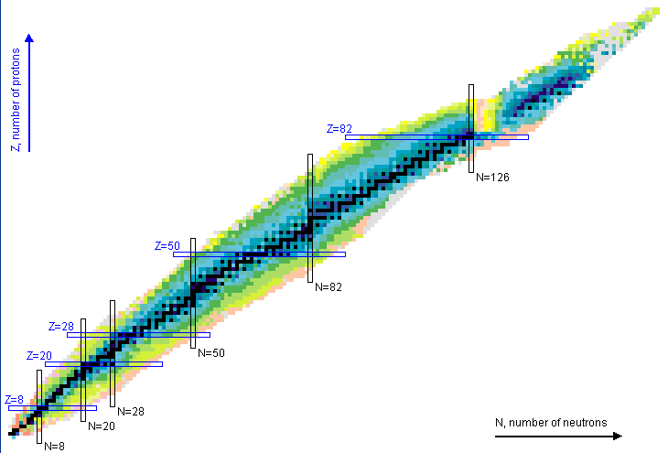
Evaluated Nuclear Structure Data File
ENSDF
3,334 nuclides
~10,000 Reactions
~4,200 Decay
It is Unique: Only Nuclear Database of this kind in the world
It is Complete: All nuclei and all level and radiation properties
It is Versatile: Feeds back into both basic and applied sciences

Slide 3
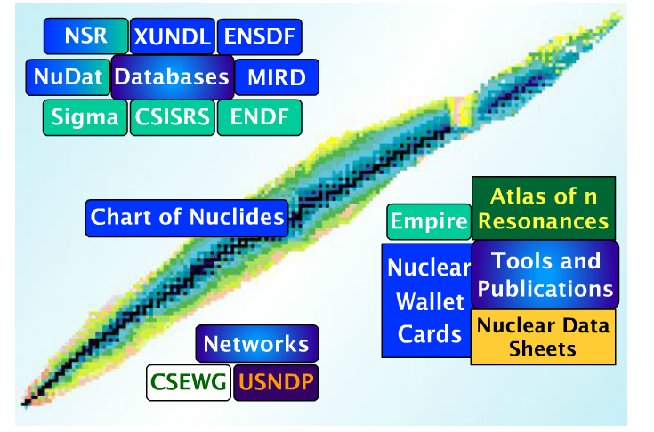
USNDP Resources for Decay Data
ENSDF: Evaluated database
All measurements considered
8 years old on average
NuDat: “Friendly ENSDF”
Instantaneous decay radiation
No comments, source, etc…
ENDF: Decay sublibrary
ENSDF + TAGS + Theory
Stable release
Don’t be afraid to ask !!

Slide 4
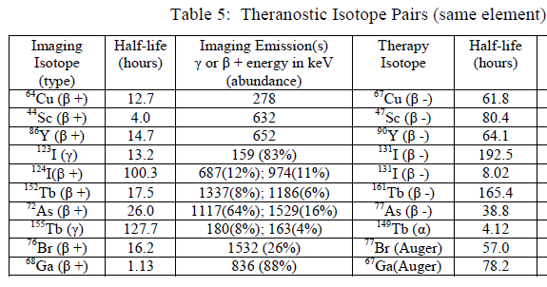

Why Decay Data ?
Forms foundation for many applications:
Nuclear Medicine
Nuclear Forensics
Reactor Decay Heat and Antineutrinos
Non-destructive Assay
Gamma-ray intensities frequently used to determine cross sections
Over half were last studied >30 years ago !!

Slide 5
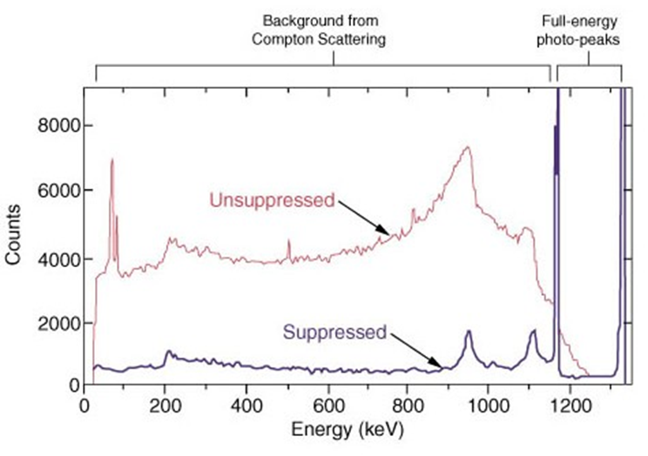
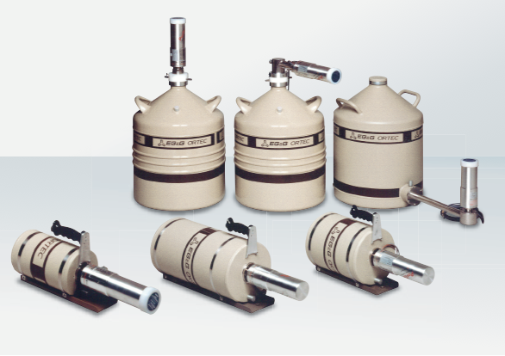
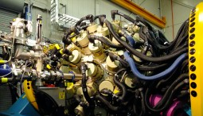
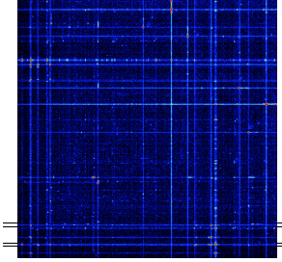
Capitalizing on advances in γ-ray spectroscopy
Compton suppression
30 Years ago: 1-2 small detectors
Present: 10-100 detectors
γγ coincidences

Slide 6
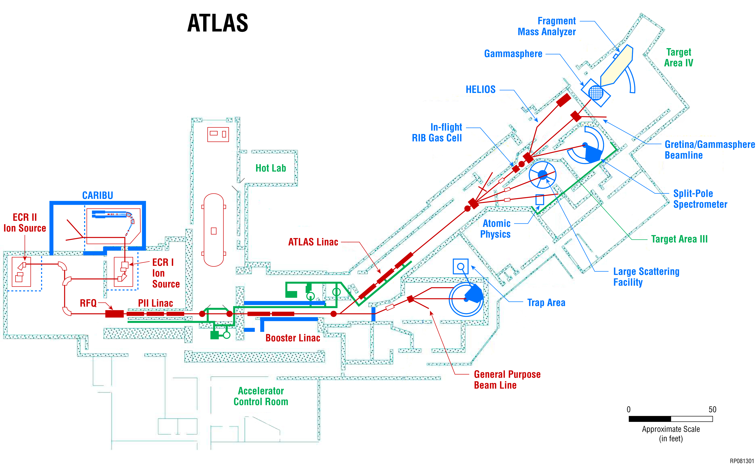
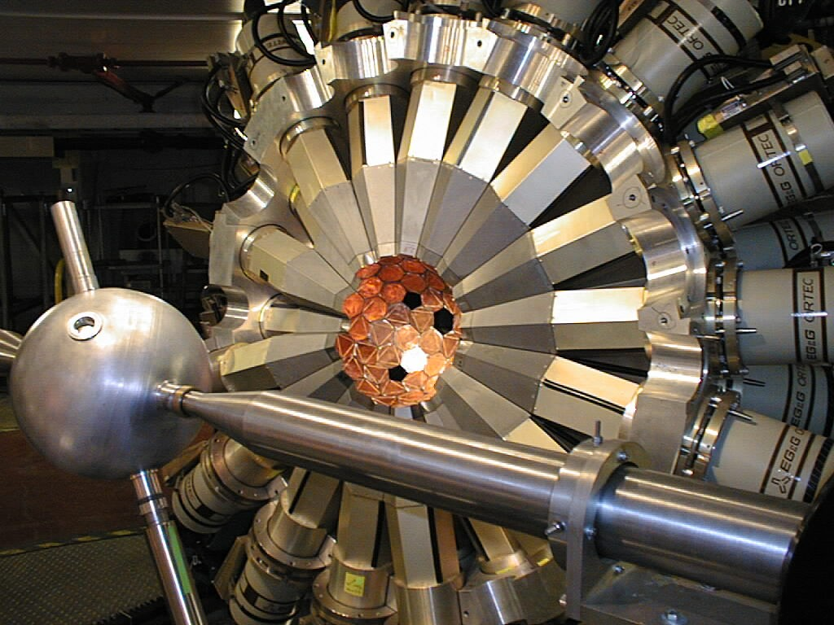
Gammasphere at Argonne National Lab
100 HPGe detectors
Compton-suppressed
Digital or analog DAQ

Slide 7
High-precision gamma-ray spectroscopy for enhancing application of medical isotopes

Slide 8
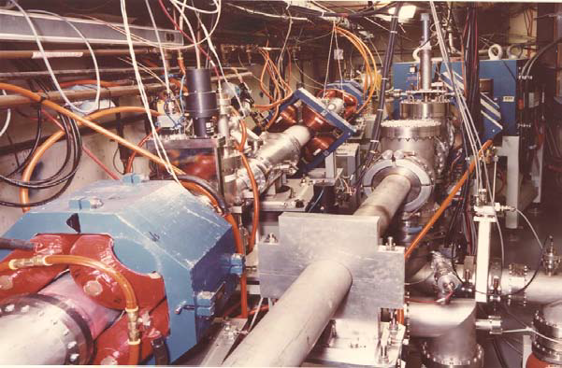
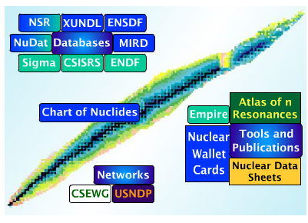
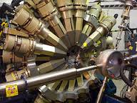
Use a “best-practice”, synergistic approach
Combine expertize in all skills needed to develop a program to enhance production and application of radioisotopes
Target design
Radiochemistry
Medical relevance
Structure & Decay Data
Reaction Data
Reaction Modeling
γ-ray spectroscopy
State-of-the-art detector systems
BLIP
UofW
USNDP
ANL
UMASS

Slide 9
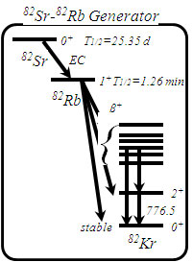
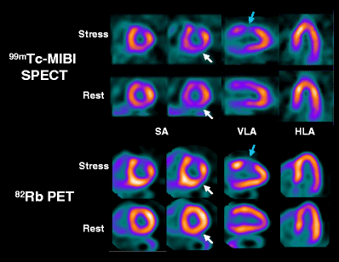
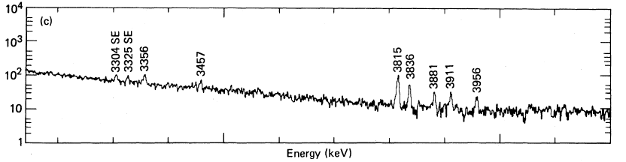
Starting point : ⁸²Rb for Cardiac PET
D. Le Guludec et al., Eur. J. Nucl. Med. Mol. Imaging 35, 1709 (2008).
2 Ge(Li) detectors
R.A. Meyer et al., Phys. Rev. C 27, 2217 (1983).

Slide 10
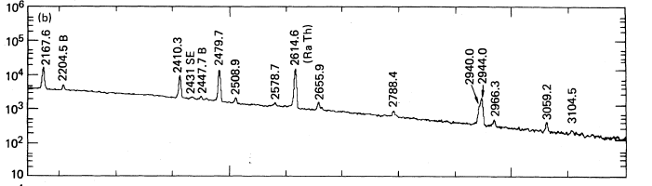
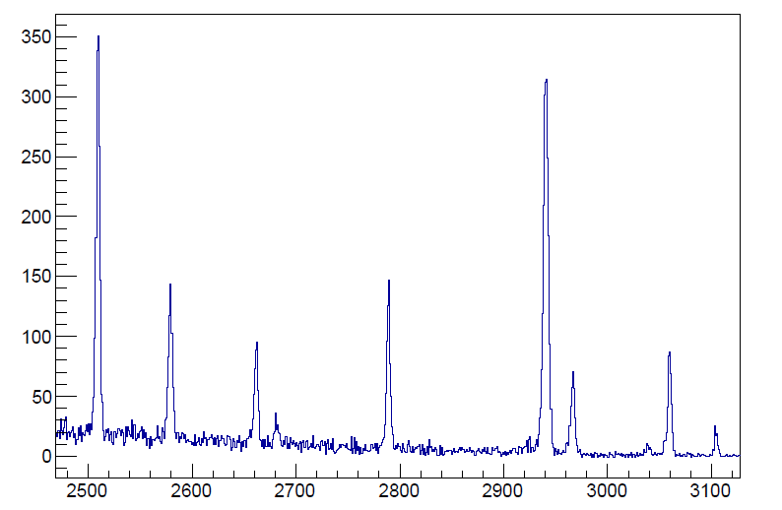
The power of Gammasphere
Prior Singles
Gate on
2⁺→0⁺

Slide 11
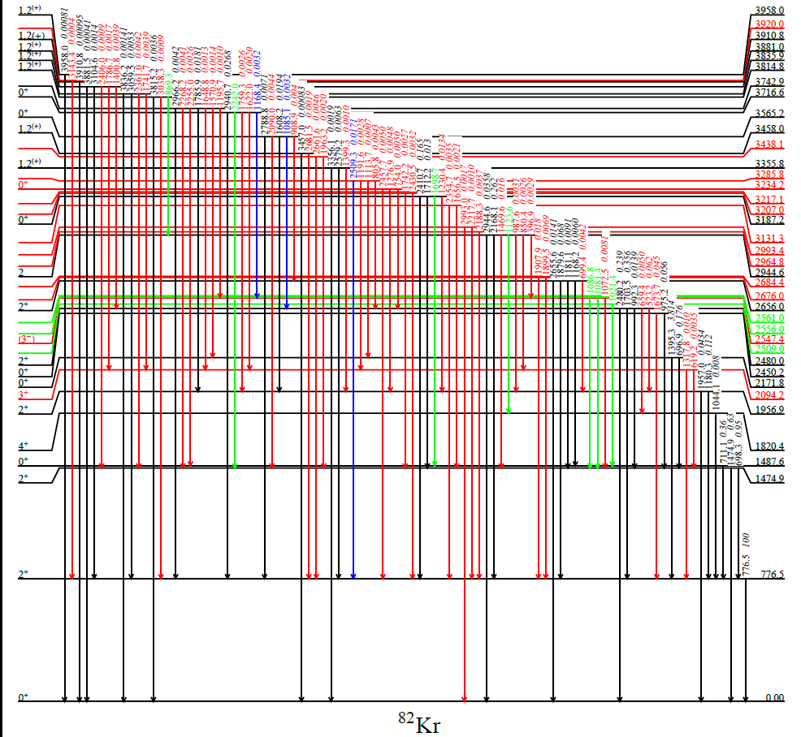
Revised decay scheme for ⁸²Rb
New
Confirmed
Removed
Moved
M. Nino et al, Phys. Rev. C 93, 024301 (2016).

Slide 12
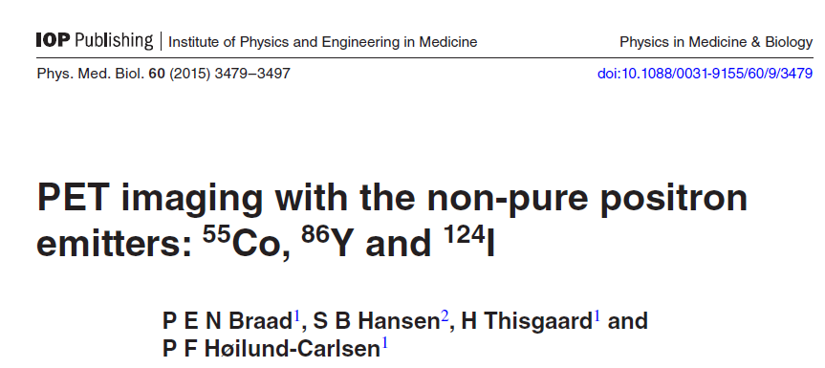
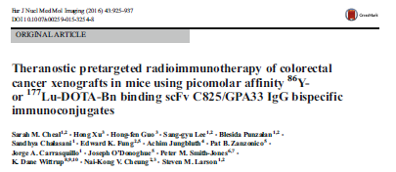
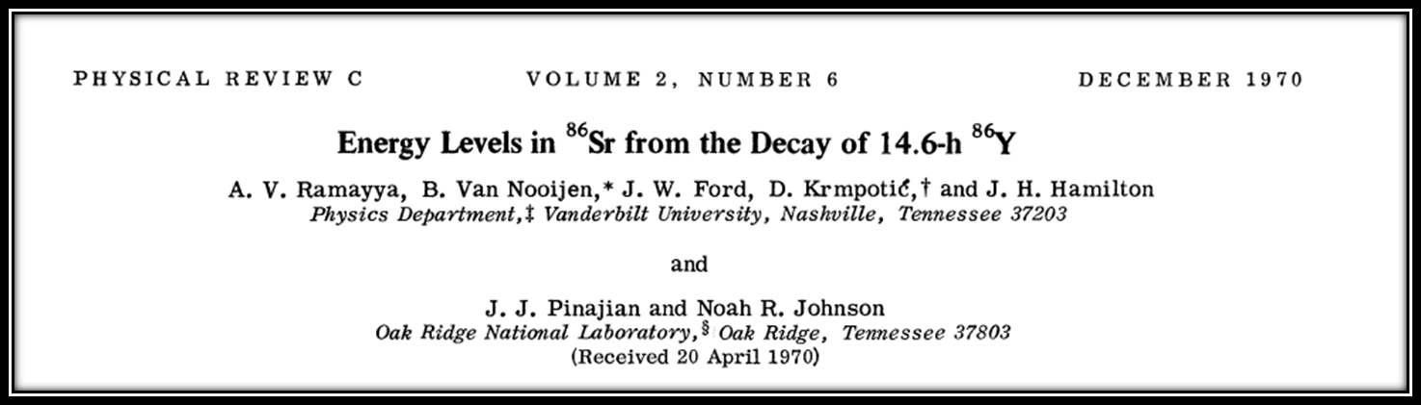
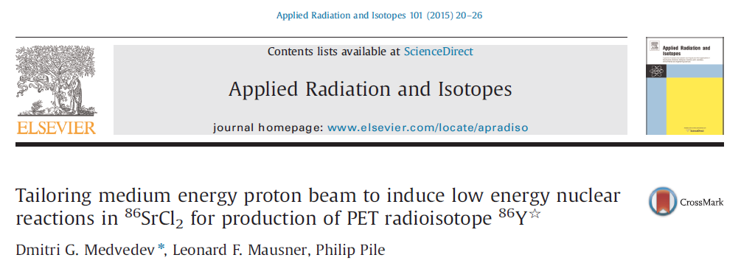
Non-conventional PET agents : ⁸⁶Y

Slide 13
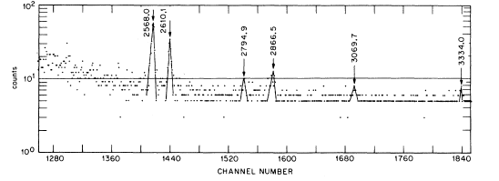
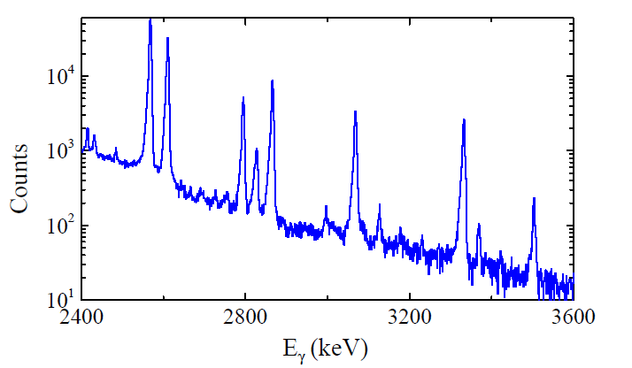
Results on ⁸⁶Y
Gate on 2⁺→0⁺
Gammasphere

Slide 14
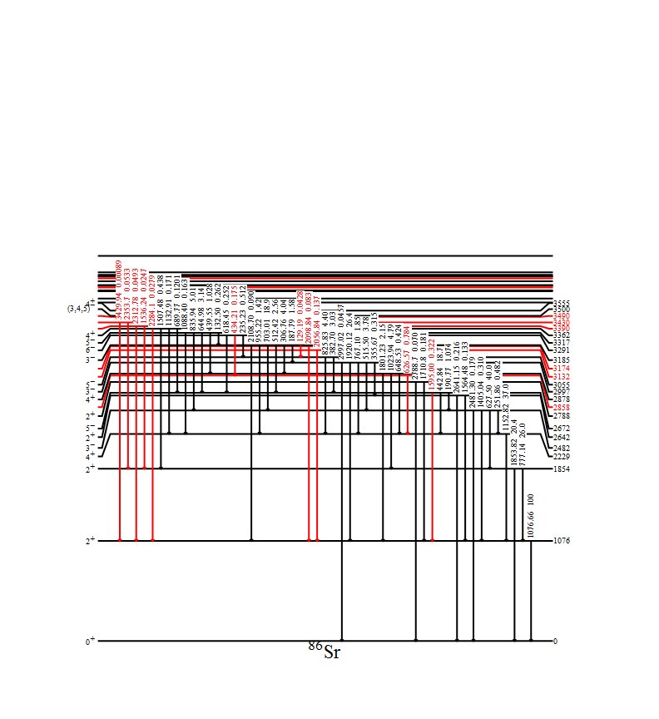
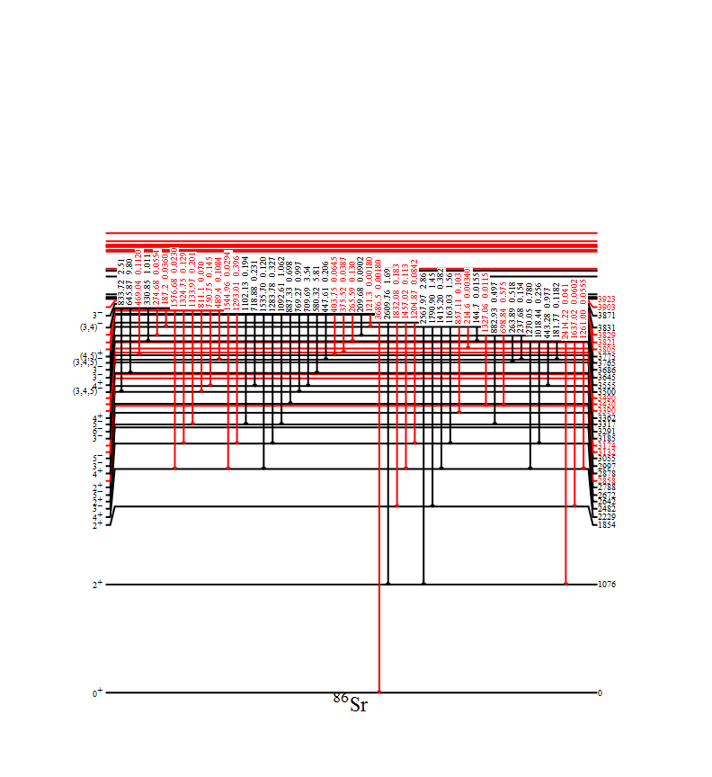
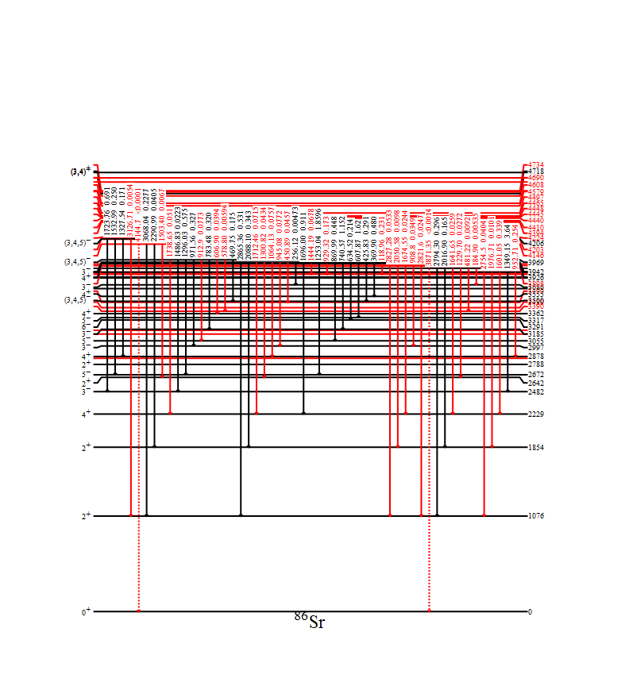
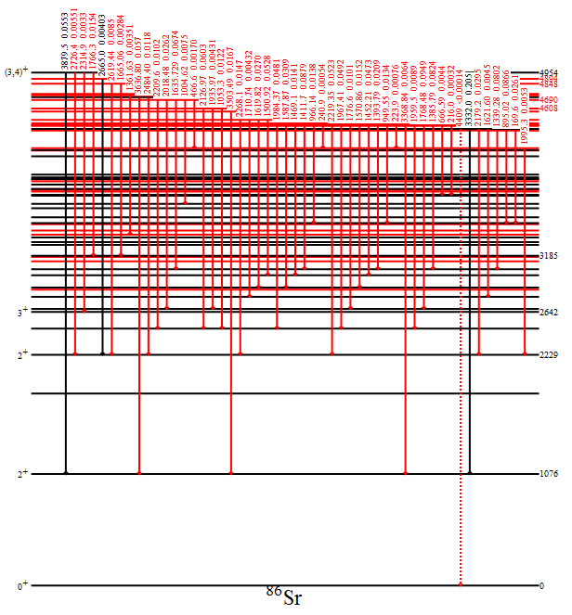
Revised Decay Scheme for ⁸⁶Y
Confirmed
New
Identified over 100 new transitions
511-keV intensity decreases by 20% !

Slide 15
High-precision gamma-ray spectroscopy for fission applications

Slide 16
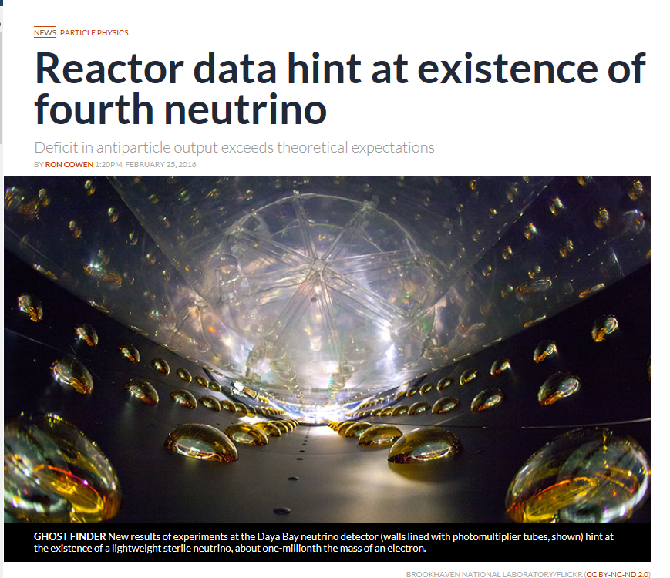
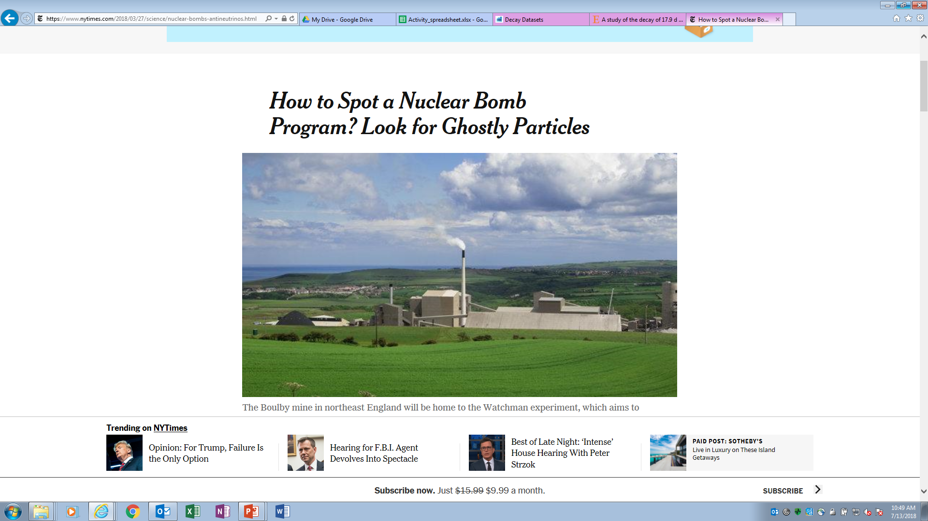
Reactor antineutrinos

Slide 17
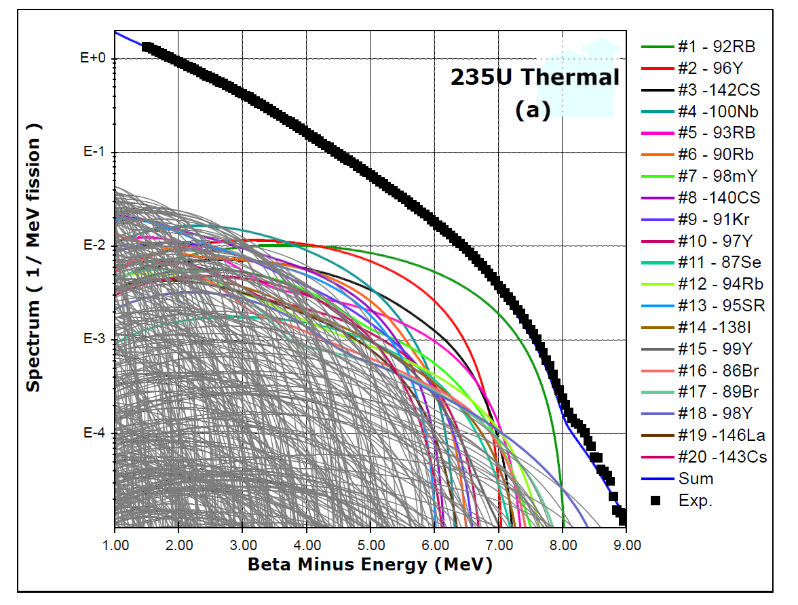
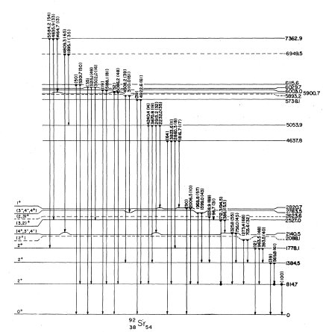
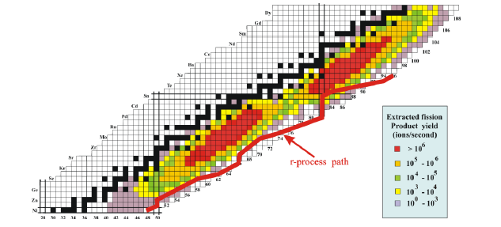
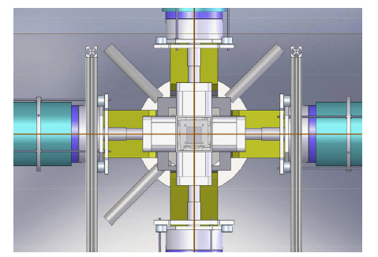
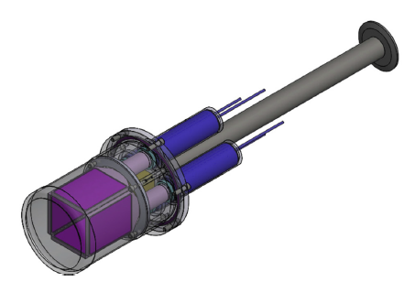
⁹²Rb for reactor antineutrinos
R. J. Olson et al., PRC 5, 2095 (1972)
CARIBU
X- Array
SATURN
⁹²Rb beam
~1000 ions/s
LLNL, NNDC, ANL collaboration

Slide 18
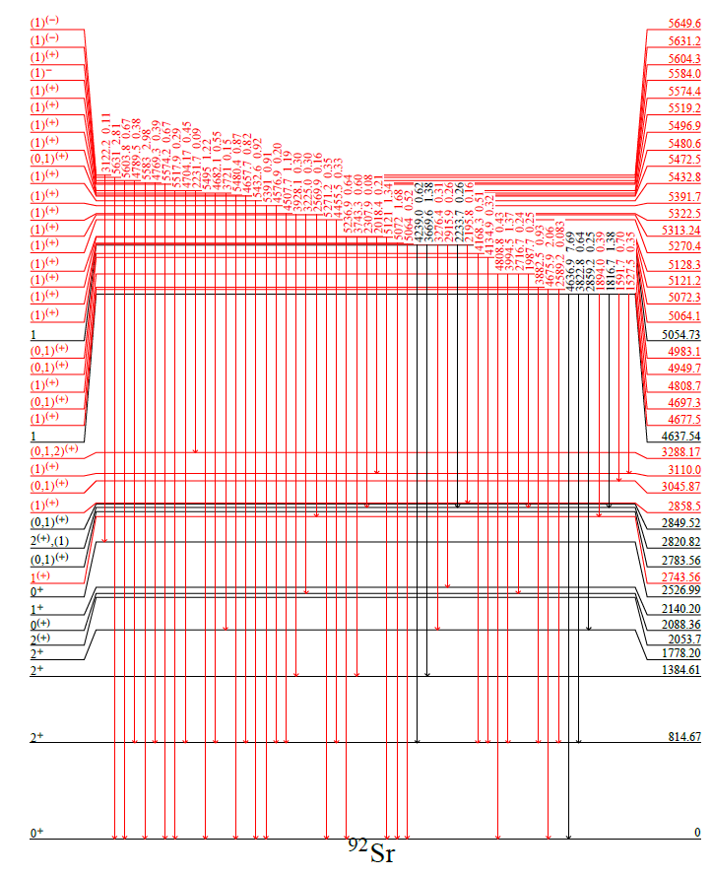
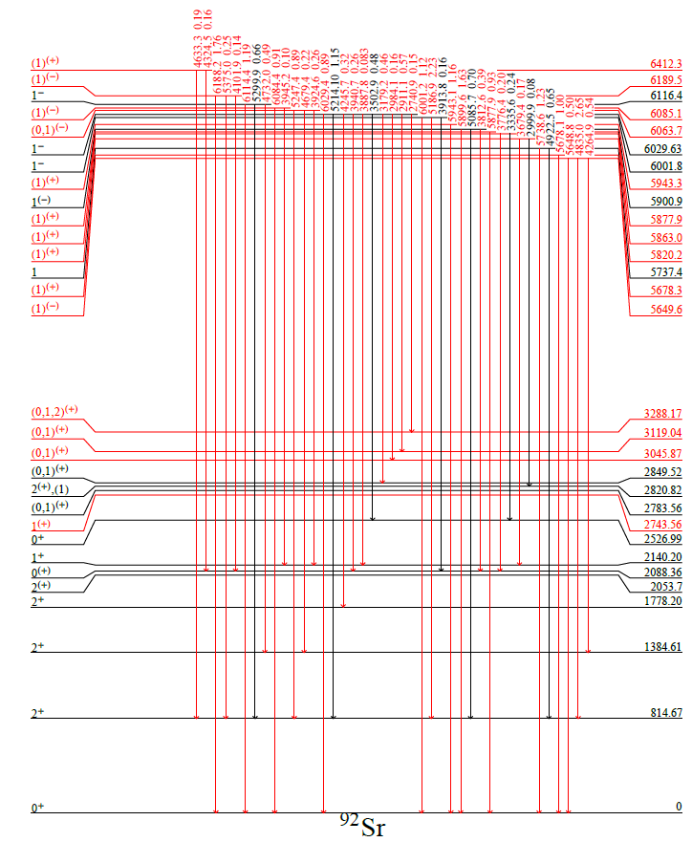
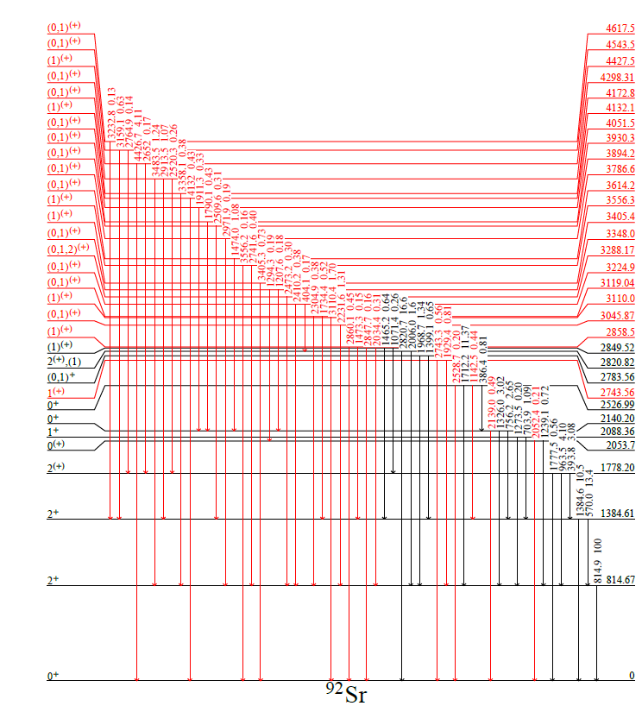
Revised level scheme for ⁹²Rb decay
Confirmed
New
52 New Levels (17 previously known)

Slide 19
Summary and Outlook
Active program to improve decay data
⁸⁶Y, ⁶¹Cu,⁷⁷Br,⁵⁵Mn,⁷⁶Br, ⁷¹As,⁷²As,⁷⁴As,⁷⁶As,¹⁸⁸Ir
Medical
⁹²Rb, ¹⁴²Ba,¹⁴²La
Reactor Antineutrinos
¹³⁰I, ¹³⁶Cs
Forensics (approved beamtime)
We can identify deficiencies, but we don’t know what’s of high priority for some applications
Welcome feedback on isotopes which would warrant a new experimental investigations

Slide 20
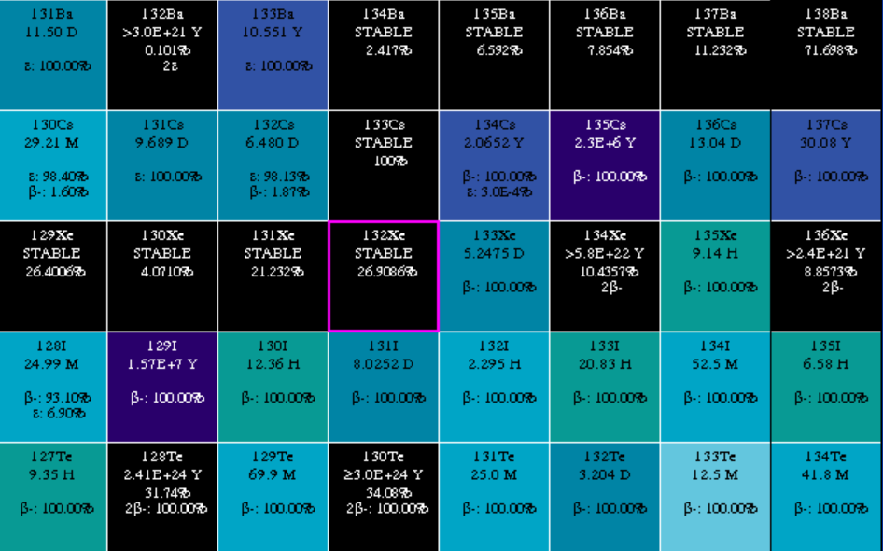
User’s Beware
Blocked Cs and I yields
(relative to well know ⁹⁹Mo) retain fission information
Presented by A. Hayes at NDNCA
INS 1976 Ann.Rept., p.47 (1977)
M.Ohshima, Y.Itoh, S.Hayashibe, M.Fujioka, N.Kawamura, T.Ishimatsu
The Low-Lying Level Structure of ¹³⁶Ba

