Slide 1
Current status of the EXFOR project
Boris Pritychenko
National Nuclear Data Center, BNL, Upton, NY 11973

Slide 2
EXFOR Effort in the U.S. and Canada
EXFOR Team: B. Pritychenko, S. Hlavac, O. Schwerer and V. Zerkin (IAEA).
NNDC: Overall database and contracts management, website support, compilation and correction of missing and older references.
Bratislava: Mainly new references compilation.
Vienna: Overall quality assurance and transmission handling.
IAEA: Web and database software development.
Smooth operation based on efforts of BNL stuff, contractors and collaborators.
Contractors (S. Hlavac and O. Schwerer) are essential for the overall success of the NNDC EXFOR effort.

Slide 3
EXFOR Statistics
New entries: 43 + 87 (BNL) = 130.
Corrected entries: 158 + 53 (BNL) = 211.
24 Preliminary and 24 final data transmissions (Preliminary transmissions go through the NRDC network quality assurance system, after implemented corrections final transmission are loaded into the database).
EXFOR database was updated 24 times, and CINDA database was updated 10 times.
More compilation details in the IAEA system based on calendar years: http://www-nds.iaea.org/exfor-master/x4compil/.
Fission yields compilation pilot project was completed.

Slide 4
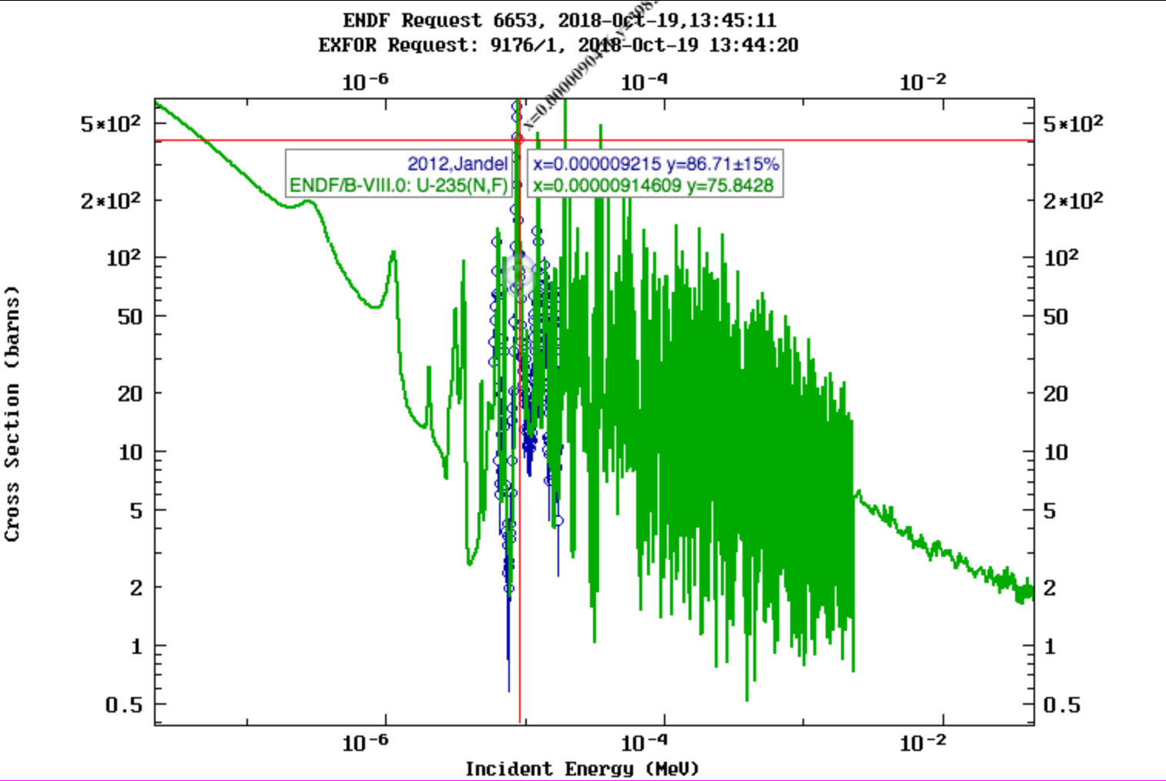
Migration to New Servers
EXFOR database was migrated from MySQL to MariaDB database software.
EXFOR Web, database and maintenance software were migrated to new servers. In fact, we tested the whole new system.
The latest version of EXFOR Web application was installed at NNDC.
New features:
Improved Zoom & Cursor functions
Interactive features
Extended PDF database

Slide 5
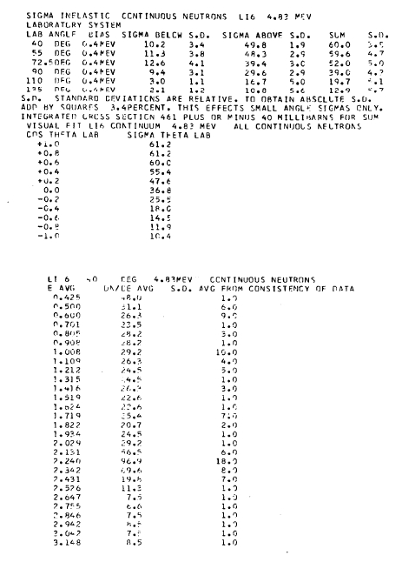
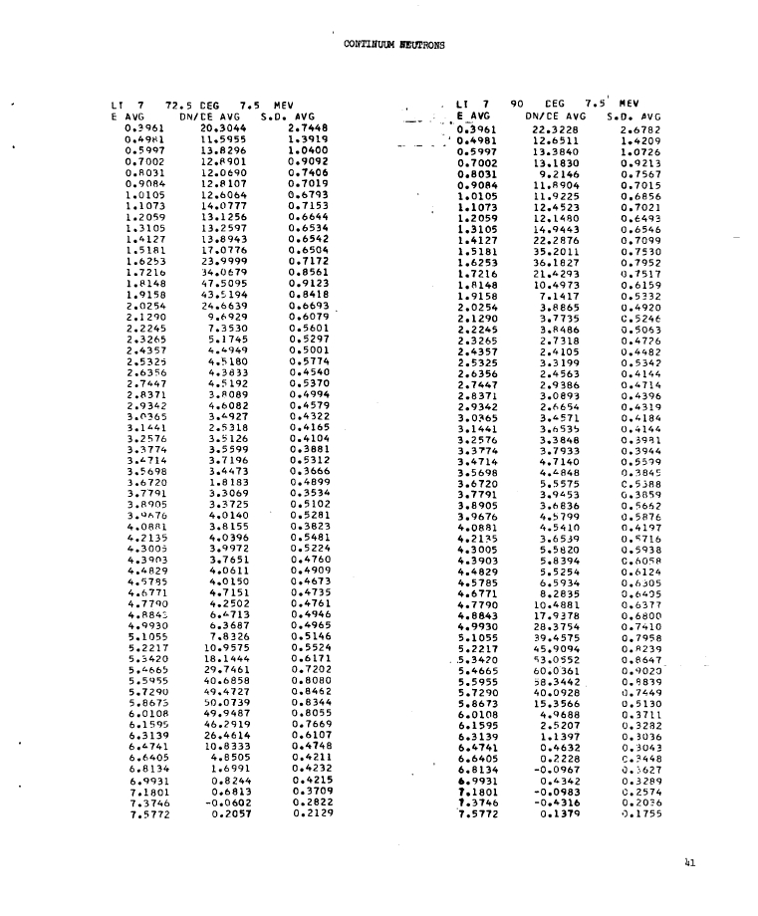
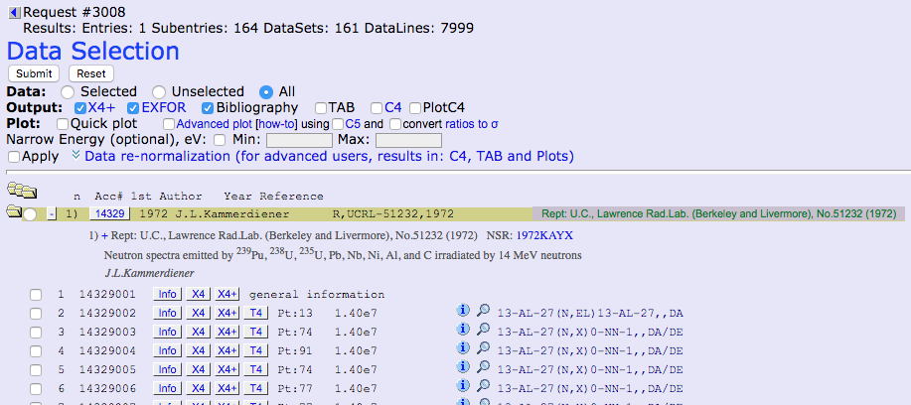
Missing Data
EXFOR criticism by F. Kaeppeler (2006-2007) for nuclear astrophysics publications, and I started my work on EXFOR compilations in 2012 from KADoNiS references.
Due to many historical and technical reasons not all nuclear physics papers and data sets were compiled, or data were not obtained by compilers for compiled entries.
We work in EXFOR on data recovery (e.g. nuclear archeology).
Data recovery includes optical character recognition and data points digitization (Area #1: 11153, 14329). Both technologies work well with high quality images and become challenging otherwise.
Finally, EXFOR team members are willing to travel to research labs and universities and collect the original data in order to provide a complete coverage of experimental nuclear reaction data.
11153.exf: LA -3765 (1967),
Library Without Walls
LANL project
#14329, Thesis of
J.L.Kammerdiener (1972)

Slide 6
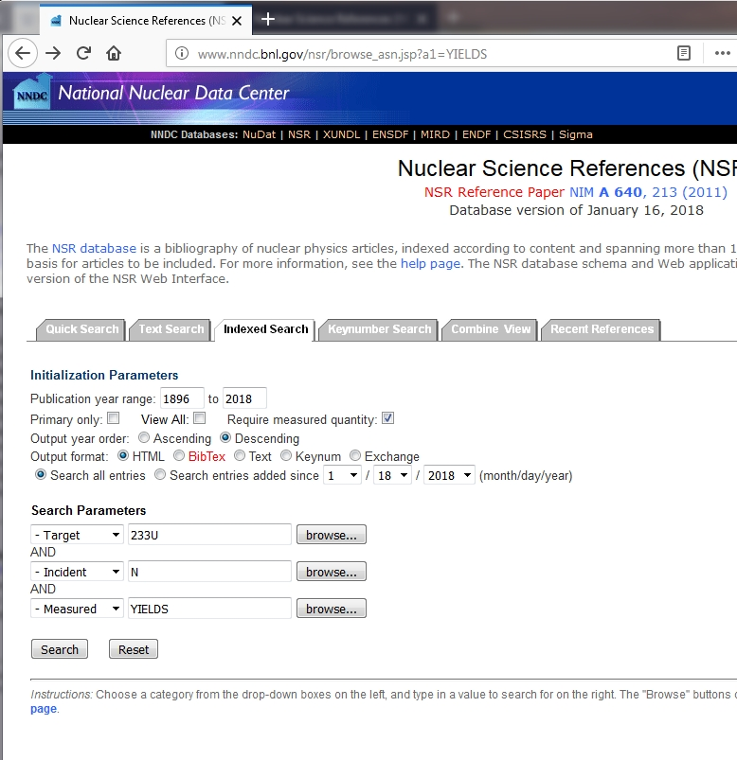
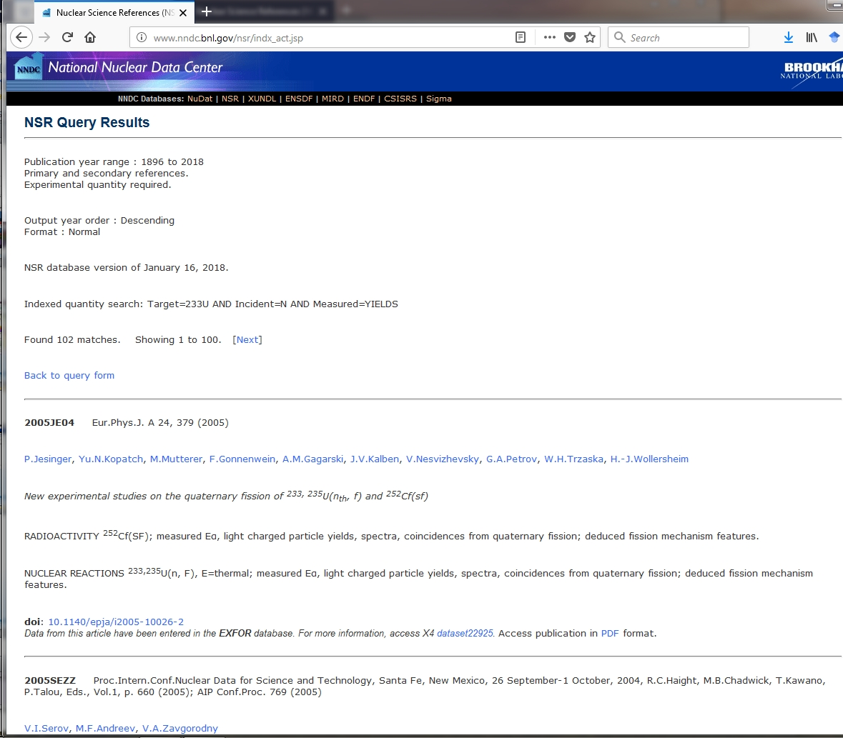
Missing Fission Yields Data
Fission Yields (FY) are fundamental for many applications.
Do we have a complete FY record in EXFOR?
The EXFOR database contains 22,294 experiments (database entries). So, computer tools are needed to investigate it.
The completeness of EXFOR was verified using the NSR database at NNDC (B. Pritychenko, O. Schwerer) + help of V. Zerkin (IAEA).
Simple NSR retrieval for ²³³U(n,F) measured fission yields (exp. data only):
Total references: 102
Potentially missing in EXFOR: 40
Data includes also other isotopes of U and Pu, ²⁵²Cf(SF).

Slide 7
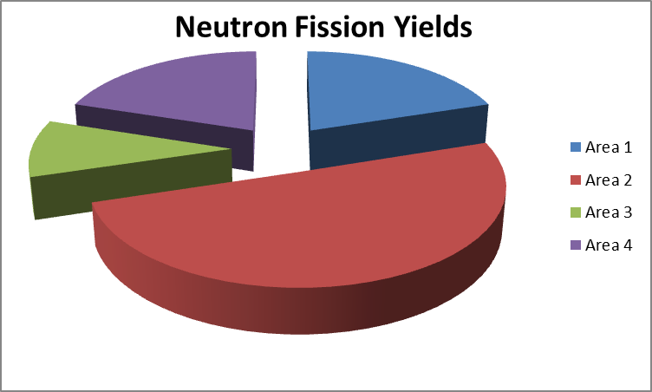
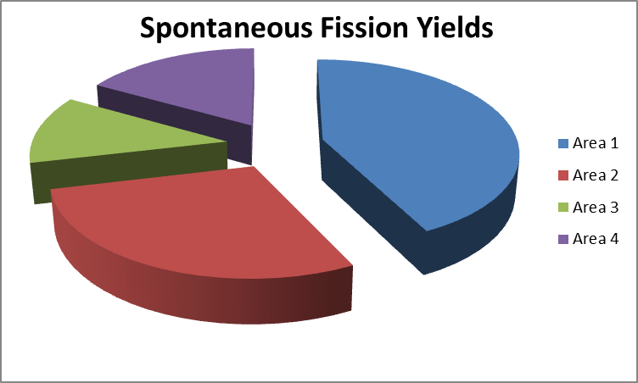
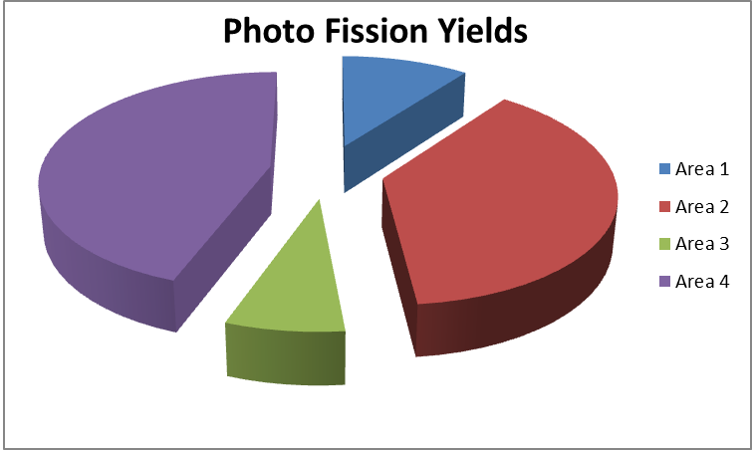
Work on FY References
Finally, nuclear structure-like search for FY NSR references was conducted at NNDC:
Potentially Missing Neutron FY: 384
Potentially Missing Spontaneous FY: 142
Potentially Missing Photo FY: 126
Non-uniform findings in the areas: #3 small (IAEA), #2 large (NEA)
Data were sorted by EXFOR areas, #1 is US and Canada, #2 Western Europe + Japan, …
Potentially, the IAEA could get W. Mills FY database (timescale is unclear).
Large volume of work on future FY compilations at NNDC, one more contractor is necessary for timely completion.

Slide 8
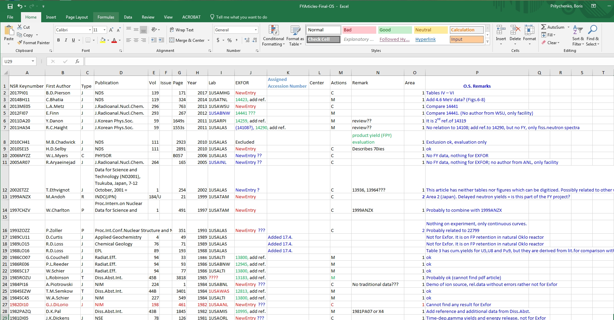
NSR FY References
Lists of new, updated, excluded (already existing) entries and difficult to find references for NF, SF and GF EXFOR entries have been generated.
All data for Photo, Spontaneous and Neutron-Induced fission yields were verified by O. Schwerer.
NSR impact
Project produced many modifications of NSR entries.
PDF collection assembly is in progress (540+), many thanks to J. Totans for rare reports.
EXFOR impact
Area #1 papers will be compiled at NNDC, other references will be passed to the NRDC for processing.
Results will be summarized in BNL report, work on NRDC memos is in progress.
NF/Area | #1 | #2 | #3 | #4 | Sum
New | 28 | 103 | 19 | 47 | 197
Updates | 39 | 68 | 14 | 20 | 141
Excluded | 2 | 16 | 1 | 7 | 26
Not Found | 9 | 4 | 3 | 3 | 19
Total | 78 | 191 | 37 | 77 | 383
SF/Area | #1 | #2 | #3 | #4 | Sum
New | 33 | 27 | 9 | 18 | 87
Updates | 15 | 9 | 5 | 6 | 35
Excluded | 1 | 3 | 0 | 0 | 4
Not Found | 11 | 2 | 3 | 0 | 16
Total | 60 | 41 | 17 | 24 | 142
GF/Area | #1 | #2 | #3 | #4 | Sum
New | 7 | 34 | 5 | 23 | 69
Updates | 2 | 6 | 2 | 30 | 40
Excluded | 0 | 0 | 2 | 0 | 2
Not Found | 4 | 8 | 0 | 3 | 15
Total | 13 | 48 | 9 | 56 | 126
 | Experiments | Data Sets | Missing References
Neutron-Induced (NFY) | 817 | 2992 | 384
Photo-Induced (PFY) | 57 | 189 | 126
Spontaneous (SFY) | 189 | 612 | 142

Slide 9
Pilot FY Compilation Project
Pilot project was launched at NNDC to estimate a FY compilation time scale.
Search for missing references at NNDC
Search for missing references (B. Pritychenko): ~160 h
Search for missing references (E. Betak): ~20 h
Verification (O. Schwerer): ~120 h
NNDC library work (J. Totans): ~120 h
Totals for searches and verification: 420 h
Pilot Compilation Project
Compilation of 15 experiments (B. Pritychenko): ~120 h
Verification of 15 experiments (O. Schwerer): ~60 h
Corrections of 18 old entries (B. Pritychenko): ~60 h
Verification of 18 old entries (O. Schwerer): ~30 h
Totals for 15 new and 18 updated entries are 180 and 90 h, respectively.
Please do not use the pilot project time scale literally, some experiments could be very time consuming. Rather consider the fact that NNDC already has invested 690 hours of work to the creation of complete FY experiments database.

Slide 10
Pilot Project Findings
NSR and EXFOR databases FY contents were improved because of the pilot project.
EXFOR compilation rules sometimes contradict with a spirit of physics.
Spallation vs. Fission
Both process produce lighter nuclei but distributions are different.
Physicists like G. Seaborg simply measure spallation or fission product cross sections or yields but it is not sufficient for EXFOR.
SF5=SPL only when spallation was explicitly measured, measuring spallation products is not sufficient in EXFOR.
Both spallation and fission timescales are small (direct/compound) to be detected in experiments, so reactions are separated using the product distributions. Therefore, it is difficult to understand the meaning of explicitly measured spallation. EXFOR rules are confusing and have to be updated.
Fission yield cross section compilation rules
SF5=IND is redundant for beta shielded products, so SF5 is undefined or blank.
N/A for fission yields.
These rules create issues with computer programs and Web interface retrievals, and they have to be revisited.

Slide 11
Conclusions
NNDC EXFOR compilation effort is complex and well-organized.
We will continue to use modern computer tools and technologies in EXFOR compilation process.
EXFOR contractors are essential for the current operation.
We need more direct contacts with research labs and universities for data recovery, and we are willing to travel and recover the original data.
Missing FY articles have been identified and compilation is in progress. This work helped to secure DOE funding and lays foundation for a future CRP effort at the IAEA.
It is a team effort.

