Slide 1
N. Nica¹, J.C. Hardy¹, V. Horvat¹, V.E. Iacob¹, H.I. Park¹, T.A. Werke¹, K.J. Glennon¹, C.M. Folden III¹, M.B. Trzhaskovskaya²,
V.I. Sabla³, J. Bryant³, and X.K. James⁵
¹ Cyclotron Institute, Texas A&M University, College Station, Texas 77843, USA
² Petersburg Nuclear Physics Institute, Gatchina 188300, Russia
³ REU summer student from Middlebury College, Middlebury VT 05753
⁴ REU summer student from University of Central Arkansas, Conway
AR 72035
⁵ REU summer student from University of Wisconsin, La Crosse
WI 54601
Precise α_{K} and α_{T} Internal Conversion Coefficients Measurements of 39.752(6)-keV E3 Transition in ^{103m}Rh: Test of Internal Conversion Theory
TEXAS A&M PROGRAM TO MEASURE ICC

Slide 2
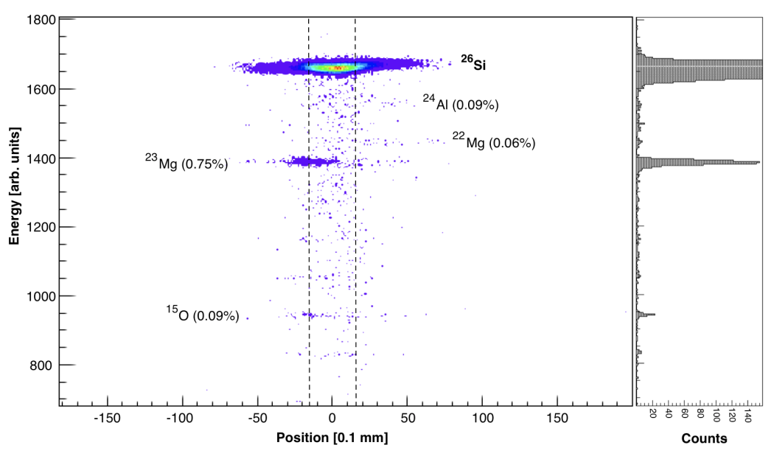
    Texas A&M - Cyclotron Institute β-γ Precision Measurements
K500 and K150 cyclotrons
+ MARS

Slide 3
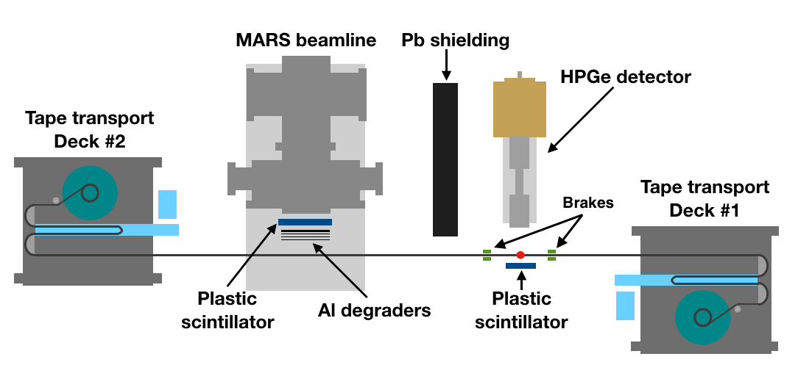
Texas A&M - Cyclotron Institute β-γ Precision Measurements
HPGe detector (γ)
Gas detector (β)
Plastic Scintillator detector (β)
Tape transport
Kamax NT acq

Slide 4
Precise α_{K} and α_{T} Internal Conversion Coefficients Measurements of 39.752(6)-keV E3 Transition in ^{103m}Rh: Test of Internal Conversion Theory
TEXAS A&M PROGRAM TO MEASURE ICC
Internal Conversion Coefficients (ICC):
Big impact on quality of nuclear science
Central for the nuclear data evaluation programs
Intensely studied by theory and experiment
Important result: hole calculation now standard

Slide 5
2002RA45 survey ICC’s theories and measurements
Theory: RHFS and RDF comparison
Exchange interaction, Finite size of nucleus, Hole treatment
Experiment:
  100 E2, M3, E3, M4, E5 ICC values, 0.5%-6% precision,
  very few <1% precision!
Conclusions, Δ(exp:theory)%:
      No hole: +0.19(26)% BEST!
      (bound and continuum states - SCF of neutral atom)
      Hole-SCF: -0.94(24)%
      (continuum - SCF of ion + hole (full relaxation of ion orbitals))
        Hole-FO: -1.18(24)%
        (continuum - ion field from bound wave functions of neutral atom
        (no relaxation of ion orbitals))
        PHYSICAL ARGUMENT
K-shell filling time vs. time to leave atom
~10⁻¹⁵ – 10⁻¹⁷ s » ~10-¹⁸ s

Slide 6
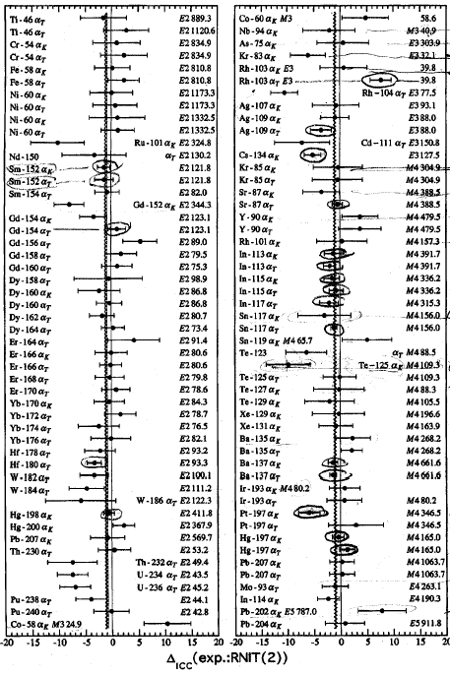
2002Ra45: 100 α_{K}(exp) cases compared with
‘hole FO’ calculations

Slide 7
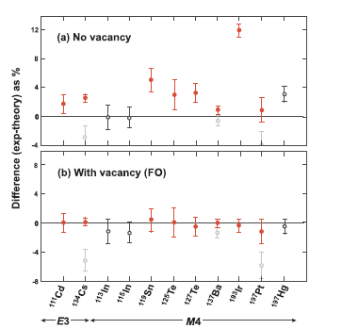
Overview of the scope and completeness of the method
Scope: Minimize ICC measurement unc (~1%) and maximize
Δ_{theory}(FO,NH)% (>4%, E3, M4)
Completeness: There is no criterion to reach the scope of comparison between ICC theories “with hole” and “no hole” except for measuring precisely as many relevant cases as practically possible

Slide 8
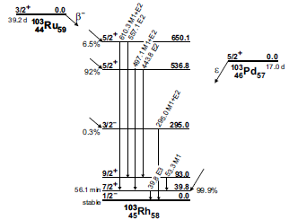

Slide 11
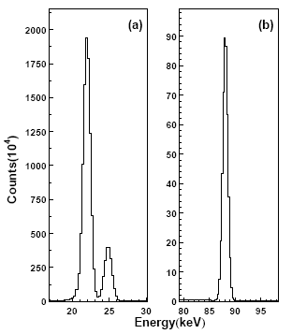
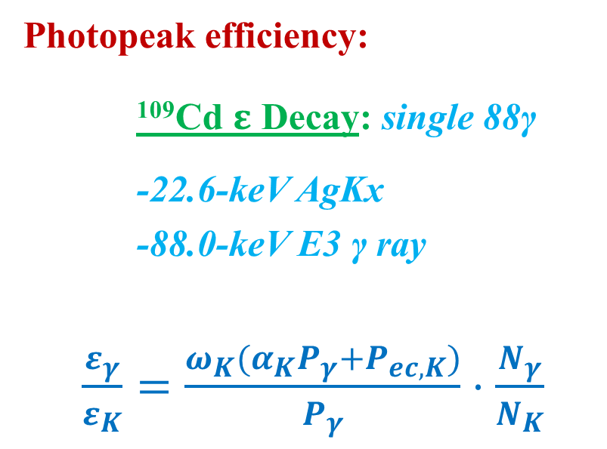
¹⁰⁹Cd Efficiency Calibration
22.6-keV AgKx & 88.0-keV E3 γ regions
Photopeak efficiency:
¹⁰⁹Cd $ε$ Decay: single 88γ
-22.6-keV AgKx
-88.0-keV E3 γ ray
$\frac{ε_{γ}}{ε_{K}}=\frac{ω_{K}(α_{K}P_{γ}+P_{ec,K})}{P_{γ}}⋅\frac{N_{γ}}{N_{K}}$

Slide 13
^{103m}Rh Run
Radioactive Sources were prepared by (n_{th},γ) reaction at TRIGA reactor of Texas A&M Nuclear Science Center at ~ 7.5 ×10¹² n/cm²s
Sources were prepared of materials with natural isotopic abundance: ¹⁰²Ru 32%, ¹⁰²Pd 1%
1. ^{103m}Ru Source(1), 545 μg/cm² RuO₂ on Al backing. Activated for 20 h, measured after 1 months for ~20 days with HPGe detector. Found ¹⁵³Gd decay (239 d) 41.3-keV K_{α} peak affecting the 39.8-keV ^{103m}Rh peak of interest
2. ^{103m}Ru Source(2), 1.1 mg/cm² Ru metal on 1.3 mg/cm² Cu metal. Activated for 32 h, measured after 1 months for ~77 days with HPGe detector and Si(Li) detector.
3. ^{103m}Pd Source(3), 4.8 mg/cm² Pd metal. Activated for 4.5 h, measured after 2 months for ~44 days with HPGe detector .

Slide 14
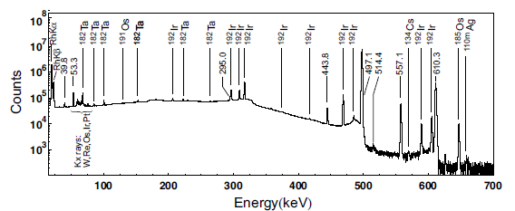
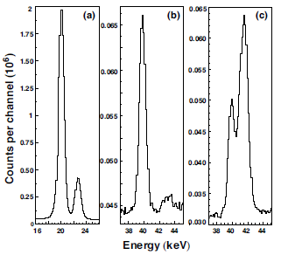
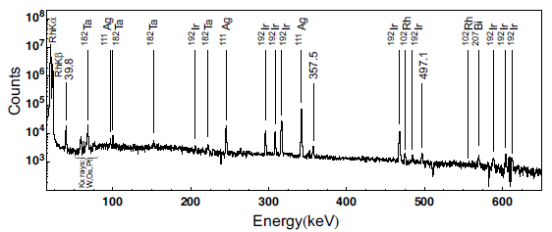
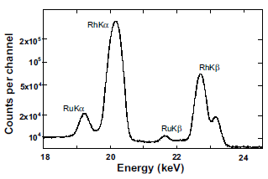
^{103m}Rh Analysis
HPGe detector
Ru/Cu Source(2): (a) Rh Kx-rays; (b) 39.8-keV γ ray
RuO₂ Source(3): (c) 39.8-keV γ ray + Eu K_{α} contamination
Ru/Cu Source(2): Impurity analysis spectrum
Pd Source(3): Impurity analysis spectrum
(Si)Li detector, Ru/Cu Source(2):
Rh Kx-rays with Ru Kx-rays (fluorescence)

Slide 15
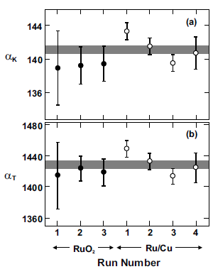

^{103m}Rh Results
(a) α_{K} and (b) α_{T} from Ru Source(1) and Source(2)
Weighted average of seven experimental results: :
From Ru run Source(1) and Source(2)
α_{K39.8 =} 141.1(23) (rel. unc. 1.6%)
α_{T39.8 =} 1428(13), (rel. unc. 0.9%)
Pd Source(3)
Consistency check: ¹⁰³Pd ε ? ¹⁰³Ru β⁻ $α_{K}+\left(1+α_{T}\right)P_{ec,K}$:1383(28) ≈ 1369(11)
Model | α_{K} | Δ(%) | α_{T} | Δ(%)
Experiment | 141.1(23) |  | 1428(13)
Theory:
a) Pure E3
No vacancy | 127.5(1) | +10.7(18) | 1388(2) | +2.9(9)
Vacancy(FO) | 135.3(1) | +4.3(17) | 1404(1) | +1.7(9)
a) E3+M4, δ=0.02 (0.04%)
No vacancy | 131.2(1) | +7.5(18) | 1410(2) | +1.3(9)
Vacancy(FO) | 139.3(1) | +1.3(17) | 1426(1) | +0.1(9)
Conclusion:
Small M4 admixture:
-Agreement with theory including the vacancy (FO)
-Disagreement with theory ignoring the vacancy

