Slide 1
Assessment of ENDF/B-VIII.0 and TENDL-2015 Evaluated Nuclear Data Libraries Using Stellar Nucleosynthesis Modeling
Boris Pritychenko¹
1 National Nuclear Data Center, Brookhaven National
Laboratory, Upton, NY 11973-5000, USA

Slide 2
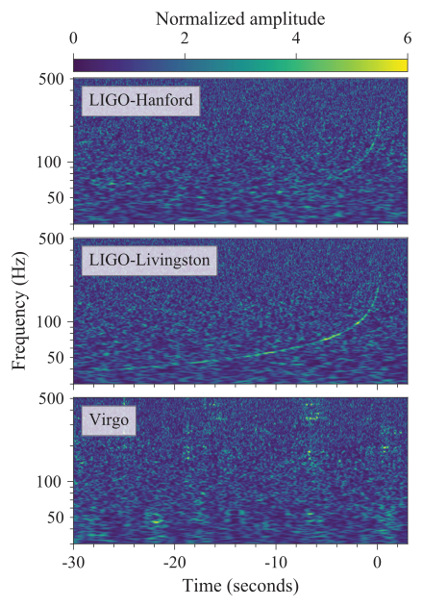
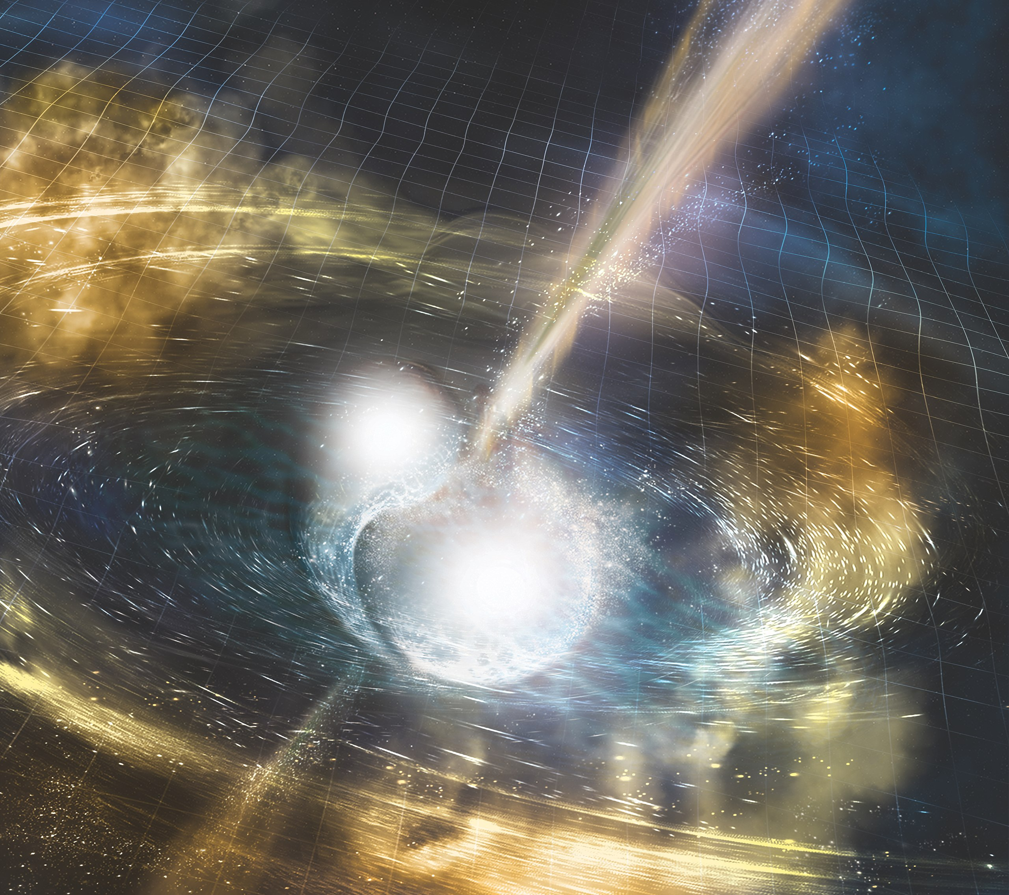
Heavy Elements Production in a Neutron Star Merger
Can we apply nuclear data libraries to address current astrophysical observations such as a multi-messenger signal from the NGC 4993 galaxy?
GW170817 was a gravitational wave signal observed by the LIGO and Virgo detectors on 17 August 2017; plus EM signal.
The rapid-neutron capture (r) process element production was tentatively observed.
The Doppler-shifted ejecta optical spectra consistent with Lanthanide and heavy elements.
The r-process abundances can be deduced from evaluated neutron cross sections and solar system element abundances.
Courtesy of NASA (Unique Gamma-Ray Burst): https://www.nasa.gov/vision/universe/watchtheskies/short_burst.html.
Artistic concept,
Courtesy of Wikipedia.

