Slide 1
Naval Nuclear Laboratory Special Purpose O-17, O-18, Be-9 (α,n) Evaluations
Jesse Holmes
Andrew Pavlou
Jason Thompson
Mike Zerkle
Cross Section Evaluation Working Group
Brookhaven National Laboratory
November 5-7, 2018

Slide 2
Applications for Special Purpose (α,n) Libraries
Calculation of yield and spectrum of neutrons produced by (α,n) reactions with light nuclides in materials containing actinide α-particle emitters.
Non-fission neutron source characterization for reactor analysis, Am-Be / Pu-Be sources and shielding, nuclear safeguards, materials non-destructive assay, etc.
JENDL/AN-2005 includes ENDF-6 format (α,n) evaluations for 17 nuclides with Z ≤ 14. No (α,n) evaluations are available in ENDF/B.
The LANL code SOURCES is considered an industry standard for (α,n) neutron source characterization.
NNL recently implemented an in-line (α,n) source sampling methodology in MC21 for Monte Carlo radiation transport simulations. The LLNL Monte Carlo code COG uses a similar approach, but only the ability to calculate neutron yields has been studied.
Other Monte Carlo codes exist that use various methods enabling (α,n) calculations (MCNP, FLUKA, GEANT, SRIM/TRIM, etc.) but suffer from a variety of disadvantages (transport expense, manual input requirements, geometry limitations, etc.).

Slide 3
Testing JENDL/AN-2005 (α,n) Evaluations
NNL tested the JENDL/AN-2005 (α,n) evaluations in MC21.
Calculated neutron yields and energy/angle spectra were compared to available experimentally measured data from public literature.
MC21 neutron yield results compared very well with most experimental data.
For neutron energy spectra, MC21 results were noted to deviate significantly from published experimental data for ^{natural}UO₂, ²³⁸PuO₂, and Am-Be sources.
The deviations were determined to be caused by physics deficiencies in the JENDL/AN-2005 evaluations for O-17, O-18, and Be-9.
NNL modified these evaluations to address the identified deficiencies and validated the new versions against experimental data.
NNL is now submitting these modified special-purpose (α,n) evaluations for inclusion in ENDF/B-VIII.1.

Slide 4
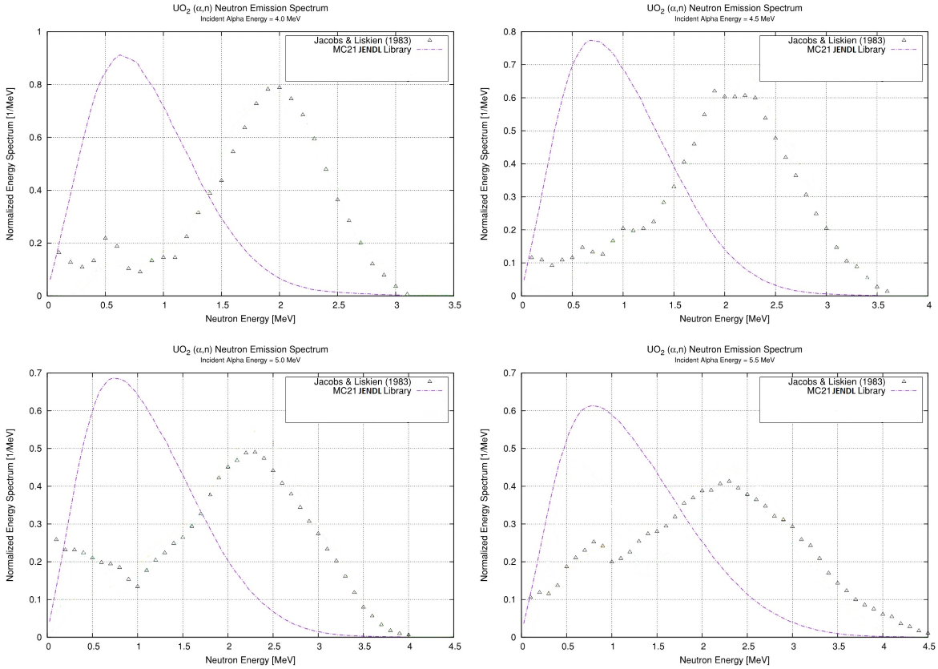
Natural-Uranium UO₂ (α,n) Neutron Spectra
JENDL Library Testing for O-17,18

Slide 5
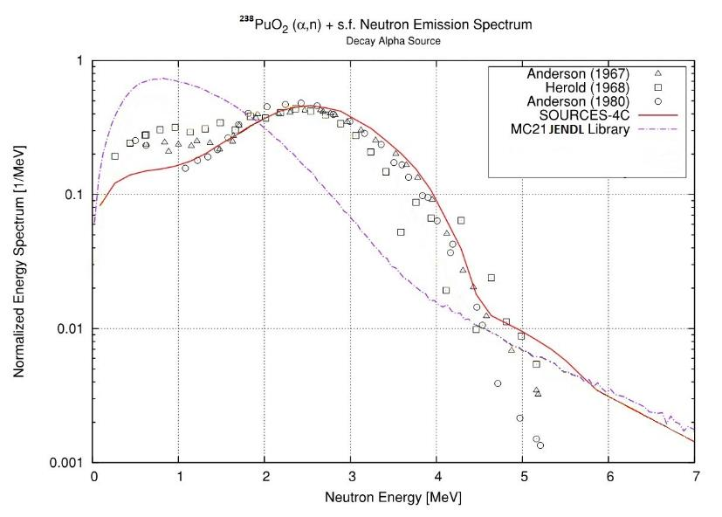

Slide 6
Problems with Kalbach-Mann Systematics
O-17 and O-18 use Kalbach-Mann systematics for File 6 coupled energy/angle distributions for MT=4 (production of one neutron in the exit channel).
Energy/angle distributions based on Kalbach-Mann systematics are decoupled from the partial cross sections for reactions leaving the residual in the ground state or particular low-level excited states.
The Q-values of low-level n^{th} excited-state reactions (including the 0th ground-state) are widely separated and strongly impact the emitted neutron energy spectrum for reactions induced by low-energy α particles.
Kalbach-Mann theory for (α,n) neutron energy/angle distributions is appropriate for very-high-energy incident α particles (tens to hundreds of MeV), where high-level residual excited states (or a continuum excited state) dominate.
Not appropriate for low-energy α particles emitted by actinide decay (approx. 4-7 MeV), which will then undergo slowing down in materials of interest.

Slide 7
File 6 Neutron Energy/Angle Modifications for O-17,18 (File 3 cross sections are unchanged)
MT | Reaction | Description
4 | (α,n) | Production of one neutron in the exit channel. Sum of MT=50-91.
16 | (α,2n) | Production of two neutrons and a residual.
22 | (α,nα’) | Production of a neutron and an α particle, plus a residual.
28 | (α,np) | Production of a neutron and a proton, plus a residual.
50-90 | (α,n₀₋₄₀) | Production of a neutron, with the residual in the 0th-40th excited state.
91 | (α,n_{c}) | Production of a neutron in the continuum not included in the above discrete representation.
201 | (α,Xn) | Total neutron production.
Nuclide | Cross Section MF3 MTs | JENDL version MF6 MTs | NNL version MF6 MTs
O17 | 4 22 50-53 91 201 | 4 22 | 22 50-53 91
O18 | 4 16 22 50-54 91 201 | 4 16 22 | 16 22 50-54 91
Color-coded MT values indicate neutron
energy/angle distribution treatment
Green: Kalbach-Mann coupled energy/angle distribution
Red: Isotropic two-body kinematics

Slide 8
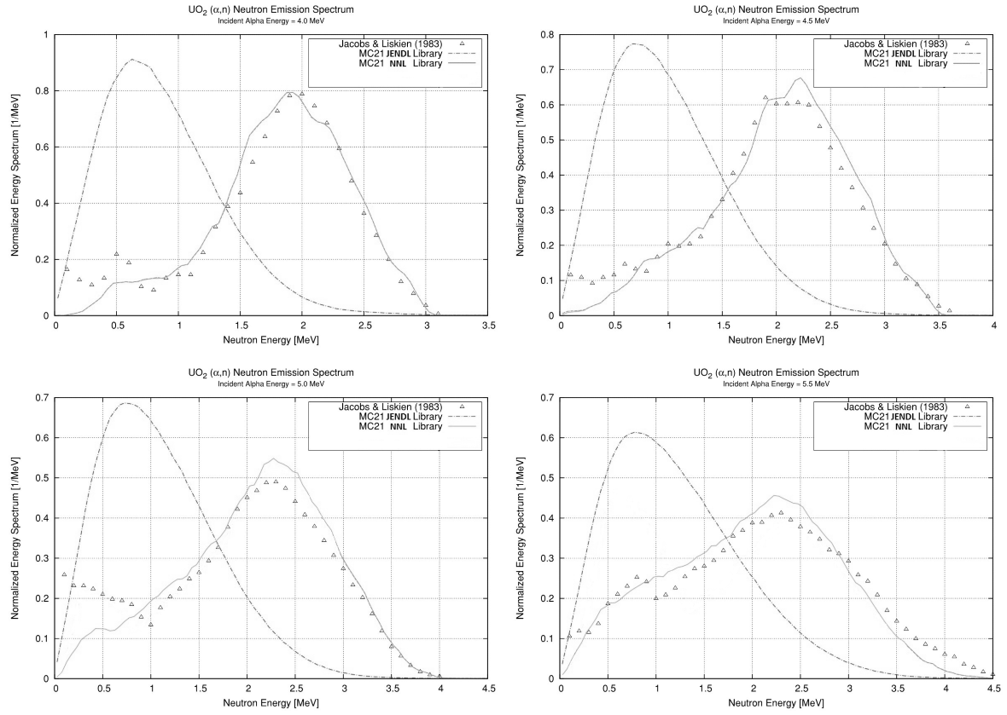
Natural-Uranium UO₂ (α,n) Neutron Spectra
JENDL vs. NNL Library Performance for O-17,18

Slide 9
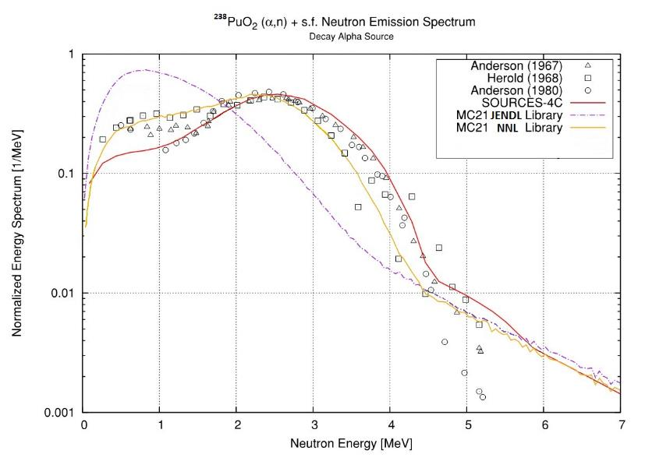

Slide 10
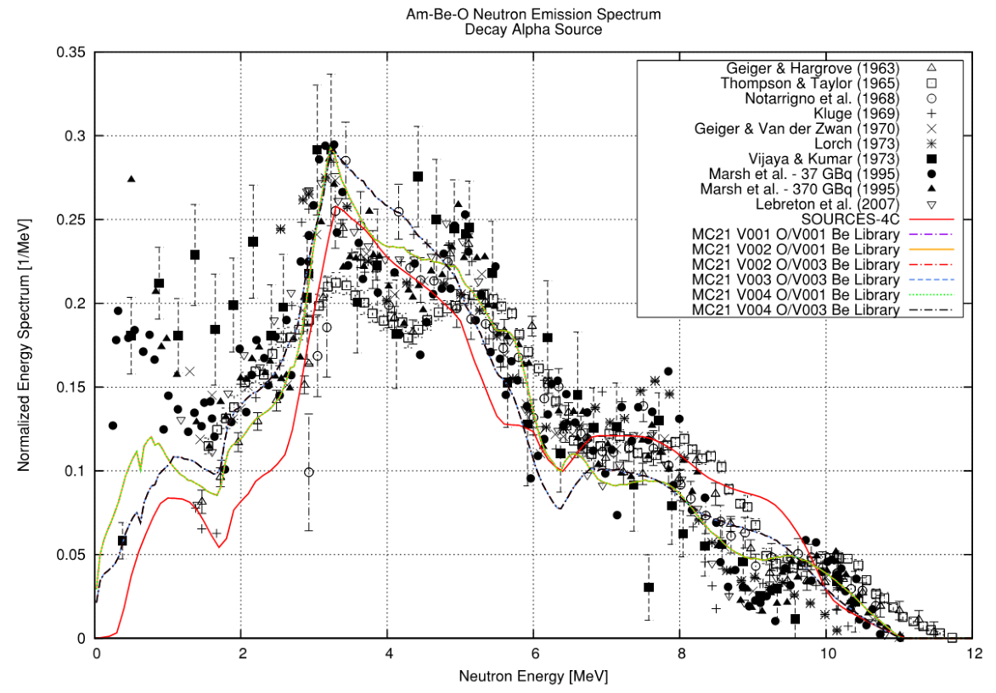

Slide 11
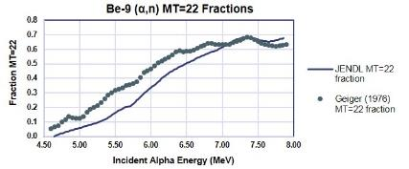
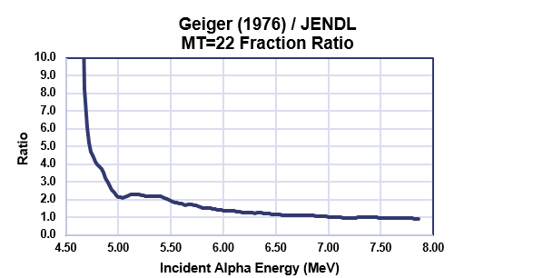
Be-9 Breakup Reaction
⁹Be(α,α′)⁹Be*→⁸Be+n (included in MT=22)
JENDL uses Gibbons (1965) to fit MT=201 total XSs. Then, MT=22 is calculated based on Obst (1972).
Van der Zwan and Geiger (1970) is used for MT=50-52,91 ratios, but not for normalization.
MT=4 (MT=50-52+91) is calculated by subtracting MT=22 from MT=201.

Slide 12
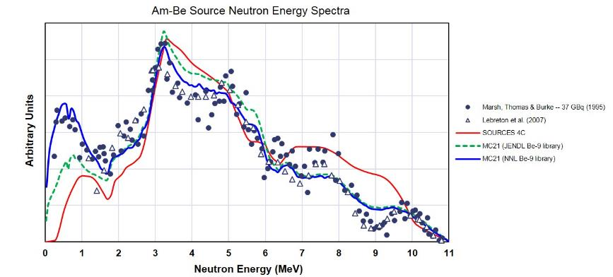
Be-9 File 3 Cross Section Modifications and Am-Be Results
JENDL MT=201 (MT=4 + MT=22) data was not modified. MT=22 cross sections were modified to be consistent with the MT=22 / MT=201 ratios experimentally measured by Geiger (1975). MT=4 (MT=50-52 + MT=91) cross sections were modified to maintain consistency with MT=201. MT=50-52,91 were rescaled to maintain consistency with MT=4 changes.

Slide 13
Summary
NNL-modified special-purpose (α,n) evaluations for O-17, O-18, and Be-9 are being submitted for inclusion in ENDF/B-VIII.1.
These evaluations are based on the original JENDL/AN-2005 evaluations with specific modifications by NNL to address physics deficiencies affecting neutron energy spectra. The NNL versions have been validated against experimental measurements.
Other JENDL/AN-2005 (α,n) evaluations were tested by NNL. These are not being submitted by NNL as no modifications were made.
For O-17, MF=3 cross sections are unchanged. MF=6 / MT=4 (using Kalbach-Mann) is removed and replaced with MF=6 / MT=50-53 (using isotropic two-body kinematics) and MF=6 / MT=91 (using original MF=6 / MT=4 Kalbach-Mann distribution). MF=6 / MT=22 is unchanged.
For O-18, MF=3 cross sections are unchanged. MF=6 / MT=4 (using Kalbach-Mann) is removed and replaced with MF=6 / MT=50-54 (using isotropic two-body kinematics) and MF=6 / MT=91 (using original MF=6 / MT=4 Kalbach-Mann distribution). MF=6 / MT=16,22 are unchanged.
For Be-9, MF=3 / MT=4,22 are modified to give ratios consistent with Geiger (1975). MF=3 / MT=201 is unchanged. MF=3 / MT=50-52,91 ratios are unchanged, but values are rescaled to be consistent with modifications to MF=3 / MT=4. MF=6 distributions are unchanged.

