Slide 1
Workshops On Nuclear Data
Catherine Romano, ORNL Lee Bernstein, LBL/UCB
CSEWG
November 5-7, 2018
Brookhaven, NY

Slide 2
Recent Events in Nuclear Data
NDNCA whitepaper release (10/15)
Nuclear Data Interagency Working Group (PMs) (6,/16)
Nuclear Energy Starts Nuclear Data and Benchmarking Program 2018
USNDP Review (7/14)
Nuclear Data Exchange Meeting presentations to program managers (4/16)
NDIWG FOA Released
NP, NE, IP, DNN R&D, DNDO (4/17)
NDIWG FOA Released
NP, ASCR, NE, DNN R&D, DP (3/18)
Workshop for Applied Nuclear Data Activities (WANDA) (1/19)
Nuclear Data Needs and Capabilities for Applications (NDNCA) Workshop (5/15)
DNN R&D Nuclear Data Roadmapping Workshop (NDREW) (01/23-25/18)
NDREW Proceedings release (7/18)
Nuclear Data Working Group
DOE-NP, DOE-NE, NNSA, DTRA, DNDO
(11/15, 12/15, 2/16, 3/16)
https://www.nndc.bnl.gov/
Notes:
This is in your handout

Slide 3
DOE Nuclear Physics has now organized two Nuclear Data Interagency Working Group FOAs
$1.5 M/year, ≤5 years
$4.0 M, ≤5 years
Participants: DOE/SC-NP, NE, Isotopes, NA-221, 222 and 113

Slide 4
FY17 NDIWG FOA Projects
Improving the Nuclear Data on Fission Product Decays at CARIBU
PI: Savard, Guy (ANL)
Novel Approach for Improving Antineutrino Spectral Predictions for Nonproliferation Applications
PI: Kondev, Filip (ANL)
²³⁸U(p,xn) and ²³⁵U(d,xn) ^{235–237}Np Nuclear Reaction Cross Sections Relevant to the Production of ^{236g}Np
PI: Fassbender, Michael (LANL)
FY18 NDIWG FOA projects not yet formally announced

Slide 5
Nuclear Data Roadmapping and Enhancement Workshop (NDREW) Participants
117 participants,
27 program managers/technical advisors
55 different institutions/organizations
9 government agencies:
DOE-Nuclear Physics
Nuclear Energy
Isotopes Program
DNN R&D (NA-22)
NA-113 (Defense Programs)
DHS/DNDO
DTRA
AFTAC
IAEA
Nuclear data users
NDA experts
Modeling and simulation experts
Nuclear data producers
Experimentalists
Evaluators
Validation and testing experts
Uncertainty quantification experts
Theorists

Slide 6
NDREW Agenda
Panel speakers provided the user’s perspective
Session Leaders:
Created introductions to their sessions
Facilitated discussion
Compiled conclusions
Contributed to proceedings

Slide 7
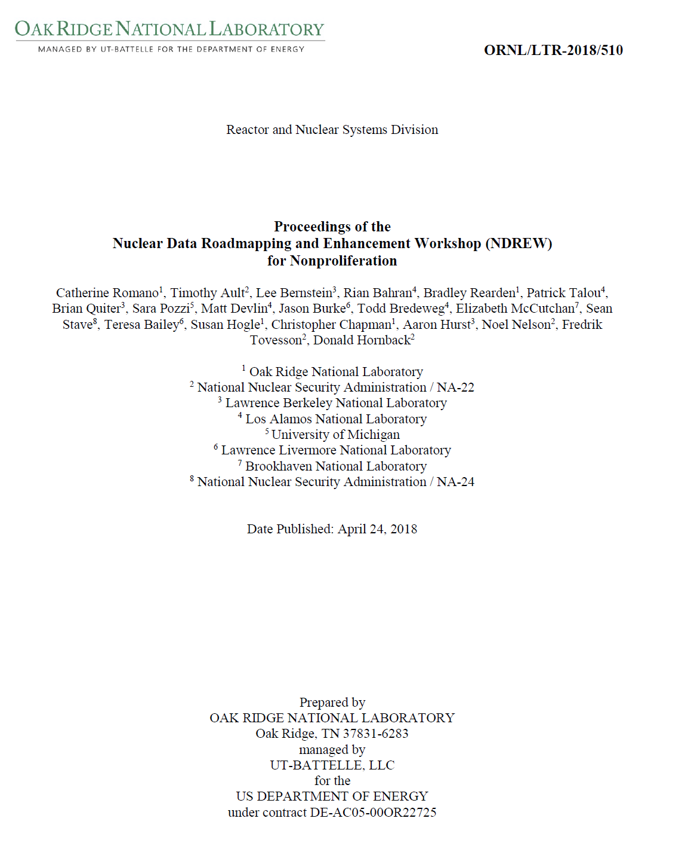
NDREW Proceedings
https://www.nndc.bnl.gov/

Slide 8
Communication is a Primary Benefit of Nuclear Data Workshops
USERS
Needs and
Impact
EVALUATORS/
PROCESSORS
Evaluation Code
Capabilities/Needs
EXPERIMENTALISTS
Experimental
Capabilities/Needs
PROGRAM MANAGERS
MISSION PRIORITIES
UNIVERSITIES
INTERNATIONAL
COLLABORATORS
Collaboration Opportunities
Coordinate efforts

Slide 9
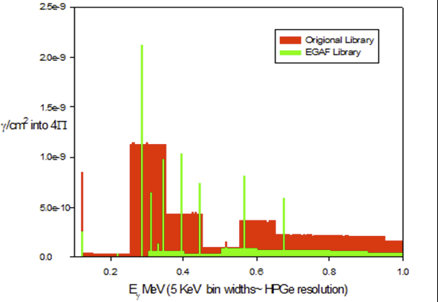
NDREW Session Summary
Data uncertainty, sensitivity, and covariance
Several tools are available or being developed that can be used to quantify nuclear data uncertainties and sensitivities
UQ/S studies can inform nuclear data priorities
Covariance data are lacking and sometimes not well quantified
Nuclear data end-use uncertainties must be defined
Brad Rearden, NDREW
Neutron capture/inelastic scattering and associated spectra
Much of the cross section data are available, but discrete gamma lines and yields are needed at neutron interrogation energies
Simulations do not provide discrete gamma emissions in a useful manner
Link ENSDF to ENDF?
Brad Sleaford, NDEM

Slide 10
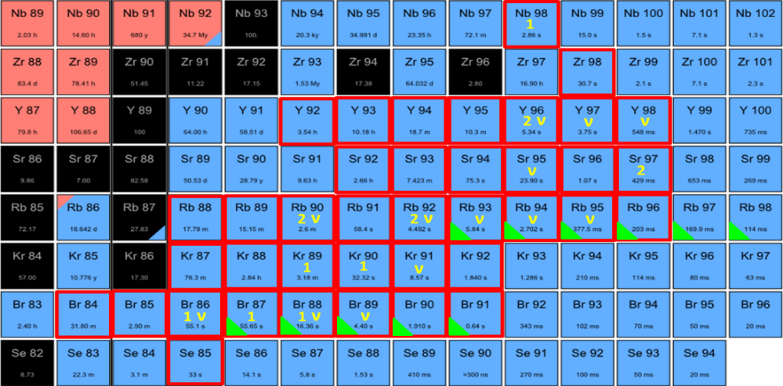
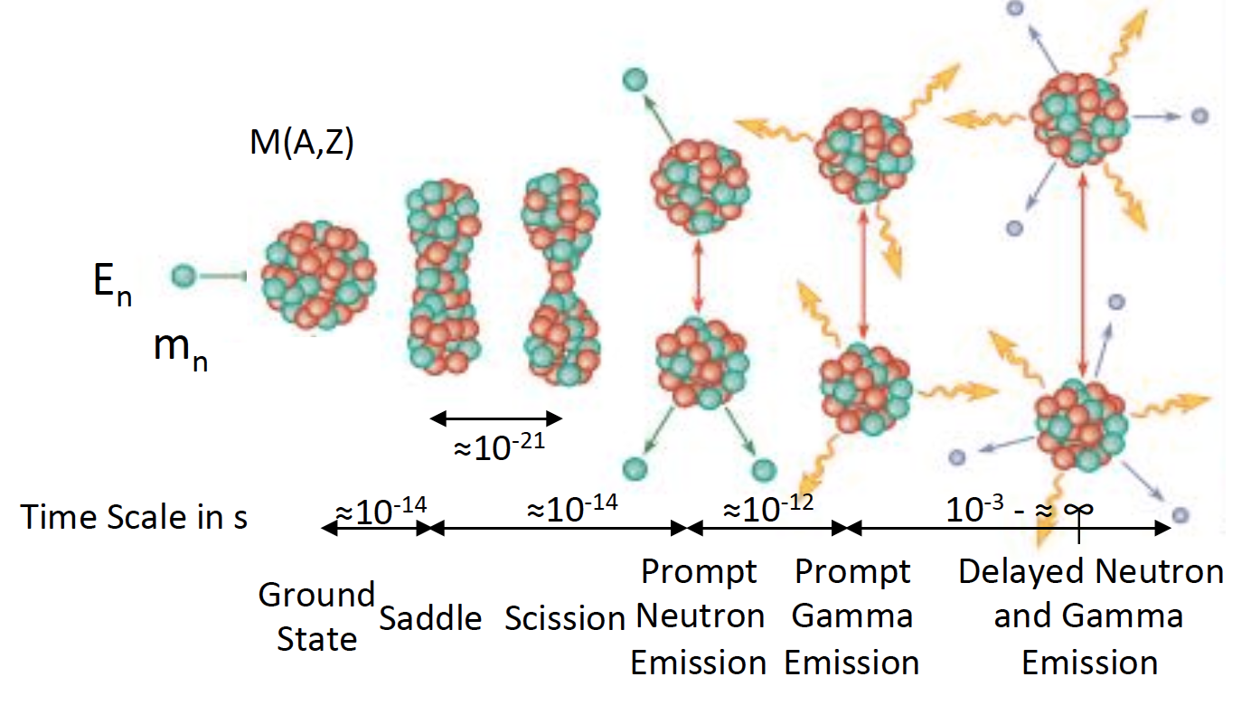
NDREW Session Summary
Fission-independent and cumulative fission yields, decay data
Large uncertainties exist in ENDF yields
Reevaluation of independent and cumulative yields is required
This effort requires correlated neutrons and gammas, and decay data
Upcoming IAEA CRP should be leveraged
MTAS β-γ
VANDLE β-n-γ
Krzysztof Rykaczewski, NDREW
Patrick Talou, NDREW

Slide 11
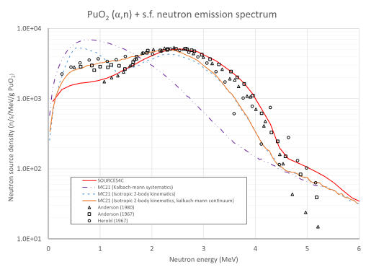
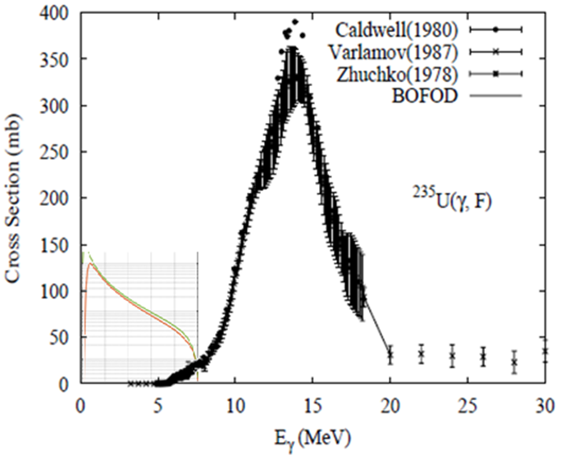
NDREW Session Summary
(alpha,n) reactions
A full upgrade of SOURCES4C would be useful to many programs
Reevaluate the cross sections
Measurements of neutron spectrum
Mike Zerkle (NNL), NDREW
Photofission
The photofission cross section varies greatly in the 6–9 MeV region of interest, causing large uncertainties
Detailed energy-dependent measurements are required
Brian Quiter, NDREW

Slide 12
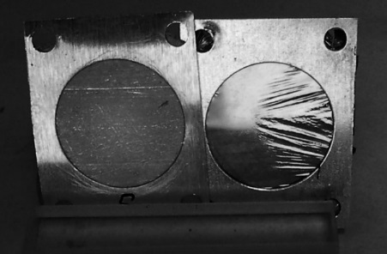
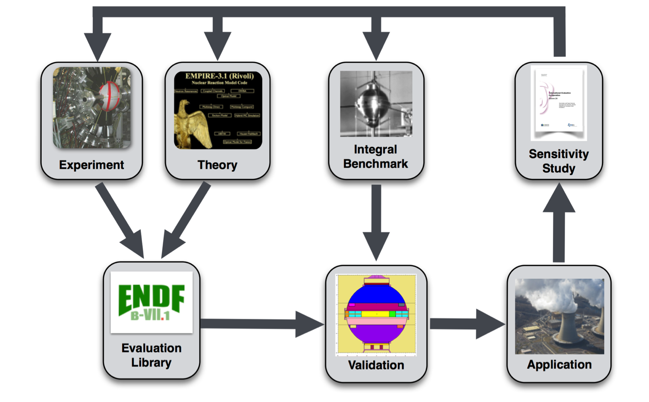
NDREW Session Summary
Targets, facilities, and detector systems
Target materials can be expensive or nonexistent
There are very limited target production capabilities in the United States for radioisotopes
Preserving neutron facilities in the United States is important
Leveraging existing science facilities for nuclear data should be examined
Benchmark development
Benchmarks are needed for problems relevant to nonproliferation to validate and test nuclear data and to identify deficiencies
All workshop topic areas pointed to the need for benchmark experiments
Tim Hallman, NDREW

Slide 13
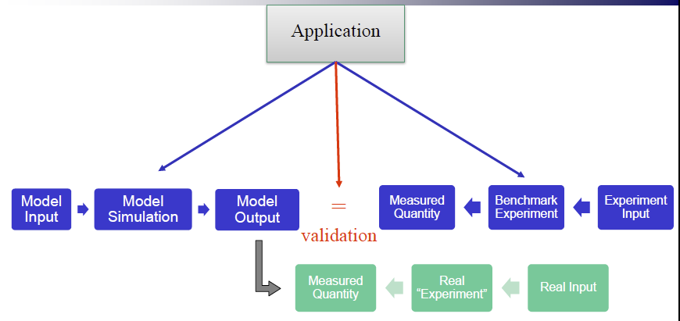
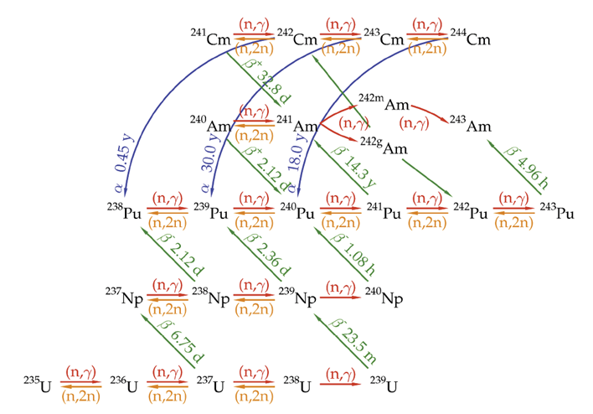
NDREW Session Summary
Data processing and transport code needs
Even if good quality data are available in ENDF, there are cases where the evaluation codes, data processing codes, or transport models cannot support the data
Code development will be required to support individual nuclear data projects
Teresa Bailey, NDREW
Actinide cross sections
The actinide “network” contains many short-lived actinides that are difficult to measure
Solution requires decay data, theoretical models and experiments
Measure well the long-lived isotopes to bound the solution of the short-lived isotopes
Susan Hogle, NDREW

Slide 14
Breakout Session Goals
Determine mission-driven nuclear data priorities with targeted uncertainties
Obtain user input
Determine all tasks required to ensure that nuclear data are available to users:
Measurements – differential and integral
Evaluations
Processing
Covariance data
Validation
Testing
Create a mechanism for peer reviewed ideas
Determine where needs overlap with other mission spaces
Capture opportunities to leverage or enhance existing funded/planned work
Think outside the confines of the typical funding mechanisms
What does it really take to get it done right?

Slide 15
NDREW Feedback
General Comments:
Collaboration opportunities
Obtained a broad view of the problems/increased awareness
Helped in understanding the needs of the different applications
Useful information was exchanged/discussion format helpful
Necessary process in addressing NA-22’s nuclear data needs
Should be annual event
Breakout Sessions:
Some of the facilitators did not engage
Facilitators inconsistent
Breakout needed to be more cozy and interactive
Agency/User input
Needs to be more application oriented
Need more detailed agency overviews/need more direction
More agency input in each breakout session
Need more user input
Thursday Afternoon Review:
Helpful for missed sessions/ too top level and general

Slide 16
Moving Forward
Annual NDIWG FOA is anticipated
Annual Workshop will provide input for the FOA
Challenges:
Prioritizing nuclear data needs when many are deemed necessary
Deconflicting between programs and international efforts
Staying mission-centric; ensuring that recommended work is relevant and necessary
Avoiding entropy by demonstrating mission impact

Slide 17
Workshop for Applied Nuclear Data Activities
January 22 – 24, 2019
George Washington University, Wash, DC
Classified day 25th (invite only)
Program focus on:
Nuclear Energy
Isotope Production
Safeguards
Same format as NDREW – facilitated discussions
2 parallel sessions
Review of NDIWG FOA funded projects
Program updates by program managers
Wrap up on Thursday afternoon

Slide 18
WANDA will be held at George Washington University Friday session at Forestall
Two additional rooms available for breakout sessions

Slide 19
Wanda Skeleton Agenda
1/22/19 | 1/23/19 | 1/24/19
Welcome (10 min) NDREW (10 min) PM talks (15 min) | Parallel Breakouts III & IV | Parallel Breakouts VII & VIII
BREAK | BREAK | BREAK
More PM talks (15 min) FY17 Project talks (15 min) FY18 Project talks (10 min) | Parallel Breakouts III & IV | Parallel Breakouts VII & VIII
LUNCH | LUNCH | LUNCH
Parallel Breakouts I & II | Parallel Breakouts V & VI | Closeout Presentations and panel discussion
BREAK | BREAK | BREAK
Parallel Breakouts I & II | Parallel Breakouts V & VI | Discussions

Slide 20
What WANDA offers
A venue to encourage communication between consumers and providers of nuclear data
A place to hear from PMs about their vision for their programs
A place to form new collaborations that ensure that data needs are addressed in an end-to-end fashion
Identified Need
Measure-ment
Compila-tion
Evalua-tion
Process-ing
Dissem-ination
The goal is a roadmap/plan for multiple sponsors to address nuclear data needs

Slide 21
Breakout Session Goals
Determine mission-driven nuclear data priorities with targeted uncertainties
Obtain user input
Determine all tasks required to ensure that nuclear data are available to users:
Measurements – differential and integral
Evaluations
Processing
Covariance data
Validation
Testing
Create a mechanism for peer reviewed ideas
Determine where needs overlap with other mission spaces
Capture opportunities to leverage or enhance existing funded/planned work
Think outside the confines of the typical funding mechanisms
What does it really take to get it done right?

Slide 22
Nuclear Data Topic Selection
General Focus: Nuclear Energy, Isotope production, Safeguards related
Nonproliferation topics not covered fully last year
Eight ½ day sessions available
SELECTION CRITERIA
MISSION IMPACT: Does anyone care? Should anyone care?
SPONSOR INTEREST: Is there a potential sponsor? Does the sponsor care?

Slide 23
Safeguards topic area suggestion
Safeguards measurements are used to ensure that nuclear material declarations are accurate; and that no significant quantities of nuclear material have been diverted for misuse or weaponization. These measurements are very dependent on the quality of the atomic and nuclear data used in the physics-based models and codes that analyze the gamma, neutron, and heat signatures collected. Poor knowledge of the underlying nuclear data, reduces the ability of a Safeguards inspector to fully quantify the uncertainties associated with safeguards measurements.
INMM -July 2019:
Suggested a Nuclear Data 101 “workshop” is planned during the NDA experts meeting on Sunday.
A nuclear data session during the regular meeting is planned

Slide 24
POTENTIAL TOPICS
DPA- fission and fusion reactors/shielding
DPA @ high energy- NASA?, spallation sources, isotope production
p,d,n,α reactions for isotope production up to 200 MeV
Includes isotope production cross sections in reactors
Cross sections in 1-3000 keV: inelastic and elastic
Dosimetry (wait for Dave’s talk)
Low energy medical photon transport, xrf, x-ray transmission
Stopping power of electrons, alphas, protons (Note Jon’s and Morgan’s talk!)
Also connected to beam therapy. Reaching out to NIH.
Safeguards: (α,n), photon transport, xrf
Auger electron spectra (medical applications)

Slide 25
POTENTIAL TOPICS (cont.)
Use of AI, machine learning
Infrastructure development from the user perspective
Structure-Informing Reaction Measurements (Thanks Morgan!)
Advanced reactors:
User presentations
Existing benchmarks - needed
NEUP project reviews
Sensitivity studies presentations – what others are needed
Thermal scattering law: graphite, molten salt, water
covariance impact
²³Na, ³⁵Cl(n,p), F scattering, Be, Li, (α,n),
Minor actinides

Slide 26
Email with invite and topic suggestions
Lee Bernstein: labernstein@lbl.gov
Cathy Romano: romanoce@ornl.gov

Slide 27
Questions?
Thank you to DNN R&D for their support

