Slide 1
ENSDF and NDS data analysis for future directions
M. Shamsuzzoha Basunia, LBNL
USNDP meeting, BNL, Nov 5 - 9, 2018

Slide 2
Outline
Observations
ENSDF file size and trend
Nuclear Data Sheets publications
Mass chain evaluation
Update: Mass chain and Nuclide
Other indicators:
Total # of XUNDL datasets since cut-off date
Average age of a mass chain
Frequency of mass chain evaluation/update
Conclusions

Slide 3
Observations
Bigger mass chain
Revision adds small fraction (~25%)
Repeating through same old data (~75%)
Documentation for no changes
Time investment:
Evaluators and reviewers
Review process getting slower
Mass chain size, takes time to finish and review
Delay - submission to publication
Indc-nds-0250, p9 (1990 NSDD)

Slide 4
ENSDF size (in Megabyte)
~76 MB in 1990 to 222 MB in 2018, about 3 times higher
For # of records: Total byte/80 bytes (lower limit)
4

Slide 5
ENSDF size (in Megabyte)
Average increase rate (5.2 MB/year) shows consistency in productivity.
FY 05, 17, and 18 show lower size increase than average rate
5

Slide 6
ENSDF facts:
In 2018:
Average # of records in a mass chain: 12,000
Ranging from ~ 1000 to 25,500
In 1990: (factor of ~3 lower than 2018)
Predicts average # of records: ~4,000
Ranging from ~330 to ~8,500
In 1980: (factor of ~9 lower than 2018)
Predicts average # of records: ~1,300
Ranging from ~110 to ~2,800
Ave. # of records ~1300 in 1980 to ~4000 in 1990, about 3 times higher
Indc-nds-0250, p15 (1990 NSDD)
6

Slide 7
Nuclear Data Sheets publications:
Total: 1041 NDS publications: 874 (full mass chain), 22 (multiple chains),
113 (mass chain update), and 32 (nuclide update)
7

Slide 8
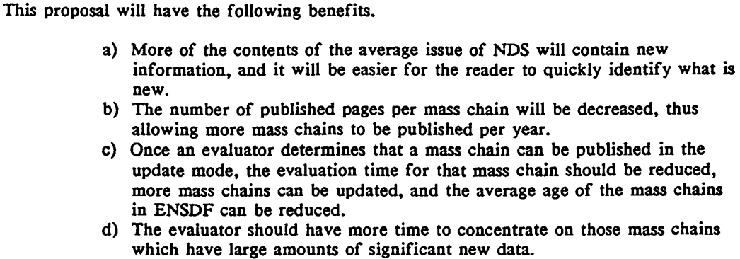
Update mode publications:
NSDD 1988 - INDC-NDS 0206, p93
8

Slide 9
XUNDL datasets and average age:
Index of ENSDF and # XUNDL since cut-off
http://www.nndc.bnl.gov/ensdf/ensdf/ensdfindices.jsp
Average age of mass chain: 6.9 years in 2004 and 8.3 years in 2015
9

Slide 10
Frequency:
10

Slide 11
Conclusions:
Average increase rate (~5.2 MB/year) shows nearly consistent ENSDF productivity since 2002
FY05, FY16, and FY17 increase rates are lower
Size of average mass chain:
Current size ~3 times bigger compared to those in 1990 (estimated)
Needs new estimate for # of mass-chain/FTE
Increasing trend of XUNDL datasets since cut-off date
Current ENSDF commitment – lower or stable?
Deal with new data and datasets only
Update mode or
Other new approach
Use valuable time to incorporate new data quickly
and improve ENSDF currency
11

Slide 12
Thank You

