Slide 1
Meeting page: https://indico.bnl.gov/event/5077/
P. Kovach did an ANSYS analysis on the 2 doghouses and the conclusion was that we don’t need additional shipping fixtures. After the Valvebox is taken off, the extension pipe may be left in air.
P. Kovach/M. Anerella said that during transportation (from 912 to 1008), it is mandatory that the truck has both tractor & trailer BOTH in air ride suspension since the shipping restrain frame has no shock absorbing features.
Approximately, when will we
open up the doghouses (when and how) ?
We’re waiting for electricians to disconnect power … Before that, the Cryo group should stop pump and put in dry nitrogen ??
repair the voltage tap ?
move the Cryostat to its original (yellow) cradle/frame in 912 ?

Slide 2
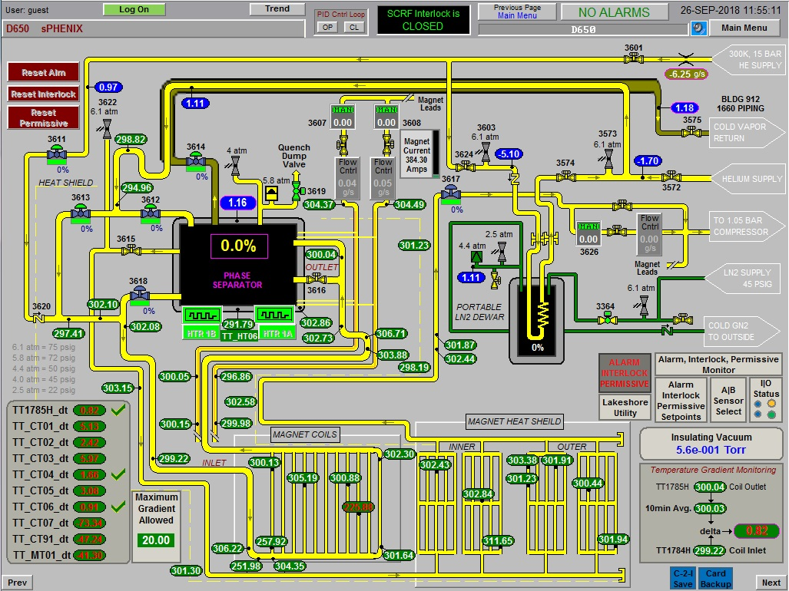

Slide 3
