Slide 1
Next Steps for CO₂ System at B820
Igor Pogorelsky (ATF)
21st ATF Program Advisory Committee and Users’ Meeting
November 14-16, 2018

Slide 2
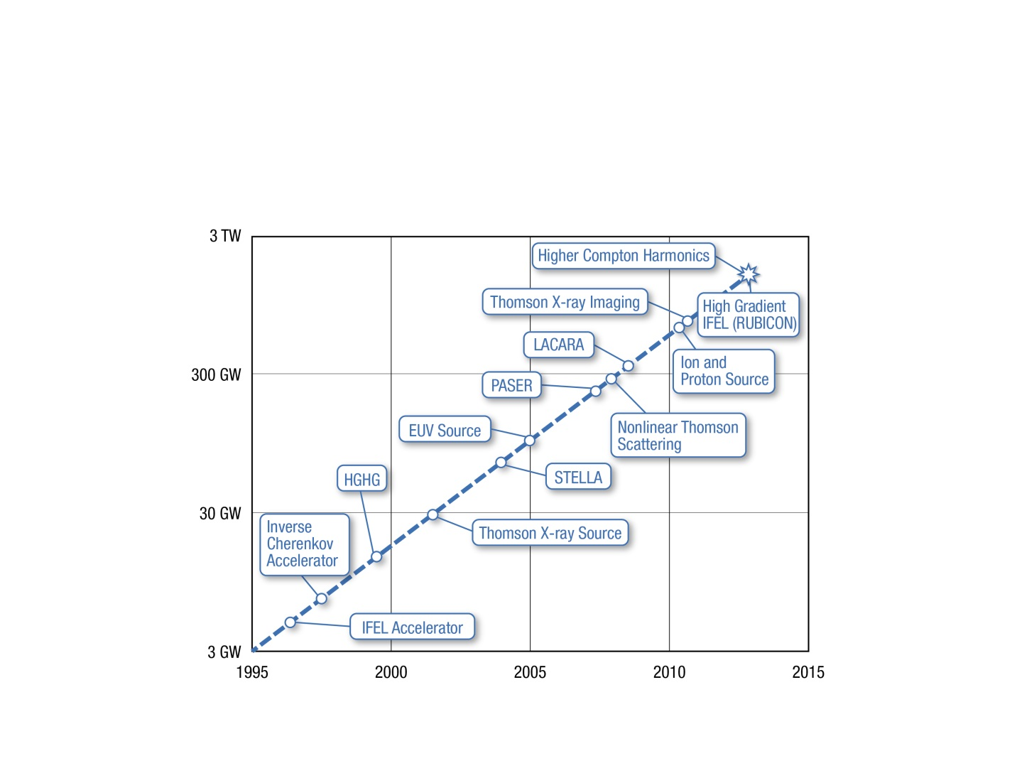
History of ATF CO₂ laser upgrades
30 TW
1995-2015
10x power increase every 7 years
Reached saturation at <2 TW due to fundamental limitations of short-pulse amplification (B-integral)
2016-2017
Regrouped to implement new concepts
R&D to make new concepts productive
2018 and after
Continue initial trend of power increase
2020
2025

Slide 3
Scientific Needs Workshop 2017
Research Thrusts identified in SNW report:
Sub-ps, TW, mid-IR pulses: Pushing the CO₂ laser technology into new paradigms of pulse duration and peak power is an important goal of the ATF. Accessing the sub-picosecond regime, while maintaining terawatt peak power, would be a major milestone for mid-IR laser development.
Mid-IR materials research: The availability of high peak power 10 micron pulses opens up many possibilities for important mid-IR materials research. Apart from characterization of perturbative nonlinearities, damage thresholds in the mid-IR are not well known.
Novel CO₂ amplifier concepts: An example of a concept that might evolve in the near future is an optically pumped CO₂ amplifier.
Enabled Priority Research Directions:
LWFA: The size of the wakefield structure is much larger than that driven by a MIR laser for the same intensity. This presents two significant opportunities: diagnosis of the wakefield acceleration process and controlled injection. Self-modulated 1 TW, 2ps; blowout 7 TW, 0.5 ps; bubble 25 TW, 0.5 ps.
Ion acceleration: Extend hole-boring radiation pressure ion acceleration to higher energy (10-20 MeV with 10 TW, 100 MeV with > 25 TW).
DLA, ICS, Laser Filamentation and Propagation in Atmosphere, IFEL, Electron Beam Phase Space Manipulation…

Slide 4


Recently completed upgrade thrusts
CPA regime
Purpose: extract and transport beam from laser amplifier without nonlinear distortions
ATF CO₂ laser system a year ago
Ti:Al2O3
20 µJ
350 fs
Amplifier 1
OPA
5 µJ
80 ps
Stretcher
30 mJ
60 ps
Isotopic amplifiers
Purpose: produce a single 2ps pulse at elevated peak power
20J
Plasma
Shutter
Amplifier 2
YAG
Plasma shutter
Purpose: block parasitic reflection from laser/plasma interaction point
~1 TW
4ps
Compressor

Slide 5
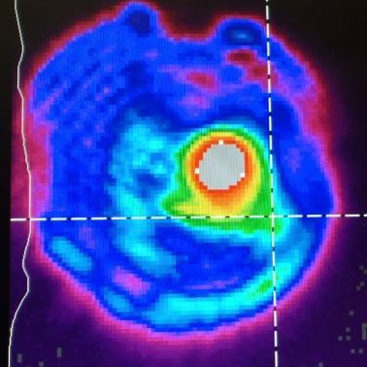
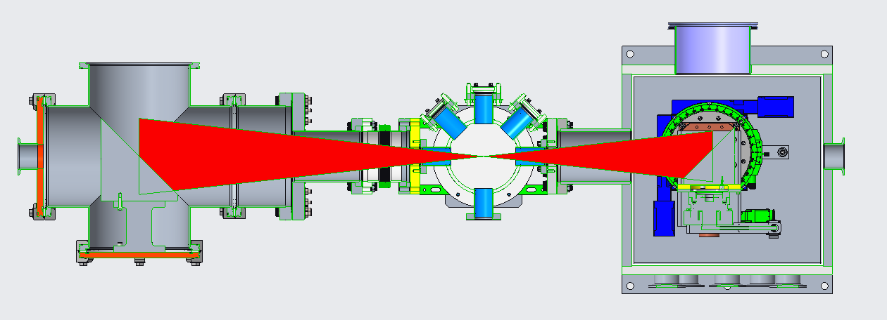
Present-day laser configuration and planned upgrades
Ti:Al2O3
20 µJ
350 fs
Amplifier 1
Upgrade R&D thrusts:
Reduce pulse expansion via stronger pulse stretching, reducing amplifier window thickness, beam profile control (apodizing, adaptive mirror)
Energy increase by improving compressor efficiency, stronger pulse stretching, implementing a bigger amplifier and window (long term)
Femtosecond regime with NLPC
        Variable polarization
        Material studies
OPA
5 µJ
60 ps
YAG 1
Stretcher
20J
30 ps
30 mJ
40 ps
Amplifier 2
In-vacuum transport to user experiments (prevents filamentation at high power)
4 ps
Work on improving:
Rep. rate (faster HV switches, optical pumping)
Beam quality
Energy/power stability
System reliability
Pulse
2.3 ps
Energy
10J
YAG 2
Compressor
Efficiency 50%
Plasma Shutter
ps
fs

Slide 6
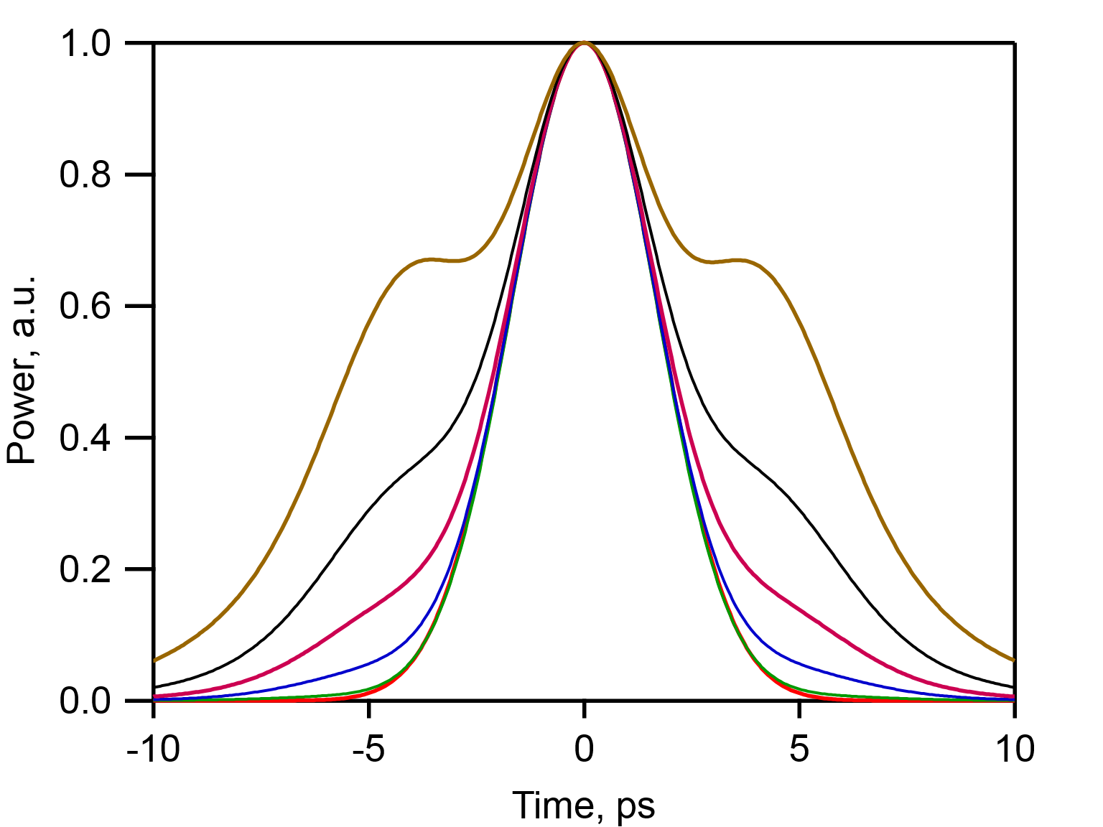
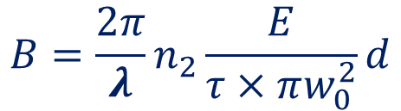
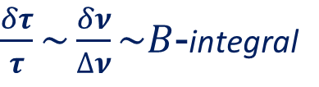
Pulse expansion due to self-phase modulation
Known for CPA lasers since 1994
$\frac{δτ}{τ}\sim \frac{δν}{∆ν}\sim B$-integral
Ways to reduce B-integral:
$$B=\frac{2π}{λ}n_{2}\frac{E}{τ×πw_{0}^{2}}d$$
Increase pulse stretching
Reduce window thickness
Flatten beam profile

Slide 7
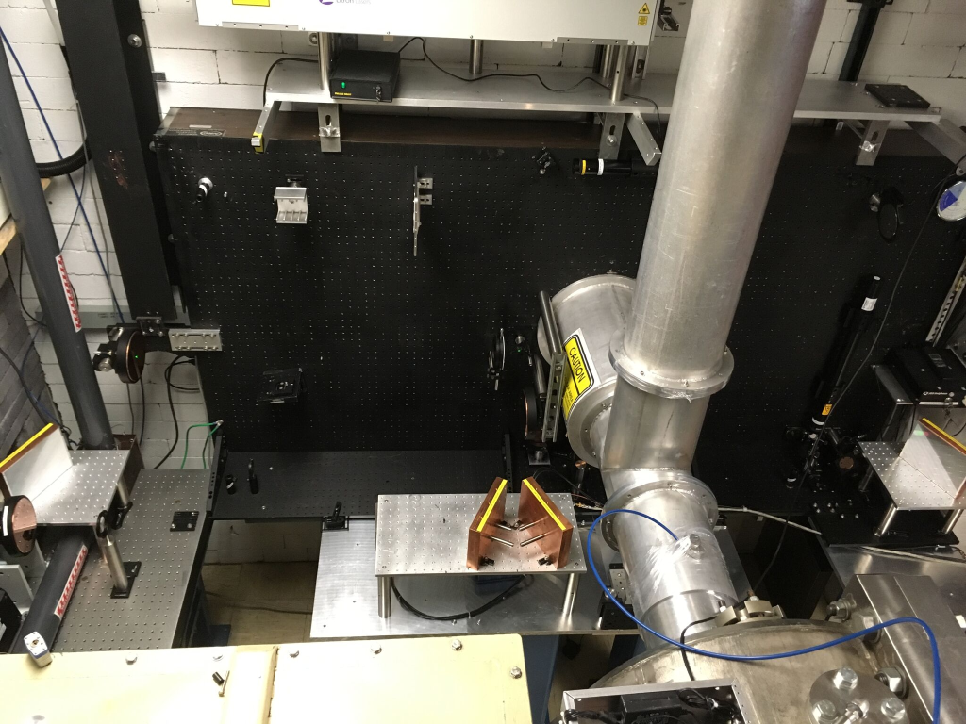
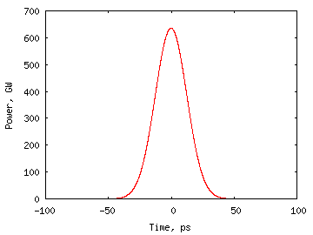
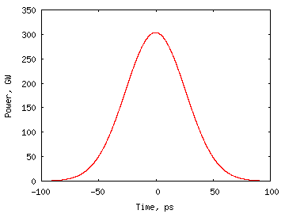
Reduce pulse expansion
CPA compressor
via stronger pulse stretching
75 lines/mm
100 lines/mm
New matching gratings will be needed for both stretcher and compressor
Producing compressor gratings is more challenging due to bigger size and energy fluence
29 ps
62 ps
Experiment with 75 lines/mm
Stronger stretching results in significant reduction of the pulse expansion due to SPM
In addition, groove profile optimization for our compressor configuration may improve the compressor efficiency from the present 50% to >70%
2-2.5TW
3-4TW
~5 TW
Expected with 100 lines/mm
@50% efficiency
Expected with 100 lines/mm
and 70% efficiency
12
14
16

Slide 8

Reduce pulse expansion
reducing amplifier window stresses and thickness
10 atm
10 atm
local stresses cause cracking
chamfer removes local stresses
=2.72” compared to 4” used in present window design
1.5 reduction in B-integral
keeping 4” thickness allows to increase the window diameter to 6”

Slide 9
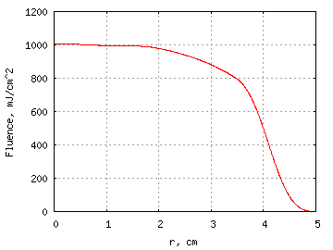

Reduce SPM by beam expansion
Expanded Gaussian beam subject to diffraction
gain
saturation
active beam
profile control
(apodization,
adaptive mirror)
after amplifier
10m distance
600
500
Maximum capability with the current final amplifier
24 J
400
300
200
-R
0
R
100
sin²

Slide 10
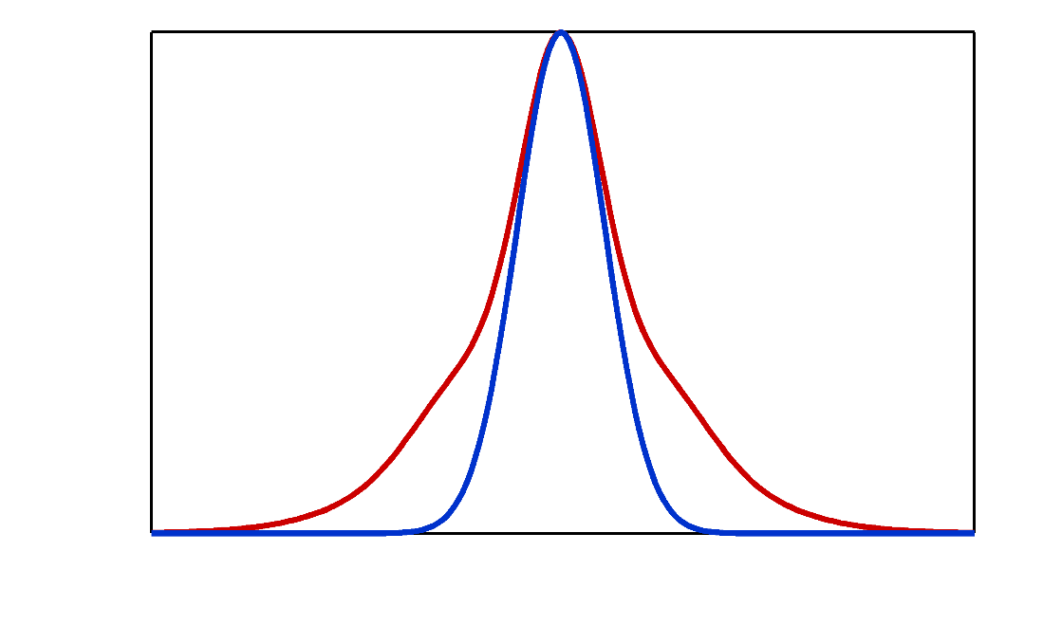
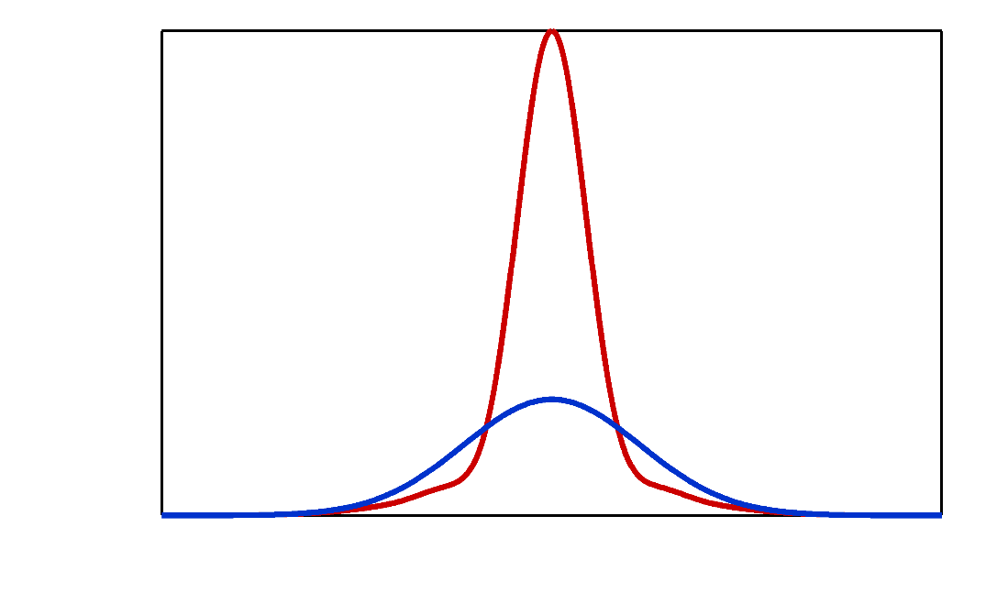
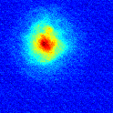
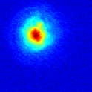
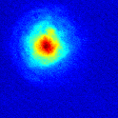
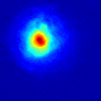
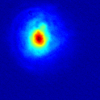
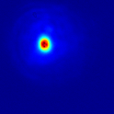
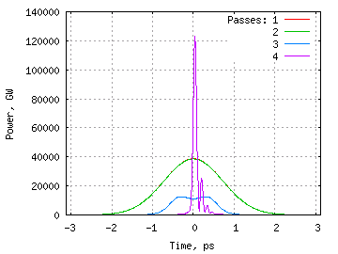
Approach to NLPC
n = n₀ + n₂I
We already observed Kerr effect on the amplifier’s output window that leads to the beam’s spectral self-chirping and spatial self-focusing
1 THz (~0.3 µm)
75 mm
75 mm
Self-focusing of a 4-ps pulse in 10-cm NaCl amplifier window
(15 m from the amplifier)
Self-focusing
(2.5 J)
)
SPM (2.5 J,
beam integral)
No self-phase
modulation
No
self-focusing
0.5 J
0.7 J
0.9 J
1.3 J
1.7 J
2.5 J
Now we are going to use this “parasitic” effect productively by compressing a self-chirped component and spatially filtering it out it via self-focusing with properly selected optical elements
Amplifier Output
SPM Focused
Spatial Filtered
Recompressed
100 fs
1.7 ps
Compressible portion of the pulse

Slide 11
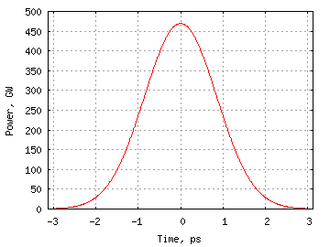
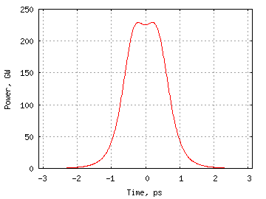
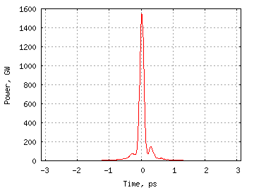
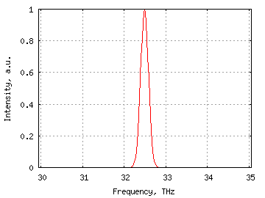
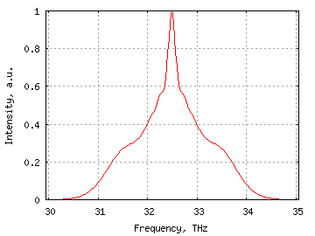
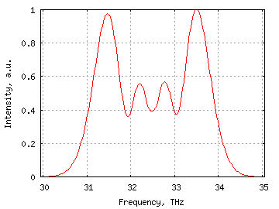
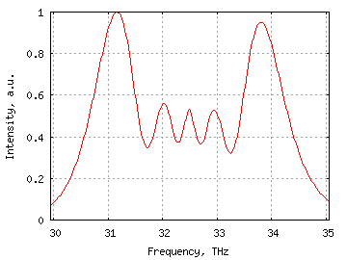
Subscale NLPC test using a fraction of the laser output
0.5 TW
1.5 TW
ZnSe
12mm
NaCl
60mm
4.5 m
7.5 m
1J
0.3J
FWHM = 2 ps
160 fs
Upon completion of this test, we will plan the full-scale implementation where NLPC is imbedded into the ATF transport line.
Starting with 5 TW, compressing to 15 TW might be feasible.

Slide 12
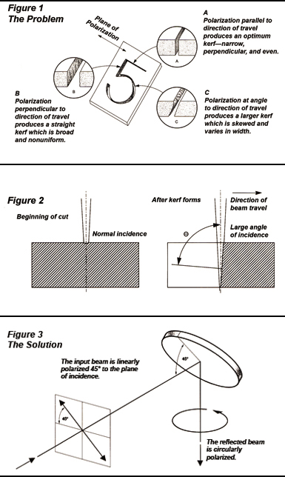
Flexible polarization
8”
12”
axis of rotation
16”
90⁰ polarization
rotation
11.3”
9”
3 mirrors on a platform rotating around the beam axis will be arranged to preserve the beam direction
11.3”
8”
Rotation of the platform by 45⁰ off the initial plane of polarization makes the polarization flip by 90⁰ after three reflections
A circular polarizer
using a mirror with
a quarter-wave
coating
Replacing the first Cu mirror with a mirror having a λ/4 coating provides circular polarization

Slide 13
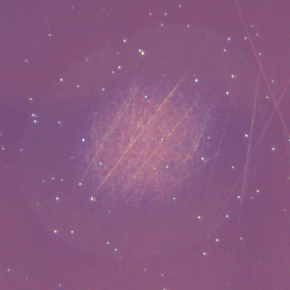
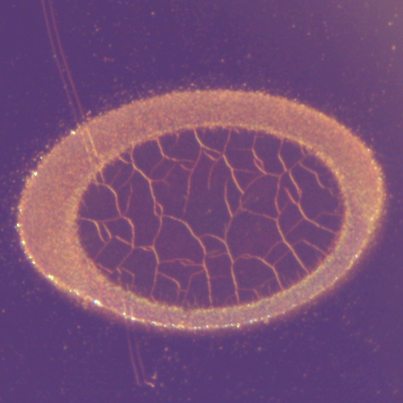
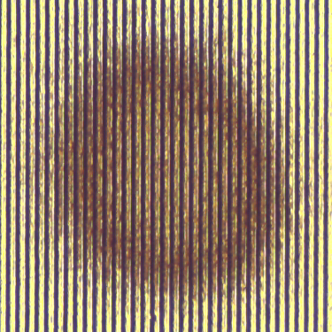
Material studies
Examples from optical damage studies conducted at ATF
9.7 J/cm²
Cu mirror
One of the scientific challenges in handling the extreme laser peak power at 9-10 μm wavelengths is that the behavior of optical materials remains largely unexplored in this spectral domain and regime.
We will continue detailed studies of:
  Damage thresholds and damage mechanisms of materials and structures generally used for both reflective and transmissive optics at the CO₂ wavelength, including various coating/substrate combinations. Specific example: choosing the best substrate and coating for compressor gratings.
  Nonlinear optical properties (nonlinear refraction and absorption) of a broad range of semiconductor and dielectric materials. Specific example: study towards NLPC.
This effort is co-aligned with user interests.
See DLA proposal from Stanford/STIOptronics/Technion.
5 J/cm²
λ/4 Si mirror
100 μm
0.53 J/cm²
2.4 J/cm²
10 J/cm²
Cu-Cu grating
3 J/cm²

Slide 14
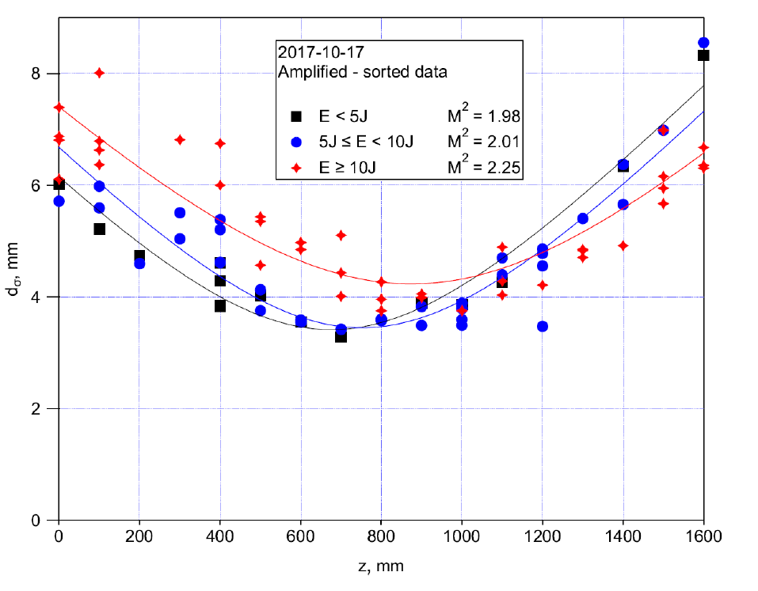
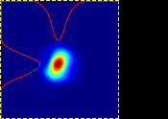
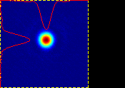
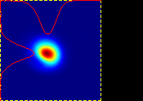
Improving beam quality, laser stability and reliability
32 μm FWHM achieved at the focus of F#=2 off-axis parabola at M²=2.
We will continue dedicated efforts in analyzing the beam parameters, identifying sources of their degradation, and improving beam handling. A new design of a plasma shutter and in-vacuum beam transport are the examples.
Equal efforts will be directed towards providing the pulse format desirable for users and improving the energy reproducibility <10%.
An ongoing rigorous program of creating large inventory of critical spares aims to reduce downtime and improve system reliability.
Measuring M² at different energy levels

Slide 15
Higher repetition rates
Front end (including regen) operates at linac’s repetition rate and up to 5 Hz, while the final amplifier is presently at 0.03 Hz.
Marx generator’s spark gaps are capable to 0.1 Hz. We will explore the possibility moving to 0.1 Hz by faster capacitor charging and gas circulation.
Thyristors are identified as faster switches for use in Marx generators. We team with STI Optronics to develop the first version of a high-repetition (potentially up to 300 Hz) power amplifier used in intra-cavity pulse circulation experiments (high-duty ICS and high-duty IFEL)
Optical pumping:
High-repetition solid state lasers can be configured to pump a high-pressure CO₂ gain vessel.
An additional benefit is in expanding the active medium choices (e.g., carbon isotopes, CO₂/N₂O) and using higher pressures (e.g., 30 atm) to increase gain and allow fs pulses. We team with Univ. of Alabama and UCLA in demonstrating CO₂ optical pumping with a Fe:ZnSe laser.
4.3μm
10μm

Slide 16
Keeping eye on safety
Implementing radiation fault studies at each incremental increase of the laser power
TLD
TLD
IR camera
Interaction Chamber
TLD
TLD
sphere
Plasma Shutter
OAP
TLDs
laser
lens
target
Test sphere 6” diam.; windows are for placing TLDs around a target
Optical transport

Slide 17
Laser experimental requirements by topical area from the report of Scientific Needs Workshop 2017
Experiment | Entry Level Requirements | ATF Laser Upgrade
Nonlinear Kerr effect | 1 TW | Yes
Non-linear LWFA | ~2 TW | Yes
Blow-out LWFA | 5 TW, 0.5 ps | Yes, near term upgrade
Bubble LWFA | 25 TW, 0.5 ps | Possible, long term upgrade
Ion acceleration | 25 TW, circ. polar | Possible, long-term upgrade
IFEL | 25 TW | Possible, long term upgrade
DLA | 10 GW | Yes
ICS | 2 TW | Yes
Phase space manipulation | ~1 TW | Yes
ATF CO₂ upgrade is matched to the scientific needs identified in SNW report

Slide 18
Summary
Completed milestones including full CPA and isotope regimes, plasma shutter and in-vacuum transport open a path to further improvements in our service to users
FY2019 might see:
  power increase through a better control of B-integral with new gratings, smarter windows and apodizing mirrors
  first results from proof-of-principle NLPC
  polarization state control
FY2020-21:
  Design and implementation of a full-scale NLPC to allow access to the “blow-out” LWFA regime and other groundbreaking applications.

