Slide 1
Study of nonequilibrium lattice dynamics in low dimensional 3D-Dirac semimetals
Tatiana Konstantinova, Yimei Zhu,
Brookhaven National Laboratory
Funding source: DOE BES (received)
2019 ATF Users Meeting: New Proposal

Slide 2
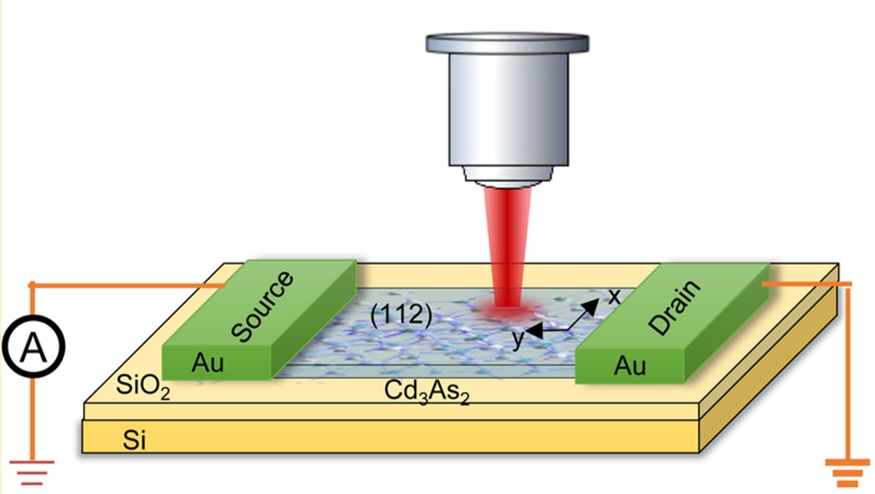
Scientific Case: 3D-Dirac semimetals as ultrafast optical devices
Unique optical properties:
Photocurrents under broadband excitations
Anisotropic photoconductivity
Resonant transparency at THz turned on by magnetic field
Promising application in ultrafast photonics and optoelectronics =>
High interest in the nonequilibrium behavior
Q.Wang, et.al, Nano Lett. 2017, 17, 834-841
Notes:
as photocurrent driven by circularly-polarized mid-IR light,18 anisotropic photoconductivity,19 optical conductivity that takes the form of a step-function tunable by external fields,20 resonant transparency at THz frequencies tuned by a magnetic eld21, and a mid-IR pass-band, tuned by the Fermi energy and lying between EF and 2EF

Slide 3
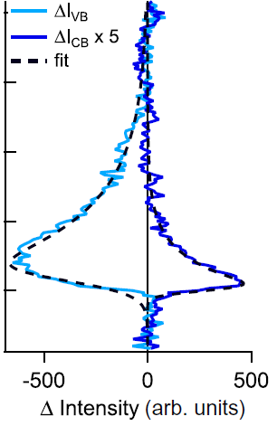
Scientific Case: Ultrafast Electron Dynamics in 3D-DSM
Lattice dynamics:
Strongly coupled modes (graphene, other low dimensional materials)
How fast energy redistributes between phonon modes
Anisotropic response
8ps
C.P. Weber, JAP 122, 223102(2017); G. Manzoni, PRL 115, 207402, (2015)
Notes:
as photocurrent driven by circularly-polarized mid-IR light,18 anisotropic photoconductivity,19 optical conductivity that takes the form of a step-function tunable by external fields,20 resonant transparency at THz frequencies tuned by a magnetic eld21, and a mid-IR pass-band, tuned by the Fermi energy and lying between EF and 2EF

Slide 4
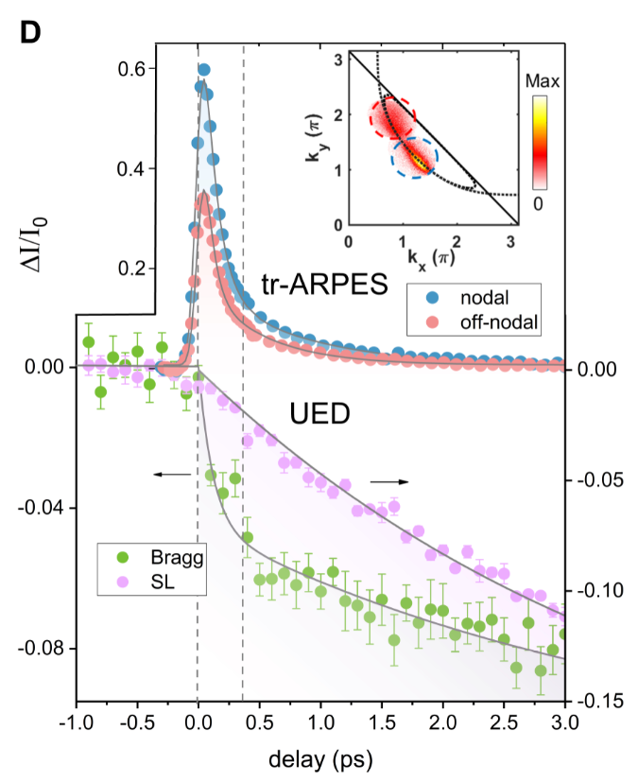
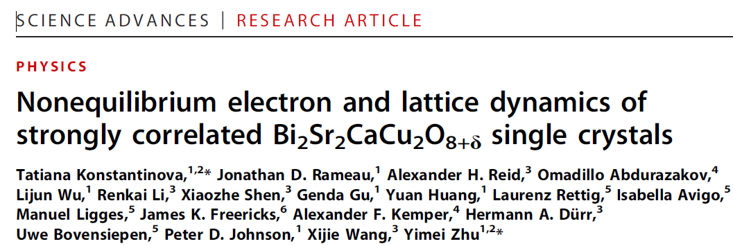
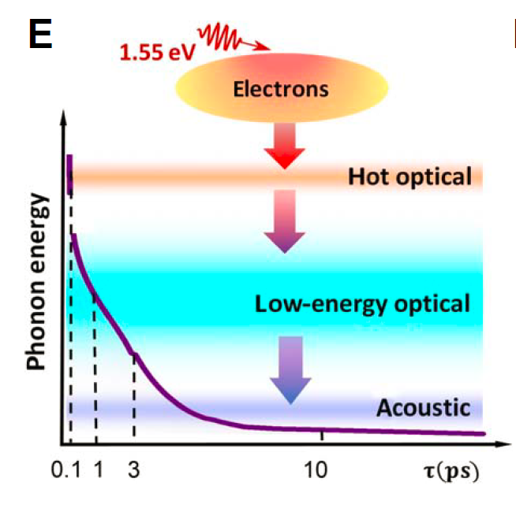
Scientific Case: Ultrafast Lattice Dynamics in low dimensional materials
Notes:
as photocurrent driven by circularly-polarized mid-IR light,18 anisotropic photoconductivity,19 optical conductivity that takes the form of a step-function tunable by external fields,20 resonant transparency at THz frequencies tuned by a magnetic eld21, and a mid-IR pass-band, tuned by the Fermi energy and lying between EF and 2EF

Slide 5
Experimental Setup: Why BNL MeV-UED?
Separates lattice response from all others (electrons, spins, etc.)
Observation of many Bragg reflections and Brillouin zones at a time
MeV provides ~100 fs temporal resolution
Accessibility

Slide 6
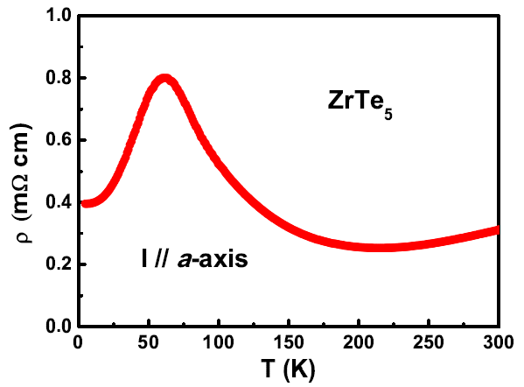
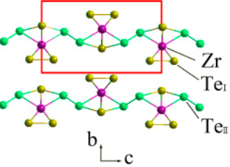
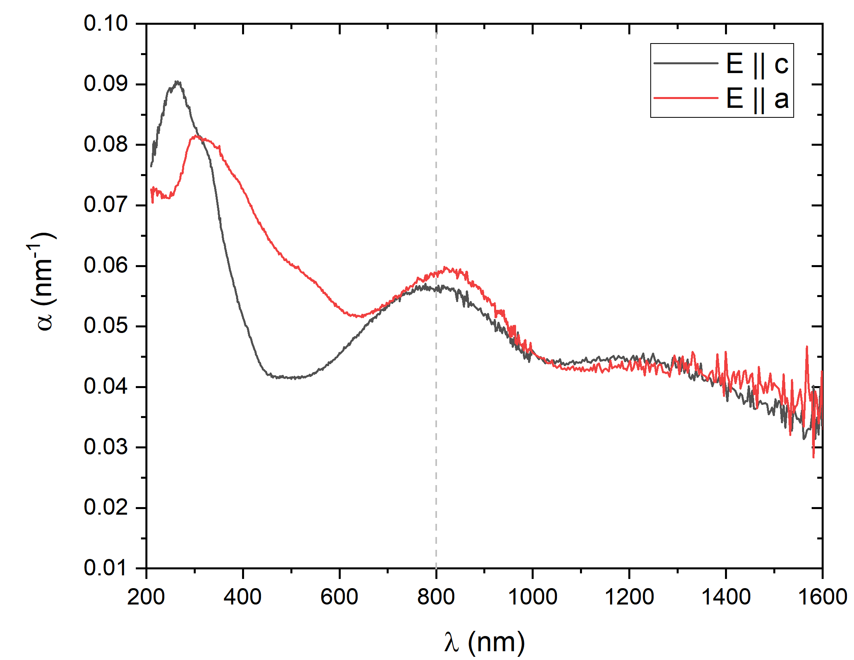
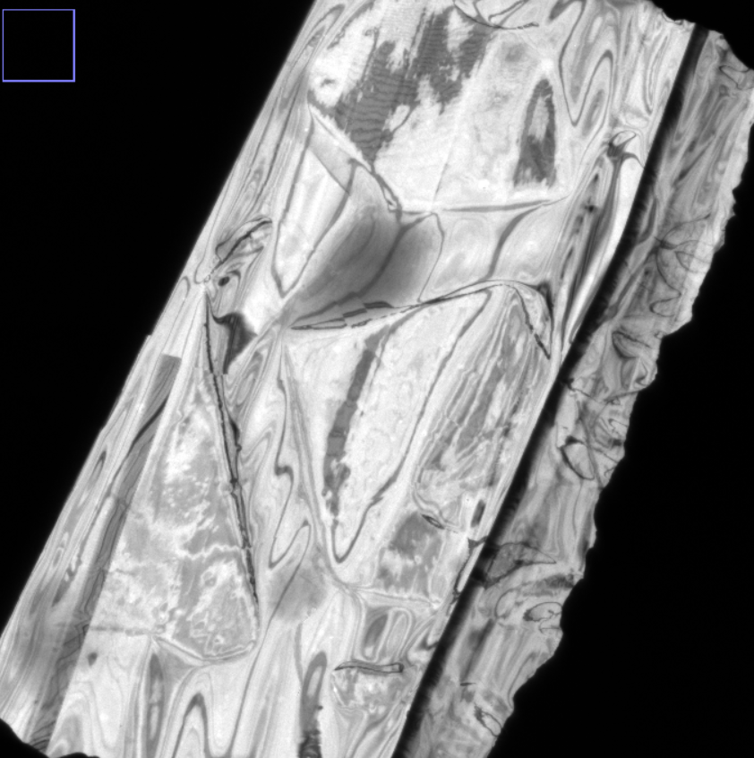
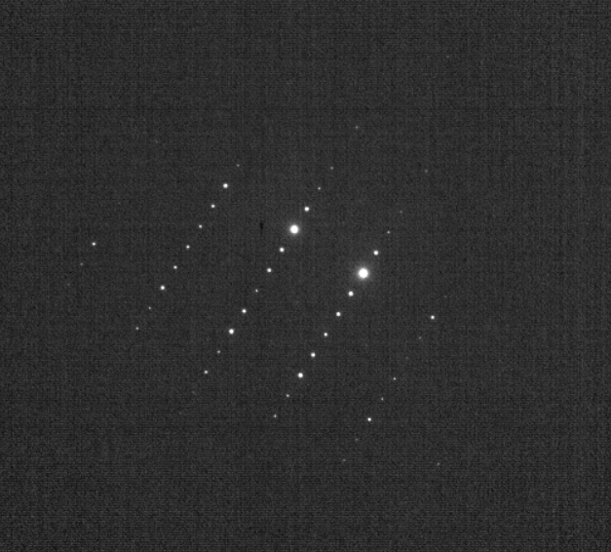
Experimental Setup: Sample (ZrTe₅)
Quasi 1D
Anomaly in conductivity
Y-Y Lv, et.al, J. Cryst Growth 457(2017), 250-254 ; R.Y Chen, et al. PRB 92(2015)
Absorption coefficient (spectrum)

Slide 7
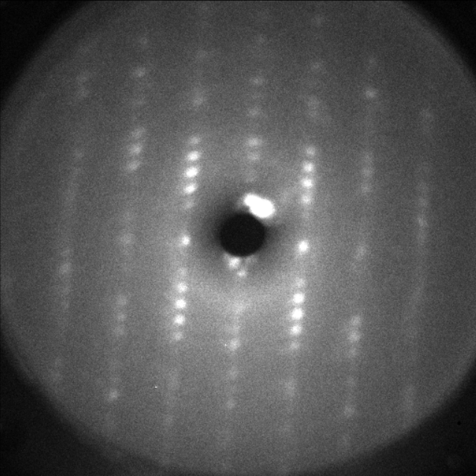
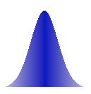
Experimental Setup: Layout
e⁻
Delay
1.55eV
F = 0.5-2.0mJ/cm²
T = 77-300 K

Slide 8
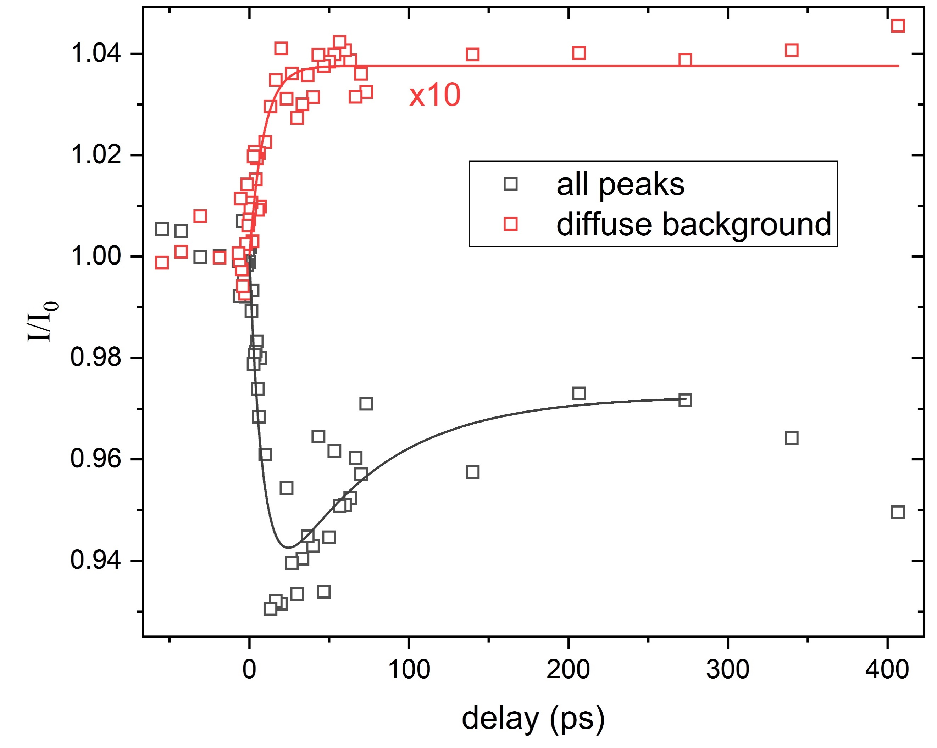
Plans: Preliminary measurements
diffraction pattern
<001>
110
220
[1-10]
Atomic dynamics include more than a simple heating: lattice deformation and recovery

Slide 9
Plans: Next steps
Measurements at room temperature:
at small delays to extract the electron-phonon coupling constant
at large delays to characterize anisotropic lattice deformation and its recovery
Measurements at low temperatures:
Compare the nonequilibrium lattice response near the resistivity anomaly and room temperature
Expected timeline : Nov 2018 – April 2019

Slide 10
Beam Requirements
Parameter | Nominal | Requested
Beam Energy (MeV) | 3 MeV | 3 MeV
Bunch Charge (pC) | 4.0 | Temporal resolution is a priority above the bunch charge
Rep. Rate (Hz) | 5 | 5
Sample Materials: ZrTe₅ (already approved for insertion)
Special Equipment: None

Slide 11
2019 Experiment Time Estimates
Run Hours (include setup time in hours estimate):
Number of experiment hours: 100
Overall % setup time: 10
Hazards & installation requirements:
Large installation (chamber, insertion device etc…): N
Pump laser use: Y
Cryogens: Y
Introducing new magnetic elements: N
Introducing new materials into the beam path: Possibly
Any other foreseeable beam line modifications: N

