Slide 1
Clearing a path through fog droplets using a short-pulse (sub-nsec) CO₂ laser
Proposal # 304285
Rich Fischer, Ted Jones, Bahman Hafizi, Dan Gordon,
Yu-hsin Chen, and Joe Penano
Naval Research Laboratory, Washington, DC
Victor Hasson
University of Arizona
Tony Ting
University of Maryland
Funding source and status (submitting to ONR)
2019 ATF Users Meeting: New Proposal

Slide 2
Scientific Case – Laser vaporization and shattering of fog droplets
IR radiation is strongly absorbed by liquid water (but weakly absorbed by atmospheric gasses)
- Water at λ = 10 um, L_{α} = 10 um
- Water at λ = 3 um, L_{α} = 1 um
Typical fog droplets: 1-30 um diameter, 0.1 g/m³ mass loading, -65 dB/km extinction
IR lasers can be used to vaporize and explosively shatter fog droplets
- slow heating: vaporization, cw lasers [1]
- fast heating: vaporization + shattering, shock waves, hot spots, superheat limit (305 deg C) [2]
Droplet scattering can shift from Mie regime to Rayleigh ➔ less scattering along path
- large droplets, Mie σ ~ a²
- small droplets, Rayleigh σ ~ a⁶ / λ⁴
Shattering experiments using pulsed IR lasers
- long pulse (20 usec)
- moderate pulse lengths (80 – 400 nsec)
[1] Mullaney et al., “Fog dissipation using a CO2 laser,” Appl. Physics Letters, 1968.
[2] Kafalas and Ferdinand, “Fog droplet vaporization and fragmentation by a 10.6-um laser pulse,” Appl. Optics, 1973.

Slide 3
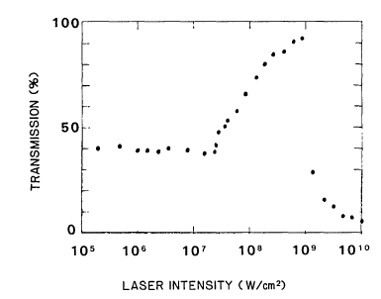
Laser transmission through a single water droplet
Droplet diameter = 53 um
SLM CO₂ laser
80 nsec pulse length
650 mJ
50 um FWHM at focus
Droplet shatter threshold intensity = 20 MW/cm²
At 1 GW/cm² ➔ laser-induced gas breakdown
Transmission improves as laser intensity increases
Kwok et al., “Enhanced transmission in CO₂-laser-aerosol interactions,” Optics Letters, 1988.

Slide 4
Benefits of short-pulse (sub-nsec) laser-droplet shattering
Reduced energy to shatter droplet (~ J/cm²)
Longer cleared path
Improved transmission
Faster shattering (use a train of pulses?)
Nonlinear channeling of short IR laser pulses (balance diffractive spreading)
Evaluate ultrafast absorption and heating of liquid water (non-thermal)

Slide 5
Past Experiment at NRL – cw vaporization of aerosols
Scattering Diagnostics
Beam Dump
Aerosol Generator
L = 100 cm
ID = 10 cm
Aerosol Flow (down)
16 um dia
700 droplets / cm³
1.07 um, 2 kW
CW Heater Laser
Aerosol Sizer
0.3 – 20 um dia
CW Probe Laser
0.53 um, 100 mW
filter
Fischer et al., “Absorption and scattering of 1.06 um laser radiation from oceanic aerosols,” Appl. Optics 48, 2009.

Slide 6
BNL Experiment – short-pulse (sub-nsec) shattering of water droplets
CW Probe Laser
Pulsed CO₂ Laser
LWIR, MWIR, SWIR, visible
Aerosol Flow (down)
Aerosol Generator
L = 100 cm
ID = 10 cm
Scattering Diagnostics
Aerosol Sizer
0.3 – 20 um dia
Beam Dump
Use collimated beam through interaction tube

Slide 7
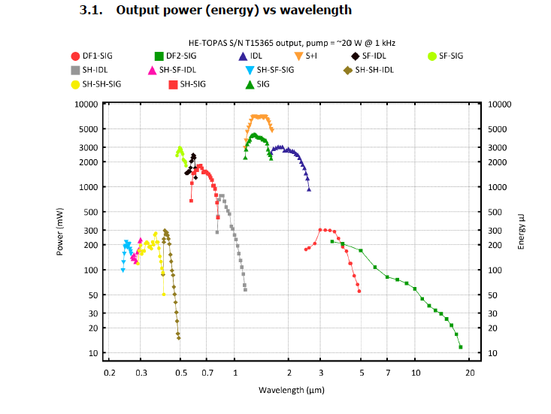
Program Plans – droplet shattering using OPA
Pulse length 50 fs - psec
NRL Topas OPA laser
Perform single-droplet shattering experiments at different IR wavelengths

Slide 8
Program Plans – droplet shattering using IR lasers
Year 1
Quarter
Vary aerosol parameters at NRL 1-2
Test probe lasers and diagnostics
Conduct laser-aerosol tests at BNL 3-4
Modify set-up as needed
Year 2
Generate single droplets at NRL 1-4
Shatter single droplets using OPA laser

Slide 9
CO₂ Laser Requirements
The following options are available at the laser source.
OPTION 1 (full power, ~1 shot per minute)
isotopic gas in final amplifier
2 TW max (2 ps, 4 J, single pulse)
9.25 um
M^2 ~ 2
linear polarization
OPTION 2 (regen only, 1.5 or 3 Hz)
3 GW max (2 ps, 6 mJ)
9.25 um
M^2 ~ 1.5
linear polarization (circular available at slightly reduced power)
** Please note any specialty laser configurations here **
Pulse length: 60 psec (2 psec)
Vary fluence ~ J/cm²
Beam diameter ~ few cm
Interaction Point location: Laser room

Slide 10
2019 Experiment Time Estimates
Run Hours (include setup time in hours estimate):
Number of CO₂ laser hours delivered to laser experiment hall (”FEL room”): 120 hours
Overall % setup time: 20%
Hazards & installation requirements:
Large installation (chamber, insertion device etc…): N
Laser use (other than CO₂): Yes
Cryogens: N
Introducing new magnetic elements: N
Introducing new materials into the beam path: N
Any other foreseeable beam line modifications: N
Please describe further where necessary
Possible probe lasers for aerosol shattering experiments
- LWIR (9-11 um)
- SWIR (1.5 um)
- visible (0.5 um)

Slide 11
Back-up Slides

Slide 12
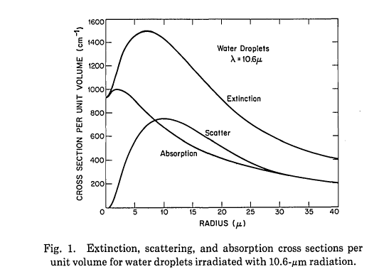
Scientific Case – Laser vaporization and shattering of fog droplets
Kafalas and Ferdinand, “Fog droplet vaporization and fragmentation by a 10.6-um laser pulse,” Appl. Optics 12 (1973)

Slide 13
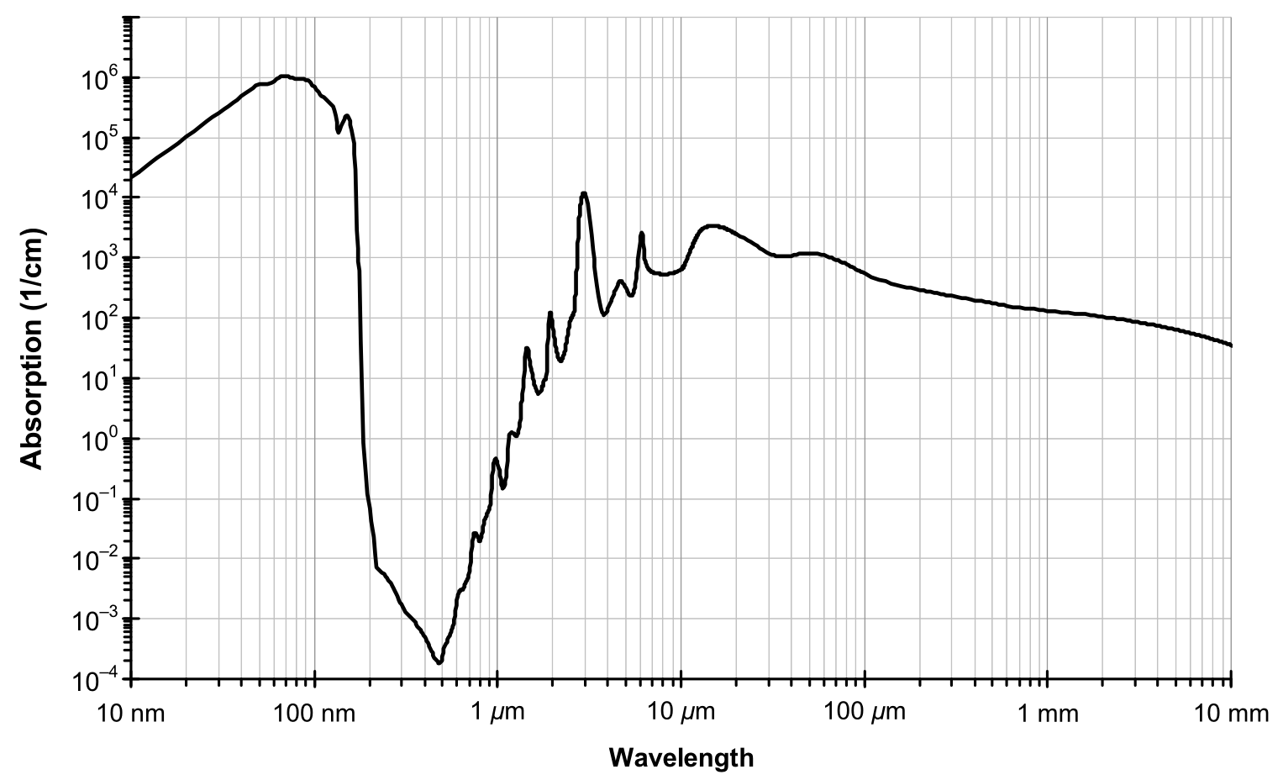
Scientific Case – Laser vaporization and shattering of fog droplets

Slide 14
Scientific Case – Laser vaporization and shattering of fog droplets
σ = 147 W / km
W = 0.1 g/m³ typical fog mass loading
σ = 14.7 x 4.34 = 63.8 dB/km agrees with measurements
fog mass loading can be higher than 0.1 g/m³
mass loading often increases with altitude (NASA aircraft measurements)
V. Chimelis, “Extinction of CO2 laser radiation by fog and rain,” Appl. Optics, 1982.

Slide 15
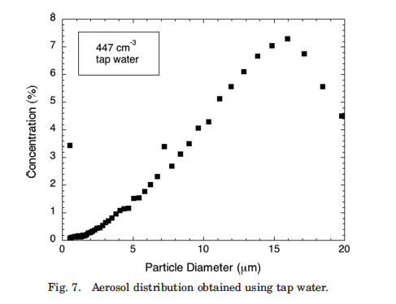
Experimental Setup

