Slide 1




Direct Measurement of Fields and Radiation in Self-Modulated Plasma Wakefield Regime
Navid Vafaei-Najafabadi¹, V. Litvinenko¹, R. Samulyak¹, M. Downer²
¹Stony Brook University
²University of Texas at Austin
Funding source and status: DOE HEP (Renew)
2019 ATF Users Meeting: New Proposal
Notes:
Beyond AE 71
Dividing the focus into two experiments – Rafal, etc

Slide 2
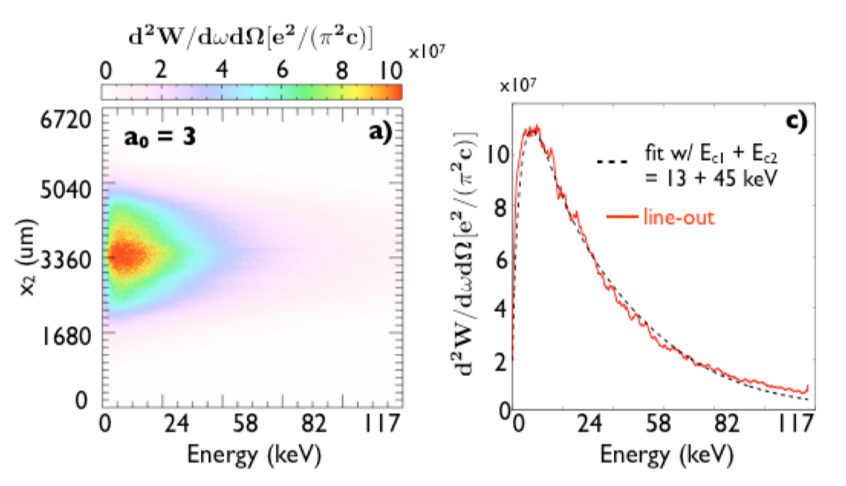
Radiation generation in ps-long SM-LWFA Regime
University of Michigan on LLE Omega EP system (400 J, 1ps, 1um)
Private Communication
Simulated x-rays from 100TW, 700 fs, 1um
N. Lemos, et al. PPCF 58 (2016)
Proton probing images of early time channel formation for the 750 J, 8.4 ps pulse interaction
L Willingale, et al, PRL, 106, 105002 (2011);
L Willingale, et al, IEEE, 39, 2616 (2011)
Notes:
DLA contribution
Threshold effect
We have similar electrons

Slide 3
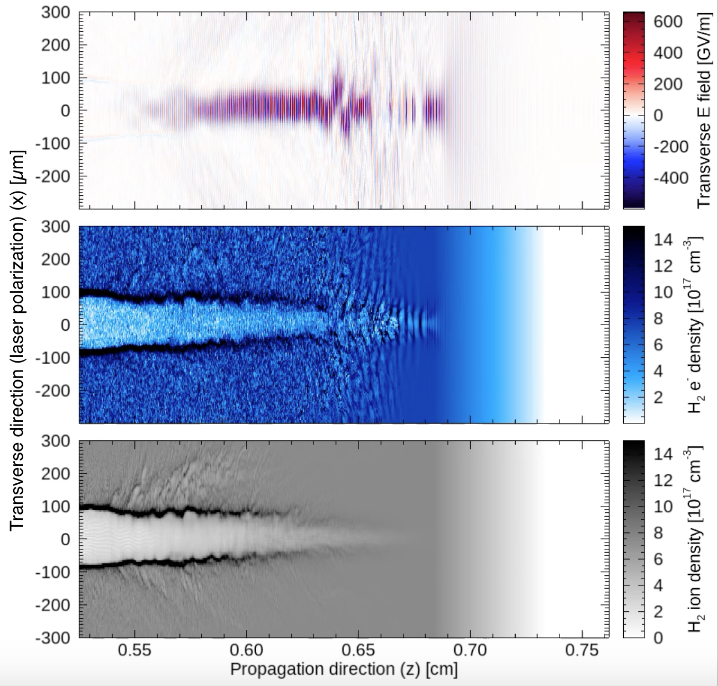
Three Interaction Regions
Instability
Channel
self modulation
1J, 4ps, 10.6um

Slide 4
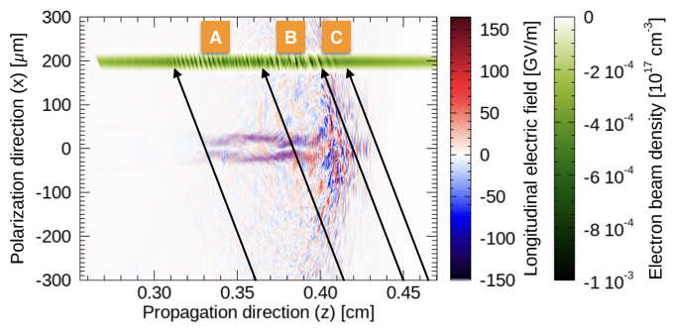
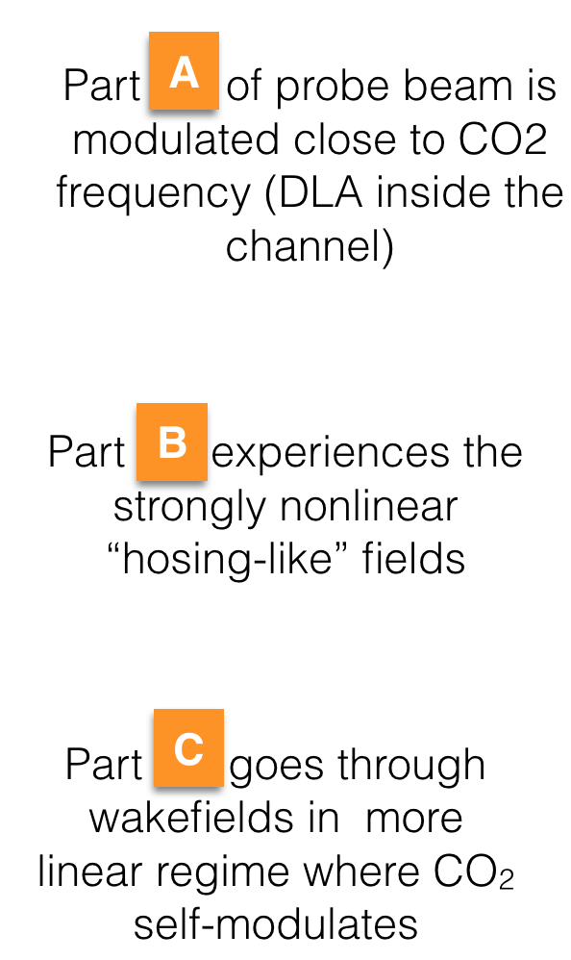
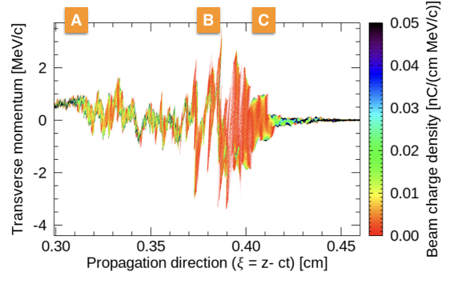
Direct Measurement of the fields helps identify and characterize different interaction regions

Slide 5
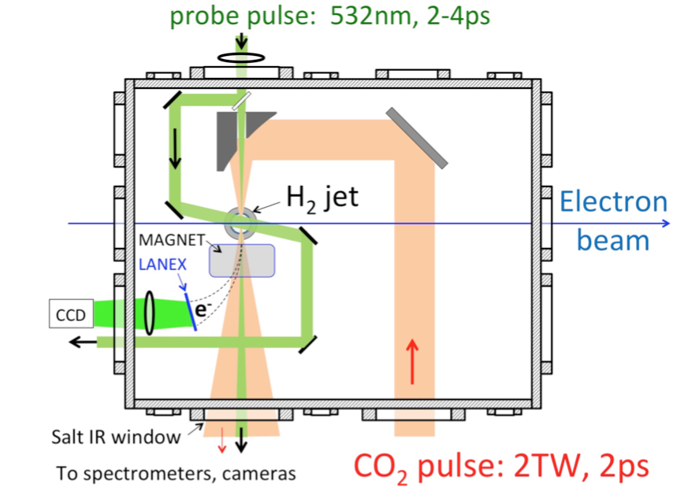
Experimental Setup (Transverse Probe)

Slide 6
Experimental Setup (Longitudinal Probe)

Slide 7
Plans
Milestones | Year
Direct measurement of the fields in a self-modulated (SM) laser wakefield accelerator (LWFA) using linac electron beam as a transverse probe | 2019
Parametric study of laser evolution in the SM regime and study of novel physics predicted by simulations in this interaction | 2019/2020
Coordinate electron characterization, wake visualization and simulations to achieve comprehensive understanding of CO2-laser-driven wakefield acceleration in nonlinear regime | 2020
Characterization of radiation-generation capability of the channel region in SM-LWFA using longitudinal probe. In particular, the role of direct laser acceleration (DLA) in enhancing the gamma radiation will be investigated | 2021

Slide 8
Electron Beam Requirements
Parameter | Nominal | Requested
Beam Energy (MeV) | 50-65 | Nominal (50-65 MeV)
Bunch Charge (nC) | 0.1-2.0 | ~1
Compression | Down to 100 fs (up to 1 kA peak current) | 100 fs
Transverse size at IP (sigma, um) | 30 – 100 (dependent on IP position) | 100 um (longitudinal probe) 1 mm (transverse probe)
Normalized Emittance (um) | 1 (at 0.3 nC) | 1
Rep. Rate (Hz) | 1.5 | Up to 1.5
Trains mode | Single bunch | Single Bunch
Special Equipment: Magnetic Spectrometer and BPMs

Slide 9
CO₂ Laser Requirements
OPTION 1 (full power, ~1 shot per minute)
isotopic gas in final amplifier
2 TW max (2 ps, 4 J, single pulse)
9.25 um
M^2 ~2
linear polarization
Ability to switch polarization would be very valuable
Interaction Point location: electron experiment hall

Slide 10
2019 Experiment Time Estimates
Run Hours (include setup time in hours estimate): 480
Number of electron beam only hours: 120
Number of CO₂ laser hours delivered to laser experiment hall (”FEL room”): N/A
Number of CO₂ laser hours, + ebeam, delivered to electron beam experiment hall: 240
Overall % setup time: 30
Hazards & installation requirements:
Large installation (chamber, insertion device etc…): Y (Differential Pumping)
Laser use (other than CO₂): Y (See Rafal’s presentation)
Cryogens: N
Introducing new magnetic elements: N
Introducing new materials into the beam path: Y (Yag BPM & Mirror)
Any other foreseeable beam line modifications: Y (Permanent magnet chicane for beam compression)

Slide 11
Longer term…
Should the laser at B820 be upgraded with equipment from B920
Simulated bubble in plasma density 1.1 x 10¹⁶ cm⁻³ ,driven by 500 fsec CO₂ laser with a₀ =1.4
Wei Lu
Two parameter sets for LWFA at ATF II. (C. Joshi)
Laser Intensity Dephasing Energy Gain Spot Matched-spot Rayleigh
a₀ (W/cm²) Length (cm) MeV w₀ (μm) w_{m} (μm) Length (mm)
2 4x10¹⁶ 10 666 200 150 12.6
4 1.6x10¹⁷ 14 1332 100 212 3.1
External injection of ~ 10fs x ~ 3μm bunches from the linear accelerator into the plasma accelerator below its self-injection threshold (SBU/BNL)
Simulations of all key LWFA/ injection processes (Tsinghua U/UCLA/SBU)
Diagnostics (UT Austin/ Tsinghua U / BNL)
10 to 100 cm long plasma source with density 5 x 10¹⁵ < n_{e} < 10¹⁷ cm⁻³

Slide 12
The End

Slide 15
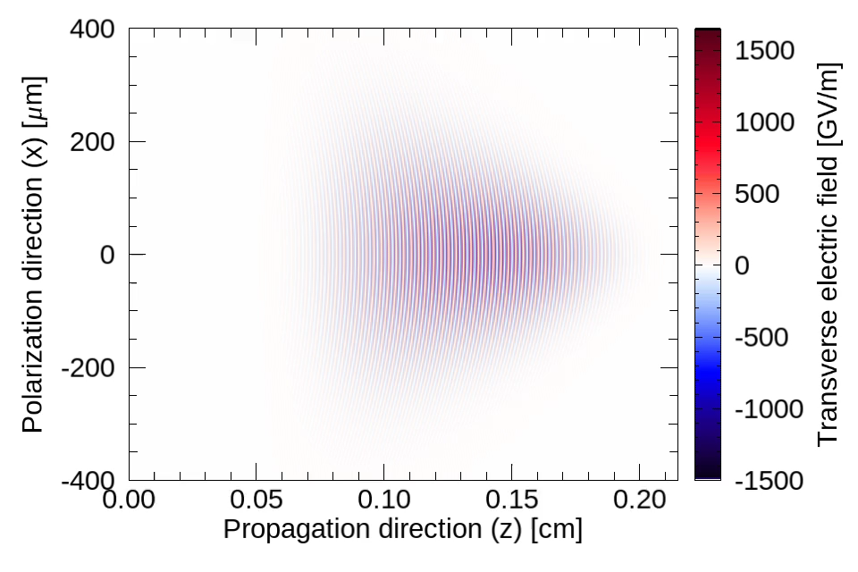
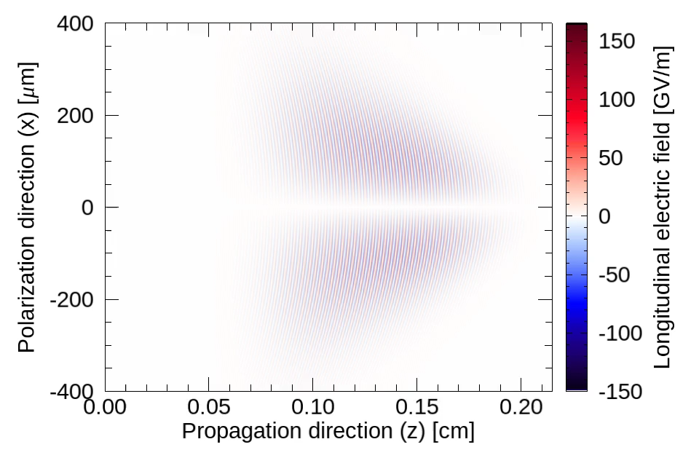
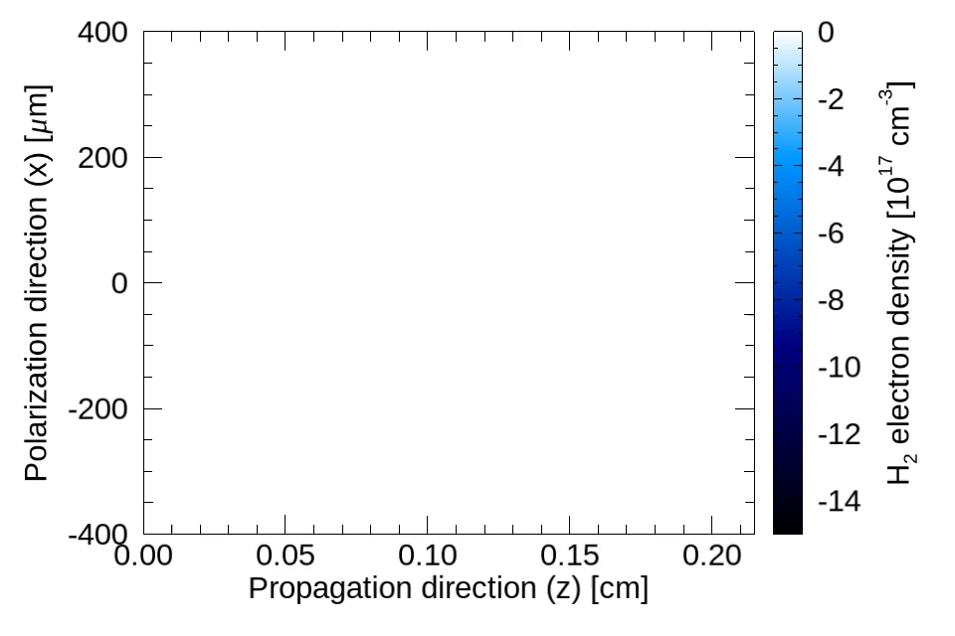
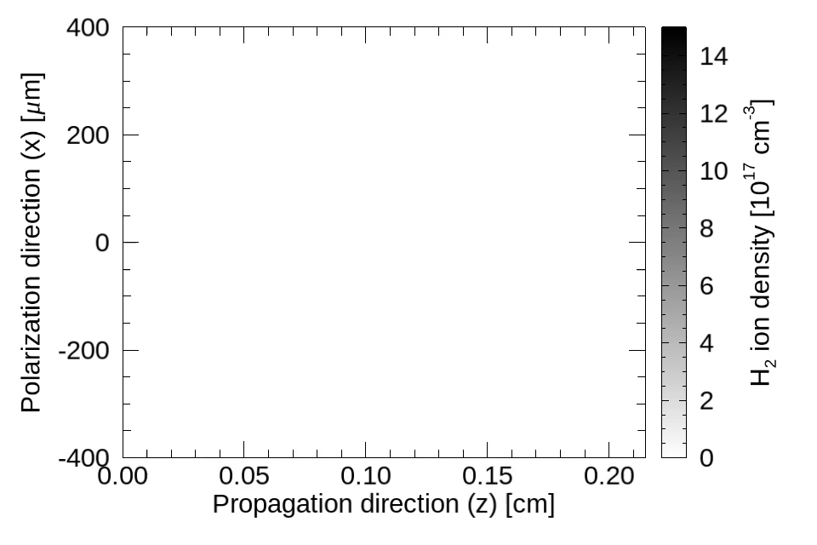
Evolution of electromagnetic fields and plasma density

Slide 18
Experiments were conducted on OMEGA EP:
  A low density plasma was plume generated using a 2.5 ns beam (1200 J)
Main interaction beam was ~ 1.3 ps at 400 J
Scanned density by varying timing
Notes:
Proton probe enables us to image the evolution of EM fields
Add energies for the laser pulses
Add something about timing to vary density

