Slide 1
21st ATF Users’ Meeting
Operations Status

Slide 2
Outline
2018 recap
Availability
User activities
Operations activities
Operations Status: What is available in 2019?
Capability operational status update
Available parameters
Available facilities
Recap of user resources and responsibilities
Time requests
Beam scheduling
Run reports

Slide 3
Availability
Availability
2018
Resource | Planned Hours | Delivered Hours | % of Planned
Electron Beam | 830 | 751 | 90
CO2 Laser | 700 | 849 | 121
UED | 830 | 929 | 112
Total | 2360 | 2529 | 107
2019
Resource | Planned Hours
Electron Beam | 640
CO2 Laser | 640
UED | 740
Total | 2020

Slide 4
User Activities Breakdown
UED now set up for turn-key materials science operations
Most setup time for accelerator focused experiments
Advanced accelerator experiments have a wide range of complex requirements

Slide 5
FY18 Summary (hours)
92 Users
Down time:
Ebeam – klystron replacement and commissioning
Laser – R&D
UED – Cathode cleaning and gun optimization

Slide 6
Operational Status: Available User Time
2019 Resource | Planned Hours | FY18 Delivered | FY19/FY18 (% Ratio)
Electron Beam | 640 | 751 | 85%
CO₂ Laser | 640 | 849 | 75%
UED | 740 | 929 | 80%
Total | 2020 | 2529 | 80%
Planning currently underway to try to bring FY19 hours in line with FY18.

Slide 7
Operational Status
Electron Beam
Linac Klystron replacement and commissioning complete
Presently approved for operations up to 60 MeV
Safety approval will be sought for higher energies as needed
Gun klystron maintenance complete
CO₂ Laser
Mixed isotope CO₂ gas now in main amplifier
Plasma shutter installed to allow higher power delivery to experiments
CPA optimization for mixed isotope setup continues
Vacuum delivery system in commissioning to deliver higher power to laser experiments and BL1 interaction points
UED
Routine turn-key operation for materials science experiments
Cathode cleaning complete and further gun optimization underway

Slide 8
Electron Beam
User Slide
Parameter | Nominal | Requested
Beam Energy (MeV) | 50-65 | Full range is ~ 15-75 MeV with highest beam quality at nominal values
Bunch Charge (nC) | 0.1-2.0 | Bunch length & emittance vary with charge
Compression | Down to 100 fs (up to 1 kA peak current) | A magnetic bunch compressor available to compress bunch down to ~ 100 fs. Beam quality is variable depending on charge and amount of compression required.
Transverse size at IP (sigma, um) | 30 – 100 (dependent on IP position) | It is possible to achieve transverse sizes below 10 um with special permanent magnet optics.
Normalized Emittance (um) | 1 (at 0.3 nC) | Variable with bunch charge
Rep. Rate (Hz) | 1.5 | 3 Hz also available if needed
Trains mode | Single bunch | Multi-bunch mode available. Trains of 24 or 48 ns spaced bunches.
Special Equipment:
Please indicate any special equipment that you expect to need, including (but not limited to) the transverse deflecting cavity, shaped bunch using mask technique, plasma capillary discharge system, bolometer/interferometer setup etc.

Slide 9
CO₂ Laser
User Slide
The following options are available at the laser source. Note that the maximum power available at your experiment interaction point will depend on the laser transport method.
OPTION 1 (full power, ~1 shot per minute) isotopic gas in final amplifier 2 TW max (2 ps, 4 J, single pulse) 9.25 um M^2 ~2 linear polarization OPTION 2 (regen only, 1.5 or 3 Hz) 3 GW max (2 ps, 6 mJ) 9.25 um M^2 ~1.5 linear polarization (circular available at slightly reduced power)
** Please note any specialty laser configurations here **
Interaction Point location: Laser room/electron experiment hall - delete as necessary (the highest peak power can be delivered to the laser room chamber and 2 beamline #1 chambers. CO₂ laser delivery to beamline #2 will see lower power due to necessary transport in air.)

Slide 10
UED
User Slide
Parameter | Nominal | Requested
Beam Energy (MeV) | 3 MeV | 3 MeV is the maximum beam energy available. Higher energies may be considered
Bunch Charge (pC) | 4.0 | Range 0.05 – 4.0. Bunch length & emittance vary with charge
Rep. Rate (Hz) | 5 | 1 - 5 Hz at present
Sample Materials:
Please provide a list of materials that you will install in the beam path.
Special Equipment:
Please indicate any special equipment that you expect to need.

Slide 11
6 Available IPs
FEL room – high power CO₂ delivered to ion chamber with gas jet capability
BL1 – 3 chambers.
IGS chamber for electron beam-only experiments
LWFA chamber for laser–ebeam experiments plus gas jet capability
Compton chamber for laser-ebeam interaction
BL2 – 1 chamber + 1 insertion device IP
Plasma chamber with capillary discharge capability and laser delivery
Designated area for wiggler structures etc. with laser interaction capability
Laser delivery to both IPs at reduced power – vacuum transport does not extend beyond BL1
Deflecting cavity diagnostic

Slide 12
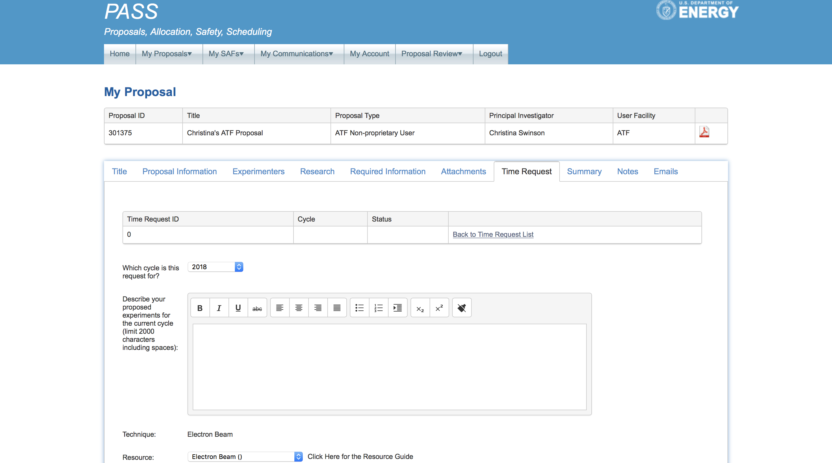
Time Request
For new experiments and experiments wishing to continue into 2019, a time request must be submitted at pass.bnl.gov

Slide 13
Beam Scheduling and Planning
Check the online schedule from the Operations tab on the ATF homepage
Submit a beam time request https://surveys.external.bnl.gov/n/ATFShiftRequest.aspx
Check that your experimental safety review is in place, email Karl Kusche (kusche@bnl.gov)
Submit installation and run plans to atf@bnl.gov
Read the Users’ Place section of the ATF website
Attend the 9 am Monday planning meeting, during your run, to coordinate technical support and experiment requirements

Slide 14
Run Reports
The lead experimenter should attend the ATF weekly meeting at 4 pm each Friday, during their run, to report that week’s progress.
PI’s should inform the ATF if they wish to designate a second person to be the main point-of-contact or lead experimenter
Submit an end-of-run survey form within 2-weeks of the run end, at https://surveys.external.bnl.gov/n/ATFUsersRunReport.aspx

