Slide 1
21st ATF Users Meeting
Welcome & Introduction
Mark Palmer
November 14, 2018

Slide 2
Outline
Welcome
ATF Introduction
ATF Outlook
  FY18 Retrospective
Moving Forward
  Re-envisioning the ATF Program
Structure of this Meeting

Slide 3
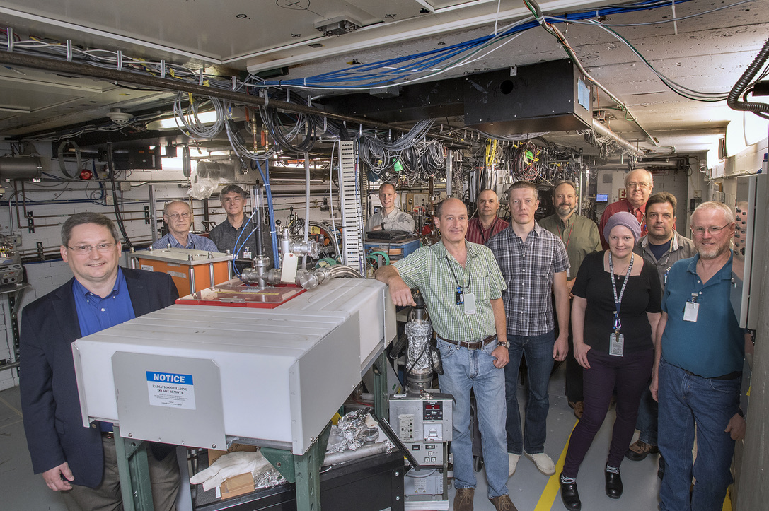
Welcome!
from the entire
ATF Team

Slide 4
A few words on Safety…
In the case of an emergency where we need to exit the building
  Nearest exit is out the conference room door and to your left
  Alternatively head up the steps and straight ahead

Slide 5
ATF Introduction

Slide 6
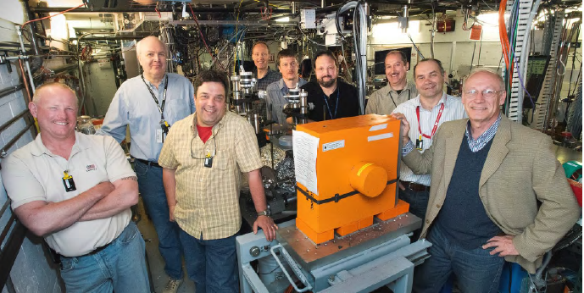
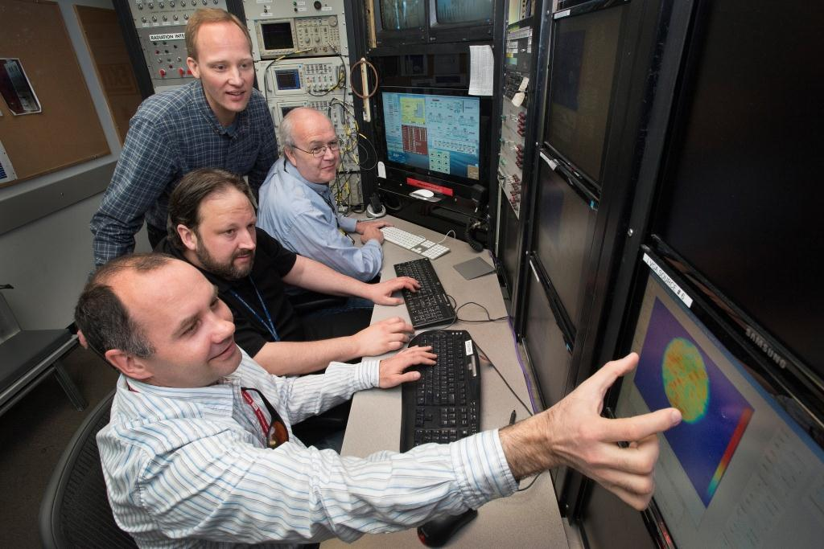
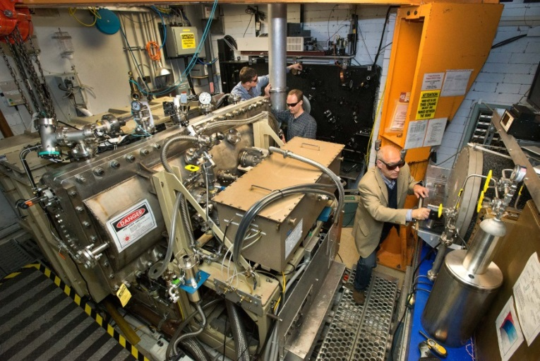
Accelerator Stewardship with the ATF
The ATF pioneered the concept of a user facility for studying new methods of accelerating electrons and ions
One-of-a-kind
combination of e-beams and lasers
Free facility access to qualified
researchers
Well established, proposal-driven, peer-reviewed, serving the accelerator community for >25 years
    A highly trained staff to support a broad array of user experiments
High-brightness electron beams
Highly Experienced Staff
Unique powerful lasers

Slide 7
ATF: A National User Facility
Designated a DOE National User Facility in 2015
https://www.bnl.gov/bnlweb/pubaf/fact_sheet/pdf/FS-ATF.pdf
Research Thrusts:
  Novel particle acceleration techniques
  R&D for smaller, more cost effective accelerators including:
    Plasma and dielectric wakefield acceleration
    Direct laser acceleration
    Inverse free-electron lasers…
  High-brightness radiation sources
  New techniques to produce electromagnetic radiation from THz to X-rays:
    FEL R&D
    Inverse Compton scattering
    THz radiation from dielectric structures…
  Beam manipulation and beam instrumentation
  Sophisticated longitudinal and transverse beam manipulation capabilities
    Wide range of beam parameters enabling development and testing of advanced accelerator hardware, beam diagnostics and detectors
  Ion generation and acceleration
    Experimental hardware for producing supersonic hydrogen gas jets provides capabilities for generating mono-energetic multi-MeV proton beams
  Ultrafast Electron Diffraction/Microscopy
  Technique for characterizing materials that is complementary to x-ray sources
    Developmental beam line and experimental station for diffraction and imaging studies with MeV-class electron beams

Slide 8
ATF Overview
A proposal-driven DOE SC national user facility, under the Accelerator Stewardship Program.
  Scientific program is guided by the Accelerator Stewardship Mission
  Experiments
    Reviewed by an external Program Advisory Committee
    3-year approval
The major ATF capabilities are:
  ~20-80 MeV electron accelerator with tunable charge, energy, energy spread, and IP beam size. Beam manipulation and measurement capabilities.
  High power CO₂ long-wavelength mid-IR laser that can be brought into interaction with the electron beam, as well as targets.
  Multiple near IR lasers that can be transported to any experiment for use as probes, or even brought into interaction with the electron beam.
  Interaction point diagnostics
  Ultrafast Electron Diffraction (UED) facility

Slide 9
ATF Outlook

Slide 10
FY18: An Eventful Year…
At the start of the year, we were focused on:
  Repairing the ATF Linac (failure of the SLAC-type klystron)
  Refurbishing capabilities at B820
  Continuing improvements to the UED facility
  Evaluating the outcomes of our Scientific Needs Workshop
  Planning for the ATF-II Upgrade at B912
By the end of the year:
  The ATF Linac was back in normal operation
  The B820 facility had undergone significant updates
    Key systems refurbished
    Significant upgrades to the Experimental Hall and CO2 Laser Systems
    With more updates on the way…
  Major refurbishment of the UED gun was completed
  First UED paper published
  BUT, ATF-II was no longer part of our plan

Slide 11
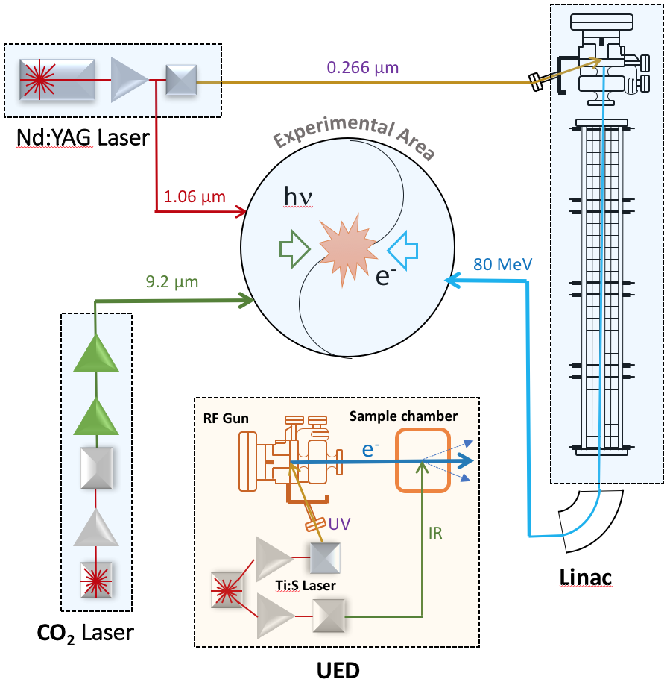
Scientific Program
UED

Slide 12
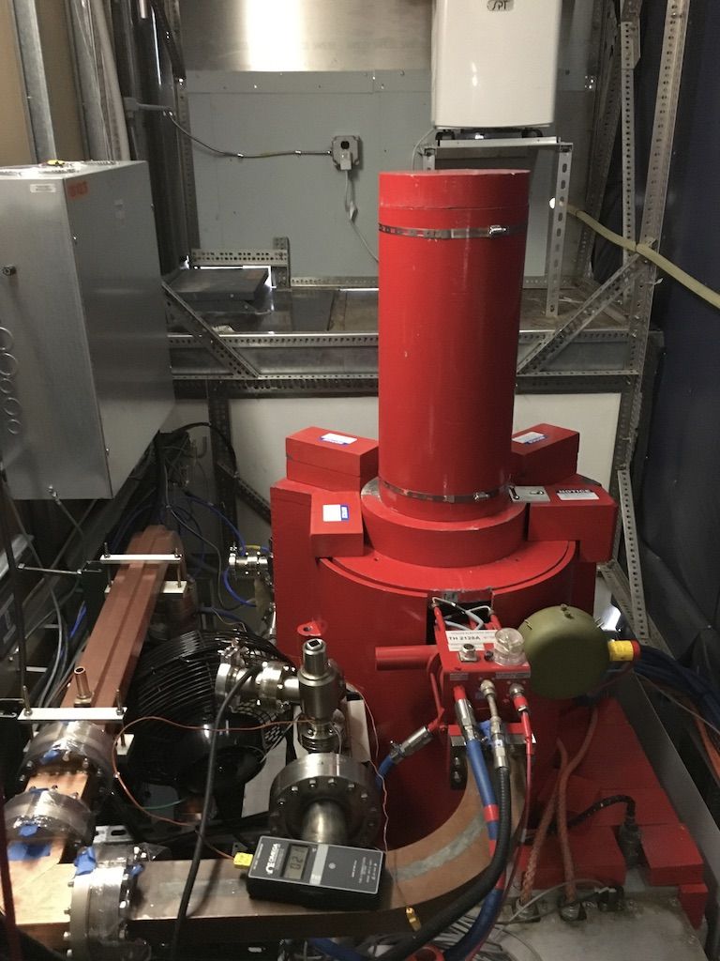
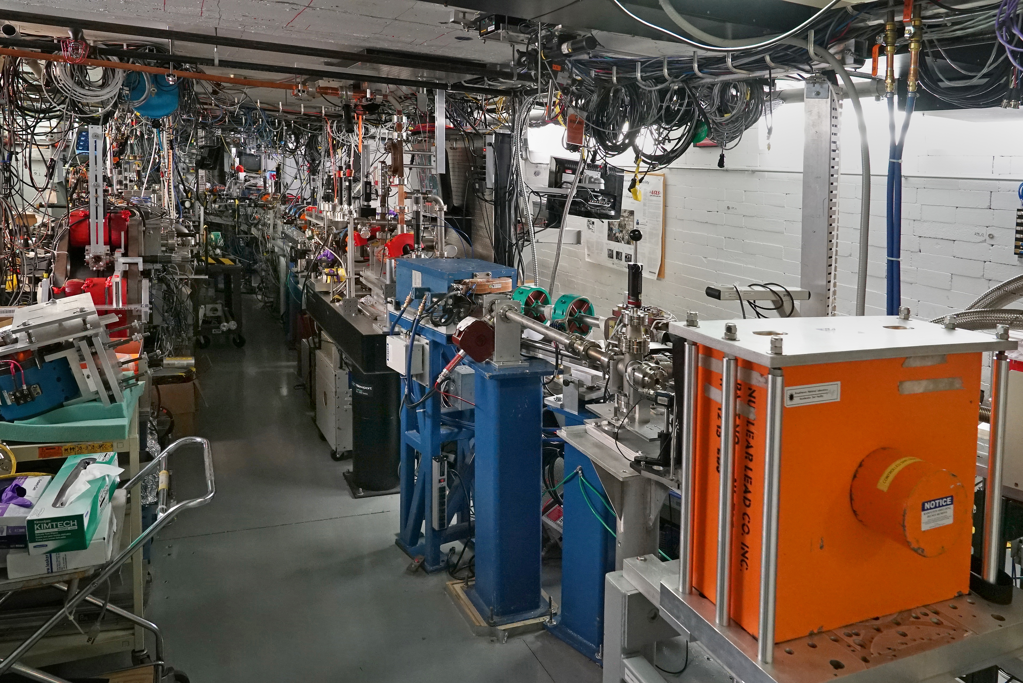
The ATF at
BNL B820
Thales 2128A
Replacement
Linac Klystron
Current Operating Guidance
  Operations at B820 will now be the future focus of the ATF Team
  Major FY18 updates
    Upgrades to CO₂ Power to Users
    Upgrades to electron beam lines
    Reliability and availability improvements
Updated
Beam Line #2

Slide 13
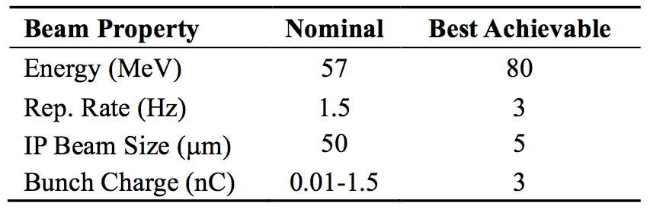
Accelerator Capabilities
The ATF accelerator generates highly-tunable electron bunches to 2 beamlines with multiple, user designed, interaction points.
Tunable properties include: energy, charge, energy spread, bunch length, transverse beamsize, …

Slide 14
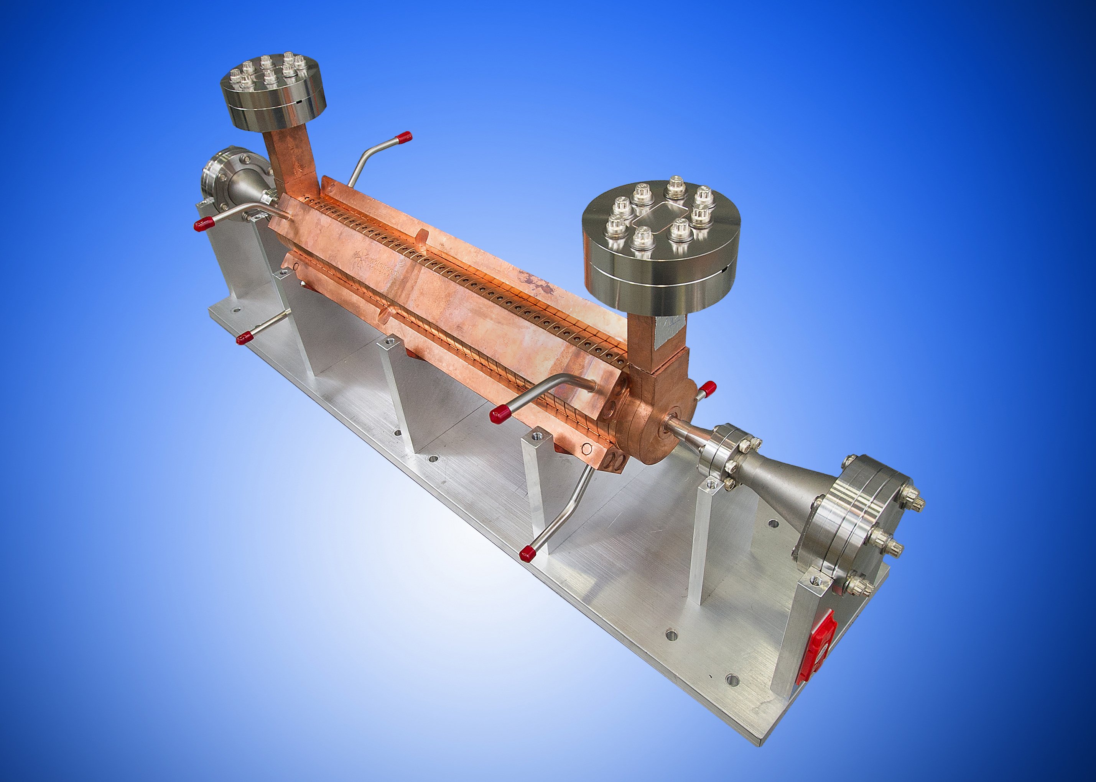
Interaction Points and Diagnostics
Six interaction points
  4 x ebeam chambers
  Insertion device IP
  1 x laser – target chamber
Laser diagnostics
Electron beam diagnostics
  Longitudinal diagnostics (deflecting cavity, bolometer/interferometer)
  Transverse diagnostics (YAG screen)
  Energy Spectrometer

Slide 15


CO₂ Laser System at B820
Ti:Al2O3
20 µJ
350 fs
Amplifier 1
OPA
See M. Polyanskiy Talk Tomorrow
5 µJ
80 ps
20 mJ
60 ps
Stretcher
10J
new
Recent Modifications:
Addition of Plasma
Shutter (2017)
Conversion to CPA
configuration (2017)
Implementation of
CO₂ isotopic gas mixture
in Amplifier 2 (2018)
Plasma
Shutter
old
Amplifier 2
YAG
~2 TW to users
new
Compressor
~0.5 TW to users
old

Slide 16
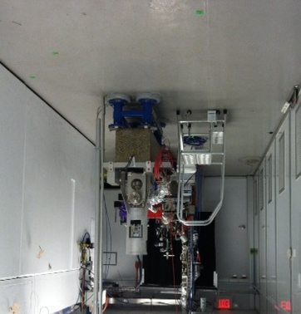
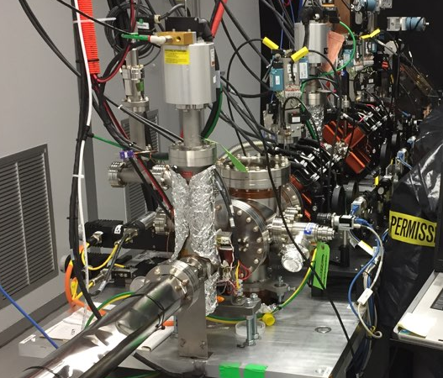
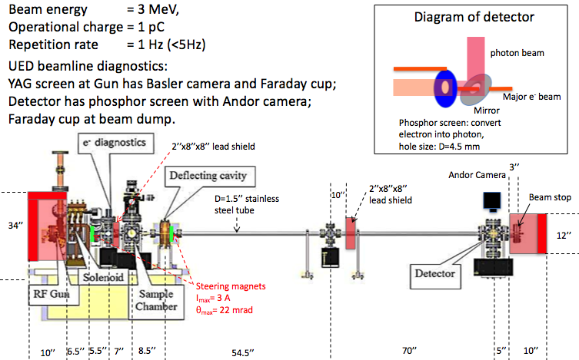
UED and UEM Development System (B912)
Quasi-2D Structural Dynamics -
Charge Density Waves
Facility fully operational in FY17
Ongoing upgrades to provide more flexible pump-probe studies
LDRD-funded effort to develop Ultrafast Electron Microscopy application underway

Slide 17
Moving Forward

Slide 18
Updating the ATF Programmatic Plan
2 Imperatives:
  Establish an effective program for our user community at B820
    What are the most critical new capabilities to deliver?
    What does our Facility R&D program need to focus on?
      We want to engage in new collaborative thrusts
    How can we provide the most effective ongoing operations plan?
  Prepare a transition plan for the UED Facility
    Provide unique and attractive user capabilities
    Engage further with the materials science user community
    Prepare a proposal to transition the facility for user science operation (as opposed to accelerator development)
These items will be the focus of tomorrow afternoon’s presentations and discussion

Slide 19
Meeting Structure
Wednesday, Nov 14
Opening Session
  ATF Status and Ongoing Efforts
Sessions 2-3
  New Proposals
Session 4
  Status Updates
Workshop Photo after lunch!
  Meet here - 1:30 sharp!
Workshop Dinner this evening at Hotel Indigo
Thursday, Nov 15
Morning Sessions
  New Proposals & Status Reports
Afternoon
  Session 1:
    Facility R&D Program
    Facility Upgrade Plans
  Session 2:
    Next Steps for B820& UED Planning
    Discussion

Slide 20
Friday
Facility Tours
  B820
  B912
Shuttle will load at the front of Berkner Hall at 9AM sharp!

