Slide 1
AE62: Sub-femtosecond bunch length diagnostic
PI: G. Andonian
Collaborators: N. Sudar, Y. Sakai (UCLA), A. Ovodenko (Radiabeam), M. Weikum (DESY), M. Babzien, M. Fedurin, K. Kusche, R. Malone, I. Pogorelsky, M. Polyanski, C. Swinson (BNL ATF)
Funding source: DOE SBIR Award # DE-SC0007701 (main) + internal funds committed
Status: * (Awaiting final technical report)
2019 ATF Users Meeting: Application for Continuation
(no experiment time received since the last users meeting)

Slide 2
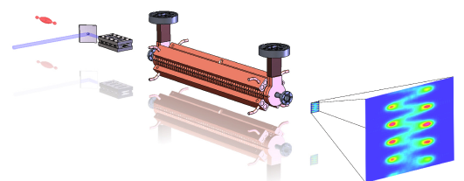
Science Case
Motivation: characterization of ultra-short bunches (sub-fs resolution)
e-beam
deflector
laser
undulator
screen
Laser (TEM₁₀ mode)/e-beam interaction in undulator
Angular modulation of beam - Dependent on longitudinal coordinate
RF deflector provides vertical streak for “slow” modulation
Angular modulation (“sweep”) observable on distant screen (x’ -> x)
Scheme provides enhanced resolution over RF deflector alone.
“Attoscope”
Notes:
Characterize bunch profile with sub-ps resolution
To understand variations in beam emittance, current density
Current techniques limited to <10fs res

Slide 3
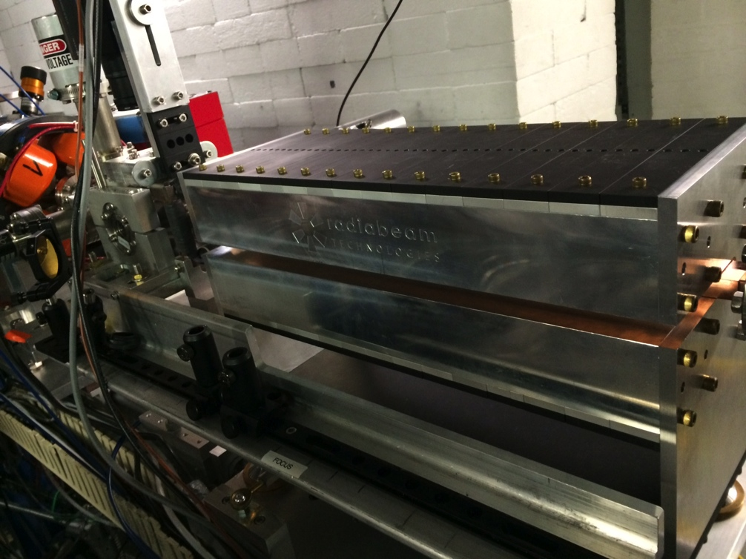
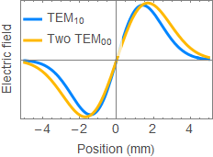
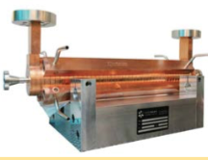
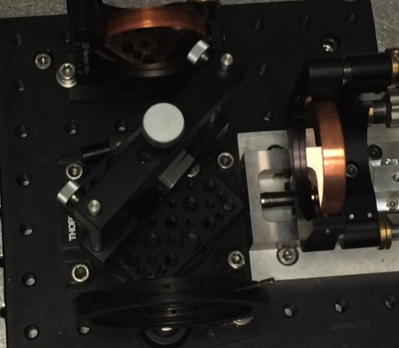
Experimental Setup
Configuration is similar to prior IFEL/Attoscope runs (BL2)
Benefits from week’s prior IFEL run (less install time)
New BL2 layout may require reconfig of mode converter

Slide 4
Plans
No beamtime in 2018 - ATF not ready for both deflector and CO2 availability at same time
Next run goal: Observe full modulation
Build off of previous results
Resolution on screen may be limiting
Deflecting voltage at TCAV,
Beam intrinsic emittance may need improvement (slits)
Deconvolve effects of beam transport
Challenge: optimal laser and x-band simulation
Leverage off IFEL experiment (alignment, synchronization)
No new HW, reconfigure mod converter to accommodate new setup
Request for next run
1-2 weeks (Reestablish laser conditions & Realign/retune undulator)
1-2 weeks run with laser + deflecting cavity
Status: No cost extension expiring

Slide 5
Electron Beam Requirements
Parameter | Nominal | Requested Experiment Parameters
Beam Energy (MeV) | 50-65 | 44-48
Bunch Charge (nC) | 0.1-0.5 | .3-.5
Compression | Down to 100 fs (up to 1 kA peak current) | N/A
Transverse size at IP (sigma, um) | 30 – 100 (dependent on IP position) | 60um
Normalized Emittance (um) | 1 (at 0.3 nC) | 1
Rep. Rate (Hz) | 1.5 | 1.5
Trains mode | Single bunch | single
Special Equipment:
Deflecting cavity

Slide 6
CO₂ Laser Requirements
The following options are available at the laser source. Note that the maximum power available at your experiment interaction point will depend on the laser transport method.
OPTION 1 (full power, ~1 shot per minute) regular gas in final amplifier (winter-spring 2018) 1 TW max (3.5 ps, 5 J, 30% of energy in post-pulses) 10.25 um M^2 ~2 linear polarization isotopic final amplifier (may be available late 2018) 2 TW max (2 ps, 4 J, single pulse) 9.25 um M^2 ~2 linear polarization OPTION 2 (regen only, 1.5 or 3 Hz) 3 GW max (2 ps, 6 mJ) 9.25 um M^2 ~1.5 linear polarization (circular available at slightly reduced power)
Interaction Point location: Laser room/ electron experiment hall - delete as necessary

Slide 7
2018 Experiment Time Estimates
Run Hours (include setup time in hours estimate):80-120
Number of electron beam only hours:80
Number of CO₂ laser hours delivered to laser experiment hall (”FEL room”):0
Number of CO₂ laser hours, + ebeam, delivered to electron beam experiment hall:80
Overall % setup time:50%
Hazards & installation requirements:
Large installation (chamber, insertion device etc…): N
Laser use (other than CO₂): N
Cryogens: N
Introducing new magnetic elements: Y (undulator)
Introducing new materials into the beam path: N
Any other foreseeable beam line modifications: Y (slits for deflecting cavity)
Please describe further where necessary

