Slide 1
Plasma compression of terawatt long wavelength laser pulses
Proposal#304309
Funding Status: ONR, Received
D.F. Gordon, Y.-H. Chen, L. A. Johnson, P. Grugan, D. Kaganovich, and A. Ting
Plasma Physics Division, Naval Research Laboratory
M. Babzien, M. N. Polyanskiy, I. V. Pogorelsky, C. Swinson and M. A. Palmer
Accelerator Test Facility, Brookhaven National Laboratory
*This work is support by Office of Naval Research and Department of Energy

Slide 2
Backward Raman amplifier pumped by ATF CO₂ laser
Plasma, n_{e}=10¹⁸ cm⁻³, L=1 mm
Femtosecond Ti:S
(“Strong Field Laser”) + downconversion
ATF CO₂ Laser
(4 J, 2 ps, 9 um)
Amplified Pulse
(1 J, 0.1 ps, 14 um)
Scientific Case Summary:
Backward Raman amplification has not been tried in the LWIR. Expect to extend basic knowledge of the process.
Plasma compression is a way to bypass limitations of CO₂ bandwidth
Ultimate payoff would be eliminating the need for high pressure in ultra-short pulse CO₂ lasers, which in turn can enhance performance.

Slide 3
Plasma compression in LWIR is distinct from previous NIR efforts
Objective is not to overcome grating size limitation, but rather to overcome bandwidth limitation of lasing medium
In NIR 10% bandwidth readily achievable, for CO2 lasers typical maximum bandwidth is 1%
  Plasma compression extends bandwidth of pump radiation
  Outperforming existing sources is much more likely than in NIR
Parasitic effects due to ion motion is suppressed relative to experiments carried out in the past
Proposed parameters:
Raman e-folds = 36
Brillouin e-folds = 1.3
(Z=1, Te=17 eV)
Turnbull experiment 2012*:
Raman e-folds = 10
Brillouin e-folds = 6
(Z=2, Te=17 eV, collisional)
* Turnbull et al., Phys. Plasmas 19, 083109 (2012)

Slide 4
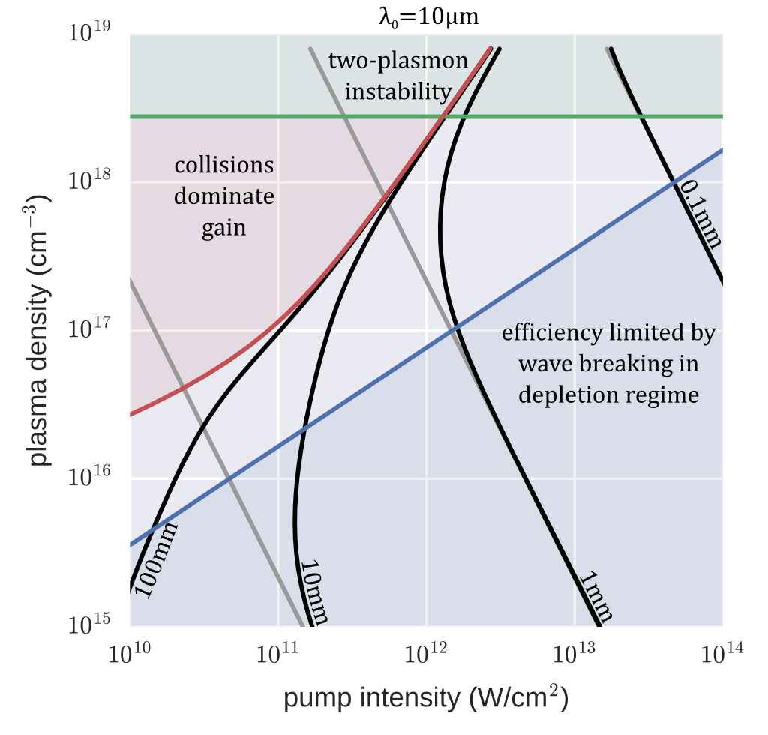
Parameter space for BRA using 10 µm pump radiation
L. Johnson et al., Phys. Plasmas 24, 033107 (2017).
Proposed
operating
point
Operating point found from 1D simulation study – not exhaustive
Corresponds to ATF laser parameters with focusing to w₀ = 500 μm
(I = 2.5×10¹⁴ W/cm², a₀ = 0.144)
Plasma source 10¹⁸ cm⁻³ , 1 mm
Pump is strong enough to tunnel ionize.
Guiding is not required.
gain length without collision
gain length with collision

Slide 5
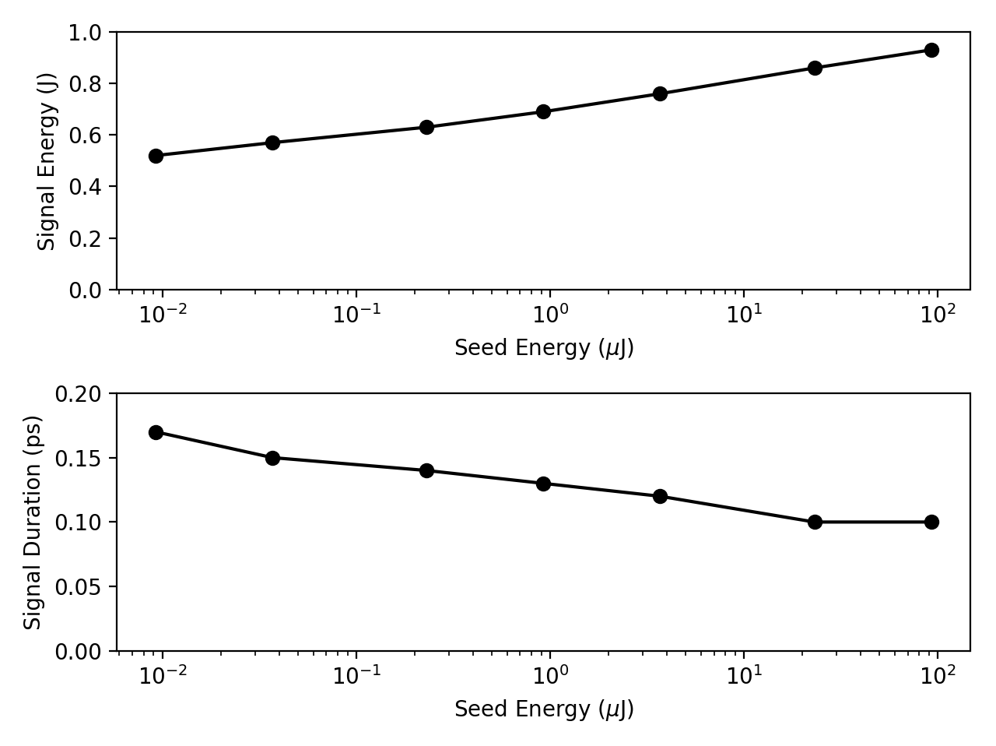
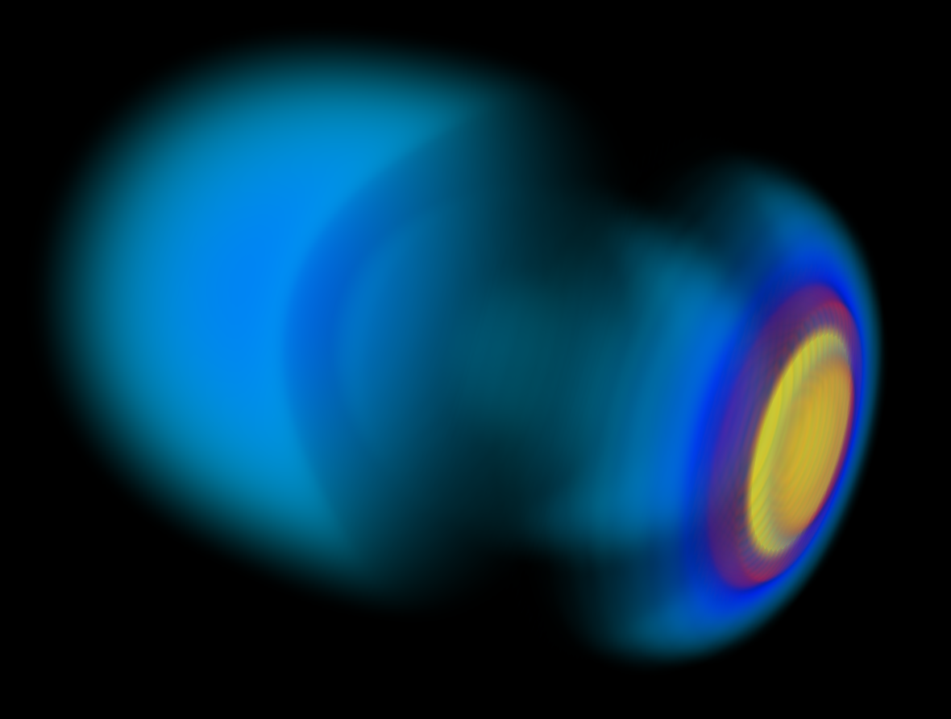
Plasma Compression Simulations
Signal
Residual Pump
3D fully nonlinear fluid simulations (turboWAVE)
Pump pulse parameters:
  10.6 micron wavelength, 3.0 Joules, 3 psec
Seed pulse parameters:
  15.5 micron wavelength, microjoule, 50 fsec
  Results highly insensitive to seed parameters
Output pulse parameters:
  15 micron wavelength, 0.7 Joules, 130 fsec

Slide 6
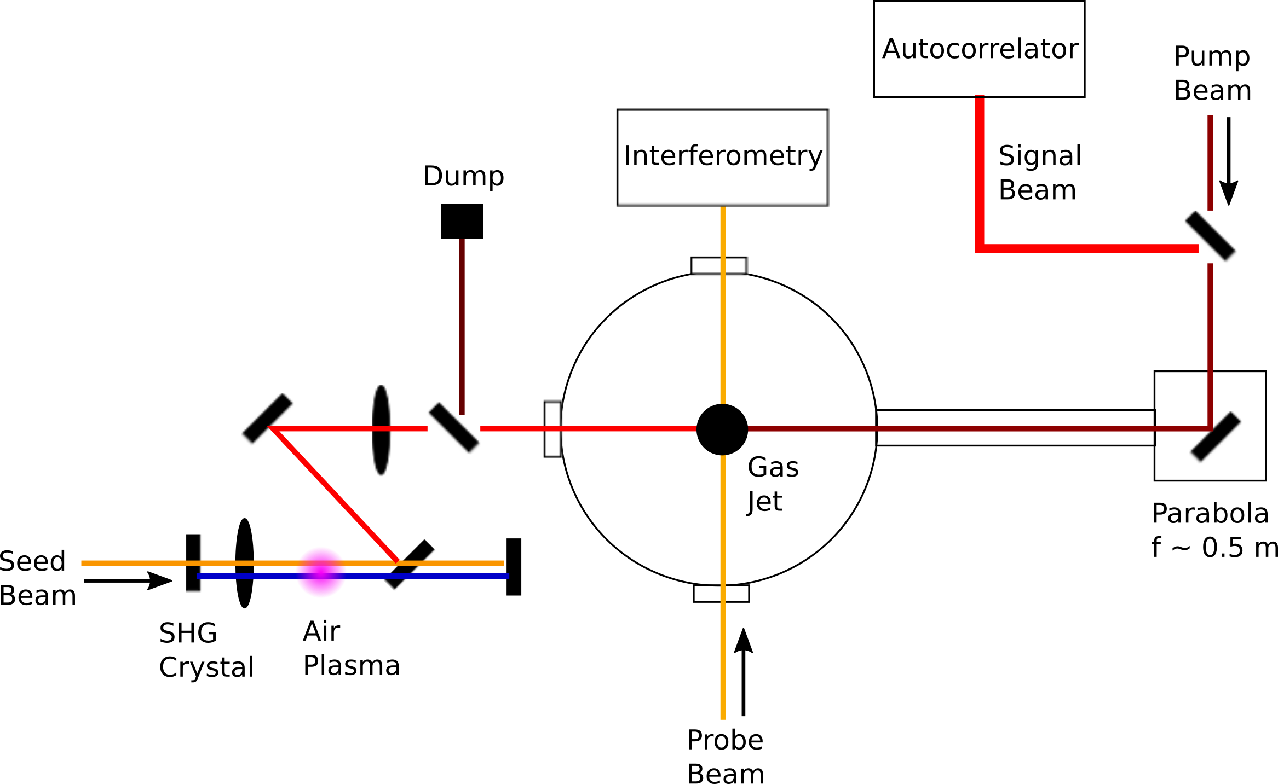
Experimental Setup (schematic)
Challenges:
Need a plasma source with V ~ 1mm³ and uniform density distribution.
Generation and transport of broadband femtosecond seed at 15 microns
- Absorption bands in air
Other major task:
A synchronized TW-class Ti:Sapphire laser
Seed
λ = 15 μm
Ti:S
10 – 100 mJ
< 100 fs
Plasma
Frequency conversion
f ~ 5 m
w₀ = 500 µm
(at focus)

Slide 7
Generating broadband, femtosecond seed with two-color laser filamentation in air
K. Y. Kim et al., Opt. Express 15, 4577 (2007);
T. I. Oh et al., New J. Phys. 15, 075002 (2013)
λ = 15 μm
air
Tunneling-ionized electrons produce a net drift current under symmetry-broken optical field
Max efficiency when 1ω and 2ω are 90˚ out of phase
Broadband emission (THz - LWIR) with center frequency ω ~ 2π/τ_{pump}

Slide 8
Alternative Seed Generation Methods
OPA and DFG combination
  Expensive ~ 100K, but known reliable method
Optical Rectification
  NRL experience, D.F. Gordon, Opt. Expr. 14, 6813 (2006)
  Required liquid helium cooled bolometer to see signal (nJ?)
Use electron beam
  Coherent transition radiation, etc.
  However, bunch length perhaps too long.

Slide 9
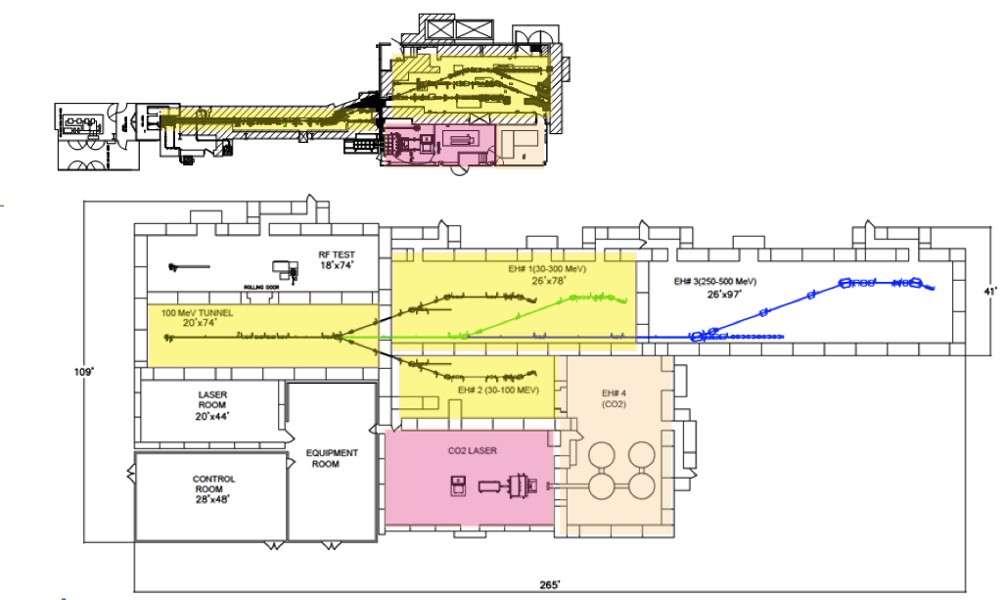
The “strong field laser” (SFL) will be commissioned at ATF
CO₂ laser
Exp.
Ti:S
Expected parameters
  Energy: 15 mJ (with 1st amp.); ~ 100 mJ (with 1st and 2nd amps.)
  Pulse duration: < 100 fs after oscillator upgrade
Expand ATF’s capability
  Can serve as femtosecond probe for ATF users

Slide 10
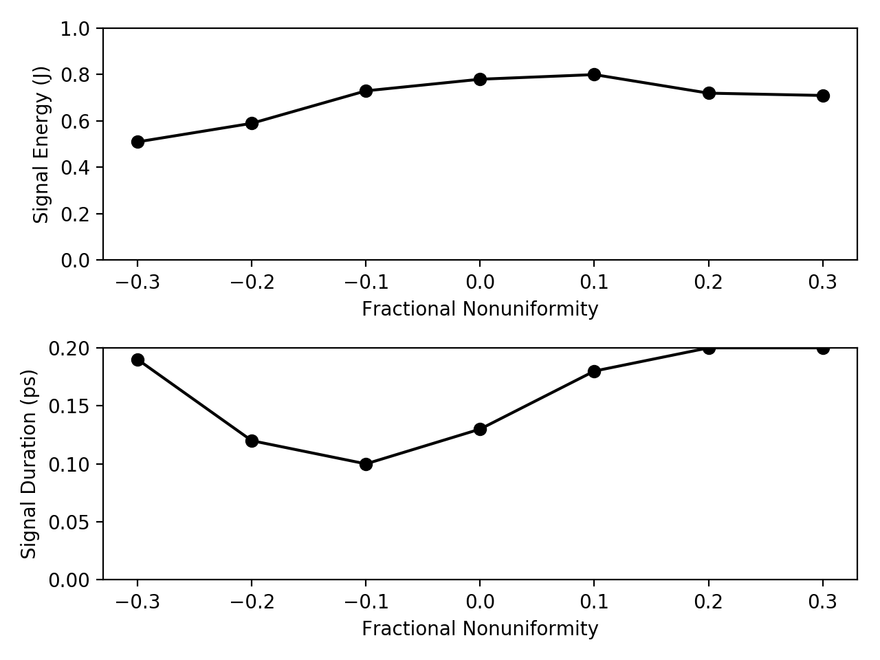
Developing the plasma source
Parameter scan in 1D BRA simulation:
axial non-uniformity of the plasma
Signal energy
vs.
plasma uniformity
Guiding structure is not required.
The effect of transverse non-uniformity needs to be studied.
Gas jet? Back-filled cell? Or something else?
Ionization
  CO₂ laser
  Ti:Sapphire
  Discharge?
Signal duration
vs.
plasma uniformity
Horizontal axis is fractional density change at pump input relative to seed input

Slide 11
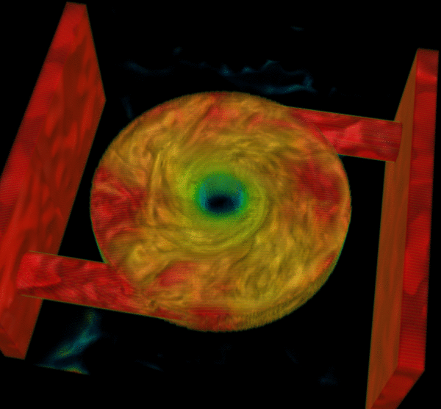
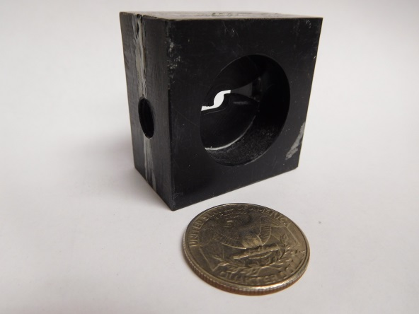
A possible solution: “plasma vortex” device
Neutral gas vortex already developed and accepted in Applied Optics.
We can tunnel ionize with pump, or preionize with discharge (in progress)

Slide 12
Plans: Major Milestones and Timeline (1)
Commisioning of Strong Field Laser (year 1, shared NRL/ATF/…)
  Room environment (clean, HVAC)
  We are attempting to bring a Navy Vitara-T slave oscillator for at least the duration of the program (3 years), otherwise ~300 hours to setup BNL oscillator
  Repair pump lasers, many alignment tasks, etc. (ATF has detailed spreadsheet of tasks and costs)
  Route beam to experimental area, synchronize
Develop seed source (underway, year 1)
  Use NRL lasers (15 mJ, kHz and 2 J, 5 Hz) to pump
  Characterize spatial mode (pyrocam, microbolometer)
  Characterize spectrum (build LWIR spectrometer)
Develop plasma source (underway, year 1)
  Develop gas flow technology, optimize optical properties, discharge

Slide 13
Plans: Major Milestones and Timeline (2)
Set up beamlines (year 2, first half)
  Build seed generation system at ATF
  Long focal length parabola focusing into plasma source
  Align and synchronize seed and pump pulses
Observe backward signal (year 2, second half)
  Energy, spectrum, pulse length
Characterize parasitic processes and optimize (year 3)
  Simulations: collisional PIC, electromagnetic hydro
  Comparison of simulated and experimental signal spectra
  Characterize transverse signal structure (e.g., pyrocam), compare with 3D simulations
  Evaluate prospects for higher compression ratios

Slide 14
Electron beam requirements
Do not plan to use the e-beam
However, could be used to generate seed pulse based on various radiation processes such as CTR
  Back of envelope gives ~100 uJ from 0.1 nC at 50 MeV assuming in coherent regime
  Naïve coherence requirements appear unattainable, but more careful analysis might be useful.

Slide 15
CO2 Laser Requirements
Full power configuration is suitable
  4 J, 2 ps, 9.25 um, M2 ~ 2, 1 shot per minute
Need much larger f-number final focusing optic
  Require ~500 micron spot size
  Could investigate IP upstream or downstream of waist, but not ideal
Pointing and timing stability
  Prefer ~100 micron accuracy at IP, timing to ~1 ps

Slide 16
2019 Experiment Time Estimates
Likely no beam time requested
  Developing seed and plasma source at NRL
  Repairing Strong Field Laser at ATF
  100% “setup” time
Hazards and Installation
  Large installation: N
  Laser use: Y, strong field laser
  Cryogens: N
  Introducing new magnetic elements: N
  Introducing new materials into beam path: N
  Any other foreseeable beamline modifications: Y (routing SFL to experiment area)

Slide 17
Backup Slides

Slide 18
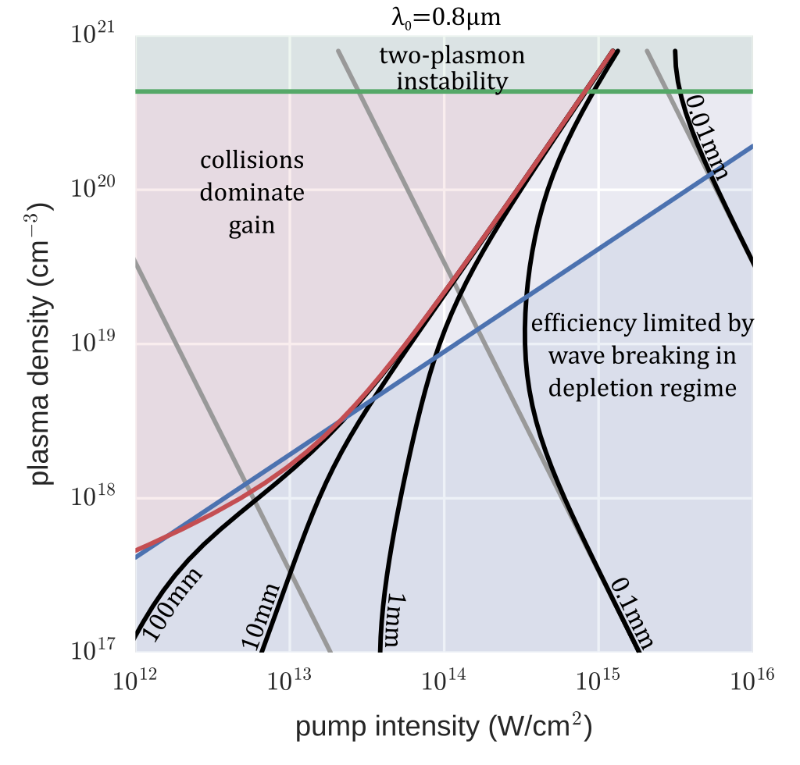
Parameter space for BRA using 800 nm pump radiation
L. Johnson et al., Phys. Plasmas 24, 033107 (2017).

Slide 19
Some earlier BRA experiments max gain ~ 1000 (µJ ➔ mJ)
Ping et al., PRE 62, R4532 (2000)
Pai et al., PRL 101, 065005 (2008)
capillary waveguide
preformed plasma waveguide
Cheng et al., PRL 94, 045003 (2005)
Ren et al., Phys. Plasmas 15, 056702 (2008)
2 mm gas jet
2-pass, 6.4% efficiency

Slide 20
Possible limiting factors
Recent results with Vulcan
  Raman and Brillouin instabilities
  Damping (collisional and Landau)
  Wavebreaking
  Filamentation
  Non-uniform plasma density
Backward Raman
(from noise)
Backward Brillouin
(from noise)
G. Vieux et al., Scientific Reports 7, 2399 (2017)

Slide 21




turboWAVE Fluid Simulations
Use relativistic cold fluid model in 1D, 2D, and 3D
  Advantage over PIC is that Coulomb collisions are straightforward to include
  Disadvantage is cannot continue simulations into wavebreaking regime
Carried out 1D PIC case for comparison
Coulomb Gauge Field Solver:
Collisional Momentum Eqn:
Advance Density using FCT:

Slide 22
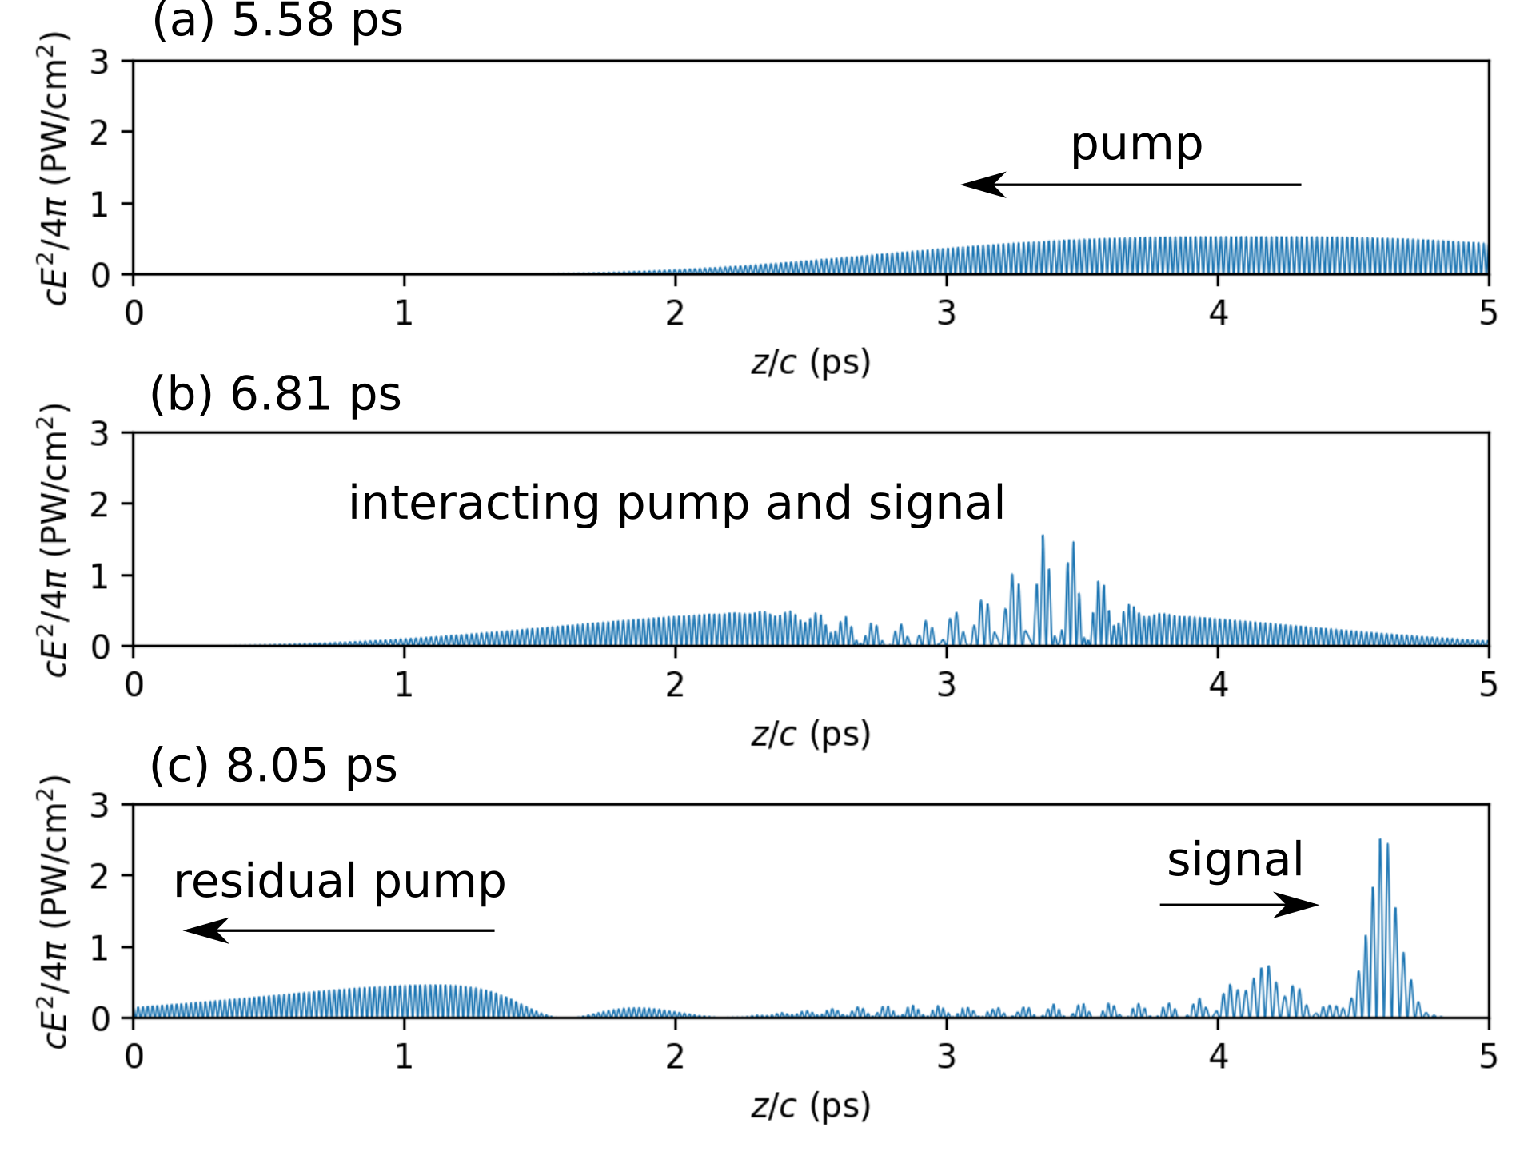
Example of 1D Fluid Simulation
Plasma: 1-mm length, n_{e}=10¹⁸ cm⁻³
Seed: 1 µJ, 50 fs, 15 µm (Δω/ω₀ ~ 1)
Pump eA/mc² = 0.144 (2.5×10¹⁴ W/cm²)
Power is quintupled
Compression ratio = 20
Compare with 1D PIC Simulation:
  Ion motion is allowed
  Assume hydrogen plasma
  Ion density perturbation is observed, with a small amount of forward Raman, but has nearly no effect on seed amplification.

Slide 23
3D Fluid Simulation Result
Signal
Signal
Residual Pump
Residual Pump
No self-focusing observed
Nearly identical to 2D and 1D results
We will extend turboWAVE PIC code to treat collisions in the plasma.
  Computationally challenging

