Slide 1
21st ATF Users Meeting
ATF Facility Updates
Chris Cullen
ATF Facility Engineer
November 14, 2018

Slide 2
Topics
UED Updates
ATF EH 2017/2018 Comparison
ATF EH Status
Beamline 1
Beamline 2
Experimental Hall Shielding
CO₂ Laser Transport
Going Forward

Slide 3
UED Updates
Gun cathode re-polished
Improved vacuum
HVAC system connected to new B912 chilled water distribution system, ample capacity
UED Cleanroom operating on new high capacity chilled water supply
Previous dedicated chiller in place as backup unit

Slide 4
ATF Experimental Hall Reconfiguration
FY17 Configuration
FY18 Configuration
BL1
Labyrinth/Shielding
Inverse Compton Scattering
Laser Wakefield
Labyrinth/Shielding
BL1
20° Leg of BL2
Straight Extension
20° Leg of BL2

Slide 5
ATF Experimental Hall
Nov 2017
Nov 2018

Slide 6
Experimental Hall Status
New shielding in place
BL2 is fully operational
BL1 serving ICS and LWFA chambers
CO₂ vacuum laser transport installed and connected to the LWFA chamber

Slide 7
Beamline 1 Improvements
Simultaneously accommodates LWFA and ICS experiments
Integrated differential pumping system in progress
ICS
LWFA

Slide 8
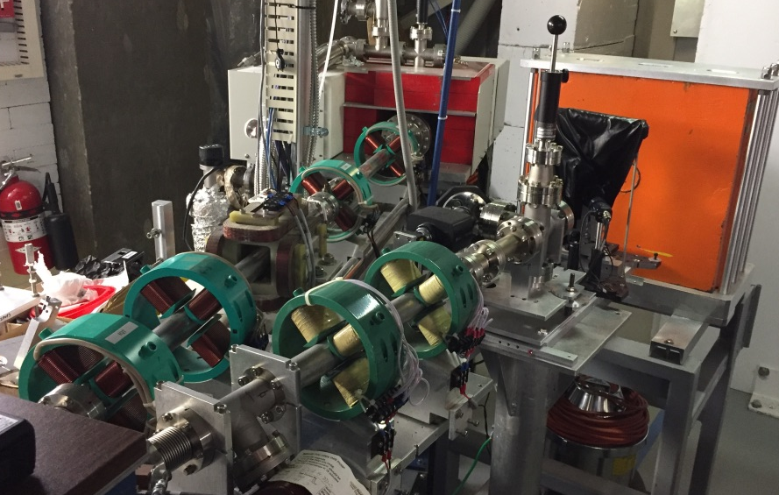
Beamline 2 Improvements
Straight extension allows measurement of longitudinal distribution (footprint) of electron bunch
Additional quadrupoles allow improved imaging
Reconfigured to take advantage of x-band cavity
Leg orientation mirrored 20° to increase floor space
20° Leg
Quadrupoles
Straight Extension

Slide 9
ATF EH Shielding Configuration
FY17 shielding configuration
FY18 shielding configuration

Slide 10
CO₂ Vacuum Laser Transport
Ion chamber, existing experimental chamber
FEL
Plasma shutter
EH
BL1 experimental chambers, ICS & LWFA

Slide 11
CO₂ Vacuum Laser Transport
Delivers high power CO₂ laser to BL1
Accommodates ICS & LWFA chambers
Laser/e-beam experiments with plasma at BL1

Slide 12
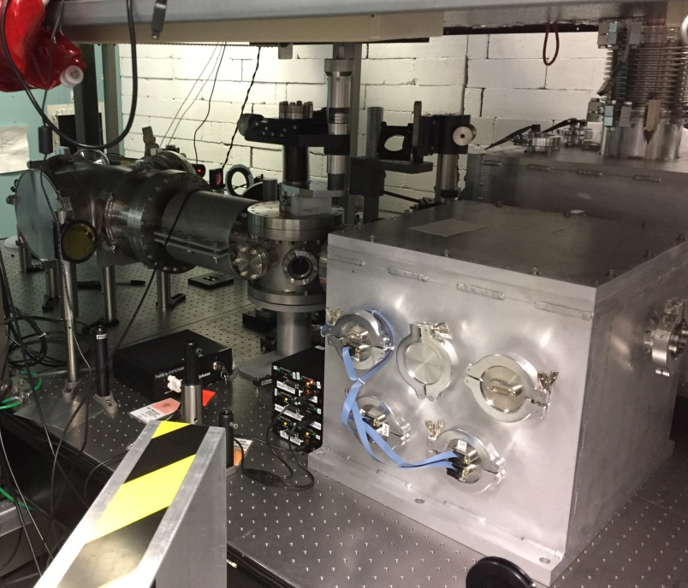
CO₂ Vacuum Laser Transport
Also delivers high power CO₂ laser to the FEL room Ion chamber
Plasma Shutter in FEL Room
Ion Chamber in FEL Room

Slide 13
CO₂ Laser Transport Plan View
FEL Room
CO₂ Main
CO₂ Amp
CO₂ Laser Transport
Beamline 1
Capability for potential expansion to BL2 exists
Experimental Hall

Slide 14
CO₂ Laser Safety Requirements
Fault studies at higher power have been conducted
Fault conditions at higher power generate x-rays
New safety requirements are necessary for fault conditions
A shielding and operation plan is being developed (ATF & RSC) to safely deliver high power beam while maintaining operational efficiency

Slide 15
Going Forward, Planned Improvements
Stable seed oscillator for UED has been ordered
NLPC subscale proof of concept demonstrator
Extended vacuum transport to include a flexible polarization adjustment for CO₂ laser transport
Integrated differential pumping on BL1

Slide 16
Thank You! Questions?

