Slide 1

Measurements and Calibration of a Deep Dielectric Charge Monitoring Sensor for the Europa Clipper Mission
Wousik Kim (JPL), John Goldsten & Zach Yokley (APL)
2019 ATF
User Meeting
2019 ATF Users Meeting: Experiment Completion Report

Slide 2
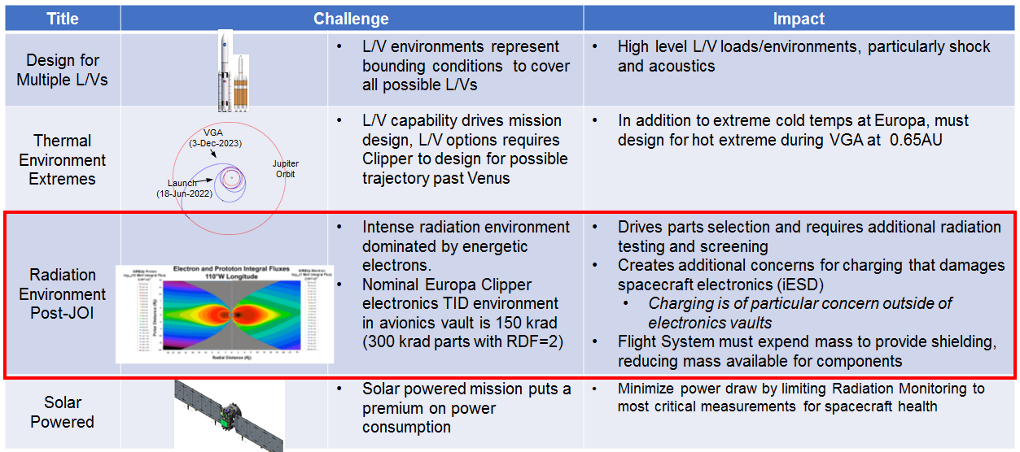
Mission Challenges – Scientific Case
L/V: Launch Vehicle, VGA: Venus Gravity Assist, JOI: Jovian Orbit Insertion, TID: Total Ionizing Dose, RDF: Radiation Design Factor, iESD: internal ElectroStatic Discharge

Slide 3
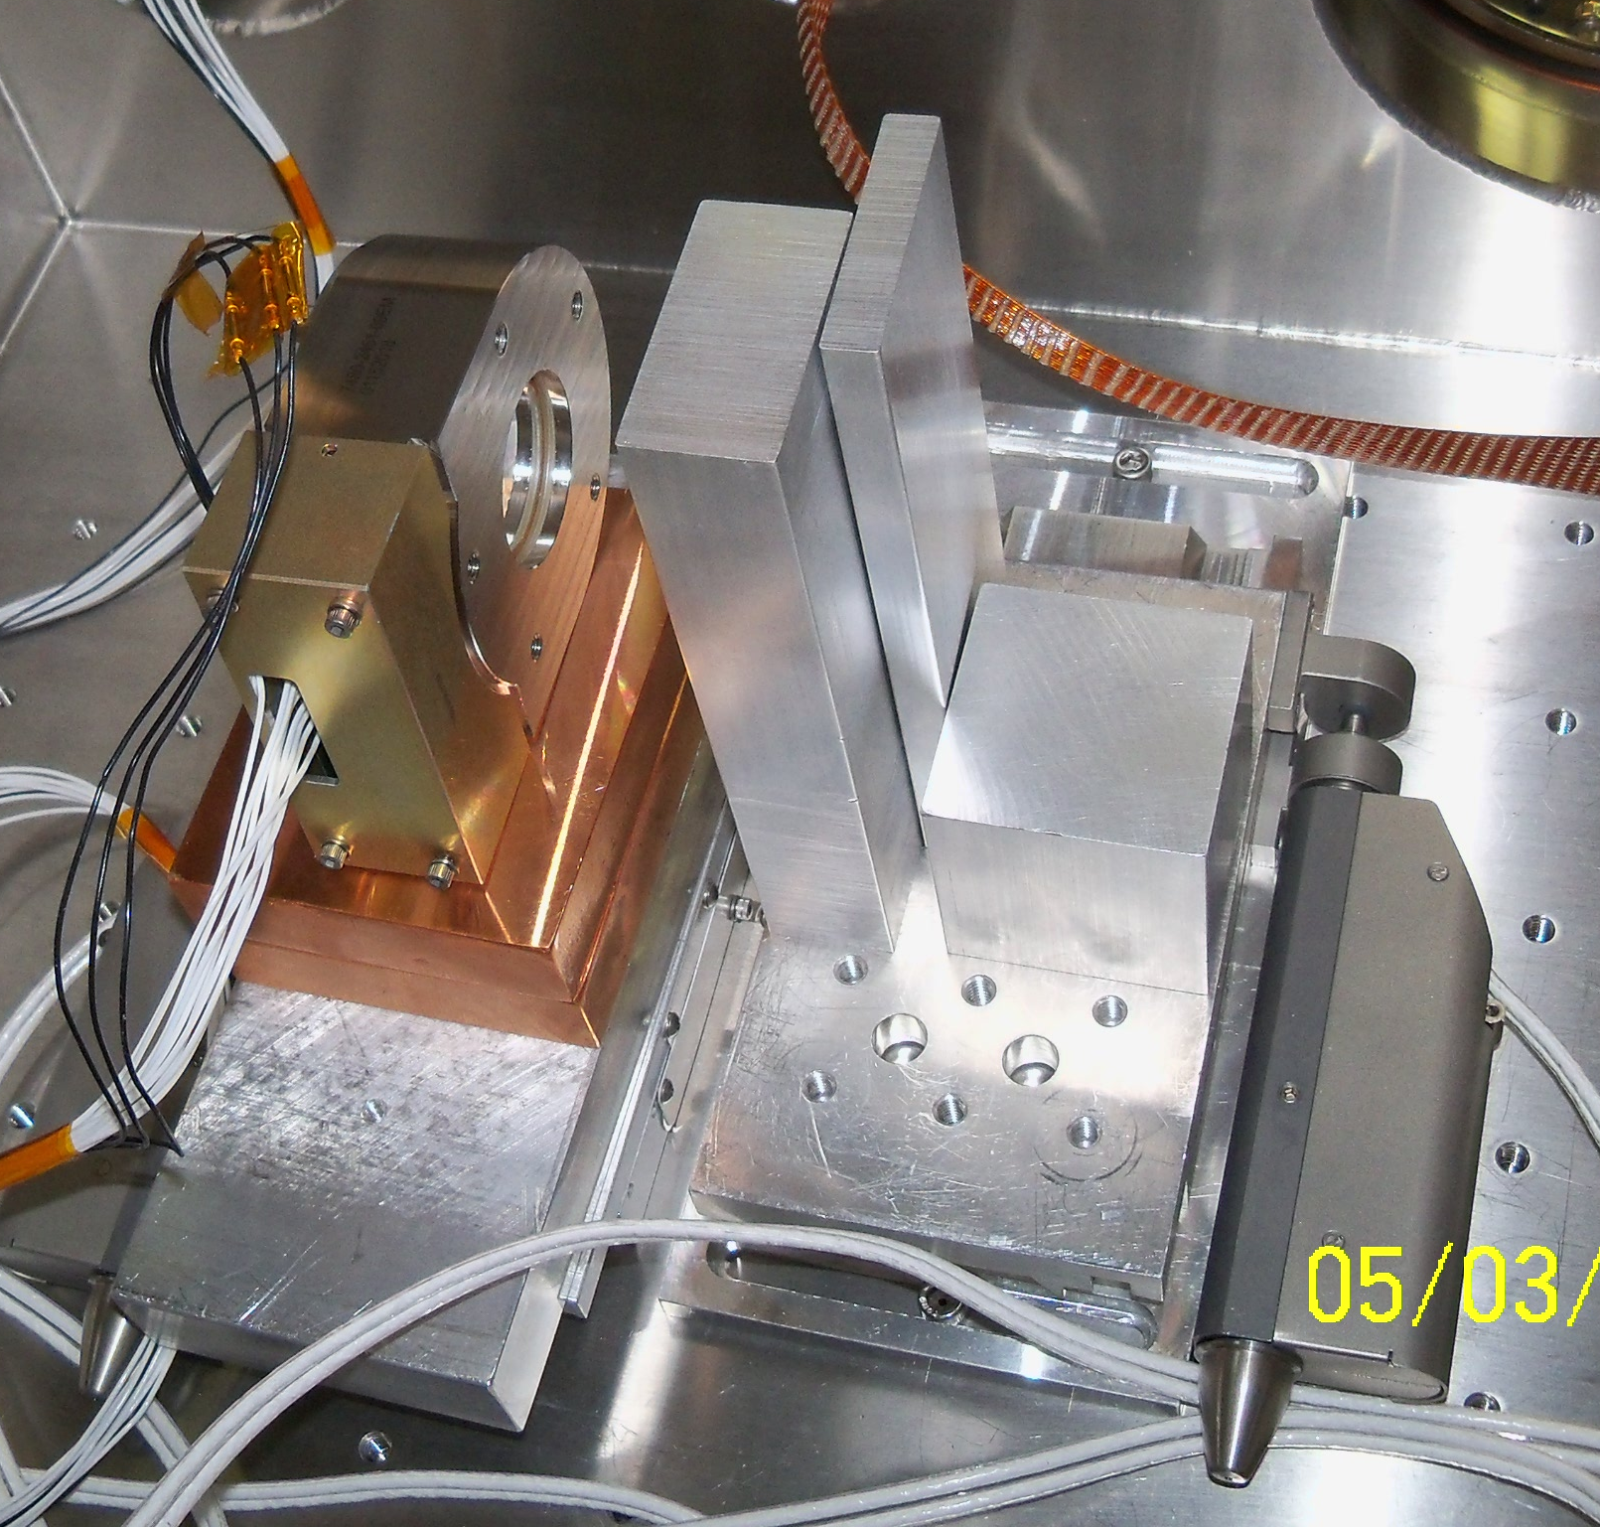
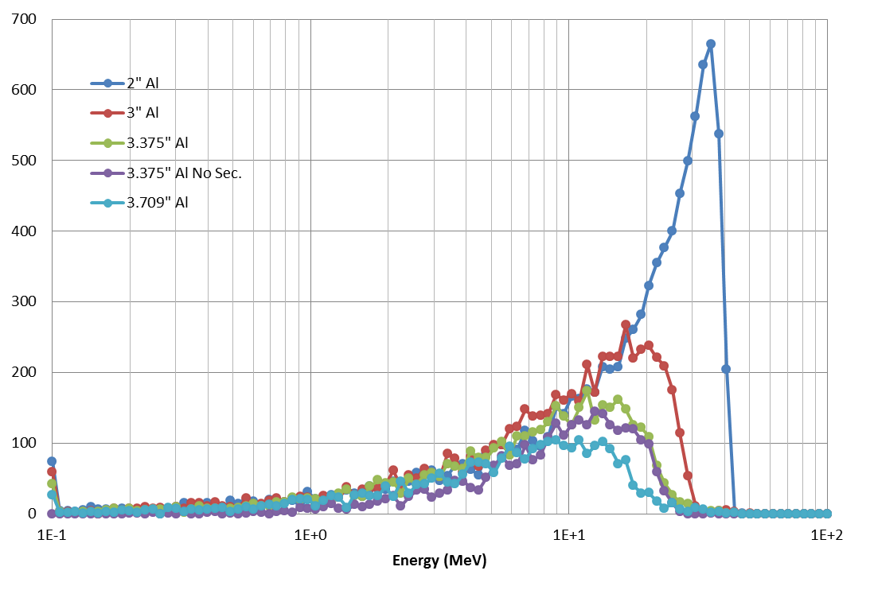
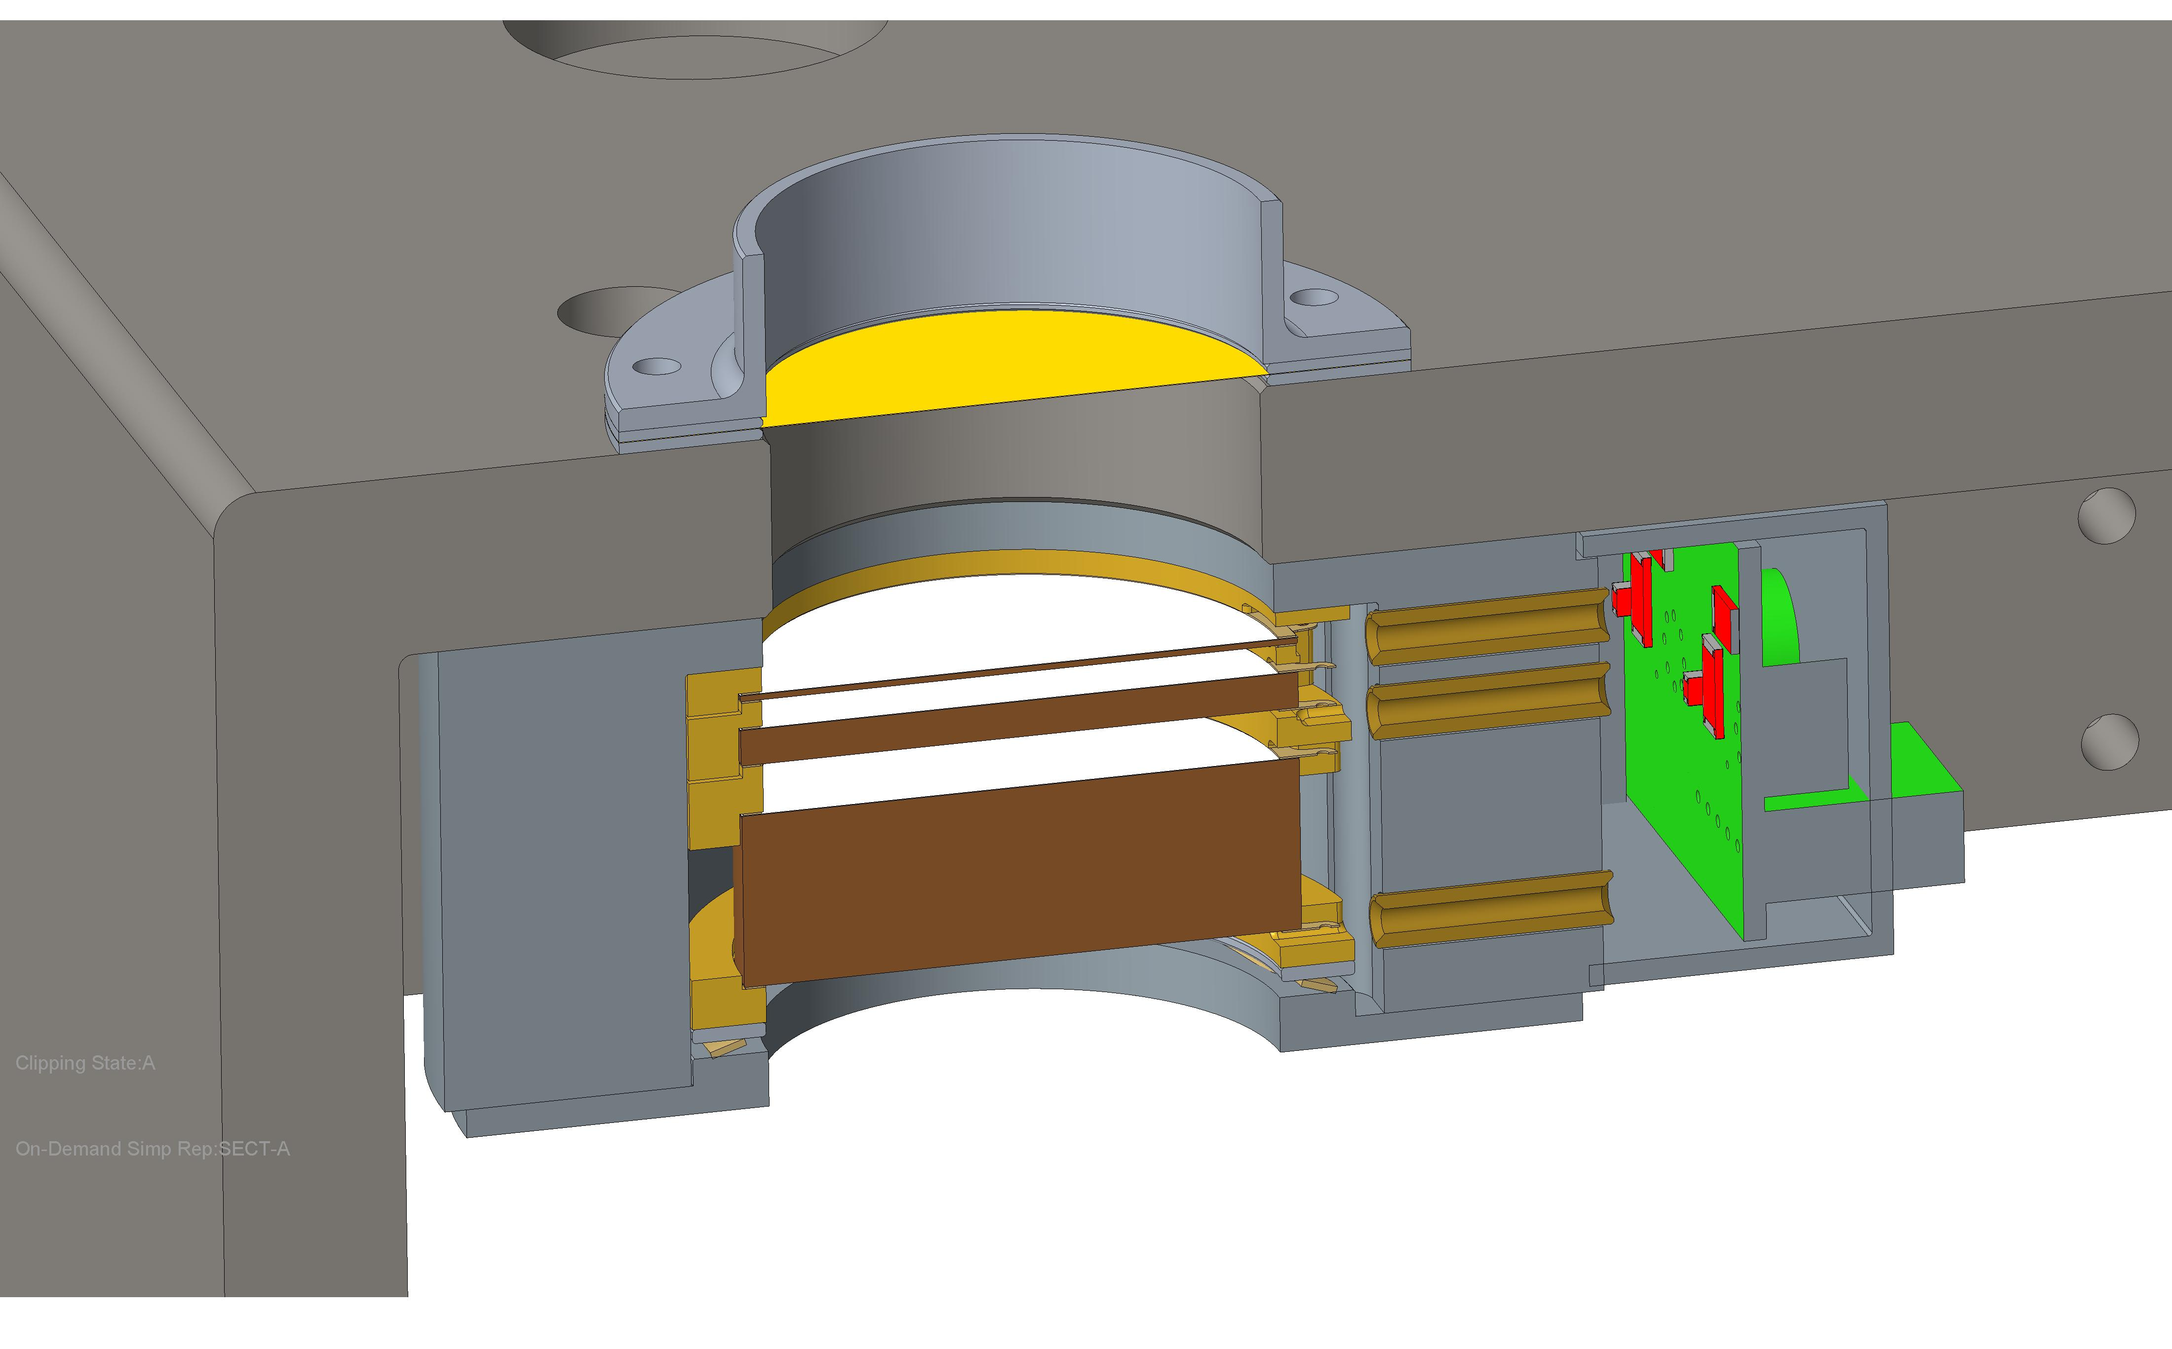
Experimental Setup
The pulsed, mono-energetic electron beam of 40-60 MeV was used.
Two motion stages allow charge stack and degraders to be moved in and out of electron beam
Degraders form low-energy tail as a way to exercise all three plates
Stepped degrader provides three positions: “none”, “thin” and “thick”
Beam
Aperture
Detector plates
Simulated Spectra
(by Geant4)
Flight Configuration
ATF Chamber Setup
The technical data in this document is controlled under the U.S. Export Regulations; release to foreign persons may require an export authorization. Pre-Decisional Information – For Planning and Discussion Purposes Only

Slide 4
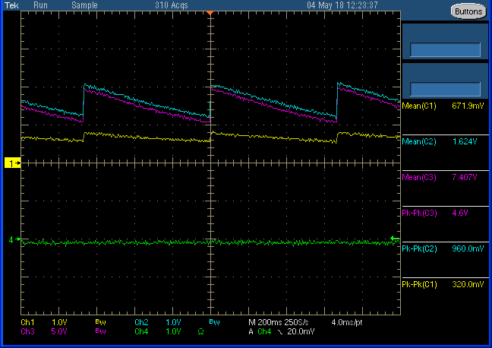
Experiment Results
100 pC pulses @ 1.5 Hz
Absolute level match prediction within factor of 2
Ratio of currents within 20%
Pulse Response
Front plate
Middle plate
Beam Sync
Back plate
Beam Degrader
50 MeV beam through thick degrader
The technical data in this document is controlled under the U.S. Export Regulations; release to foreign persons may require an export authorization. Pre-Decisional Information – For Planning and Discussion Purposes Only

Slide 5
Conclusions & Further Work
Experiment at ATF was very successful in validating sensor response to high energy electrons
Considering adding 4th charge plate to better cover ultra-wide energy range
Would like to return and experiment again after development of the engineering model sensor
Simulations and beam experiment in agreement – good opportunity to publish results from final sensor

