Slide 1
IFEL Acceleration with Optical Energy Recovery
Alex Murokh¹ and Pietro Musumeci²,
¹RadiaBeam Technologies, LLC.
²UCLA Department of Physics and Astronomy
Funding source and status: Proposals in progress to multiple agencies
2019 ATF Users Meeting: Future Proposals

Slide 2
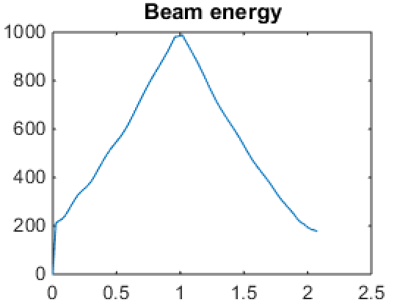
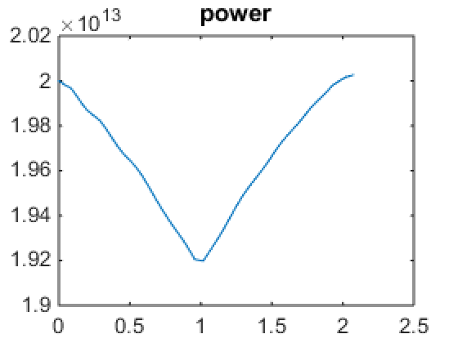
Scientific Case
High intensity, compact (< 10 m), 10 MeV class gamma ray source:
150 MeV injector
~ 10 TW igniter laser (i.e. 1064 nm)
IFEL 1 GeV energy booster stage
ICS interaction chamber
TESSA decelerator for laser power recovery
Injector SRF Linac
Gamma-rays

Slide 3
Scientific Case
High intensity, compact (< 10 m) 10 MeV class gamma ray source:
150 MeV injector
~ 10 TW igniter laser (i.e. 1064 nm)
IFEL 1 GeV energy booster stage
ICS interaction chamber
TESSA decelerator for laser power recovery
~ 100 MeV
Pockels cell
TESSA decelerator
Beam dump
Igniter laser
2 x Prebuncher
~ 1 GeV
Gamma rays
photoinjector
linac
~ 150 MeV
IFEL accelerator
ICS

Slide 4
Experimental Setup
Build another Rubicon undulator in TESSA configuration
Measure acceleration and deceleration in sequence
Demonstrate good capture
CO2 laser
Long laser pulse
2 x Prebuncher
~ 100 MeV
TESSA decelerator
Beam dump
photoinjector
linac
~ 50 MeV
IFEL accelerator
Phase shifter
~ 40 MeV
4

Slide 5
Plans
Find funding
new SBIR proposals (DOE and DOD)
AFRL proposal
Phase IIB for AE76, etc.
Design the experiment in detail
Model the dynamics and optimize for longer laser Rayleigh range
Design non-invasive energy distribution measurement in the middle section
Submit formal proposal at the next ATF Users meeting

Slide 6
Electron Beam Requirements
Parameter | Nominal | Requested
Beam Energy (MeV) | 50-65 | 50-55 MeV
Bunch Charge (nC) | 0.1-2.0 | 0.1-0.3 nC
Compression | Down to 100 fs (up to 1 kA peak current) | ~ 0.3 ps
Transverse size at IP (sigma, um) | 30 – 100 (dependent on IP position) | ~ 50 µm
Normalized Emittance (um) | 1 (at 0.3 nC) | 1 (at 0.3 nC)
Rep. Rate (Hz) | 1.5 | 1.5
Trains mode | Single bunch | Single bunch

Slide 7
CO₂ Laser Requirements
The following options are available at the laser source. Note that the maximum power available at your experiment interaction point will depend on the laser transport method.
OPTION 1 (full power, ~1 shot per minute) isotopic gas in final amplifier 1-2 TW (1-2 ps, 2 J, single pulse) 9.25 um M^2 ~2 circular polarization
2019 Experiment Time Estimates
N/A

