Slide 1
Archiving storage
Evaluation of IBM TS4500
Technology meeting

Slide 2
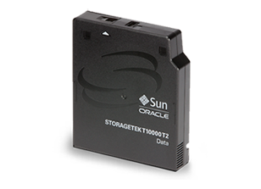
Long Term Storage
Keeping 100+ PB data for a long time
Life Expectancy
9940B tapes in round silo (9-15 years old) migrated to LTO:
99.9% successful rate
Tape: 30 years
Reliability
Bit Error Rate (BER): Number of user bits transferred between two unrecoverable error events
T10K, LTO-7, LTO-8, IBM JD: 1 x 10¹⁹
1 error event in 1.25 exabytes *
Performance
T10K | LTO-7 | LTO-8 | IBM JD
250 MB/s | 300 MB/s | 360 MB/s | 360 MB/s
Scalability
Just add more tape cartridges.
Add more tape libraries.
* https://www.lto.org/wp-content/uploads/2014/07/LTO_Get_The_Facts_10_15.pdf

Slide 3
Scalability
Increasing Capacity
- Add Tapes

Slide 4
scalability
Library Full?
Add Library

Slide 5
Scalability
Increasing Bandwidth
- Add Tape Drives
LTO-7: 300 MB/s
Bandwidth can be expended easily by adding more drives
To install a tape drive, about 45 minutes, ready to use.
30 minutes to put a drive into library, 15 minutes to config.
Bandwidth can be controlled easily by allocating number of drives.

Slide 6
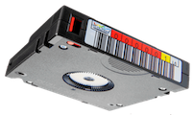
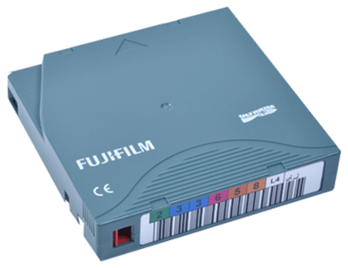
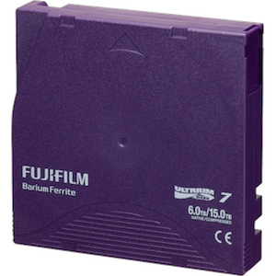
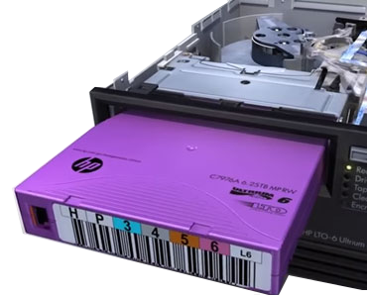
Tape Reliability
Media Types | Cartridges | Average Mounts | Max Mounts
LTO-7 | 10,219 | 31.2 | 736
LTO-6 | 22,445 | 52.8 | 664
LTO-5 | 15,684 | 67.3 | 1,225
We have near zero failures with LTO-6 and LTO-7
Recalled 10,310,154 files from LTO-7
Drive Types | Loaded
LTO-7 | 360 k
LTO-6 | 1,218 K
LTO-5 | 780 K
Recalled 20,510,168 files from LTO-6
Most of the IO errors were caused by excessive usage of our tape drives

Slide 7
Tape Reliability
Media Types | Cartridges | Average Mounts | Max Mounts
LTO-7 | 9,057 | 31.2 | 736
LTO-6 | 22,345 | 52.8 | 664
LTO-5 | 15,684 | 67.3 | 1,225
2017 LTO-7
We have near zero failures with LTO-6 and LTO-7
2015 LTO-6
Drive Types | Loaded
LTO-7 | 360 k
LTO-6 | 1,218 K
LTO-5 | 780 K
Recalled 10,310,154 files from LTO-7
Recalled 20,510,168 files from LTO-6
2012 LTO-5
Most of the IO errors were caused by excessive usage of our tape drives

Slide 8
Change!
Oracle dropped Tape Drive Development – No T10K-E
Oracle made no any official announcement about the the future of tape business
Oracle products are expensive
LTO 7 Drive:
Oracle | IBM
~$13K | ~$8K
Rumor: Oracle will increase the support cost
Other National Labs already moved:
Organization | Library | Tape Drive
CERN | IBM TS4500 | IBM TS1155
Oak Ridge | SpectraLogic | IBM TS11xx
NERSC | IBM TS4500 | IBM TS1155
Fermilab | IBM TS4500 | LTO-8
LANL | IBM TS4500 | ?

Slide 9
Other users
We (Tier-1) are no longer the largest tape users
The major tape users are the cloud and social media companies.
The cloud companies are switching to new libraries and new tape drives

Slide 10
Oracle SL8500
39 tapes per load
39 LTO-7 = 234 TB
Will take ~ 7 minutes
Tape initializing:
1 min/tape-drive
Library Capacity: 10,088 Tapes
LTO-7: 60,528 TB or 60.5 PB
Provide 1 PB storage
LTO-7: 3.5 hours
LTO-8: 1 hr 42 min
LTO-8: 121,056 TB or 120 PB
Dual CAPs
78 tapes per load

Slide 11
Oracle SL8500 - Expanding library
Storage Expansion Modules (max 5)
Basic config:
3 Modules
Max config:
8 Modules
10,088 slots
Drives Module
Robotic Module
Interface Module
Must grow to the left
Max 32 silos

Slide 12
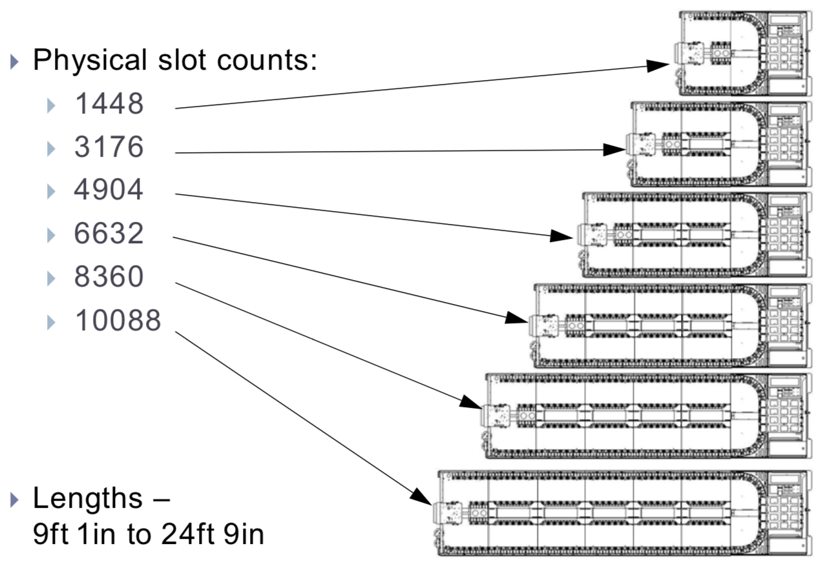
Oracle sl8500 expansion map

Slide 13
Max Drive bays
64 Tape Drives / Library
LTO-7: 64 x 300 MB/s = 19.2 GB/s
LTO-8: 64 x 360 MB/s = 23 GB/s

Slide 14
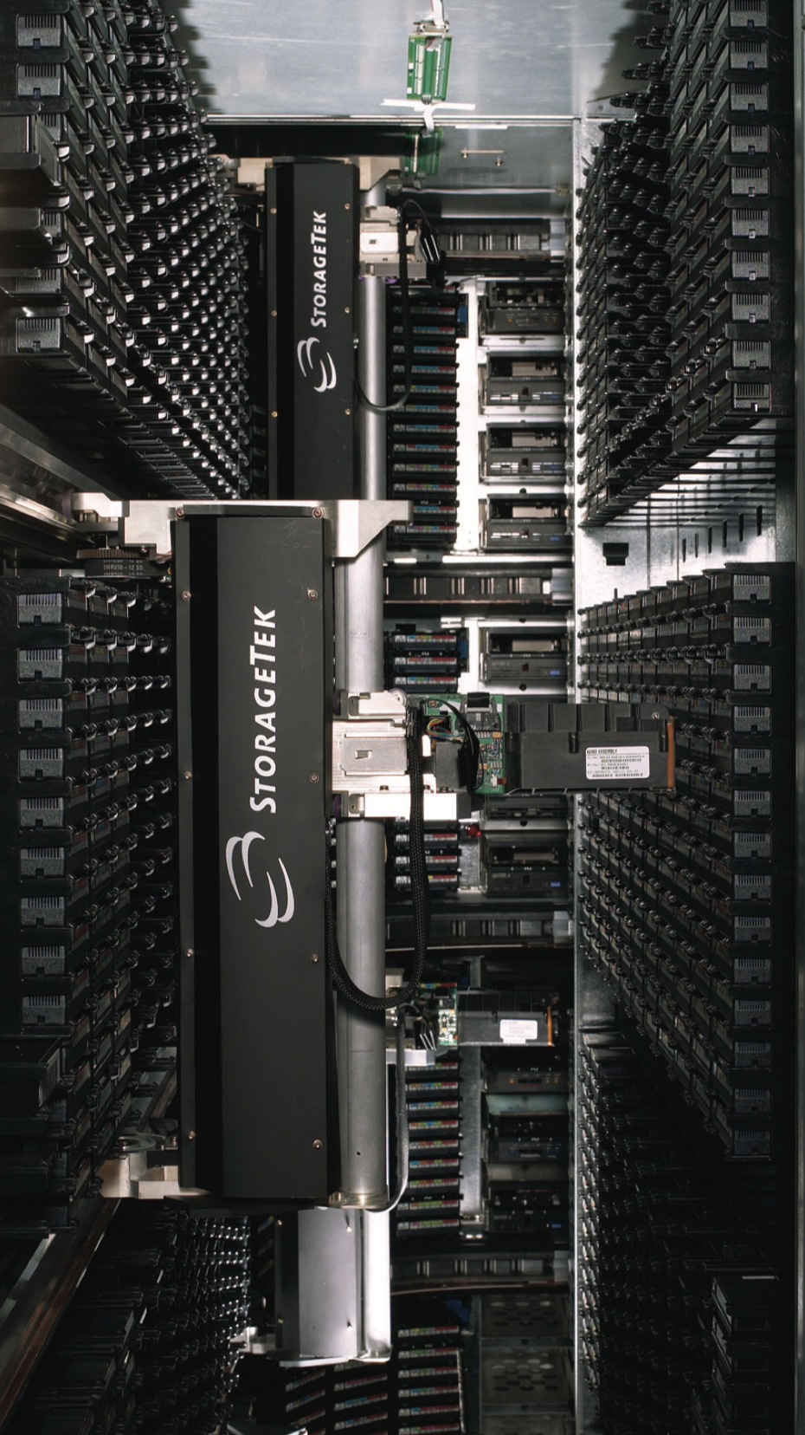
Performance
Cartridge Slots
4 Levels (LSM)
, dual robots on each level
Robot
All cartridges are on the same tier (Tier 0)
Cartridges can be moved to a different LSM via elevators
It will take addition time to move a tape to a different LSM. (~25 sec)
Mount a tape
Robot find the tape
Delivery the tape to a specified drive
Load the tape (positioning)
Elevator
Read data
Requesting a 1 G file on LTO-7 from HPSS may take 33 sec to complete

Slide 15
IBM TS4500
Dual input/output (I/O) slots, 16 each
32 JD cartridges per load, 36 LTO cartridge
2 min 5 sec to fill the 16 slot tray and place tray in library (manual effort)
1 min 5 sec for the robot to put the tapes to slots** (robotic automation)
I/O Station
Assume 32 tapes would need 2 x time: 3 min 10 sec x 2 = 6 min 20 sec.
Average 12 sec per tape
32 JD = 480 TB
36 LTO 7 = 216 TB
36 LTO 8 = 432 TB
Tape initializing:
1 min/tape-drive
In theory!
We do not know the overhead due to the high density tray.
Provide 1 PB storage
JD: 1 hour 22 min
LTO-7: 3.5 hours
Worst case? 4x longer?
JD: 6 hours?
LTO-7: 14 hours?

Slide 16
IBM TS4500 - Expanding the capacity
L Frame – Base unit, with drives
L Frame
S Frame
S Frame
D Frame – with drives
S Frame
Max 7 D Frame
D Frame
S Frame
I/O Station is optional
S Frame – no drives
Each frame can be either
LTO or TS Technologies
Maximum 18 frames
Maximum 8 “Drive” frames
1 L Frame
7 D Frame
Grow either way
Maximum 8 x 2 I/O stations
256 TS Tapes
288 LTO Tapes

Slide 17
IBM TS4500 - Accessors (robots)
Drive
Frame
Drive
Frame
Dual Accessors (robots)
One for left 1/2
One for right 1/2

Slide 18
Oracle SL8500 Space usage
Tapes can travel across libraries

Slide 19
IBM TS4500 Space REQUIREMENT
TS4500 Floor layout with required service clearance
18 Frame Dual Accessor (HA)
TOP VIEW
595.8”
Back
535.8”
1
2
3
4
5
6
7
8
9
10
11
12
13
14
15
16
17
18
30”
47.7”
107.7”(8’11”
Front
30”
Note: not drawn to scale
30” Clearance required on all sides, 36 “ recommended.

Slide 20
IBM TS4500 Space usage
Tapes can NOT travel across libraries
18 Frame library
18 Frame library
18 Frame library
72”
30”
minimum

Slide 21
IBM TS4500 - cartridge slots
Tier-0 High Performance
Tier-0 : slots on the door
High Density slots: 4 or 5 cartridges per slot
High Density slots
IBM TS (J series): Tier-1 – Tier-4
LTO : Tier-1 – Tier-5

Slide 22
IBM TS4500 - cartridge slots
Tier-0 High Performance
Tier-0 : slots on the door
High Density slots: 4 or 5 cartridges per slot
High Density slots
IBM TS (J series): Tier-1 – Tier-4
LTO : Tier-1 – Tier-5
Tier-5
Tier-4
Tier-3
Tier-2
Tier-1
Top view of High Density slots

Slide 23
IBM TS4500 - cartridge slots
Tier-0 High Performance
Tier-0 : slots on the door
High Density slots: 4 or 5 cartridges per slot
High Density slots
IBM TS (J series): Tier-1 – Tier-4
LTO : Tier-1 – Tier-5
Tier-5
Tier-4
Tier-3
Tier-2
Tier-1

Slide 24
IBM TS4500 - cartridge slots
Tier-0 High Performance
Tier-0 : slots on the door
High Density slots: 4 or 5 cartridges per slot
High Density slots
IBM TS (J series): Tier-1 – Tier-4
LTO : Tier-1 – Tier-5
Tier-5
Tier-4
Tier-3
Tier-2
Tier-1

Slide 25
IBM TS4500 - cartridge slots
Tier-0 High Performance
Tier-0 : slots on the door
High Density slots: 4 or 5 cartridges per slot
High Density slots
IBM TS (J series): Tier-1 – Tier-4
LTO : Tier-1 – Tier-5
Tier-5
Tier-4
Tier-3
Tier-2
Tier-1
Cartridge in Tier-4 takes extra ~27 seconds

Slide 26
IBM TS4500 - cartridge slots
Tier-0 High Performance
Tier-0 : slots on the door
High Density slots: 4 or 5 cartridges per slot
High Density slots
IBM TS (J series): Tier-1 – Tier-4
LTO : Tier-1 – Tier-5
Tier-5
Tier-4
Tier-3
Tier-2
Tier-1
Cartridge in Tier-4 takes extra ~27 seconds

Slide 27
Robots vs accessor
Oracle SL8500
IBM TS4500
Dual Accessors
Dual Robots
Max 8 robots
Max 8 Tapes can be mounted at the same time, if 2 tapes from each LSM
Dual grabbers
Max 2 Tapes at once

Slide 28
Robots vs accessors
Oracle SL8500
IBM TS4500
8 robots
2 x dual grabbers
This is in theory!
8 tapes
4 tapes
Faster?

Slide 29
Robots vs accessor – possible scenarios 1
Oracle SL8500
IBM TS4500
Need to mount a tape from level 1
3 steps, slow!
Extra ~25 sec
2D, No elevator!
Faster!
Next available drive is in level 4

Slide 30
Robots vs accessor – possible scenarios 2
Oracle SL8500
IBM TS4500
All needed tapes are on the same LSM
Only 2 robots
2 Accessors
About the same!

Slide 31
Robots vs accessor – possible scenarios 3
Oracle SL8500
IBM TS4500
All tapes are on Tier-0
Tier-0 High Performance
High Density slots
<40 % Full, all Tier-0 and Tier-1
Faster!
~60 % Full, 20% tapes in Tier -2
Expect slower!
> 60 % Full,
Tier-3 and 4 are used
Expect much slower!

Slide 32
MOUNT + read: SL8500+LTO7 vs TS4500+JD
LTO-7: 300 MB/s
TS1150 + JD: 360 MB/s
Read 1 GB (1st file)
TS4500 Read 3 tapes from Tier-4
SL8500 (Tier-0): 34 sec (2,0,26,2,1 -> 2,0,1,3)
1 G (Tier-4): 54 sec
1st tape
TS4500 (Tier-0): 27 sec
10 G (Tier-4): 1 min 33 sec
Faster!
2nd tape Larger file!
TS4500 (Tier-4): 54 sec
1 G (Tier-4): 1 min 23 sec
Slower! (27 secs to move a tape out of Tier-4)
3rd tape, slowing down
Read 10 GB (1st file)
SL8500 (Tier-0): 1 min 24 sec
TS4500 (Tier-0): 1 min 17 sec
Faster!
TS4500 (Tier-4): 1 min 33 sec
Slower!
Dual grabber, can grab 2 tapes

Slide 33
Conclusion: Tape mount
TS4500 Tier-0 vs SL8500 same LSM
TS4500 is ~7 sec faster
TS4500 Tier-4 (+27 sec) vs SL8500 across 4 LSM (+25 sec)
SL8500 is ~2 sec faster (assume SAME)
There are 4 LSM in SL8500
There are 4 Tiers in TS4500 (HD)
Mount rate maybe the same
There are 5 Tiers when using LTO
Mount rate for T-5 maybe slower
However, when the library is near full, TS4500 need to find room to swap the tapes out.
This might be very time consuming.
Tape mount is an issue ONLY when reading a few files per tape. When reading more files from a single tape, the weight of tape mount time becomes less important.
TS4500 has ”intelligent algorithm” to keep cold tape to deeper tier, frequent accessed tape in the front tier.

Slide 34
Other TS4500 users: Tape mount
CERN do not see any tape mount issue with TS4500
No one really see any significant difference in tape mount performance
The earlier version of IBM library: TS3500 had many issues
However, the new TS4500 is much better than TS3500

Slide 35
Max Read performance: LTO7 vs TS1150/JD
LTO-7: 300 MB/s
TS1150 + JD: 360 MB/s
Big file (10GB) | LTO-7 | TS1150 | Gain %
10% 80 files | 103.9 | 153.35 | 47.59%
50% 400 files | 156.97 | 242.47 | 54.47%
100% 800 files | 251.87 | 352.84 | 40.09%
Small file (1GB) | LTO-7 | TS1150
10% 980 files | 32.33 | 73.69 | 127.93%
50% 5811 files | 120.24 | 177.04 | 47.24%
100% 9793 files | 236.03 | 343.98 | 45.74%
Aggregated Small file (1GB) | LTO-7 | TS1150
10% 979 files | 35.44 | 39.82 | 12.36%
50% 4899 files | 136.35 | 177.80 | 30.40%
100% 9798 files | 252.19 | 345.61 | 37.04%

Slide 36
Max Read performance: LTO7 vs TS1150/JD
LTO-7: 300 MB/s
TS1150 + JD: 360 MB/s
Big file (10GB) | LTO-7 | TS1150 | Gain %
10% 80 files | 103.9 | 153.35 | 47.59%
50% 400 files | 156.97 | 242.47 | 54.47%
100% 800 files | 251.87 | 352.84 | 40.09%
Small file (1GB) | LTO-7 | TS1150
10% 980 files | 32.33 | 73.69 | 127.93%
50% 5811 files | 120.24 | 177.04 | 47.24%
100% 9793 files | 236.03 | 343.98 | 45.74%
Aggregated Small file (1GB) | LTO-7 | TS1150
10% 979 files | 35.44 | 39.82 | 12.36%
50% 4899 files | 136.35 | 177.80 | 30.40%
100% 9798 files | 252.19 | 345.61 | 37.04%

Slide 37
Max Read performance: LTO7 vs TS1150/JD
LTO-7: 300 MB/s
TS1150 + JD: 360 MB/s
Big file (10GB) | LTO-7 | TS1150 | Gain %
10% 80 files | 103.9 | 153.35 | 47.59%
50% 400 files | 156.97 | 242.47 | 54.47%
100% 800 files | 251.87 | 352.84 | 40.09%
Small file (1GB) | LTO-7 | TS1150
10% 980 files | 32.33 | 73.69 | 127.93%
50% 5811 files | 120.24 | 177.04 | 47.24%
100% 9793 files | 236.03 | 343.98 | 45.74%
Aggregated Small file (1GB) | LTO-7 | TS1150
10% 979 files | 35.44 | 39.82 | 12.36%
50% 4899 files | 136.35 | 177.80 | 30.40%
100% 9798 files | 252.19 | 345.61 | 37.04%

Slide 38
Max Read performance: LTO7 vs TS1150/JD
84%
LTO-7: 300 MB/s
TS1150 + JD: 360 MB/s
98%
Big file (10GB) | LTO-7 | TS1150 | Gain %
10% 80 files | 103.9 | 153.35 | 47.59%
50% 400 files | 156.97 | 242.47 | 54.47%
100% 800 files | 251.87 | 352.84 | 40.09%
Small file (1GB) | LTO-7 | TS1150
10% 980 files | 32.33 | 73.69 | 127.93%
50% 5811 files | 120.24 | 177.04 | 47.24%
100% 9793 files | 236.03 | 343.98 | 45.74%
Aggregated Small file (1GB) | LTO-7 | TS1150
10% 979 files | 35.44 | 39.82 | 12.36%
50% 4899 files | 136.35 | 177.80 | 30.40%
100% 9798 files | 252.19 | 345.61 | 37.04%
LTO Tapes drives supports offset ordered recalls (Sequentially Access)
The serpentine nature of tape may still result in long seek times between file reads
This example illustrates 5:16 of tape movement without tape I/O
39 sec
48 sec
File 1
72 sec
File 2
File 3
45 sec
File 4
19 sec
File 5
93 sec
Enterprise tape drives now support Recommended Access Ordering (RAO)
Multiple tape recalls are properly ordered by the tape drive to reduce recall time
Tests show that RAO improves multiple file recalls by 30% to 60%
This SAME example illustrates 2:06 of tape movement without tape I/O
21 sec
File 2
13 sec
14 sec
File 4
File 1
12 sec
File 5
8 sec
58 sec
File 3
Reference: HPSS An overview, Jim Gerry (IBM)²

Slide 39
Recommended Access Order (RAO)
LTO Tapes drives supports offset ordered recalls (Sequentially Access)
The serpentine nature of tape may still result in long seek times between file reads
This example illustrates 5:16 of tape movement without tape I/O
39 sec
48 sec
File 1
72 sec
File 2
File 3
45 sec
File 4
19 sec
93 sec
File 5
Enterprise tape drives now support Recommended Access Ordering (RAO)
Multiple tape recalls are properly ordered by the tape drive to reduce recall time
Tests show that RAO improves multiple file recalls by 30% to 60%
This SAME example illustrates 2:06 of tape movement without tape I/O
File 1
21 sec
13 sec
14 sec
12 sec
File 2
File 3
58 sec
File 4
8 sec
File 5
Reference: HPSS An overview, Jim Gerry (IBM)²

Slide 40
Max Read performance: RAO Test
LTO-7: 300 MB/s
TS1150 + JD: 360 MB/s
Big file (10GB) | No RAO | RAO | Gain %
10% 80 files | 153.35 | 244.61 | 59.51%
50% 400 files | 242.47 | 311.2 | 28.35%
100% 800 files | 352.84 | 332.39 | -5.80%
Small file (1GB) | No RAO | RAO
10% 980 files | 73.69 | 105.57 | 43.26%
50% 5811 files | 177.04 | 174.53 | -1.42%
100% 9793 files | 343.98 | 334.72 | -2.69%
Aggregated Small file (1GB) | No RAO | RAO
10% 979 files | 39.82 | 20.18 | -49.32%
50% 4899 files | 177.80 | 56.48 | -68.23%
100% 9798 files | 345.61 | 132.08 | -61.78%

Slide 41
Drive read Perf Conclusion: LTO7 vs TS1150/JD
LTO-7: 300 MB/s
84%
TS1150 + JD: 360 MB/s
TS1150 is much faster than LTO-7
98%
TS1150 can reach 98% efficiency
LTO-7 can only reach 84% the most
Big file (10GB) | LTO-7 | TS1150 | Gain %
10% 80 files | 103.9 | 153.35 | 47.59%
50% 400 files | 156.97 | 242.47 | 54.47%
100% 800 files | 251.87 | 352.84 | 40.09%
Small file (1GB) | LTO-7 | TS1150
10% 980 files | 32.33 | 73.69 | 127.93%
50% 5811 files | 120.24 | 177.04 | 47.24%
100% 9793 files | 236.03 | 343.98 | 45.74%
Aggregated Small file (1GB) | LTO-7 | TS1150
10% 979 files | 35.44 | 39.82 | 12.36%
50% 4899 files | 136.35 | 177.80 | 30.40%
100% 9798 files | 252.19 | 345.61 | 37.04%
Both media can reach max capacity
IBM 3592 JD Media (15 TB): $195
$13/TB
LTO-7 (6 TB): $56
$9.6/TB
Per TB cost, 35% more,
performance is ~50% gain
JE will be released in Nov 20, 18-20 TB

Slide 42
Proposed config
ATLAS RUN 4: 350 PB/year, ~ 1 PB/day, 43 TB/hr, 12 GB/s
IBM 1155, LTO-8: 360 MB/s, Assume real speed: 250 MB/s.
Need 50 Drives for write
Should reserve 96 Drives for read + write
Max # of drive/frame: 16, max drive frames: 8, max number of drives: 16x8=128
Back
1 L, 7 D, Evenly distributed
4 with IO, 4 no IO
12 Drives per L/D Frame
Tier-4
Cold (old) data
Tier-3
L
D
D
D
D
D
D
D
Tier-2
New data
Tier-1
IO
IO
IO
IO
1
2
3
4
5
6
7
8
9
10
11
12
13
14
15
16
17
18
Tier-0
New data
Front
Capacity: L: 660, D+IO:660, D:740, S: 1000/798 (end frame)
18 Frames: 15,196 slots (1L + 3xD+IO + 4 x D + 2Send + 8 S)
This config: HP slots: 3280+3080=6,360, HD slots: 8,836
If use JE media: HP slots: 127 PB, HD slots: 176 PB

Slide 43
What other Sites doing?
Organization | Library | Qty | Tape Drive | Qty
CERN | IBM TS4500 | 1 (+1 soon) | IBM TS1155 LTO-8 | 46xTS1150, 2xTS1155
Oak Ridge | SpectraLogic |  | IBM TS115x
NERSC | IBM TS4500 | 2 | IBM TS1155
Fermilab | IBM TS4500 | 2 (10 frame) | LTO-8 | 56 LTO-8 36 LTO-8
LANL | IBM TS4500
J-Lab | IBM TS3500 |  | LTO-8 | 8 LTO-8
CSCS | IBM TS4500 |  | IBM TS115x | 30

Slide 44
Thanks
A special THANK YOU for everyone involved in setting up the IBM loaner library
Guangwei Che
Tim Chou
Ognian Novakov
Frank Burstein
Mark Lukasczyk
John McCarthy
Alexandr Zaytsev

