Slide 1
PPMP Overview
The sPHENIX PPEP signed/approved Aug 2018 was used as a basis for the PPMP.
We plan to produce a PMP as part of the establishment of the sPHENIX Performance baseline.
We have endeavored to incorporate the DOE-NP guidance on Lab Management of MIE Projects <$50M into the document.

Slide 2
PPMP Commonality with the PPEP
The following information in the draft PPMP is unchanged from the approved PPEP:
Preliminary Project baseline scope
Threshold KPP’s, Objective KPP’s and UPP’s
The Total Project Cost by WBS
The Critical path
The Level 2 Project Milestones
The L2 and L3 Work Breakdown Structure
The WBS Dictionary
Preliminary Funding Profile
Life Cycle Costs
Responsibility Description of the Management team: Project Director, Project Manager, Project Scientist, Resource Coordinator, Project Engineer, Chief Mech Eng, Project Controls
ES&H and QA
Transition to Operations and Project Close Out

Slide 3
PPMP Differences from the PPEP
The following information or section in the draft PPMP is different than in the PPEP
The Level 1 MIE Milestone table
Tailoring strategy
Org chart
Description of Job responsibilities of DOE, the FPM, the BHSO Manager (new), BNL Lab Director, BNL ALD and BNL Director of OPPO for Detector Projects
The Baseline Change Control Process and the BCC thresholds and Authorities
Project Reporting
EVMS implementation
Project Reviews

Slide 4
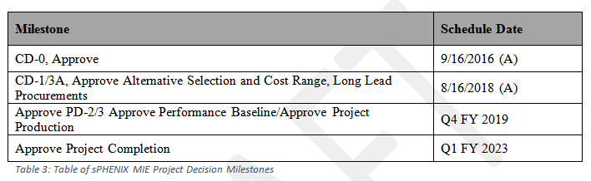
PPMP Level 1 Milestones
What where CD-2, CD-3, CD-4 become PD-2, PD-3 and Project Completion

Slide 5
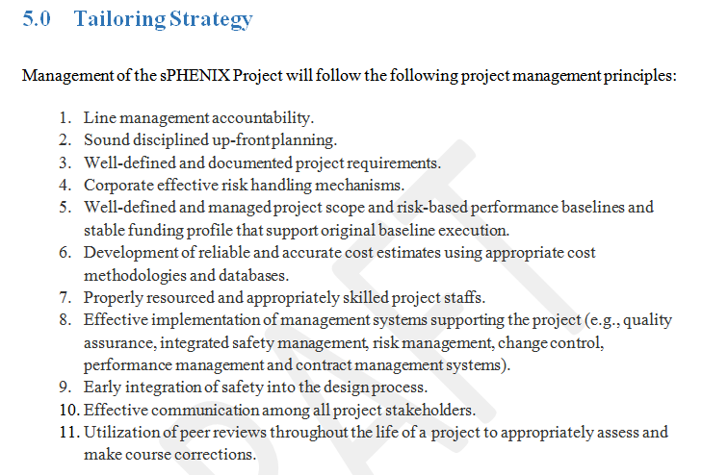
PPMP Tailoring Strategy
The revised tailoring strategy takes into account the memo from DOE on projects
with TPCs < $50M (08/02/18), and the DOE-NP guidance from Sept 2018.

Slide 6
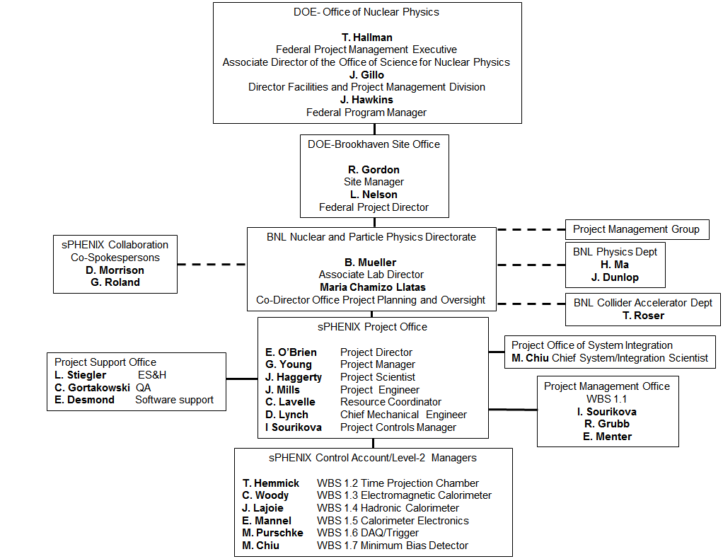
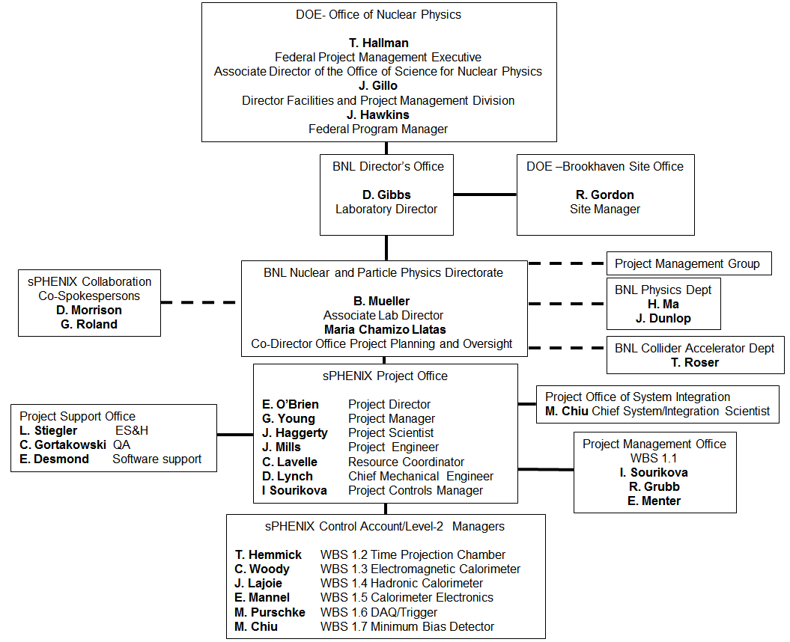
PPMP Org Chart
PPEP
PPMP

Slide 7
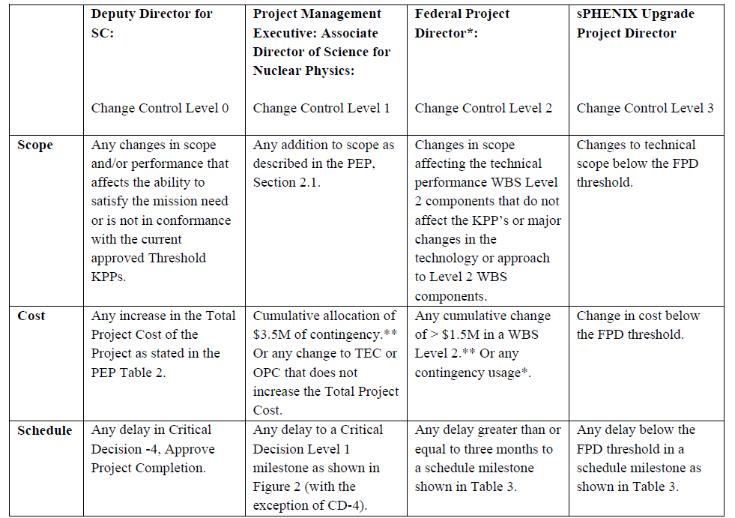
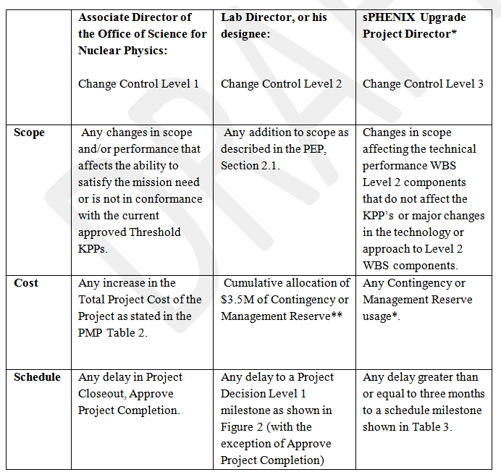
PPMP Baseline Change Control
Four levels of BCC goes to three. No FPD. Now there is BNL Lab Director or designee
PPEP
PPMP

Slide 8
PPMP EVMS
There is significant tailoring of the EVMS approach in the draft PPMP:
The sPHENIX project will implement a tailored approach to the BNL EVMS. BNL has a DOE certified EVM System that will be implemented on the sPHENIX project using a tailored approach. The sPHENIX project will follow the principles of EVMS:
Objectively assess accomplishments at the work performance level
Plan all work scope for the program from inception to completion
Break down the program work scope into finite pieces that can be assigned to a responsible person or organization for control of technical, schedule, and cost objectives
Integrate program work scope, schedule, and cost objectives into a performance measurement baseline plan against which accomplishments may be measured
Use actual costs incurred and recorded in accomplishing the work performed
Analyze significant variances from the plan, forecast impacts, and prepare an estimate at completion based on performance to date and work to be performed
Control changes to the baseline and maintain the baseline throughout contract execution
Use EVMS information in the organization’s management processes

Slide 9
PPMP EVMS
Tailoring the implementation of EVMS will include:
Eliminating the use of Control Account Work Authorization documents
Generating Cumulative to date Variance Analysis if the cost or schedule variances exceed the thresholds.
Reporting a WBS only Cost Performance Report on a monthly basis
The EVMS for sPHENIX will use the standard project controls tools that are used on most BNL projects including: Primavera for scheduling, Cobra for Earned Value Reporting, PeopleSoft for Actual Costs and Procurement and Integrated Project Database for reporting.
After PD-2/3 approval, the sPHENIX Project will generate a monthly Cost Performance Report (CPR) each month by WBS that provides BCWS (planned value), BCWP (earned value) and ACWP (actual costs) for current month and cumulative to date. The cost and schedule variances and SPI and CPI indices will be calculated and reported each month. The calculated remaining contingency on the ETC will be calculated and reported each month. Variance analysis will be written for each Control Account when the cumulative cost and schedule variances exceed the following thresholds:
Cumulative variations of -$100K
SPI and CPI variations of +/- 10%

Slide 10
PPMP Reporting
References to PARS II and the FPD have been removed from the text in the PPMP.
The sPHENIX MIE will provide the Lab Director, the BHSO Manager and the FPM a monthly project progress report, and consistent with tailored requirements to the EVMS description document as defined in the PMP. The report will be made available to the NPP ALD and the Director for OPPO, Detector Projects. After PD-2/3 approval, the report will include the latest earned value data together with a variance analysis provided in the monthly report. The Lab Director, or his designee, will organize regular project performance meetings, nominally annually, with the project personnel, the BHSO Site Office Manager, the FPM, the NPP ALD and the Director of OPPO, Detector Projects. The project will also schedule regular monthly calls to report on project status. Other organizations or personnel who may also participate in these calls include the Lab Director, or his designee, BHSO Site Office Manager, or his designee, the FPM, the NPP ALD, the Director for OPPO, Detector Projects, and others as appropriate. The purpose of these calls is to provide updates on project progress and to anticipate, discuss, and resolve issues.

Slide 11

PPMP Reviews

Slide 12
Back Up

Slide 13
Summary of Technical Progress
Initial analysis of the test beam data for the small TPC prototype indicates the test detector met performance resolution specs
The SAMPA v5 (TPC front end chip) is ready for multi-project run submission
Independent review concluded that it is ready for MPR submission
Full TPC readout chain: GEM+8-SAMPA Fee Board+FELIX 2.0 has been successfully readout
First magnet barrel steel sector which doubles as the OHCal steel structure, arrived at BNL and met dimensional specs. Second sector arrives Fri Oct 26
EMCal preproduction blocks continue to be made at UIUC. 12 shipped to BNL.
Orders for preproduction EMCal readout electronics have been placed for Sector -0
Rad damage tests have identified two components that need to be substituted on EMCal interface board. New rad hard components have been chosen
Calorimeter electronics preproduction crate controller and clock module have been sent out for production

Slide 14
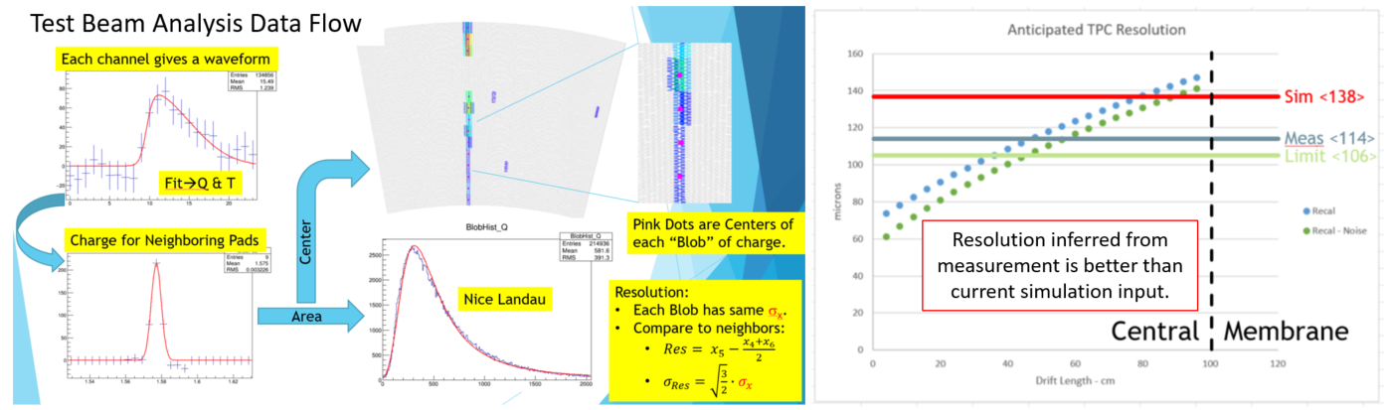
Technical Progress TPC
Analysis of test beam data going from raw wave form in the upper left through the cluster energy loss distribution titled “Nice Landau”, to an event display with red dots shown on cluster centroids in the plots on the middle of the page, and finally to the calculated resolution based on the test beam results shown in the far right plot.

Slide 15
Technical Progress EMCal Blocks
The status of the production of blocks for Sector 0 at UIUC. The legend gives the key to the numerical code that shows were each block is in the various stages of production. A code of 7 indicates that the block has been shipped to BNL.

Slide 16
Technical Progress EMCal
Twelve Type I absorber blocks for Sector 0 in the lab at BNL. The dots on each block are small reflectors that are used to provide reference points for a 3D scanner that is used to scan the blocks and measure their shape.
Fiber readout end for two of the twelve Type I absorber blocks received at BNL. The block on the left has no missing fibers while the block on the right has ~ 30 missing fibers.

Slide 17
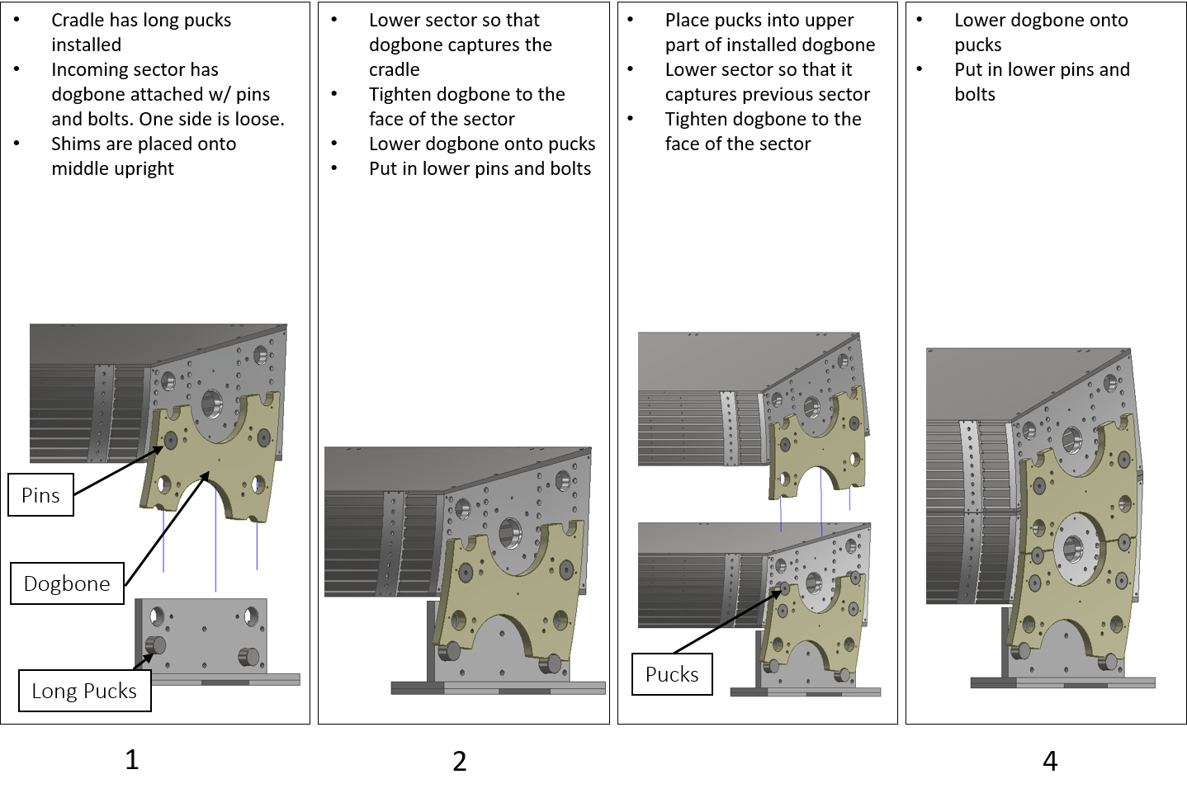
Technical Progress on HCal
Assembly test procedure for the outer HCAL sectors using the go/no-go cradle. One sector will be fit into the cradle, with additional sectors being test fit to the first sector using the “dogbones” and pucks.

Slide 18
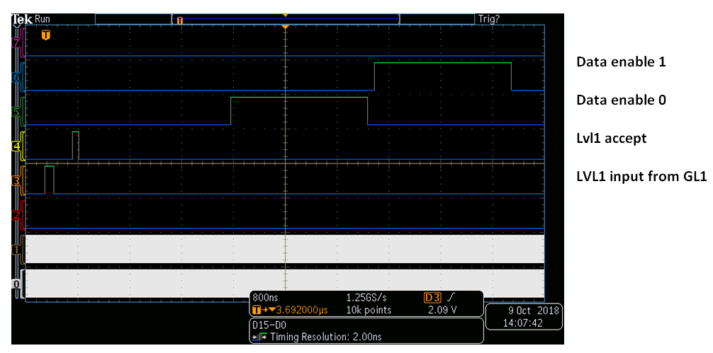
Technical Progress on DAQ/Trigger
For the first time, we combined a version of the Global Level-1 trigger (“GL1”) with the “Global Timing Module” (GTM). The GL1 will determine whether or not the data from a given beam-beam crossing in RHIC will be accepted by the data acquisition, while the GTM handles the detector system-specific details.
We have procured the first 3 boards of the GL1 and GTM hardware. Those boards, featuring a powerful Xilinx Zynq FPGA. The prototype versions of both firmware implementations have been tested and appear to be working according to the specifications.

