Slide 1

INTT-MVTX Mechanical Support and Installation
Mickey Chiu

Slide 2
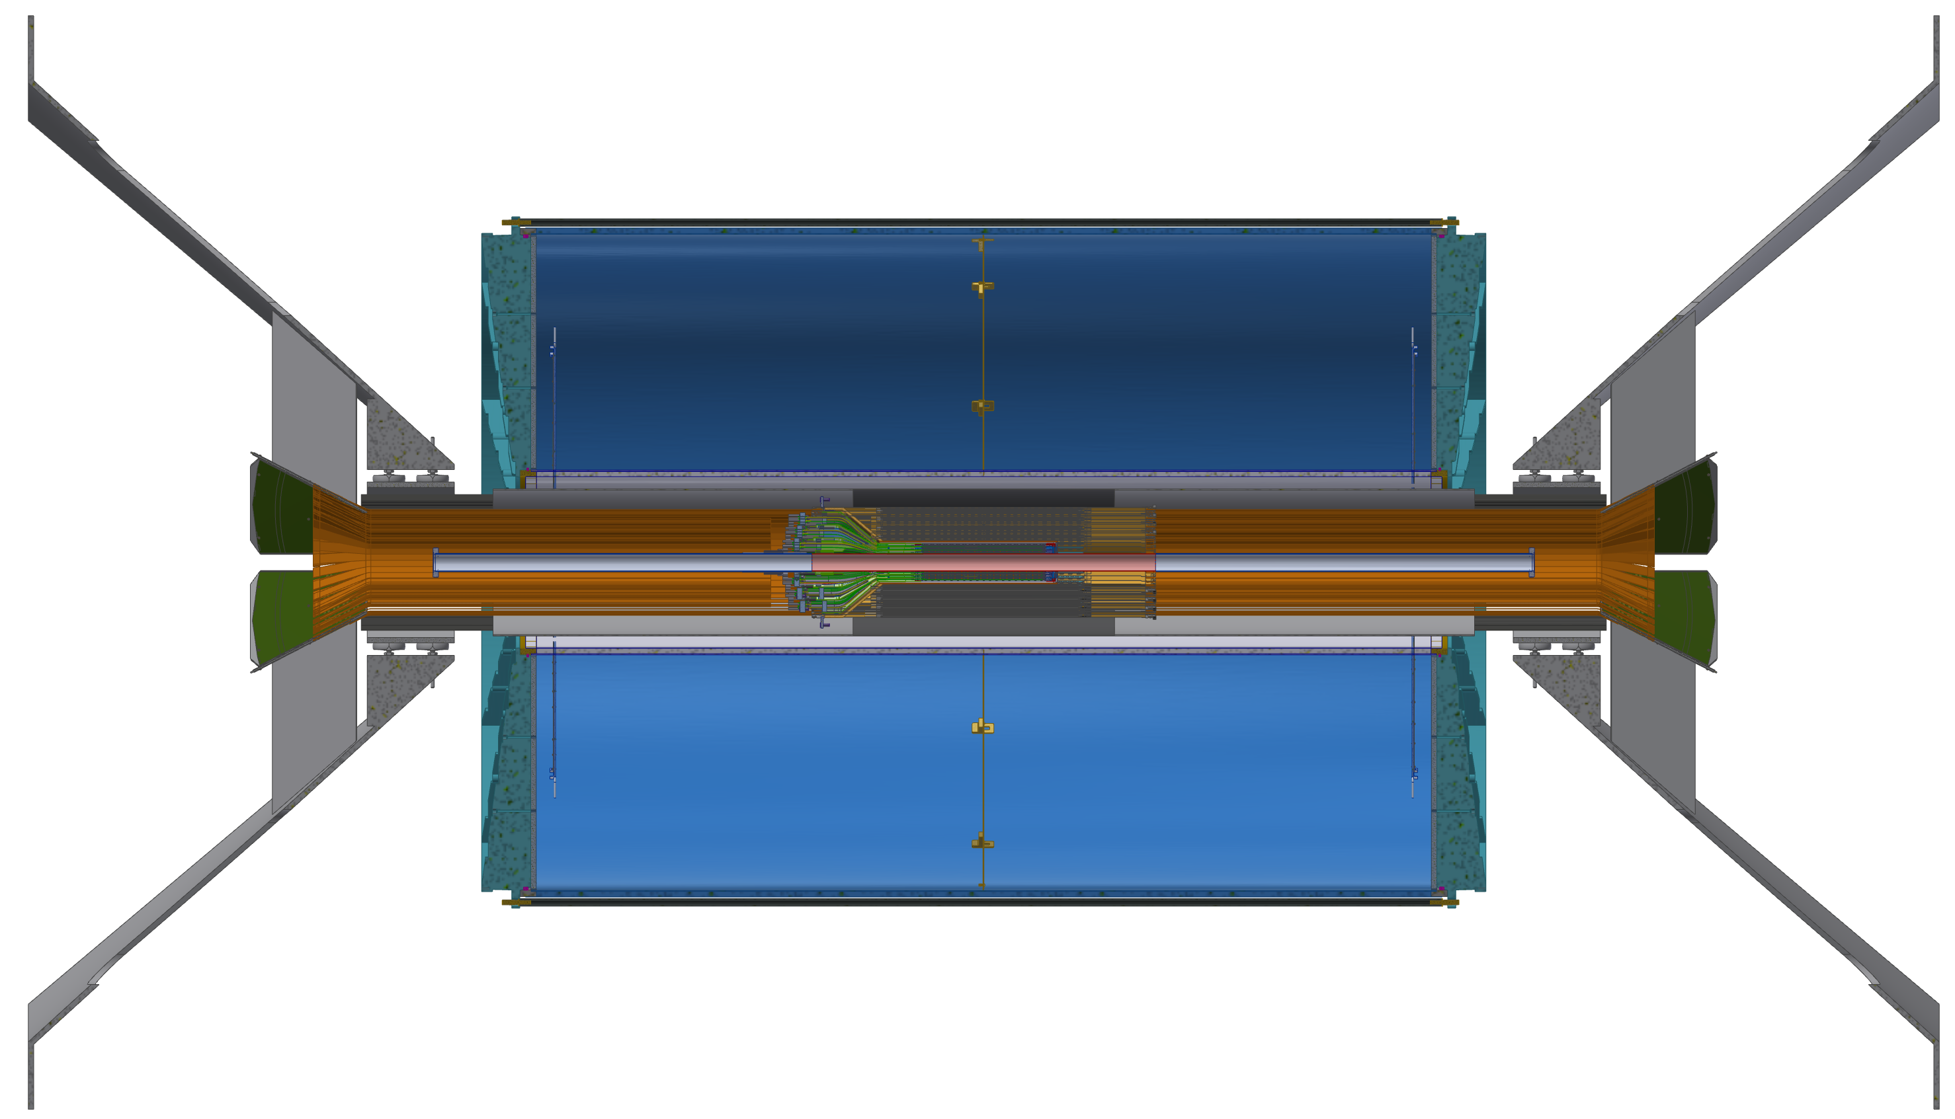
Inner Tracking Support Concept
Mounts to inner support ring
MVTX Outer Patch??
INTT ROCs
INTT Support
(holds rails which hold INTT)
MVTX will either be supported outside TPC (and cantilevered)
Plenty of space outside TPC for support structures and patch panel
OR supported off INTT inner shell structure

Slide 3
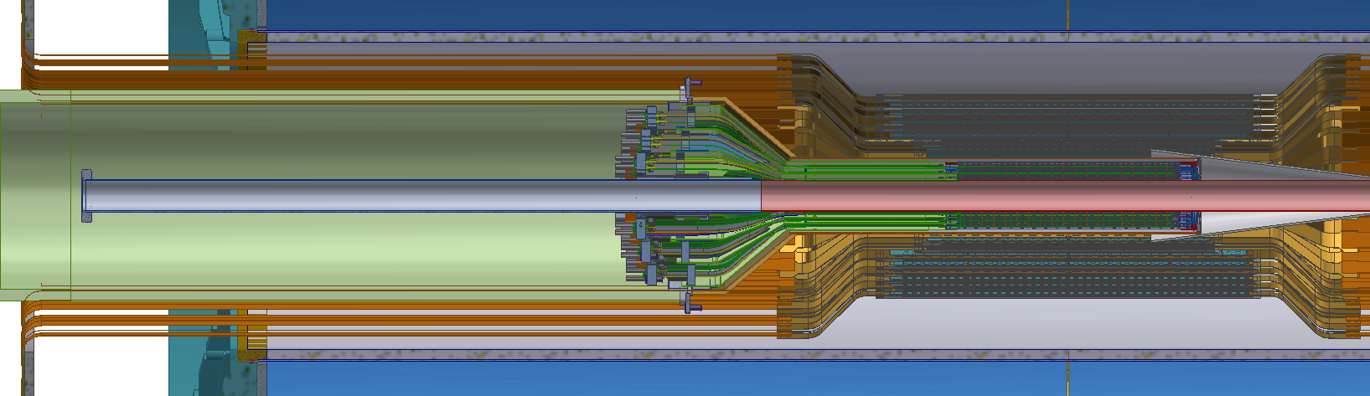
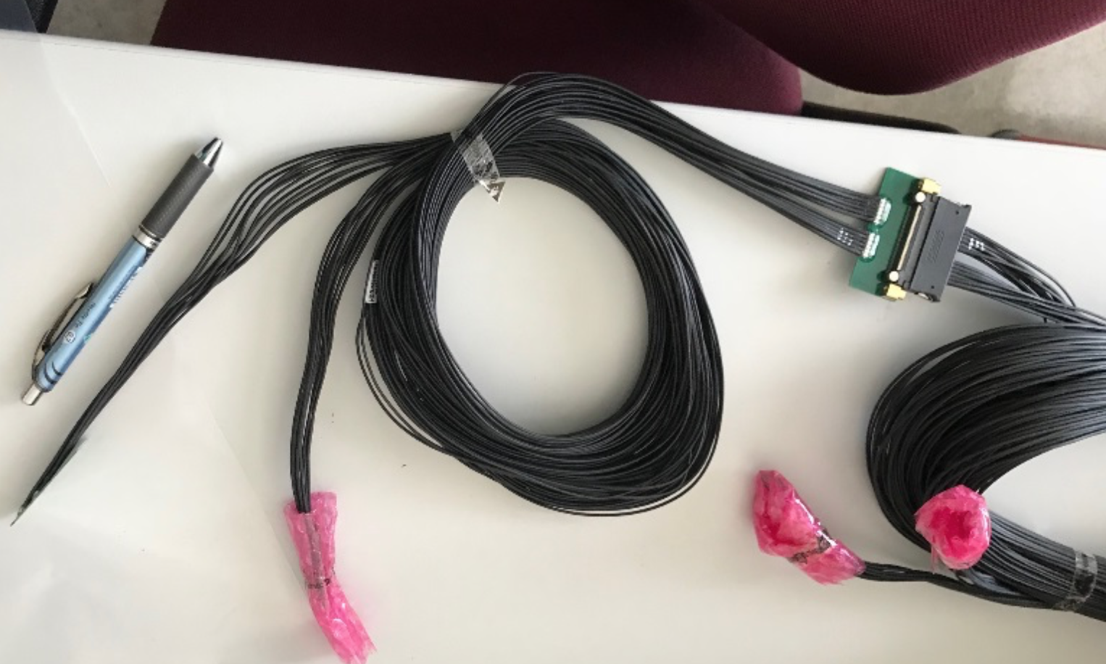
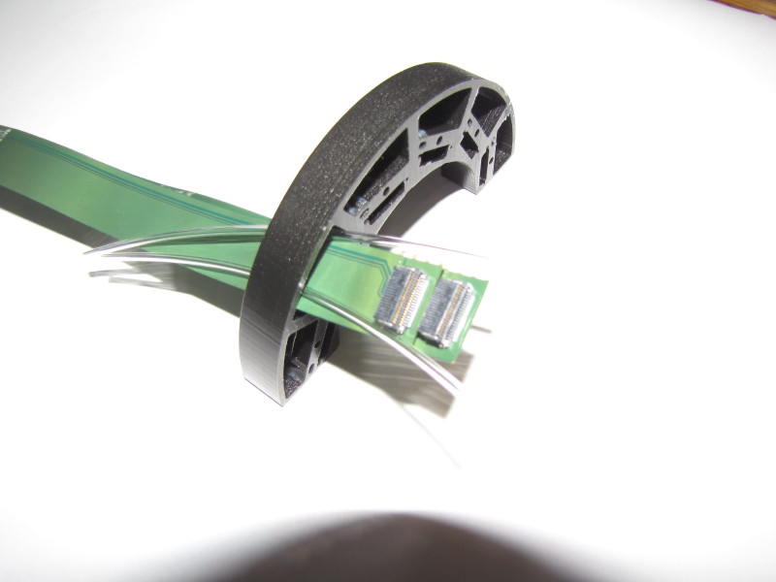
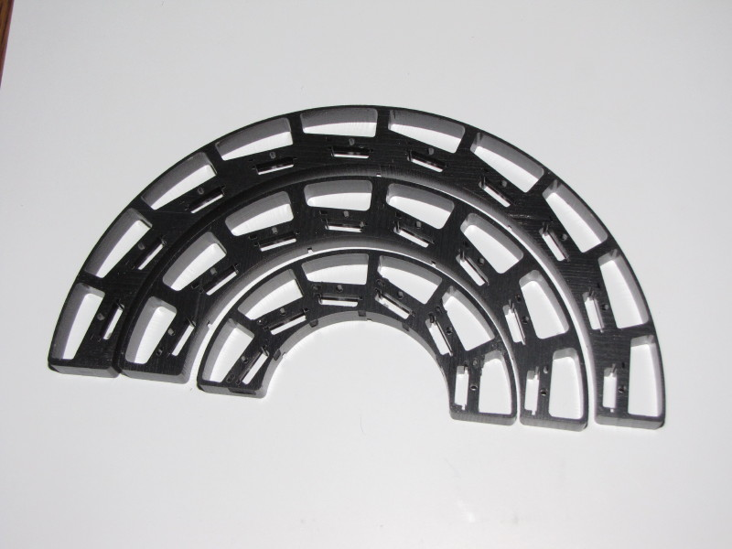
MVTX Inner Cabling Concept
MVTX Outer Patch??:
SAMTEC coax signal cables
Power (LV, Bias)
Cooling
MVTX 1st Inner Patch: HDI Signal Cable.
MVTX 2nd Inner Patch?? Two Power Cables.

Slide 4
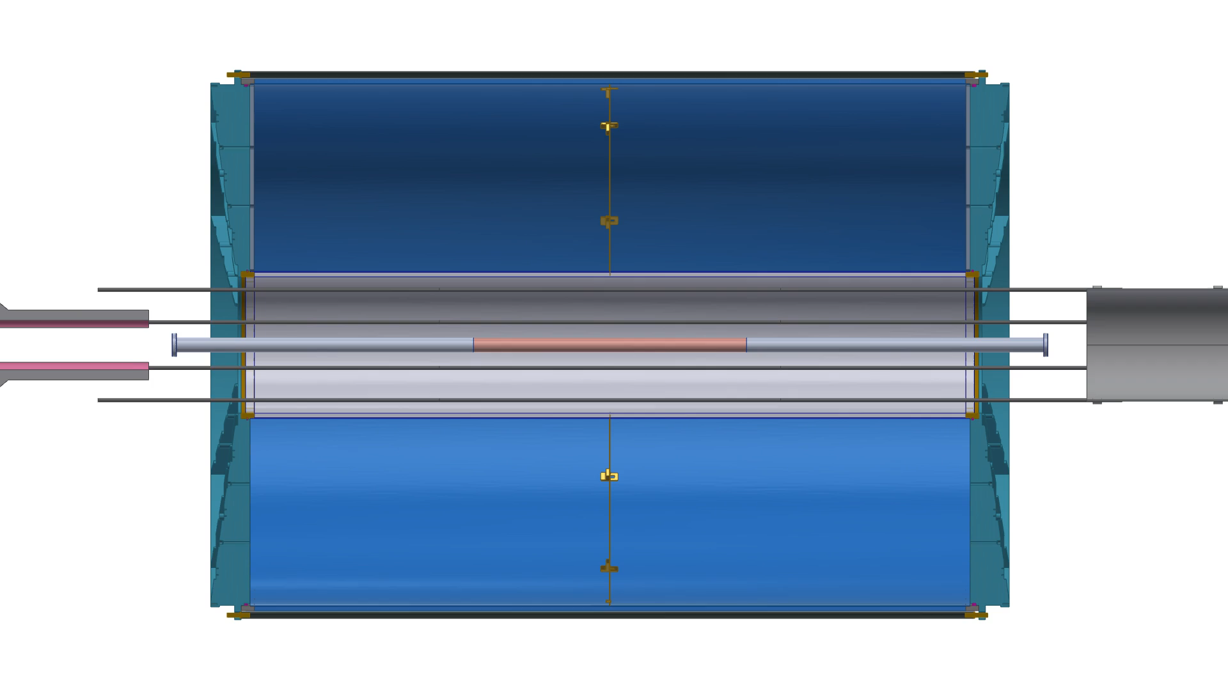
MVTX INTT Installation Scheme
MVTX and INTT are assembled in lab into self-contained halves (two clamshells), placed on rails, and slid into position
After placement into position, external cables from racks are connected to the outer MVTX patch panel
For INTT they are cables going to ROCs
Currently investigating modification of beam-pipe to remove flange – may make installation much easier since one can close up MVTX clamshell and then insert

Slide 5
Summary
Still several aspects of the MVTX-INTT support and installation that need to be detailed out
However, we do not anticipate any showstoppers
2nd Inner Patch Panel
Outer Patch Panel
What kind of SAMTEC cable can be used (halogen-free or not)
Space required, exact mounting scheme, etc
How to support detector in final position
Cantilevered or off INTT support structure

Slide 6
BACKUP SLIDES

Slide 7
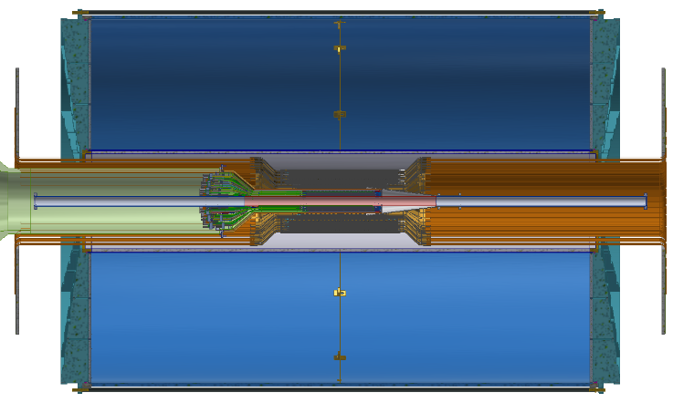

MVTX - INTT - TPC

Slide 8
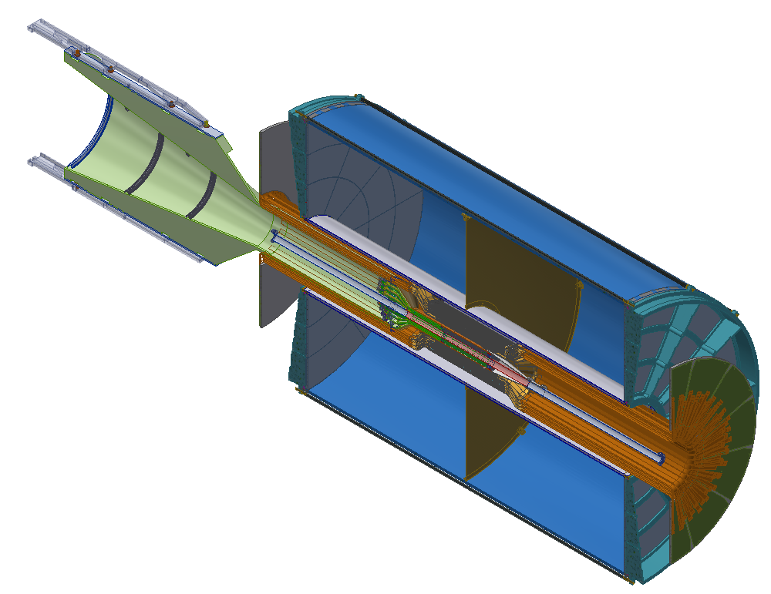
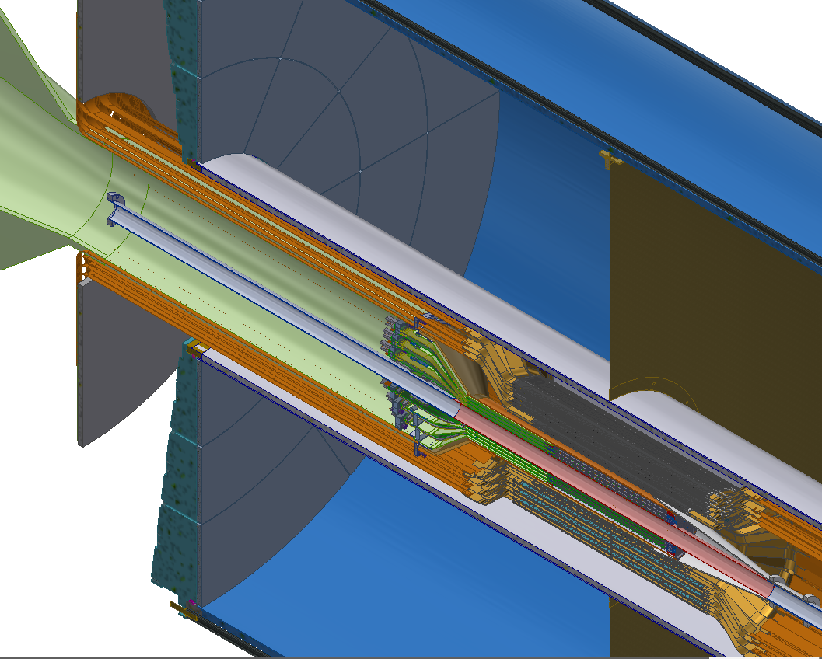
Cables

Slide 9
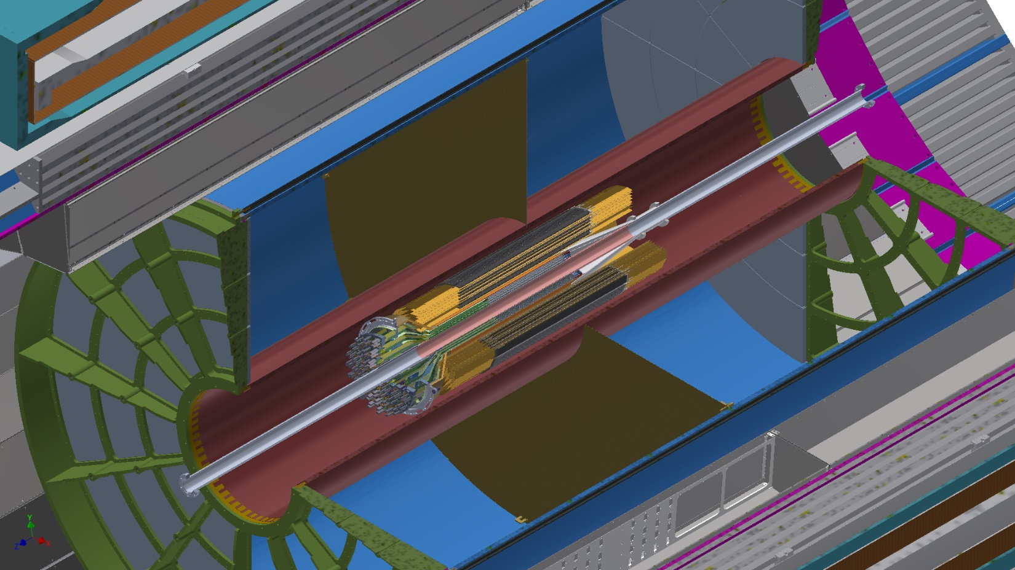
sPHENIX

Slide 10
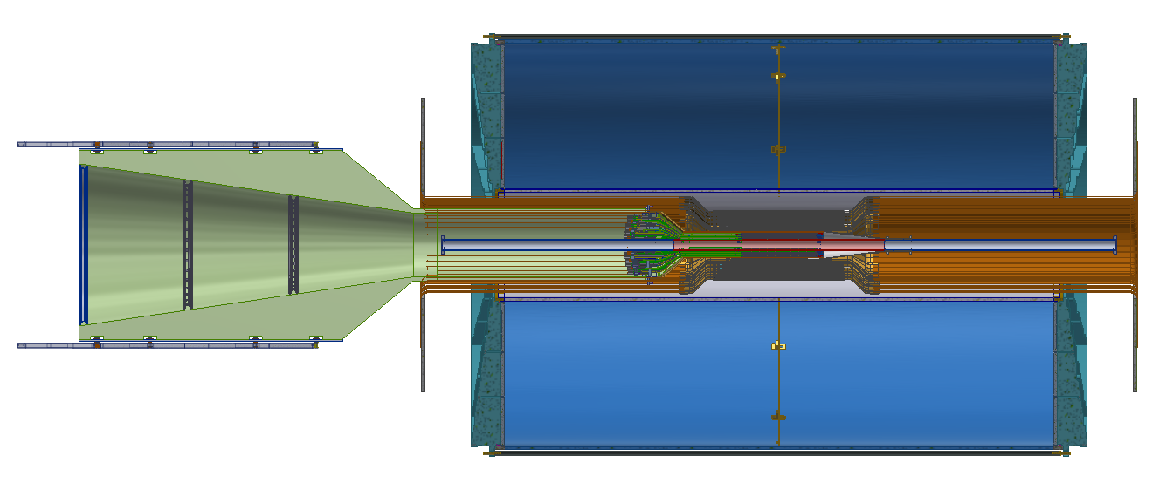
MVTX - INTT - TPC

Slide 11
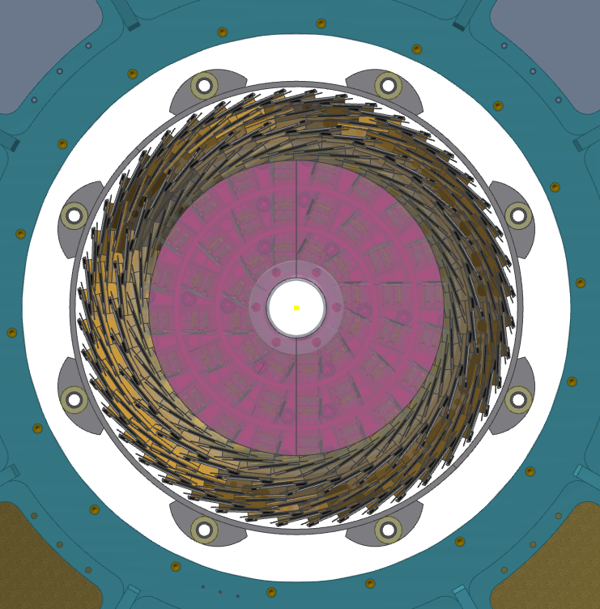
INTT – MVTX – TPC
CFC Support Rail
and Bearing Blocks
OR = 185
HDI connector (rigid)
TPC inner
Edge R = 200 mm
MVTX Envelope (rigid)
OR = 107 mm
INTT Shell
Support (rigid)
IR = 160 mm
TPC Clearance
15 mm

Slide 12
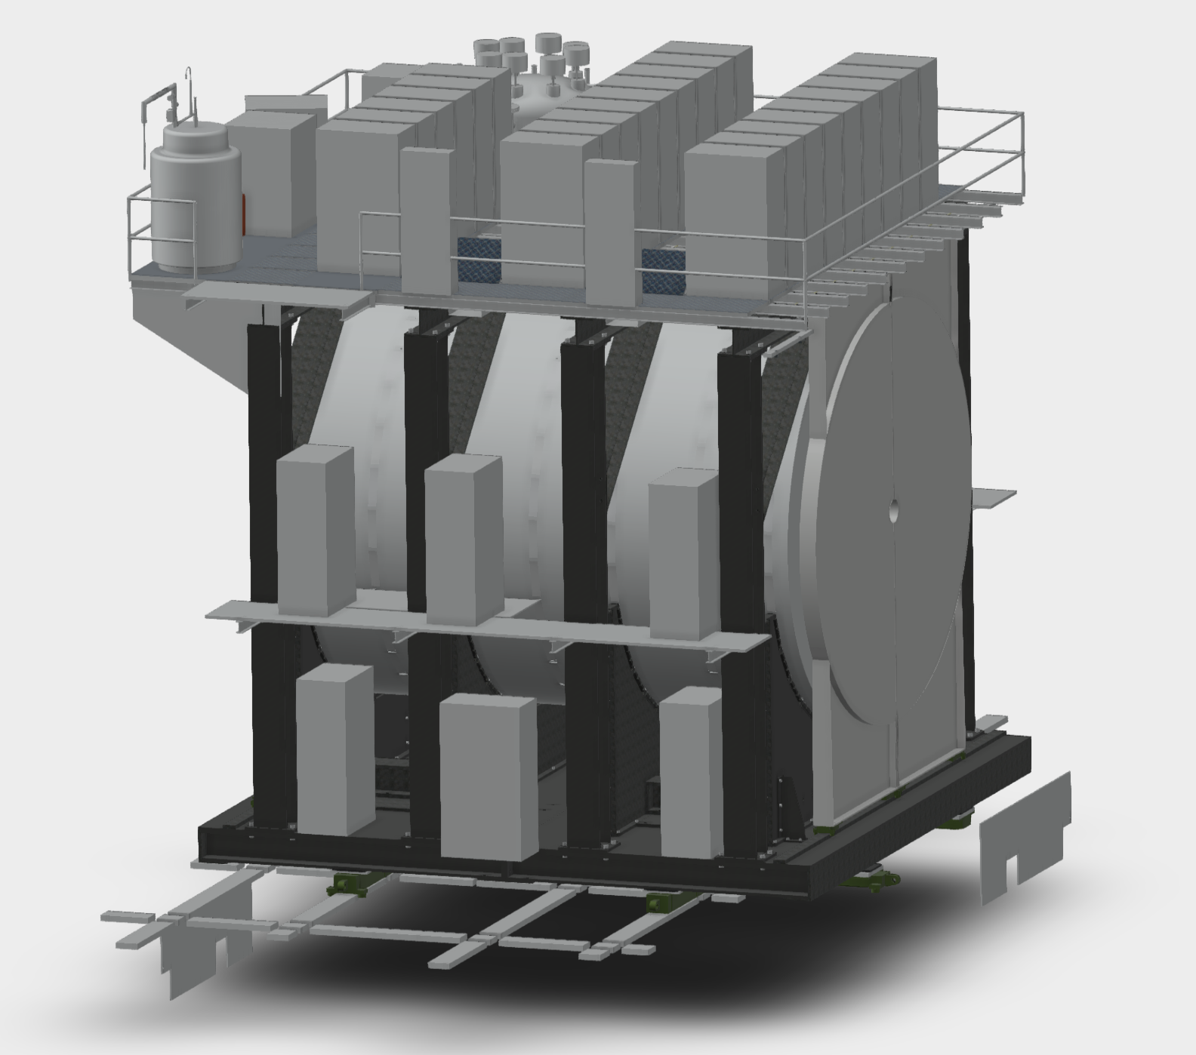
sPHENIX Racks
MBD
TPC
3B9
3C9
Rack Name | Subsystem
2E2 | HCAL
2W2 | HCAL
1E1 | EMCAL Digi
1E3 | EMCAL Digi
1W1 | EMCAL Digi
1W3 | EMCAL Digi
3A1 | EMCAL Digi
3A6 | EMCAL Digi
3C1 | EMCAL Digi
3C9 | EMCAL Digi
3A3 | EMCAL Control/Bias
3A4 | EMCAL Control/Bias
3C3 | EMCAL Control/Bias
3C7 | EMCAL Control/Bias
3A3 | TPC
3A4 | TPC
3C2 | TPC
3C8 | TPC
2W1 | INTT
2W3 | INTT
2E1 | MVTX
2E3 | MVTX
3B5 | MBD
EMCAL
3A5
3A6
3B7
3B8
3C7
3C8
3A3
3A4
3B5
3B6
3C5
3C6
3A1
3A2
3B3
3B4
3C3
3C4
3B1
3B2
3C1
3C2
West Arm Racks
2W1 2W2 2W3
1W1 1W2 1W3
MVTX
2E1
2E2
North
HCAL
2E3
EMCAL
1E1
1E3
1E2
(PATCH)
Cables have 6” clearance to get out of detector at door
Analog signals have priority for rack location

